Slide 1
Computer Vision Seminar
Welcome and Introduction

Slide 2
About the class
COMP 648: Computer Vision Seminar
Instructor: Vicente Ordóñez (Vicente Ordóñez Román)
Website: https://www.cs.rice.edu/~vo9/cv-seminar
Location: Zoom – Keck Hall 101
Times: Tuesdays from 4pm to 5:15pm Central Time
Office Hours: TBD
Discussion Forum: Piazza – Sign up below
https://piazza.com/rice/fall2022/comp648

Slide 3
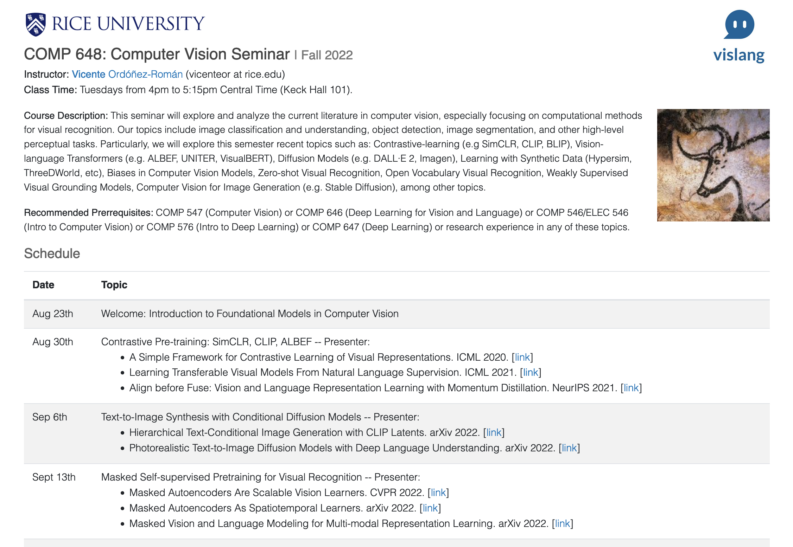
https://www.cs.rice.edu/~vo9/cv-seminar

Slide 4
My Background
Associate Professor, 2021 - Present
Visiting Academic 2021 - Present
Assistant Professor, 2016 - 2021
Visiting Professor, 2019
Adobe Research
Visiting Researcher, 2015 - 2016
MS, PhD in CS,
2009-2015
… also spent time at:

Slide 5
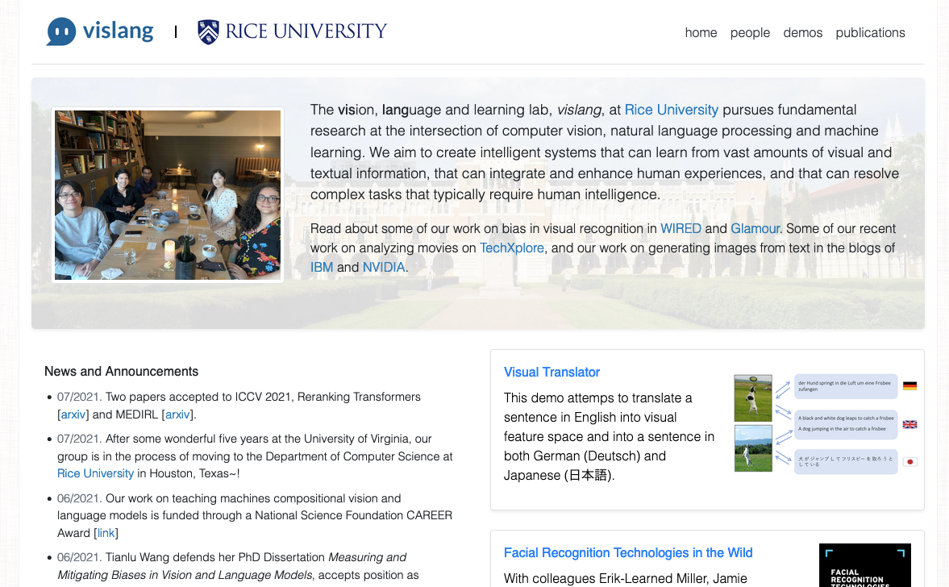
vision, language and learning
http://vislang.ai

Slide 6
Pre-requisites for this Seminar
At least introductory knowledge of Deep Learning: Convolutional Neural Networks, Recurrent Neural Networks, Transformers, Generative Adversarial Networks.
COMP 547 (Computer Vision) or COMP 646 (Deep Learning for Vision and Language) or COMP 546/ELEC 546 (Intro to Computer Vision) or COMP 576 (Intro to Deep Learning) or COMP 647 (Deep Learning) or research experience in any of these topics.

Slide 7
COMP 646: Deep Learning for Vision and Language
Computer Vision: Image Processing, Image Filtering
Deep Neural Networks, Multi-layer Perceptrons
Convolutional Neural Networks (CNNs)
Recurrent Neural Networks (RNNs)
Transformers – Deep Muti-head Soft Attention Layers
Generative Adversarial Networks (GANs)
Optimization: Learning Rates, Learning Rate Schedules, Momentum, Stochastic Gradient Descent, Mini-batch SGD, Sampling, Data Augmentation, Regularization, Overfitting/underfitting.

Slide 8
COMP 648: Recent Advances (2020/2021/2022/2023)
Contrastive Pretraining (e.g. CLIP and CLIP-derived models)
Self-supervised Pretraining (e.g. Masked Modeling for Images)
Diffusion Models (e.g. DALLE-2 – how are they replacing GANs)
Deep Matching (e.g. SuperGLUE, Reranking Transformers)
Pretraining for Visual Grounding/Localization (e.g. GLIP, OwL-ViT)
Universal Deep Models (e.g. DeepMind’s Flamingo, GATO)
Bias and Fairness concerns in Deep Learning and ML
Other Recent Topics of Interest…

Slide 9
How to best take advantage of this seminar
Read the papers in advance. They will be posted on the website. Especially if not familiar with a topic.
Ask questions in advance about papers that are going to be discussed. Use the discussion forum for this class. (Sign up here: https://piazza.com/rice/fall2022/comp648)

Slide 10
Grading
Satisfactory/Unsatisfactory
Satisfactory as long as you present a paper at least once throughout the semester and participate actively in discussions (soft attendance). E.g. aim for attending at least 10 out of the 14 sessions of the seminar. However, stay home if you’re sick overrides any other concern. I’m doing my part today but I should also be resting.

Slide 11
Questions?
Next session: Ziyan will be presenting
Please review the following papers
A Simple Framework for Contrastive Learning of Visual Representations. ICML 2020. [link]
Learning Transferable Visual Models From Natural Language Supervision. ICML 2021. [link]
Align before Fuse: Vision and Language Representation Learning with Momentum Distillation. NeurIPS 2021. [link]

