Slide 1
Deep Learning for Vision & Language
Machine Learning I: Supervised vs Unsupervised Learning Linear Classifiers / Regressors

Slide 2
Machine Learning
The study of algorithms that learn from data.

Slide 3
Supervised Learning vs Unsupervised Learning
$$x → y$$
$$x$$
cat
dog
bear
dog
bear
dog
cat
cat
bear

Slide 4
Supervised Learning vs Unsupervised Learning
$$x → y$$
$$x$$
cat
dog
bear
dog
bear
dog
cat
cat
bear

Slide 5
Supervised Learning vs Unsupervised Learning
$$x → y$$
$$x$$
cat
dog
bear
Classification
dog
Clustering
bear
dog
cat
cat
bear

Slide 6
Supervised Learning…
Classification
cat
Face Detection
Language Parsing
Structured Prediction

Slide 7
Supervised Learning…
= $f( )$
cat
= $f( )$
= $f( )$

Slide 8
Machine Learning – Regression vs Classification
$$y=f(x)$$
Regression: y is a continuous variable e.g. in some interval of values e.g. in (0, 10]
Classification: y is a discrete variable e.g. could take a set of values {0, 1, 2, 3, 4}

Slide 9
Machine Learning – Regression vs Classification
$$y=f(x)$$
Also notice that both y and x could be vectors – and they usually are for many problems we will study.
Also notice that f can be any function from the simplest you can think of to the most complicated composition of functions.

Slide 10
For instance, Linear Regression and Classification
$$y=wx+b$$
Note: (w, b) are the coefficients in the linear regression, and will also be referred as parameters.
Also notice if x is a vector then w must also be a vector of coefficients.
A lot of work in Machine Learning and optimization is finding the right set of parameters (w, b) that can map any pairs of (x,y) values for a given problem.

Slide 11
ML Classifier / Regression models
K-nearest neighbors
Linear classifier / Linear regression
Naïve Bayes classifiers
Decision Trees
Random Forests
Boosted Decision Trees
Neural Networks

Slide 12
Supervised Learning – k-Nearest Neighbors
cat
dog
bear
k=3
cat, cat, dog
cat
cat
dog
bear
dog
bear

Slide 13
Supervised Learning – k-Nearest Neighbors
cat
dog
bear
k=3
cat
cat
bear, dog, dog
dog
bear
dog
bear

Slide 14
ML Classifier / Regression models
K-nearest neighbors
Linear classifier / Linear regression
Naïve Bayes classifiers
Decision Trees
Random Forests
Boosted Decision Trees
Neural Networks

Slide 15
Linear Regression
Example: Hollywood movie data
input variables x
output variables y
production
costs
promotional costs
genre of
the movie
box office first week
total book
sales
total revenue USA
total revenue international
$$x_{1}^{(1)}$$
$$x_{2}^{(1)}$$
$$x_{3}^{(1)}$$
$$x_{4}^{(1)}$$
$$x_{5}^{(1)}$$
$$x_{6}^{(1)}$$
$$x_{7}^{(1)}$$
$$x_{1}^{(2)}$$
$$x_{2}^{(2)}$$
$$x_{3}^{(2)}$$
$$x_{4}^{(2)}$$
$$x_{5}^{(2)}$$
$$x_{6}^{(2)}$$
$$x_{7}^{(2)}$$
$$x_{1}^{(3)}$$
$$x_{2}^{(3)}$$
$$x_{3}^{(3)}$$
$$x_{4}^{(3)}$$
$$x_{5}^{(3)}$$
$$x_{6}^{(3)}$$
$$x_{7}^{(3)}$$
$$x_{1}^{(4)}$$
$$x_{2}^{(4)}$$
$$x_{3}^{(4)}$$
$$x_{4}^{(4)}$$
$$x_{5}^{(4)}$$
$$x_{6}^{(4)}$$
$$x_{7}^{(4)}$$
$$x_{1}^{(5)}$$
$$x_{2}^{(5)}$$
$$x_{3}^{(5)}$$
$$x_{4}^{(5)}$$
$$x_{5}^{(5)}$$
$$x_{6}^{(5)}$$
$$x_{7}^{(5)}$$

Slide 16
Linear Regression
Example: Hollywood movie data
input variables x
output variables y
production
costs
promotional costs
genre of
the movie
box office first week
total book
sales
total revenue USA
total revenue international
$$x_{1}^{(1)}$$
$$x_{2}^{(1)}$$
$$x_{3}^{(1)}$$
$$x_{4}^{(1)}$$
$$x_{5}^{(1)}$$
$$y_{1}^{(1)}$$
$$y_{2}^{(1)}$$
$$x_{1}^{(2)}$$
$$x_{2}^{(2)}$$
$$x_{3}^{(2)}$$
$$x_{4}^{(2)}$$
$$x_{5}^{(2)}$$
$$y_{1}^{(2)}$$
$$y_{2}^{(2)}$$
$$x_{1}^{(3)}$$
$$x_{2}^{(3)}$$
$$x_{3}^{(3)}$$
$$x_{4}^{(3)}$$
$$x_{5}^{(3)}$$
$$y_{1}^{(3)}$$
$$y_{2}^{(3)}$$
$$x_{1}^{(4)}$$
$$x_{2}^{(4)}$$
$$x_{3}^{(4)}$$
$$x_{4}^{(4)}$$
$$x_{5}^{(4)}$$
$$y_{1}^{(4)}$$
$$y_{2}^{(4)}$$
$$x_{1}^{(5)}$$
$$x_{2}^{(5)}$$
$$x_{3}^{(5)}$$
$$x_{4}^{(5)}$$
$$x_{5}^{(5)}$$
$$y_{1}^{(5)}$$
$$y_{2}^{(5)}$$

Slide 17
Linear Regression
Example: Hollywood movie data
input variables x
output variables y
production
costs
promotional costs
genre of
the movie
box office first week
total book
sales
total revenue USA
total revenue international
$$x_{1}^{(1)}$$
$$x_{2}^{(1)}$$
$$x_{3}^{(1)}$$
$$x_{4}^{(1)}$$
$$x_{5}^{(1)}$$
$$y_{1}^{(1)}$$
$$y_{2}^{(1)}$$
training
data
$$x_{1}^{(2)}$$
$$x_{2}^{(2)}$$
$$x_{3}^{(2)}$$
$$x_{4}^{(2)}$$
$$x_{5}^{(2)}$$
$$y_{1}^{(2)}$$
$$y_{2}^{(2)}$$
$$x_{1}^{(3)}$$
$$x_{2}^{(3)}$$
$$x_{3}^{(3)}$$
$$x_{4}^{(3)}$$
$$x_{5}^{(3)}$$
$$y_{1}^{(3)}$$
$$y_{2}^{(3)}$$
$$x_{1}^{(4)}$$
$$x_{2}^{(4)}$$
$$x_{3}^{(4)}$$
$$x_{4}^{(4)}$$
$$x_{5}^{(4)}$$
$$y_{1}^{(4)}$$
$$y_{2}^{(4)}$$
test
data
$$x_{1}^{(5)}$$
$$x_{2}^{(5)}$$
$$x_{3}^{(5)}$$
$$x_{4}^{(5)}$$
$$x_{5}^{(5)}$$
$$y_{1}^{(5)}$$
$$y_{2}^{(5)}$$

Slide 18
Linear Regression
$$\hat{y}=\sum_{i}{w_{i}x_{i}}$$
Prediction,
Inference,
Testing
$$\hat{y}=W^{T}x$$
$$L\left(W\right)=\sum_{d=1}^{|D|}{l({\hat{y}}^{(d)}, y^{(d)})}$$
Training,
Learning, Parameter estimation
Objective minimization
$$D=\{(x^{\left(d\right)},y^{\left(d\right)})\}$$
$$W^{∗}=argmin L(W)$$

Slide 19
Linear Regression
$${\hat{y}}_{j}=\sum_{i}{w_{ji}x_{i}}$$
Prediction,
Inference,
Testing
$$\hat{y}=W^{T}x$$
$$L\left(W\right)=\sum_{d=1}^{|D|}{\sum_{j}{l({{\hat{y}}_{j}}^{(d)}, {y_{j}}^{(d)})}}$$
Training,
Learning, Parameter estimation
Objective minimization
$$D=\{(x^{\left(d\right)},y^{\left(d\right)})\}$$
$$W^{∗}=argmin L(W)$$

Slide 20
Linear Regression – Least Squares
$${\hat{y}}_{j}=\sum_{i}{w_{ji}x_{i}}$$
$$\hat{y}=W^{T}x$$
$$L\left(W\right)=\sum_{d=1}^{|D|}{\sum_{j}{{\left({{\hat{y}}_{j}}^{(d)}− {y_{j}}^{\left(d\right)}\right)}^{2}}}$$
Training,
Learning, Parameter estimation
Objective minimization
$$D=\{(x^{\left(d\right)},y^{\left(d\right)})\}$$
$$W^{∗}=argmin L(W)$$

Slide 21
Linear Regression – Least Squares
$$L\left(W\right)=\sum_{d=1}^{|D|}{\sum_{j}{{\left({{\hat{y}}_{j}}^{\left(d\right)}− y^{\left(d\right)}\right)}^{2}}}$$
$${\hat{y}}_{j}^{(d)}=\sum_{i}{w_{ji}x_{i}^{(d)}}$$
$$L\left(W\right)=\sum_{d=1}^{|D|}{\sum_{j}{{\left(\sum_{i}{w_{ji}x_{i}^{(d)}}− y^{\left(d\right)}\right)}^{2}}}$$

Slide 22
Linear Regression – Least Squares
$$L\left(W\right)=\sum_{d=1}^{|D|}{\sum_{j}{{\left(\sum_{i}{w_{ji}x_{i}^{(d)}}− y^{\left(d\right)}\right)}^{2}}}$$
$$W^{∗}=argmin L(W)$$

Slide 23
How to find the minimum of a function L(W)?
$$L\left(w\right)$$
$$\frac{∂L\left(w\right)}{∂w}=0$$
$$w$$

Slide 24
Linear Regression – Least Squares
$\frac{∂L(W)}{∂w_{ji}}=\frac{∂}{∂w_{ji}}(\sum_{d=1}^{|D|}{\sum_{j}{{\left(\sum_{i}{w_{ji}x_{i}^{(d)}}− y^{\left(d\right)}\right)}^{2}}}$)
$$\frac{∂L(W)}{∂w_{ji}}=0$$
…
$$W={(X}^{T}{X)}^{−1}X^{T}Y$$

Slide 25
ML Classifier / Regression models
K-nearest neighbors
Linear classifier / Linear regression
Naïve Bayes classifiers
Decision Trees
Random Forests
Boosted Decision Trees
Neural Networks

Slide 26
Neural Network with One Layer
$$sigmoid\left(z\right)=\frac{1}{1+e^{−z}}$$
$$x_{1}$$
$${W=[w}_{ji}]$$
$$a_{1}$$
$$x_{2}$$
$$x_{3}$$
$$a_{2}$$
$$x_{4}$$
$$x_{5}$$
$a_{j}=sigmoid(\sum_{i}{w_{ji}x_{i}+}b_{j}$)

Slide 27
Neural Network with One Layer
$$L\left(W, b\right)=\sum_{d=1}^{|D|}{{\left(a^{\left(d\right)}− y^{\left(d\right)}\right)}^{2}}$$
$$a_{j}^{(d)}=sigmoid(\sum_{i}{w_{ji}x_{i}^{\left(d\right)}+}b_{j})$$
Bias parameters
$$L\left(W, b\right)=\sum_{j,d}{{\left(sigmoid(\sum_{i}{w_{ji}x_{i}^{\left(d\right)}+}b_{j})− y_{j}^{\left(d\right)}\right)}^{2}}$$

Slide 28
Neural Network with One Layer
$$L\left(W, b\right)=\sum_{j,d}{{\left(sigmoid(\sum_{i}{w_{ji}x_{i}^{\left(d\right)}+}b_{j})− y_{j}^{\left(d\right)}\right)}^{2}}$$
$$\frac{∂L}{∂w_{uv}}=0$$
(1) We can compute this derivative but often there will be no
closed-form solution for W when dL/dw = 0
(2) Also, even for linear regression where the solution was $W={(X}^{T}{X)}^{−1}X^{T}Y, computing this expression might be expensive or infeasible. e.g. think of computing {(X}^{T}{X)}^{−1}$ for a very large
dataset with a million $x_{i}$

Slide 29
Gradient Descent
1. Start with a random value of w (e.g. w = 12)
$$L\left(w\right)$$
2. Compute the gradient (derivative) of L(w) at point w = 12. (e.g. dL/dw = 6)
3. Recompute w as:
w = w – lambda * (dL / dw)
w=12
$$w$$

Slide 30
Gradient Descent
$$L\left(w\right)$$
2. Compute the gradient (derivative) of L(w) at point w = 12. (e.g. dL/dw = 6)
3. Recompute w as:
w = w – lambda * (dL / dw)
w=10
$$w$$

Slide 31
Gradient Descent
$$L\left(w\right)$$
2. Compute the gradient (derivative) of L(w) at point w = 12. (e.g. dL/dw = 6)
3. Recompute w as:
w = w – lambda * (dL / dw)
w=8
$$w$$

Slide 32
Gradient Descent
expensive
$$λ=0.01$$
$$L(w,b)=\sum_{i=1}^{n}{ l(w,b)}$$
Initialize w and b randomly
for e = 0, num_epochs do
Compute:
$$dL(w,b)/dw$$
and
$$dL(w,b)/db$$
Update w:
$$w=w −λ dL(w,b)/dw$$
Update b:
$$b=b −λ dL(w,b)/db$$
Print:
$$L(w,b)$$
// Useful to see if this is becoming smaller or not.
end

Slide 33
Stochastic Gradient Descent (mini-batch)
$$λ=0.01$$
$$L_{B}(w,b)=\sum_{i=1}^{B}{ l(w,b)}$$
Initialize w and b randomly
for e = 0, num_epochs do
for b = 0, num_batches do
Compute:
$$dL_{B}(w,b)/dw$$
and
$$dL_{B}(w,b)/db$$
Update w:
$$w=w −λ dl(w,b)/dw$$
Update b:
$$b=b −λ dl(w,b)/db$$
Print:
$$L_{B}(w,b)$$
// Useful to see if this is becoming smaller or not.
end
end

Slide 34
In this class we will mostly rely on…
K-nearest neighbors
Linear classifiers
Naïve Bayes classifiers
Decision Trees
Random Forests
Boosted Decision Trees
Neural Networks

Slide 35
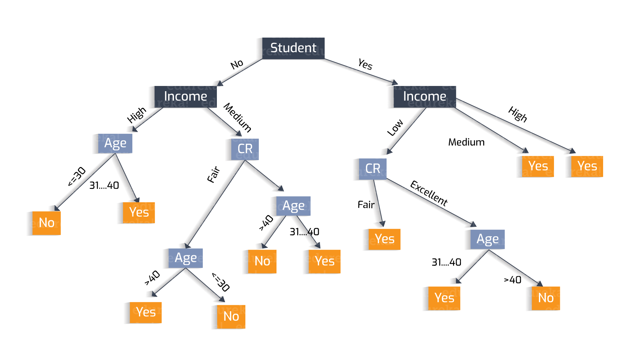
Why?
Decisions Trees
https://heartbeat.fritz.ai/understanding-the-mathematics-behind-decision-trees-22d86d55906 by Nikita Sharma

Slide 36
Why?
Decisions Trees are great because they are often interpretable.
However, they usually deal better with categorical data – not input pixel data.
https://heartbeat.fritz.ai/understanding-the-mathematics-behind-decision-trees-22d86d55906 by Nikita Sharma

Slide 37
Regression vs Classification
Regression
Labels are continuous variables – e.g. distance.
Losses: Distance-based losses, e.g. sum of distances to true values.
Evaluation: Mean distances, correlation coefficients, etc.
Classification
Labels are discrete variables (1 out of K categories)
Losses: Cross-entropy loss, margin losses, logistic regression (binary cross entropy)
Evaluation: Classification accuracy, etc.

Slide 38
Supervised Learning - Classification
Training Data
Test Data
cat
dog
cat
.
.
.
.
.
.
bear

Slide 39
Supervised Learning - Classification
Training Data
cat
$$x_{1}=[ ]$$
$$y_{1}=[ ]$$
dog
$$x_{2}=[ ]$$
$$y_{2}=[ ]$$
cat
$$x_{3}=[ ]$$
$$y_{3}=[ ]$$
.
.
.
bear
$$x_{n}=[ ]$$
$$y_{n}=[ ]$$

Slide 40
Supervised Learning - Classification
Training Data
targets /
labels /
ground truth
We need to find a function that
maps x and y for any of them.
inputs
predictions
$$x_{1}=[x_{11} { x}_{12} x_{13} { x}_{14}]$$
$$y_{1}=$$
1
$${\hat{y}}_{1}=$$
1
$$\hat{y_{i}}=f(x_{i};θ)$$
$$x_{2}=[x_{21} { x}_{22} x_{23} { x}_{24}]$$
$$y_{2}=$$
2
$${\hat{y}}_{2}=$$
2
$$x_{3}=[x_{31} { x}_{32} x_{33} { x}_{34}]$$
$$y_{3}=$$
1
$${\hat{y}}_{3}=$$
2
How do we ”learn” the parameters
of this function?
.
.
.
We choose ones that makes the
following quantity small:
$$\sum_{i=1}^{n}{Cost(\hat{y_{i}}, y_{i})}$$
$$x_{n}=[x_{n1} { x}_{n2} x_{n3} { x}_{n4}]$$
$$y_{n}=$$
3
$${\hat{y}}_{n}=$$
1

Slide 41
Stochastic Gradient Descent
How to choose the right batch size B?
How to choose the right learning rate lambda?
How to choose the right loss function, e.g. is least squares good enough?
How to choose the right function/classifier, e.g. linear, quadratic, neural network with 1 layer, 2 layers, etc?

Slide 42
Linear Regression
Example: Hollywood movie data
input variables x
output variables y
production
costs
promotional costs
genre of
the movie
box office first week
total book
sales
total revenue USA
total revenue international
$$x_{1}^{(1)}$$
$$x_{2}^{(1)}$$
$$x_{3}^{(1)}$$
$$x_{4}^{(1)}$$
$$x_{5}^{(1)}$$
$$y_{1}^{(1)}$$
$$y_{2}^{(1)}$$
training
data
$$x_{1}^{(2)}$$
$$x_{2}^{(2)}$$
$$x_{3}^{(2)}$$
$$x_{4}^{(2)}$$
$$x_{5}^{(2)}$$
$$y_{1}^{(2)}$$
$$y_{2}^{(2)}$$
$$x_{1}^{(3)}$$
$$x_{2}^{(3)}$$
$$x_{3}^{(3)}$$
$$x_{4}^{(3)}$$
$$x_{5}^{(3)}$$
$$y_{1}^{(3)}$$
$$y_{2}^{(3)}$$
$$x_{1}^{(4)}$$
$$x_{2}^{(4)}$$
$$x_{3}^{(4)}$$
$$x_{4}^{(4)}$$
$$x_{5}^{(4)}$$
$$y_{1}^{(4)}$$
$$y_{2}^{(4)}$$
test
data
$$x_{1}^{(5)}$$
$$x_{2}^{(5)}$$
$$x_{3}^{(5)}$$
$$x_{4}^{(5)}$$
$$x_{5}^{(5)}$$
$$y_{1}^{(5)}$$
$$y_{2}^{(5)}$$

Slide 43
Training, Validation (Dev), Test Sets
Training Set
Validation Set
Testing Set

Slide 44
Training, Validation (Dev), Test Sets
Training Set
Validation Set
Testing Set
Used during development

Slide 45
Training, Validation (Dev), Test Sets
Training Set
Validation Set
Testing Set
Only to be used for evaluating the model at the very end of development and any changes to the model after running it on the test set, could be influenced by what you saw happened on the test set, which would invalidate any future evaluation.

Slide 46
How to pick the right model?

Slide 47
Linear Regression – 1 output, 1 input
$$y$$
$$(x_{8},y_{8})$$
$$(x_{6},y_{6})$$
$$(x_{7},y_{7})$$
$$(x_{4},y_{4})$$
$$(x_{5},y_{5})$$
$$(x_{2},y_{2})$$
$$(x_{3},y_{3})$$
$$(x_{1},y_{1})$$
$$x$$

Slide 48
Linear Regression – 1 output, 1 input
$$y$$
$$(x_{8},y_{8})$$
$$(x_{6},y_{6})$$
$$(x_{7},y_{7})$$
$$(x_{4},y_{4})$$
$$(x_{5},y_{5})$$
$$(x_{2},y_{2})$$
$$(x_{3},y_{3})$$
$$(x_{1},y_{1})$$
$$x$$
Model:
$$\hat{y}=wx+b$$

Slide 49
Linear Regression – 1 output, 1 input
$$y$$
$$(x_{8},y_{8})$$
$$(x_{6},y_{6})$$
$$(x_{7},y_{7})$$
$$(x_{4},y_{4})$$
$$(x_{5},y_{5})$$
$$(x_{2},y_{2})$$
$$(x_{3},y_{3})$$
$$(x_{1},y_{1})$$
$$x$$
Model:
$$\hat{y}=wx+b$$

Slide 50
Linear Regression – 1 output, 1 input
$$y$$
$$(x_{8},y_{8})$$
$$(x_{6},y_{6})$$
$$(x_{7},y_{7})$$
$$(x_{4},y_{4})$$
$$(x_{5},y_{5})$$
$$(x_{2},y_{2})$$
$$(x_{3},y_{3})$$
$$(x_{1},y_{1})$$
$$x$$
$$L\left(w,b\right)=\sum_{i=1}^{i=8}{{\left({\hat{y}}_{i}−y_{i}\right)}^{2}}$$
Model:
$$\hat{y}=wx+b$$
Loss:

Slide 51
Quadratic Regression
$$y$$
$$(x_{8},y_{8})$$
$$(x_{6},y_{6})$$
$$(x_{7},y_{7})$$
$$(x_{4},y_{4})$$
$$(x_{5},y_{5})$$
$$(x_{2},y_{2})$$
$$(x_{3},y_{3})$$
$$(x_{1},y_{1})$$
$$x$$
$$L\left(w,b\right)=\sum_{i=1}^{i=8}{{\left({\hat{y}}_{i}−y_{i}\right)}^{2}}$$
Model:
$$\hat{y}=w_{1}x^{2}+w_{2}x+b$$
Loss:

Slide 52
n-polynomial Regression
$$y$$
$$(x_{8},y_{8})$$
$$(x_{6},y_{6})$$
$$(x_{7},y_{7})$$
$$(x_{4},y_{4})$$
$$(x_{5},y_{5})$$
$$(x_{2},y_{2})$$
$$(x_{3},y_{3})$$
$$(x_{1},y_{1})$$
$$x$$
$$L\left(w,b\right)=\sum_{i=1}^{i=8}{{\left({\hat{y}}_{i}−y_{i}\right)}^{2}}$$
Model:
$$\hat{y}=w_{n}x^{n}+…+w_{1}x+b$$
Loss:

Slide 53
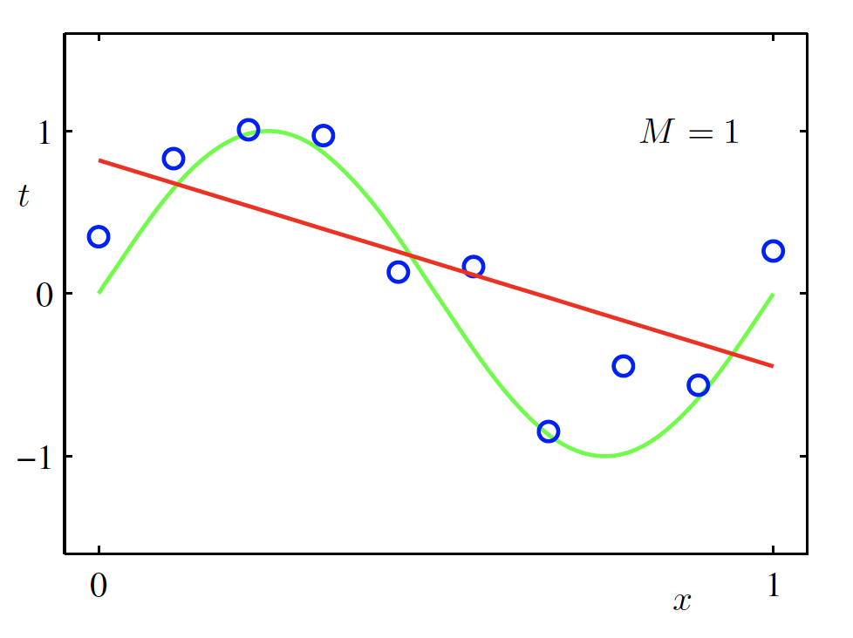
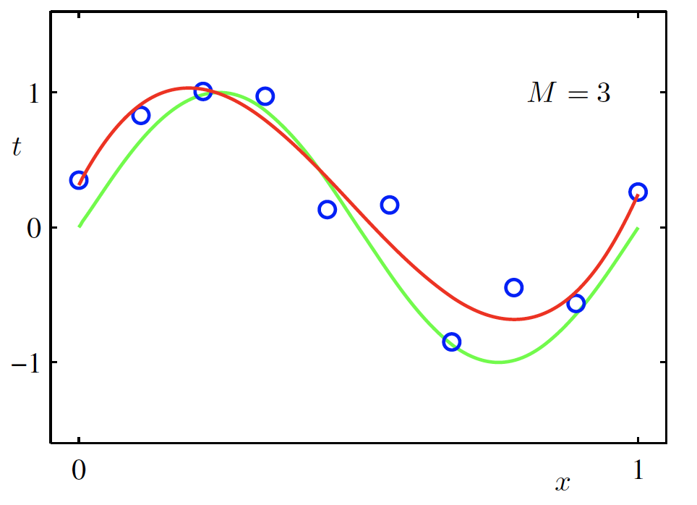
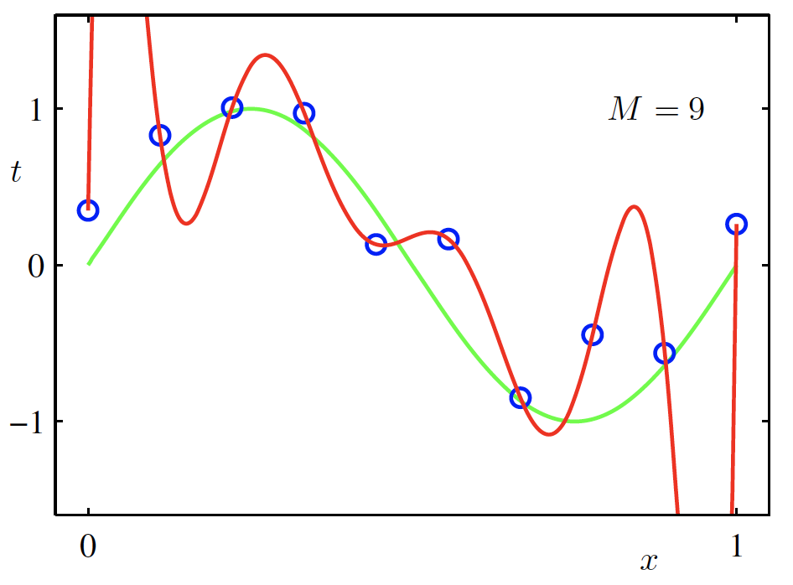
Overfitting
$f$ is a polynomial of degree 9
$f$ is linear
$f$ is cubic
$Loss\left(w\right)$ is high
$Loss\left(w\right)$ is low
$Loss\left(w\right)$ is zero!
Underfitting
Overfitting
High Bias
High Variance
Christopher M. Bishop – Pattern Recognition and Machine Learning
Credit: C. Bishop. Pattern Recognition and Mach. Learning.

Slide 54
Questions?

