Slide 1
Deep Learning for Vision & Language
Machine Learning II: MLPs, Backpropagation, Pytorch

Slide 2
About the class
COMP 646: Deep Learning for Vision and Language
Instructor: Vicente Ordóñez (Vicente Ordóñez Román)
Website: https://www.cs.rice.edu/~vo9/deep-vislang
Location: Keck Hall 100
Times: Tuesdays and Thursdays
from 4pm to 5:15pm
Office Hours: Wednesdays 10am to noon (DH2080)
Teaching Assistants: Ayush, Jefferson, Jaywon, Zilin
Discussion Forum: Piazza (Sign-up Link on Rice Canvas and Class Website)

Slide 3



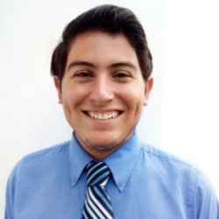
Teaching Assistants
Ayush Sachdeva
Office Hours:
Mondays 10 to 11am
Brochstein Pavilion
Jaywon Koo
Office Hours:
Tuesdays 10 to 11am
DH 3037
Zilin Xiao
Office Hours:
Thursdays 10 to 11am
DH 3108
Jefferson Hernandez
Office Hours:
Wednesdays 1 to 2pm
DH 2088

Slide 4
Assignment 1
Assignment 1 is released and is available on the class website and to be submitted via Canvas.
Due: Monday January 29th, midnight (you can and should submit early but not late – do not wait until finishing the whole assignment to have a version uploaded on canvas)

Slide 5
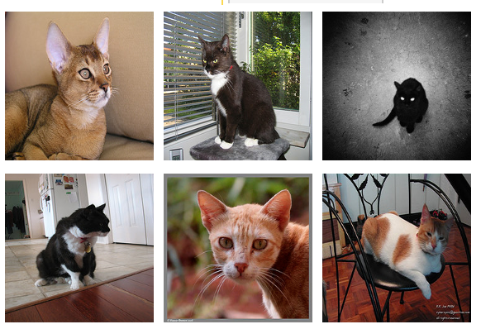
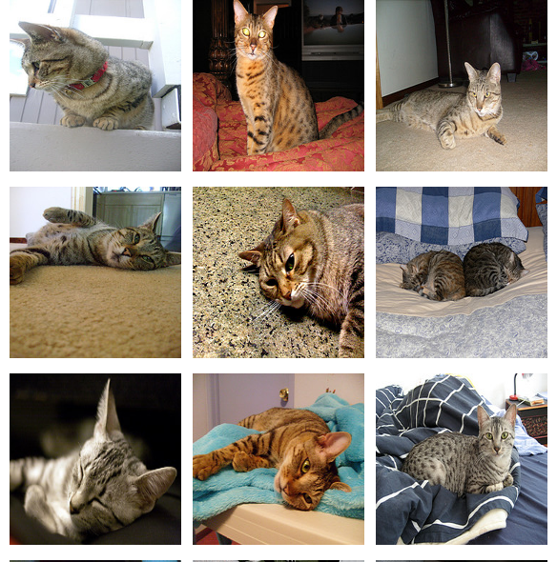
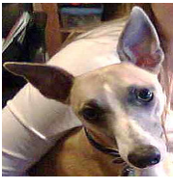
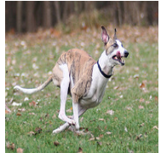
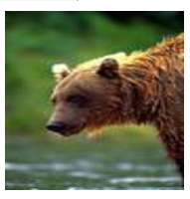
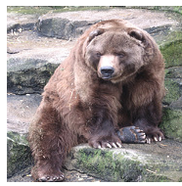
Supervised Learning - Classification
Training Data
Test Data
cat
dog
cat
.
.
.
.
.
.
bear

Slide 6








Supervised Learning - Classification
Training Data
cat
$$x_{1}=[ ]$$
$$y_{1}=[ ]$$
dog
$$x_{2}=[ ]$$
$$y_{2}=[ ]$$
cat
$$x_{3}=[ ]$$
$$y_{3}=[ ]$$
.
.
.
bear
$$x_{n}=[ ]$$
$$y_{n}=[ ]$$

Slide 7







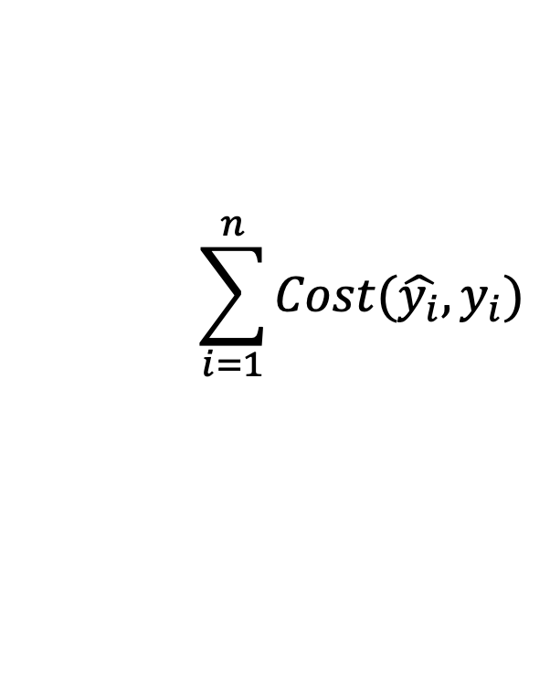


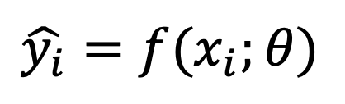



Supervised Learning - Classification
Training Data
targets /
labels /
ground truth
We need to find a function that
maps x and y for any of them.
inputs
predictions
$$x_{1}=[x_{11} { x}_{12} x_{13} { x}_{14}]$$
$$y_{1}=$$
1
$${\hat{y}}_{1}=$$
1
$$\hat{y_{i}}=f(x_{i};θ)$$
$$x_{2}=[x_{21} { x}_{22} x_{23} { x}_{24}]$$
$$y_{2}=$$
2
$${\hat{y}}_{2}=$$
2
$$x_{3}=[x_{31} { x}_{32} x_{33} { x}_{34}]$$
$$y_{3}=$$
1
$${\hat{y}}_{3}=$$
2
How do we ”learn” the parameters
of this function?
.
.
.
We choose ones that makes the
following quantity small:
$$\sum_{i=1}^{n}{Cost(\hat{y_{i}}, y_{i})}$$
$$x_{n}=[x_{n1} { x}_{n2} x_{n3} { x}_{n4}]$$
$$y_{n}=$$
3
$${\hat{y}}_{n}=$$
1

Slide 8
Supervised Learning - Classification
Training Data
Test Data
cat
dog
cat
.
.
.
.
.
.
bear

Slide 9
Supervised Learning - Classification
Training Data
cat
$$x_{1}=[ ]$$
$$y_{1}=[ ]$$
dog
$$x_{2}=[ ]$$
$$y_{2}=[ ]$$
cat
$$x_{3}=[ ]$$
$$y_{3}=[ ]$$
.
.
.
bear
$$x_{n}=[ ]$$
$$y_{n}=[ ]$$

Slide 10
Supervised Learning - Classification
Training Data
targets /
labels /
ground truth
We need to find a function that
maps x and y for any of them.
inputs
predictions
$$x_{1}=[x_{11} { x}_{12} x_{13} { x}_{14}]$$
$$y_{1}=$$
1
$${\hat{y}}_{1}=$$
1
$$\hat{y_{i}}=f(x_{i};θ)$$
$$x_{2}=[x_{21} { x}_{22} x_{23} { x}_{24}]$$
$$y_{2}=$$
2
$${\hat{y}}_{2}=$$
2
$$x_{3}=[x_{31} { x}_{32} x_{33} { x}_{34}]$$
$$y_{3}=$$
1
$${\hat{y}}_{3}=$$
2
How do we ”learn” the parameters
of this function?
.
.
.
We choose ones that makes the
following quantity small:
$$\sum_{i=1}^{n}{Cost(\hat{y_{i}}, y_{i})}$$
$$x_{n}=[x_{n1} { x}_{n2} x_{n3} { x}_{n4}]$$
$$y_{n}=$$
3
$${\hat{y}}_{n}=$$
1

Slide 11
Supervised Learning – Linear Softmax
Training Data
targets /
labels /
ground truth
inputs
$$x_{1}=[x_{11} { x}_{12} x_{13} { x}_{14}]$$
$$y_{1}=$$
1
$$x_{2}=[x_{21} { x}_{22} x_{23} { x}_{24}]$$
$$y_{2}=$$
2
$$x_{3}=[x_{31} { x}_{32} x_{33} { x}_{34}]$$
$$y_{3}=$$
1
.
.
.
$$x_{n}=[x_{n1} { x}_{n2} x_{n3} { x}_{n4}]$$
$$y_{n}=$$
3

Slide 12




Supervised Learning – Linear Softmax
Training Data
targets /
labels /
ground truth
inputs
predictions
$$x_{1}=[x_{11} { x}_{12} x_{13} { x}_{14}]$$
$$y_{1}=$$
[1 0 0]
$${\hat{y}}_{1}=$$
[0.85 0.10 0.05]
$$x_{2}=[x_{21} { x}_{22} x_{23} { x}_{24}]$$
$$y_{2}=$$
[0 1 0]
$${\hat{y}}_{2}=$$
[0.20 0.70 0.10]
$$x_{3}=[x_{31} { x}_{32} x_{33} { x}_{34}]$$
$$y_{3}=$$
[1 0 0]
$${\hat{y}}_{3}=$$
[0.40 0.45 0.15]
.
.
.
$$x_{n}=[x_{n1} { x}_{n2} x_{n3} { x}_{n4}]$$
$$y_{n}=$$
[0 0 1]
$${\hat{y}}_{n}=$$
[0.40 0.25 0.35]

Slide 13






Supervised Learning – Linear Softmax
$$x_{i}=[x_{i1} { x}_{i2} x_{i3} { x}_{i4}]$$
$$y_{i}=$$
[1 0 0]
$${\hat{y}}_{i}= [f_{1} f_{2} f_{3}]$$
$$a_{1}=w_{11}x_{i1}+w_{12}x_{i2}+w_{13}x_{i3}+w_{14}x_{i4}+b_{c}$$
$$a_{2}=w_{21}x_{i1}+w_{22}x_{i2}+w_{23}x_{i3}+w_{24}x_{i4}+b_{d}$$
$$a_{3}=w_{31}x_{i1}+w_{32}x_{i2}+w_{33}x_{i3}+w_{34}x_{i4}+b_{b}$$
$$f_{1}=e^{a_{1}}/{(e}^{a_{1}}+e^{a_{2}}+e^{a_{3}})$$
$$f_{2}=e^{a_{2}}/{(e}^{a_{1}}+e^{a_{2}}+e^{a_{3}})$$
$$f_{3}=e^{a_{3}}/{(e}^{a_{1}}+e^{a_{2}}+e^{a_{3}})$$

Slide 14
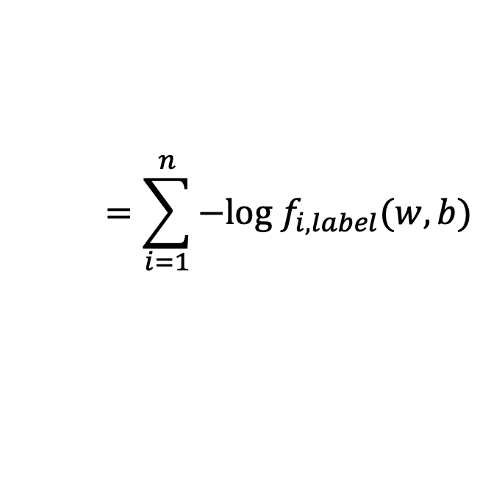
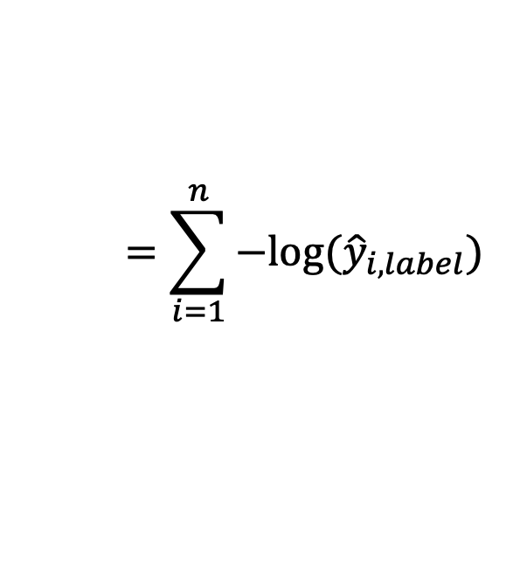
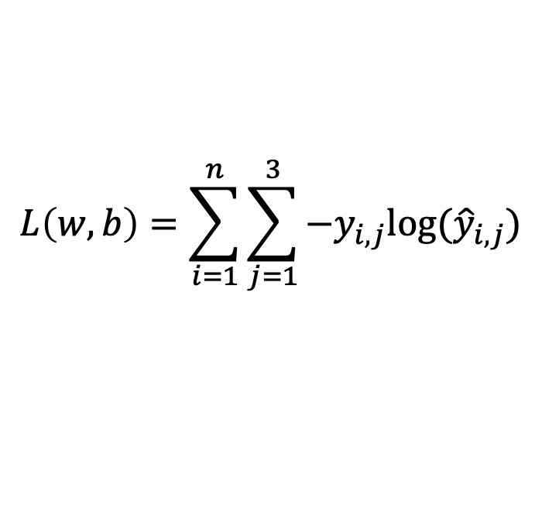

How do we find a good w and b?
$$x_{i}=[x_{i1} { x}_{i2} x_{i3} { x}_{i4}]$$
$$y_{i}=$$
[1 0 0]
$${\hat{y}}_{i}= [f_{1}(w,b) f_{2}(w,b) f_{3}(w,b)]$$
We need to find w, and b that minimize the following:
$$L\left(w,b\right)=\sum_{i=1}^{n}{\sum_{j=1}^{3}{−y_{i,j}log⁡({\hat{y}}_{i,j})}}$$
$$=\sum_{i=1}^{n}{−log⁡({\hat{y}}_{i,label})}$$
$$=\sum_{i=1}^{n}{−log f_{i,label}(w,b)}$$
Why?

Slide 15



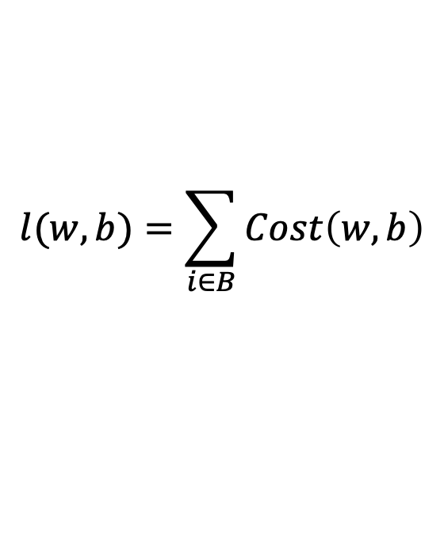



(mini-batch) Stochastic Gradient Descent (SGD)
$$λ=0.01$$
$$l(w,b)=\sum_{i∈B}{Cost\left(w,b\right)}$$
Initialize w and b randomly
for e = 0, num_epochs do
for b = 0, num_batches do
Compute:
$$dl(w,b)/dw$$
and
$$dl(w,b)/db$$
Update w:
$$w=w −λ dl(w,b)/dw$$
Update b:
$$b=b −λ dl(w,b)/db$$
Print:
$$l(w,b)$$
// Useful to see if this is becoming smaller or not.
end
end

Slide 16
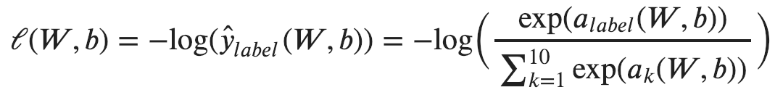
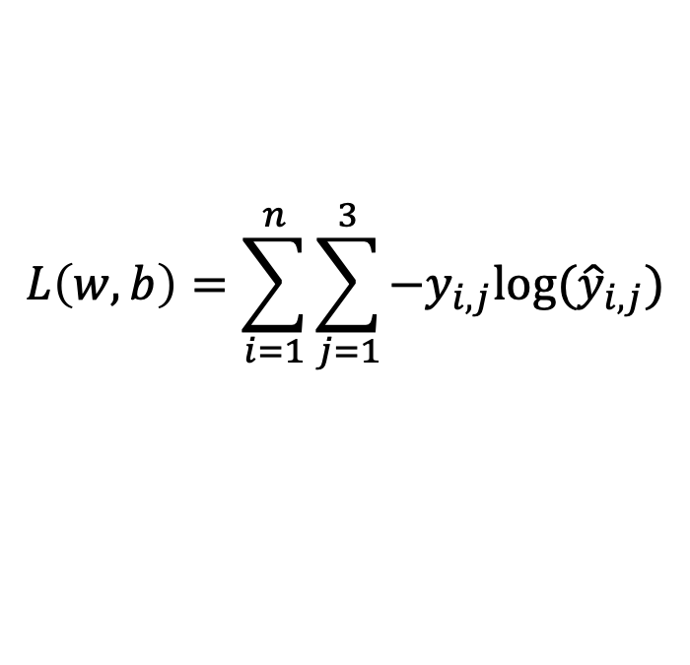
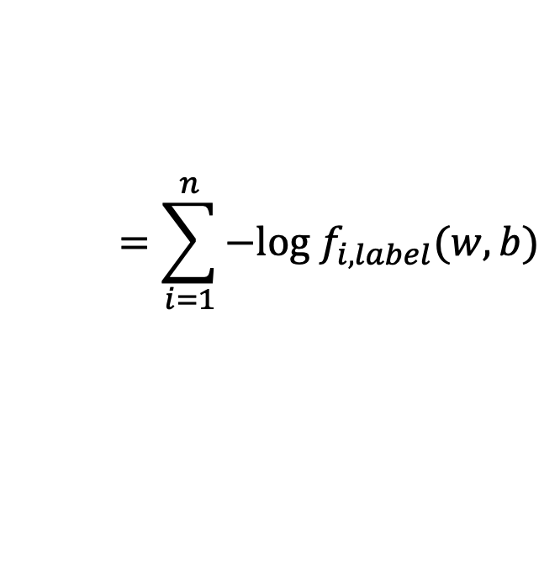
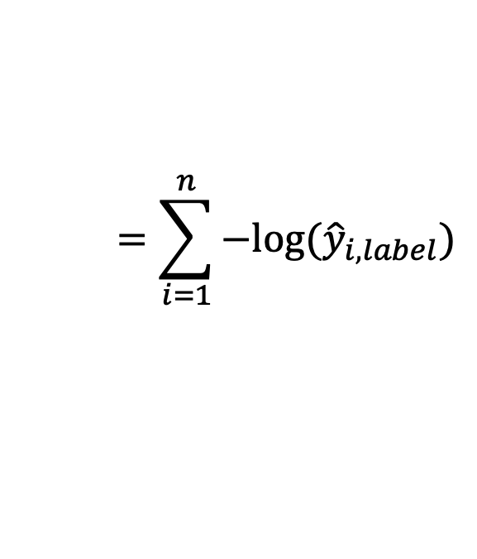
Computing Analytic Gradients
This is what we have:
$$L\left(w,b\right)=\sum_{i=1}^{n}{\sum_{j=1}^{3}{−y_{i,j}log⁡({\hat{y}}_{i,j})}}$$
$$=\sum_{i=1}^{n}{−log⁡({\hat{y}}_{i,label})}$$
$$=\sum_{i=1}^{n}{−log f_{i,label}(w,b)}$$
To simplify let’s assume n = 1
3

Slide 17



Supervised Learning – Linear Softmax
$$x=[x_{1} { x}_{2} x_{3} { x}_{4}]$$
$$y=$$
[1 0 0]
$$\hat{y}= [f_{1} f_{2} f_{3}]$$
$$a_{1}=w_{11}x_{1}+w_{12}x_{2}+w_{13}x_{3}+w_{14}x_{4}+b_{c}$$
$$a_{2}=w_{21}x_{1}+w_{22}x_{2}+w_{23}x_{3}+w_{24}x_{4}+b_{d}$$
$$a_{3}=w_{31}x_{1}+w_{32}x_{2}+w_{33}x_{3}+w_{34}x_{4}+b_{b}$$
$$f_{1}=e^{a_{1}}/{(e}^{a_{1}}+e^{a_{2}}+e^{a_{3}})$$
$$f_{2}=e^{a_{2}}/{(e}^{a_{1}}+e^{a_{2}}+e^{a_{3}})$$
$$f_{3}=e^{a_{3}}/{(e}^{a_{1}}+e^{a_{2}}+e^{a_{3}})$$

Slide 18
Computing Analytic Gradients
This is what we have:
3

Slide 19
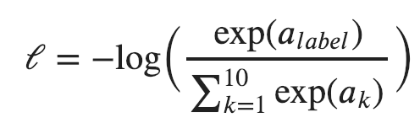
Computing Analytic Gradients
This is what we have:
3
3
Reminder:
$$a_{i}=(w_{i,1}x_{1}+w_{i,2}x_{2}+w_{i,3}x_{3}+w_{i,4}x_{4})+b_{i}$$

Slide 20
Computing Analytic Gradients
This is what we have:
3

Slide 21
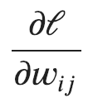

Computing Analytic Gradients
This is what we have:
3
This is what we need:
for each
for each

Slide 22
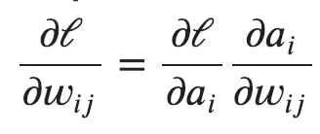
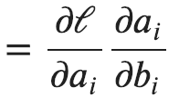
Computing Analytic Gradients
This is what we have:
3
Step 1: Chain Rule of Calculus

Slide 23
Computing Analytic Gradients
This is what we have:
3
Step 1: Chain Rule of Calculus
Let’s do these first

Slide 24
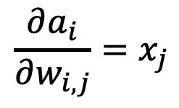
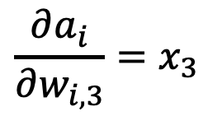
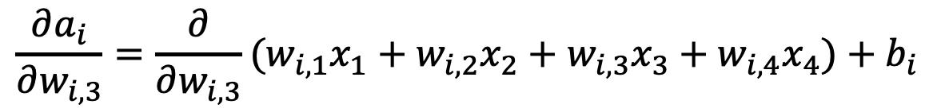
Computing Analytic Gradients
$$a_{i}=(w_{i,1}x_{1}+w_{i,2}x_{2}+w_{i,3}x_{3}+w_{i,4}x_{4})+b_{i}$$
$$\frac{∂a_{i}}{∂w_{i, 3}}=\frac{∂}{∂w_{i, 3}}(w_{i,1}x_{1}+w_{i,2}x_{2}+w_{i,3}x_{3}+w_{i,4}x_{4})+b_{i}$$
$$\frac{∂a_{i}}{∂w_{i, 3}}=x_{3}$$
$$\frac{∂a_{i}}{∂w_{i, j}}=x_{j}$$

Slide 25
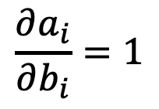
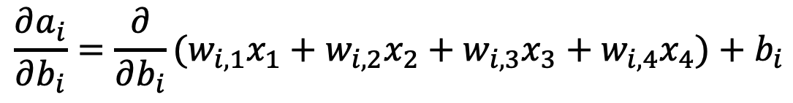
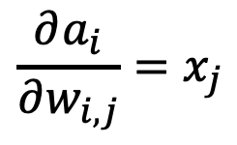
Computing Analytic Gradients
$$\frac{∂a_{i}}{∂w_{i, j}}=x_{j}$$
$$a_{i}=(w_{i,1}x_{1}+w_{i,2}x_{2}+w_{i,3}x_{3}+w_{i,4}x_{4})+b_{i}$$
$$\frac{∂a_{i}}{∂b_{i}}=\frac{∂}{∂b_{i}}(w_{i,1}x_{1}+w_{i,2}x_{2}+w_{i,3}x_{3}+w_{i,4}x_{4})+b_{i}$$
$$\frac{∂a_{i}}{∂b_{i}}=1$$

Slide 26

Computing Analytic Gradients
$$\frac{∂a_{i}}{∂w_{i, j}}=x_{j}$$
$$\frac{∂a_{i}}{∂b_{i}}=1$$

Slide 27
Computing Analytic Gradients
This is what we have:
3
Step 1: Chain Rule of Calculus
Now let’s do this one (same for both!)

Slide 28
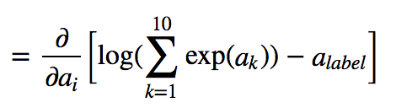
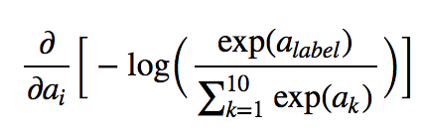
Computing Analytic Gradients
3
3
In our cat, dog, bear classification example: i = {1, 2, 3}

Slide 29
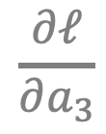
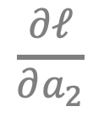
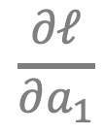
Computing Analytic Gradients
3
3
In our cat, dog, bear classification example: i = {1, 2, 3}
$$\frac{∂ℓ}{∂a_{1}}$$
$$\frac{∂ℓ}{∂a_{2}}$$
$$\frac{∂ℓ}{∂a_{3}}$$
Let’s say: label = 2
We need:

Slide 30
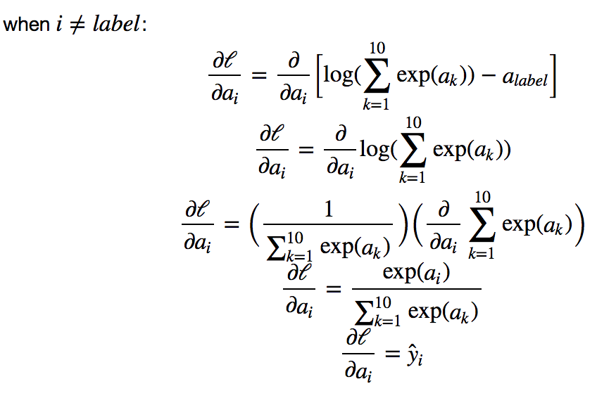

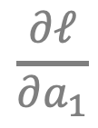

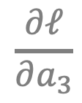
Computing Analytic Gradients
3
$$\frac{∂ℓ}{∂a_{1}}$$
$$\frac{∂ℓ}{∂a_{3}}$$
3
3
3
3
$$={\hat{y}}_{i}$$
$$={\hat{y}}_{i}$$
3

Slide 31
Supervised Learning – Linear Softmax
$$x_{i}=[x_{i1} { x}_{i2} x_{i3} { x}_{i4}]$$
$$y_{i}=$$
[1 0 0]
$${\hat{y}}_{i}= [f_{1} f_{2} f_{3}]$$
$$a_{1}=w_{11}x_{i1}+w_{12}x_{i2}+w_{13}x_{i3}+w_{14}x_{i4}+b_{c}$$
$$a_{2}=w_{21}x_{i1}+w_{22}x_{i2}+w_{23}x_{i3}+w_{24}x_{i4}+b_{d}$$
$$a_{3}=w_{31}x_{i1}+w_{32}x_{i2}+w_{33}x_{i3}+w_{34}x_{i4}+b_{b}$$
$$f_{1}=e^{a_{1}}/{(e}^{a_{1}}+e^{a_{2}}+e^{a_{3}})$$
$$f_{2}=e^{a_{2}}/{(e}^{a_{1}}+e^{a_{2}}+e^{a_{3}})$$
$$f_{3}=e^{a_{3}}/{(e}^{a_{1}}+e^{a_{2}}+e^{a_{3}})$$

Slide 32
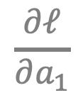
Computing Analytic Gradients
3
$$\frac{∂ℓ}{∂a_{1}}$$
$$\frac{∂ℓ}{∂a_{3}}$$
3
3
3
3
$$={\hat{y}}_{i}$$
$$={\hat{y}}_{i}$$
3

Slide 33
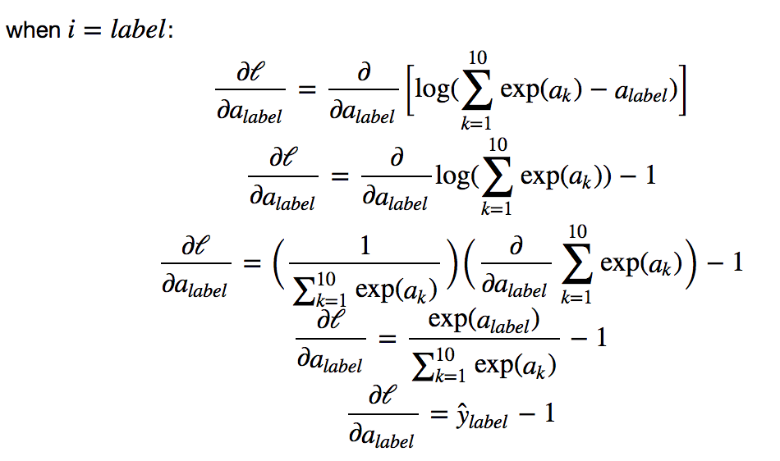
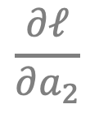

Computing Analytic Gradients
3
$$\frac{∂ℓ}{∂a_{2}}$$
3
3
3
3
$$={\hat{y}}_{i}−1$$
3

Slide 34
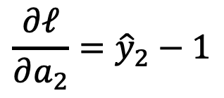
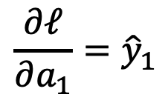
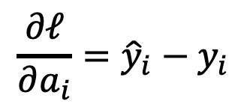
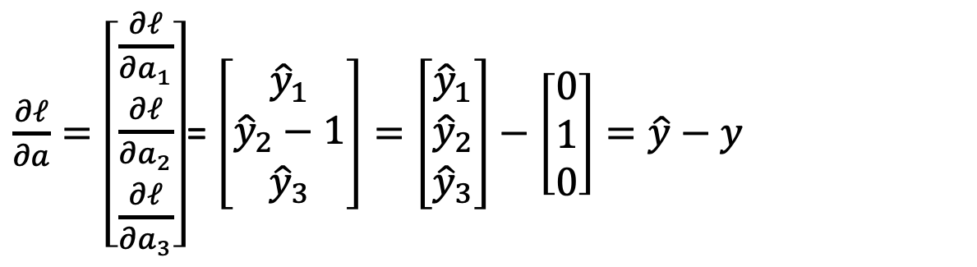
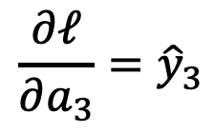
Computing Analytic Gradients
label = 2
$$\frac{∂ℓ}{∂a_{1}}={\hat{y}}_{1}$$
$$\frac{∂ℓ}{∂a_{2}}={\hat{y}}_{2}−1$$
$$\frac{∂ℓ}{∂a_{3}}={\hat{y}}_{3}$$
$\frac{∂ℓ}{∂a}=\left[\begin{aligned}\frac{∂ℓ}{∂a_{1}} \\ \frac{∂ℓ}{∂a_{2}} \\ \frac{∂ℓ}{∂a_{3}}\end{aligned}\right]$= $\left[\begin{aligned}{\hat{y}}_{1} \\ {\hat{y}}_{2}−1 \\ {\hat{y}}_{3}\end{aligned}\right]=\left[\begin{aligned}{\hat{y}}_{1} \\ {\hat{y}}_{2} \\ {\hat{y}}_{3}\end{aligned}\right]−\left[\begin{aligned}0 \\ 1 \\ 0\end{aligned}\right]=\hat{y}−y$
$$\frac{∂ℓ}{∂a_{i}}={\hat{y}}_{i}−y_{i}$$

Slide 35
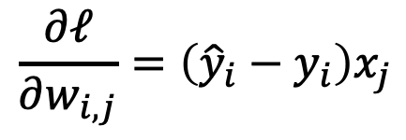
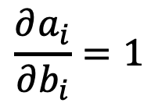
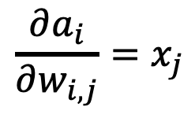
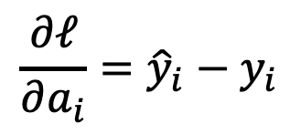
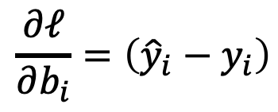
Computing Analytic Gradients
$$\frac{∂a_{i}}{∂w_{i, j}}=x_{j}$$
$$\frac{∂a_{i}}{∂b_{i}}=1$$
$$\frac{∂ℓ}{∂a_{i}}={\hat{y}}_{i}−y_{i}$$
$$\frac{∂ℓ}{∂w_{i, j}}=\left({\hat{y}}_{i}−y_{i}\right)x_{j}$$
$$\frac{∂ℓ}{∂b_{i}}=\left({\hat{y}}_{i}−y_{i}\right)$$

Slide 36
Automatic Differentiation
You only need to write code for the operations in the prediction step,
Gradient computation can be computed “automatically”.
Pytorch (Facebook -- mostly):
Tensorflow (Google -- mostly):
MXNet (Amazon -- mostly):
https://pytorch.org/
https://www.tensorflow.org/
https://mxnet.apache.org/versions/1.9.0/

Slide 37



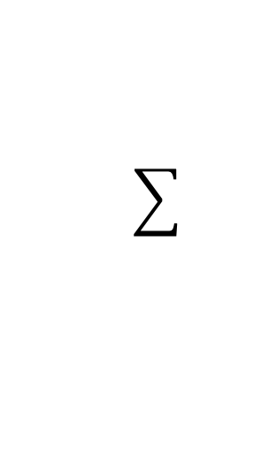







Perceptron Model
Frank Rosenblatt (1957) - Cornell University
Activation
function
$$x_{1}$$
$$w_{1}$$
$$f\left(x\right)=\left\{\begin{aligned}1, if \sum_{i=0}^{n}{w_{i}x_{i}}+b>0 \\ &0, otherwise \end{aligned}\right.$$
$$x_{2}$$
$$w_{2}$$
$$w_{3}$$
$$x_{3}$$
$$w_{4}$$
$$x_{4}$$
More: https://en.wikipedia.org/wiki/Perceptron

Slide 38
Perceptron Model
Frank Rosenblatt (1957) - Cornell University
!?
$$x_{1}$$
$$w_{1}$$
$$f\left(x\right)=\left\{\begin{aligned}1, if \sum_{i=0}^{n}{w_{i}x_{i}}+b>0 \\ &0, otherwise \end{aligned}\right.$$
$$x_{2}$$
$$w_{2}$$
$$w_{3}$$
$$x_{3}$$
$$w_{4}$$
$$x_{4}$$
More: https://en.wikipedia.org/wiki/Perceptron

Slide 39
Perceptron Model
Frank Rosenblatt (1957) - Cornell University
Activation
function
$$x_{1}$$
$$w_{1}$$
$$f\left(x\right)=\left\{\begin{aligned}1, if \sum_{i=0}^{n}{w_{i}x_{i}}+b>0 \\ &0, otherwise \end{aligned}\right.$$
$$x_{2}$$
$$w_{2}$$
$$w_{3}$$
$$x_{3}$$
$$w_{4}$$
$$x_{4}$$
More: https://en.wikipedia.org/wiki/Perceptron

Slide 40




Activation Functions
Step(x)
Sigmoid(x)
Tanh(x)
ReLU(x) = max(0, x)

Slide 41










Two-layer Multi-layer Perceptron (MLP)
”hidden" layer
Loss / Criterion
$$x_{1}$$
$$a_{1}$$
$$x_{2}$$
$$a_{2}$$
$${\hat{y}}_{1}$$
$$y_{1}$$
$$x_{3}$$
$$a_{3}$$
$$x_{4}$$
$$a_{4}$$

Slide 42






Linear Softmax
$$x_{i}=[x_{i1} { x}_{i2} x_{i3} { x}_{i4}]$$
$$y_{i}=$$
[1 0 0]
$${\hat{y}}_{i}= [f_{c} f_{d} f_{b}]$$
$$g_{c}=w_{c1}x_{i1}+w_{c2}x_{i2}+w_{c3}x_{i3}+w_{c4}x_{i4}+b_{c}$$
$$g_{d}=w_{d1}x_{i1}+w_{d2}x_{i2}+w_{d3}x_{i3}+w_{d4}x_{i4}+b_{d}$$
$$g_{b}=w_{b1}x_{i1}+w_{b2}x_{i2}+w_{b3}x_{i3}+w_{b4}x_{i4}+b_{b}$$
$$f_{c}=e^{g_{c}}/{(e}^{g_{c}}+e^{g_{d}}+e^{g_{b}})$$
$$f_{d}=e^{g_{d}}/{(e}^{g_{c}}+e^{g_{d}}+e^{g_{b}})$$
$$f_{b}=e^{g_{b}}/{(e}^{g_{c}}+e^{g_{d}}+e^{g_{b}})$$

Slide 43


Linear Softmax
$$x_{i}=[x_{i1} { x}_{i2} x_{i3} { x}_{i4}]$$
$$y_{i}=$$
[1 0 0]
$${\hat{y}}_{i}= [f_{c} f_{d} f_{b}]$$
$$g_{c}=w_{c1}x_{i1}+w_{c2}x_{i2}+w_{c3}x_{i3}+w_{c4}x_{i4}+b_{c}$$
$$w=\left[\begin{matrix}w_{c1} & w_{c2} & w_{c3} & w_{c4} \\ w_{d1} & w_{d2} & w_{d3} & w_{d4} \\ w_{b1} & w_{b2} & w_{b3} & w_{b4}\end{matrix}\right]$$
$$g_{d}=w_{d1}x_{i1}+w_{d2}x_{i2}+w_{d3}x_{i3}+w_{d4}x_{i4}+b_{d}$$
$$g_{b}=w_{b1}x_{i1}+w_{b2}x_{i2}+w_{b3}x_{i3}+w_{b4}x_{i4}+b_{b}$$
$$b=\left[\begin{matrix}b_{c} & b_{d} & b_{b}\end{matrix}\right]$$
$$f_{c}=e^{g_{c}}/{(e}^{g_{c}}+e^{g_{d}}+e^{g_{b}})$$
$$f_{d}=e^{g_{d}}/{(e}^{g_{c}}+e^{g_{d}}+e^{g_{b}})$$
$$f_{b}=e^{g_{b}}/{(e}^{g_{c}}+e^{g_{d}}+e^{g_{b}})$$

Slide 44

Linear Softmax
$$x_{i}=[x_{i1} { x}_{i2} x_{i3} { x}_{i4}]$$
$$y_{i}=$$
[1 0 0]
$${\hat{y}}_{i}= [f_{c} f_{d} f_{b}]$$
$$w=\left[\begin{matrix}w_{c1} & w_{c2} & w_{c3} & w_{c4} \\ w_{d1} & w_{d2} & w_{d3} & w_{d4} \\ w_{b1} & w_{b2} & w_{b3} & w_{b4}\end{matrix}\right]$$
$$g=wx^{T}+b^{T}$$
$$b=\left[\begin{matrix}b_{c} & b_{d} & b_{b}\end{matrix}\right]$$
$$f_{c}=e^{g_{c}}/{(e}^{g_{c}}+e^{g_{d}}+e^{g_{b}})$$
$$f_{d}=e^{g_{d}}/{(e}^{g_{c}}+e^{g_{d}}+e^{g_{b}})$$
$$f_{b}=e^{g_{b}}/{(e}^{g_{c}}+e^{g_{d}}+e^{g_{b}})$$

Slide 45

Linear Softmax
$$x_{i}=[x_{i1} { x}_{i2} x_{i3} { x}_{i4}]$$
$$y_{i}=$$
[1 0 0]
$${\hat{y}}_{i}= [f_{c} f_{d} f_{b}]$$
$$w=\left[\begin{matrix}w_{c1} & w_{c2} & w_{c3} & w_{c4} \\ w_{d1} & w_{d2} & w_{d3} & w_{d4} \\ w_{b1} & w_{b2} & w_{b3} & w_{b4}\end{matrix}\right]$$
$$g=wx^{T}+b^{T}$$
$$b=\left[\begin{matrix}b_{c} & b_{d} & b_{b}\end{matrix}\right]$$
$$f=softmax(g)$$

Slide 46

Linear Softmax
$$x_{i}=[x_{i1} { x}_{i2} x_{i3} { x}_{i4}]$$
$$y_{i}=$$
[1 0 0]
$${\hat{y}}_{i}= [f_{c} f_{d} f_{b}]$$
$$f=softmax(wx^{T}+b^{T})$$

Slide 47


Two-layer MLP + Softmax
$$x_{i}=[x_{i1} { x}_{i2} x_{i3} { x}_{i4}]$$
$$y_{i}=$$
[1 0 0]
$${\hat{y}}_{i}= [f_{c} f_{d} f_{b}]$$
$$a_{1}=sigmoid(w_{[1]}x^{T}+b_{[1]}^{T})$$
$$f=softmax(w_{[2]}{a_{1}}^{T}+b_{[2]}^{T})$$

Slide 48





N-layer MLP + Softmax
$$x_{i}=[x_{i1} { x}_{i2} x_{i3} { x}_{i4}]$$
$$y_{i}=$$
[1 0 0]
$${\hat{y}}_{i}= [f_{c} f_{d} f_{b}]$$
$$a_{1}=sigmoid(w_{[1]}x^{T}+b_{[1]}^{T})$$
$$a_{2}=sigmoid(w_{[2]}a_{1}^{T}+b_{[2]}^{T})$$
$$…$$
$$a_{k}=sigmoid(w_{[k]}a_{k−1}^{T}+b_{[k]}^{T})$$
$$…$$
$$f=softmax(w_{[n]}a_{n−1}^{T}+b_{[n]}^{T})$$

Slide 49





How to train the parameters?
$$x_{i}=[x_{i1} { x}_{i2} x_{i3} { x}_{i4}]$$
$$y_{i}=$$
[1 0 0]
$${\hat{y}}_{i}= [f_{c} f_{d} f_{b}]$$
$$a_{1}=sigmoid(w_{[1]}x^{T}+b_{[1]}^{T})$$
$$a_{2}=sigmoid(w_{[2]}a_{1}^{T}+b_{[2]}^{T})$$
$$…$$
$$a_{k}=sigmoid(w_{[k]}a_{k−1}^{T}+b_{[k]}^{T})$$
$$…$$
$$f=softmax(w_{[n]}a_{n−1}^{T}+b_{[n]}^{T})$$

Slide 50



Forward pass (Forward-propagation)
$${\hat{y}}_{1}$$
$$x_{1}$$
$$a_{1}$$
$$x_{2}$$
$$a_{2}$$
$${\hat{y}}_{2}$$
$$y_{1}$$
$$x_{3}$$
$$a_{3}$$
$$x_{4}$$
$$a_{4}$$

Slide 51





Forward pass (Forward-propagation)
$$z_{i}=\sum_{i=0}^{n}{w_{1ij}x_{i}}+b_{1}$$
$$a_{i}= Sigmoid(z_{i})$$
$$p_{1}=\sum_{i=0}^{n}{w_{2i}a_{i}}+b_{2}$$
$$y_{1}= Sigmoid(p_{i})$$
$$x_{1}$$
$$a_{1}$$
$$x_{2}$$
$$a_{2}$$
$${\hat{y}}_{1}$$
$$y_{1}$$
$$x_{3}$$
$$a_{3}$$
$$x_{4}$$
$$a_{4}$$
$Loss=L(y_{1},$ ${\hat{y}}_{1})$

Slide 52



How to train the parameters?
$$x_{i}=[x_{i1} { x}_{i2} x_{i3} { x}_{i4}]$$
$$y_{i}=$$
[1 0 0]
$${\hat{y}}_{i}= [f_{c} f_{d} f_{b}]$$
$$a_{1}=sigmoid(w_{[1]}x^{T}+b_{[1]}^{T})$$
$$a_{2}=sigmoid(w_{[2]}a_{1}^{T}+b_{[2]}^{T})$$
$$…$$
We can still use SGD
$$a_{k}=sigmoid(w_{[k]}a_{k−1}^{T}+b_{[i]}^{T})$$
$$…$$
We need!
$$\frac{∂l}{∂w_{[k]ij}}$$
$$\frac{∂l}{∂b_{\left[k\right]i}}$$
$$f=softmax(w_{[n]}a_{n−1}^{T}+b_{[n]}^{T})$$

Slide 53




How to train the parameters?
$$x_{i}=[x_{i1} { x}_{i2} x_{i3} { x}_{i4}]$$
$$y_{i}=$$
[1 0 0]
$${\hat{y}}_{i}= [f_{c} f_{d} f_{b}]$$
$$a_{1}=sigmoid(w_{[1]}x^{T}+b_{[1]}^{T})$$
$$a_{2}=sigmoid(w_{[2]}a_{1}^{T}+b_{[2]}^{T})$$
$$…$$
We can still use SGD
$$a_{i}=sigmoid(w_{[k]}a_{k−1}^{T}+b_{[k]}^{T})$$
$$…$$
We need!
$$f=softmax(w_{[n]}a_{n−1}^{T}+b_{[n]}^{T})$$
$$\frac{∂l}{∂w_{[k]ij}}$$
$$\frac{∂l}{∂b_{\left[k\right]i}}$$
$$l=loss(f, y)$$

Slide 54
How to train the parameters?
$$x_{i}=[x_{i1} { x}_{i2} x_{i3} { x}_{i4}]$$
$$y_{i}=$$
[1 0 0]
$${\hat{y}}_{i}= [f_{c} f_{d} f_{b}]$$
$$a_{1}=sigmoid(w_{[1]}x^{T}+b_{[1]}^{T})$$
$$a_{2}=sigmoid(w_{[2]}a_{1}^{T}+b_{[2]}^{T})$$
$$…$$
We can still use SGD
$$a_{i}=sigmoid(w_{[k]}a_{k−1}^{T}+b_{[k]}^{T})$$
$$…$$
We need!
$$f=softmax(w_{[n]}a_{n−1}^{T}+b_{[n]}^{T})$$
$$\frac{∂l}{∂w_{[k]ij}}$$
$$\frac{∂l}{∂b_{\left[k\right]i}}$$
$$l=loss(f, y)$$

Slide 55

How to train the parameters?
$$x_{i}=[x_{i1} { x}_{i2} x_{i3} { x}_{i4}]$$
$$y_{i}=$$
[1 0 0]
$${\hat{y}}_{i}= [f_{c} f_{d} f_{b}]$$
$$a_{1}=sigmoid(w_{[1]}x^{T}+b_{[1]}^{T})$$
$$a_{2}=sigmoid(w_{[2]}a_{1}^{T}+b_{[2]}^{T})$$
$$…$$
$$\frac{∂l}{∂w_{[k]ij}}=\frac{∂l}{∂a_{n−1}} \frac{∂a_{n−1}}{∂a_{n−2}}…\frac{∂a_{k−2}}{∂a_{k−1}}\frac{∂a_{k−1}}{∂w_{\left[k\right]ij}}$$
$$a_{i}=sigmoid(w_{[k]}a_{k−1}^{T}+b_{[k]}^{T})$$
$$…$$
$$f=softmax(w_{[n]}a_{n−1}^{T}+b_{[n]}^{T})$$
$$l=loss(f, y)$$

Slide 56







Backward pass (Back-propagation)
$${\frac{∂L}{∂x_{k}}}_{}=(\frac{∂}{∂x_{k}}\sum_{i=0}^{n}{w_{1ij}x_{i}}+b_{1})\frac{∂L}{∂z_{i}}$$
$${\frac{∂L}{∂z_{i}}}_{}=\frac{∂}{∂z_{i}}Sigmoid(z_{i})\frac{∂L}{∂a_{k}}$$
$${\frac{∂L}{∂a_{k}}}_{}=(\frac{∂}{∂a_{k}}\sum_{i=0}^{n}{w_{2i}a_{i}}+b_{2})\frac{∂L}{∂p_{1}}$$
${\frac{∂L}{∂p_{1}}}_{}=\frac{∂}{∂p_{1}}Sigmoid(p_{i})$ $\frac{∂L}{∂{\hat{y}}_{1}}$
$$x_{1}$$
$$a_{1}$$
$$x_{2}$$
$$a_{2}$$
$${\hat{y}}_{1}$$
$$y_{1}$$
$$x_{3}$$
$$a_{3}$$
$$x_{4}$$
$$a_{4}$$
$${\frac{∂L}{∂w_{2i}}=\frac{∂p_{1}}{∂w_{2i}}\frac{∂L}{∂p}}_{1}$$
$\frac{∂L}{∂{\hat{y}}_{1}}=\frac{∂}{∂{\hat{y}}_{1}}L(y_{1},$ ${\hat{y}}_{1})$
$${\frac{∂L}{∂w_{1ij}}=\frac{∂z_{i}}{∂w_{1ij}}\frac{∂L}{∂z}}_{i}$$

Slide 57
Automatic Differentiation
You only need to write code for the forward pass,
backward pass is computed automatically.
Pytorch (Facebook -- mostly):
Tensorflow (Google -- mostly):
MXNet (Amazon -- mostly):
https://pytorch.org/
https://www.tensorflow.org/
https://mxnet.apache.org/versions/1.9.0/

Slide 58

Defining a Model in Pytorch (Two Layer NN)

Slide 59


1. Creating Model, Loss, Optimizer

Slide 60

2. Running forward and backward on a batch

Slide 61









Birdsnap
Computer Vision
Face Detection in Cameras

Slide 62
Human Vision / Human Brain
Geometry
Machine Learning
Deep Learning
Computer Vision
Optics / Cameras
Robotics

Slide 63
Who is using Computer Vision?
Facebook – Oculus VR, Image Search, Image tagging, Content filtering, Instagram, etc.
Google/Alphabet – Waymo, DeepMind, Image Search, Google Earth/Maps, Street View, Google Photos, etc.
Adobe – Photoshop, Premiere, Lightroom, etc.
Snap Inc – Snapchat, Smart Goggles, Filters, Face Detection, Style Transfer, etc.
eBay Inc – Product Search, Product Matching, Content Filtering, Duplicate Removal, etc.
Amazon – Warehouse robotics, Smart Stores, Product Search.
IBM – Image Retrieval, Medical Applications, Product Quality.
Microsoft – Hololens, Optical Character Recognition (OCR), Face Detection, Cloud Services.
Apple – Face Verification, Enhanced cameras and chips for image processing.

Slide 64


https://bristles.ai/

Slide 65

https://bristles.ai/

Slide 66


https://www.mercuryalert.ai/

Slide 67


Phiar.ai (now part of Google)

Slide 68


Images
Can be viewed as a matrix with pixel values

Slide 69

Images
Or as a function in a 2D domain
$$z=f(x, y)$$

Slide 70
Color Images
Can be viewed as tensors (3-dimensional arrays)
T =
sizeof(T) = 3 x height x width
Channels are usually RGB: Red, Green, and Blue
Other color spaces: HSV, HSL, LUV, XYZ, Lab, CMYK, etc

Slide 71


Why is it hard?

Slide 72

This is just as hard for computers

Slide 73

Why is Computer Vision hard?
Ambiguities due to viewpoints

Slide 74

Why is Computer Vision hard?
Ambiguities due to viewpoints

Slide 75

Why is Computer Vision hard?
Issues with Illumination

Slide 76

Why is Computer Vision hard?
Background
clutter

Slide 77

Why is Computer Vision hard?
Intra-class
variation

Slide 78
Computer Vision vs Image Processing
Computer Vision: Image Knowledge
cat
deer

Slide 79

Computer Vision vs Image Processing
Image Processing: Image Image

Slide 80




Basic Image Processing
$$I$$
$$αI$$
$$α>1$$
Primer on Image Processing: https://bit.ly/3lGEdwv

Slide 81
Questions?

