Slide 1
Deep Learning for Vision & Language
Natural Language Processing I: Introduction

Slide 2
Natural Language Processing
The study of automatic reasoning over text / language

Slide 3
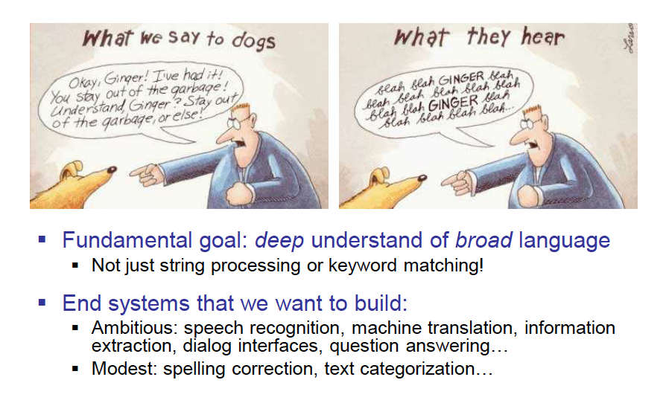
Slide by Dan Klein

Slide 4
Why is NLP Hard?
Human Language is Ambiguous
Task: Pronoun Resolution
  Jack drank the wine on the table. It was red and round.
  Jack saw Sam at the party. He went back to the bar to get another drink.
  Jack saw Sam at the party. He clearly had drunk too much.
    [Adapted from Wilks (1975)]
Slide by Yejin Choi

Slide 5
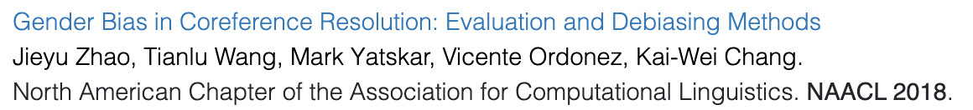
Why is NLP Hard?
Human Language Requires World Knowledge
Task: Co-Reference Resolution
  The doctor hired a secretary because she needed help with new patients.
  The physician hired the secretary because he was highly recommended.
    [From some of our group’s work]
Adapted from a slide by Yejin Choi

Slide 6
Why is NLP Hard?
Human Language is Ambiguous
Learning mother tongue (native language)
-- you might think it’s easy, but…
  compare 5 year old V.S. 10 year old V.S. 20 year old
Learning foreign languages
  – even harder
Slide by Yejin Choi

Slide 7
Word Segmentation
Slide from Ray Mooney
Breaking a string of characters into a sequence of words.
In some written languages (e.g. Japanese) words are not separated by spaces.
Even in English, characters other than white-space can be used to separate words [e.g. , ; . - : ( ) ]
Examples from English URLs:
  jumptheshark.com ⇒ jump the shark .com
  myspace.com/pluckerswingbar
  ⇒ myspace .com pluckers wing bar
  ⇒ myspace .com plucker swing bar

Slide 8
Morphological Analysis
Morphology is the field of linguistics that studies the internal structure of words. (Wikipedia)
A morpheme is the smallest linguistic unit that has semantic meaning (Wikipedia)
  e.g. “carry”, “pre”, “ed”, “ly”, “s”
Morphological analysis is the task of segmenting a word into its morphemes:
  carried ⇒ carry + ed (past tense)
  independently ⇒ in + (depend + ent) + ly
  Googlers ⇒ (Google + er) + s (plural)
  unlockable ⇒ un + (lock + able) ?
  ⇒ (un + lock) + able ?
Slide from Ray Mooney

Slide 9
German
555 --> fünf­hundert­fünf­und­fünfzig
7254 → Siebentausendzweihundertvierundfünfzig

Slide 10
Part Of Speech (POS) Tagging
Annotate each word in a sentence with a part-of-speech.
Useful for subsequent syntactic parsing and word sense disambiguation.
I ate the spaghetti with meatballs.
Pro V Det N Prep N
John saw the saw and decided to take it to the table.
PN V Det N Con V Part V Pro Prep Det N
Slide from Ray Mooney
Notes:
Word sense disambiguation, e.g. bank (can be noun or verb, e.g. bank the ball off the side vs I got some money from the bank)

Slide 11
Phrase Chunking
Slide from Ray Mooney
Find all noun phrases (NPs) and verb phrases (VPs) in a sentence.
  [NP I] [VP ate] [NP the spaghetti] [PP with] [NP meatballs].
  [NP He ] [VP reckons ] [NP the current account deficit ] [VP will narrow ] [PP to ] [NP only # 1.8 billion ] [PP in ] [NP September ]
Notes:
Break sentences down into phrasal units

Slide 12
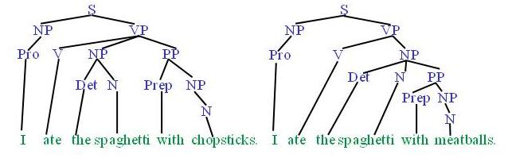
Syntactic Parsing
Slide from Ray Mooney
Produce the correct syntactic parse tree for a sentence.
Notes:
And at a higher level can automatically produce a complete syntactic parse tree for a sentence

Slide 13
Word Sense Disambiguation (WSD)
Words in natural language usually have a fair number of different possible meanings.
  Ellen has a strong interest in computational linguistics.
  Ellen pays a large amount of interest on her credit card.
For many tasks (question answering, translation), the proper sense of each ambiguous word in a sentence must be determined.
Slide from Ray Mooney

Slide 14
Other tasks more “advanced” tasks:
Text classification
  Simple: Is this text English or Spanish?
  Harder: Is this text about Toys or Weapons?
  Even harder: Is this text written by Shakespeare or not?
Text Generation
  Free form: Generate arbitrary human-like produced text
  Conditional: Generate text that has certain style
Entailment, can text statement A be deduced from text statement B?
Question Answering (QA), Given a question text, give a text answer.
Dialog – same as VQA but continuous back and forth

Slide 15







How to represent a word?
one-hot encodings
dog
cat
person
holding
tree
computer
using
1
2
3
4
5
6
7
$$[1 0 0 0 0 0 0 0 0 0 ]$$
$$[0 1 0 0 0 0 0 0 0 0 ]$$
$$[0 0 1 0 0 0 0 0 0 0 ]$$
$$[0 0 0 1 0 0 0 0 0 0 ]$$
$$[0 0 0 0 1 0 0 0 0 0 ]$$
$$[0 0 0 0 0 1 0 0 0 0 ]$$
$$[0 0 0 0 0 0 1 0 0 0 ]$$
What we see

Slide 16
How to represent a word?

Slide 17




How to represent a phrase/sentence?
bag-of-words representation
person holding dog
{1, 3, 4}
$$[1 0 1 1 0 0 0 0 0 0 ]$$
person holding cat
{2, 3, 4}
dog
cat
person
holding
tree
computer
using
$$[0 1 1 1 0 0 0 0 0 0 ]$$
person using computer
{3, 7, 6}
$$[0 0 1 0 0 1 1 0 0 0 ]$$
person using computer person holding cat
{3, 3, 7, 6, 2}
$$[0 1 2 1 0 1 1 0 0 0 ]$$
What we see
What if vocabulary is very large?

Slide 18
Sparse Representation
bag-of-words representation
person holding dog
{1, 3, 4}
indices = [1, 3, 4] values = [1, 1, 1]
person holding cat
{2, 3, 4}
indices = [2, 3, 4] values = [1, 1, 1]
person using computer
{3, 7, 6}
indices = [3, 7, 6] values = [1, 1, 1]
person using computer person holding cat
{3, 3, 7, 6, 2}
indices = [3, 7, 6, 2] values = [2, 1, 1, 1]
What we see

Slide 19
Recap
Bag-of-words encodings for text (e.g. sentences, paragraphs, captions, etc)
You can take a set of sentences/documents and classify them, cluster them, or compute distances between them using this representation.

Slide 20
Problem with this bag-of-words representation
my friend makes a nice meal
These would be the same using bag-of-words
my nice friend makes a meal

Slide 21
Bag of Bi-grams
indices = [10132, 21342, 43233, 53123, 64233] values = [1, 1, 1, 1, 1]
my friend makes a nice meal
{my friend, friend makes, makes a, a nice, nice meal}
indices = [10232, 43133, 21342, 43233, 54233] values = [1, 1, 1, 1, 1]
my nice friend makes a meal
{my nice, nice friend, friend makes, makes a, a meal}
A dense vector-representation would be very inefficient
Think about tri-grams and n-grams
What we see

Slide 22
Recommended reading: n-gram language models
Yejin Choi’s course on Natural Language Processing
http://www3.cs.stonybrook.edu/~ychoi/cse628/lecture/02-ngram.pdf

Slide 23
Modern way of representing Phrases/Text
Pre-trained Neural Network
Continuous Bag of Words (CBOW) – Word embeddings
Sequence-based representations (RNNs, LSTMs)
Transformer-based representations (e.g. BERT, GPT-2, T5, etc)
my friend makes a nice meal

Slide 24
Back to how to represent a word?
Problem: distance between words using one-hot encodings always the same
dog
cat
person
1
2
3
$$[1 0 0 0 0 0 0 0 0 0 ]$$
$$[0 1 0 0 0 0 0 0 0 0 ]$$
$$[0 0 1 0 0 0 0 0 0 0 ]$$
Idea: Instead of one-hot-encoding use a histogram of commonly co-occurring words.
What we see

Slide 25
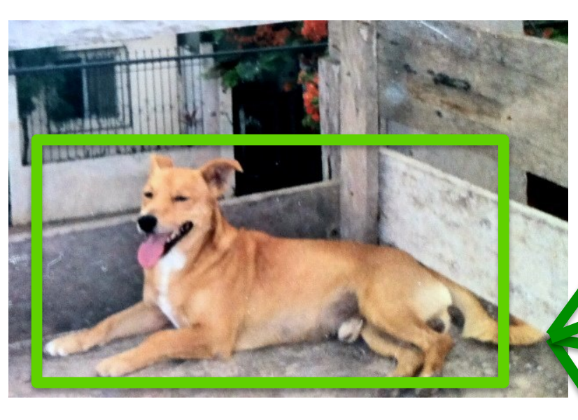
Distributional Semantics
Dogs are man’s best friend.
I saw a dog on a leash walking in the park.
friend
leash
park
walking
walks
food
legs
runs
sleeps
sits
…
His dog is his best companion.
He walks his dog in the late afternoon
…
dog
$$[3 2 3 4 2 4 3 5 6 7 …]$$
What we see

Slide 26
Distributional Semantics
food
walks
window
runs
mouse
invented
legs
sleeps
mirror
tail
…
dog
cat
person
$$[5 5 0 5 0 0 5 5 0 2 …]$$
$$[5 4 1 4 2 0 3 4 0 3 … ]$$
$$[5 5 1 5 0 2 5 5 0 0 …]$$
This vocabulary can be extremely large
What we see

Slide 27
Toward more Compact Representations
food
walks
window
runs
mouse
invented
legs
sleeps
mirror
tail
…
dog
cat
person
$$[5 5 0 5 0 0 5 5 0 2 …]$$
$$[5 4 1 4 2 0 3 4 0 3 … ]$$
$$[5 5 1 5 0 2 5 5 0 0 …]$$
This vocabulary can be extremely large
What we see

Slide 28
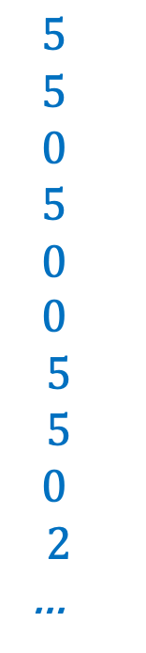
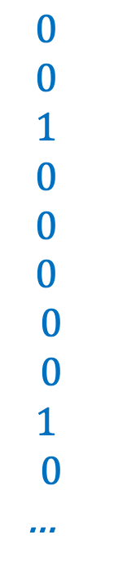
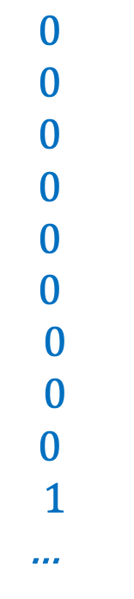
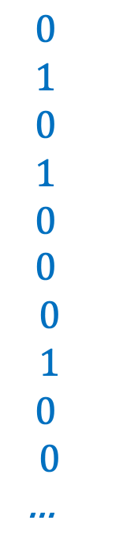
Toward more Compact Representations
$$5$$
$$5$$
$$0$$
$$5$$
$$0$$
$$0$$
$$5$$
$$5$$
$$0$$
$$2$$
…
$$0$$
$$1$$
$$0$$
$$1$$
$$0$$
$$0$$
$$0$$
$$1$$
$$0$$
$$0$$
…
$$0$$
$$0$$
$$0$$
$$0$$
$$0$$
$$0$$
$$0$$
$$0$$
$$0$$
$$1$$
…
$$0$$
$$0$$
$$1$$
$$0$$
$$0$$
$$0$$
$$0$$
$$0$$
$$1$$
$$0$$
…
dog =
=
w1
+ w2
+ w3
+ …
What we see
legs, running,
walking
tail, fur,
ears
mirror, window,
door

Slide 29
Toward more Compact Representations
dog =
w1
w2
w3
The basis vectors can be found using Principal Component Analysis (PCA)
This is known as Latent Semantic Analysis sometimes in NLP,
maybe not anymore?
What we see

Slide 30
Toward more Compact Representations:
Word Embeddings
dog =
w1
w2
w3
The weights w1, …, wn are found using a neural network
Word2Vec: https://arxiv.org/abs/1301.3781
What we see

Slide 31



Word2Vec – CBOW Version
First, create a huge matrix of word embeddings initialized with random values – where each row is a vector for a different word in the vocabulary.
d
$$w_{1}$$
$$w_{2}$$
n
…
$$w_{n}$$

Slide 32
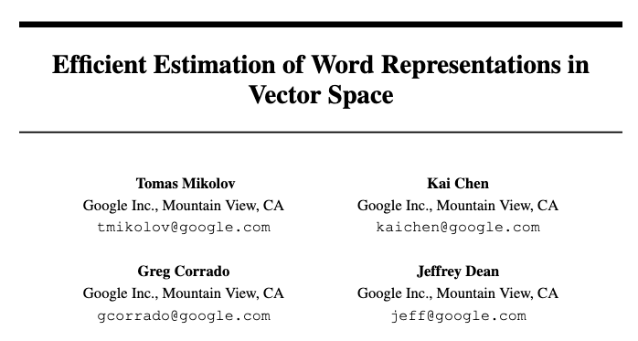

Slide 33
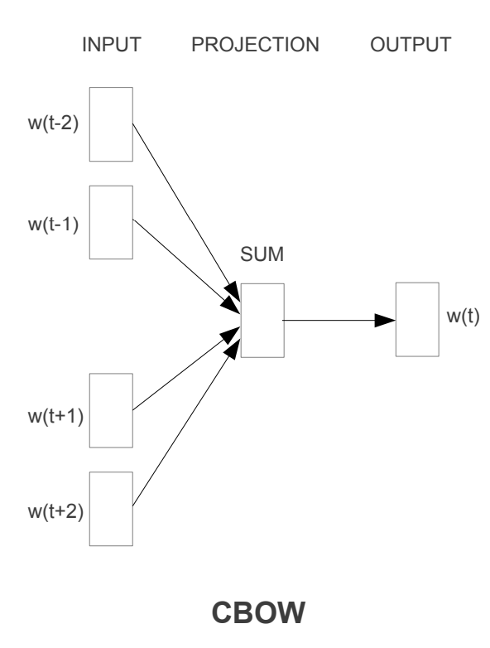



Word2Vec – CBOW Version
Then, collect a lot of text, and solve the following regression problem for a large corpus of text:
d
“the big dog plays ball”
$$w_{1}$$
the
$$w_{2}$$
big
n
…
dog
plays
ball
$$w_{n}$$

Slide 34
Pre-trained Language Models
1-hot vectors
The
big
dog
plays
with
a
ball

Slide 35
Pre-trained Language Models
Transformer Model
1-hot vectors
The
big
dog
plays
with
a
ball

Slide 36
Pre-trained Language Models
y = dog
Softmax classifier
across n possible words
Transformer Model
1-hot vectors
The
big
plays
with
a
ball

Slide 37
Pre-trained Language Models
y = with
Softmax classifier
across n possible words
Transformer Model
1-hot vectors
The
big
dog
plays
a
ball

Slide 38
Pre-trained Language Models
y₁ = big
y₂ = with
Softmax classifier
across n possible words
Softmax classifier
across n possible words
Transformer Model
1-hot vectors
The
dog
plays
a
ball

Slide 39
Generative Language Models
y = ball
Softmax classifier
across n possible words
Transformer Model
1-hot vectors
The
big
dog
plays
with
a

Slide 40
Practical Issues - Tokenization
For each text representation we usually need to separate a sentence into tokens – we have assumed words in this lecture (or pairs of words) – but tokens could also be characters and anything in-between.
Word segmentation can be used as tokenization.
  In the assignment I was lazy I just did “my sentence”.split(“ “) and called it a day.
  However, even English is more difficult than that because of punctuation, double spaces, quotes, etc. For English I would recommend you too look up the great word tokenization tools in libraries such as Python’s NLTK and Spacy before you try to come up with your own word tokenizer.

Slide 41
Issues with Word based Tokenization
We already mentioned that tokenization can be hard even when word-based for other languages that don’t use spaces in-between words.
Word tokenization can also be bad for languages where the words can be “glued” together like German or Turkish.
  Remember fünf­hundert­fünf­und­fünfzig? It wouldn’t be feasible to have a word embedding for every number in the German language.
It is problematic to handle words that are not in the vocabulary e.g. a common practice is to use a special <OOV> (out of vocabulary) token for those words that don’t show up in the vocabulary.

Slide 42
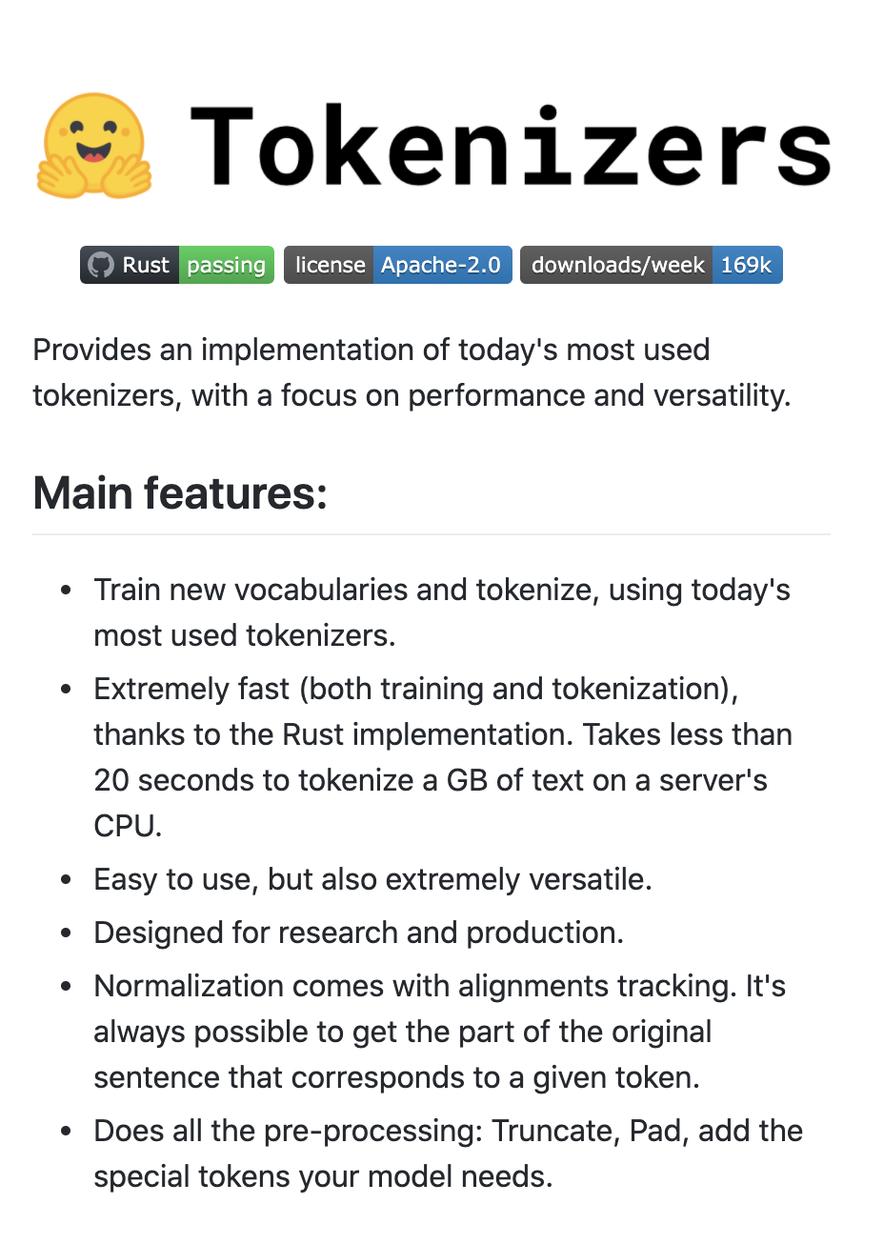
Solution: Sub-word Tokenization
Byte-pair Encoding Tokenization (BPE)
  Start from small strings and based on substring counts iteratively use larger sequences until you define a vocabulary that maximizes informative subtokens. That way most will correspond to words at the end.
Byte-level BPE Tokenizer
  Do the same but at the byte representation level not at the substring representation level.
We will discuss these more as we discuss Transformer Models
huggingface/tokenizers

Slide 43
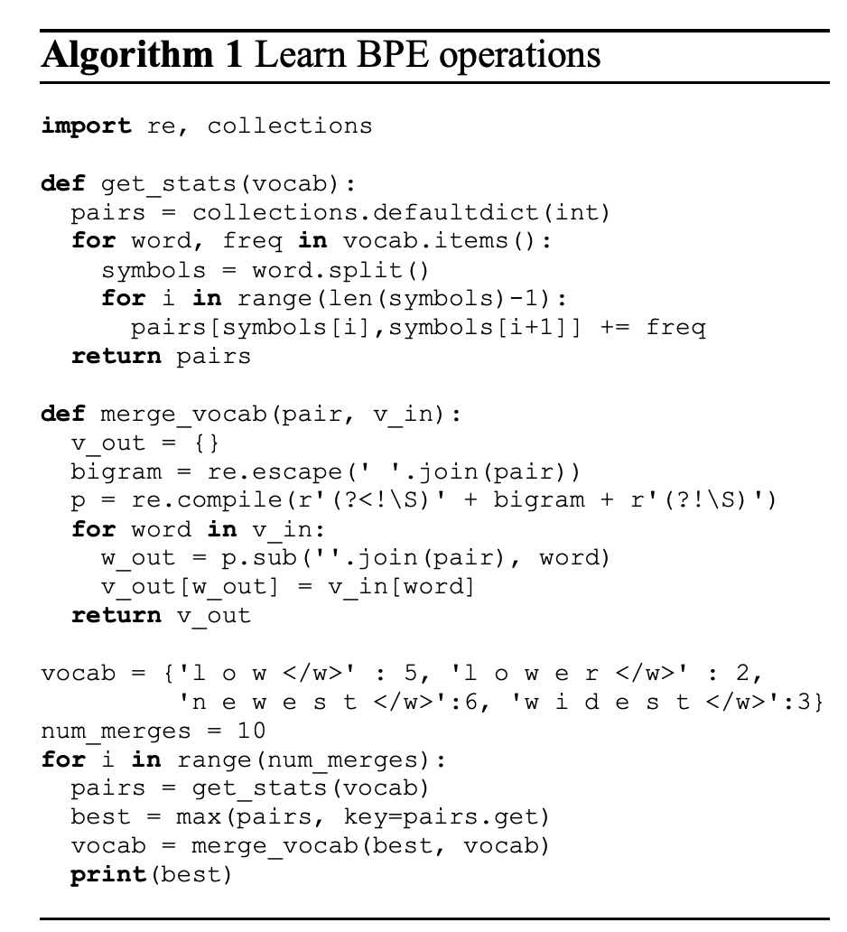
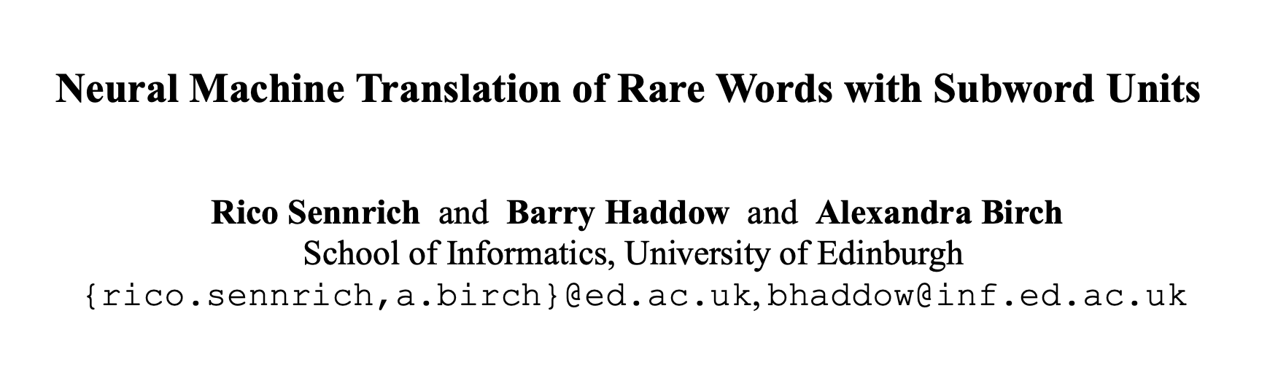
BPE Tokenization Overview
Learn BPE operations (python code on the right) – from the paper.
Use said operations to construct your sub-word vocabulary.
Treat each sub-word token as a “word” in any models we will discuss.
https://colab.research.google.com/drive/1gUjL_h2tXdTtPSfxbBP-6MkE_BMck6gm?usp=sharing

Slide 44
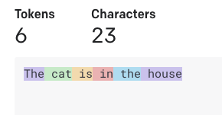
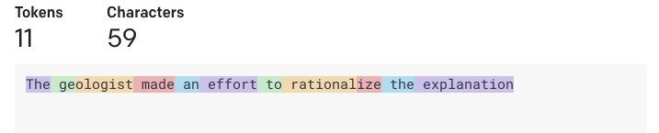

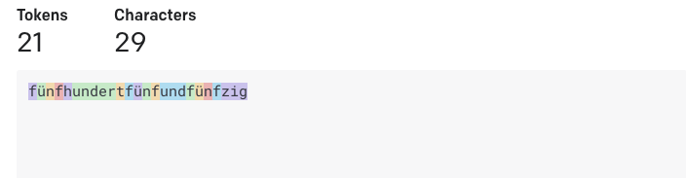
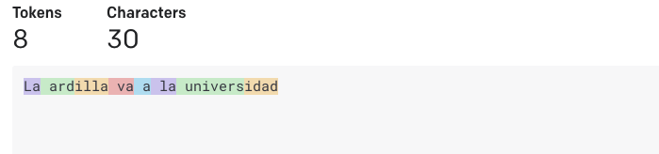


Tokenization used in GPT-3
https://platform.openai.com/tokenizer
The cat is in the house
The geologist made an effort to rationalize the explanation
fünf­hundert­fünf­und­fünfzig
La ardilla va a la universidad

Slide 45
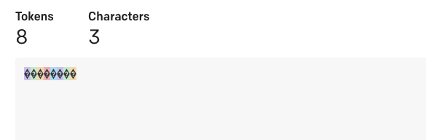

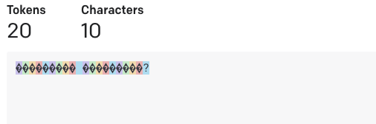
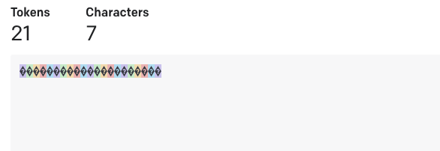

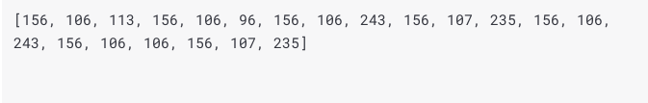
Tokenization used in GPT-3
https://platform.openai.com/tokenizer
深層学
কেমন আছেন?
வணக்கம்

Slide 46
Questions?

