Slide 1
Deep Learning for Vision & Language
Natural Language Processing I: RNNs and Transformers

Slide 2
Second Assignment
Due Next Monday and third and final assignment to follow soon.
Submit your project proposal – think about the amount of work it would take to a) Create an assignment 4, b) Solve assignment 4. Often in research and entrepreneurship asking a good question/finding the right problem is more important than giving a great answer/solution.

Slide 3
Recurrent Neural Networks
These are models for handling sequences of things.
Each input is not a vector but a sequence of input vectors.
e.g. Each input can be a “word embedding” or any “word” representation – we will use in our first examples one-hot encoded tokens but in practice continuous dense word embeddings are used.

Slide 4
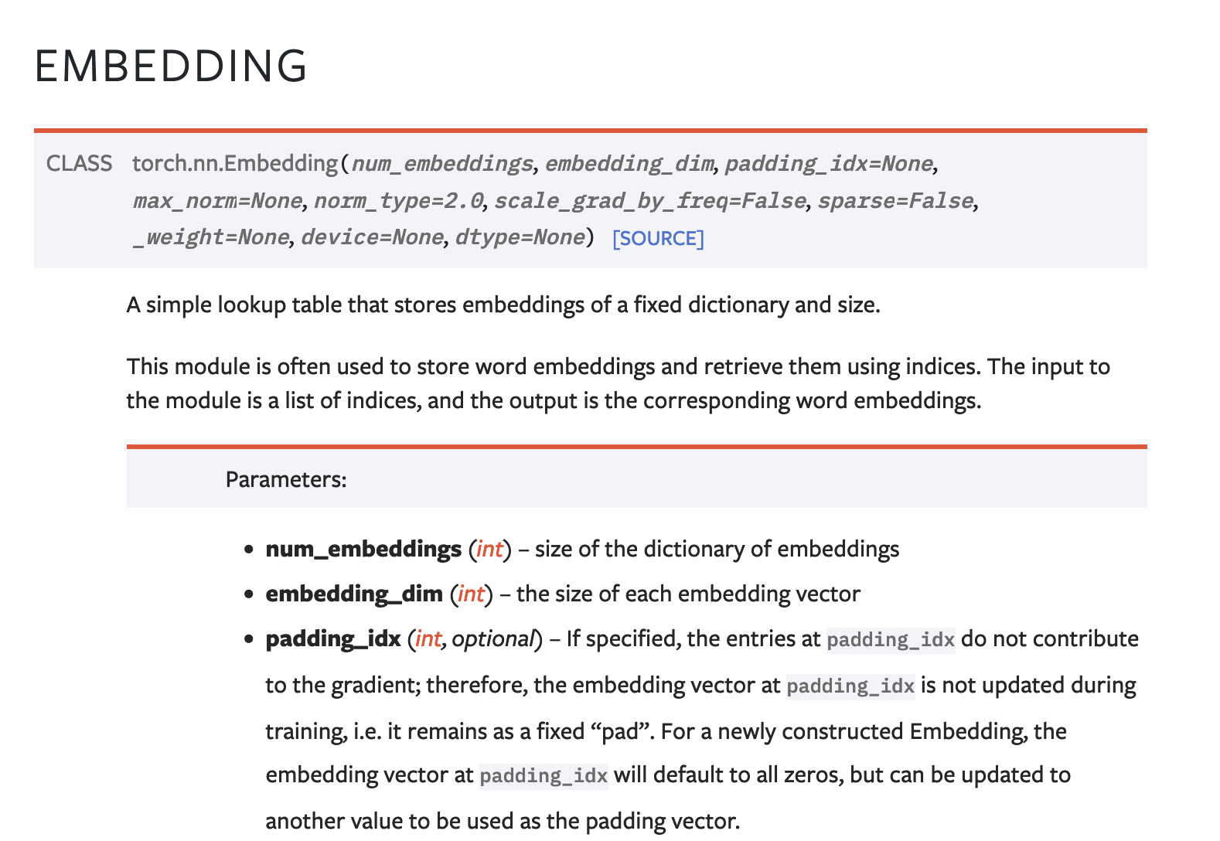
The Embedding Layer nn.Embedding

Slide 5
The Embedding Layer nn.Embedding
d
dog
cat
apple
work#
the
nn.Embedding(n, d)
n
…
under
wizard
zealot

Slide 6
Recurrent Neural Network Cell
$$h_{0}$$
$$RNN$$
$$h_{1}$$
$$x_{1}$$

Slide 7
Recurrent Neural Network Cell
$$h_{1}=tanh⁡(W_{hh}h_{0}+W_{hx}x_{1})$$
$$h_{0}$$
$$RNN$$
$$h_{1}$$
$$x_{1}$$

Slide 8
Recurrent Neural Network Cell
$$y_{1}$$
$$h_{1}$$
$$h_{0}$$
$$RNN$$
$$h_{1}$$
$$h_{1}=tanh⁡(W_{hh}h_{0}+W_{hx}x_{1})$$
$$x_{1}$$
$$y_{1}=softmax⁡(W_{hy}h_{1})$$

Slide 9
Recurrent Neural Network Cell
$$y_{1}=[0.1, 0.05, 0.05, 0.1, 0.7]$$
$$h_{1}=[0.1 0.2 0 −0.3 −0.1 ]$$
$$h_{0}=[0 0 0 0 0 0 0 ]$$
$$RNN$$
$$h_{1}=[0.1 0.2 0 −0.3 −0.1 ]$$
$$h_{1}=tanh⁡(W_{hh}h_{0}+W_{hx}x_{1})$$
$$x_{1}= [0 0 1 0 0]$$
$$y_{1}=softmax⁡(W_{hy}h_{1})$$

Slide 10
Recurrent Neural Network Cell
$$y_{1}=[0.1, 0.05, 0.05, 0.1, 0.7]$$
e (0.7)
$$h_{1}=[0.1 0.2 0 −0.3 −0.1 ]$$
$$h_{0}=[0 0 0 0 0 0 0 ]$$
$$RNN$$
$$h_{1}=[0.1 0.2 0 −0.3 −0.1 ]$$
$$x_{1}= [0 0 1 0 0]$$
c
a b c d e

Slide 11
Recurrent Neural Network Cell
$$y_{1}$$
$$h_{1}$$
$$h_{0}$$
$$RNN$$
$$h_{1}$$
$$h_{1}=tanh⁡(W_{hh}h_{0}+W_{hx}x_{1})$$
$$x_{1}$$
$$y_{1}=softmax⁡(W_{hy}h_{1})$$

Slide 12
Recurrent Neural Network Cell
$$h_{1}$$
$$h_{0}$$
$$RNN$$
$$h_{1}$$
$$h_{1}=tanh⁡(W_{hh}h_{0}+W_{hx}x_{1})$$
$$x_{1}$$

Slide 13
Recurrent Neural Network Cell
$$h_{0}$$
$$RNN$$
$$h_{1}$$
$$h_{1}=tanh⁡(W_{hh}h_{0}+W_{hx}x_{1})$$
$$x_{1}$$

Slide 14
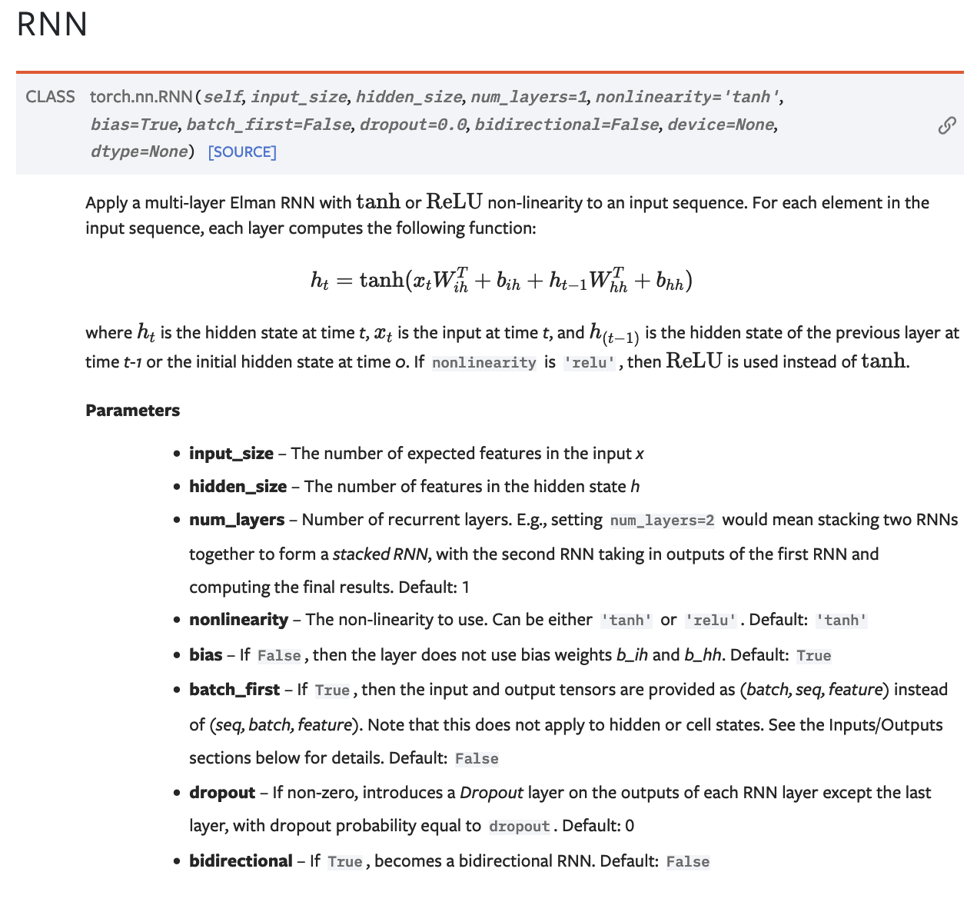
Pytorch RNN

Slide 15
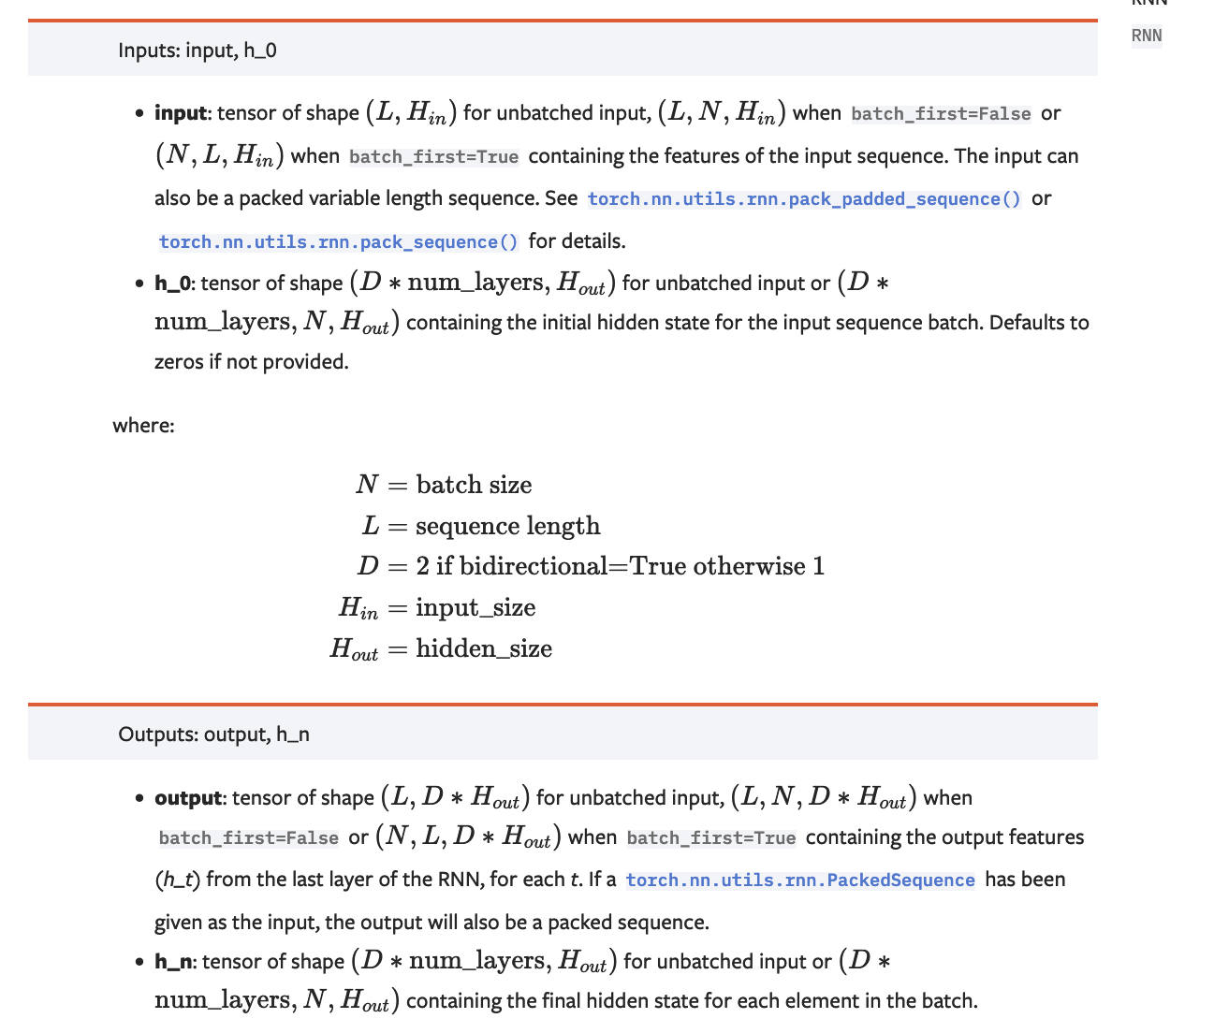

Slide 16
(Unrolled) Recurrent Neural Network
$$h_{0}$$
$$RNN$$
$$h_{1}$$
$$h_{2}$$
$$h_{3}$$
$$RNN$$
$$RNN$$
$$x_{1}$$
$$x_{2}$$
$$x_{3}$$

Slide 17
How can it be used? – e.g. Tagging a Text Sequence One-to-one Sequence Mapping Problems
<<possessive>>
<<noun>>
<<verb>>
$$y_{1}$$
$$y_{2}$$
$$y_{3}$$
$$h_{1}$$
$$h_{2}$$
$$h_{3}$$
$$h_{0}$$
$$RNN$$
$$h_{1}$$
$$h_{2}$$
$$h_{3}$$
$$RNN$$
$$RNN$$
$$x_{1}$$
$$x_{2}$$
$$x_{3}$$
my
car
works

Slide 18
How can it be used? – e.g. Tagging a Text Sequence One-to-one Sequence Mapping Problems
Training examples don’t need to be the same length!
input
output
my car works
<<possessive>> <<noun>> <<verb>>
my dog ate the assignment
<<possessive>> <<noun>> <<verb>> <<pronoun>> <<noun>>
my mother saved the day
<<possessive>> <<noun>> <<verb>> <<pronoun>> <<noun>>
the smart kid solved the problem
<<pronoun>> <<qualifier>> <<noun>> <<verb>> <<pronoun>> <<noun>>

Slide 19
How can it be used? – e.g. Tagging a Text Sequence One-to-one Sequence Mapping Problems
Training examples don’t need to be the same length!
input
output
L(my car works) = 3
L (<<possessive>> <<noun>> <<verb>>) = 3
L( my dog ate the assignment ) = 5
L (<<possessive>> <<noun>> <<verb>> <<pronoun>> <<noun>>) = 5
L( my mother saved the day ) = 5
L (<<possessive>> <<noun>> <<verb>> <<pronoun>> <<noun>>) = 5
L( the smart kid solved the problem ) = 6
L (<<pronoun>> <<qualifier>> <<noun>> <<verb>> <<pronoun>> <<noun>>) = 6

Slide 20
How can it be used? – e.g. Tagging a Text Sequence One-to-one Sequence Mapping Problems
Training examples don’t need to be the same length!
If we assume a vocabulary of a 1000 possible words and 20 possible output tags
input
output
T: 1000 x 3
T: 20 x 3
T: 1000 x 5
T: 20 x 5
T: 1000 x 5
T: 20 x 5
T: 1000 x 6
T: 20 x 6

Slide 21
How can it be used? – e.g. Tagging a Text Sequence One-to-one Sequence Mapping Problems
Training examples don’t need to be the same length!
If we assume a vocabulary of a 1000 possible words and 20 possible output tags
input
output
T: 1000 x 3
T: 20 x 3
T: 1000 x 5
T: 20 x 5
T: 1000 x 5
T: 20 x 5
T: 1000 x 6
T: 20 x 6
How do we create batches if inputs and outputs have different shapes?

Slide 22
How can it be used? – e.g. Tagging a Text Sequence One-to-one Sequence Mapping Problems
Training examples don’t need to be the same length!
If we assume a vocabulary of a 1000 possible words and 20 possible output tags
input
output
T: 1000 x 3
T: 20 x 3
T: 1000 x 5
T: 20 x 5
T: 1000 x 5
T: 20 x 5
T: 1000 x 6
T: 20 x 6
How do we create batches if inputs and outputs have different shapes?
Solution 1: Forget about batches, just process things one by one.

Slide 23
How can it be used? – e.g. Tagging a Text Sequence One-to-one Sequence Mapping Problems
Training examples don’t need to be the same length!
If we assume a vocabulary of a 1000 possible words and 20 possible output tags
input
output
T: 1000 x 3
T: 20 x 3
T: 1000 x 5
T: 20 x 5
T: 1000 x 5
T: 20 x 5
T: 1000 x 6
T: 20 x 6
How do we create batches if inputs and outputs have different shapes?
Solution 2: Zero padding.
We can put the above vectors in
T: 4 x 1000 x 6

Slide 24
How can it be used? – e.g. Scoring the Sentiment of a Text Sequence Many-to-one Sequence to score problems
positive / negative sentiment rating
$$y_{}$$
$$h_{n}$$
$$h_{0}$$
$$RNN$$
$$h_{1}$$
$$h_{2}$$
…
$$RNN$$
$$h_{n}$$
$$RNN$$
$$RNN$$
$$x_{1}$$
$$x_{2}$$
$$x_{3}$$
$$x_{n}$$
the
cat
likes
<<EOS>>

Slide 25
How can it be used? – e.g. Sentiment Scoring Many to one Mapping Problems
Input training examples don’t need to be the same length! In this case outputs can be.
input
output
this restaurant has good food
Positive
this restaurant is bad
Negative
this restaurant is the worst
Negative
this restaurant is well recommended
Positive

Slide 26
How can it be used? – e.g. Text Generation Auto-regressive model – Sequence to Sequence during Training, Auto-regressive during test
DURING TRAINING
The
world
is
not
enough
<END>
$$y_{1}$$
$$y_{2}$$
$$y_{3}$$
$$y_{4}$$
$$y_{5}$$
$$y_{6}$$
$$h_{1}$$
$$h_{2}$$
$$h_{3}$$
$$h_{4}$$
$$h_{5}$$
$$h_{6}$$
$$h_{0}$$
RNN
$$h_{1}$$
RNN
$$h_{2}$$
RNN
$$h_{3}$$
RNN
$$h_{4}$$
RNN
$$h_{5}$$
RNN
$$x_{1}$$
$$x_{2}$$
$$x_{3}$$
$$x_{4}$$
$$x_{5}$$
$$x_{6}$$
<START>
The
world
is
not
enough

Slide 27
How can it be used? – e.g. Text Generation Auto-regressive Models
Input training examples don’t need to be the same length! In this case outputs can be.
input
output
<START> this restaurant has good food
this restaurant has good food <END>
<START> this restaurant is bad
this restaurant is bad <END>
<START> this restaurant is the worst
this restaurant is the worst <END>
<START> this restaurant is well recommended
this restaurant is well recommended <END>

Slide 28
How can it be used? – e.g. Text Generation Auto-regressive model – Sequence to Sequence during Training, Auto-regressive during test
DURING TESTING
$$h_{0}$$
RNN
$$x_{1}$$
<START>

Slide 29
How can it be used? – e.g. Text Generation Auto-regressive model – Sequence to Sequence during Training, Auto-regressive during test
DURING TESTING
The
$$y_{1}$$
$$h_{1}$$
$$h_{0}$$
RNN
$$h_{1}$$
$$x_{1}$$
<START>

Slide 30
How can it be used? – e.g. Text Generation Auto-regressive model – Sequence to Sequence during Training, Auto-regressive during test
DURING TESTING
The
$$y_{1}$$
$$h_{1}$$
$$h_{0}$$
RNN
$$h_{1}$$
RNN
$$x_{1}$$
$$x_{2}$$
<START>

Slide 31
How can it be used? – e.g. Text Generation Auto-regressive model – Sequence to Sequence during Training, Auto-regressive during test
DURING TESTING
The
world
$$y_{1}$$
$$y_{2}$$
$$h_{1}$$
$$h_{2}$$
$$h_{0}$$
RNN
$$h_{1}$$
RNN
$$h_{2}$$
$$x_{1}$$
$$x_{2}$$
<START>

Slide 32
How can it be used? – e.g. Text Generation Auto-regressive model – Sequence to Sequence during Training, Auto-regressive during test
DURING TESTING
The
world
is
not
enough
<END>
$$y_{1}$$
$$y_{2}$$
$$y_{3}$$
$$y_{4}$$
$$y_{5}$$
$$y_{6}$$
$$h_{1}$$
$$h_{2}$$
$$h_{3}$$
$$h_{4}$$
$$h_{5}$$
$$h_{6}$$
$$h_{0}$$
RNN
$$h_{1}$$
RNN
$$h_{2}$$
RNN
$$h_{3}$$
RNN
$$h_{4}$$
RNN
$$h_{5}$$
RNN
$$x_{1}$$
$$x_{2}$$
$$x_{3}$$
$$x_{4}$$
$$x_{5}$$
$$x_{6}$$
<START>

Slide 33
How can it be used? – e.g. Machine Translation Sequence to Sequence – Encoding – Decoding – Many to Many mapping
DURING TRAINING
The
world
is
not
enough
<END>
$$y_{1}$$
$$y_{2}$$
$$y_{3}$$
$$y_{4}$$
$$y_{5}$$
$$y_{6}$$
$$h_{1}$$
$$h_{2}$$
$$h_{3}$$
$$h_{4}$$
$$h_{5}$$
$$h_{6}$$
$$h_{0}$$
RNN
$$h_{1}$$
RNN
$$h_{2}$$
RNN
$$h_{3}$$
RNN
$$h_{4}$$
RNN
$$h_{5}$$
RNN
$$h_{0}$$
RNN
$$h_{1}$$
RNN
$$h_{2}$$
RNN
$$h_{3}$$
RNN
$$h_{4}$$
RNN
$$h_{5}$$
RNN
$$x_{1}$$
$$x_{2}$$
$$x_{3}$$
$$x_{4}$$
$$x_{5}$$
$$x_{6}$$
$$x_{1}$$
$$x_{2}$$
$$x_{3}$$
$$x_{4}$$
$$x_{5}$$
$$x_{6}$$
<START>
El
mundo
no
es
suficiente
<START>
The
world
is
not
enough

Slide 34
How can it be used? – e.g. Machine Translation
Sequence to Sequence Models
Input training examples don’t need to be the same length! In this case outputs can be.
input
output
<START> este restaurante tiene buena comida
this restaurant has good food <END>
<START> this restaurant has good food
<START> el mundo no es suficiente
the world is not enough <END>
<START> the world is not enough

Slide 35
How can it be used? – e.g. Machine Translation Sequence to Sequence – Encoding – Decoding – Many to Many mapping
DURING TRAINING – (Alternative)
The
world
is
not
enough
<END>
$$y_{1}$$
$$y_{2}$$
$$y_{3}$$
$$y_{4}$$
$$y_{5}$$
$$y_{6}$$
$$h_{1}$$
$$h_{2}$$
$$h_{3}$$
$$h_{4}$$
$$h_{5}$$
$$h_{6}$$
$$h_{0}$$
RNN
$$h_{1}$$
RNN
$$h_{2}$$
RNN
$$h_{3}$$
RNN
$$h_{4}$$
RNN
$$h_{5}$$
RNN
$$x_{1}$$
$$x_{2}$$
$$x_{3}$$
$$x_{4}$$
$$x_{5}$$
$$x_{6}$$
The
world
is
not
enough
$$h_{0}$$
RNN
$$h_{1}$$
RNN
$$h_{2}$$
RNN
$$h_{3}$$
RNN
$$h_{4}$$
RNN
$$h_{5}$$
RNN
$$x_{1}$$
$$x_{2}$$
$$x_{3}$$
$$x_{4}$$
$$x_{5}$$
$$x_{6}$$
<START>
El
mundo
no
es
suficiente

Slide 36
Problems
Long Sequences lead to vanishing
Hidden states can not carry information in a long sequence (Telephone Game problem)

Slide 37
Solutions Proposed
Use another hidden state variable and experiment with more complex transition functions than h = tanh(W₁h + W₂x).
Read about LSTMs, GRUs, etc

Slide 38
LSTM Cell (Long Short-Term Memory)
$$h_{0}$$
$$h_{1}$$
$$LSTM$$
$$c_{0}$$
$$c_{1}$$
$$x_{1}$$

Slide 39
Solutions Proposed
Use another hidden state variable and experiment with more complex transition functions than h = tanh(W₁h + W₂x).
Read about LSTMs, GRUs, etc
Encode the sentences both from left-to-right and right-to-left using two RNNs and combine the final hidden states from each direction.
Read about Bidirectional RNNs (BiRNNs), BiLSTMs, BiGRUs

Slide 40
Bidirectional Recurrent Neural Network
<<pronoun>>
<<noun>>
<<verb>>
$$y_{1}$$
$$y_{2}$$
$$y_{3}$$
$$h_{1}$$
$$h_{2}$$
$$h_{3}$$
$$h_{0}$$
$$BRNN$$
$$h_{1}$$
$$BRNN$$
$$h_{2}$$
$$BRNN$$
$$h_{3}$$
$$x_{1}$$
$$x_{2}$$
$$x_{3}$$
the
cat
wants

Slide 41
Solutions Proposed
Use another hidden state variable and experiment with more complex transition functions than h = tanh(W₁h + W₂x).
Read about LSTMs, GRUs, etc
Encode the sentences both from left-to-right and right-to-left using two RNNs and combine the final hidden states from each direction.
Read about Bidirectional RNNs (BiRNNs), BiLSTMs, BiGRUs
Stack RNNs, use an RNN that feeds its output states to another RNN and this second RNN outputs the final output states.
Stacked RNNs, or Deep RNNs.

Slide 42
Stacked Recurrent Neural Network
$$y_{1}$$
$$y_{2}$$
$$y_{3}$$
$$h_{1}$$
$$h_{2}$$
$$h_{3}$$
$$h_{0}$$
$$RNN$$
$$h_{1}$$
$$RNN$$
$$h_{2}$$
$$RNN$$
$$h_{3}$$
$${\check{h}}_{1}$$
$${\check{h}}_{2}$$
$${\check{h}}_{3}$$
$${\check{h}}_{0}$$
$$RNN$$
$${\check{h}}_{1}$$
$$RNN$$
$${\check{h}}_{2}$$
$$RNN$$
$${\check{h}}_{3}$$
$$x_{1}$$
$$x_{2}$$
$$x_{3}$$
c
a
t

Slide 43
Stacked Bidirectional Recurrent Neural Network
$$y_{1}$$
$$y_{2}$$
$$y_{3}$$
$$h_{1}$$
$$h_{2}$$
$$h_{3}$$
$$h_{0}$$
$$RNN$$
$$h_{1}$$
$$RNN$$
$$h_{2}$$
$$RNN$$
$$h_{3}$$
$${\check{h}}_{1}$$
$${\check{h}}_{2}$$
$${\check{h}}_{3}$$
$${\check{h}}_{0}$$
$$RNN$$
$${\check{h}}_{1}$$
$$RNN$$
$${\check{h}}_{2}$$
$$RNN$$
$${\check{h}}_{3}$$
$$x_{1}$$
$$x_{2}$$
$$x_{3}$$
c
a
t

Slide 44
Best Solution: Learning Attention Weights

Slide 45
RNNs – Sequence to score prediction
Classify
[English, German, Swiss German, Gaelic, Dutch, Afrikaans, Luxembourgish, Limburgish, other]
$$y_{6}$$
$$h_{6}$$
$$h_{0}$$
RNN
$$h_{1}$$
RNN
$$h_{2}$$
RNN
$$h_{3}$$
RNN
$$h_{4}$$
RNN
$$h_{5}$$
RNN
$$x_{1}$$
$$x_{2}$$
$$x_{3}$$
$$x_{4}$$
$$x_{5}$$
$$x_{6}$$
<START>
El
mundo
no
es
suficiente

Slide 46
RNNs for Text Generation (Auto-regressive)
The
world
is
not
enough
<END>
$$y_{1}$$
$$y_{2}$$
$$y_{3}$$
$$y_{4}$$
$$y_{5}$$
$$y_{6}$$
$$h_{1}$$
$$h_{2}$$
$$h_{3}$$
$$h_{4}$$
$$h_{5}$$
$$h_{6}$$
$$h_{0}$$
RNN
$$h_{1}$$
RNN
$$h_{2}$$
RNN
$$h_{3}$$
RNN
$$h_{4}$$
RNN
$$h_{5}$$
RNN
$$x_{1}$$
$$x_{2}$$
$$x_{3}$$
$$x_{4}$$
$$x_{5}$$
$$x_{6}$$
<START>
The
world
is
not
enough
+ Noise vector

Slide 47
RNNs for Machine Translation Seq-to-Seq
The
world
is
not
enough
<END>
$$y_{1}$$
$$y_{2}$$
$$y_{3}$$
$$y_{4}$$
$$y_{5}$$
$$y_{6}$$
$$h_{1}$$
$$h_{2}$$
$$h_{3}$$
$$h_{4}$$
$$h_{5}$$
$$h_{6}$$
$$h_{0}$$
RNN
$$h_{1}$$
RNN
$$h_{2}$$
RNN
$$h_{3}$$
RNN
$$h_{4}$$
RNN
$$h_{5}$$
RNN
$$x_{1}$$
$$x_{2}$$
$$x_{3}$$
$$x_{4}$$
$$x_{5}$$
$$x_{6}$$
The
world
is
not
enough
$$h_{6}$$
$$h_{0}$$
RNN
$$h_{1}$$
RNN
$$h_{2}$$
RNN
$$h_{3}$$
RNN
$$h_{4}$$
RNN
$$h_{5}$$
RNN
$$x_{1}$$
$$x_{2}$$
$$x_{3}$$
$$x_{4}$$
$$x_{5}$$
$$x_{6}$$
<START>
El
mundo
no
es
suficiente

Slide 48
RNNs for Machine Translation Seq-to-Seq
The
world
is
not
enough
<END>
Perhaps a better idea is to
compute the average h vector across all steps
and pass this to the decoder
$$y_{1}$$
$$y_{2}$$
$$y_{3}$$
$$y_{4}$$
$$y_{5}$$
$$y_{6}$$
$$h_{1}$$
$$h_{2}$$
$$h_{3}$$
$$h_{4}$$
$$h_{5}$$
$$h_{6}$$
$$h_{0}$$
RNN
$$h_{1}$$
RNN
$$h_{2}$$
RNN
$$h_{3}$$
RNN
$$h_{4}$$
RNN
$$h_{5}$$
RNN
$$x_{1}$$
$$x_{2}$$
$$x_{3}$$
$$x_{4}$$
$$x_{5}$$
$$x_{6}$$
The
world
is
not
enough
$$\overline{h}$$
$$h_{1}$$
$$h_{2}$$
$$h_{3}$$
$$h_{4}$$
$$h_{5}$$
$$h_{6}$$
$$\overline{h}=\frac{1}{n}\sum{h_{i}}$$
$$h_{0}$$
RNN
$$h_{1}$$
RNN
$$h_{2}$$
RNN
$$h_{3}$$
RNN
$$h_{4}$$
RNN
$$h_{5}$$
RNN
$$x_{1}$$
$$x_{2}$$
$$x_{3}$$
$$x_{4}$$
$$x_{5}$$
$$x_{6}$$
<START>
El
mundo
no
es
suficiente

Slide 49
RNNs for Machine Translation Seq-to-Seq
The
world
is
not
enough
<END>
Perhaps an even better idea is to
compute the average h vector across all steps
and pass this to the decoder at each time
step in the decoder!
$$y_{1}$$
$$y_{2}$$
$$y_{3}$$
$$y_{4}$$
$$y_{5}$$
$$y_{6}$$
$$h_{1}$$
$$h_{2}$$
$$h_{3}$$
$$h_{4}$$
$$h_{5}$$
$$h_{6}$$
$$h_{0}$$
RNN
$$h_{1}$$
RNN
$$h_{2}$$
RNN
$$h_{3}$$
RNN
$$h_{4}$$
RNN
$$h_{5}$$
RNN
$$x_{1}$$
$$x_{2}$$
$$x_{3}$$
$$x_{4}$$
$$x_{5}$$
$$x_{6}$$
The
world
is
not
enough
$$\overline{h}$$
$$h_{1}$$
$$h_{2}$$
$$h_{3}$$
$$h_{4}$$
$$h_{5}$$
$$h_{6}$$
$$\overline{h}=\frac{1}{n}\sum{h_{i}}$$
$$h_{0}$$
RNN
$$h_{1}$$
RNN
$$h_{2}$$
RNN
$$h_{3}$$
RNN
$$h_{4}$$
RNN
$$h_{5}$$
RNN
$$x_{1}$$
$$x_{2}$$
$$x_{3}$$
$$x_{4}$$
$$x_{5}$$
$$x_{6}$$
<START>
El
mundo
no
es
suficiente

Slide 50
RNNs for Machine Translation Seq-to-Seq
The
world
is
not
enough
<END>
Perhaps an even better idea is to
compute the average h vector across all steps
and pass this to the decoder at each time
step in the decoder but using a weighted average
with learned weights!!
$$y_{1}$$
$$y_{2}$$
$$y_{3}$$
$$y_{4}$$
$$y_{5}$$
$$y_{6}$$
$$h_{1}$$
$$h_{2}$$
$$h_{3}$$
$$h_{4}$$
$$h_{5}$$
$$h_{6}$$
$$h_{0}$$
RNN
$$h_{1}$$
RNN
$$h_{2}$$
RNN
$$h_{3}$$
RNN
$$h_{4}$$
RNN
$$h_{5}$$
RNN
$$x_{1}$$
$$x_{2}$$
$$x_{3}$$
$$x_{4}$$
$$x_{5}$$
$$x_{6}$$
The
world
is
not
enough
$$\overline{h}$$
$$h_{1}$$
$$h_{2}$$
$$h_{3}$$
$$h_{4}$$
$$h_{5}$$
$$h_{6}$$
$$\overline{h}=\sum{a_{i}h_{i}}$$
$$h_{0}$$
RNN
$$h_{1}$$
RNN
$$h_{2}$$
RNN
$$h_{3}$$
RNN
$$h_{4}$$
RNN
$$h_{5}$$
RNN
$$x_{1}$$
$$x_{2}$$
$$x_{3}$$
$$x_{4}$$
$$x_{5}$$
$$x_{6}$$
<START>
El
mundo
no
es
suficiente

Slide 51
RNNs for Machine Translation Seq-to-Seq
Only showing the third time step encoder-decoder connection
The
world
is
not
enough
<END>
Perhaps an even better idea is to
compute the average h vector across all steps
and pass this to the decoder at each time
step in the decoder but using a weighted average
with learned weights, and the weights are specific
for each time step!!!
$$y_{1}$$
$$y_{2}$$
$$y_{3}$$
$$y_{4}$$
$$y_{5}$$
$$y_{6}$$
$$h_{1}$$
$$h_{2}$$
$$h_{3}$$
$$h_{4}$$
$$h_{5}$$
$$h_{6}$$
$$v_{0}$$
RNN
$$v_{1}$$
RNN
$$v_{2}$$
RNN
$$v_{3}$$
RNN
$$v_{4}$$
RNN
$$v_{5}$$
RNN
$$x_{1}$$
$$x_{2}$$
$$x_{3}$$
$$x_{4}$$
$$x_{5}$$
$$x_{6}$$
The
world
is
not
enough
$$\overline{h}$$
$$h_{1}$$
$$h_{2}$$
$$h_{3}$$
$$h_{4}$$
$$h_{5}$$
$$h_{6}$$
$$\overline{h_{j}}=\sum{a_{j,i}h_{i}}$$
RNN
RNN
RNN
RNN
RNN
RNN
such that:
$$h_{0}$$
$$h_{1}$$
$$h_{2}$$
$$h_{3}$$
$$h_{4}$$
$$h_{5}$$
$$a_{j,i}=\frac{exp⁡(h_{j}v_{j−1})}{\sum{exp⁡(h_{i}v_{i−1})}}$$
$$x_{1}$$
$$x_{2}$$
$$x_{3}$$
$$x_{4}$$
$$x_{5}$$
$$x_{6}$$
<START>
El
mundo
no
es
suficiente

Slide 52
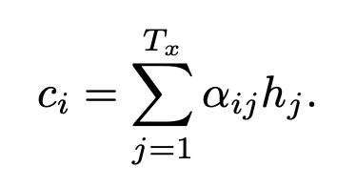
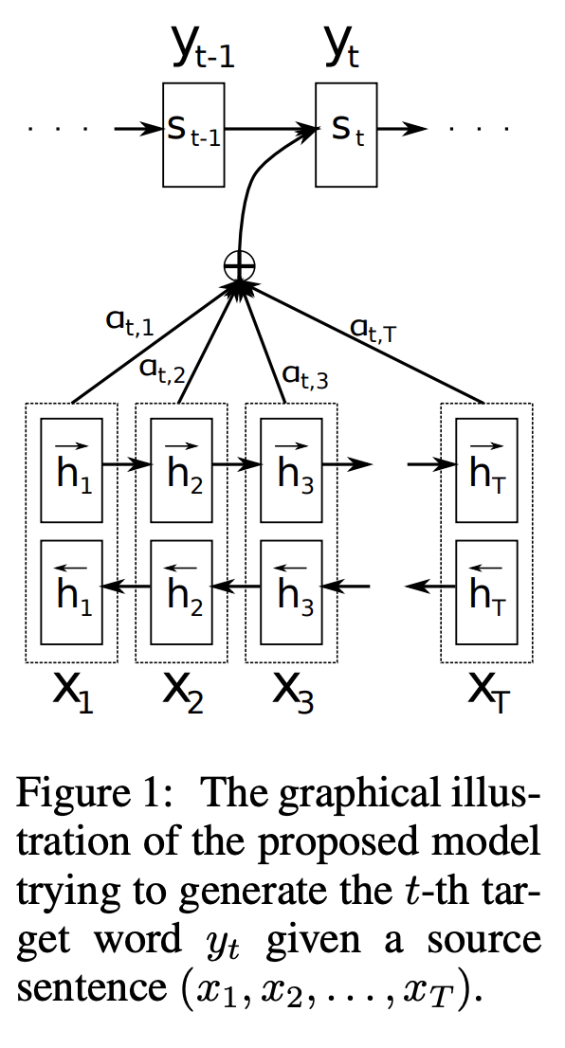
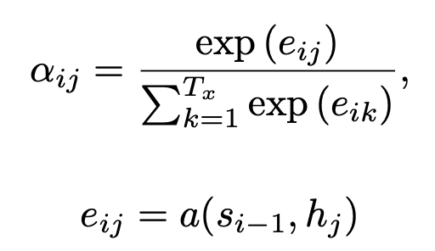
Let’s take a look at one of the first papers introducing this idea.

Slide 53
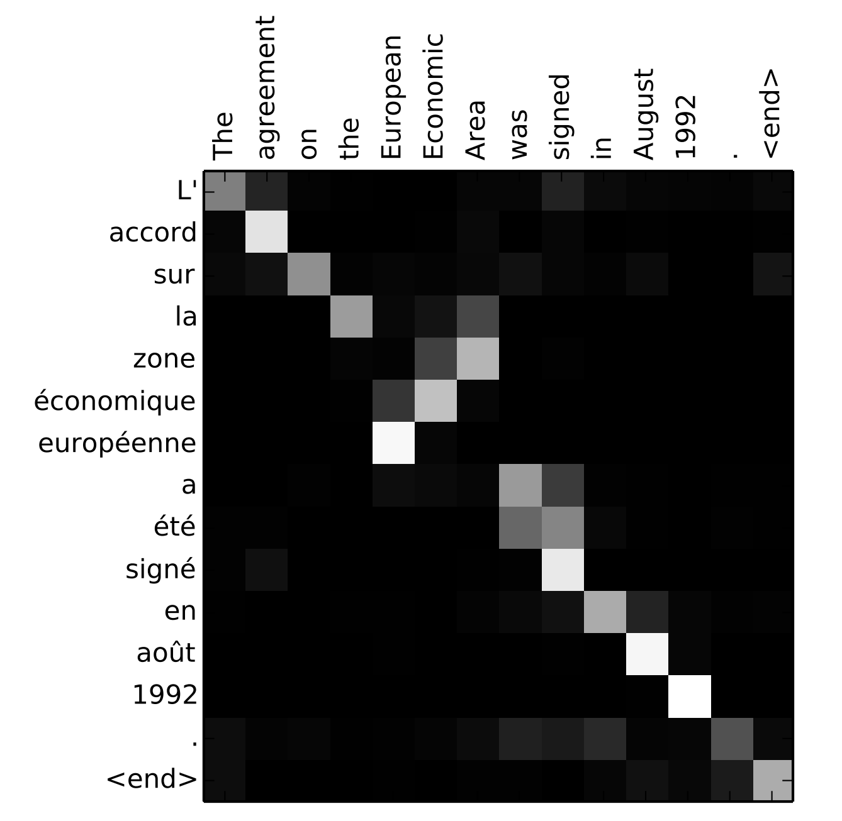
Let’s look at the Attention weights

Slide 54
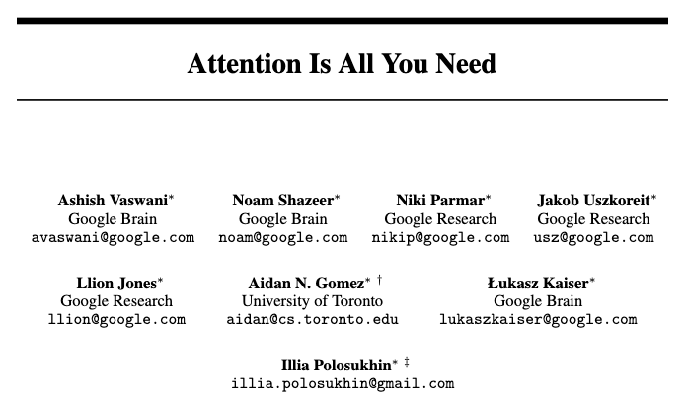
Transformers: Attention is All You Need

Slide 55
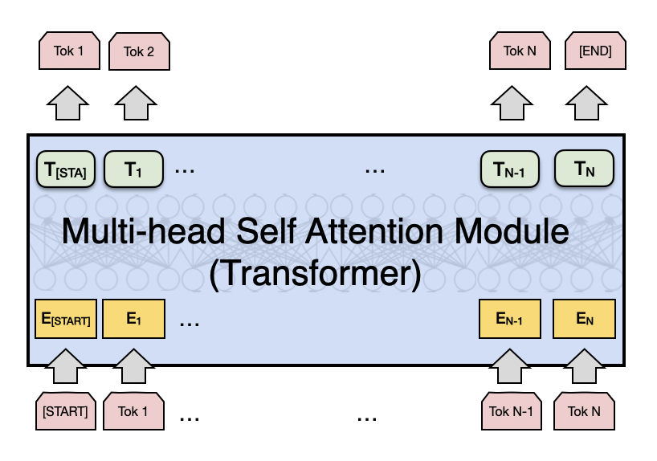
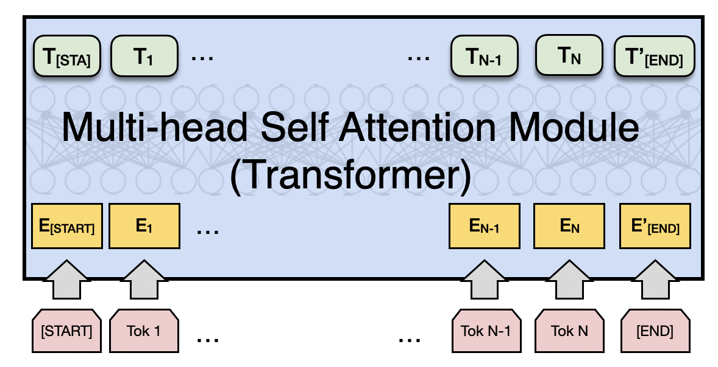
Attention is All you Need (no RNNs)
Vaswani et al. Attention is all you need
https://arxiv.org/abs/1706.03762
Decoder
Encoder
Fixed number of input tokens
[but hey! we can always define a large enough length and add mask tokens]

Slide 56
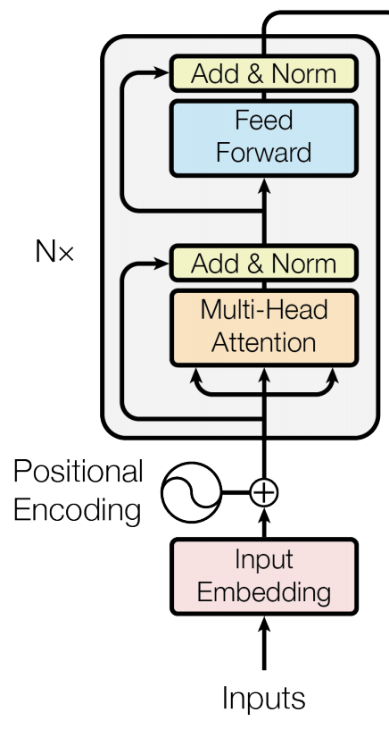
Attention is All you Need (no RNNs)
Vaswani et al. Attention is all you need
https://arxiv.org/abs/1706.03762
Decoder
Encoder
Fixed number of input tokens
[but hey! we can always define a large enough length and add mask tokens]

Slide 57
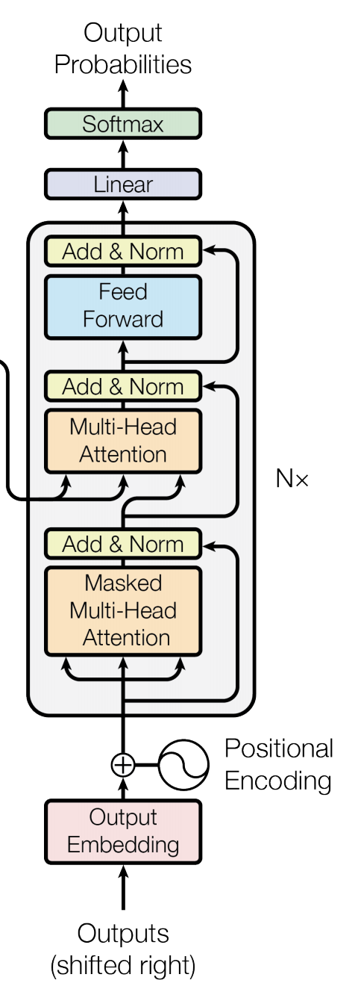
Attention is All you Need (no RNNs)
Vaswani et al. Attention is all you need
https://arxiv.org/abs/1706.03762
Decoder
Encoder
Fixed number of input tokens
[but hey! we can always define a large enough length and add mask tokens]

Slide 58
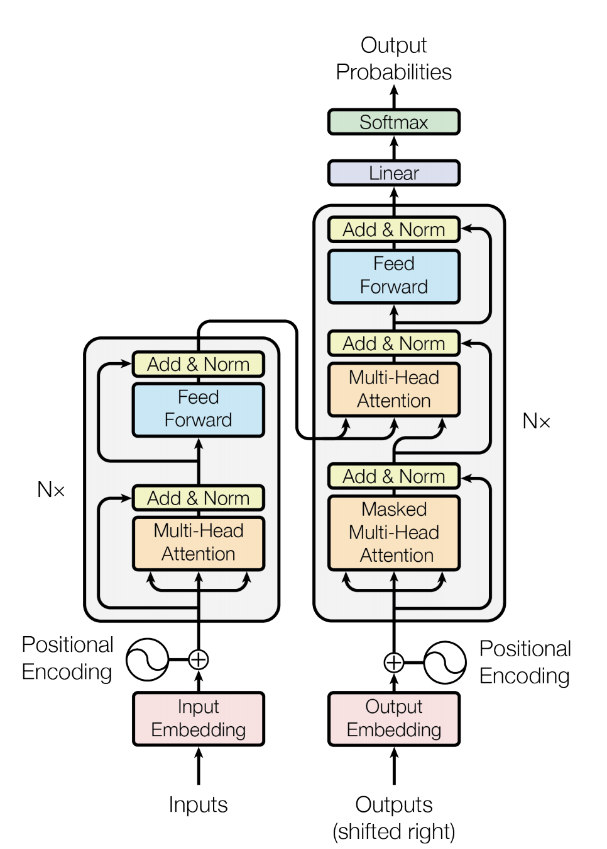
We can also draw this as in the paper:
Vaswani et al. Attention is all you need
https://arxiv.org/abs/1706.03762

Slide 59
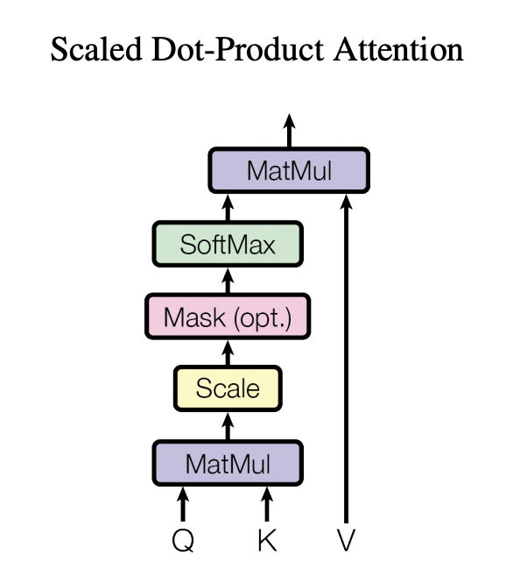
Regular Attention: + Scaling factor
Vaswani et al. Attention is all you need
https://arxiv.org/abs/1706.03762

Slide 60
This is not unlike what we already used before
Only showing the third time step encoder-decoder connection
The
world
is
not
enough
<END>
V: those are h’s here
Q: those are h’s here
K: those are v’s here
$$y_{1}$$
$$y_{2}$$
$$y_{3}$$
$$y_{4}$$
$$y_{5}$$
$$y_{6}$$
$$h_{1}$$
$$h_{2}$$
$$h_{3}$$
$$h_{4}$$
$$h_{5}$$
$$h_{6}$$
$$v_{0}$$
RNN
$$v_{1}$$
RNN
$$v_{2}$$
RNN
$$v_{3}$$
RNN
$$v_{4}$$
RNN
$$v_{5}$$
RNN
$$x_{1}$$
$$x_{2}$$
$$x_{3}$$
$$x_{4}$$
$$x_{5}$$
$$x_{6}$$
The
world
is
not
enough
$$\overline{h}$$
$$h_{1}$$
$$h_{2}$$
$$h_{3}$$
$$h_{4}$$
$$h_{5}$$
$$h_{6}$$
$$\overline{h_{j}}=\sum{a_{j,i}h_{i}}$$
RNN
RNN
RNN
RNN
RNN
RNN
such that:
$$h_{0}$$
$$h_{1}$$
$$h_{2}$$
$$h_{3}$$
$$h_{4}$$
$$h_{5}$$
$$a_{j,i}=\frac{exp⁡(h_{j}v_{j−1})}{\sum{exp⁡(h_{i}v_{i−1})}}$$
$$x_{1}$$
$$x_{2}$$
$$x_{3}$$
$$x_{4}$$
$$x_{5}$$
$$x_{6}$$
<START>
El
mundo
no
es
suficiente

Slide 61
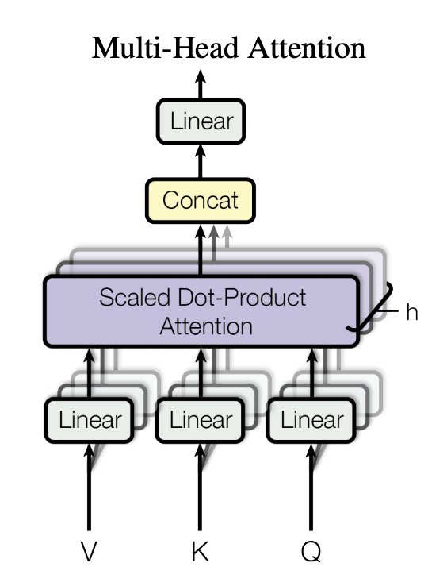
Multi-head Attention: Do not settle for just one set of attention weights.
Vaswani et al. Attention is all you need
https://arxiv.org/abs/1706.03762

Slide 62
We can lose track of position since we are aggregating across all locations
Vaswani et al. Attention is all you need
https://arxiv.org/abs/1706.03762

Slide 63
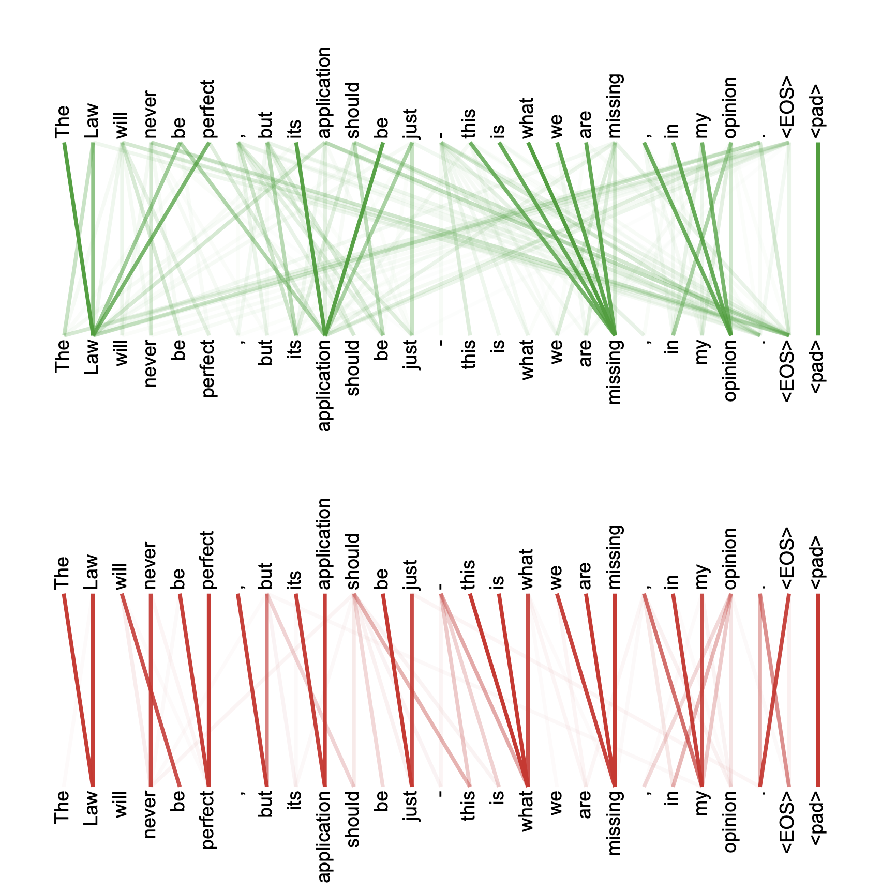
Multi-headed attention weights are harder to interpret obviously

Slide 64
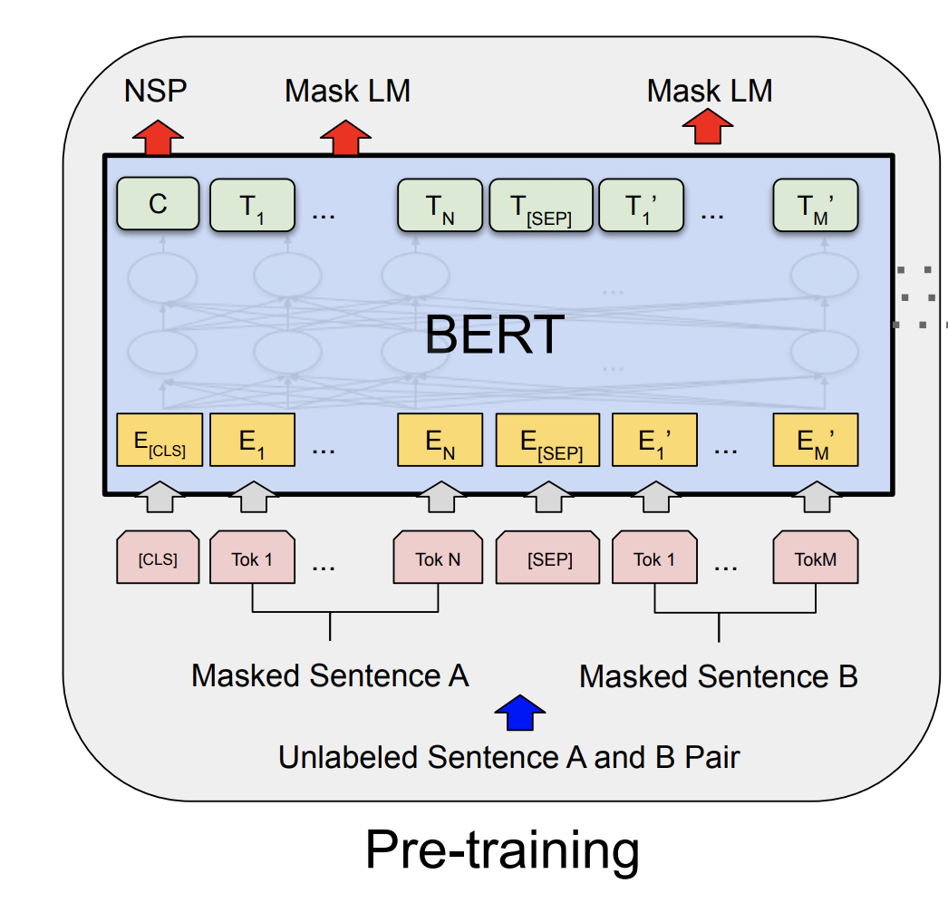
The BERT Encoder Model
Devlin et al. BERT: Pre-training of Deep Bidirectional Transformers for Language Understanding . https://arxiv.org/abs/1810.04805
Important things to know
No decoder
Train the model to fill-in-the-blank by masking some of the input tokens and trying to recover the full sentence.
The input is not one sentence but two sentences separated by a [SEP] token.
Also try to predict whether these two input sentences are consecutive or not.

Slide 65
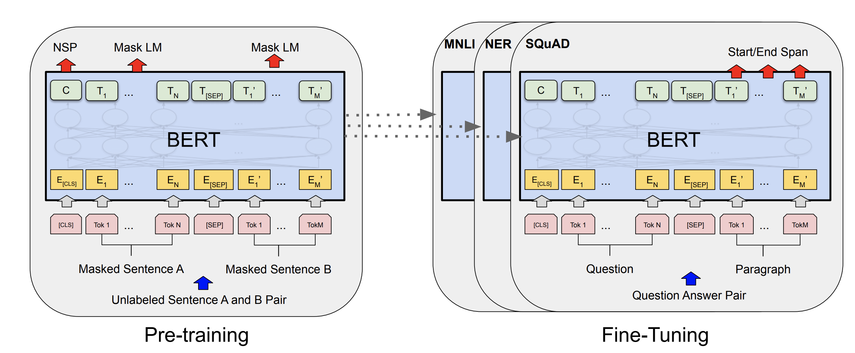
The BERT Encoder Model
Devlin et al. BERT: Pre-training of Deep Bidirectional Transformers for Language Understanding . https://arxiv.org/abs/1810.04805

Slide 66
The BERT Encoder-only Model
Devlin et al. BERT: Pre-training of Deep Bidirectional Transformers for Language Understanding . https://arxiv.org/abs/1810.04805

Slide 67
The T5 Encoder-Decoder Model
Decoder
Encoder

Slide 68
The GPT-2, GPT-3 Decoder-only Model
Decoder

Slide 69
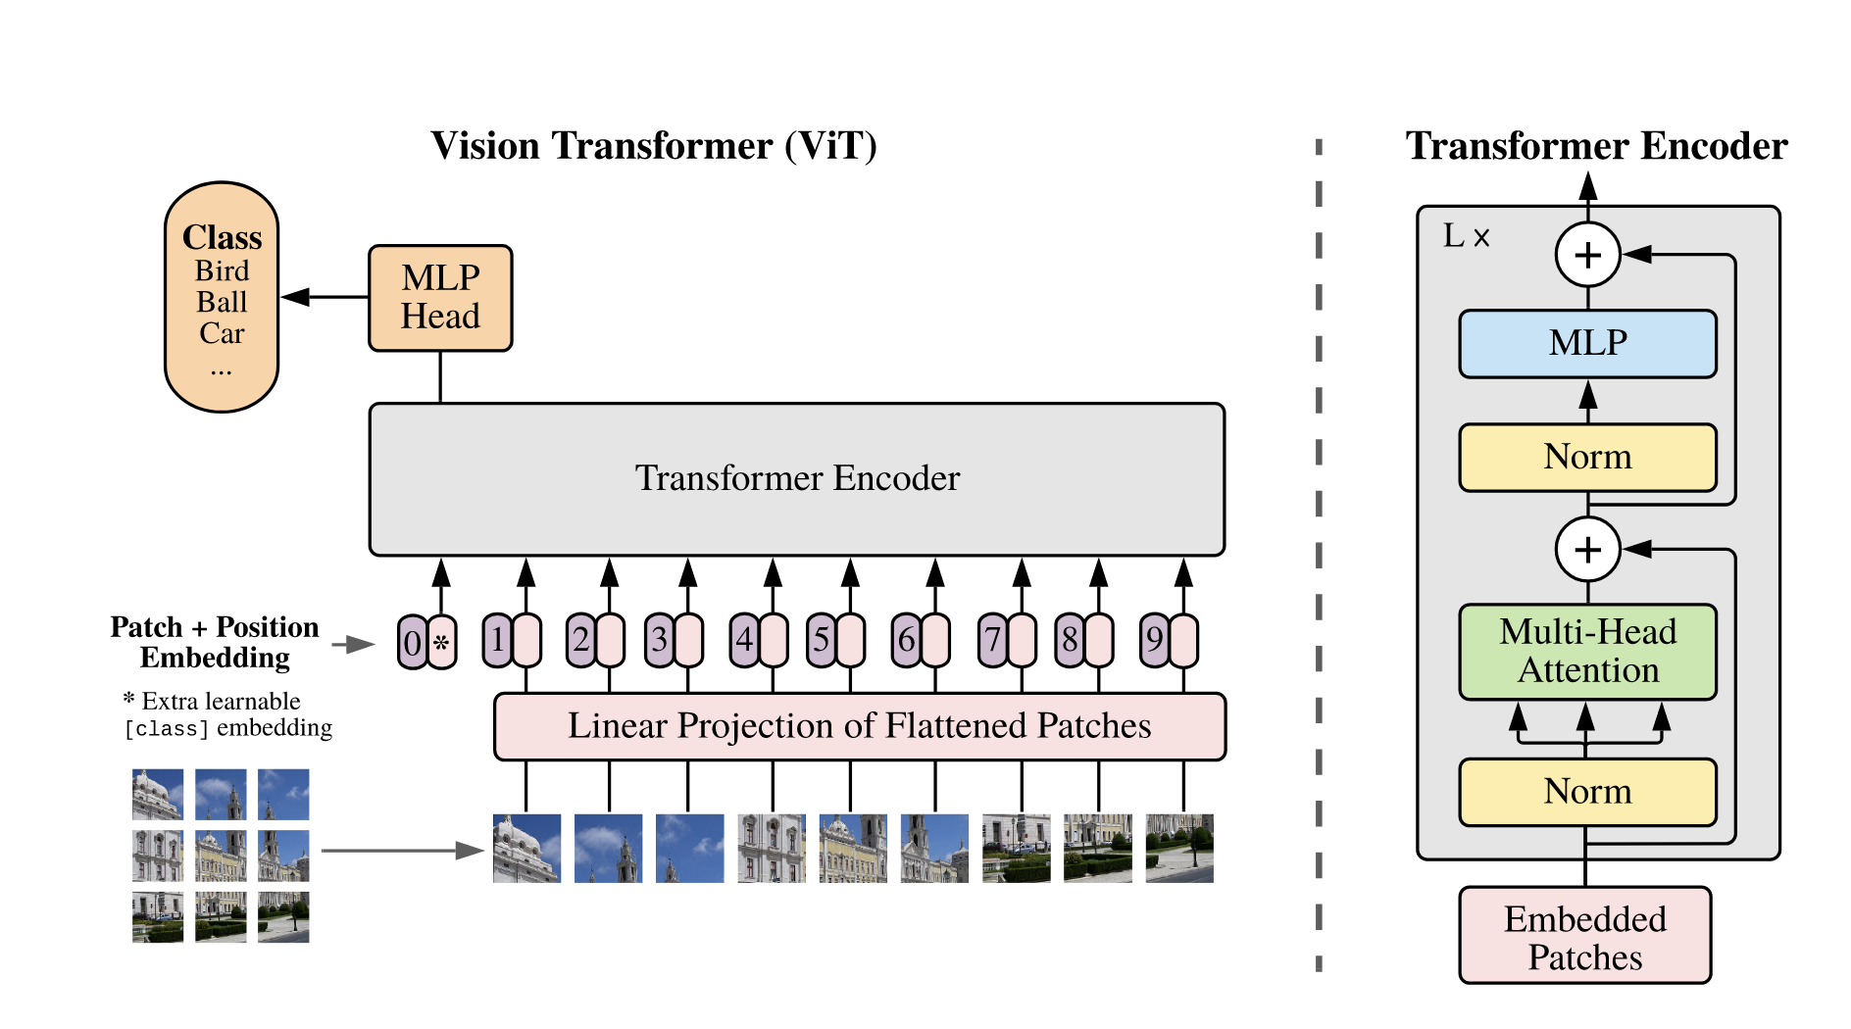
Vision Transformers
https://arxiv.org/abs/2010.11929
An Image is Worth 16x16 Words: Transformers for Image Recognition at Scale
Alexey Dosovitskiy, Lucas Beyer, Alexander Kolesnikov, Dirk Weissenborn, Xiaohua Zhai, Thomas Unterthiner, Mostafa Dehghani, Matthias Minderer, Georg Heigold, Sylvain Gelly, Jakob Uszkoreit, Neil Houlsby

Slide 70
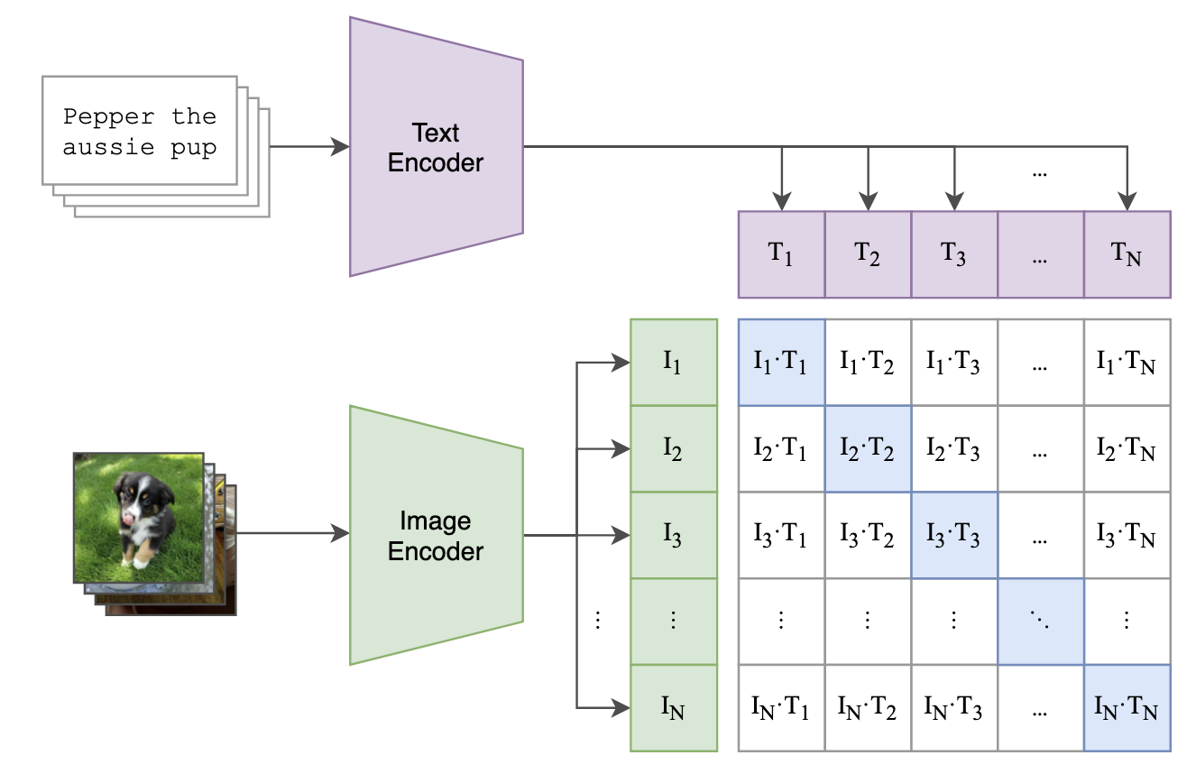
The CLIP Model
$$L=\sum_{k}{ℓ\left(I_{k}T_{k}\right)}$$
$$ℓ\left(I_{k}T_{k}\right)=−\log\left(\frac{exp⁡(sim\left(I_{k}, T_{k}\right))}{\sum_{t=1}^{2N}{1\left[k≠i\right]exp⁡(sim\left(I_{k}, T_{t}\right))}}\right)$$
https://arxiv.org/abs/2103.00020
Learning Transferable Visual Models From Natural Language Supervision
Alec Radford, Jong Wook Kim, Chris Hallacy, Aditya Ramesh, Gabriel Goh, Sandhini Agarwal, Girish Sastry, Amanda Askell, Pamela Mishkin, Jack Clark, Gretchen Krueger, Ilya Sutskever

Slide 71
The CLIP Model
$$L=\sum_{k}{ℓ_{1}\left(I_{k}T_{k}\right)+ℓ_{2}(I_{k}T_{k})}$$
$$ℓ_{1}\left(I_{k}T_{k}\right)=−\log\left(\frac{exp⁡(sim\left(I_{k}, T_{k}\right))}{\sum_{t=1}^{2N}{1\left[k≠i\right]exp⁡(sim\left(I_{k}, T_{t}\right))}}\right)$$
$$ℓ_{2}\left(I_{k}T_{k}\right)=−\log\left(\frac{exp⁡(sim\left(I_{k}, T_{k}\right))}{\sum_{t=1}^{2N}{1\left[k≠i\right]exp⁡(sim\left(I_{t}, T_{k}\right))}}\right)$$
https://arxiv.org/abs/2103.00020
Learning Transferable Visual Models From Natural Language Supervision
Alec Radford, Jong Wook Kim, Chris Hallacy, Aditya Ramesh, Gabriel Goh, Sandhini Agarwal, Girish Sastry, Amanda Askell, Pamela Mishkin, Jack Clark, Gretchen Krueger, Ilya Sutskever

Slide 72
Questions?

