Slide 1
Deep Learning for Vision & Language
Natural Language Processing I: Transformers II

Slide 2
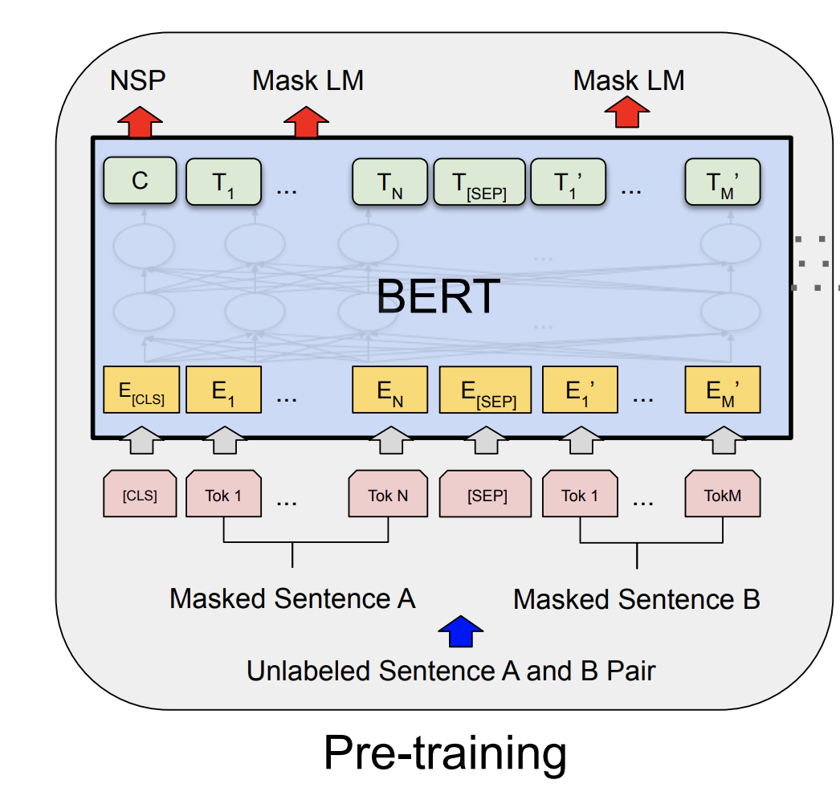
The BERT Encoder Model (October, 2018)
Devlin et al. BERT: Pre-training of Deep Bidirectional Transformers for Language Understanding . https://arxiv.org/abs/1810.04805
Important things to know
No decoder
Train the model to fill-in-the-blank by masking some of the input tokens and trying to recover the full sentence.
The input is not one sentence but two sentences separated by a [SEP] token.
Also try to predict whether these two input sentences are consecutive or not.

Slide 3
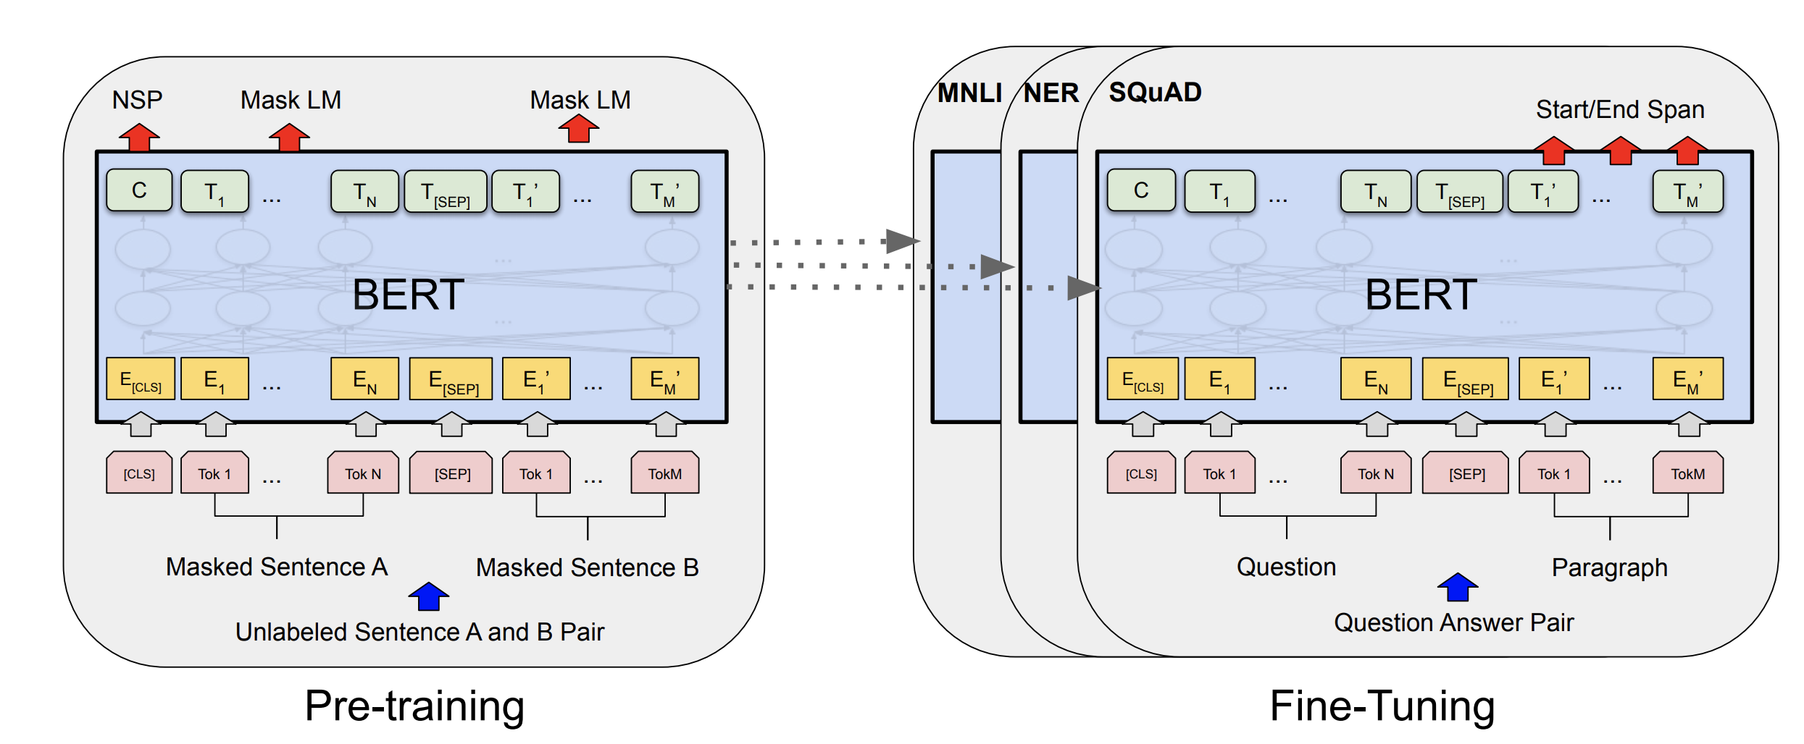
The BERT Encoder Model
Devlin et al. BERT: Pre-training of Deep Bidirectional Transformers for Language Understanding . https://arxiv.org/abs/1810.04805

Slide 4
The BERT Encoder-only Model
Devlin et al. BERT: Pre-training of Deep Bidirectional Transformers for Language Understanding . https://arxiv.org/abs/1810.04805

Slide 5
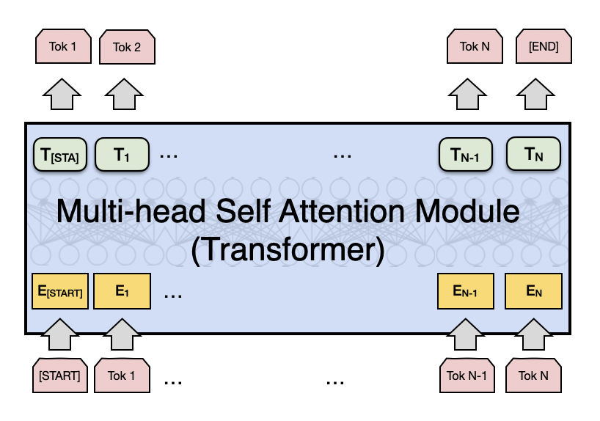
The GPT-2, GPT-3 Decoder-only Model
Decoder

Slide 6
The GPT-2 Model (Feb, 2019)
https://openai.com/blog/better-language-models/

Slide 7
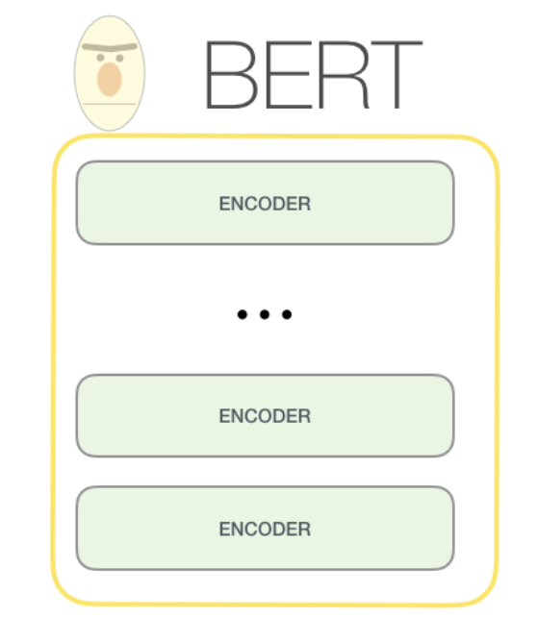
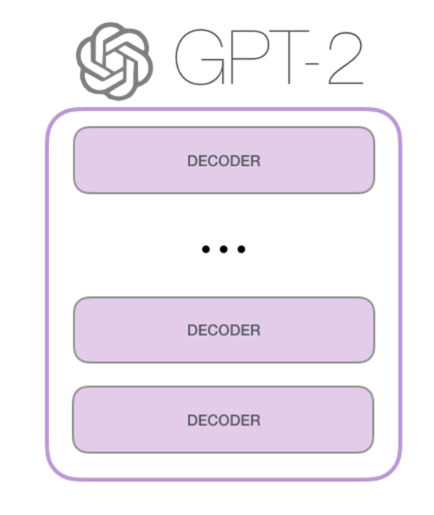
The GPT-2 Model
https://jalammar.github.io/illustrated-gpt2/

Slide 8
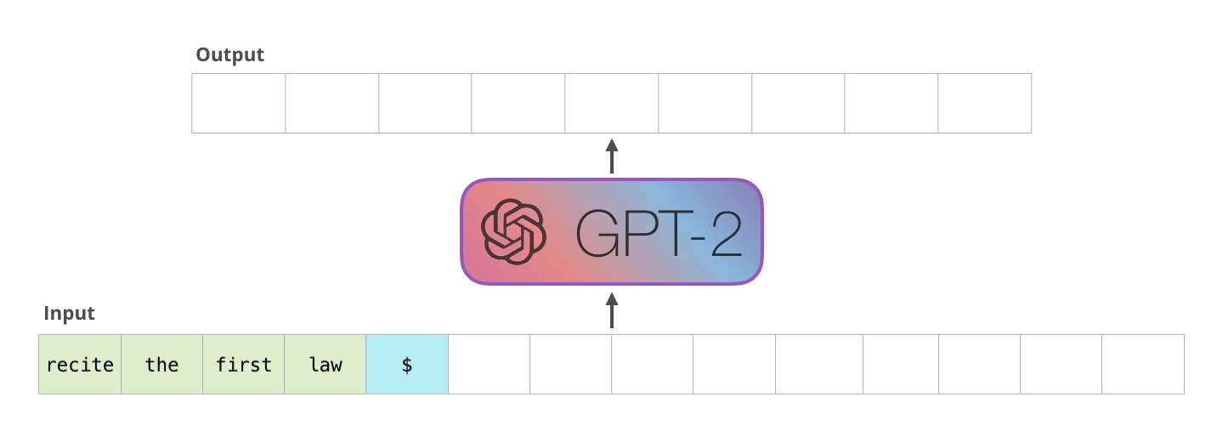
The GPT-2 Model
https://jalammar.github.io/illustrated-gpt2/

Slide 9
The GPT-2 Model
https://jalammar.github.io/illustrated-gpt2/

Slide 10
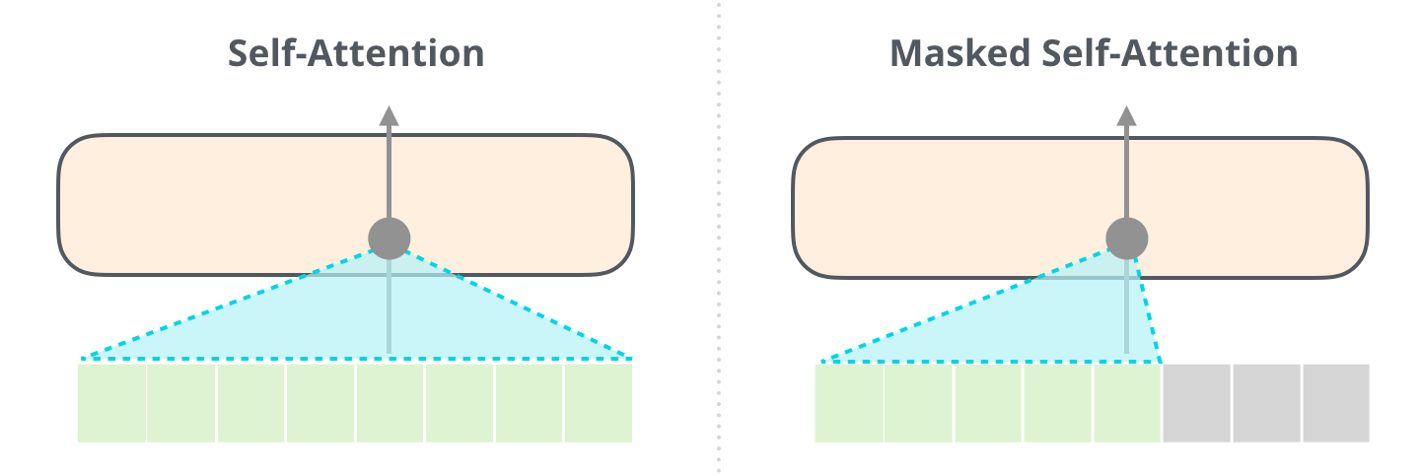
The GPT-2 Model
BERT
GPT
https://jalammar.github.io/illustrated-gpt2/

Slide 11
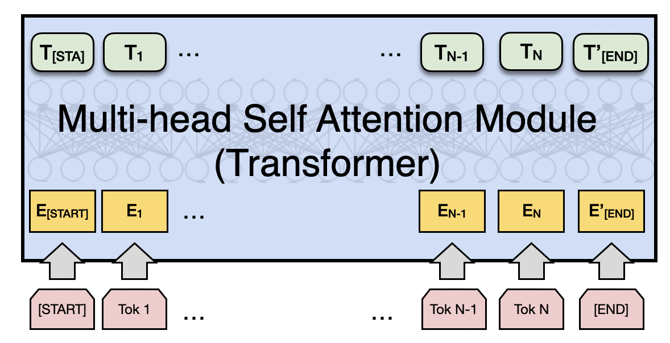
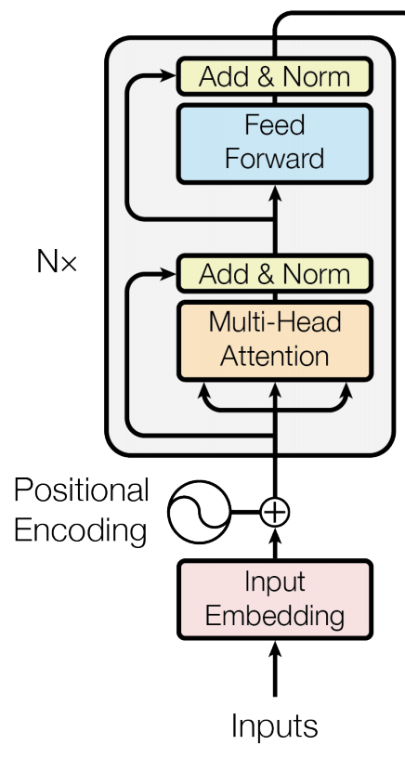
Attention is All you Need
Vaswani et al. Attention is all you need
https://arxiv.org/abs/1706.03762
Decoder
Encoder
Fixed number of input tokens
[but hey! we can always define a large enough length and add mask tokens]

Slide 12
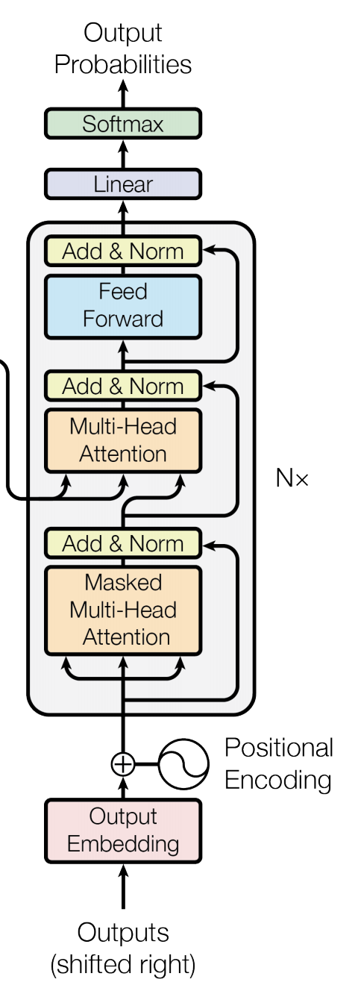
Attention is All you Need
Vaswani et al. Attention is all you need
https://arxiv.org/abs/1706.03762
Decoder
Encoder
Fixed number of input tokens
[but hey! we can always define a large enough length and add mask tokens]

Slide 13
The GPT-2 Model
BERT
GPT
https://jalammar.github.io/illustrated-gpt2/

Slide 14
The GPT-2 Model
https://jalammar.github.io/illustrated-gpt2/

Slide 15
GPT-1 vs GPT-2 vs GPT-3
 | GPT-1 | GPT-2 | GPT-3
Parameters | 117 Million | 1.5 Billion | 175 Billion
Decoder Layers | 12 | 48 | 96
Context Token Size | 512 | 1024 | 2048
Hidden Layer | 768 | 1600 | 12288
Batch Size | 64 | 512 | 3.2M
https://360digitmg.com/blog/types-of-gpt-in-artificial-intelligence

Slide 16
GPT-3 (July, 2020)
https://arxiv.org/abs/2005.14165

Slide 17
GPT family keeps growing
GPT-3.5
GPT-3.5-turbo
GPT-4
GPT-4-turbo
PaLM (Google)
Gemini family (Gemini Pro) (Google)
Mistral 7xMoE (Open Source by Mistral.ai)
Llama-2 70B (Open Source by Meta AI)
Competitors

Slide 18
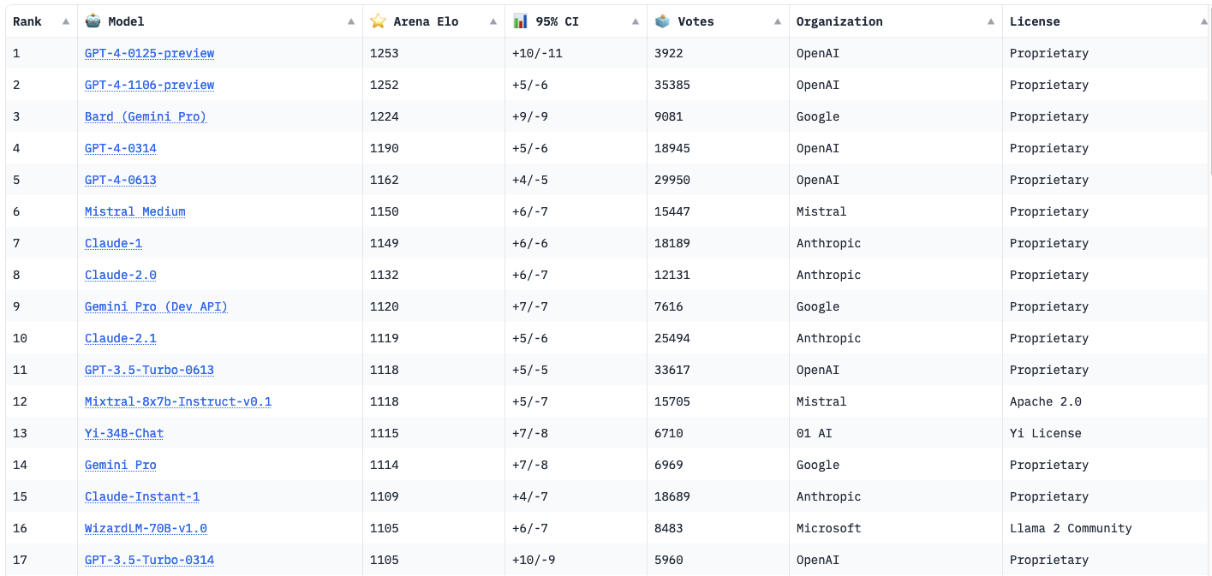
LLM Leader Board https://chat.lmsys.org/

Slide 19
LLM Leader Board https://chat.lmsys.org/

Slide 20
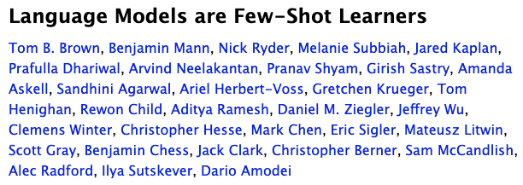
Prompt Engineering
https://arxiv.org/abs/2005.14165

Slide 21
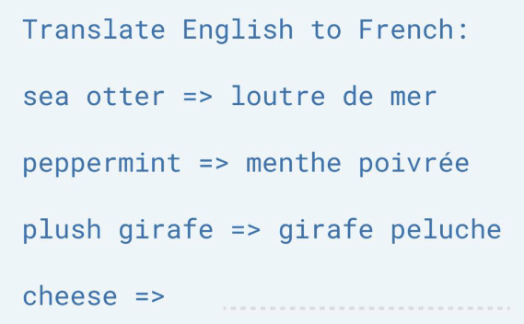
Prompt Engineering
https://arxiv.org/abs/2005.14165

Slide 22
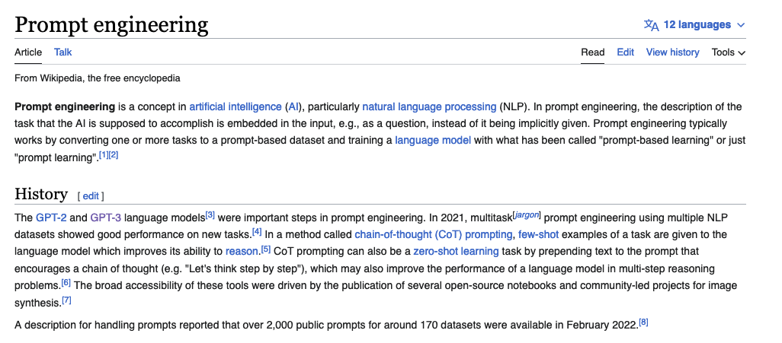
Prompt Engineer

Slide 23
How would you come up with a solution for this problem?
The kid is throwing rocks at the window
The <subject>kid</subject> is throwing <object>rocks</object> at the <destination>window</destination>

Slide 24
Prompt Engineering
Input: The cat is throwing the ball into the ground
Output: The <subject>cat</subject> is throwing the <object>ball</object> into the <destination>ground</ground>
Input: The snake is being attacked by the wolf
Output: The <object>snake</object> is being attacked by the <actor>wolf</actor>
Input: The kid is throwing rocks at the window
Output:

Slide 25
Prompt Engineering
Any Large Language Model (LLM) such as GPT-3 can be turned into a general purpose problem solver in this way.
Obviously, it is not going to work well for every use case.
Other Large Language Models trained at the scale of GPT-3 that are actually publicly available:
BLOOM-176B and OPT-175B:

Slide 26
However these are still limited
Predicting the next word can lead to intelligent behavior such as the one exemplified earlier however this still limited
What makes some of the new LLMs special? ChatGPT (GPT-3.5, 3.5 Turbo, 4, 4-turbo), FLAN-T5, OPT-IML

Slide 27
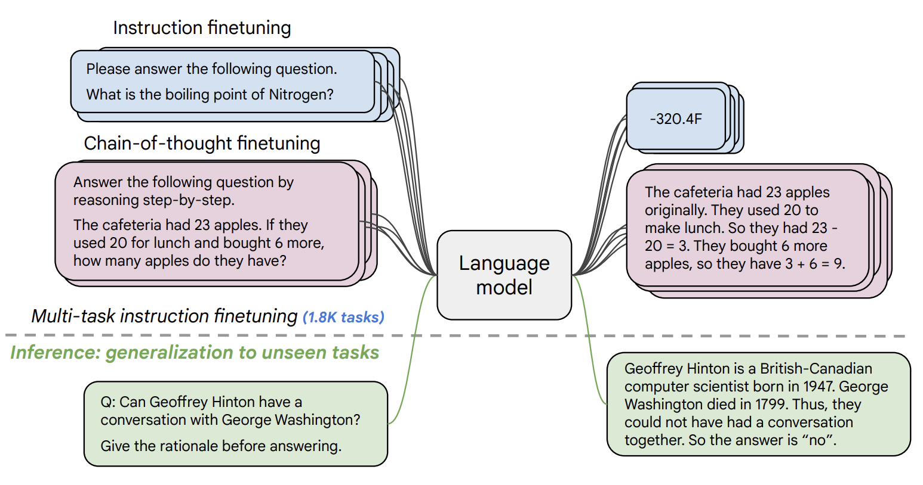
Instruction Tuning (e.g. FLAN-T5 by Google)
https://arxiv.org/pdf/2210.11416.pdf

Slide 28
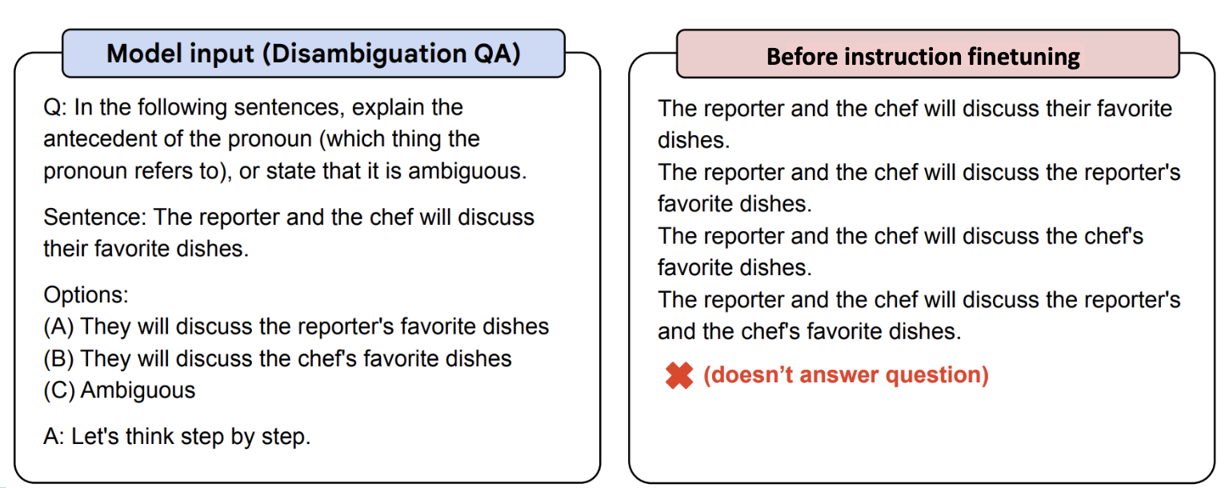
FLAN-T5

Slide 29
FLAN-T5

Slide 30
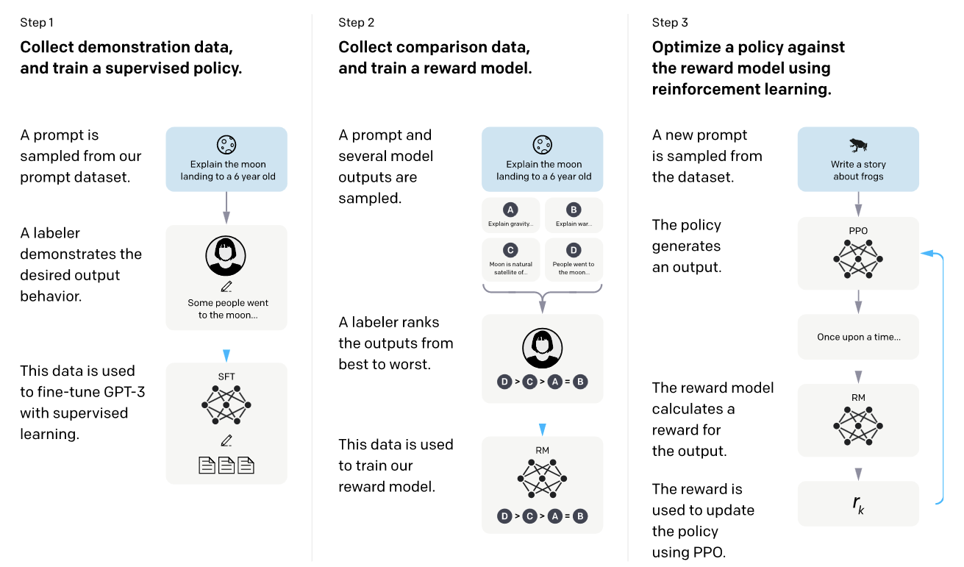
InstructGPT (ChatGPT)
https://arxiv.org/abs/2203.02155

Slide 31
Step by Step: Train a Reward Model that learns from Human Ratings e.g. from 1 to 5
https://gist.github.com/JoaoLages/c6f2dfd13d2484aa8bb0b2d567fbf093

Slide 32
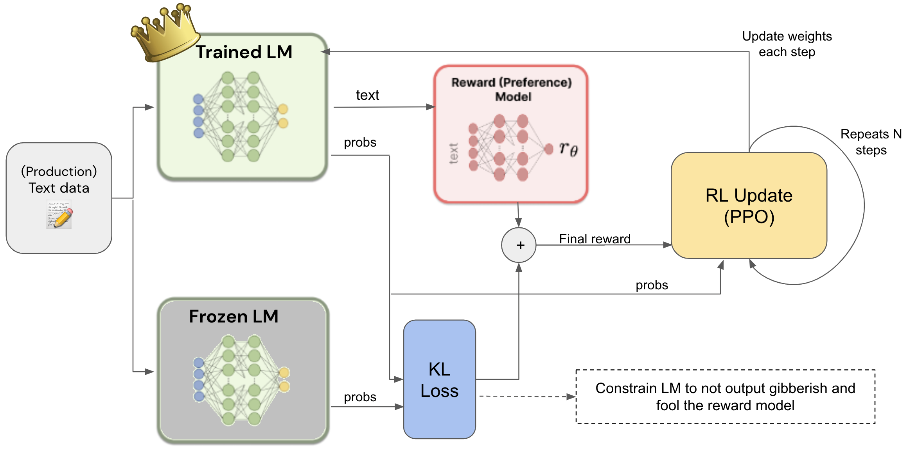
Step by Step: Train the LM to generate text that gets high reward but still produces stuff that makes sense
https://gist.github.com/JoaoLages/c6f2dfd13d2484aa8bb0b2d567fbf093

Slide 33
Recommended Slide Deck
http://web.stanford.edu/class/cs224n/slides/cs224n-2023-lecture11-prompting-rlhf.pdf

Slide 34
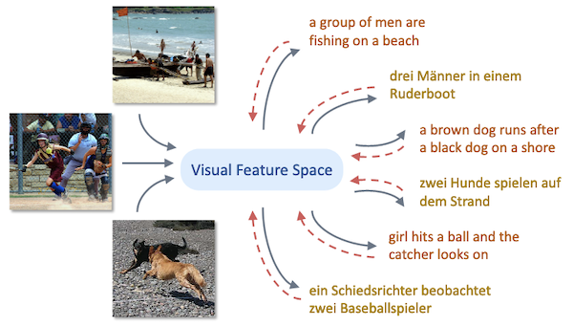
Next Step: Multimodality

Slide 35
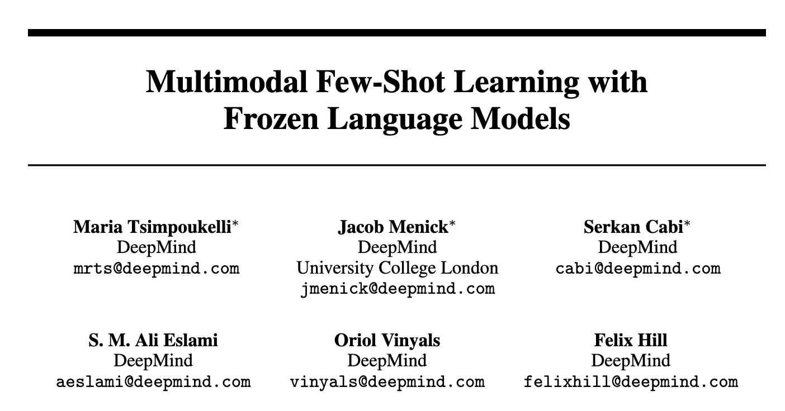
NeurIPS 2021

Slide 36
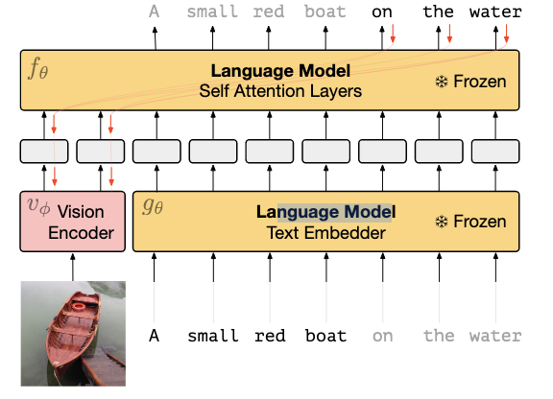
Training:

Slide 37
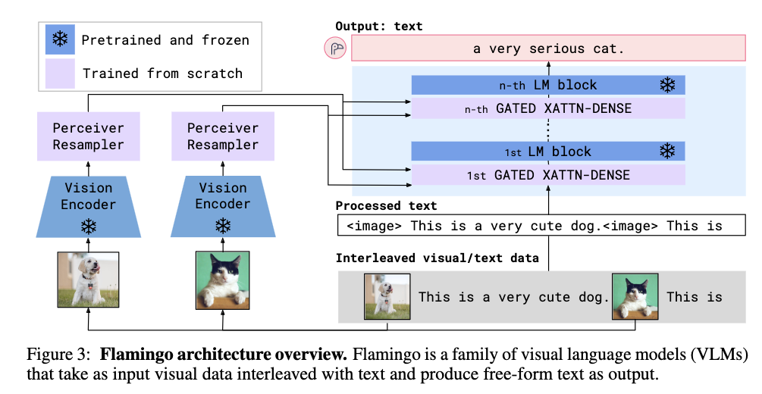
Flamingo
https://arxiv.org/pdf/2204.14198.pdf

Slide 38
Flamingo
https://arxiv.org/pdf/2204.14198.pdf

Slide 39
Questions?

