Slide 1
Deep Learning for Vision & Language
Convolutional Neural Networks for Detection and Segmentation

Slide 2
Object Detection
deer
cat

Slide 3
Object Detection as Classification
deer?
CNN
cat?
background?

Slide 4
Object Detection as Classification
deer?
CNN
cat?
background?

Slide 5
Object Detection as Classification
deer?
CNN
cat?
background?

Slide 6
Object Detection as Classification with Sliding Window
deer?
CNN
cat?
background?

Slide 7
Object Detection as Classification with Box Proposals

Slide 8
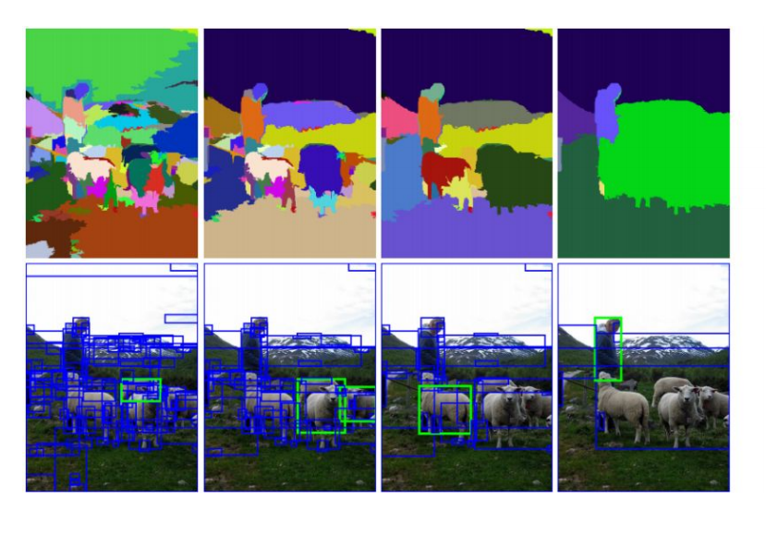
Box Proposal Method – SS: Selective Search
Segmentation As Selective Search for Object Recognition. van de Sande et al. ICCV 2011

Slide 9
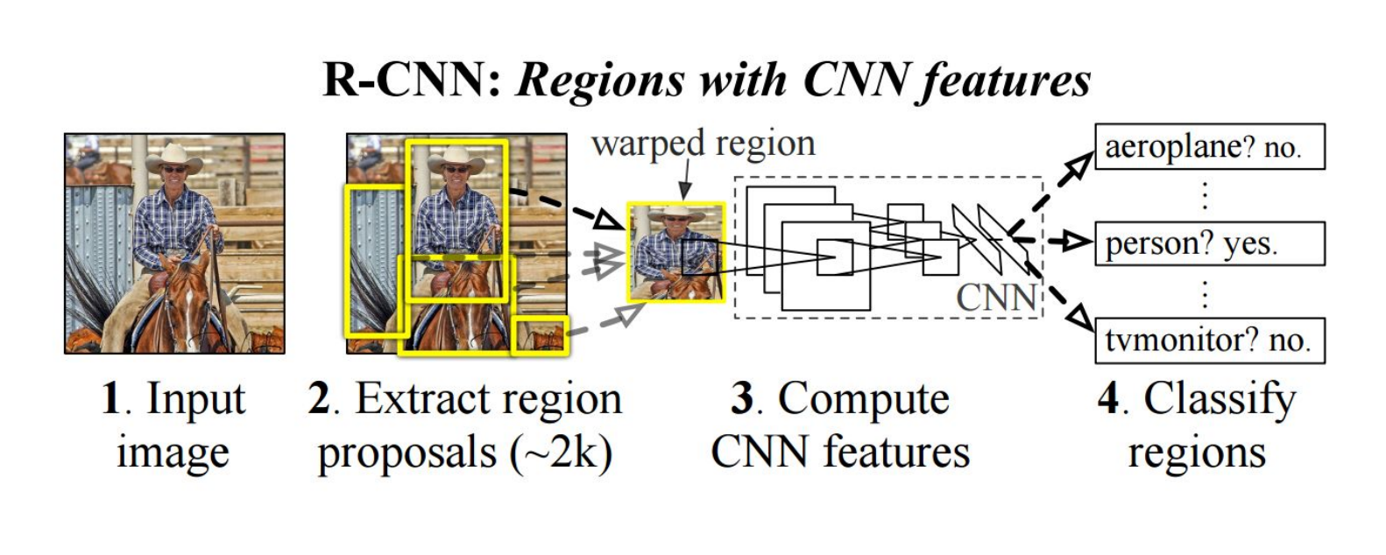
RCNN
https://people.eecs.berkeley.edu/~rbg/papers/r-cnn-cvpr.pdf
Rich feature hierarchies for accurate object detection and semantic segmentation. Girshick et al. CVPR 2014.

Slide 10
Fast-RCNN
Idea: No need to recompute features for every box independently, Regress refined bounding box coordinates.
https://arxiv.org/abs/1504.08083
Fast R-CNN. Girshick. ICCV 2015.
https://github.com/sunshineatnoon/Paper-Collection/blob/master/Fast-RCNN.md

Slide 11
Faster-RCNN
Idea: Integrate the Bounding Box Proposals as part of the CNN predictions
https://arxiv.org/abs/1506.01497
Ren et al. NIPS 2015.

Slide 12
Single-shot Object Detectors
No two-steps of box proposals + Classification
Anchor Points for predicting boxes

Slide 13
YOLO- You Only Look Once
Idea: No bounding box proposals. Predict a class and a
box for every location
in a grid.
https://arxiv.org/abs/1506.02640
Redmon et al. CVPR 2016.

Slide 14
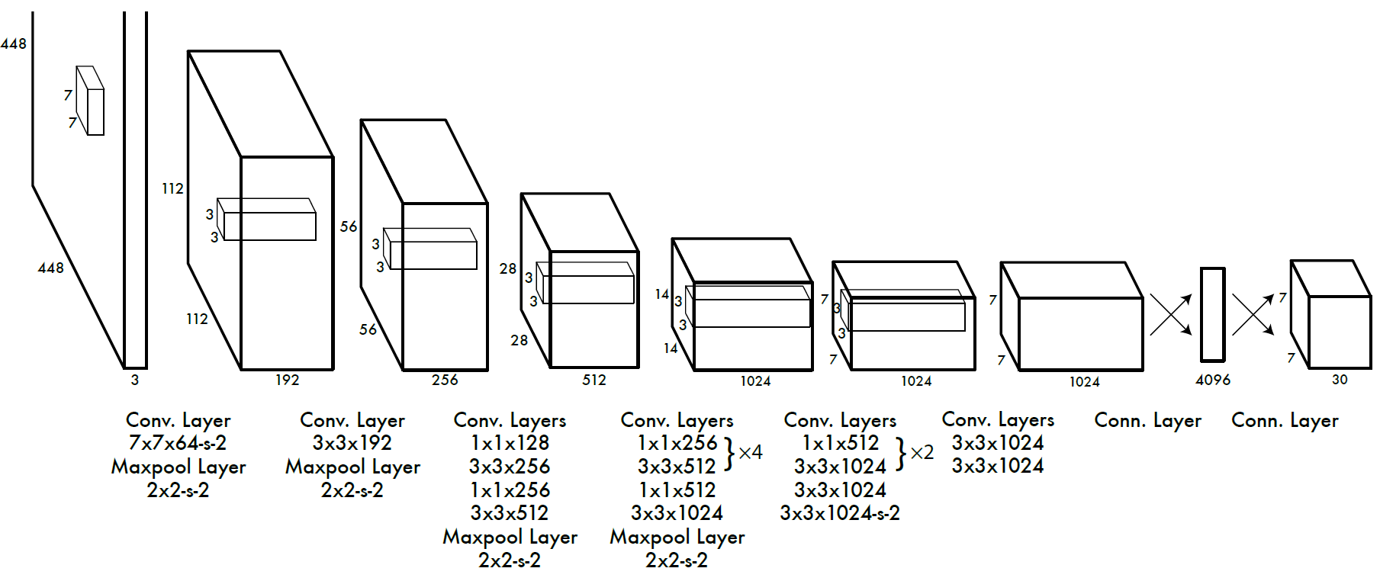
YOLO- You Only Look Once
Divide the image into 7x7 cells.
Each cell trains a detector.
The detector needs to predict the object’s class distributions.
The detector has 2 bounding-box predictors to predict
bounding-boxes and confidence scores.
https://arxiv.org/abs/1506.02640
Redmon et al. CVPR 2016.

Slide 15
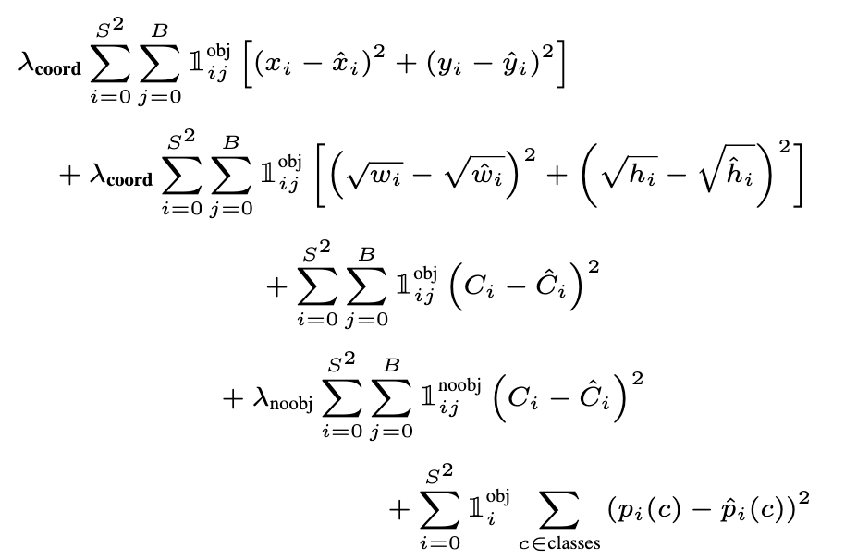
YOLO - Loss Function

Slide 16
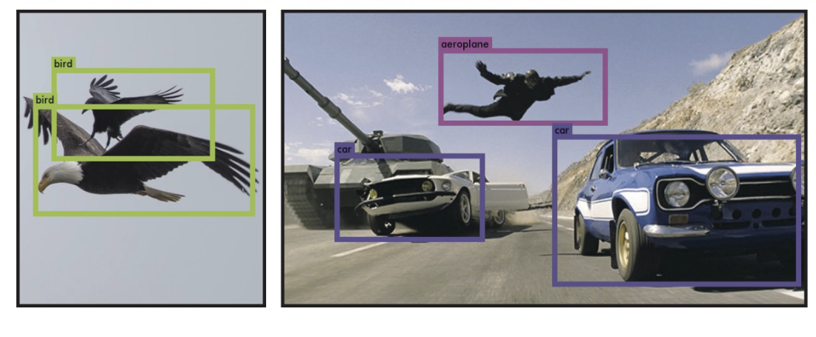
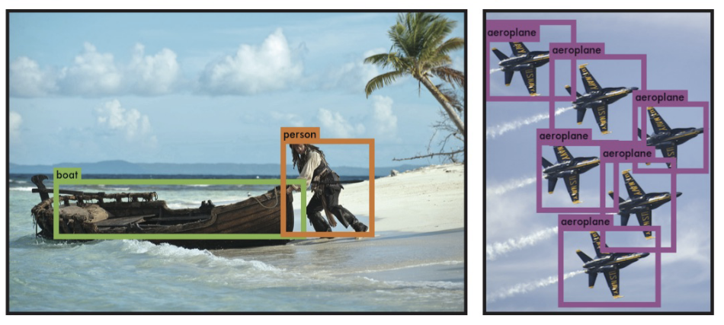

Slide 17
SSD: Single Shot Detector
Idea: Similar to YOLO, but denser grid map, multiscale grid maps. + Data augmentation + Hard negative mining + Other design choices in the network.
Liu et al. ECCV 2016.

Slide 18
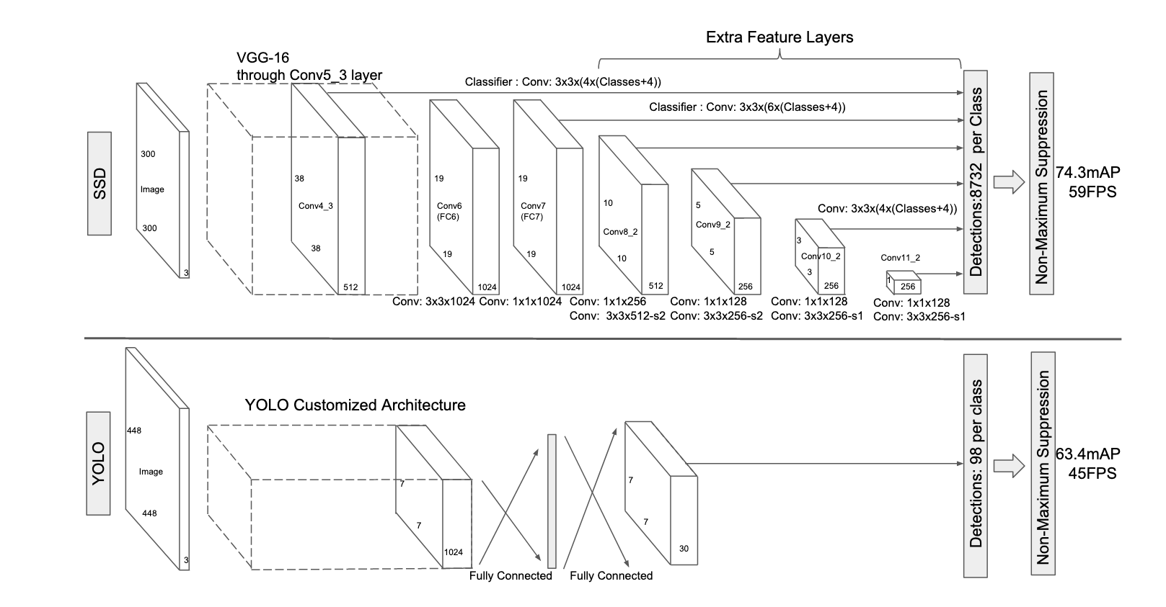
SSD vs YOLO

Slide 19
Semantic Segmentation / Image Parsing
deer
cat
trees
grass

Slide 20
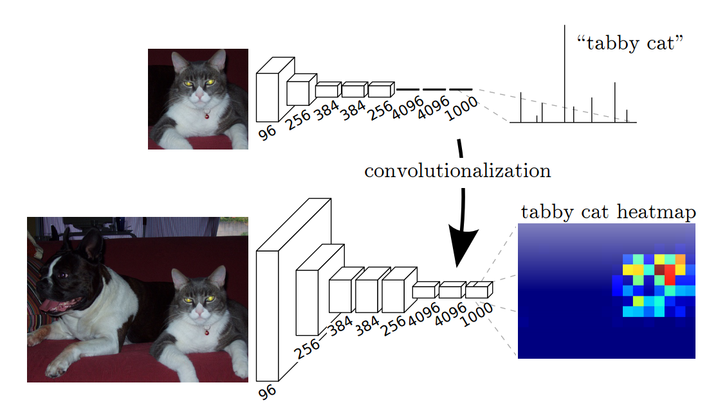
Idea 1: Convolutionalization
However resolution of the segmentation map is low.
https://people.eecs.berkeley.edu/~jonlong/long_shelhamer_fcn.pdf

Slide 21
Alexnet
https://www.saagie.com/fr/blog/object-detection-part1

Slide 22
Idea 1: Convolutionalization
nn.Linear(4096, 1000) == nn.Conv2D(4096, 1000, kernel_size = 1, stride = 1)
$$≡$$

Slide 23
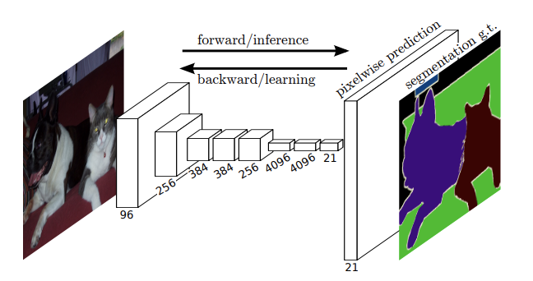
Fully Convolutional Networks (CVPR 2015)

Slide 24
Idea 2: Up-sampling Convolutions or ”Deconvolutions”
http://cvlab.postech.ac.kr/research/deconvnet/

Slide 25
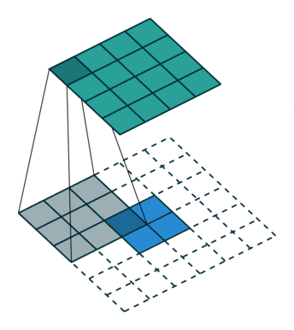
Idea 2: Up-sampling Convolutions or ”Deconvolutions”
https://github.com/vdumoulin/conv_arithmetic

Slide 26
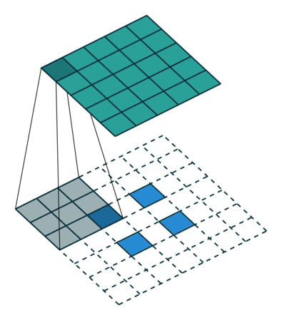
Idea 2: Up-sampling Convolutions or ”Deconvolutions”
https://github.com/vdumoulin/conv_arithmetic

Slide 27
Idea 2: Up-sampling Convolutions or ”Deconvolutions”
Deconvolutional Layers
Upconvolutional Layers
Backwards Strided Convolutional Layers
Fractionally Strided Convolutional Layers
Transposed Convolutional Layers
Spatial Full Convolutional Layers

Slide 28
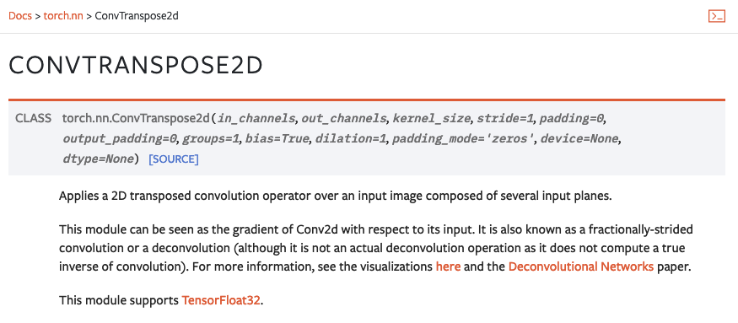
Pytorch

Slide 29
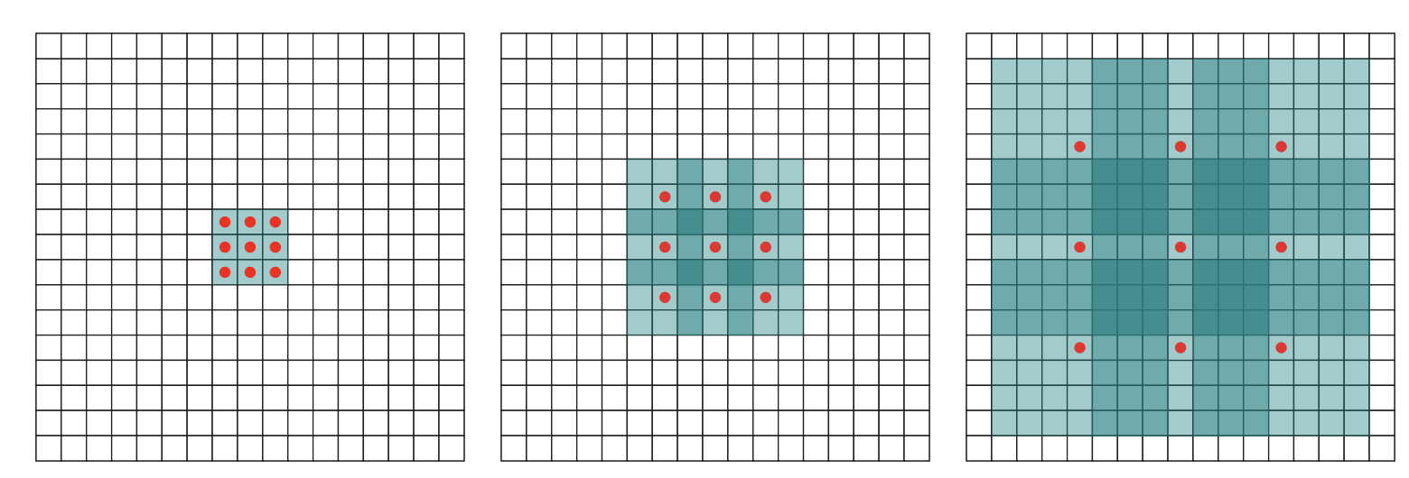
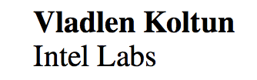
Idea 3: Dilated Convolutions
ICLR 2016

Slide 30
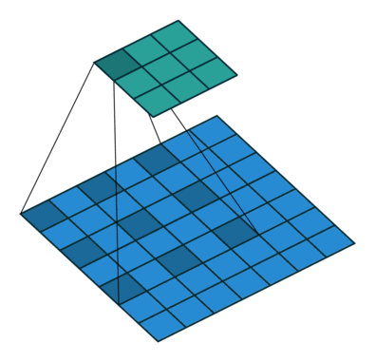
Idea 3: Dilated Convolutions
ICLR 2016

Slide 31
Convolutional Layer in pytorch
kernel_size
Input
out_channels x
Output
kernel_size
in_channels
out_channels (equals the number of convolutional filters for this layer)
in_channels (e.g. 3 for RGB inputs)

Slide 32
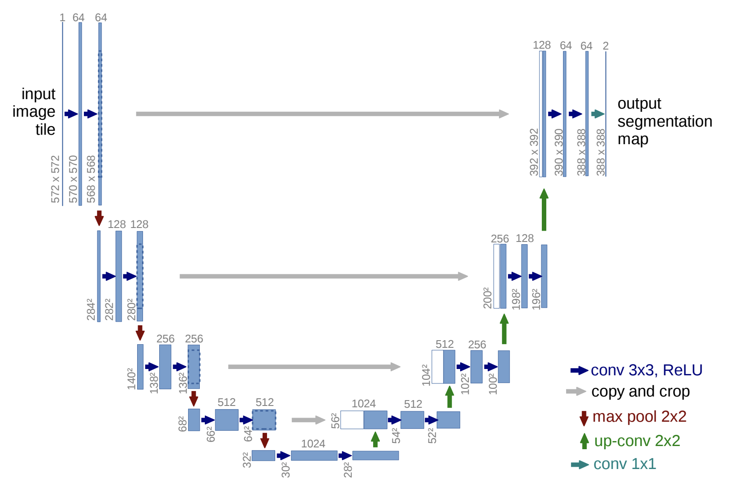
https://arxiv.org/abs/1505.04597
https://github.com/milesial/Pytorch-UNet
https://github.com/usuyama/pytorch-unet

Slide 33
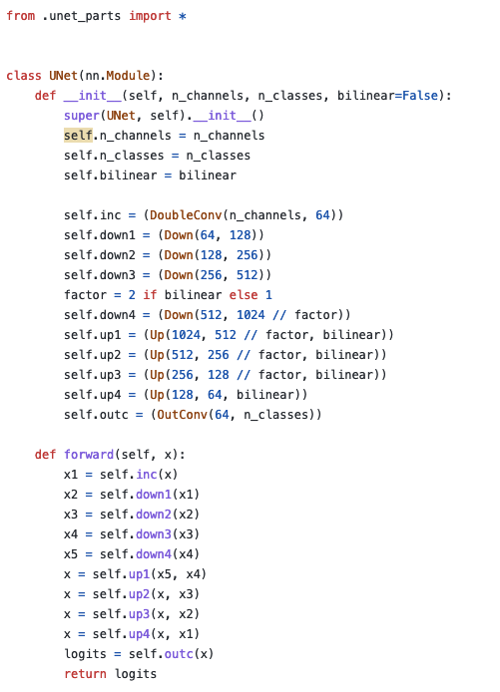
UNet in Pytorch
https://github.com/milesial/Pytorch-UNet/blob/master/unet/unet_model.py

Slide 34
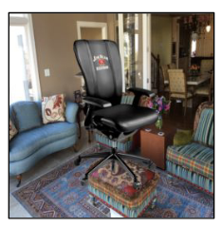
Chair segmentation - Training

Slide 35
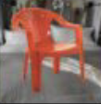
Chair segmentation - Prediction

Slide 36
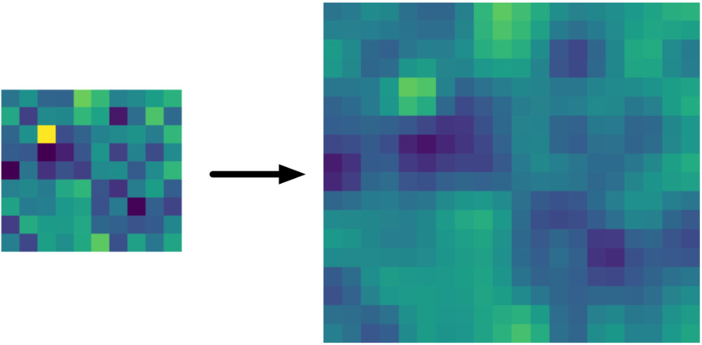
Bilinear Upsampling Layer
https://machinethink.net/blog/coreml-upsampling/

Slide 37
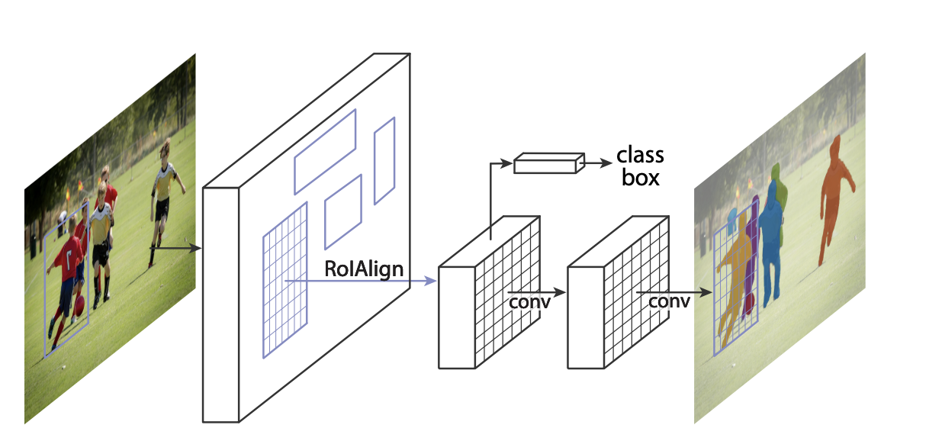
https://github.com/facebookresearch/detectron2
https://arxiv.org/abs/1703.06870

Slide 38
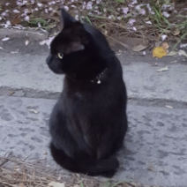
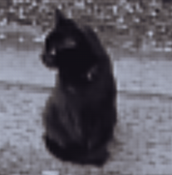
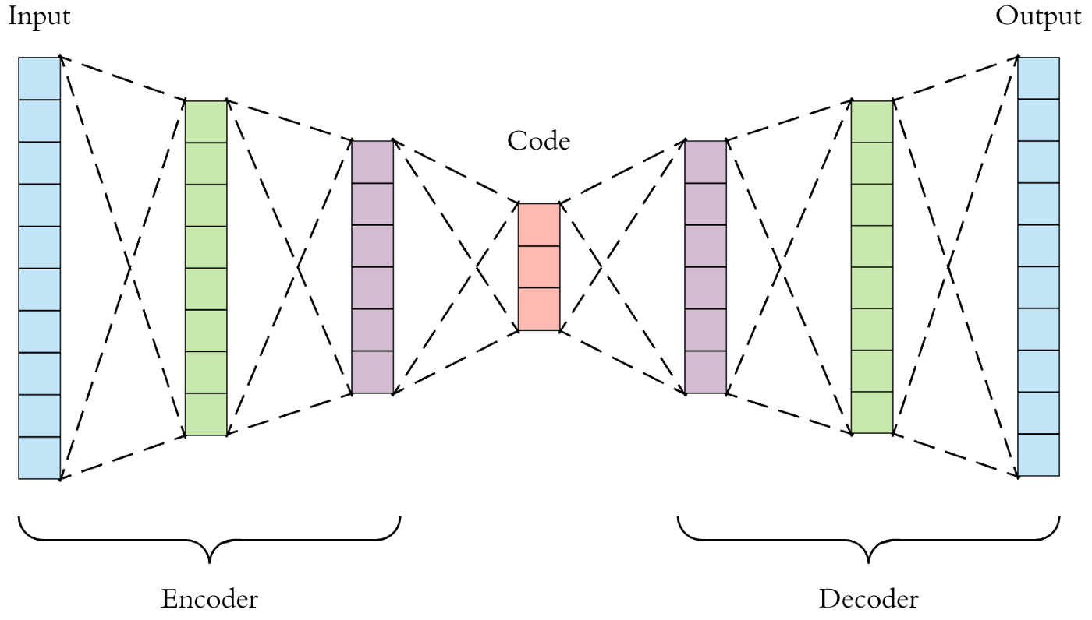
AutoEncoder Models (Downsample, Upsample)

Slide 39
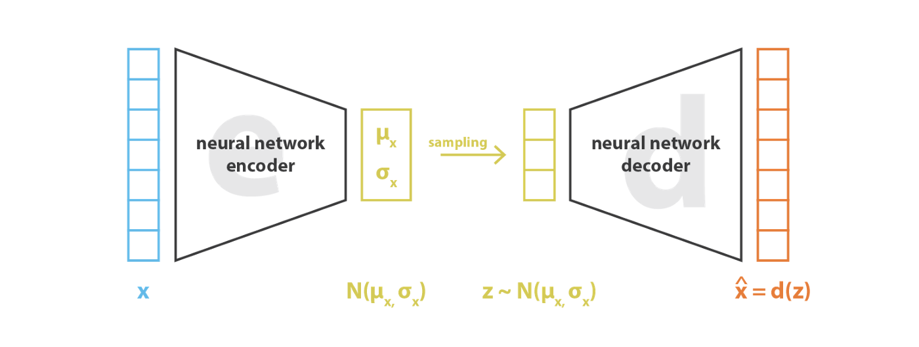
Variational AutoEncoders (VAE)
https://pytorch.org/docs/stable/generated/torch.normal.html
https://ai.stackexchange.com/questions/30176/are-mean-and-standard-deviation-in-variational-autoencoders-unique

Slide 40
Reparameterization “trick”
https://pytorch.org/docs/stable/generated/torch.normal.html
https://ai.stackexchange.com/questions/30176/are-mean-and-standard-deviation-in-variational-autoencoders-unique

Slide 41
Questions

