Slide 1
Deep Learning for Vision & Language
Feature-space Optimization: Adversarial Examples, GANs, Style Transfer

Slide 2
What we have been doing: Optimize weights in the network to predict bus (correct class).
$$I$$
$$y=f(I;w)$$
$$L(y, bus)$$
bus
$$w=w −λ\frac{∂L}{∂w}$$

Slide 3
New Idea: Create Adversarial Inputs by optimizing the input image to predict ostrich (wrong class).
$$I$$
$$y=f(I;w)$$
$$L(y, ostrich)$$
ostrich
$$I=I −λ\frac{∂L}{∂I}$$
Work on Adversarial examples by Goodfellow et al. , Szegedy et. al., etc.

Slide 4
Convnets (optimize input to predict ostrich)
ostrich
Work on Adversarial examples by Goodfellow et al. , Szegedy et. al., etc.

Slide 6
All get predicted as ostrich

Slide 7
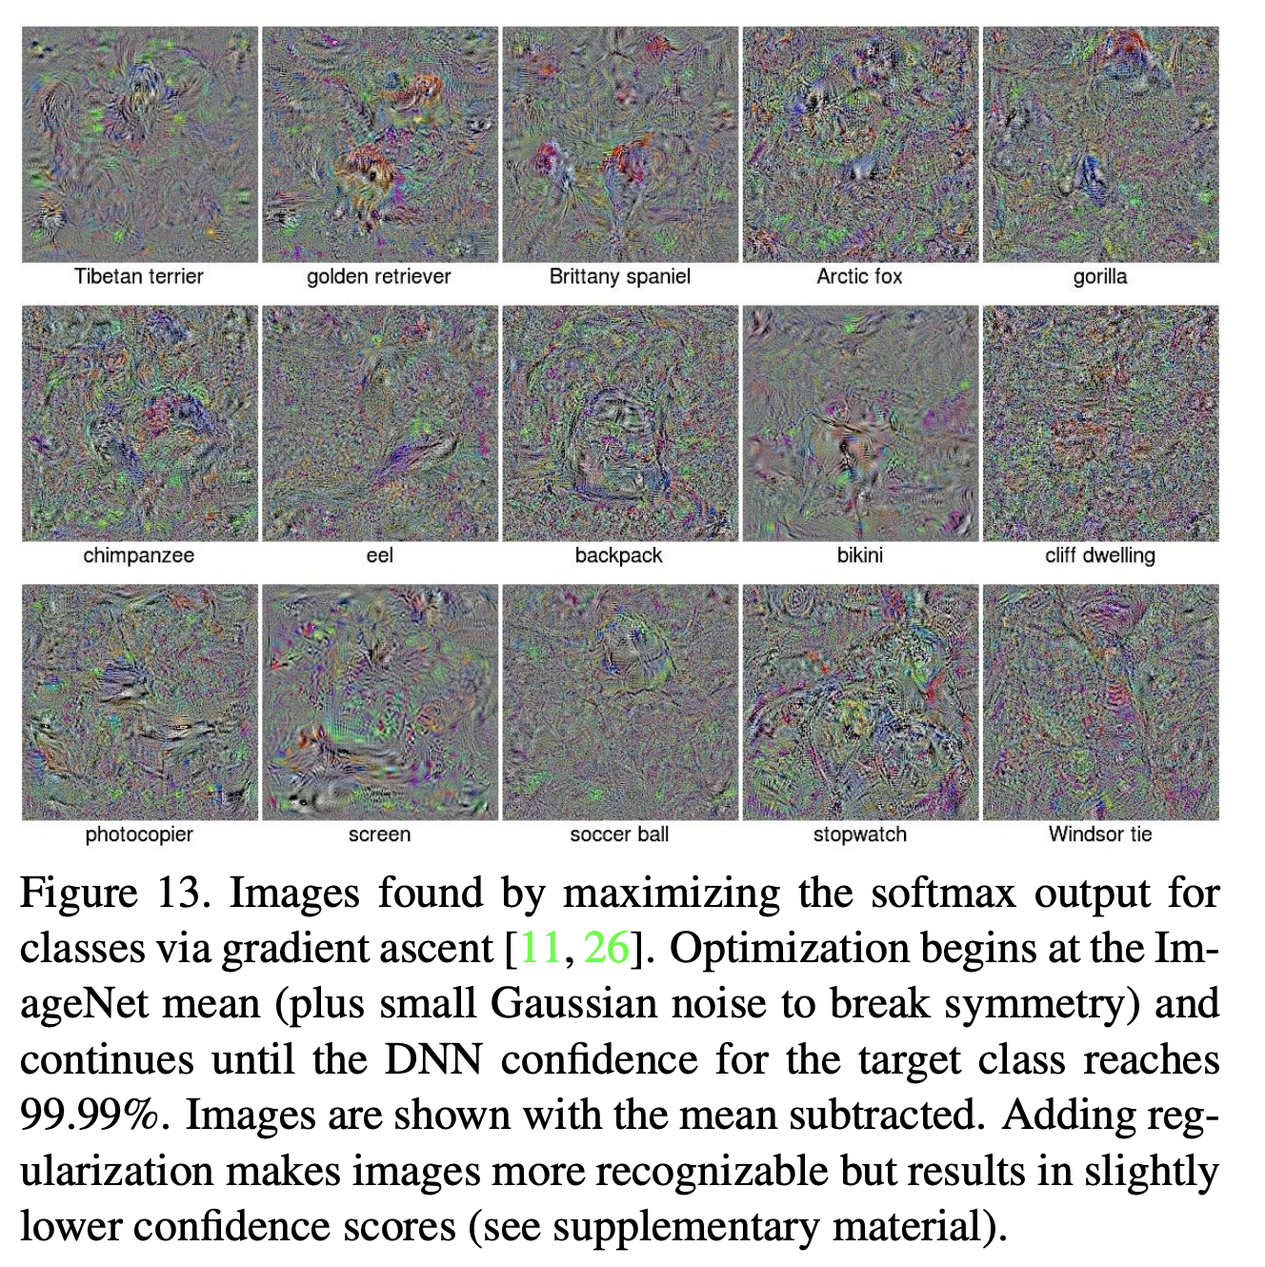
Deep Neural Networks are Easily Fooled: High Confidence Predictions for Unrecognizable Images
Anh Nguyen, Jason Yosinski, Jeff Clune, 2014

Slide 8
New Idea: Create Adversarial Inputs by optimizing the input image to predict ostrich (wrong class).
$$I$$
$$y=f(I;w)$$
$$L(y, parking meter)$$
parking meter
$$I=I −λ\frac{∂L}{∂I}$$
Work on Adversarial examples by Goodfellow et al. , Szegedy et. al., etc.

Slide 9
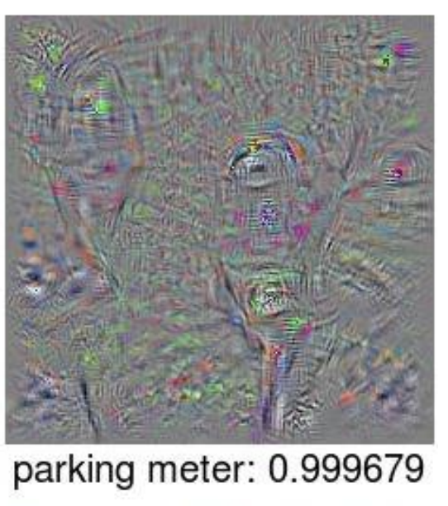

Slide 10
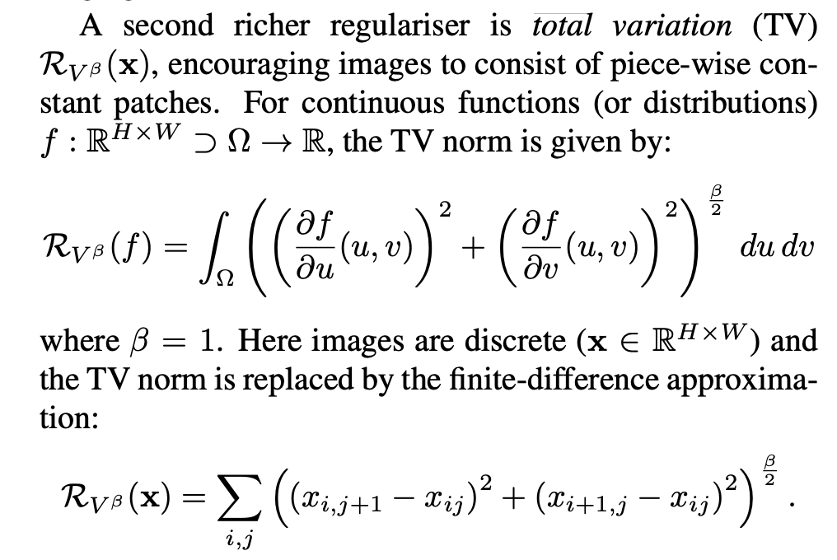
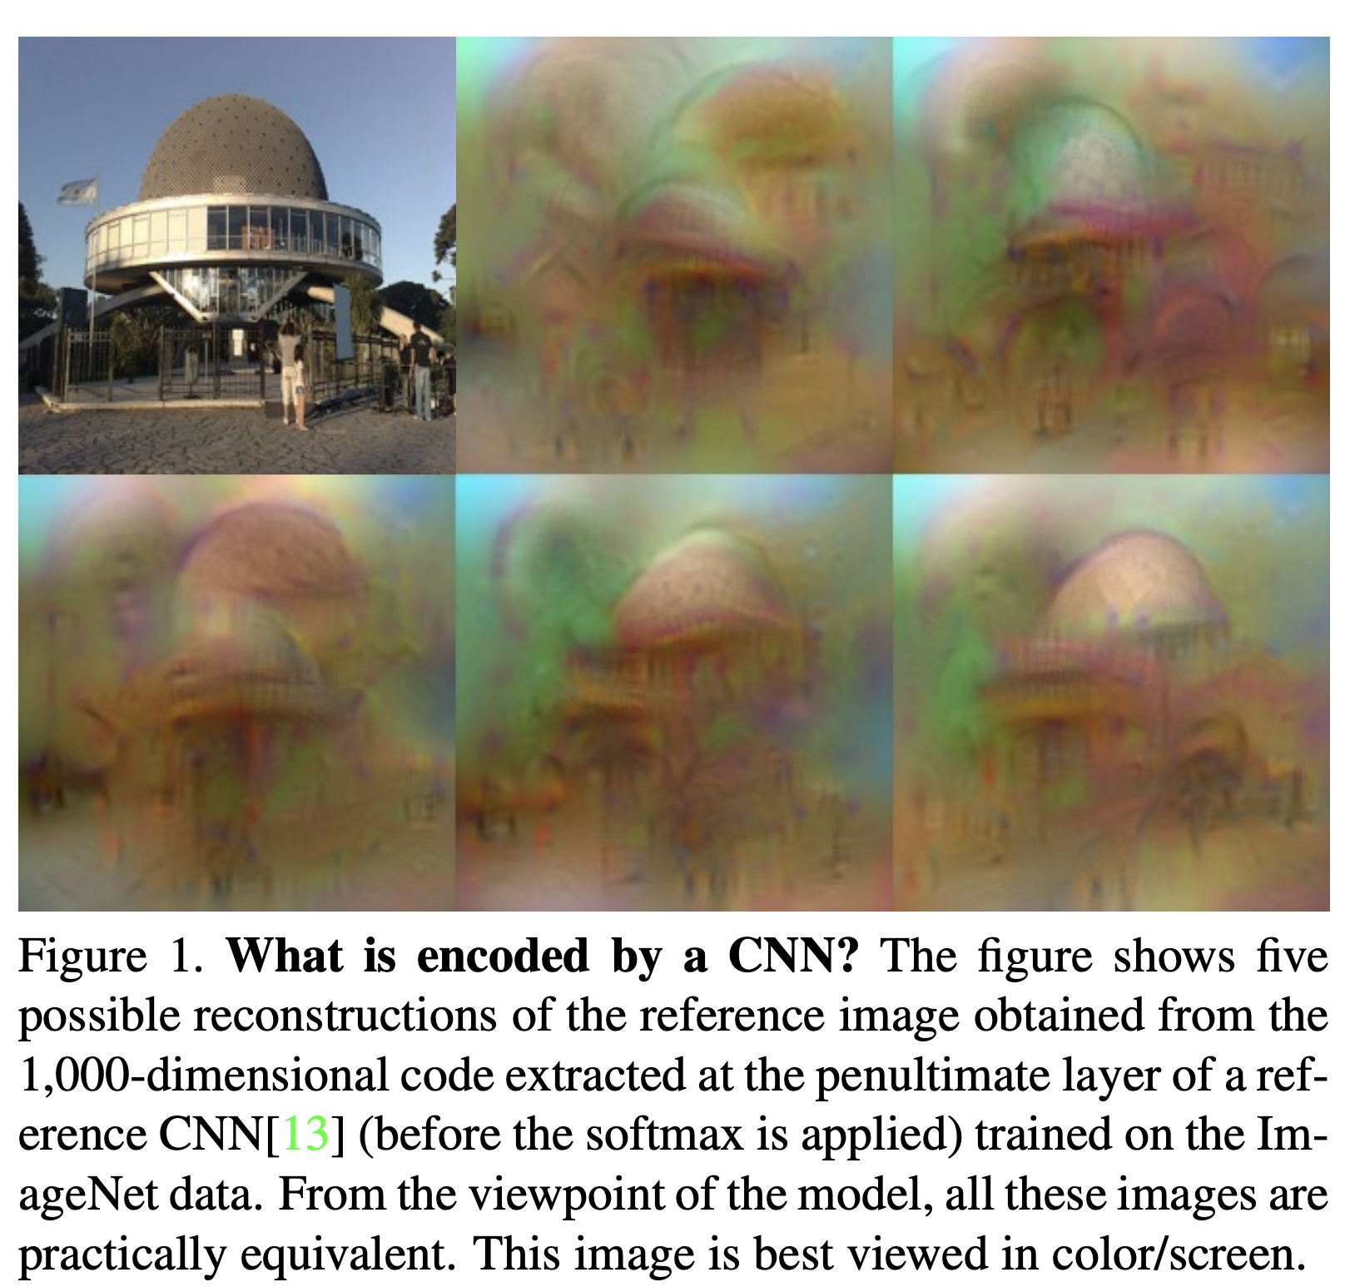
Total Variation Regularization
Mahendran and Vedaldi, Understanding Deep Image Representations by Inverting Them, 2014

Slide 11
Taking the idea to the extreme: Google’s DeepDream
https://research.googleblog.com/2015/06/inceptionism-going-deeper-into-neural.html
Generate your own in Pytorch:
https://github.com/XavierLinNow/deepdream_pytorch

Slide 12
Generative Adversarial Networks (GAN) [Goodfellow et al 2014]
https://deeplearning4j.org/generative-adversarial-network

Slide 13
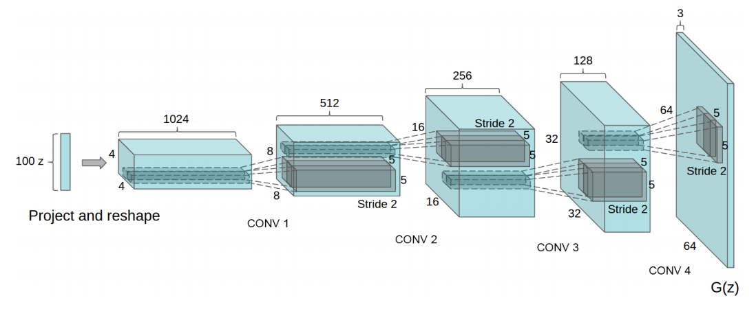
Generative Network (closer look)
Radford et. al. Unsupervised Representation Learning with Deep Convolutional Generative Adversarial Networks. ICLR 2016

Slide 14
Generative Adversarial Networks (GAN) [Goodfellow et al.]
https://deeplearning4j.org/generative-adversarial-network

Slide 15
Generative Adversarial Networks (GAN) [Goodfellow et al.]
https://deeplearning4j.org/generative-adversarial-network

Slide 16
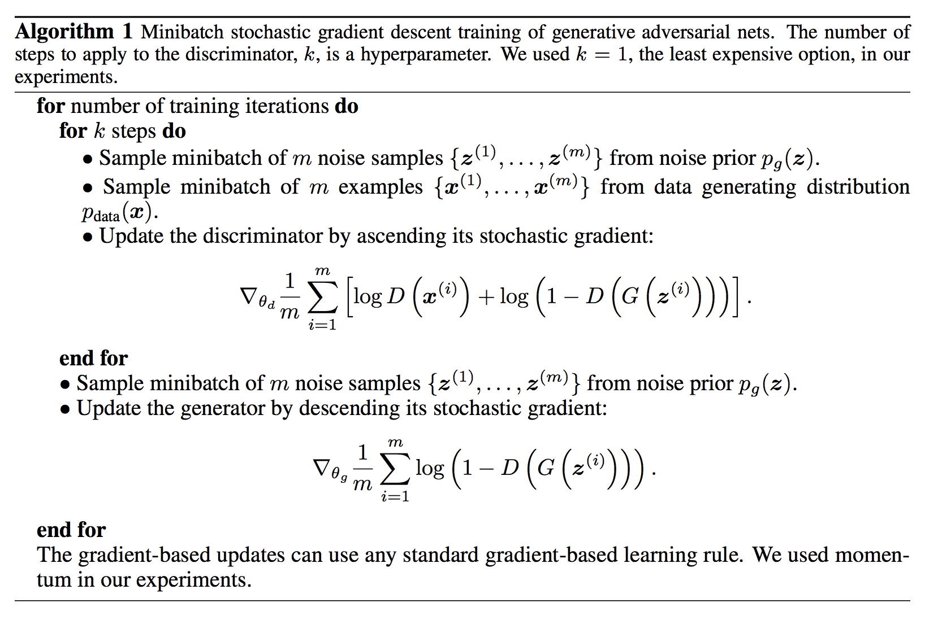
Goodfellow et al. NeurIPS 2014

Slide 17
Update Discriminator D
Goodfellow et al. NeurIPS 2014

Slide 18
Update Generator G
Goodfellow et al. NeurIPS 2014

Slide 19
Until Desirable Results are Achieved?
Goodfellow et al. NeurIPS 2014

Slide 20
Generative Adversarial Networks (GAN) [Goodfellow et al.]
https://deeplearning4j.org/generative-adversarial-network

Slide 21
Generative Adversarial Networks (GAN) [Goodfellow et al.]
GANs are hard to train, loss for the discriminator and generator might fluctuate.
There are many choices for loss, and other auxiliary signals.
Training of these models is even less well understood than for other deep models.
https://deeplearning4j.org/generative-adversarial-network

Slide 22
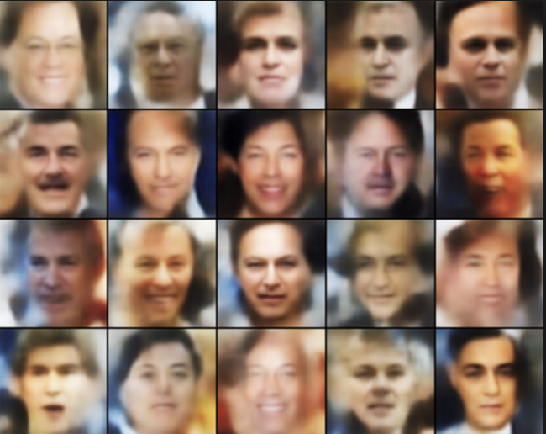
Basic GAN Results (Example implementation is provided in Pytorch’s examples)
http://torch.ch/blog/2015/11/13/gan.html

Slide 23
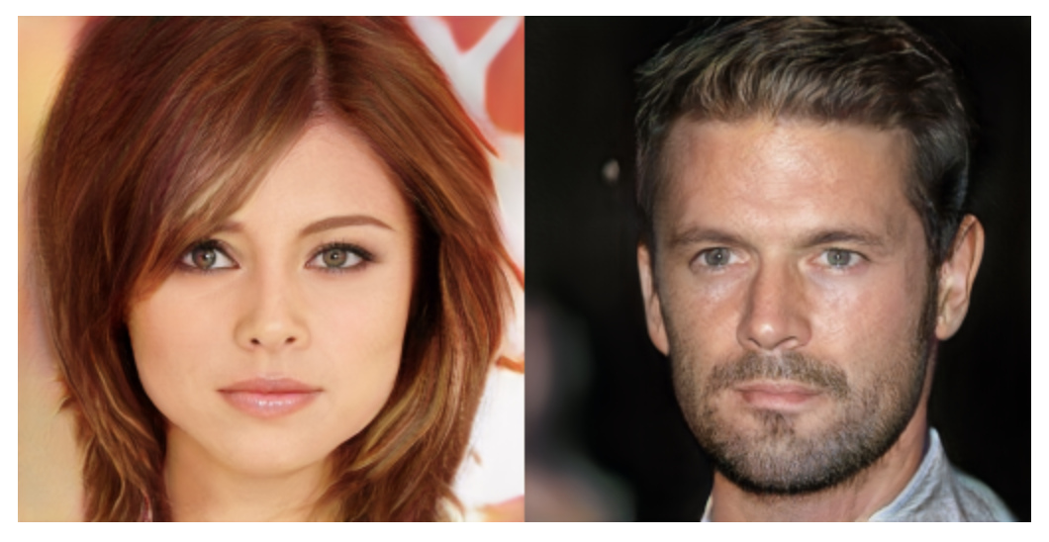
NVidia’s progressive GANs ICLR 2018

Slide 24
Google’s BigGAN

Slide 25
Google’s BigGAN
Teddy Bear
Microphone
http://aiweirdness.com/post/179626595787/the-creepiest-images-generated-by-biggan

Slide 26
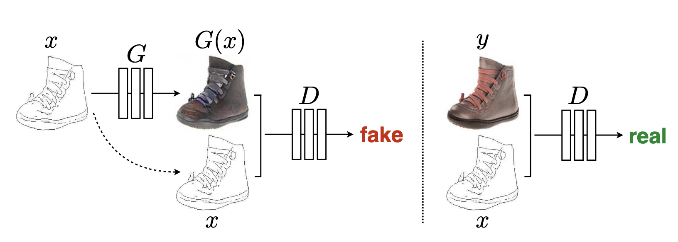
Conditional GANs: Input is not just Noise
Isola et al. CVPR 2017: Image-to-Image Translation with Conditional Adversarial Networks

Slide 27
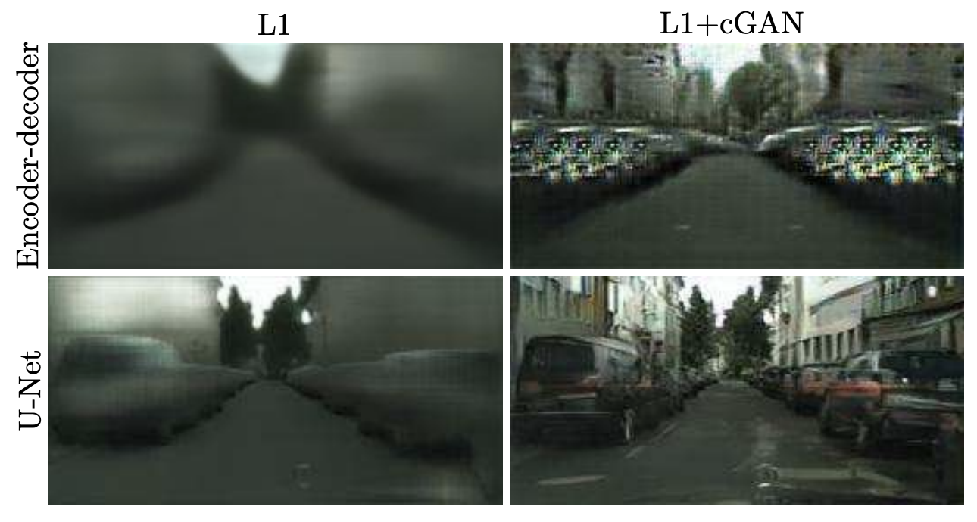
Conditional GANs: Also Hard to Train
Result they obtained with a regular Fully Convolutional Network
Result they obtained with a U-Net network (with skip-connections)
Isola et al. CVPR 2017: Image-to-Image Translation with Conditional Adversarial Networks

Slide 28
Conditional GANs: Also Hard to Train
Ronneberger et al. MICCAI 2015. U-Net: Convolutional Networks for Biomedical Image Segmentation

Slide 29
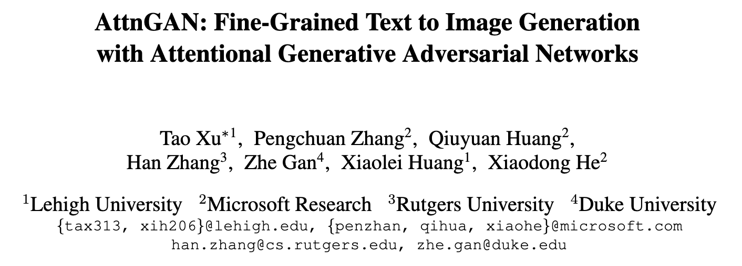
Conditional GANs / Text-conditioned

Slide 30
Conditional GANs / Text-conditioned

Slide 31
Conditional GANs / Text-conditioned

Slide 32
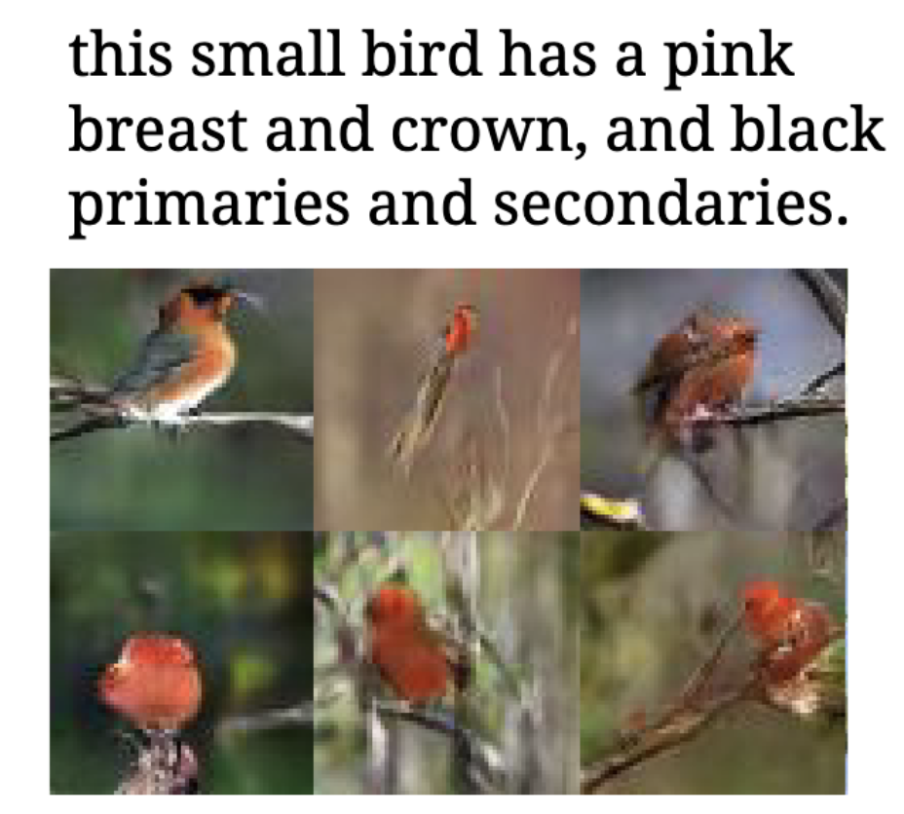
Conditional GANs / Text-conditioned

Slide 33
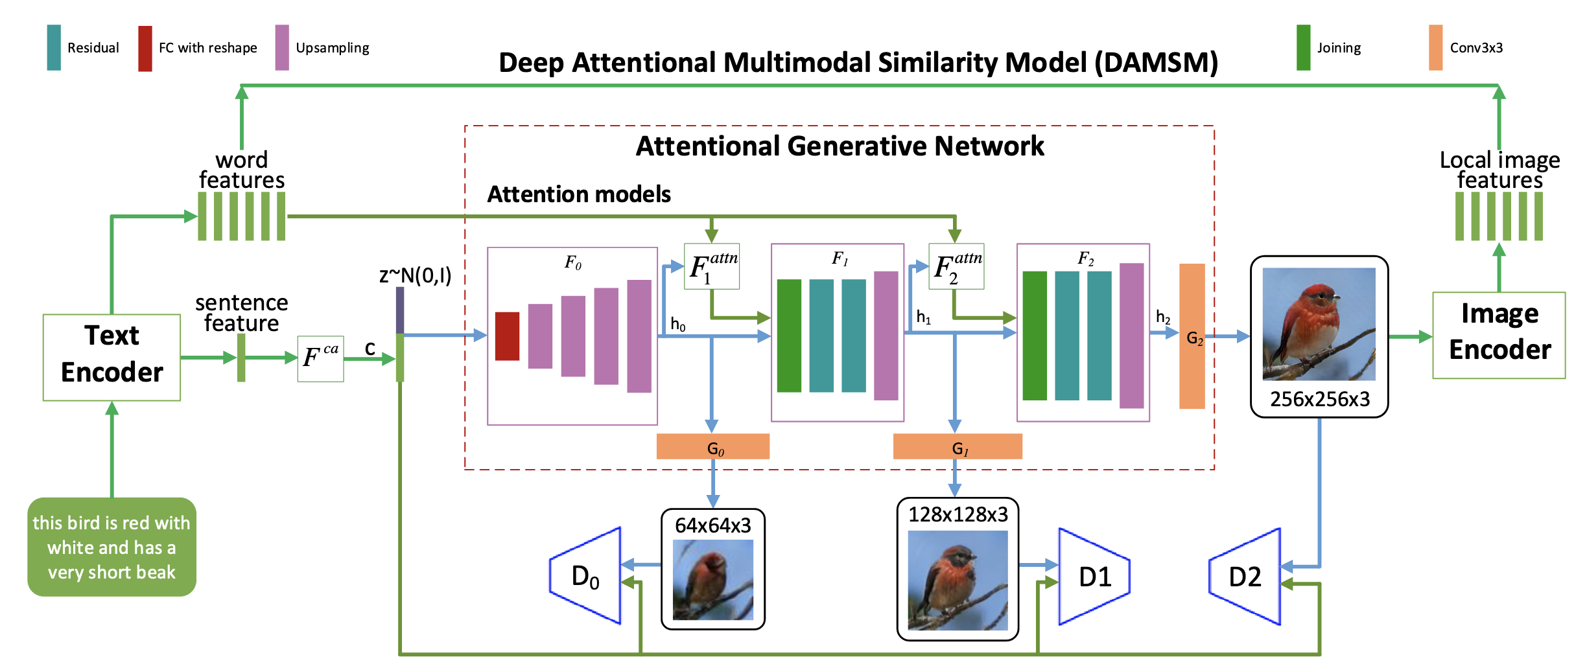
Conditional GANs / Text-conditioned

Slide 34
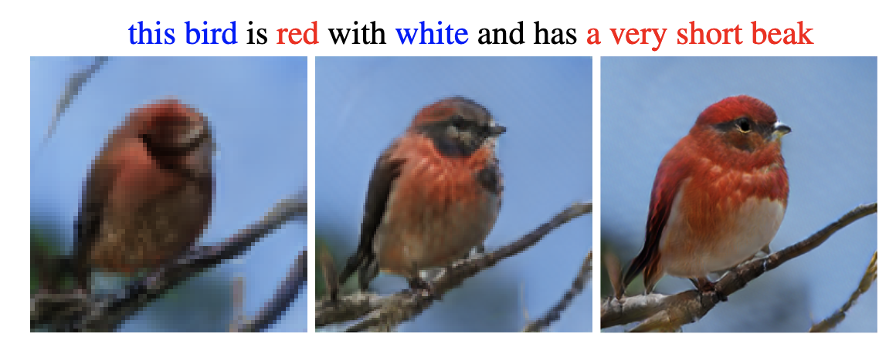
Conditional GANs / Text-conditioned

Slide 35
More on the Idea of Feature Space Optimization
Gatys et. al. Image Style Transfer Using Convolutional Neural Networks. CVPR 2016

Slide 36
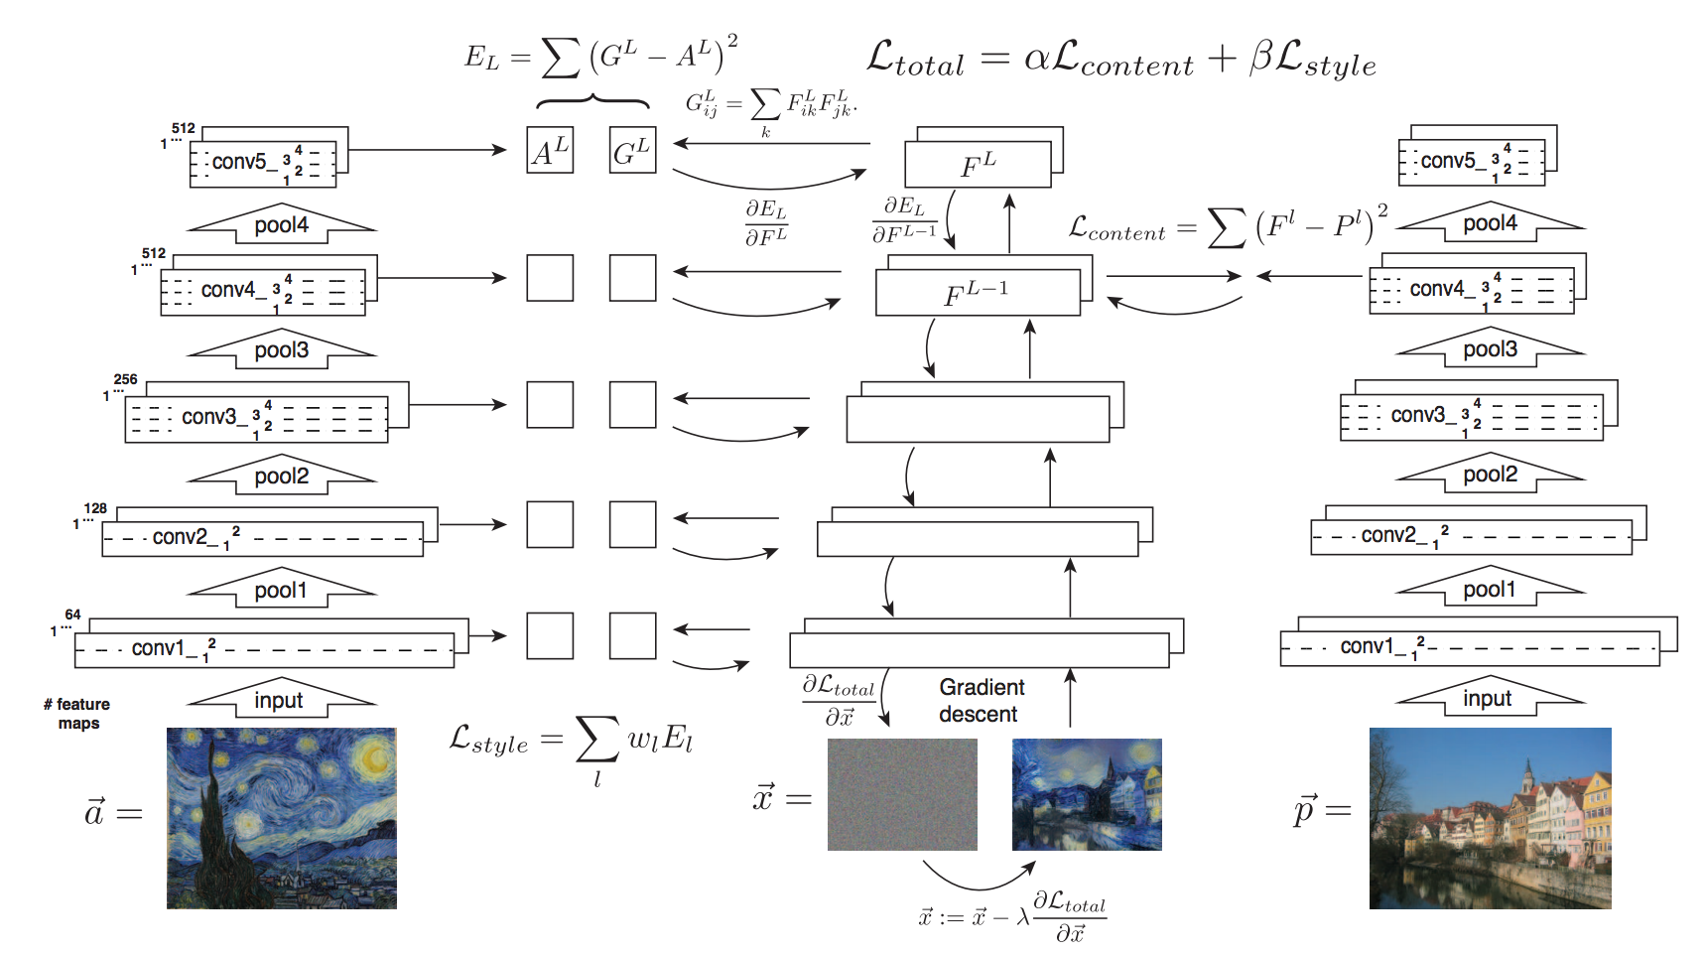

Slide 37
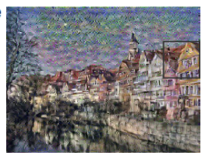
Gatys et. al. Image Style Transfer Using Convolutional Neural Networks. CVPR 2016
Idea 1: Image Reconstruction from Features

Slide 38
Gatys et. al. Image Style Transfer Using Convolutional Neural Networks. CVPR 2016
Idea 1: Image Reconstruction from Features

Slide 39
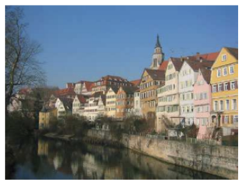
Gatys et. al. Image Style Transfer Using Convolutional Neural Networks. CVPR 2016
Idea 1: Image Reconstruction from Features

Slide 40
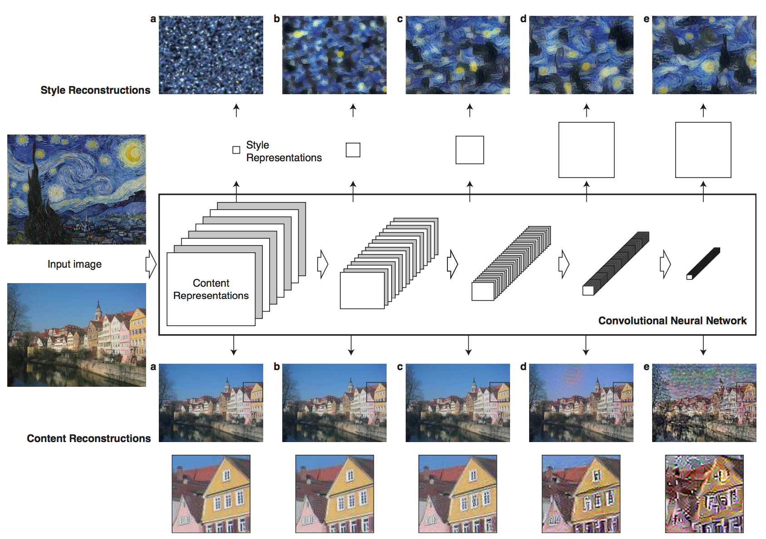
Gatys et. al. Image Style Transfer Using Convolutional Neural Networks. CVPR 2016

Slide 41
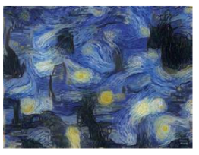
Gatys et. al. Image Style Transfer Using Convolutional Neural Networks. CVPR 2016
Idea 2: Backpropagation of Style

Slide 42
Gatys et. al. Image Style Transfer Using Convolutional Neural Networks. CVPR 2016
Idea 2: Backpropagation of Style

Slide 43
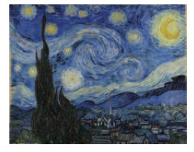
Gatys et. al. Image Style Transfer Using Convolutional Neural Networks. CVPR 2016
Idea 2: Backpropagation of Style

Slide 44
Gatys et. al. Image Style Transfer Using Convolutional Neural Networks. CVPR 2016

Slide 45
Gatys et. al. Image Style Transfer Using Convolutional Neural Networks. CVPR 2016

Slide 46
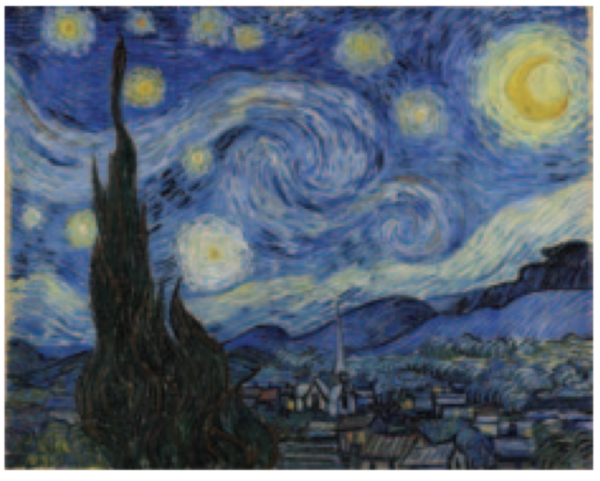
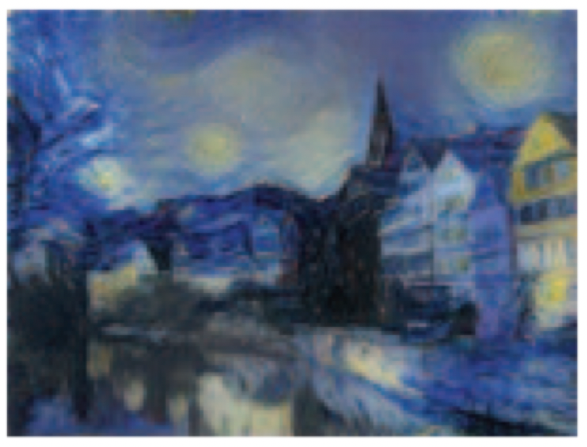
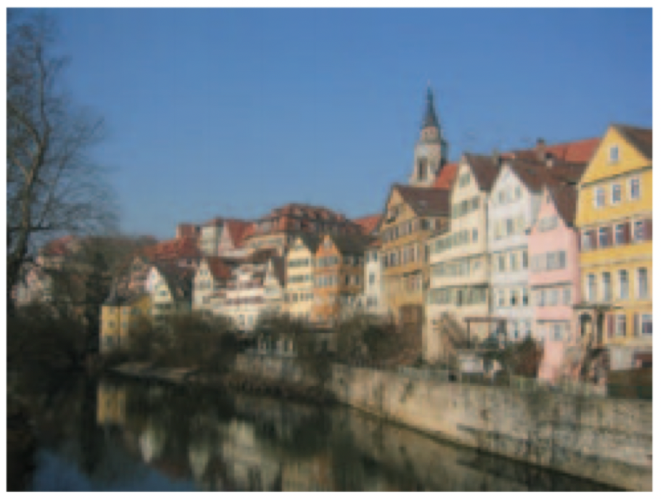
Gatys et. al. Image Style Transfer Using Convolutional Neural Networks. CVPR 2016

Slide 47
Questions

