Slide 1
Deep Learning for Vision & Language
Course Recap

Slide 2
Final Project
PDF Project report (4 pages).
Link to source code / github or google drive or dropbox links to code.
5 slides presenting your work -- ideally a video (optional) of you walking me through your project in case I have trouble running it or understanding your report [Motivation] [Problem Setup] [Model] [Experiments] [Results] / you can also submit a link for this part.
Due: April 22nd

Slide 3
Grading Criteria
Originality: Either in the idea itself, the application itself, or the experiments you present in your final report. Are you teaching me something new that is not obvious? The more clear this answer is yes, the more likely you get full points on this part. Technical soundness: Are you describing how your solution and the components that you used in your solution with good amount of details and correct technical accuracy? You should provide enough details to understand just by reading your report what you did. If I have to look at your code to understand what you did then technical soundness will not receive as high a score. If you re-used a component e.g. CLIP or something else, but from reading your report it seems obvious you're not understanding what this model does. Then, this can also lead to points deducted. Results: Does your report present results in a way that is easy to understand -- e.g. example of input outputs of your model -- and does your project provide quantitative empirical and/or statistical evidence of your solution -- e.g. plots/figures/tables/etc. Ideally most projects should have both types of "results". Presentation: Is your project report of top quality, (e.g. as shown in the template), or did you include figures that are just screenshots of some experiment you run on a notebook, e.g. your plots do not have clear labeling for what is being shown in the x-axis or what are the units, your images look too low resolution. Anything of those issues will get you points deducted automatically. Your presentation in your project report has to be scientific manuscript quality.

Slide 4
Common Mistakes that lead to Point Deductions
Including figures you did not make yourself but just borrowed from somewhere else.
Not exporting your figures properly leading to blurry fonts when zooming in
Not making your text large enough for it to be legible without zooming in a lot into the document
Not actually including any results of your method and discussion of results
Not including references to original papers for components of your solution that you are clearly relying on
Including screenshots of your command line or jupyter/colab notebook as quick way of showing results in your report.

Slide 5
Also be careful about the following
Clearly indicate what you did – it should be clear what was done by you and what was not done by you by reading your report.
Any code you submit will be by default assumed that was authored by you and your team mates unless indicated otherwise. It is okay to rely on other people’s code or existing code but the Instructor should have an easy time judging what is yours and what is not.

Slide 6
Today
Course Recap
Future Directions

Slide 7
What you learned in this class?
Machine Learning Basics (SGD, Losses, Evaluation)
Computer Vision (CNNs, Detection, Segmentation, Vision Transform.)
Natural Language Processing (RNNs, Transformers, GPTs)
Vision and Language (RefExp, VQA, CLIP, cGANs, Diffusion)
Self-supervised Representation Learning for Images, Text and Video
Practical Implementation Aspects / Technical Skills

Slide 8
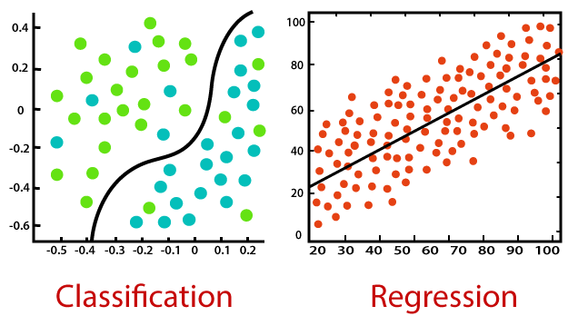
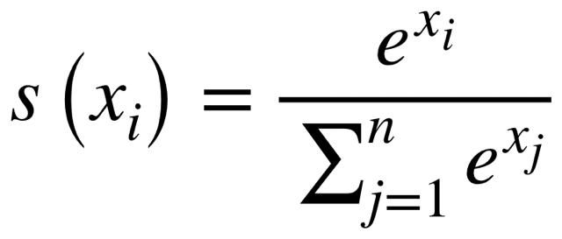
Machine Learning : Introduction
Supervised Learning vs Unsupervised Learning (+Self-supervised)
Classification vs Regression
Least Squares Regression (Mean Squared Error MSE Loss – L1Loss)
Simple Linear Classifiers e.g. Softmax Classifiers
https://static.javatpoint.com/tutorial/machine-learning/images/regression-vs-classification-in-machine-learning.png

Slide 9
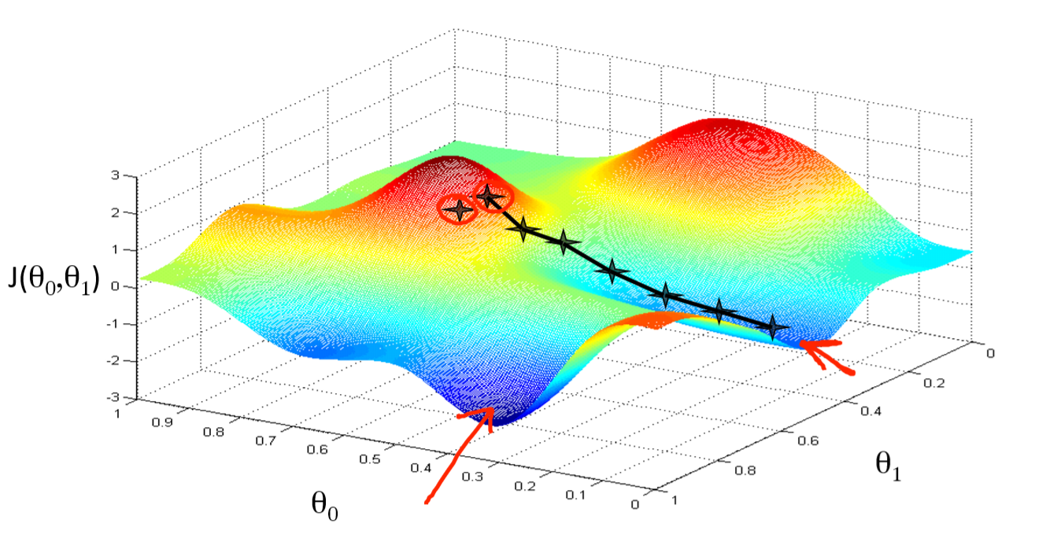
Machine Learning: Optimization
Gradient Descent (GD)
(mini-batch) Stochastic Gradient Descent (SGD)
Regularization, Momentum, Overfitting vs Underfitting
Data Preprocessing and Data Augmentation
Training / Validation / Testing
https://miro.medium.com/proxy/1*f9a162GhpMbiTVTAua_lLQ.png

Slide 10
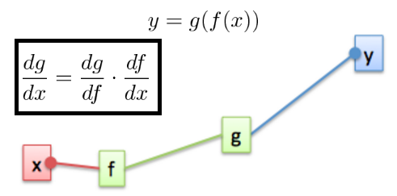
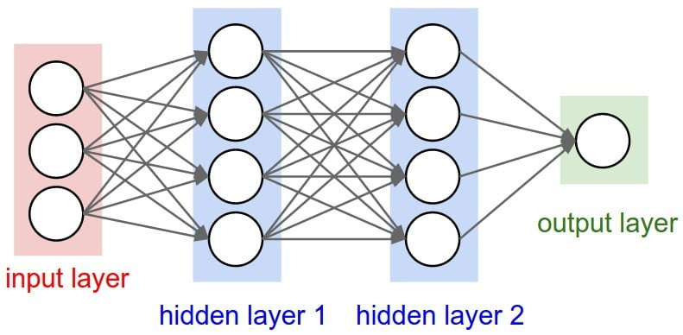
Neural Networks: Backpropagation
The Perceptron Model
Multi-layer Perceptrons (Neural Networks of Linear Layers)
Linear Layers and Non-linear Activations (ReLU, Sigmoid, Tanh)
The backpropagation algorithm (Chain-rule) and SGD
Pytorch’s automatic differentiation (loss.backward() and param.grad)
https://s7280.pcdn.co/wp-content/uploads/2020/07/Two-or-more-hidden-layers-comprise-a-Deep-Neural-Network.png
https://www.oreilly.com/library/view/hands-on-convolutional-neural/9781789130331/assets/85cb6c18-9cbc-44ff-9db6-c7d90d3c7cf0.png

Slide 11
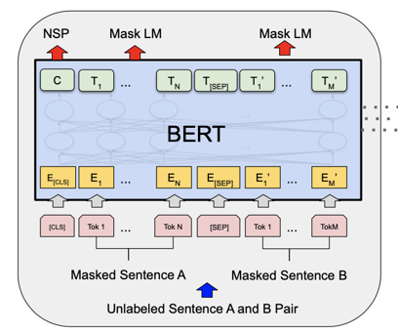
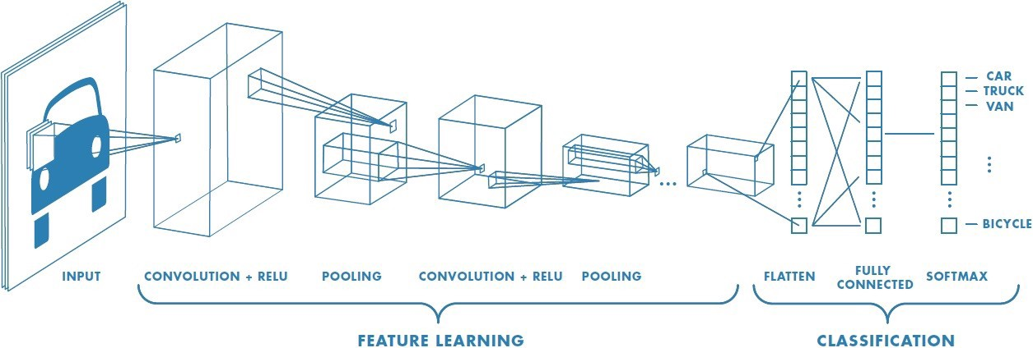
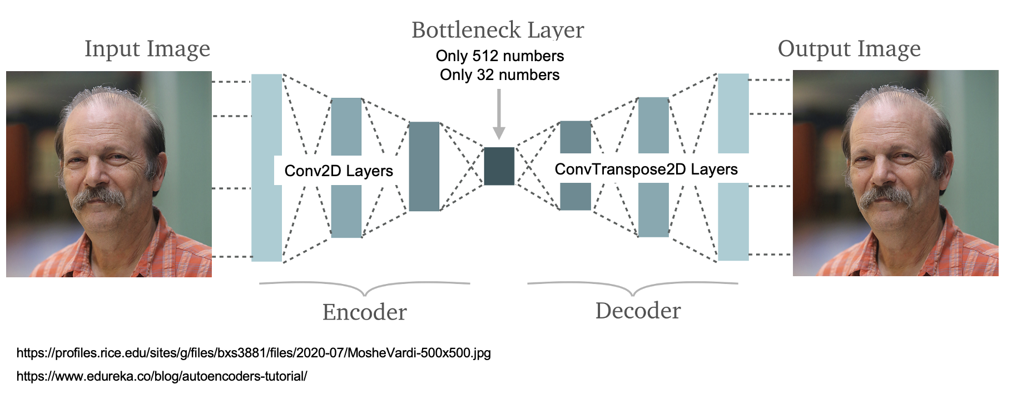
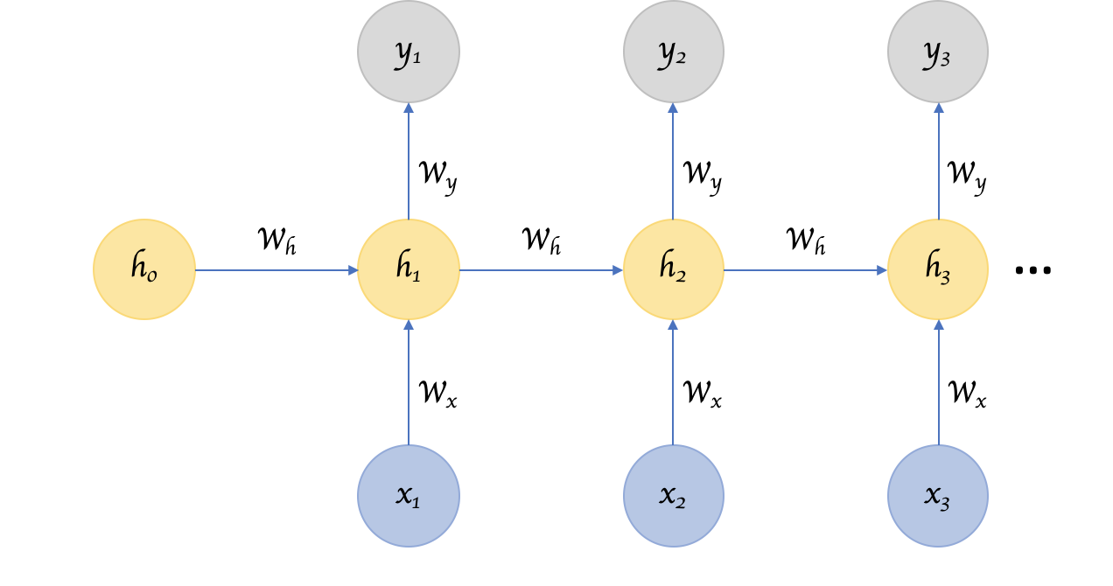
Neural Networks: Models
Transformer Networks
Autoencoder Networks
Convolutional Neural Networks
Recurrent Neural Networks

Slide 12
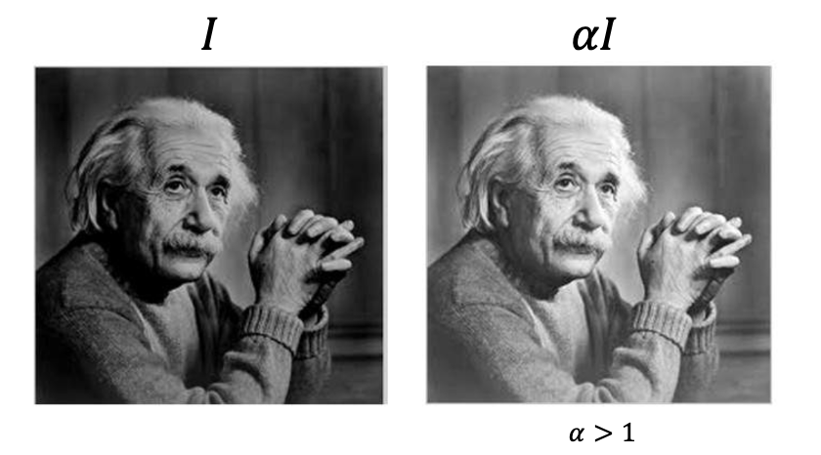
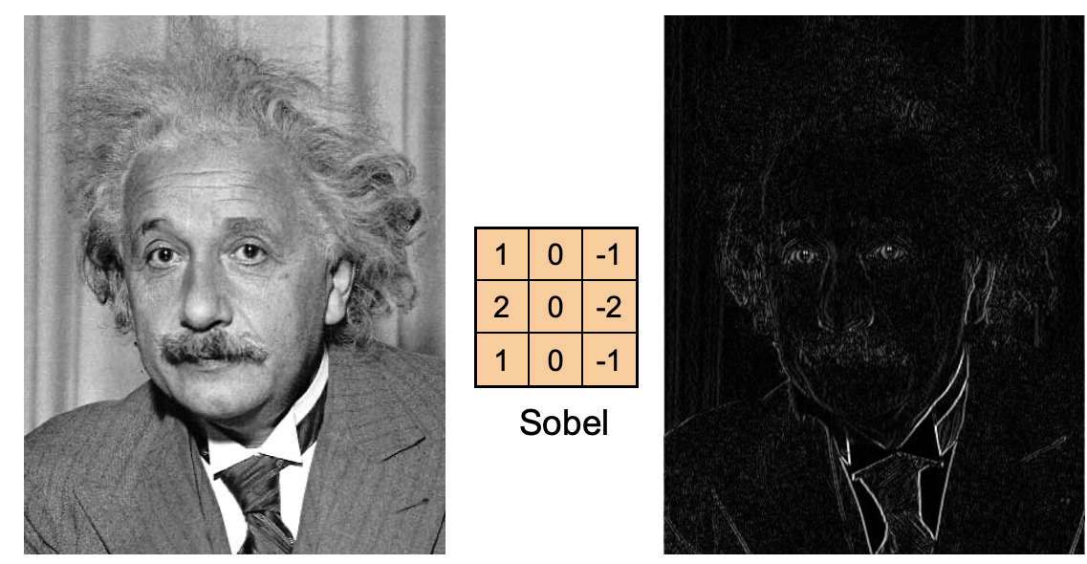
Intro to Computer Vision: Image Manipulations
Image Processing and Manipulation (Brightness, Cropping, Normalizing, Resizing)
Image Filtering and the Convolutional Operator (Box/Mean Filter, Gaussian Blur, Sobel Filtering)

Slide 13
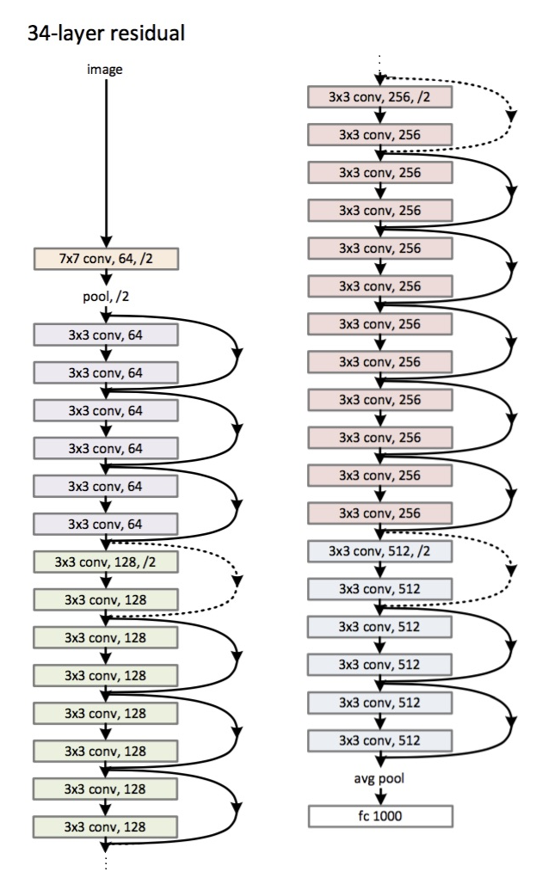
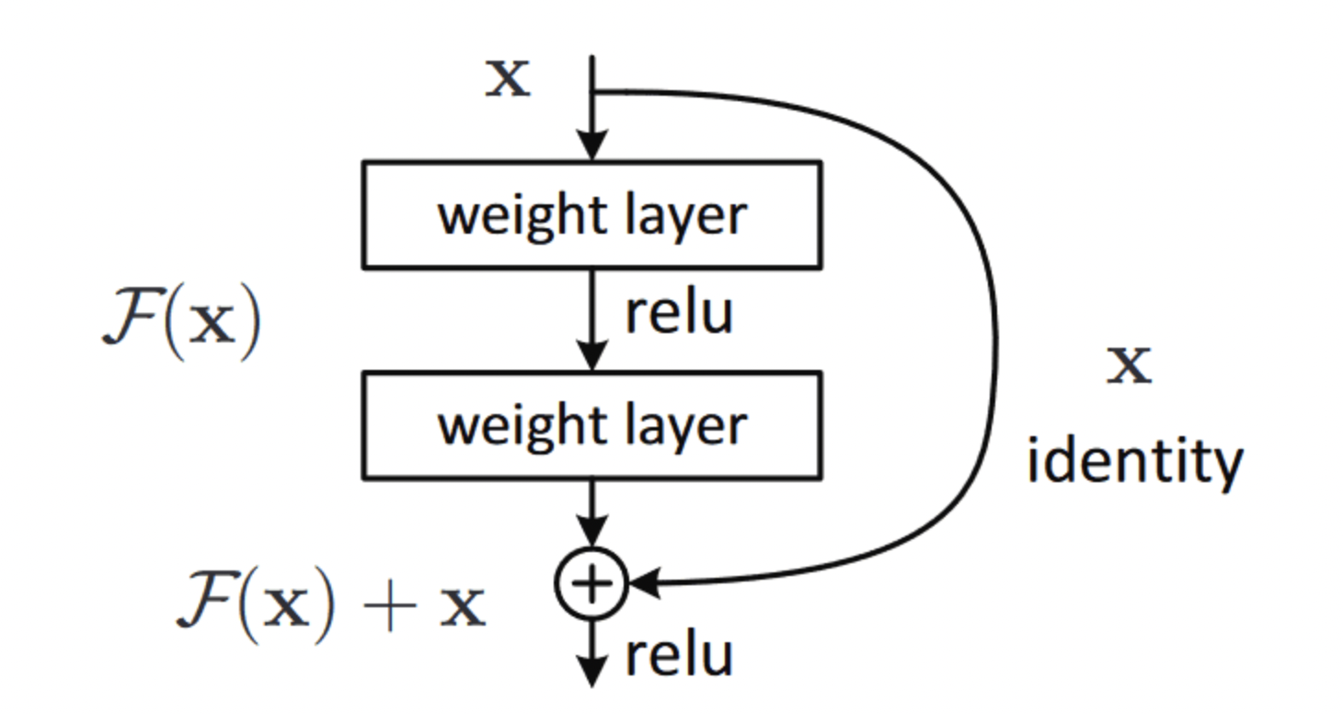
Computer Vision: CNN Architectures
Datasets: Imagenet (objects), SUN (scenes)
Convolutional Neural Network Architectures for Images
AlexNet, VGGNet, GoogLeNet, ResNets, Densenet
Layers: Dropout, Batch Normalization, Max Pooling

Slide 14
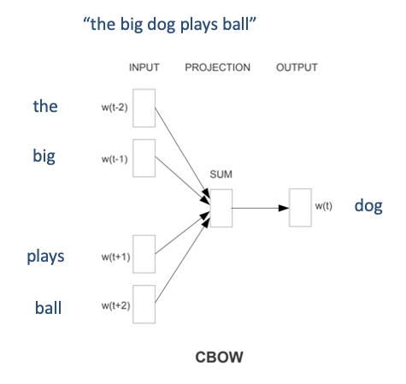
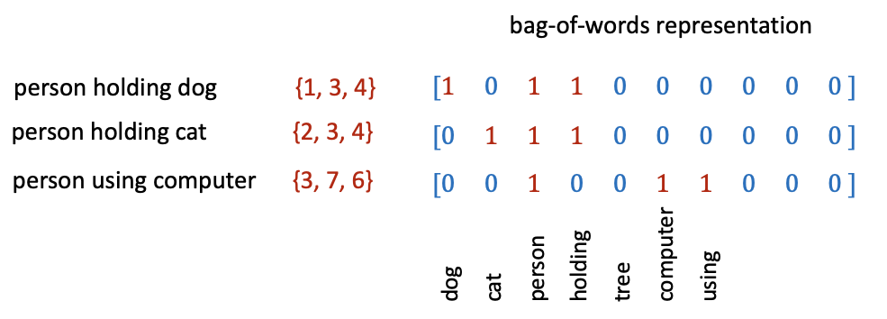
Intro to Natural Language Processing
Representing text as Bag of Words
Continuous Bag of Words (CBOW) -- i.e. Learned Word Embeddings
Part-of-speech tagging, Text parsing, Entailment Resolution
Tokenizers (including BytePairEncoding BPE)

Slide 15
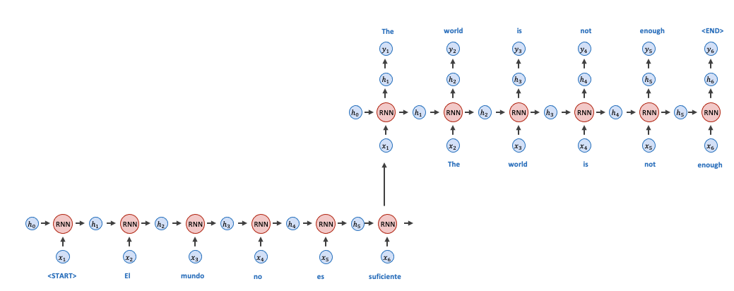
Natural Language Processing: RNNs
Recurrent Neural Networks (RNNs)
Gated Recurrent Units (GRUs), Long-short Term Memory Networks (LSTMs)
Auto-regressive Models

Slide 16
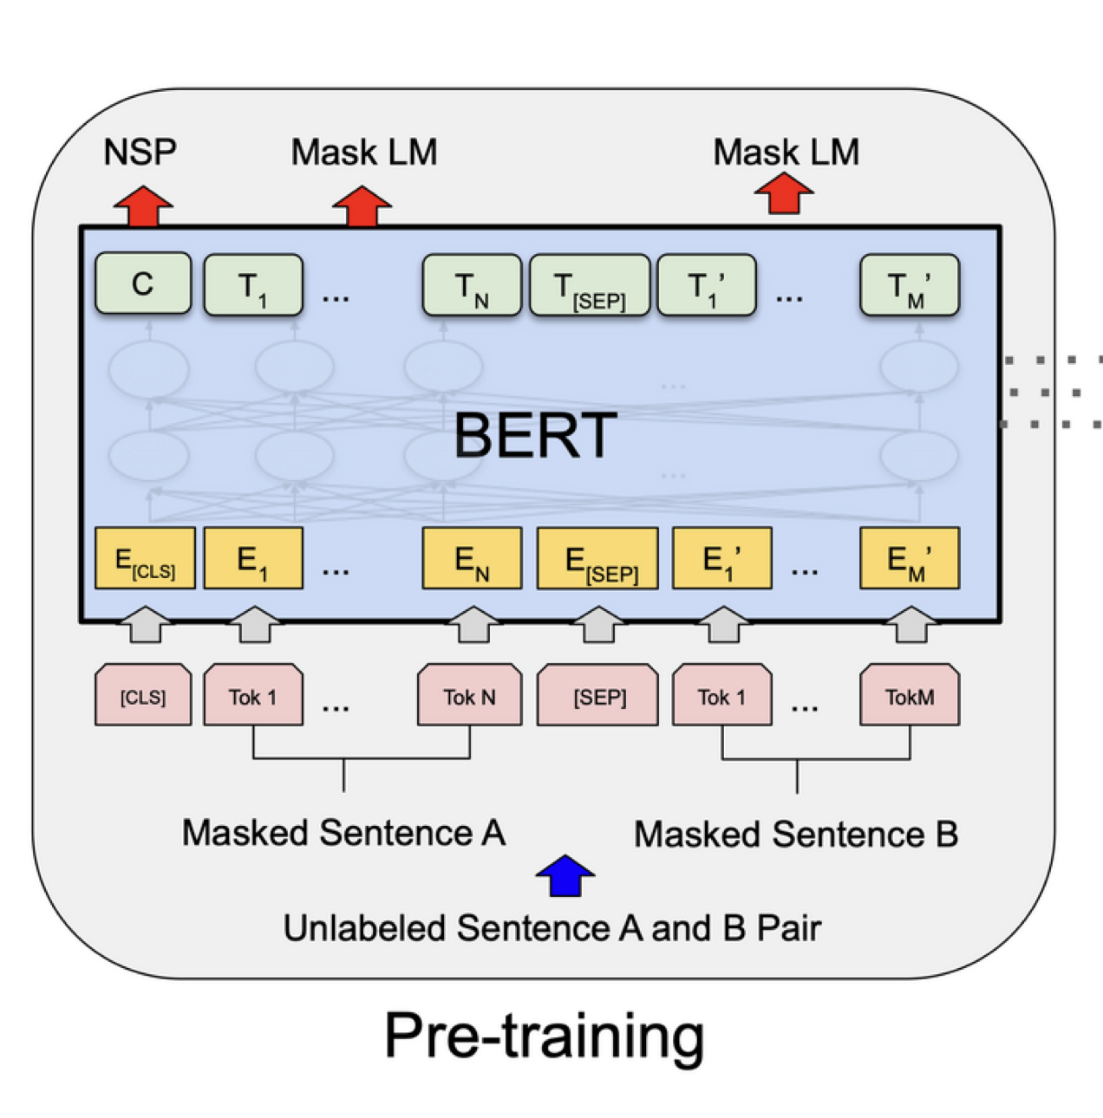
Natural Language Processing: Transformers
Transformer Models (Attention is all you need)
Single Head vs Multi-head Attention
Self-Attention and Masked Self-Attention
Positional Encodings
Masked Language Modeling (MLM)
The BERT Transformer Model
Other transformer models: GPT-2, GPT-3, T5, BLOOM, OPT, LLAMA, BART

Slide 17
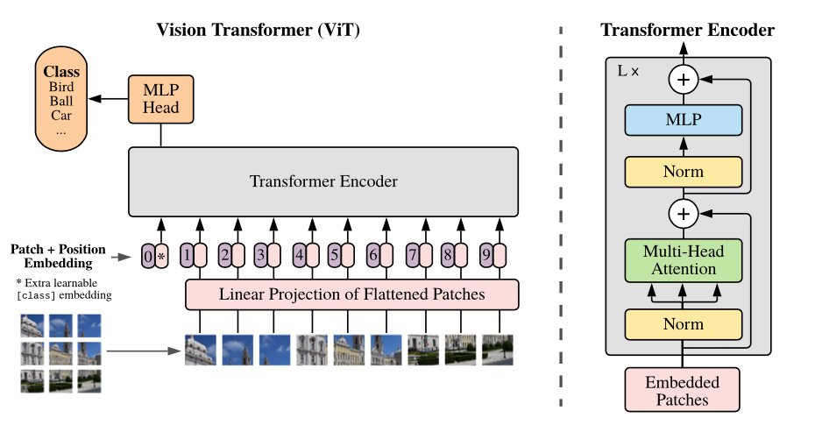
Computer Vision: Transformers
Transformers for Images
The ViT Transformer

Slide 18
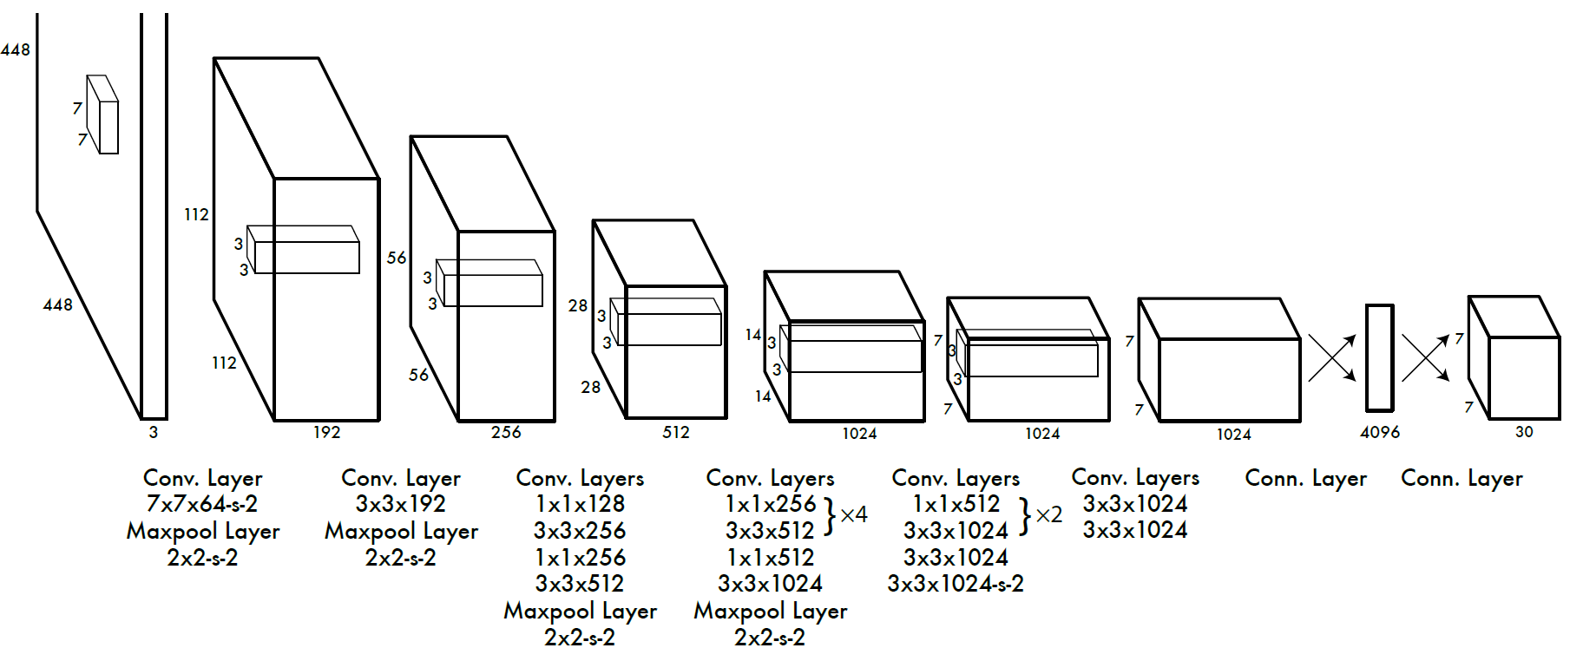
Computer Vision: Object Detection
Convolutional Neural Networks for Object Detection
Two-Stage: RCNN, Fast-RCNN, Faster-RCNN
Single-Stage: You Only Look Once (YOLO), Single-Shot Detector (SSD)
Faster-RCNN: Two-stage detector
YOLO: Single-stage detector

Slide 19
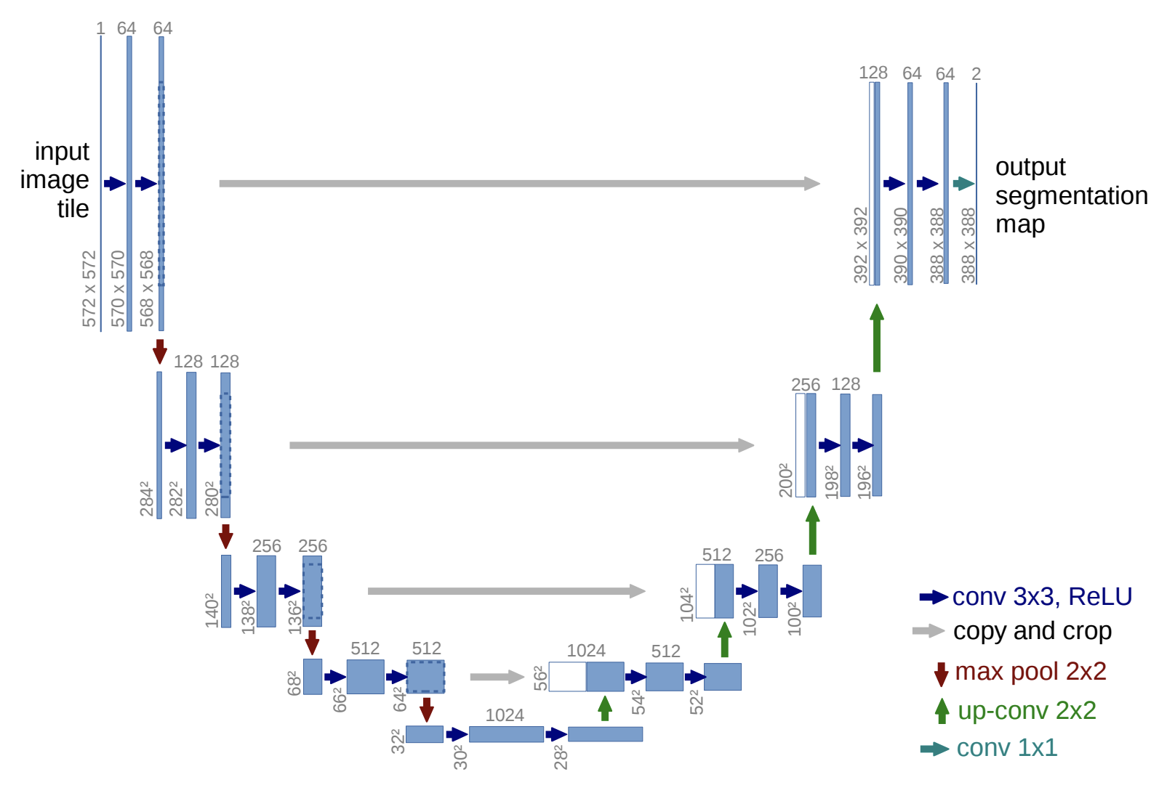
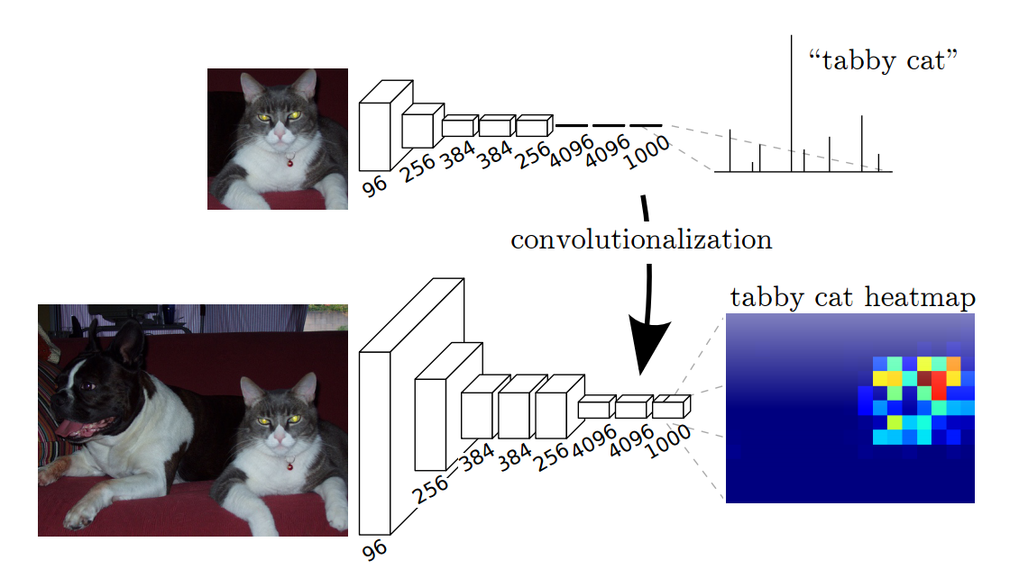
Computer Vision: Segmentation
Convolutional Neural Networks for Segmentation
Upsampling Convolutions, and Dilated Convolutions
U-Nets, Fully Convolutional Nets, and Mask-RCNN
Fully Convolutional Networks
U-Net: Upsampling convolutions and skip connections

Slide 20
Computer Vision: Object Detection with Transformers
Vision Transformers for Object Detection (DETR)
Hungarian Loss through Bipartite Matching

Slide 21
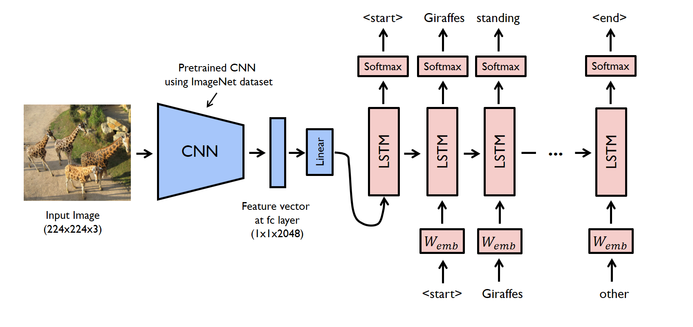
Vision and Language
Image Captioning (CNNs + RNNs): Autoregressive + Greedy decoding
https://raw.githubusercontent.com/yunjey/pytorch-tutorial/master/tutorials/03-advanced/image_captioning/png/model.png

Slide 22
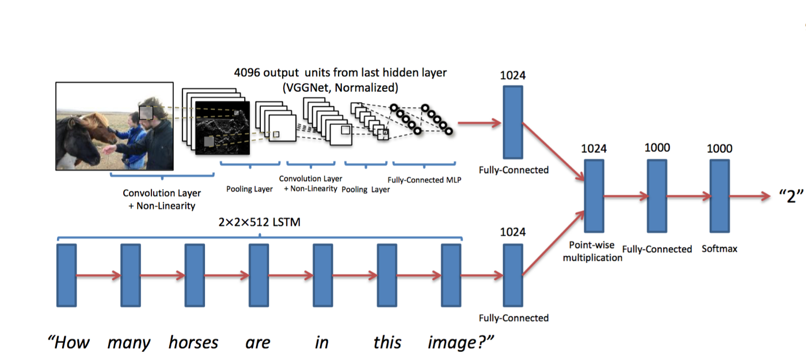
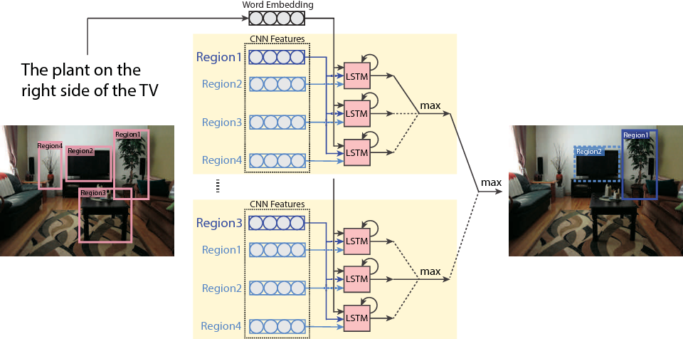
Vision and Language: VQA, RefExps
Visual Question Answering (CNNs + RNNs + MLPs)
Referring Expression Generation (Faster-RCNN + RNNs)
Referring Expression Comprehension (Faster-RCNN + RNNs + MLPs)
https://miro.medium.com/max/1400/1*QbWaFSNaO3GTgjQZOxhdDg.png
https://d3i71xaburhd42.cloudfront.net/f25b9aed37614aae007fc876f31eed0595ab9cd0/5-Figure2-1.png

Slide 23
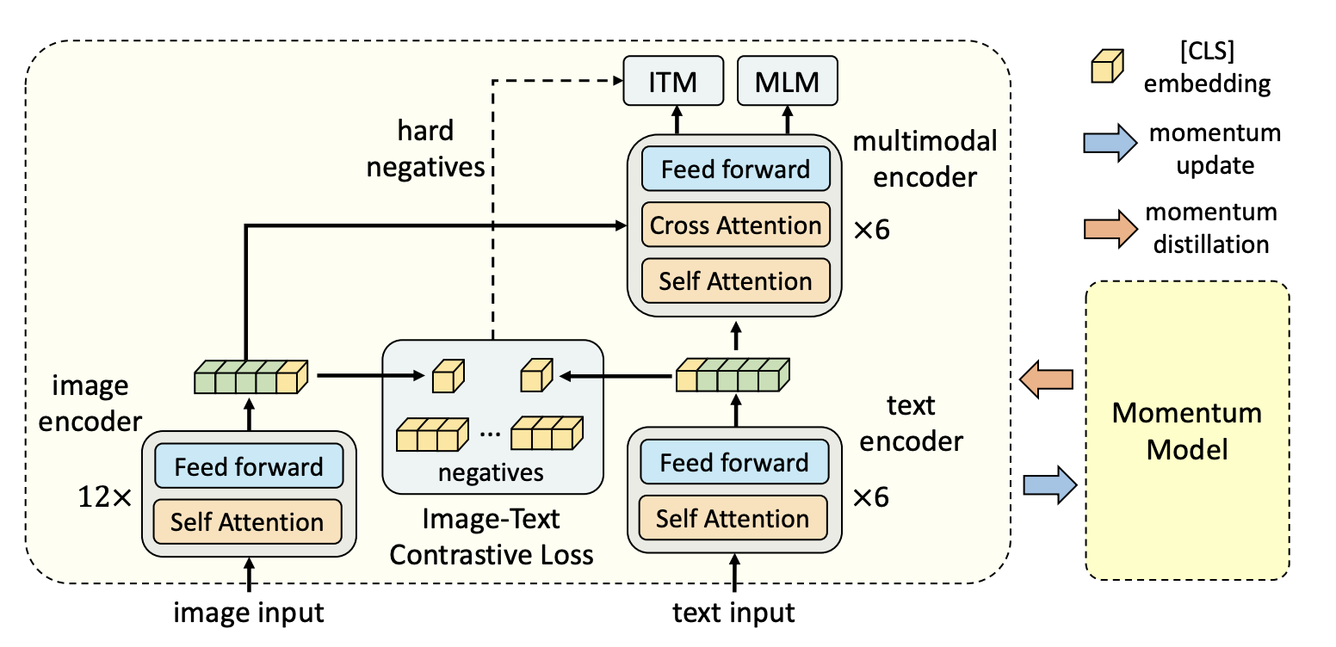
Vision and Language: Transformers
Vision-Language Transformers (e.g. ALBEF)
Align before Fuse: Vision and Language Representation Learning with Momentum Distillation

Slide 24
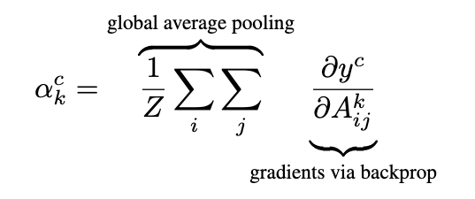
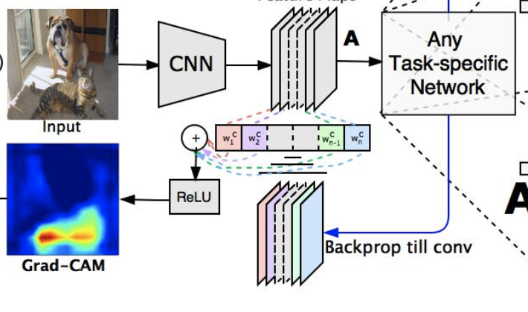
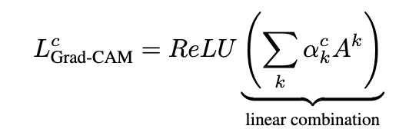
Vision and Language: Explanations

Slide 25
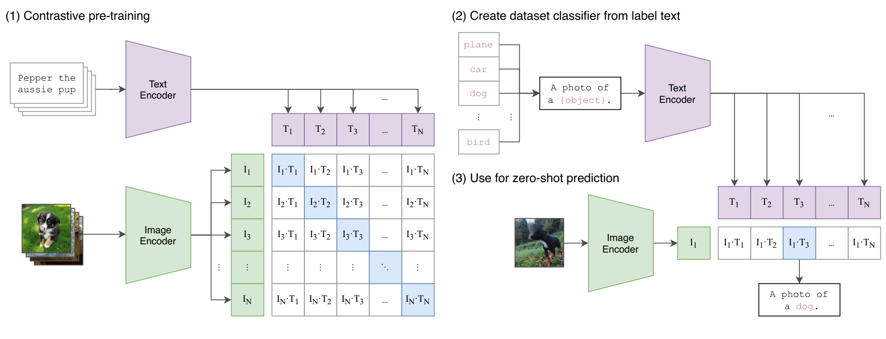
Vision and Language: Contrastive Learning
Vision-Language Contrastive Learning (CLIP)
Zero-shot visual recognition through CLIP visual prompt engineering

Slide 26
Vision and Language: Text-to-Image
Conditional GANs (Text-to-image synthesis)
AutoEncoders + Transformers (DALL-E and DALL-E mini)
Reed, Scott & Akata, Zeynep & Yan, Xinchen & Logeswaran, Lajanugen & Schiele, Bernt & Lee, Honglak. (2016). Generative Adversarial Text to Image Synthesis.

Slide 27
Vision and Language: Text-to-Image
Conditional GANs (Text-to-image synthesis)
AutoEncoders + Transformers (DALL-E and DALL-E mini)

Slide 28
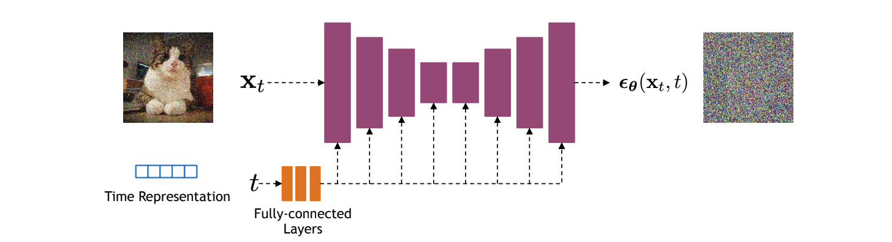
Vision and Language: Text to Image
Reverse Diffusion Models (e.g. DALLE-2, StableDiffusion, Imagen)

Slide 29
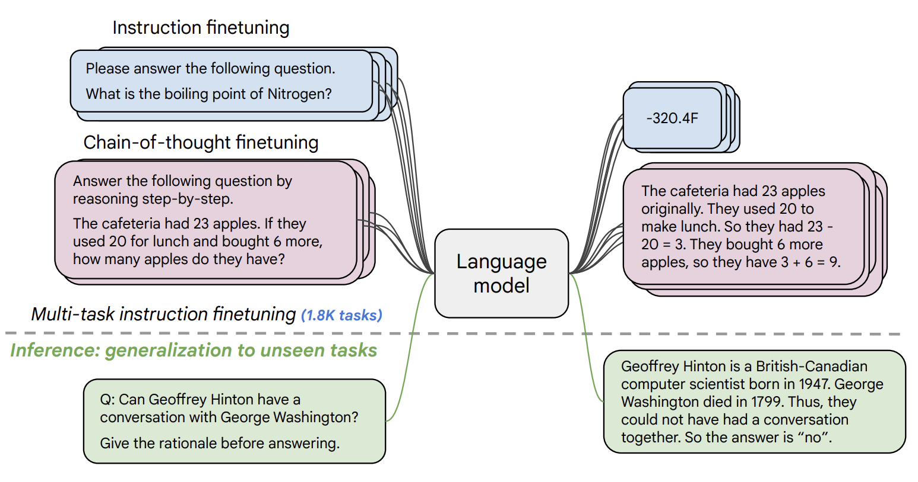
Natural Language Processing: Instruction Following LLMs and Chatbot LLMs
Finetuned on Instructions: FLAN-T5, OPT-IML
Tuned with Reinforcement Learning with Human Feedback: InstructGPT, ChatGPT
https://arxiv.org/pdf/2210.11416.pdf

Slide 30
Vision and Language: Advanced Multimodal Models
Tuned LLMs with Image data: Frozen, Flamingo, GPT-4V, among others…

Slide 31
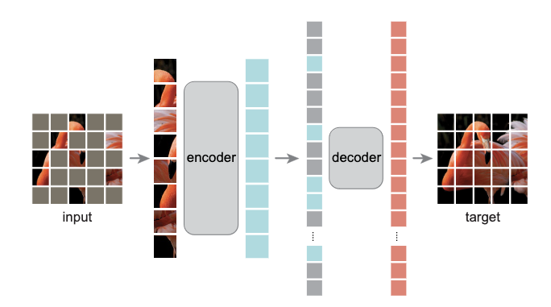
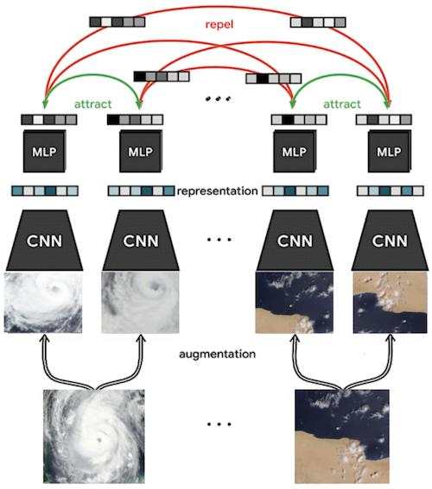
Computer Vision: Self-supervision
Basic Pretext tasks: Colorization, context prediction, counting
Contrastive Learning through Augmented Views: e.g. SimCLR
Masked AutoEncoders (MAEs)

Slide 32
Practical Aspects
Python + Pytorch + Automatic Differentiation + GPU
Liveloss / Weights and Biases: For experiment Monitoring
Matplotlib, LiveLossPlot, Torchvision, PIL (Python Imaging Library)
Huggingface Transformers/Tokenizers Library

Slide 33
Practical Aspects
Interactive Coding Tools
Google Colab Notebooks and Amazon SageMaker Lab
Powered by Project Jupyter

Slide 34
Practical Aspects
Containers: Docker and Singularity
Batch processing: SLURM and the Rice NOTS Cluster
+ Whatever you ended up needing for your course project

Slide 35
Practical Aspects: What else I recommend?
Pytorch’s advanced features:
Distributed training across multiple GPUs, and across multiple nodes with multiple GPUs. Torch.
Cloud: AWS, Google Cloud, Microsoft Azure, Oracle Cloud
On Demand vs Spot Instances
Submitting batch processing jobs through containers
Weights & Biases, Tensorboard, Comet
Other frameworks:
Tensorflow, Apache MXNet, JAX (low level support for some optimized operations)
ONNX: Cross-platform compatible model checkpoint file.

Slide 36
Practical Aspects: User Interfaces/Demos Recommended
Flask (or Django): For dynamic python-based server-side deployments
Jinja2 for templating your output HTML (if needed)
JQuery, Bootstrap, React, ReactNative, Vue.js: For App Development

Slide 37
Things we didn’t cover in the class
Vision and Language Navigation
(e.g. see https://arxiv.org/abs/1711.07280)
Visual Commonsense Reasoning
(e.g. see https://visualcommonsense.com/)
Other topics:
Reinforcement Learning (Prof Vaibhav Unhelkar)
Graph Neural Networks and Graph ML (Prof. Arlei Silva)
Information Retrieval (Prof Xia Ben Hu)
Neural Radiance Fields (NERFs) (Prof Guha Balakrishnan)
3D Computer Vision and Imaging (Prof. Ashok Veeraraghavan)
Robotics (Kaiyu Hang and Lydia Kavraki)

Slide 38
Rice University - Resources
https://entrepreneurship.rice.edu/
https://riceventures.org/

Slide 39
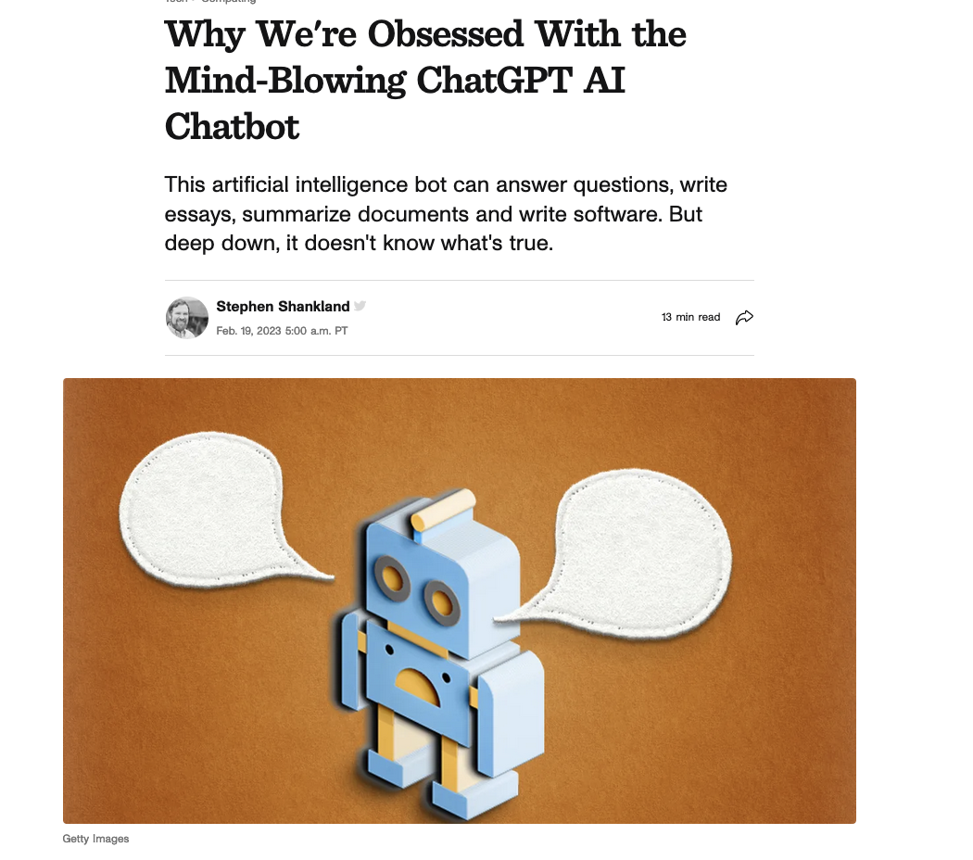
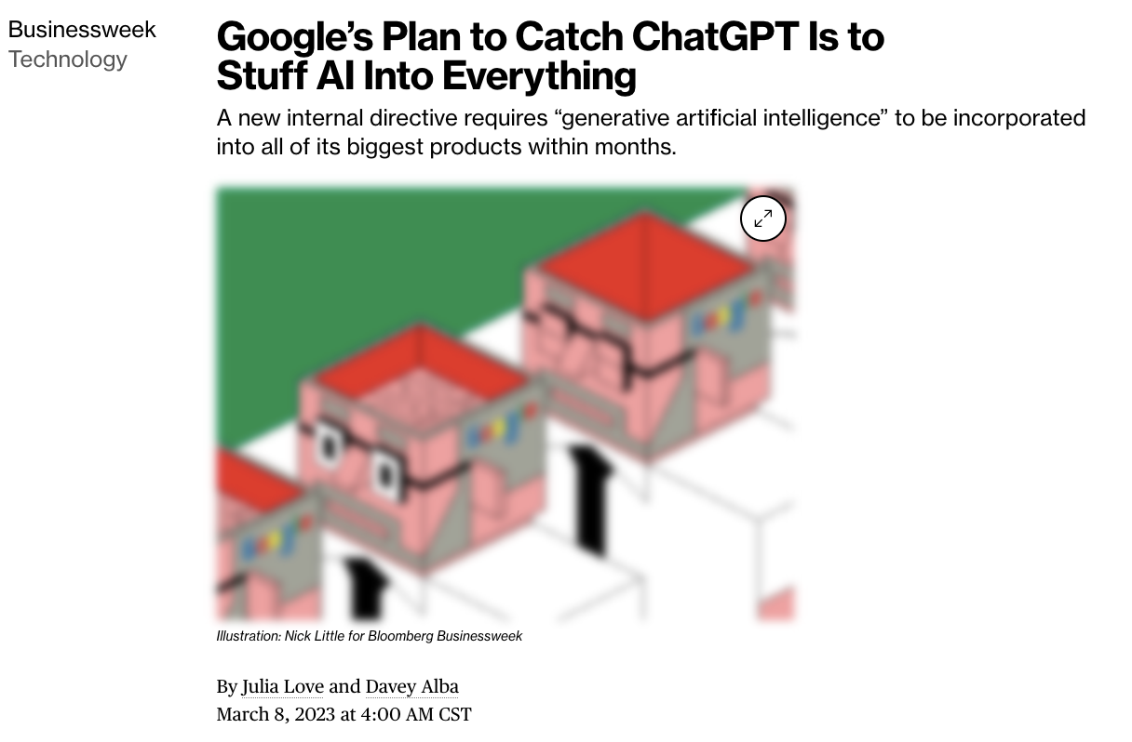
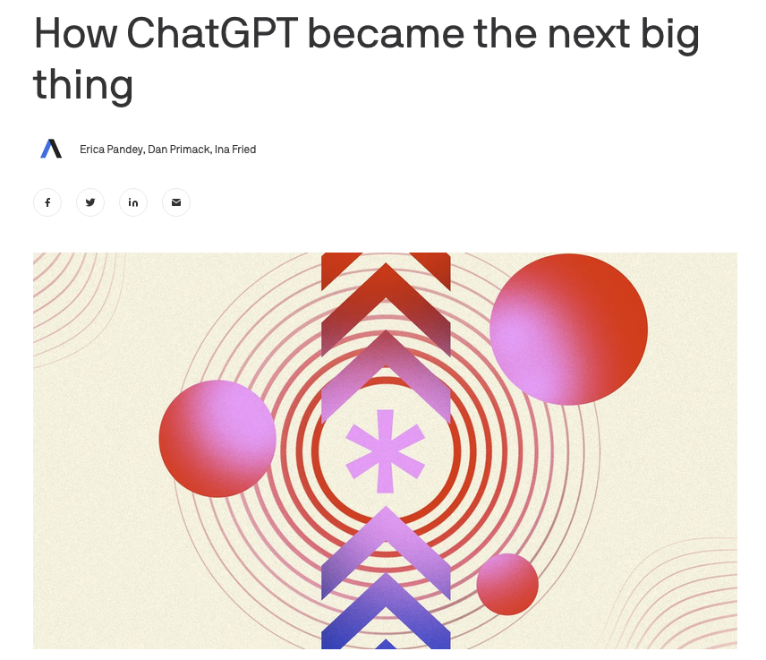
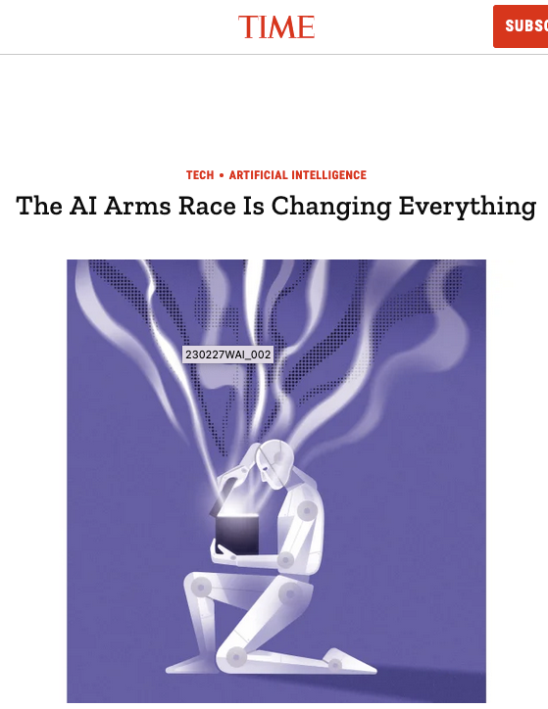
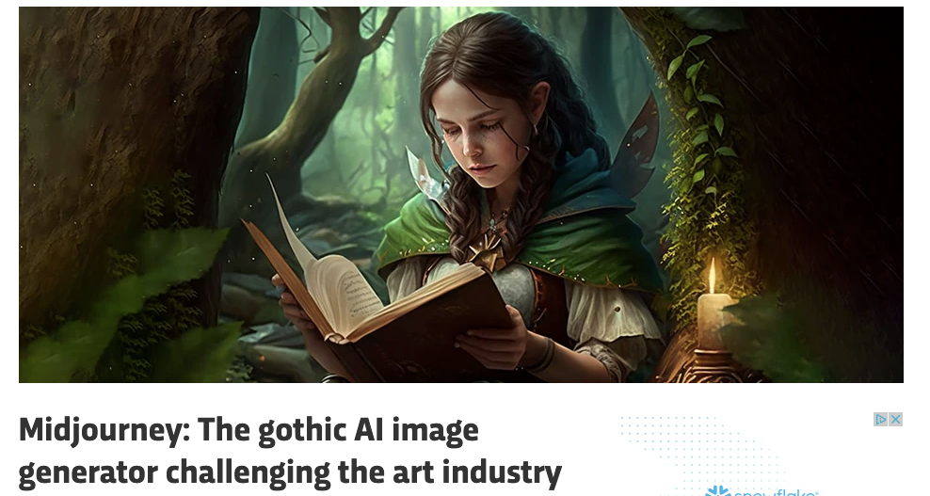
Other things to be aware about…

Slide 40
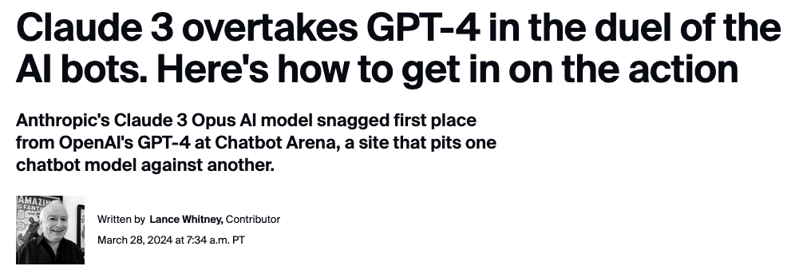
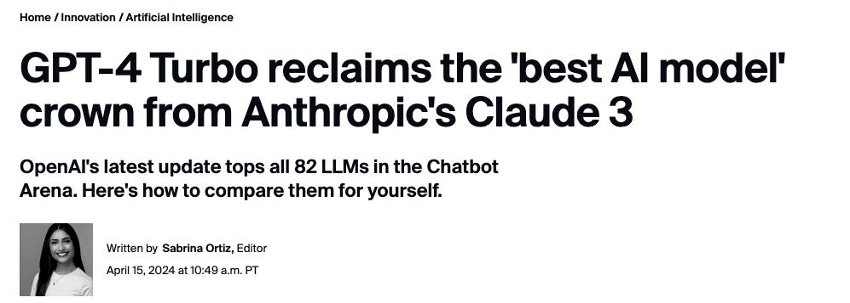
More recently

Slide 41
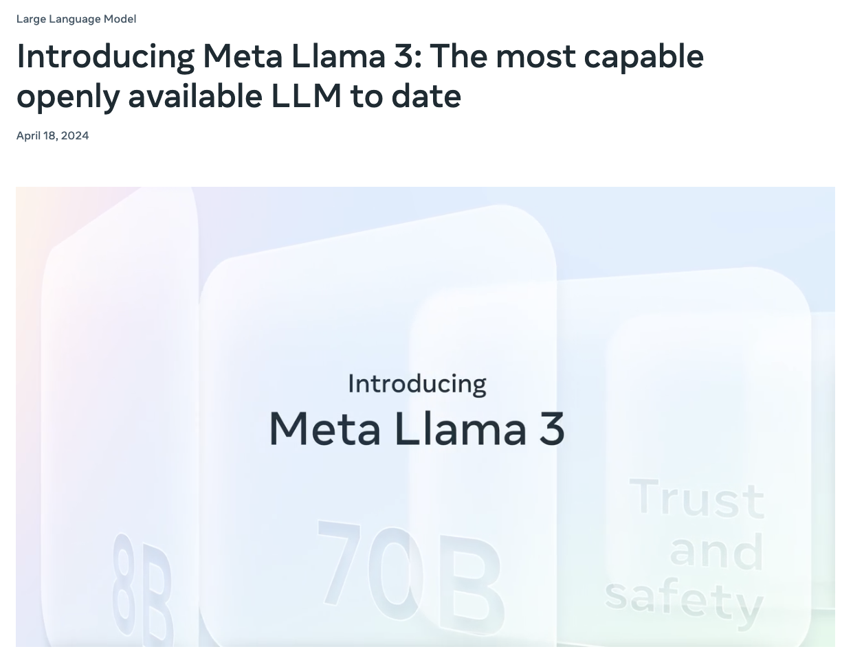

Slide 42
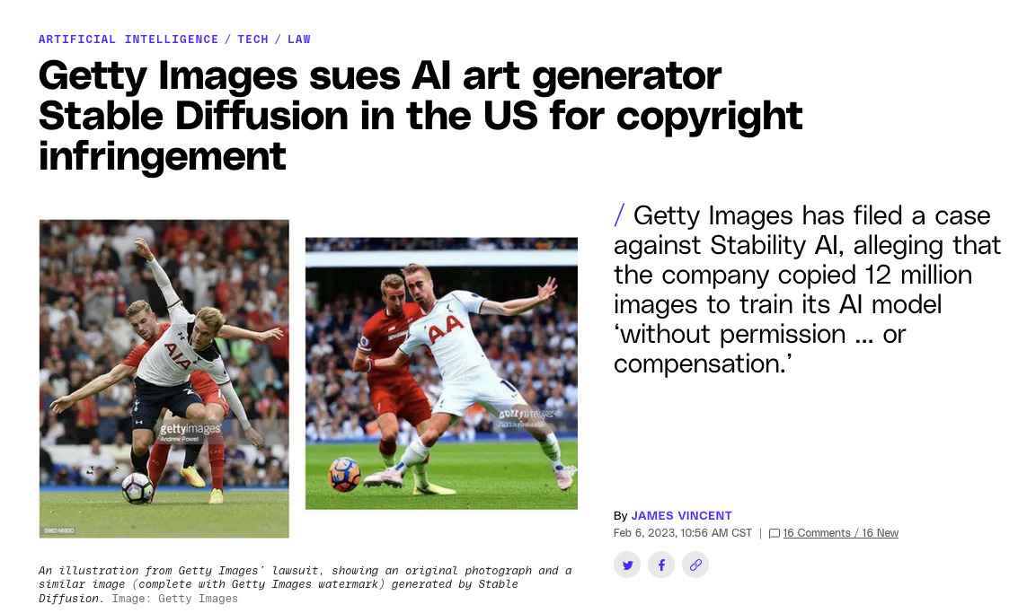
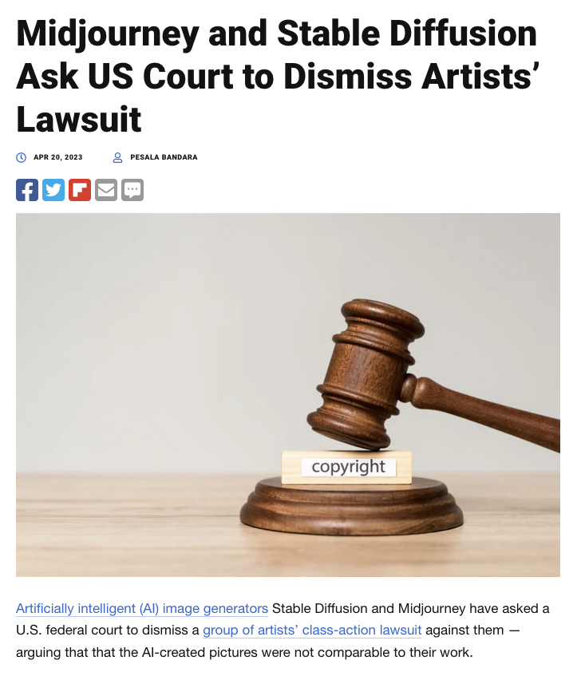
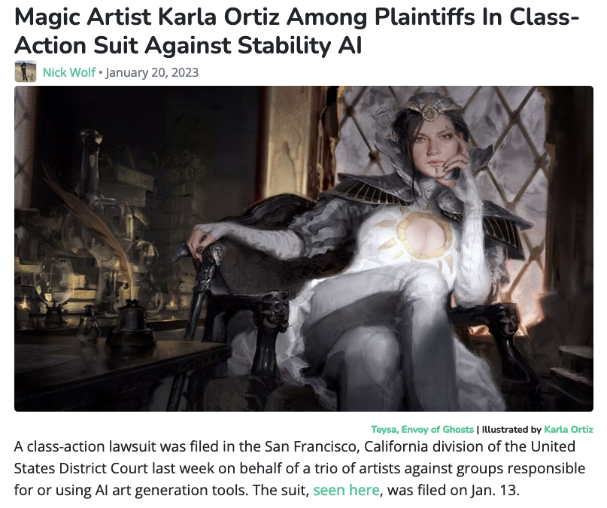
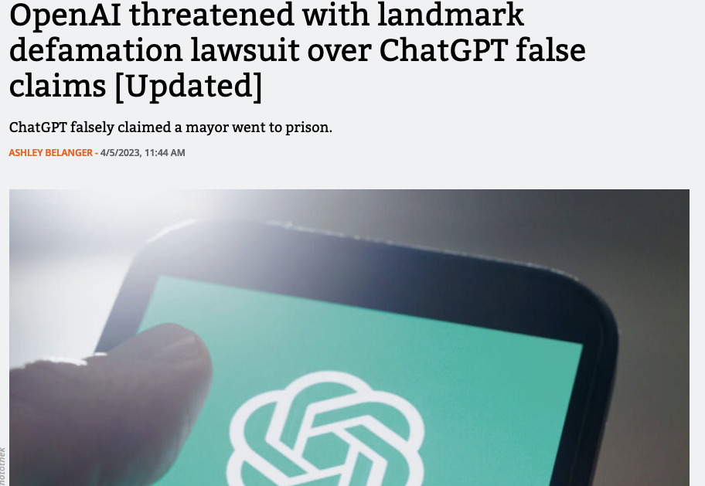
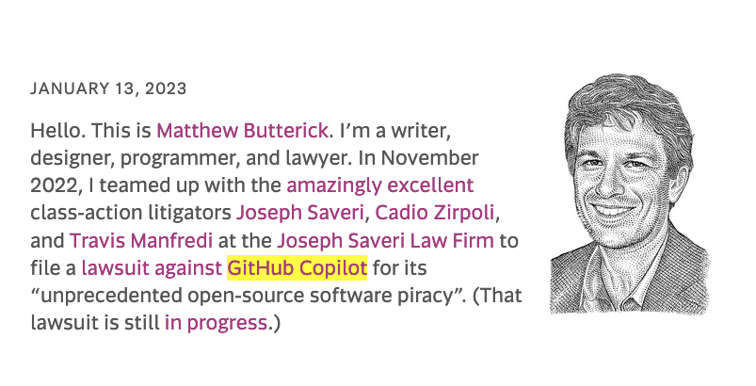
Other things to be aware about…

Slide 43
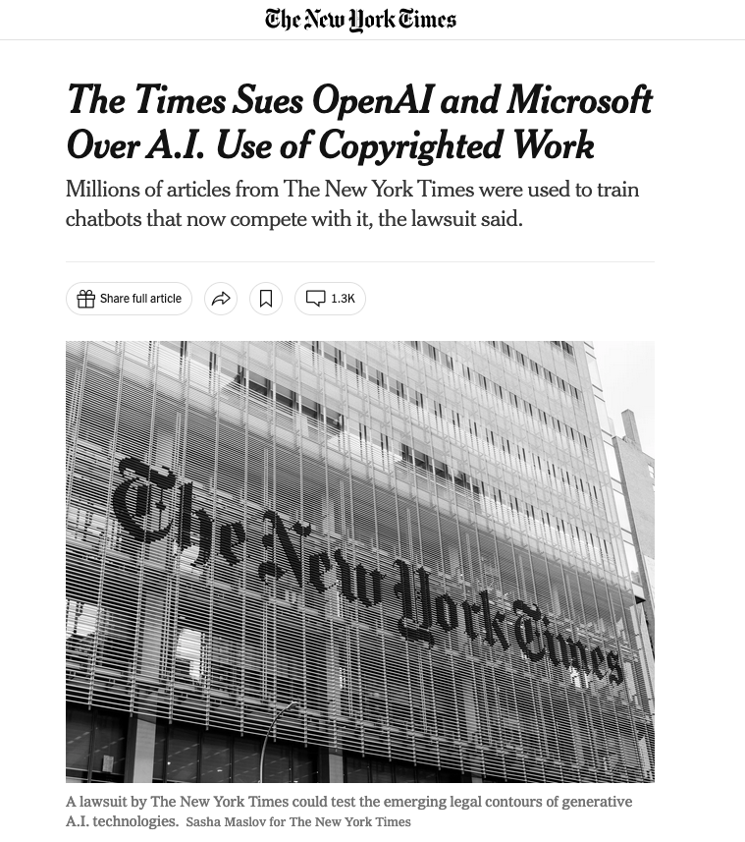
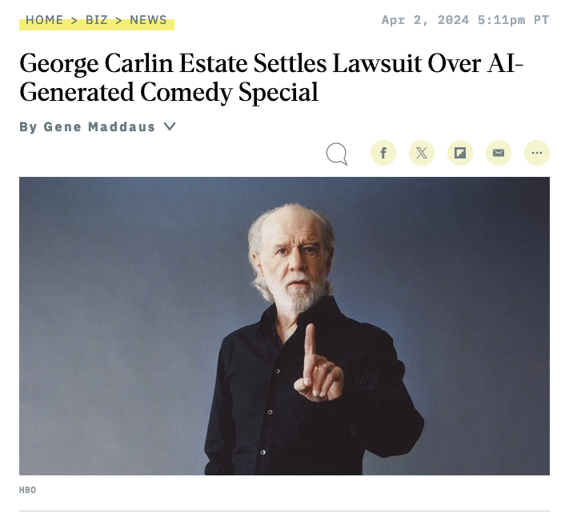
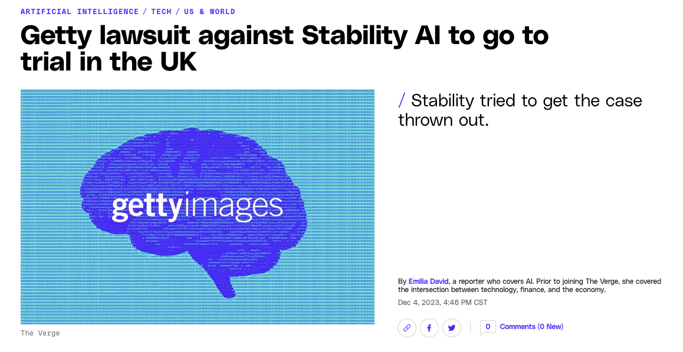
More recently

Slide 44
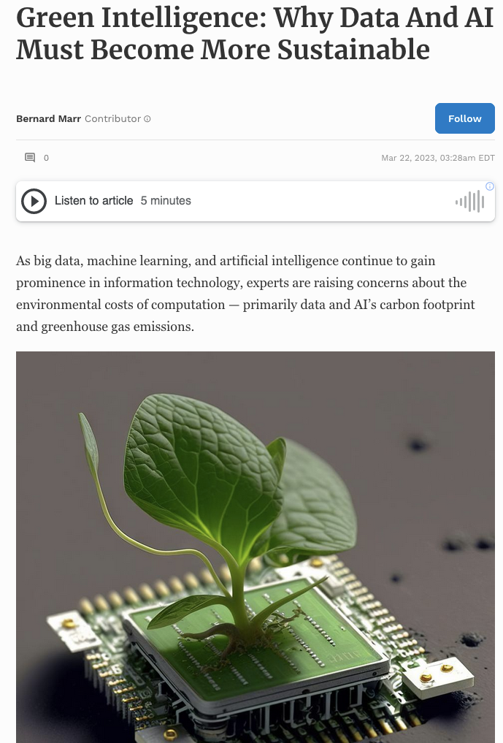
Other things to be aware about…

Slide 45
Other things to be aware about…

Slide 46
Other things to be aware about…

Slide 47
Thanks Everyone
Finish your course projects – I provided feedback to all progress reports and if I have not, let me know by email. At least in Canvas all my tickets are closed so far on progress report.
Keep in touch – especially if you go on to do something great using computer vision / vision-language – always happy to hear back from students

