Slide 1
Introduction to Rivanna
20 March 2019

Slide 2


Rivanna in More Detail
Compute Nodes
Head Nodes
ssh client
Ethernet
Home Directory
Other Storage
Scratch
(Lustre)
Infiniband

Slide 3
Allocations
Rivanna is allocated:
At the most basic level, an allocation refers to a chunk of CPU time that you receive and can use too run your computation.
Allocations are measured in service units (SUs), where
1 SU = 1 core-hour
All accounts on a given allocation share the service units.

Slide 4
Connecting & Logging Onto Rivanna

Slide 5
How to connect to Rivanna
There are three ways to connect to Rivanna:
1. ssh client
Instructions for installing and using an ssh client are provided in the appendix of these slides.
2. FastX
Using your web browser, go to URL
https://rivanna-desktop.hpc.virginia.edu
and log in.
Click on “Launch Session”;
Select “MATE” and click on “Launch”
3. Open-on-Demand -- Coming Soon!
Using your web browser, go to URL
https://rivanna-portal.hpc.virginia.edu
You will need to “Netbadge” in.
Regardless of how you connect, you must use the UVa Anywhere VPN when off-grounds.
See http://its.virginia.edu/vpn/ for details.

Slide 6
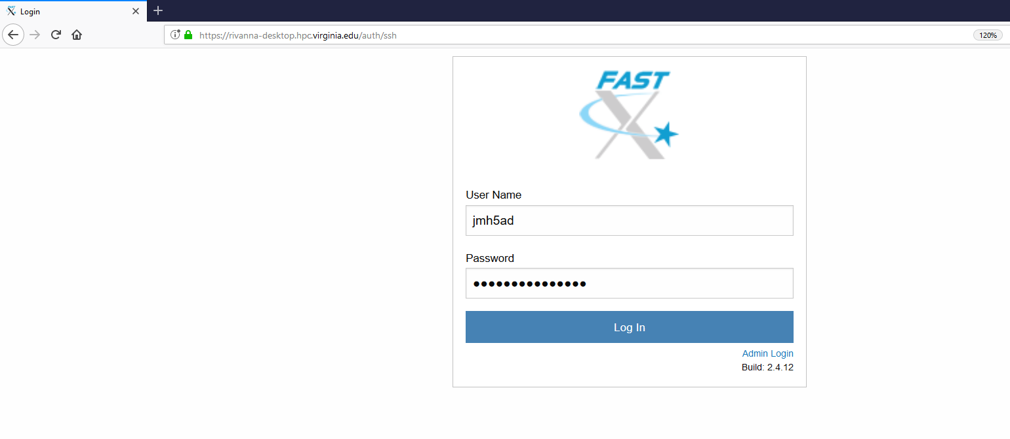
We will use FastX today:
In your web browser, go to URL:
https://rivanna-desktop.hpc.virginia.edu

Slide 7
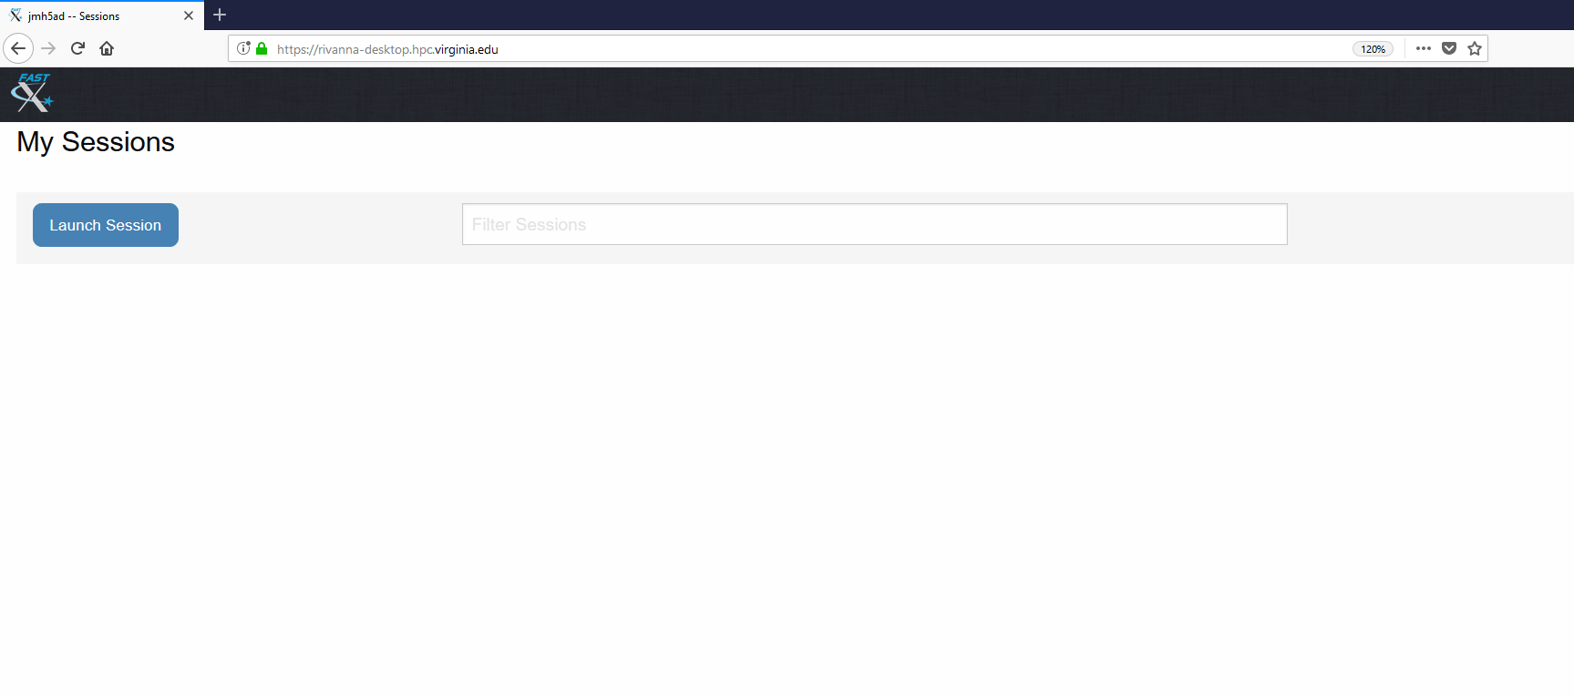
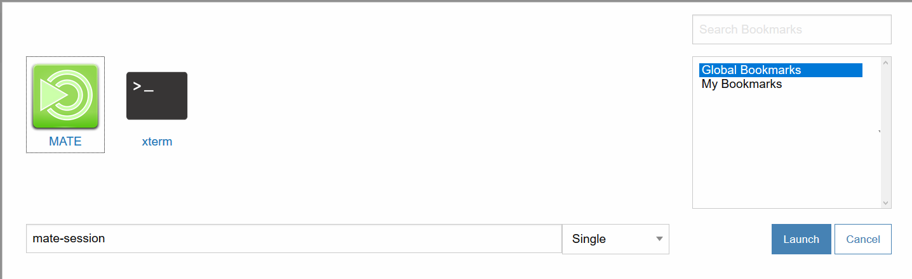
Starting up FastX
Click “Launch Session”; Select MATE; Click Launch

Slide 8
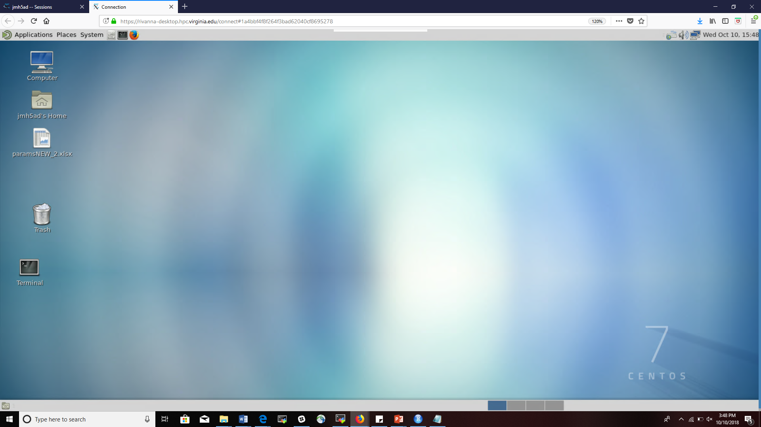
FastX Environment
A desktop for working on Rivanna

Slide 9
Cluster Environment

Slide 10
After you have logged in . . .
You will be in your home directory.
How you navigate will depend on how you connected to Rivanna.
ssh client:
A terminal window will appear. To navigate within your directory, you will need to use Unix/Linux commands.
See https://arcs.virginia.edu/UNIX-tutorials-for-beginners to learn more about Unix/Linux commands
FastX:
A desktop environment will appear. You can use your mouse to navigate or open a terminal window to use Unix/Linux commands or start interacive applications.
Open-on-Demand:
A dashboard will appear. You can click on the menu items across the top to access different tools, like a file manager, a job composer, or interactive applications.

Slide 11
Your Home Directory
The default home directory on Rivanna has 50GB of storage capacity
This directory is distinct from the 4GB home directory provided by ITS.
The ITS home directory is available as /tiny/$USER

Slide 12
Checking your Home Storage
To see how much disk space you have used in your home directory, open a Terminal window and type hdquota at the command-line prompt:
$ hdquota
Filesystem | Used | Avail | Limit | Percent Used
qhome 39G 12G 51G 77%

Slide 13
Checking your Allocation
To see how many SUs you have available for running jobs, type allocations at the command-line prompt:
$ allocations
Allocations available to Misty S. Theatre(mst3k):
* robot_build: less than 6,917 service-units remaining.
* gizmonic-testing: less than 5,000 service-units remaining.
* servo: less than 59,759 service-units remaining, allocation will expire on 2017-01-01.
* crow-lab: less than 2,978 service-units remaining.
* gypsy: no service-units remaining

Slide 14
Your /scratch Directory
Each user will have access to 10 TB of temporary storage.
It is located in a subdirectory under /scratch, and named with your userID
e.g., /scratch/mst3k
You are limited to 350,000 files in your scratch directory.
Important:
/scratch is NOT permanent storage and files older than 90 days will be marked for deletion.

Slide 15
Running Jobs from Scratch
We recommend that you run your jobs out of your /scratch directory for two reasons:
/scratch is on a Lustre filesystem (a storage system designed specifically for parallel access).
/scratch is connected to the compute nodes with Infiniband (a very fast network connection).
We also recommend that
You keep copies of your programs and data in more permanent locations (e.g., your home directory or leased storage).
After your jobs finish, you copy the results to more permanent storage).

Slide 16
Checking your /scratch Storage
To see the amount of scratch space that is available to you, type sfsq at the command line prompt.
$ sfsq
'scratch' usage status for ‘mst3k', last updated: 2016-09-08 16:26:12
- ~28/10,000 GBs allocated disk space
- 153/350,000 files created
- 151/153 files marked for deletion due to age limits
To view a list of all files marked for deletion, please run 'sfsq -l'

Slide 17
Moving data onto Rivanna
You have several options for transferring data onto your home or /scratch directories.
Use the scp command in a terminal window.
Use a drag-and-drop option with MobaXterm (Windows) or Fugu (Mac OS).
Use the web browser in the FastX desktop to download data from UVA Box.
Set up a Globus endpoint on your laptop and use the Globus web interface to transfer files.
(See https://arcs.virginia.edu/globus for details)

Slide 18
Modules

Slide 19
Modules
Any application software that you want to use will need to be loaded with the module load command.
For example:
module load matlab
module load anaconda/5.2. 0-py3.6
module load gcc R/3.5.1
You will need to load the module any time that you create a new shell
Every time that you log out and back in
Every time that you run a batch job on a compute node

Slide 20
Module Details
module avail – Lists all available modules and versions.
module spider – Shows all available modules
module key keyword – Shows modules with the keyword in the description
module list – Lists modules loaded in your environment.
module load mymod – Loads the default module to set up the environment for some software.
module load mymod/N.M – Loads a specific version N.M of software mymod.
module load compiler mpi mymod – For compiler- and MPI- specific modules, loads the modules in the appropriate order and, optionally, the version.
module purge – Clears all modules.

Slide 21
Learning more about a Module
To locate a python module, try the following:
To find bioinformatics software packages, try this:
The available software is also listed on our website:
https://arcs.virginia.edu/software-list
$ module avail python
$ module spider python
$ module key python
$ module key bio

Slide 22
Partitions (Queues)

Slide 23
Partitions (Queues)
Rivanna has several partitions (or queues) for job submissions.
You will need to specify a partition when you submit a job.
To see the partitions that are available to you, type queues at the command-line prompt.
$ queues
Queue Availability Time Queue Maximum Maximum Idle SU Usable
(partition) (idle%) Limit Limit Cores/Job Mem/Core Nodes Rate Accounts
standard 43 13(72.2%) 7-days none 20 64-GB 195 1.00 robot-build, gypsy
dev 1833(65.2%) 1 hours none 4 254GB 59 0.00 robot-build, gypsy
parallel 3528(73.5%) 3-days none 240 64-GB 176 1.00 robot-build, gypsy
largemem 48(60.0%) 7-days none 16 500-GB 3 1.00 robot-build, gypsy
gpu 334(85.0%) 3-days none 8 128-GB 10 1.00 robot-build, gypsy
knl 2048(100.0%) 3-days none 2048 1-GB 8 1.00 robot-build, gypsy

Slide 24
Compute Node Partitions (aka Queues)
Queue Name | Purpose | Job Time Limit | Memory / Node | Cores / Node | # of Available Nodes | SU / Core Hour
standard | For jobs on a single compute node | 7 days | 128 GB 256 GB | 20 28 | 265 (20-core nodes shared w/ parallel queue) | 1.0
gpu | For jobs that can use general purpose graphical processing units (GPGPUs) (K80 or P100) | 3 days | 256 GB | 28 | 14 (max 4 nodes per job) | 1.0
parallel | For large parallel jobs on up to 120 nodes (<= 2400 CPU cores) | 3 days | 128 GB 256 GB | 20 | 240 (shared w/ standard queue) | 1.0
largemem | For memory intensive jobs (<= 16 cores/node) | 7 days | 1 TB | 16 | 5 (max 2 per user) | 1.0
dev | To run jobs that are quick tests of code | 1 hour | 128 GB | 4 | 2 | 0.0

Slide 25
SLURM scripts

Slide 26
SLURM
SLURM is the Simple Linux Utility for Resource Management.
It manages the hardware resources on the cluster (e.g. compute nodes/cpu cores, compute memory, etc.).
SLURM allows you to request resources within the cluster to run your code.
It is used for submitting jobs to compute nodes from an access point (generally called a frontend).
Frontends are intended for editing, compiling, and very short test runs.
Production jobs go to the compute nodes through the resources manager.
SLURM documentation:
https://arcs.virginia.edu/slurm
http://slurm.schedmd.com/documentation.html

Slide 27
Basic SLURM Script
A SLURM script is a bash script with
SLURM directives (#SBATCH) and
command-line instructions for running your program.
#!/bin/bash
#SBATCH --nodes=1 #total number of nodes for the job
#SBATCH --ntasks=1 #how many copies of code to run
#SBATCH --cpus-per-task=1 #number of cores to use
#SBATCH --time=1-12:00:00 #amount of time for the whole job
#SBATCH --partition=standard #the queue/partition to run on
#SBATCH --account=myGroupName #the account/allocation to use
module purge
module load anaconda #load modules that my job needs
python hello.py #command-line execution of my job

Slide 28
Basic SLURM Job (Shorthand notation)
Most of the SLURM directives have a short hand notation for the options
#!/bin/bash
#SBATCH –N 1 #total number of nodes for the job
#SBATCH –n 1 #how many copies of code to run
#SBATCH –c 1 #number of cores to use
#SBATCH –t 12:00:00 #amount of time for the whole job
#SBATCH –p standard #the queue/partition to run on
#SBATCH –A myGroupName #the account/allocation to use
module purge
module load anaconda #load modules that my job needs
python hello.py #command-line execution of my job

Slide 29
Submitting a SLURM Job
To submit the SLURM command file to the queue, use the sbatch command at the command line prompt.
For example, if the script on the previous slide is in a file named job_script.slurm, we can submit it as follows:
-bash-4.1$ sbatch job_script.slurm
Submitted batch job 18316

Slide 30
Checking Job Status
To display the status of only your active jobs, type:
squeue –u <your_user_id>
-bash-4.1$ squeue –u mst3k
JOBID PARTITION NAME USER ST TIME NODES NODELIST(REASON)
standard job_sci mst3k R 1:45 1 udc-aw38-34-l
The squeue command will show pending jobs and running jobs, but not failed, canceled or completed job.

Slide 31
Checking Job Status
To display the status of all jobs, type:
sacct –S <start_date>
-bash-4.1$ sacct –S 2019-01-29
3104009 RAxML_NoC+ standard hpc_build 20 COMPLETED 0:0
3104009.bat+ batch hpc_build 20 COMPLETED 0:0
3104009.0 raxmlHPC-+ hpc_build 20 COMPLETED 0:0
3108537 sys/dashb+ gpu hpc_build 1 CANCELLED+ 0:0
3108537.bat+ batch hpc_build 1 CANCELLED 0:15
3108562 sys/dashb+ gpu hpc_build 1 TIMEOUT 0:0
3108562.bat+ batch hpc_build 1 CANCELLED 0:15
3109392 sys/dashb+ gpu hpc_build 1 TIMEOUT 0:0
3109392.bat+ batch hpc_build 1 CANCELLED 0:15
3112064 srun gpu hpc_build 1 FAILED 1:0
3112064.0 bash hpc_build 1 FAILED 1:0
The sacct command lists all jobs (pending, running, completed, canceled, failed, etc.) since the specified date.

Slide 32
Deleting a Job
To delete a job from the queue, use the scancel command with the job ID number at the command line prompt:
-bash-4.1$ scancel 18316

Slide 33
ExampleS

Slide 34
To follow along . . .
Go ahead and log into Rivanna.
If using FastX, open up a terminal window.
First, we will copy a set of examples into your account. At the command line, type:
cd
scp -r /share/resources/source_code/CS6501_examples/ .

Slide 35
Hello World Job
To see that the directory is there, type:
Move to the first folder (i.e., 01_serial) by typing:
You will see 2 files: hello.py and hello.slurm
To view the contents of files, type more followed by the filename:
ls
cd CS6501_examples/01_simple_SLURM
ls
more hello.slurm

Slide 36
Simple SLURM Job
If your program performs lots of computation, but uses only one processor, you should use the standard queue.
#!/bin/bash
#SBATCH --nodes=1
#SBATCH --ntasks=1
#SBATCH --cpus-per-task=1
#SBATCH --time=00:05:00
#SBATCH --partition=standard
#SBATCH --account=your_allocation #Edit to class-cs6501-004-sp19
module purge
module load anaconda
python hello.py

Slide 37
Simple Job
Your results will be placed in a file with the name slurm_12345678.out, where 12345678 is replaced with the job ID number from your job submission.
Type ls to see if the output file exists in your directory.
You can look at the results by typing more following by the filename. For example:
more slurm_12345678.out

Slide 38
PyTorch Job
PyTorch is an open source Python package to create deep learning networks.
The latest PyTorch versions are provided as prebuilt Singularity containers (called tensorflow) on Rivanna.
All of the tensorflow container images provided on Rivanna require access to a GPU node.

Slide 39
PyTorch Container
Before you run PyTorch, you will need to move a copy of the tensorflow container into your /scratch directory.
This step only needs to be done once.
module load singularity
module load tensorflow/1.12.0-py36
cp $CONTAINERDIR/tensorflow-1.12.0-py36.simg /scratch/$USER

Slide 40
Using GPUs
Certain applications can utilize for general purpose graphics processing units (GPGPUs) to accelerate computations.
GPGPUs on Rivanna:
K80: dual GPUs per board, can do double precision
P100: single GPUs per board, double precision is software (slow)
You must first request the gpu queue. Then with the gres option, type the architecture (if you care) and the number of GPUs.
#SBATCH -p gpu
#SBATCH --gres=gpu:k80:2

Slide 41
Caution: Limited # of GPUs
There are only a handful of GPUs on Rivanna:
10 K80s with 4 GPUs each
4 P100s with 4 GPUs each
You can check the status of the GPUs in two ways:
Type queues to see the percentage idle
Type sinfo | grep gpu to see if any GPU nodes are down.

Slide 42
Putting it all together in a Script SLURM Script
#!/bin/bash
#SBATCH -o test.out
#SBATCH -e test.err
#SBATCH -p gpu
#SBATCH --gres=gpu:1
#SBATCH -c 2
#SBATCH -t 01:00:00
#SBATCH -A your_allocation
module purge
module load singularity
module load tensorflow
# Assuming that the container has been copied to /scratch/$USER
containerdir=/scratch/$USER
echo $containdir
singularity exec --nv $containdir/tensorflow-1.12.0-py36.simg \
python pytorch_mnist.py
aa

Slide 43
Need more help?
Office Hours
Tuesdays: 3 pm - 5 pm, PLSB 430
Thursdays: 10 am - noon, HSL, downstairs
Thursdays: 3 pm - 5 pm, PLSB 430
Website:
arcs.Virginia.edu
Or, for immediate help:
hpc-support@virginia.edu

Slide 44
Appendices
A: Using Jupyter Notebooks on Rivanna
B: Connecting to Rivanna with an ssh client
C: Connecting to Rivanna with MobaXterm
D: Neural Networks

Slide 45
Appendix A
Using Jupyter Notebooks on Rivanna

Slide 46
JupyterLab
JupyterLab is a web-based tool that allows multiple users to run Jupyter notebooks on a remote system.
ARCS now provides JupyterLab on Rivanna.

Slide 47
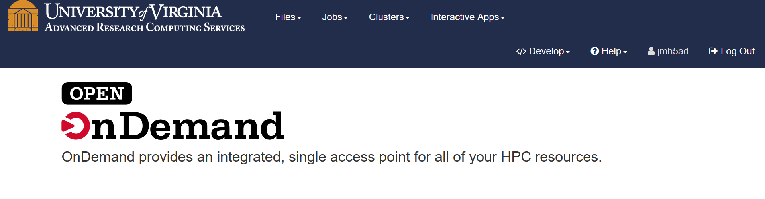
Accessing JupyterLab
To access JupyterLab, type the following in your web browser:
https://rivanna-portal.hpc.virginia.edu/
After logging in via Netbadge in, you will be directed to the Open OnDemand main page.

Slide 48
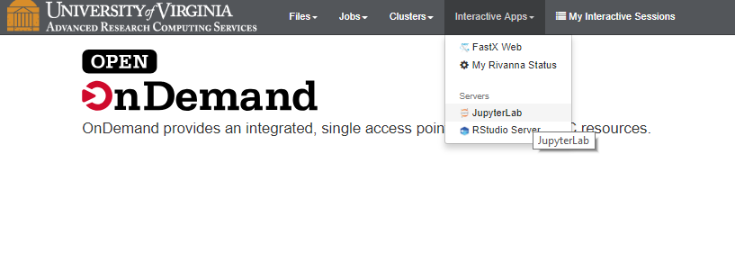
Starting Jupyter Instance
In the top, click on “Interactive Apps” and in the drop-down box, click on “Jupyter Lab”.

Slide 49
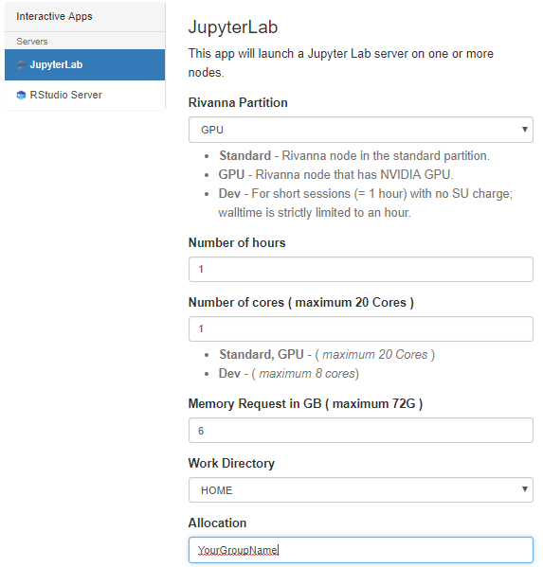
Starting a Jupyter Instance
Our example will be using TensorFlow; so, we need to make sure that we select the Rivanna Partition called “GPU”.
Also, don’t forget to put in your “MyGroup” name for the Allocation
Finally, click the blue “Launch” button at the bottom of the form (not shown here).
A form will appear that allows you to specify the resources for your Notebook.

Slide 50
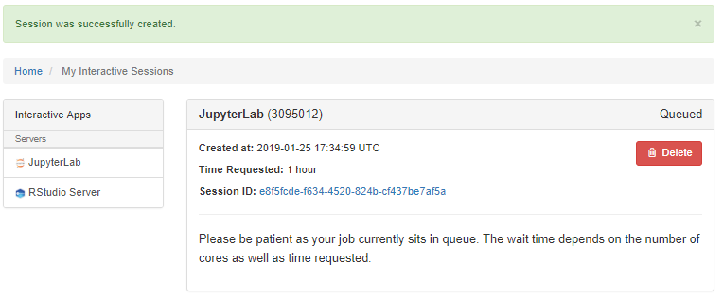
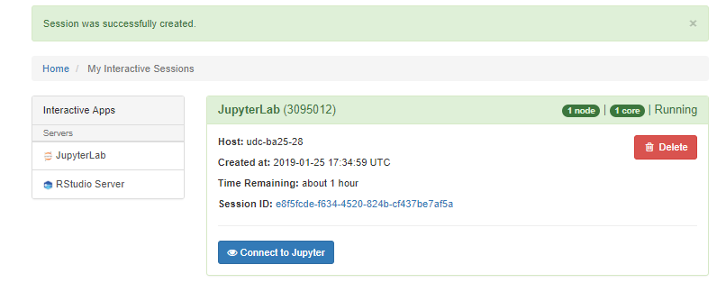
Starting a Jupyter Instance
Wait until a blue button with “Connect to Jupyter” appears.
Click on the blue button.
It may take a little bit of time for the resources to be allocated.

Slide 51
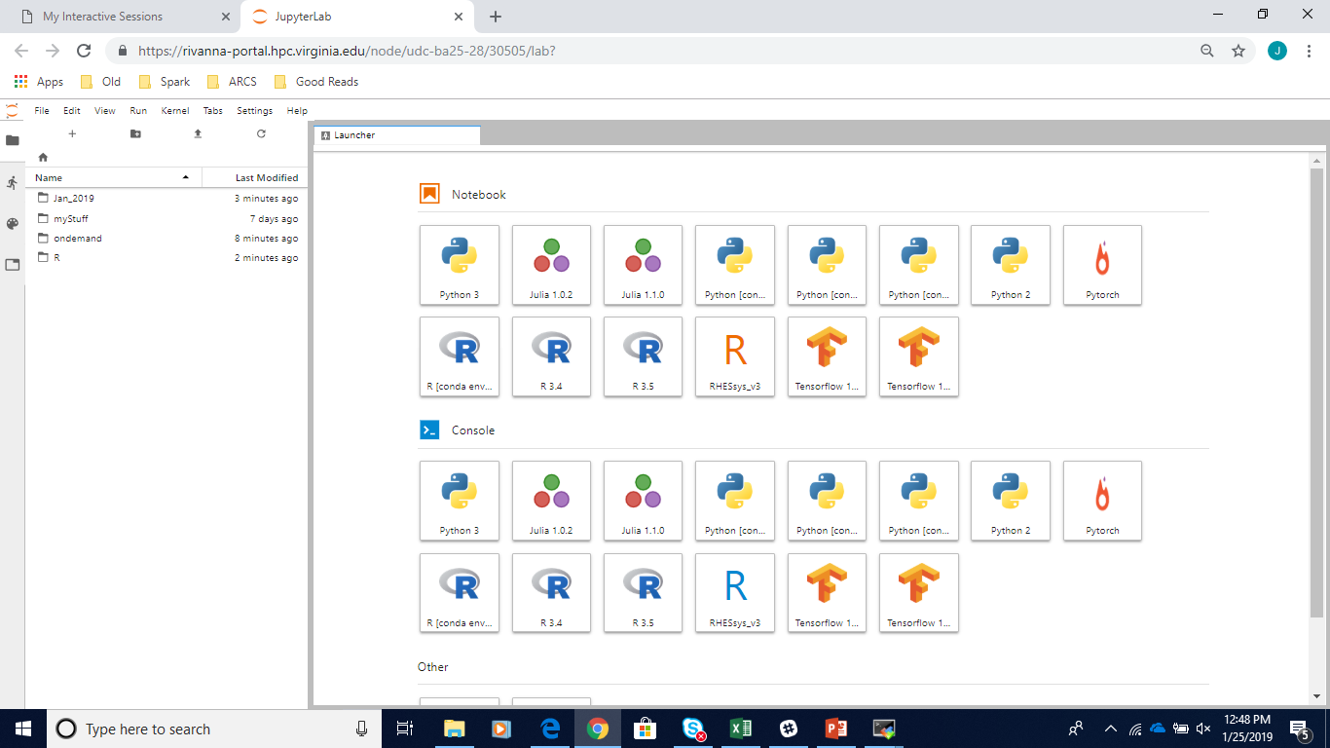
JupyterLab Environment
You should see a list of folders and files in your home directory.
And, a set of tiles with empty notebooks or consoles.

Slide 52
Opening a Notebook
If you have an existing notebook, you can use the left-pane to maneuver to the file and click on it to open it.
Or, if you want to start a new notebook, you can click on the notebook tile, for the appropriate underlying system.

Slide 53
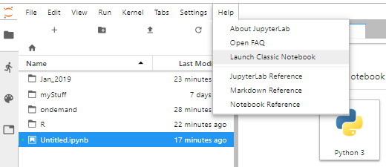
Classic Notebook
If you feel more comfortable working with the former Jupyter interface, you can select:
Help> Launch Classic Notebook
But, for our example, we will stay with the Jupyter Lab format.

Slide 54
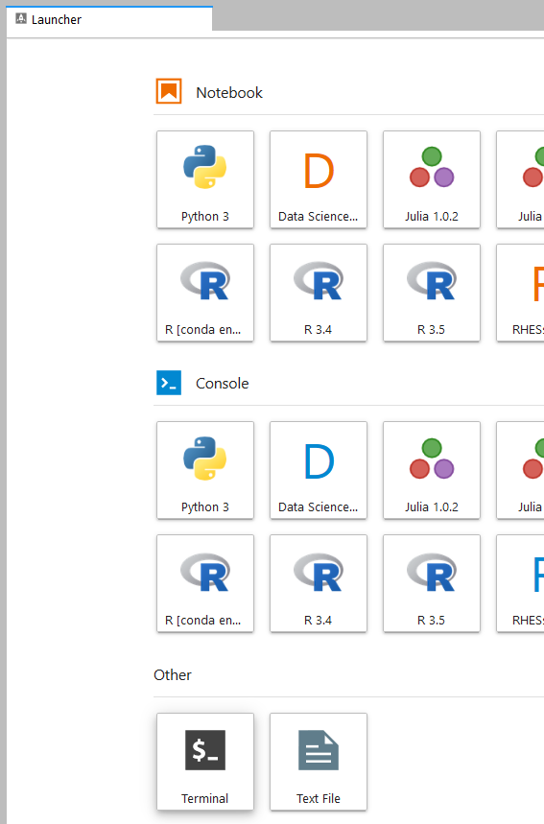
Copying our Notebook to your Directory
We will open a terminal window to copy files into our home directory.
In the Launcher panel, scroll down until you see the “Other” category.
Click on the Terminal tile.

Slide 55
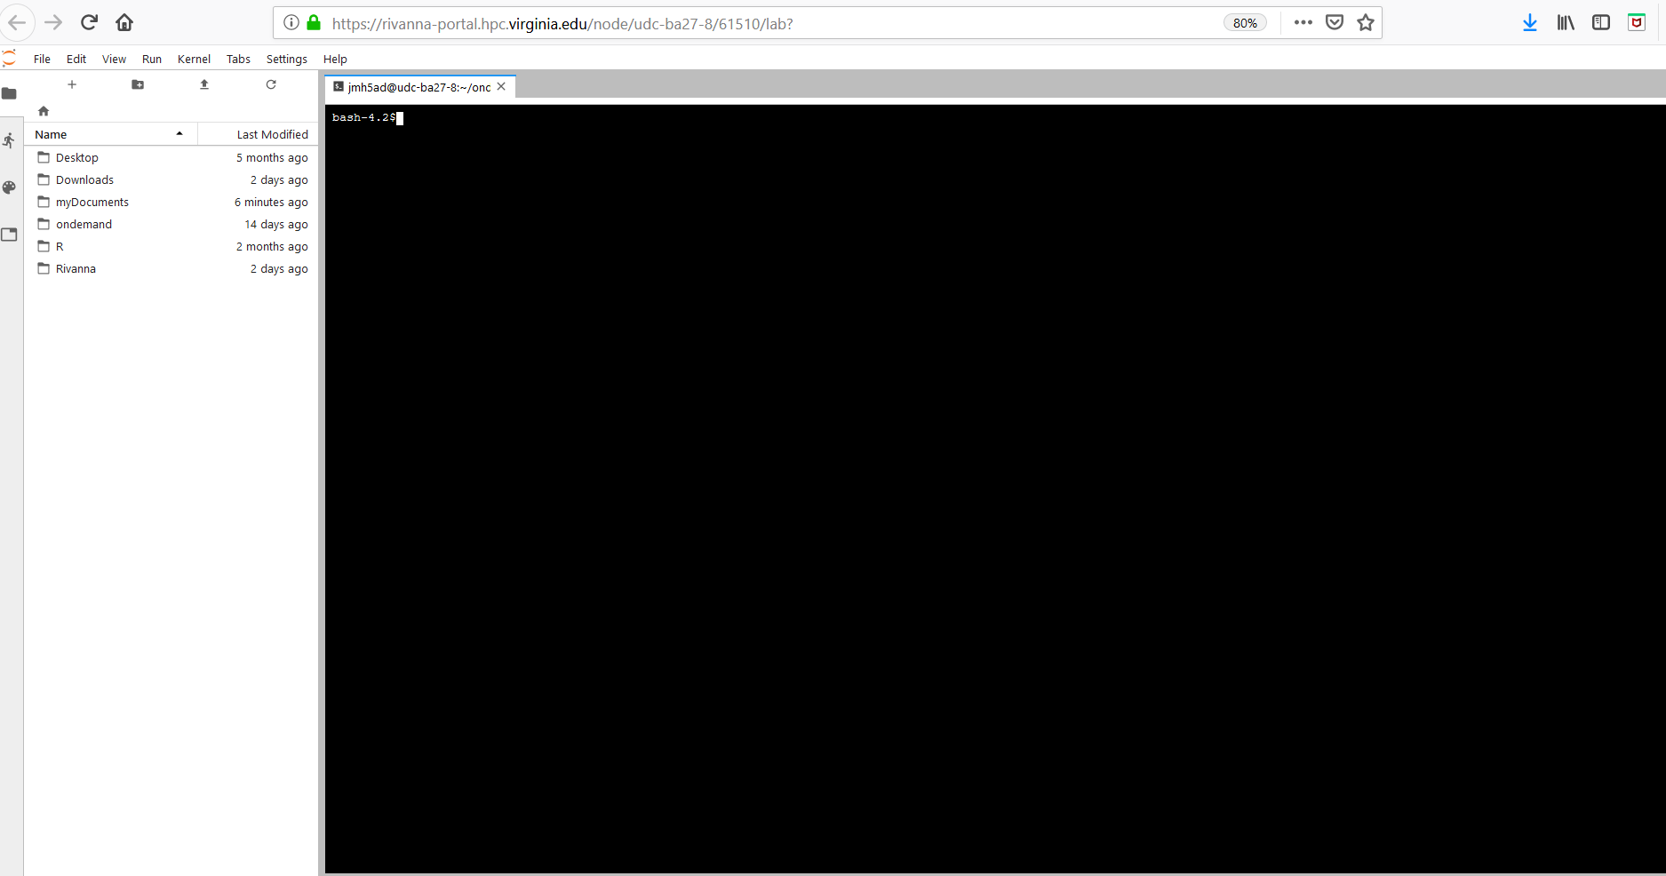
The Terminal Window
A terminal window (or shell) will appear in a separate tab:

Slide 56
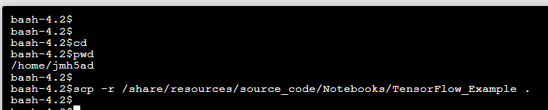
Copying our Notebook to your Directory
Make sure that you are in your home directory by typing cd.
Type:
cd
scp -r /share/resources/source_code/Notebooks/TensorFlow_Example .

Slide 57
Opening the Notebook
Close the browser tab for the Terminal Window.
You should be back on the page that shows your Home directory in Jupyter. (If not, click on the browser tab to get back to the Jupyter Home page.)
In the file browser pane, click on the folders TensorFlow_Example and Notebooks to get to the file: Python_TensorFlow.ipynb
Double-click on Python_TensorFlow.ipynb to open the notebook.

Slide 58
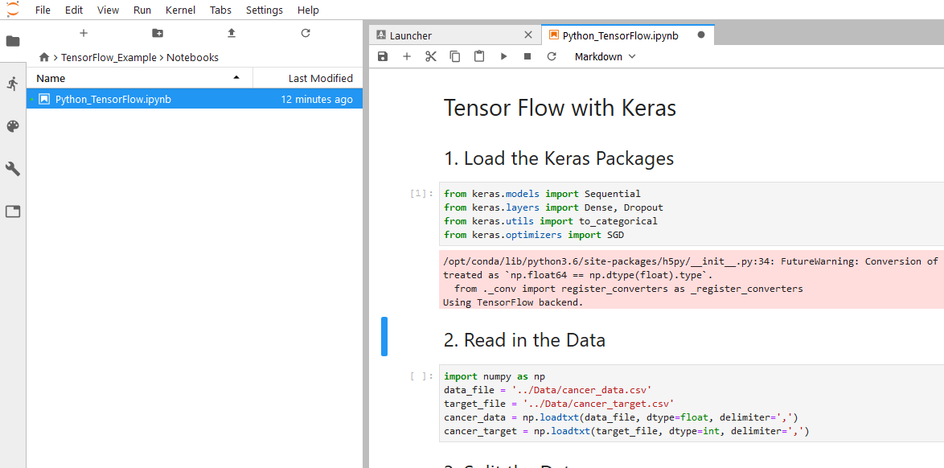
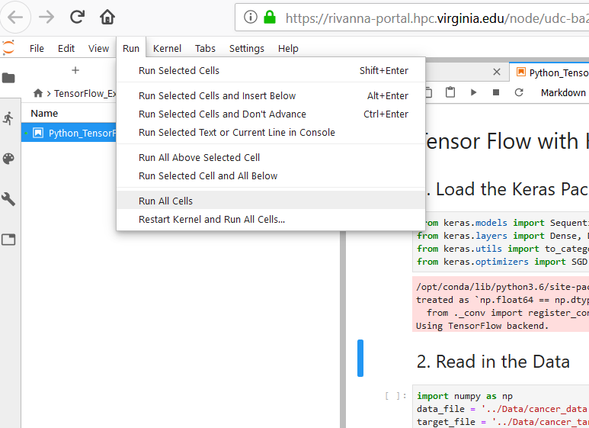
Running the Notebook
To run a particular cell, click inside the cell and press Shift & Enter or Ctrl & Enter.
Shift & Enter will advance to the next cell
Ctrl & Enter will stay in the same cell
To run the entire notebook, select
Run > Run All Cells

Slide 59
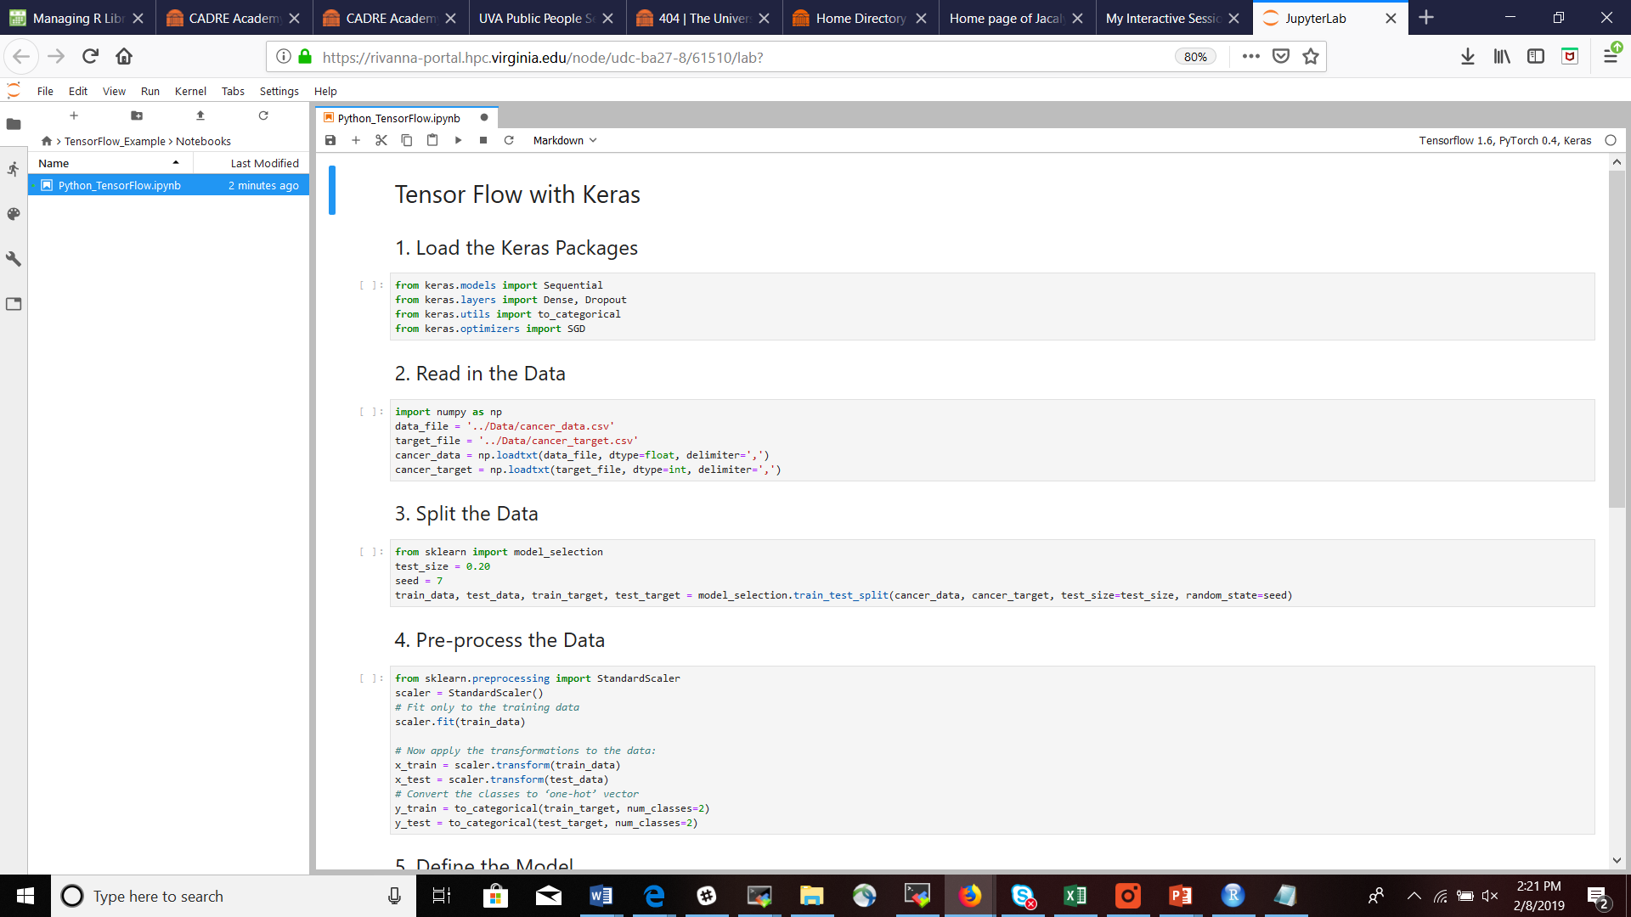
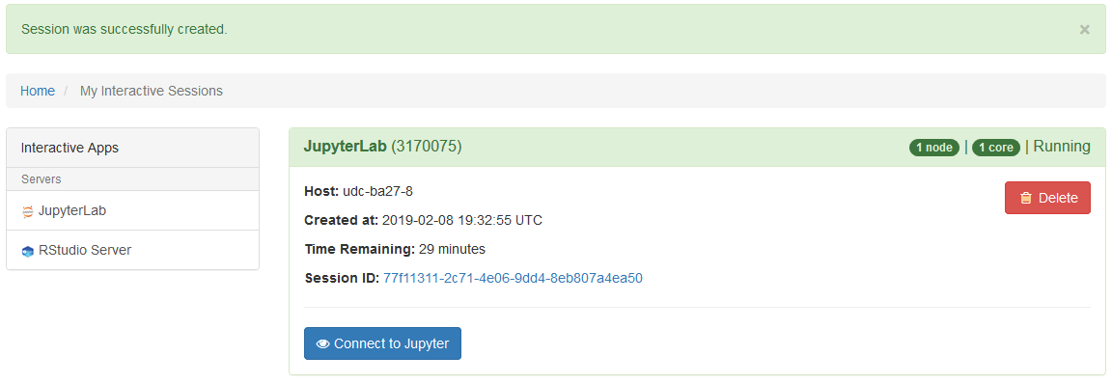
Cautions
Any changes that you make to the notebook may be saved automatically.
When the time for your session expires, the session will end without warning.
Your Jupyter session will continue running until you delete it.
Go back to the “Interactive Sessions” tab.
Click on the red Delete button.

Slide 60
Appendix B
Connecting to Rivanna with an ssh client

Slide 61
SSH Clients
You will need an ssh (secure shell) client on your computer.
On a Mac or Linux system, use ssh (Terminal application on Macs)
ssh –Y mst3k@rivanna.hpc.virginia.edu
On a Windows system, use MobaXterm
To install MobaXterm use the URL: http://mobaxterm.mobatek.net
The free "home" version is fine for our purpose.
When you are Off-Grounds, you must use the UVa Anywhere VPN client.

Slide 62
Connecting to the Cluster
The hostname for the Interactive frontends: rivanna.hpc.virginia.edu
(does load-balancing among the three front-ends)
However, you also can log onto a specific front-end:
rivanna1.hpc.virginia.edu
rivanna2.hpc.virginia.edu
rivanna3.hpc.virginia.edu
rivanna-viz.hpc.virginia.edu

Slide 63
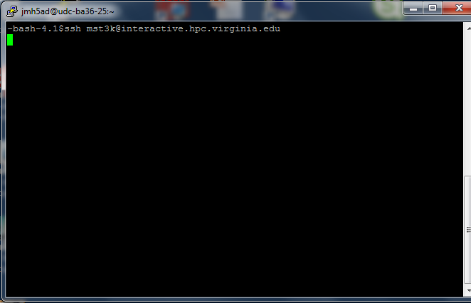
Connecting to the Cluster with ssh
If you are on a Mac or Linux machine your can connect with ssh.
Bring up a terminal window and type:
ssh –Y userID@rivanna.hpc.virginia.edu
When it prompts you for
for a password, use
your Eservices password.

Slide 64
Appendix C
Connecting to Rivanna with MobaXterm (Windows)

Slide 65
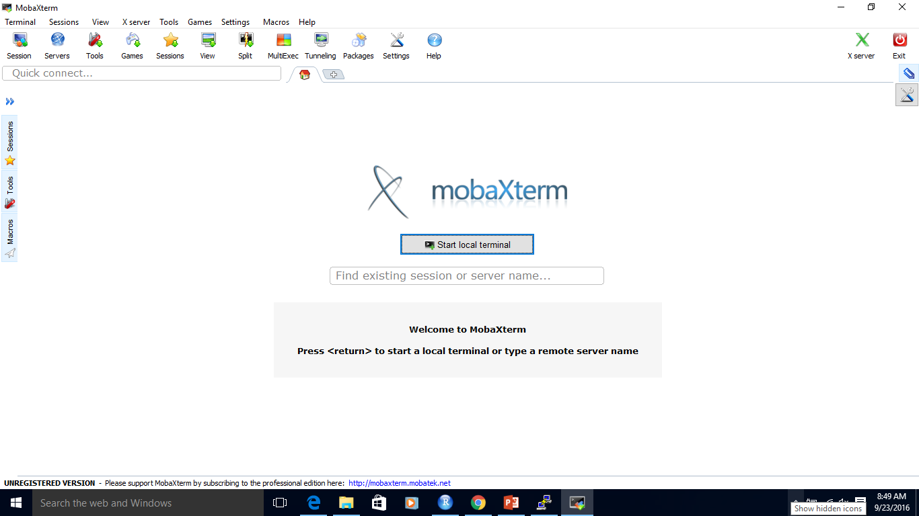
Connecting to the Cluster with MobaXterm
The first time that you start up MobaXterm, click on the Session icon
qj3fe

Slide 66
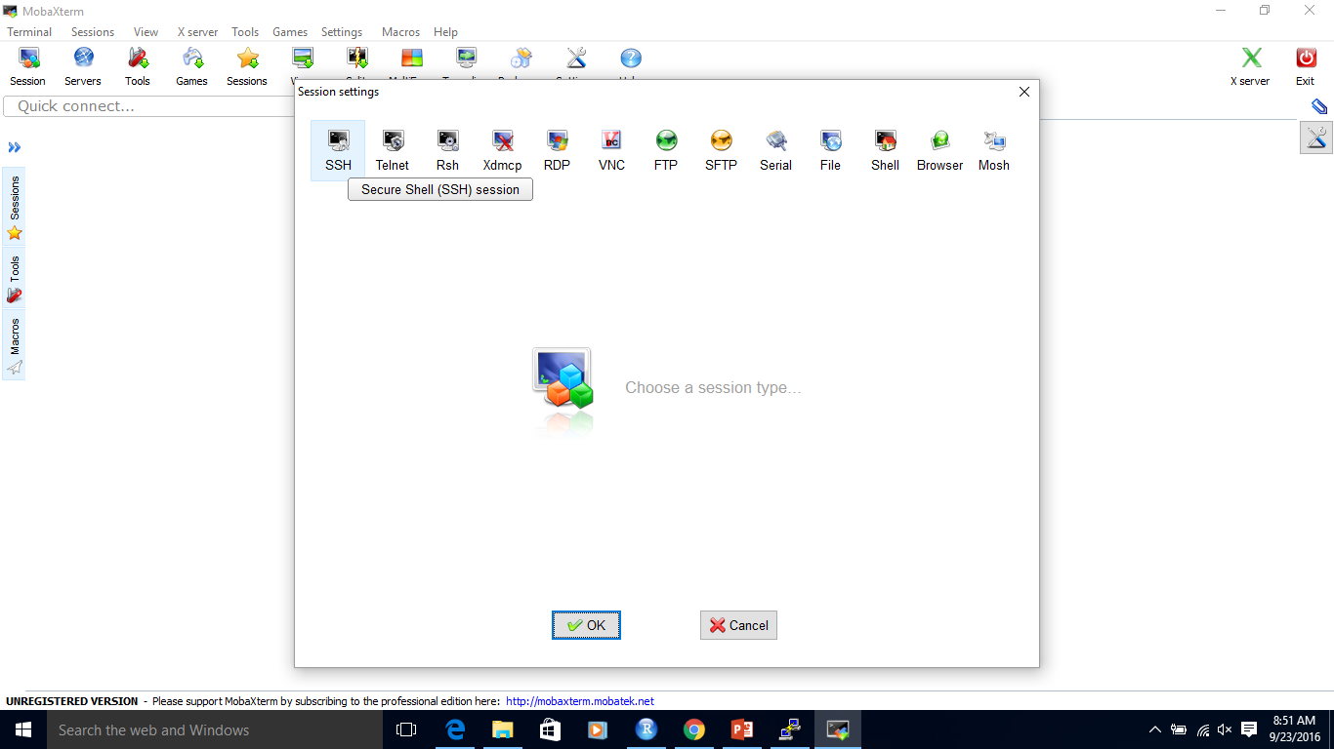
Connecting to the Cluster with MobaXterm
It will bring up a window asking for the type of session.
Select SSH and click Okay.

Slide 67
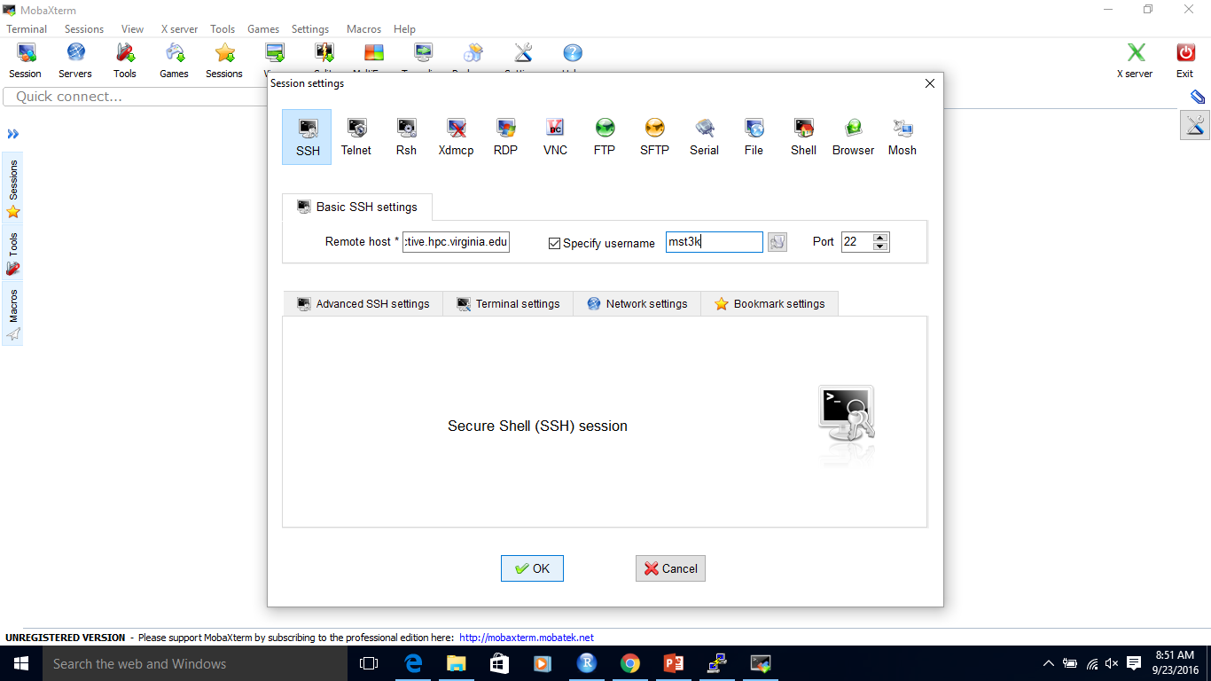
Connecting to the Cluster with MobaXterm
It will prompt you for remote host and username.
You will have to click on the box next to “Specify username” before you can type in your username.

Slide 68
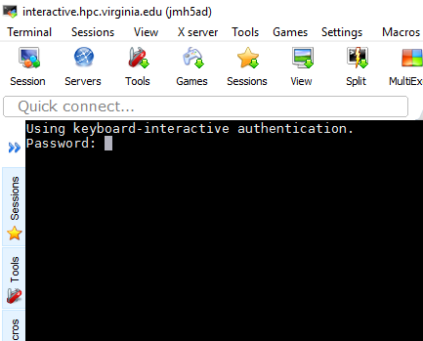
Connecting to the Cluster with MobaXterm
It will prompt you for your password.
Note: It will appear as if nothing is happening when you type in your password. It will not display circles or asterisks in place of the characters that you type.

Slide 69
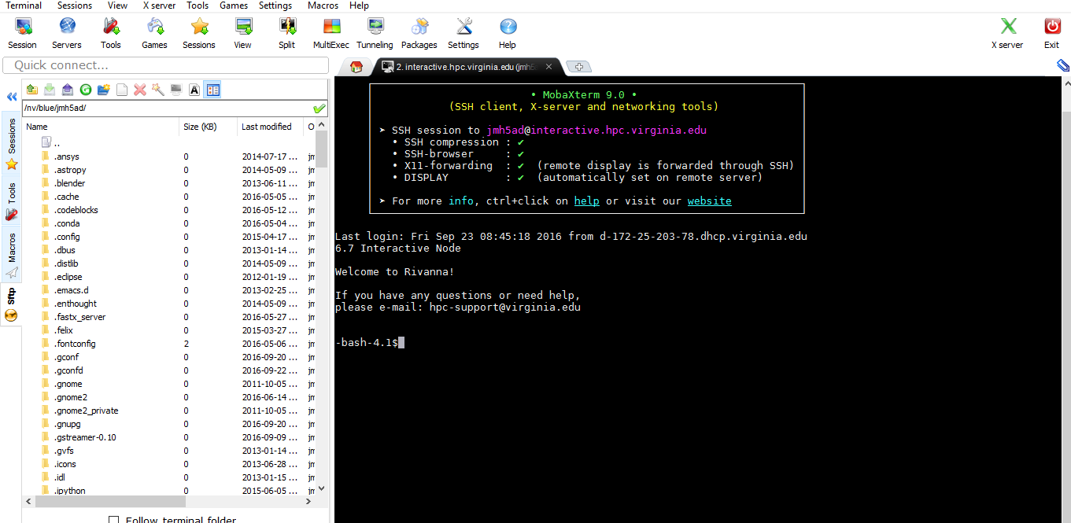
Connecting to the Cluster with MobaXterm
Finally, a split screen will appear.
The right pane is a terminal window.
The left pane is a list of files in your remote folder that you can click, drag, and drop onto your local desktop.

Slide 70
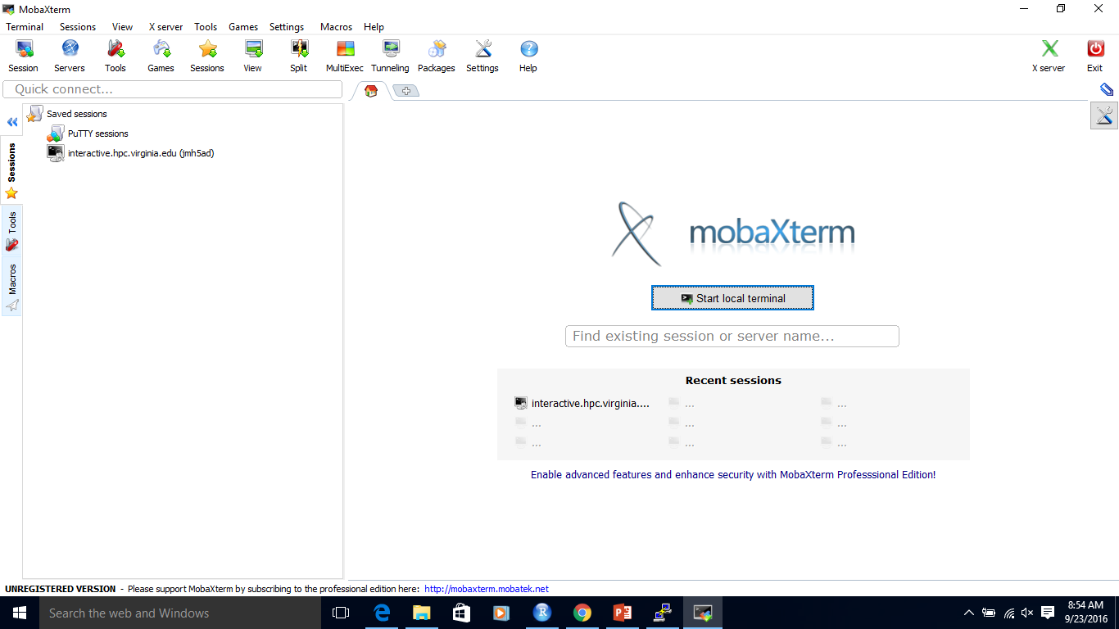
Connecting to the Cluster with MobaXterm
MobaXterm will save your session information.
The next time that you open MobaXterm, you can double-click on the Session that you want.

Slide 71
Appendix D
Neural Networks

Slide 72
Neural Network
A computational model used in machine learning which is based on the biology of the human brain.

Slide 73
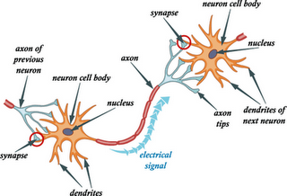
Neurons in the Brain
Neurons continuously receive signals, process the information, and fires out another signal.
The human brain has about 86 billion neurons, according to Dr. Suzana Herculano-Houzel
Diagram borrowed from
http://study.com/academy/lesson/synaptic-cleft-definition-function.html

Slide 74











Simulation of a Neuron
The “incoming signals” could be values from a data set(s).
A simple computation (like a weighted sum) is performed by the “nucleus”.
The result, y, is “fired out”.
$$x_{1}$$
$$x_{2}$$
$$w_{1}$$
$$w_{2}$$
$$\sum_{i}{w_{i}x_{i}}$$
$$x_{3}$$
y
$$w_{3}$$
$$x_{4}$$
$$w_{4}$$
$$x_{5}$$
$$w_{5}$$

Slide 75
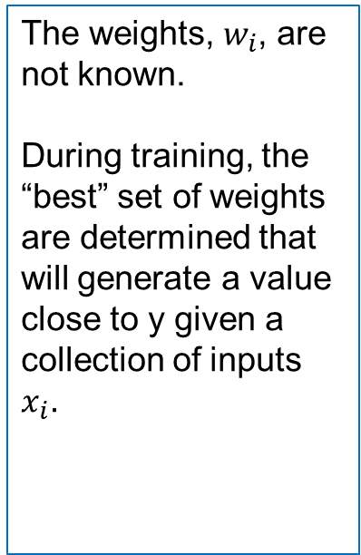
Simulation of a Neuron
The weights, $w_{i}$, are not known.
During training, the “best” set of weights are determined that will generate a value close to y given a collection of inputs $x_{i}.$
$$x_{1}$$
$$x_{2}$$
$$w_{1}$$
$$w_{2}$$
$$\sum_{i}{w_{i}x_{i}}$$
$$x_{3}$$
y
$$w_{3}$$
$$x_{4}$$
$$w_{4}$$
$$x_{5}$$
$$w_{5}$$

Slide 76
Simulation of a Neuron
A single neuron does not provide much information (often times, a 0/1 value)

Slide 77


A Network of Neurons
Different computations with different weights can be performed to produce different outputs.
$$x_{1}$$
$$y_{1}$$
$$x_{2}$$
$$x_{3}$$
$$y_{2}$$
This is called a feedforward network because all values progress from the input to the output.
$$x_{4}$$
$$x_{5}$$

Slide 78
A Network of Neurons
Input
Layer
Hidden Layer
Output
Layer
A neural network has a single hidden layer
A network with two or more hidden layers is called a “deep neural network”.
$$x_{1}$$
$$y_{1}$$
$$x_{2}$$
$$x_{3}$$
$$x_{4}$$
$$y_{2}$$
$$x_{5}$$

Slide 79
Tensor Flow

Slide 80
What is TensorFlow?
An example of deep learning; a neural network that has many layers.
A software library, developed by the Google Brain Team

Slide 81
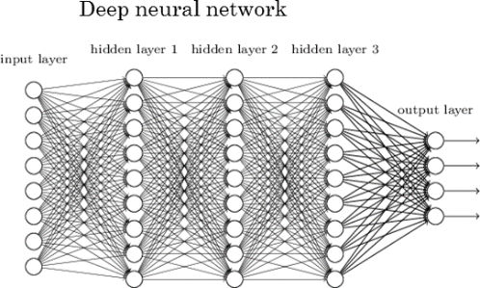
Deep Learning Neural Network
Image borrowed from:
http://www.kdnuggets.com/2017/05/deep-learning-big-deal.html

Slide 82
Terminology: Tensors
Tensor: A multi-dimensional array
Example: A sequence of images can be represented as a 4-D array: [image_num, row, col, color_channel]
Px_value[1, 1, 3, 2]=1
Image #0
Image #1

Slide 83
Terminology: Computational Graphs
Computational graphs help to break down computations.
For example, the graph for y=(x1+x2)*(x2 - 5) is
x1
a = x1 + x2
y = a*b
x2
The beauty of computational graphs is that they show where computations can be done in parallel.
b = x2 - 5

Slide 84
Convolutional Neural Networks

Slide 85
What are Convolutional Neural Networks?
Originally, convolutional neural networks (CNNs) were a technique for analyzing images.
CNNs apply multiple neural networks to subsets of a whole image in order to identify parts of the image.
Applications have expanded to include analysis of text, video, and audio.

Slide 86

The Idea behind CNN
Recall the old joke about the blind-folded scientists trying to identify an elephant.
A CNN works in a similar way. It breaks an image down into smaller parts and tests whether these parts match known parts.
It also needs to check if specific parts are within certain proximities.
For example, the tusks are near the trunk and not near the tail.
Image borrowed from https://tekrighter.wordpress.com/2014/03/13/metabolomics-elephants-and-blind-men/

Slide 87
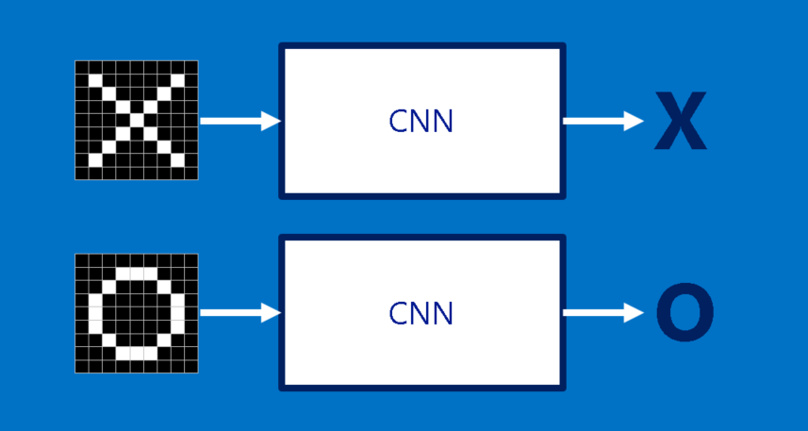
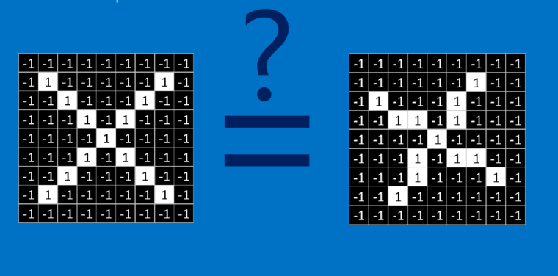
Is the image on the left most like an X or an O?
Images borrowed from
http://brohrer.github.io/how_convolutional_neural_networks_work.html

Slide 88
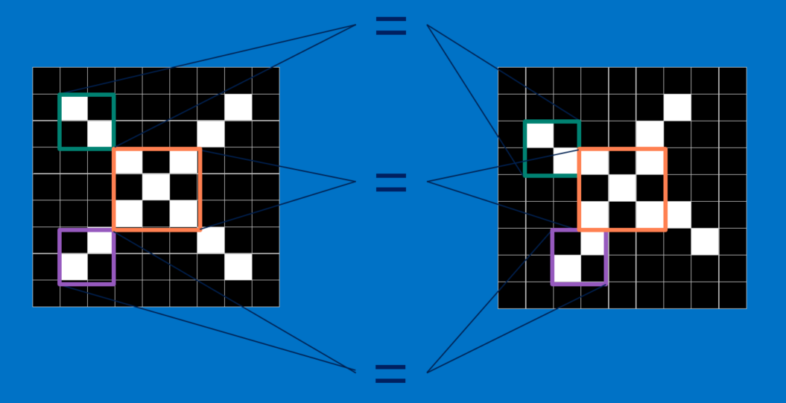
What features are in common?

Slide 89
Building Blocks of CNN
CNN performs a combination of layers
Convolution Layer
Compares a feature with all subsets of the image
Creates a map showing where the comparable features occur
Rectified Linear Units (ReLU) Layer
Goes through the features maps and replaces negative values with 0
Pooling Layer
Reduces the size of the rectified feature maps by taking the maximum value of a subset
And, ends with a final layer
Classification (Fully-connected layer) layer
Combines the specific features to determine the classification of the image

Slide 90

Steps
Convolution Rectified Linear Pooling
.
.
.
These layer can be repeated multiple times.
The final layer converts the final feature map to the classification.
{

Slide 91

Example: MNIST Data
The MNIST data set is a collection of hand-written digits (e.g., 0 – 9).
Each digit is captured as an image with 28x28 pixels.
The data set is already partitioned into a training set (60,000 images) and a test set (10,000 images).
The tensorflow packages have tools for reading in the MNIST datasets.
More details on the data are available at http://yann.lecun.com/exdb/mnist/
Image borrowed from
Getting Started with TensorFlow by Giancarlo Zaccone

Slide 92
Coding CNN: General Steps
Load PyTorch Packages
Define How to Transform Data
Read in the Training Data
Read in the Test Data
Define the Model
Configure the Learning Process
Define the Training Process
Define the Testing Process
Train & Test the Model

Slide 93
1. Load PyTorch Packages
import torch
import torch.nn as nn
import torch.nn.functional as F
import torch.optim as optim
from torchvision import datasets, transforms
Import os

Slide 94
2. Define How to Transform Data
image_mean = 0.1307
image_std = 0.3081
batch_size = 64
test_batch_size = 1000
numCores = int(os.getenv(‘SLURM_CPUS_PER_TASK’))
`
transform = transforms.Compose([transforms.ToTensor(),
transforms.Normalize((image_mean, ), (image_std, ))])

Slide 95
3. Read in the Training Data
train_loader = torch.utils.data.DataLoader(
datasets.MNIST('../data', train=True, download=True,
transform=transform), batch_size = batch_size,
shuffle = True, num_workers = numCores)

Slide 96
4. Read in the Test Data
test_loader = torch.utils.data.DataLoader(
datasets.MNIST('../data', train=False,
transform=transform), vatch_size = test_batch_size,
shuffle = True, num_workers = numCores)

Slide 97
5. Define the Model
class Net(nn.Module):
def __init__(self):
super(Net, self).__init__()
self.conv1 = nn.Conv2d(1, 20, 5, 1)
self.conv2 = nn.Conv2d(20, 50, 5, 1)
self.fc1 = nn.Linear(4*4*50, 500)
self.fc2 = nn.Linear(500, 10)
def forward(self, x):
x = F.relu(self.conv1(x))
x = F.max_pool2d(x, 2, 2)
x = F.relu(self.conv2(x))
x = F.max_pool2d(x, 2, 2)
x = x.view(-1, 4*4*50)
x = F.relu(self.fc1(x))
x = self.fc2(x)
return F.log_softmax(x, dim=1)

Slide 98
5. Define the Model
class Net(nn.Module):
def __init__(self):
super(Net, self).__init__()
self.conv1 = nn.Conv2d(1, 20, 5, 1)
self.conv2 = nn.Conv2d(20, 50, 5, 1)
self.fc1 = nn.Linear(4*4*50, 500)
self.fc2 = nn.Linear(500, 10)
def forward(self, x):
x = F.relu(self.conv1(x))
x = F.max_pool2d(x, 2, 2)
x = F.relu(self.conv2(x))
x = F.max_pool2d(x, 2, 2)
x = x.view(-1, 4*4*50)
x = F.relu(self.fc1(x))
x = self.fc2(x)
return F.log_softmax(x, dim=1)
nn.Conv2d parameters:
# of Input Channels
# of Output Channels
Kernel size
Stride size
Padding defaults to 0

Slide 99
5. Define the Model
class Net(nn.Module):
def __init__(self):
super(Net, self).__init__()
self.conv1 = nn.Conv2d(1, 20, 5, 1)
self.conv2 = nn.Conv2d(20, 50, 5, 1)
self.fc1 = nn.Linear(4*4*50, 500)
self.fc2 = nn.Linear(500, 10)
def forward(self, x):
x = F.relu(self.conv1(x))
x = F.max_pool2d(x, 2, 2)
x = F.relu(self.conv2(x))
x = F.max_pool2d(x, 2, 2)
x = x.view(-1, 4*4*50)
x = F.relu(self.fc1(x))
x = self.fc2(x)
return F.log_softmax(x, dim=1)
Where do the sizes come from in nn.Linear?
Initially, 1x28x28
W_out = floor((W_in – kernel + 2*padding)/2) + 1
After first convolution: 20x12x12
After second convolution: 50x4x4

Slide 100
6. Configure the Learning Process
epochs = 10
lr = 0.01
momentum = 0.5
seed = 1
log_interval = 100
torch.manual_seed(seed)
device = torch.device("cuda")
model = Net().to(device)
optimizer = optim.SGD(model.parameters(), lr=lr, momentum=momentum)

Slide 101
7. Define the Training Process
def train(model, device, train_loader, optimizer, epoch, log_interval):
model.train()
for batch_idx, (data, target) in enumerate(train_loader):
data, target = data.to(device), target.to(device)
optimizer.zero_grad()
output = model(data)
loss = F.nll_loss(output, target)
loss.backward()
optimizer.step()
if batch_idx % log_interval == 0:
print('Train Epoch: {} [{}/{} ({:.0f}%)]\tLoss: {:.6f}'.format(epoch, batch_idx * len(data), len(train_loader.dataset), 100. * batch_idx / len(train_loader), loss.item()))

Slide 102
8. Define the Testing Process
def test(model, device, test_loader):
model.eval()
test_loss = 0
correct = 0
with torch.no_grad():
for data, target in test_loader:
data, target = data.to(device),target.to(device)
output = model(data)
test_loss += F.nll_loss(output, target, reduction='sum').item() # sum up batch loss
pred = output.argmax(dim=1, keepdim=True) # get the index of the max log-probability
correct += pred.eq(target.view_as(pred)).sum().item()

Slide 103
8. Define the Testing Process (con’t)
test_loss /= len(test_loader.dataset)
print('\nTest set: Average loss: {:.4f}, Accuracy: {}/{} ({:.0f}%)\n'.format(
test_loss, correct, len(test_loader.dataset),
100. * correct / len(test_loader.dataset)))

Slide 104
9. Train & Test the Model
for epoch in range(1, epochs + 1):
train(model, device, train_loader, optimizer,
epoch, log_interval)
test(model, device, test_loader)

