Slide 1
Generative Adversarial Networks (GANs)

Slide 2
Today’s Class
Adversarial Examples – Input Optimization
Generative Adversarial Networks (GANs)
Conditional GANs
Style-Transfer Networks

Slide 3
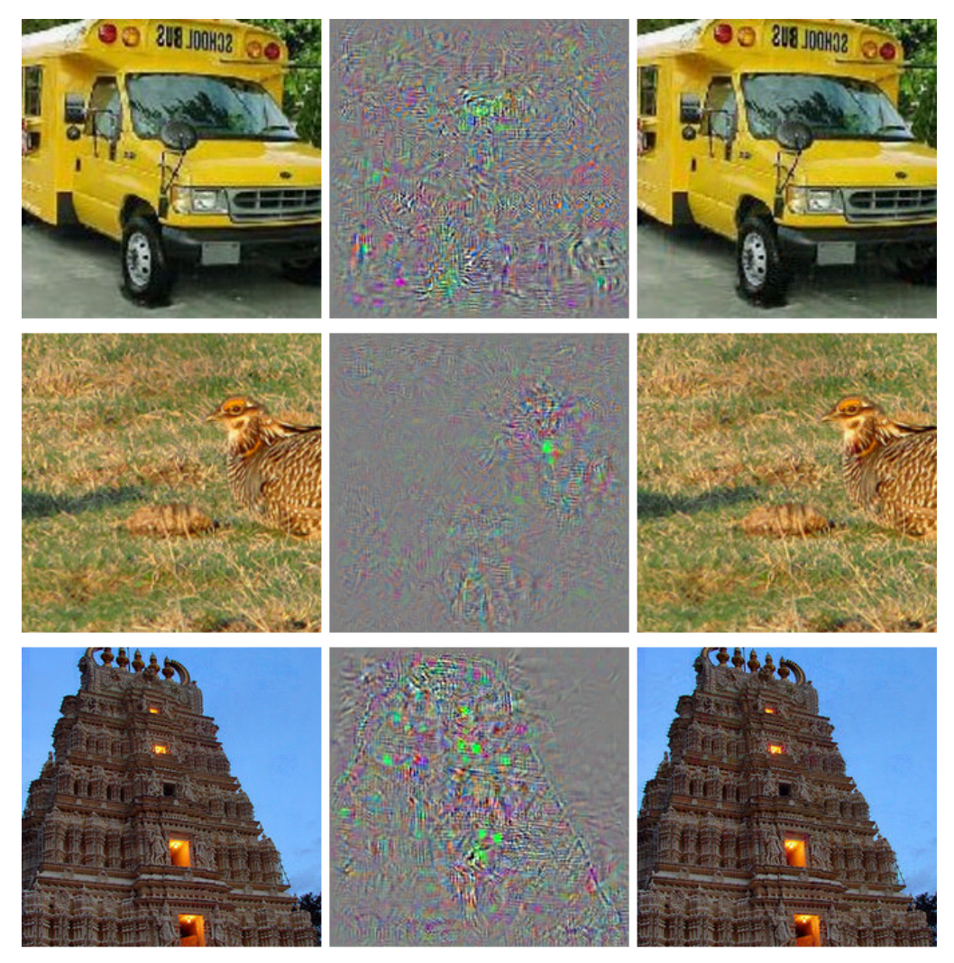



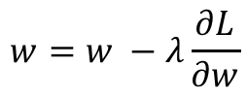
What we have been doing: Optimize weights in the network to predict bus (correct class).
$$I$$
$$y=f(I;w)$$
$$L(y, bus)$$
bus
$$w=w −λ\frac{∂L}{∂w}$$

Slide 4

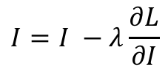
New Idea: Create Adversarial Inputs by optimizing the input image to predict ostrich (wrong class).
$$I$$
$$y=f(I;w)$$
$$L(y, ostrich)$$
ostrich
$$I=I −λ\frac{∂L}{∂I}$$
Work on Adversarial examples by Goodfellow et al. , Szegedy et. al., etc.

Slide 5
Convnets (optimize input to predict ostrich)
ostrich
Work on Adversarial examples by Goodfellow et al. , Szegedy et. al., etc.

Slide 7
All get predicted as ostrich

Slide 8
Taking the idea to the extreme: Google’s DeepDream
https://research.googleblog.com/2015/06/inceptionism-going-deeper-into-neural.html
Generate your own in Pytorch:
https://github.com/XavierLinNow/deepdream_pytorch

Slide 9
Generative Adversarial Networks (GAN) [Goodfellow et al.]
https://deeplearning4j.org/generative-adversarial-network

Slide 10
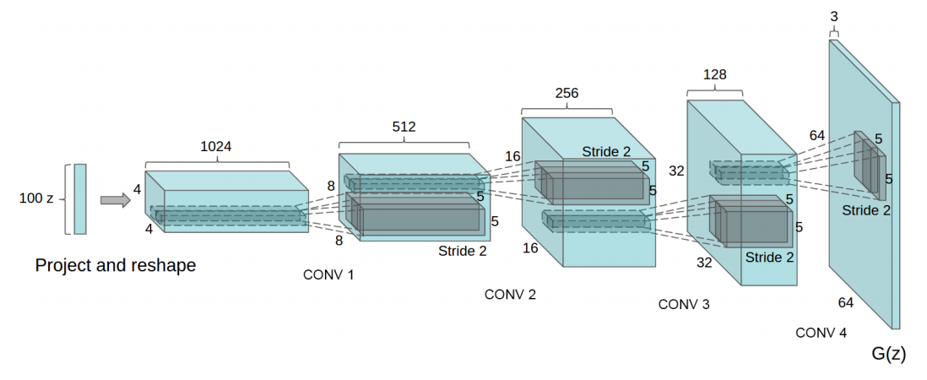
Generative Network (closer look)
Radford et. al. Unsupervised Representation Learning with Deep Convolutional Generative Adversarial Networks. ICLR 2016

Slide 11
Generative Network (closer look)
Deconvolutional Layers
Upconvolutional Layers
Backwards Strided Convolutional Layers
Fractionally Strided Convolutional Layers
Transposed Convolutional Layers
Spatial Full Convolutional Layers
Radford et. al. Unsupervised Representation Learning with Deep Convolutional Generative Adversarial Networks. ICLR 2016

Slide 12
Generative Adversarial Networks (GAN) [Goodfellow et al.]
https://deeplearning4j.org/generative-adversarial-network

Slide 13
Generative Adversarial Networks (GAN) [Goodfellow et al.]
https://deeplearning4j.org/generative-adversarial-network

Slide 14
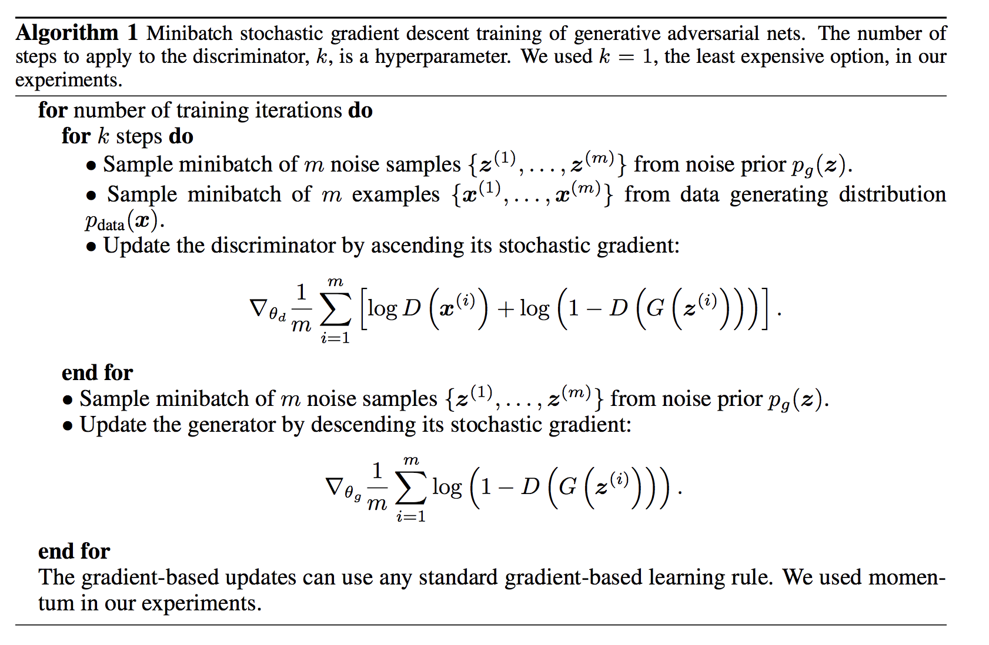
Goodfellow et al. NeurIPS 2014

Slide 15
Update Discriminator D
Goodfellow et al. NeurIPS 2014

Slide 16
Update Generator
G
Goodfellow et al. NeurIPS 2014

Slide 17
Until Desirable Results are Achieved?
Goodfellow et al. NeurIPS 2014

Slide 18
Generative Adversarial Networks (GAN) [Goodfellow et al.]
https://deeplearning4j.org/generative-adversarial-network

Slide 19
Generative Adversarial Networks (GAN) [Goodfellow et al.]
GANs are hard to train, loss for the discriminator and generator might fluctuate.
There are many choices for loss, and other auxiliary signals.
Training of these models is even less well understood than for other deep models.
https://deeplearning4j.org/generative-adversarial-network

Slide 20
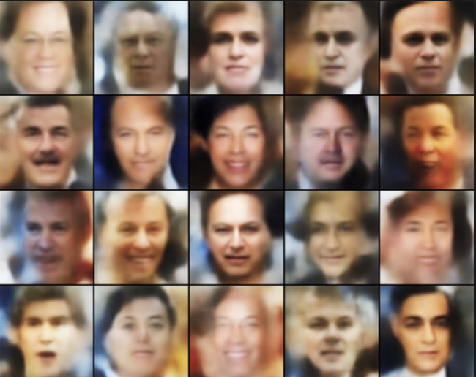
Basic GAN Results (Example implementation is provided in Pytorch’s examples)
http://torch.ch/blog/2015/11/13/gan.html

Slide 21
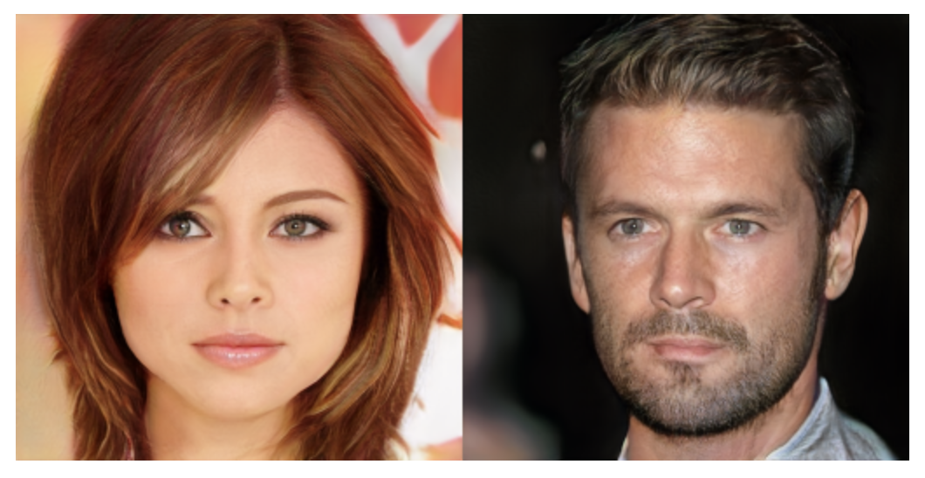
NVidia’s progressive GANs ICLR 2018

Slide 22
Google’s BigGAN

Slide 23
Google’s BigGAN
Teddy Bear
Microphone
http://aiweirdness.com/post/179626595787/the-creepiest-images-generated-by-biggan

Slide 24
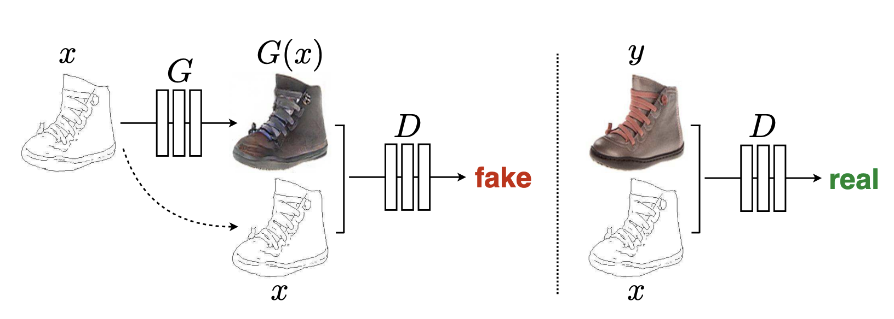
Conditional GANs: Input is not just Noise
Isola et al. CVPR 2017: Image-to-Image Translation with Conditional Adversarial Networks

Slide 25
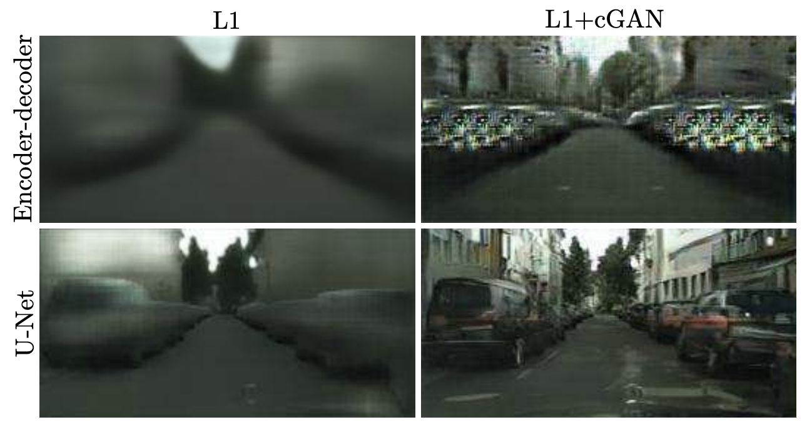
Conditional GANs: Also Hard to Train
Result they obtained with a regular Fully Convolutional Network
Result they obtained with a U-Net network (with skip-connections)
Isola et al. CVPR 2017: Image-to-Image Translation with Conditional Adversarial Networks

Slide 26
Conditional GANs: Also Hard to Train
Ronneberger et al. MICCAI 2015. U-Net: Convolutional Networks for Biomedical Image Segmentation

Slide 27
More on the Idea of Feature Space Optimization
Gatys et. al. Image Style Transfer Using Convolutional Neural Networks. CVPR 2016

Slide 28
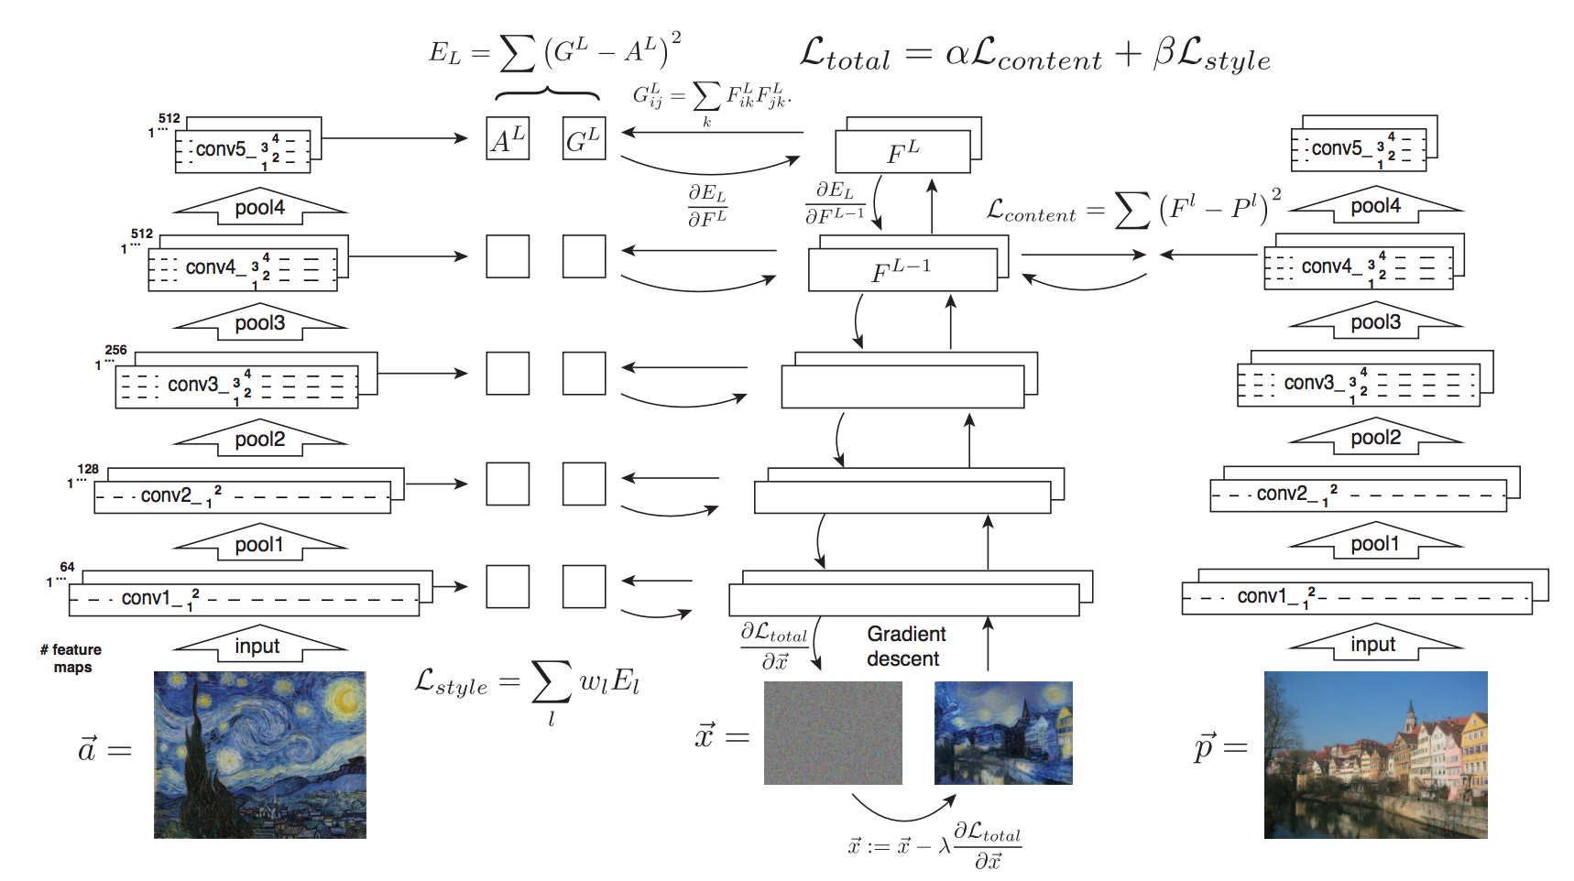
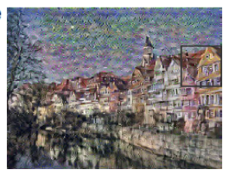
Gatys et. al. Image Style Transfer Using Convolutional Neural Networks. CVPR 2016
Idea 1: Image Reconstruction from Features

Slide 29

Gatys et. al. Image Style Transfer Using Convolutional Neural Networks. CVPR 2016
Idea 1: Image Reconstruction from Features

Slide 30
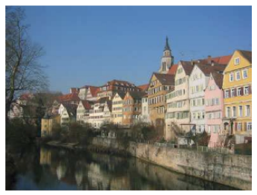
Gatys et. al. Image Style Transfer Using Convolutional Neural Networks. CVPR 2016
Idea 1: Image Reconstruction from Features

Slide 31
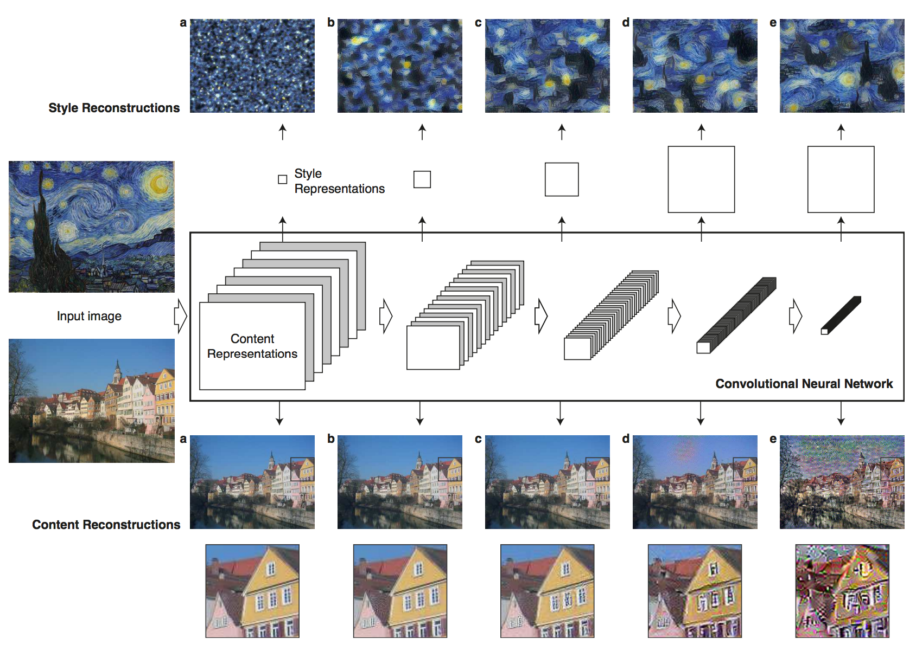
Gatys et. al. Image Style Transfer Using Convolutional Neural Networks. CVPR 2016

Slide 32

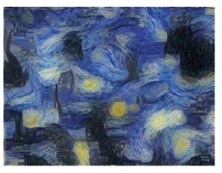
Gatys et. al. Image Style Transfer Using Convolutional Neural Networks. CVPR 2016
Idea 2: Backpropagation of Style

Slide 33

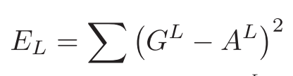
Gatys et. al. Image Style Transfer Using Convolutional Neural Networks. CVPR 2016
Idea 2: Backpropagation of Style

Slide 34
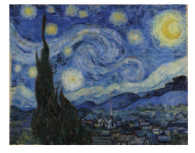
Gatys et. al. Image Style Transfer Using Convolutional Neural Networks. CVPR 2016
Idea 2: Backpropagation of Style

Slide 35
Gatys et. al. Image Style Transfer Using Convolutional Neural Networks. CVPR 2016

Slide 36
Gatys et. al. Image Style Transfer Using Convolutional Neural Networks. CVPR 2016

Slide 37
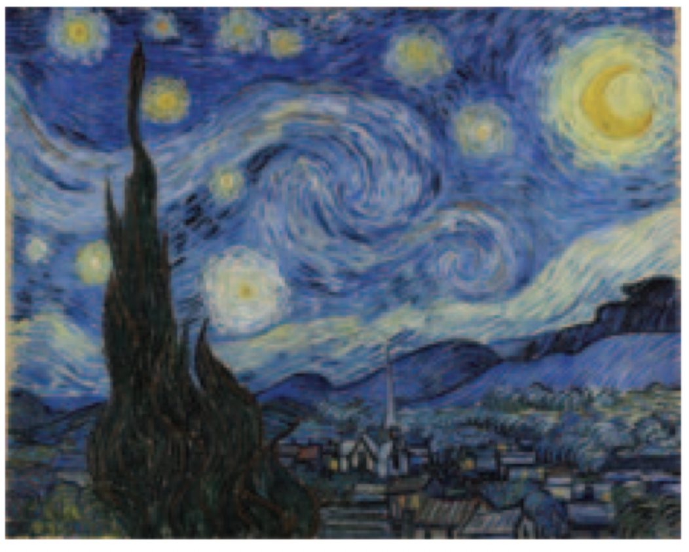
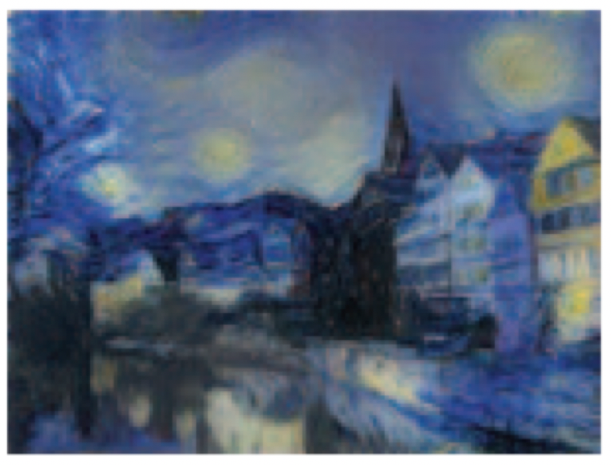
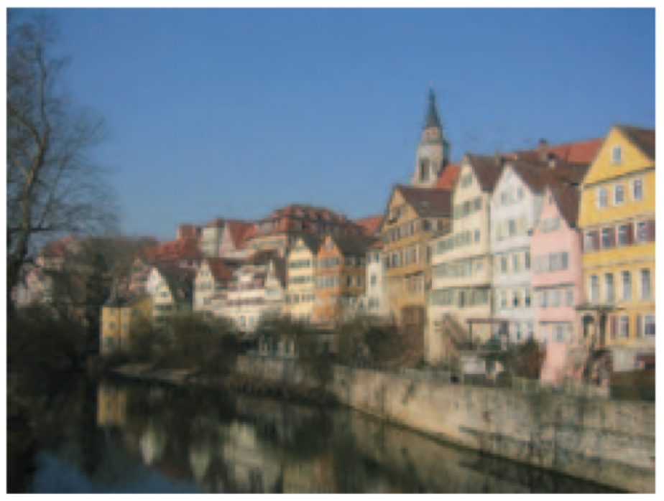
Gatys et. al. Image Style Transfer Using Convolutional Neural Networks. CVPR 2016

Slide 38
Questions?

