Slide 1
Open Topics

Slide 2
Today’s Class
Video: Optical flow, Two-Stream Networks, Tracking
VQA: Datasets, Challenges, Models

Slide 3
From images to videos
A video is a sequence of frames captured over time
Now our image data is a function of space (x, y) and time (t)

Slide 4
Why is motion useful?

Slide 5
Why is motion useful?

Slide 6
Optical flow
Definition: optical flow is the apparent motion of brightness patterns in the image
Note: apparent motion can be caused by lighting changes without any actual motion
Think of a uniform rotating sphere under fixed lighting vs. a stationary sphere under moving illumination
GOAL: Recover image motion at each pixel from optical flow
Source: Silvio Savarese

Slide 7
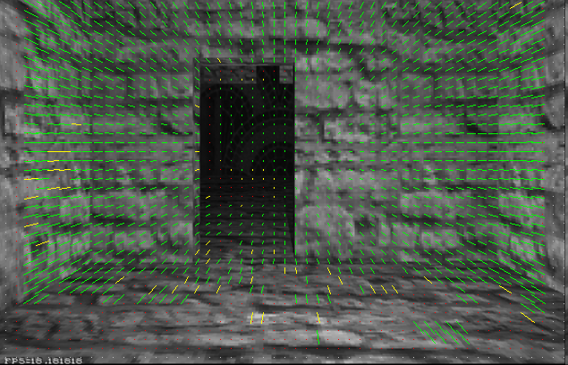
Optical flow
Vector field function of the spatio-temporal image brightness variations
Picture courtesy of Selim Temizer - Learning and Intelligent Systems (LIS) Group, MIT

Slide 8
Estimating optical flow
I(x,y,t–1)
I(x,y,t)
Given two subsequent frames, estimate the apparent motion field u(x,y), v(x,y) between them
Key assumptions
Brightness constancy: projection of the same point looks the same in every frame
Small motion: points do not move very far
Spatial coherence: points move like their neighbors
Source: Silvio Savarese

Slide 9
Key Assumptions: small motions

Slide 10
Key Assumptions: spatial coherence
* Slide from Michael Black, CS143 2003

Slide 11
Key Assumptions: brightness Constancy
* Slide from Michael Black, CS143 2003

Slide 12
The brightness constancy constraint
I(x,y,t–1)
I(x,y,t)
Brightness Constancy Equation:
Linearizing the right side using Taylor expansion:
Image derivative along x
Source: Silvio Savarese
Hence,

Slide 13
The brightness constancy constraint
B. Lucas and T. Kanade. An iterative image registration technique with an application to stereo vision. In Proceedings of the International Joint Conference on Artificial Intelligence, pp. 674–679, 1981.
I(x,y,t–1)
I(x,y,t)
Brightness Constancy Equation:
Linearizing the right side using Taylor expansion:
Image derivative along x
Source: Silvio Savarese
Hence,

Slide 14
Action Classification from Video
Recommended Paper to Read:

Slide 15
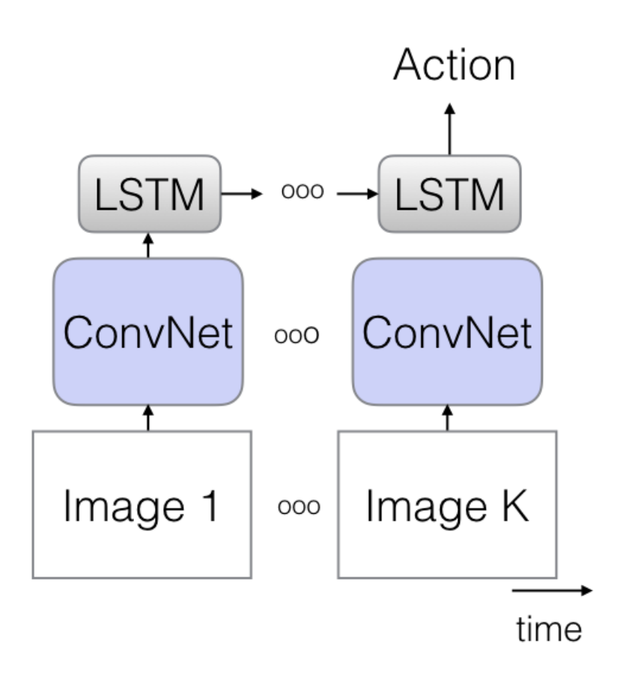
Action Classification from Video
CNN + LSTM over sequence of frames
Figure from Carreira & Zisserman, 2018

Slide 16
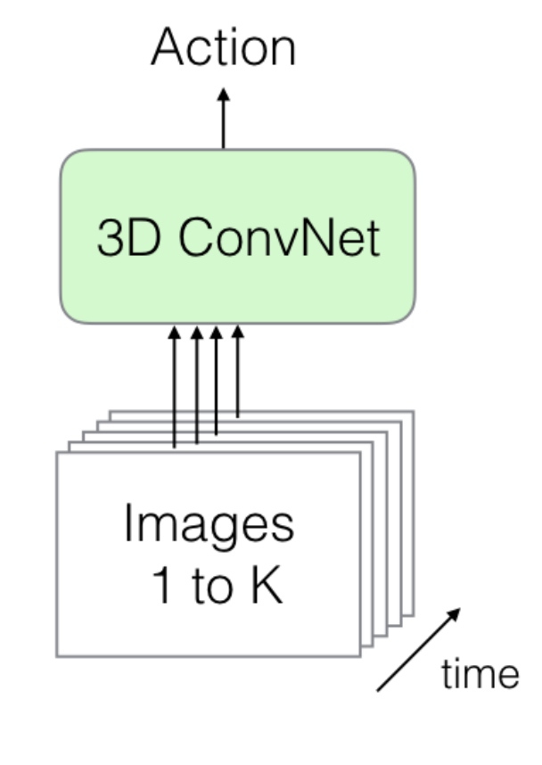
Action Classification from Video
3D CNN of consecutive frames across time
Figure from Carreira & Zisserman, 2018

Slide 17
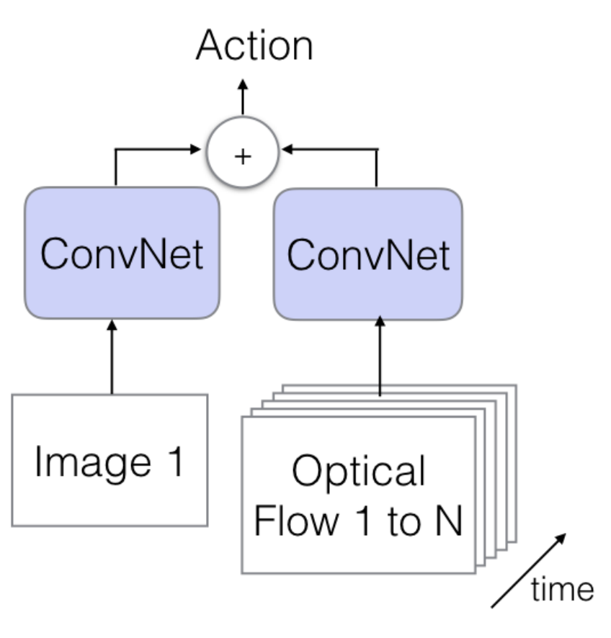
Action Classification from Video
Two Stream CNN: Images + Flow Map
Figure from Carreira & Zisserman, 2018

Slide 18
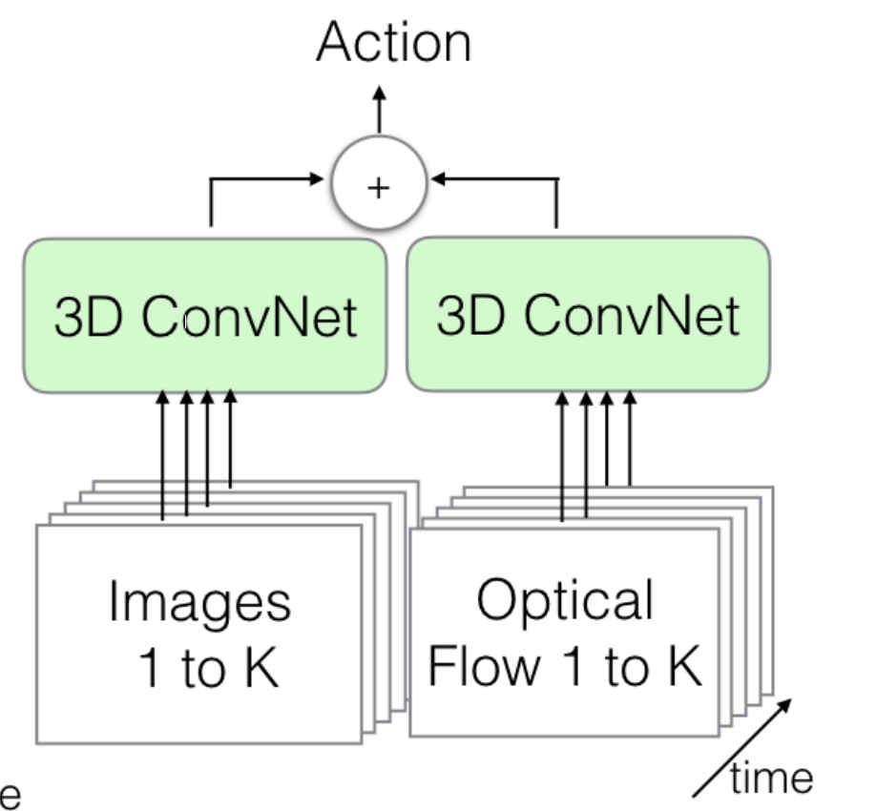
Action Classification from Video
Two Stream 3D CNN: Images + Flow Map
Figure from Carreira & Zisserman, 2018

Slide 19
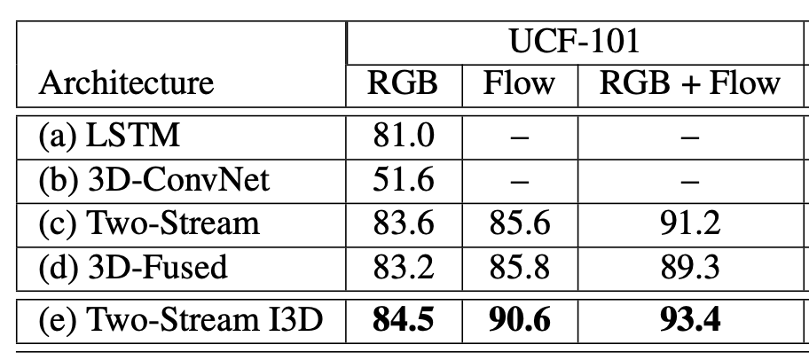
Action Classification from Video
Results on UCF101 actions
Figure from Carreira & Zisserman, 2018

Slide 20
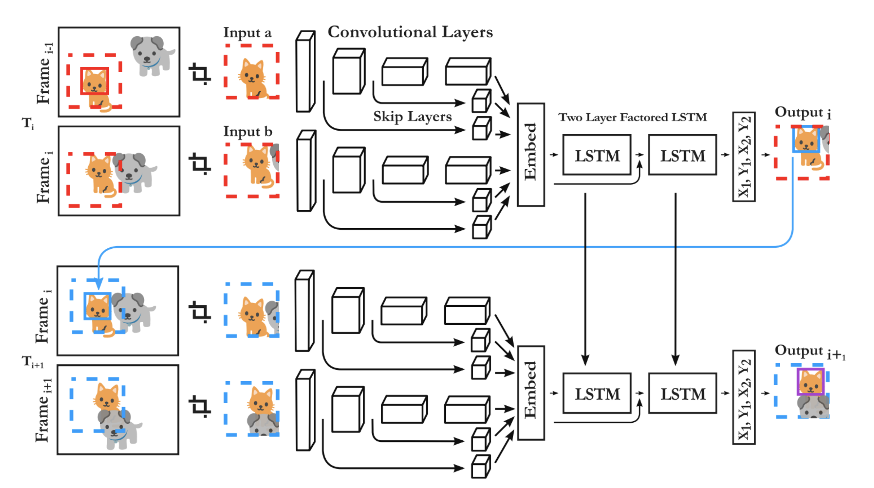
Some Deep Learning (non Flow)-based tracker
Gordon, Farhadi, Fox. Re3: Real-Time Recurrent Regression Networks for Object Tracking

Slide 21
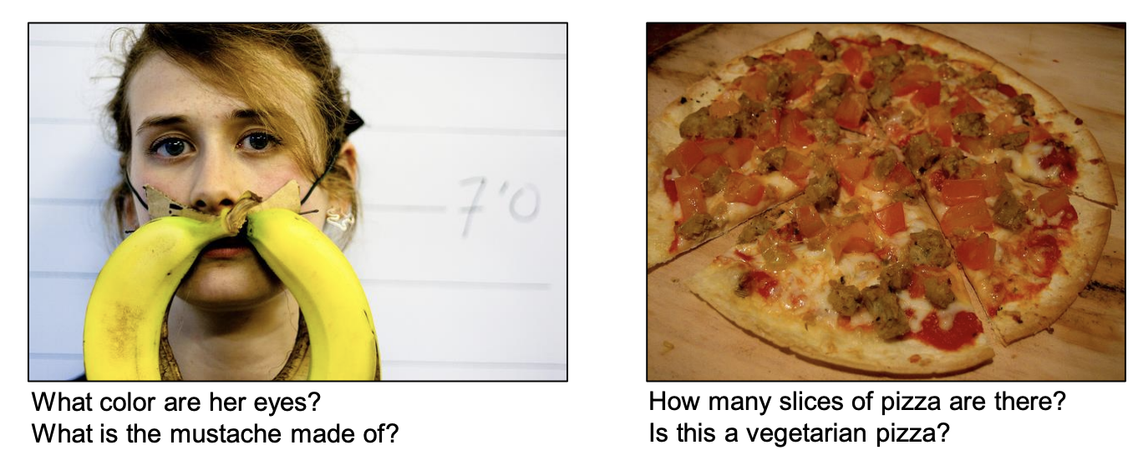
Visual Question Answering
Picture from Agrawal et al 2015

Slide 22
Visual Question Answering
Challenges? Pitfalls?
Picture from Agrawal et al 2015

Slide 23
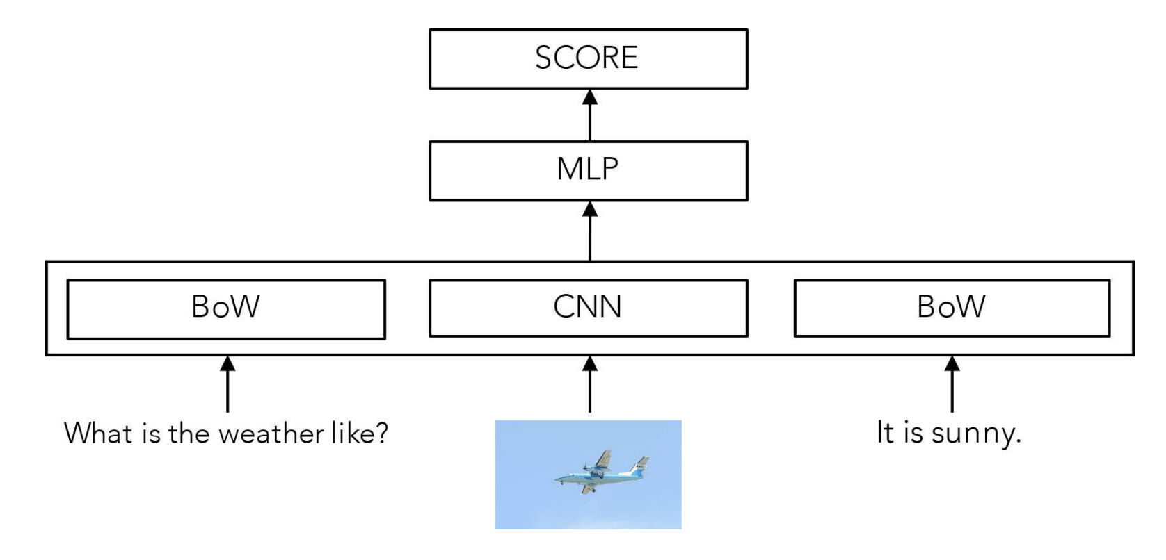
Visual Question Answering: Simplest (but effective) Model

Slide 24
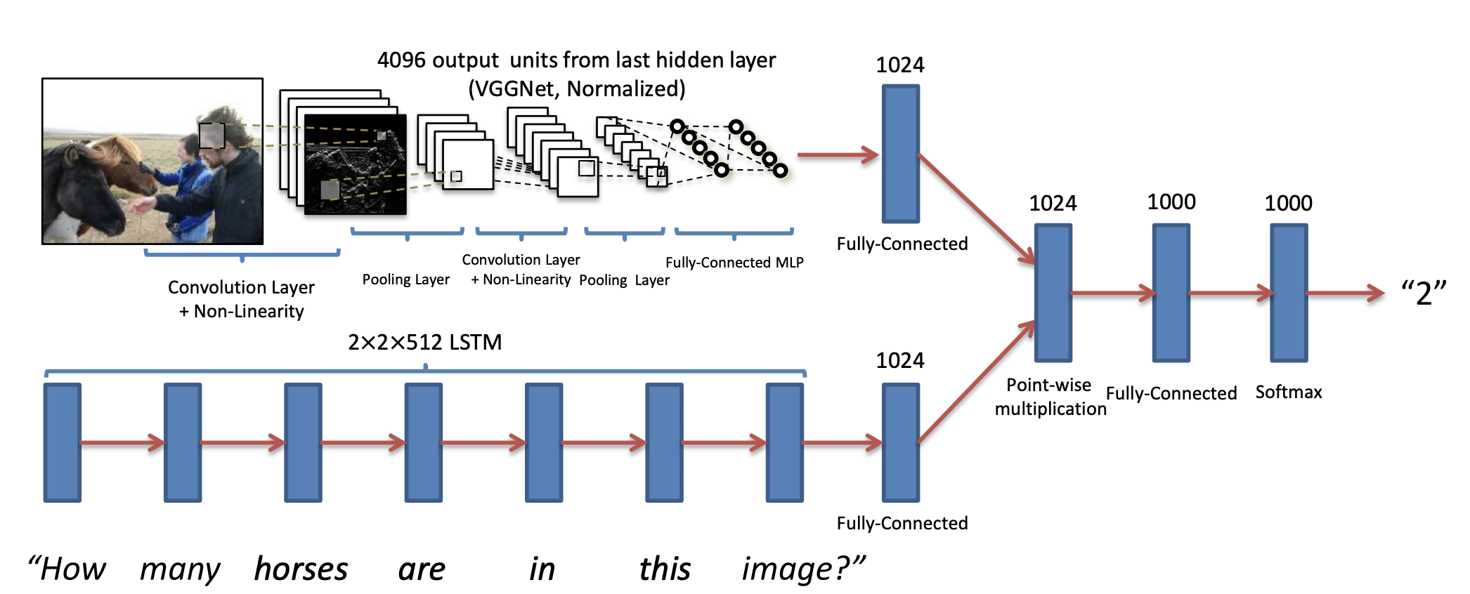
Open Ended Questions Model

Slide 25
Open Ended Questions

Slide 26
Memory Networks (QA but text-only)
Sukhbaatar et al 2015

Slide 27
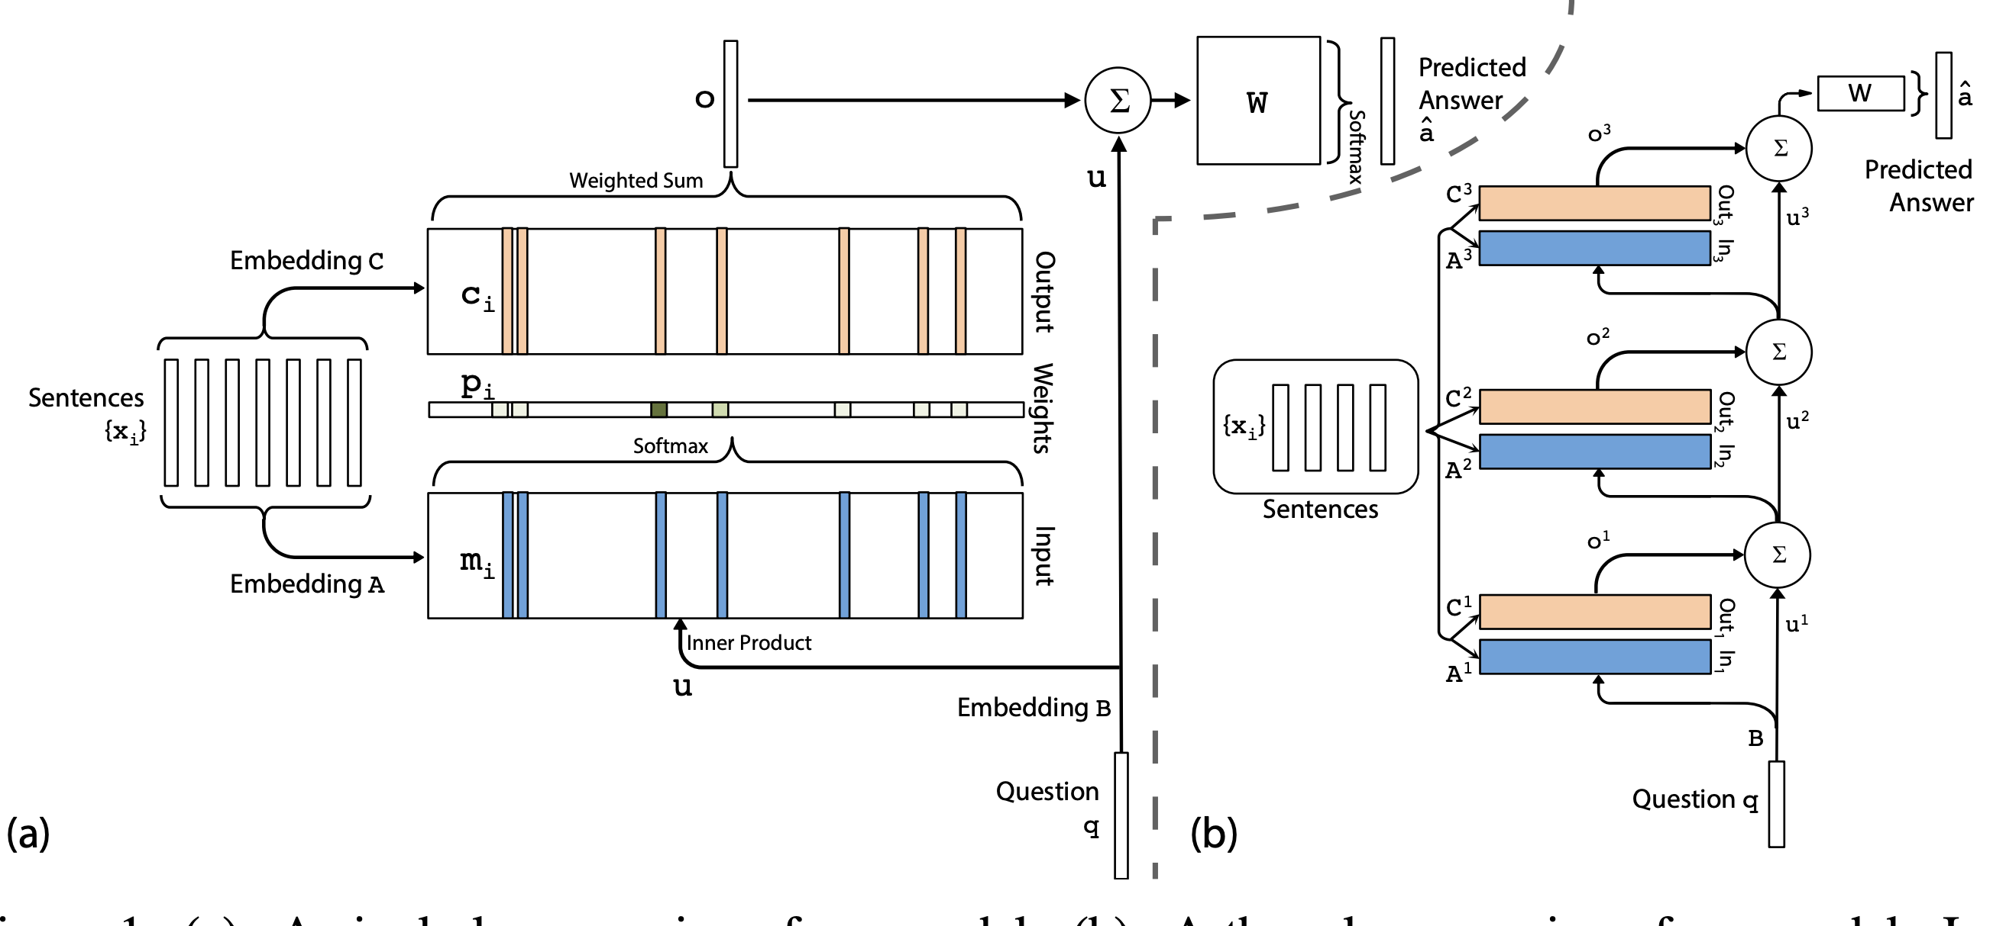
Memory Networks
Sukhbaatar et al 2015

Slide 28
Memory Networks for VQA

Slide 29
Questions?

