Slide 1
Softmax Classifier + SGD

Slide 2
Today’s Class
Intro to Machine Learning
What is Machine Learning?
Supervised Learning: Classification with K-nearest neighbors
Unsupervised Learning: Clustering with K-means clustering
Softmax Classifier
Stochastic Gradient Descent
Regularization

Slide 3
Teaching Assistants
Ziyan Yang
(tw8cb@virginia.edu)
Office Hours: Thursdays 3 to 5pm (Rice 442)
Paola Cascante-Bonilla
(pc9za@virginia.edu)
Hours: Fridays 2 to 4pm (Rice 442)

Slide 4
Also…
Assignment 2 will be released between today and tomorrow.
Subscribe and check Piazza regularly, important information about assignments will go there. Please use Piazza.

Slide 5
Machine Learning
Machine learning is the subfield of computer science that gives "computers the ability to learn without being explicitly programmed.”
- term coined by Arthur Samuel 1959 while at IBM
The study of algorithms that can learn from data.
In contrast to previous Artificial Intelligence systems based on Logic, e.g. ”Expert Systems”

Slide 6
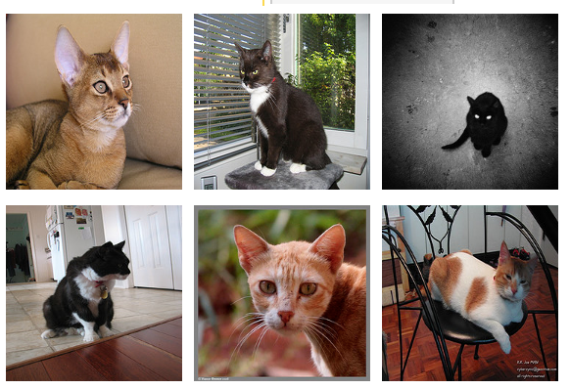
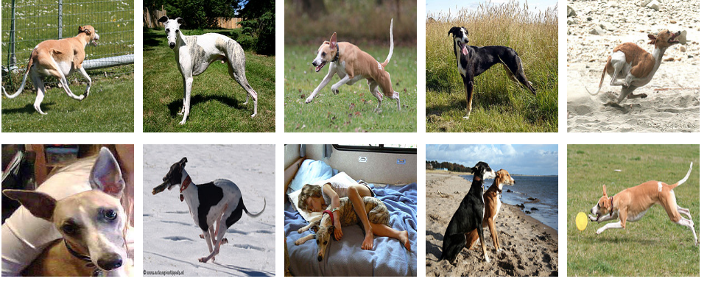
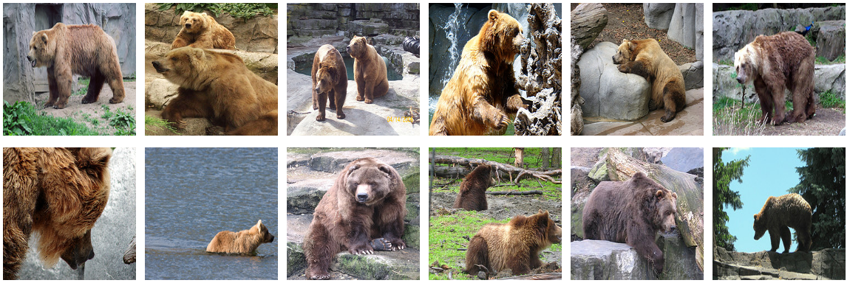

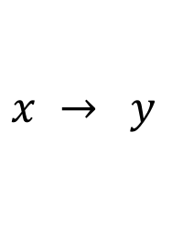
Supervised Learning vs Unsupervised Learning
$$x → y$$
$$x$$
cat
dog
bear
dog
bear
dog
cat
cat
bear

Slide 7
Supervised Learning vs Unsupervised Learning
$$x → y$$
$$x$$
cat
dog
bear
dog
bear
dog
cat
cat
bear

Slide 8
Supervised Learning vs Unsupervised Learning
$$x → y$$
$$x$$
cat
dog
bear
Classification
dog
Clustering
bear
dog
cat
cat
bear

Slide 9
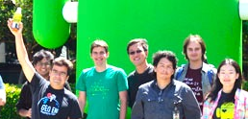
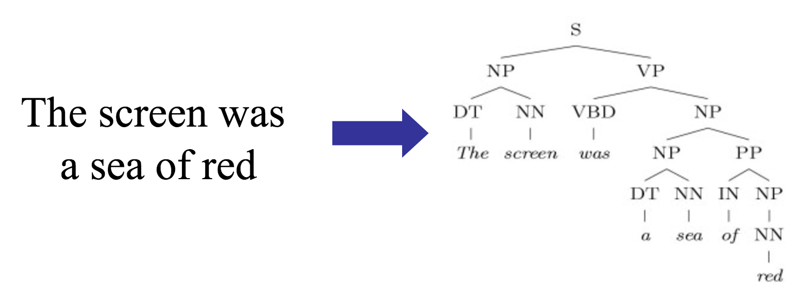
Supervised Learning Examples
Classification
cat
Face Detection
Language Parsing
Structured Prediction

Slide 10
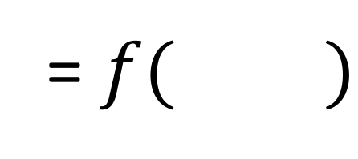
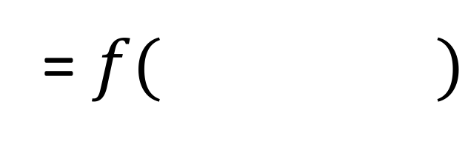
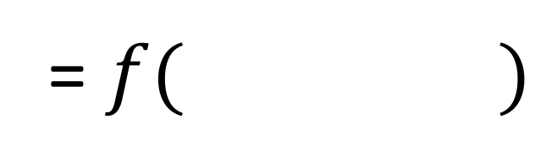
Supervised Learning Examples
= $f( )$
cat
= $f( )$
= $f( )$

Slide 11
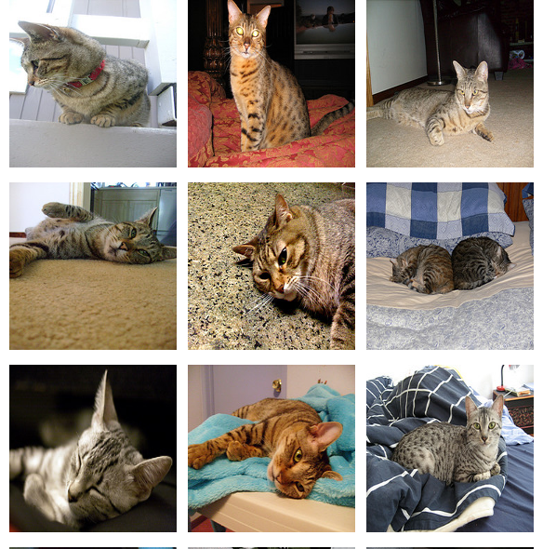
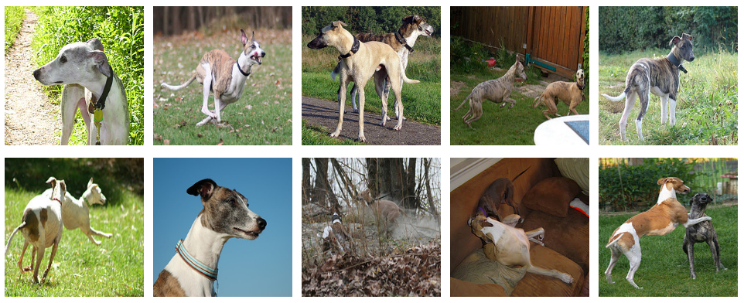
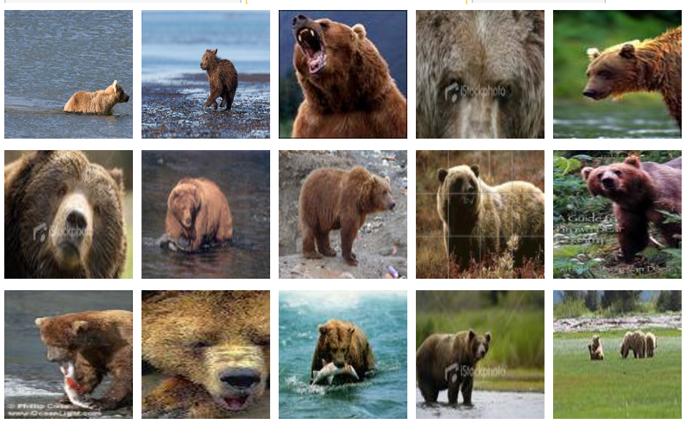
Supervised Learning – k-Nearest Neighbors
cat
dog
bear
k=3
cat, cat, dog
cat
cat
dog
bear
dog
bear

Slide 12
Supervised Learning – k-Nearest Neighbors
cat
dog
bear
k=3
cat
cat
bear, dog, dog
dog
bear
dog
bear

Slide 13
Supervised Learning – k-Nearest Neighbors
How do we choose the right K?
How do we choose the right features?
How do we choose the right distance metric?

Slide 14
Supervised Learning – k-Nearest Neighbors
How do we choose the right K?
How do we choose the right features?
How do we choose the right distance metric?
Answer: Just choose the one combination that works best!
BUT not on the test data.
Instead split the training data into a ”Training set” and
a ”Validation set” (also called ”Development set”)

Slide 15
Training, Validation (Dev), Test Sets
Training Set
Validation Set
Testing Set

Slide 16
Training, Validation (Dev), Test Sets
Training Set
Validation Set
Testing Set
Used during development

Slide 17
Training, Validation (Dev), Test Sets
Training Set
Validation Set
Testing Set
Only to be used for evaluating the model at the very end of development and any changes to the model after running it on the test set, could be influenced by what you saw happened on the test set, which would invalidate any future evaluation.

Slide 18
Unsupervised Learning – k-means clustering
k = 3
1. Initially assign all images to a random cluster

Slide 19
Unsupervised Learning – k-means clustering
k = 3
2. Compute the
mean image (in feature space) for each cluster

Slide 20
Unsupervised Learning – k-means clustering
k = 3
3. Reassign images to clusters
based on similarity to cluster means

Slide 21
Unsupervised Learning – k-means clustering
k = 3
4. Keep repeating
this process
until convergence

Slide 22
Unsupervised Learning – k-means clustering
k = 3
4. Keep repeating
this process
until convergence

Slide 23
Unsupervised Learning – k-means clustering
k = 3
4. Keep repeating
this process
until convergence

Slide 24
Unsupervised Learning – k-means clustering
How do we choose the right K?
How do we choose the right features?
How do we choose the right distance metric?
How sensitive is this method with respect to the random assignment of clusters?
Answer: Just choose the one combination that works best!
BUT not on the test data.
Instead split the training data into a ”Training set” and
a ”Validation set” (also called ”Development set”)

Slide 25
Supervised Learning - Classification
Training Data
Test Data
cat
dog
cat
.
.
.
.
.
.
bear

Slide 26
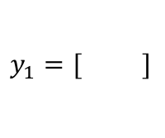
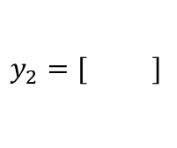
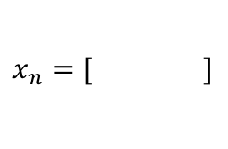
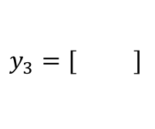
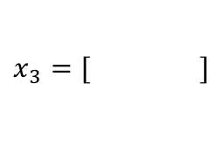
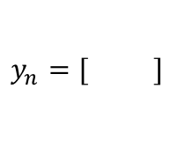
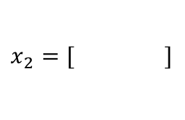
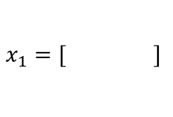
Supervised Learning - Classification
Training Data
cat
$$x_{1}=[ ]$$
$$y_{1}=[ ]$$
dog
$$x_{2}=[ ]$$
$$y_{2}=[ ]$$
cat
$$x_{3}=[ ]$$
$$y_{3}=[ ]$$
.
.
.
bear
$$x_{n}=[ ]$$
$$y_{n}=[ ]$$

Slide 27
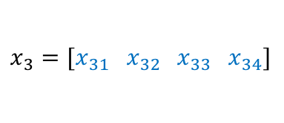


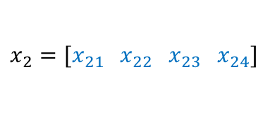


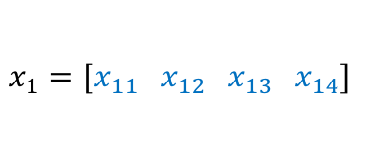
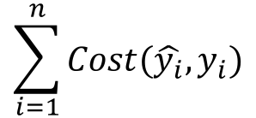




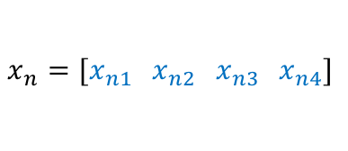

Supervised Learning - Classification
Training Data
targets /
labels /
ground truth
We need to find a function that
maps x and y for any of them.
inputs
predictions
$$x_{1}=[x_{11} { x}_{12} x_{13} { x}_{14}]$$
$$y_{1}=$$
1
$${\hat{y}}_{1}=$$
1
$$\hat{y_{i}}=f(x_{i};θ)$$
$$x_{2}=[x_{21} { x}_{22} x_{23} { x}_{24}]$$
$$y_{2}=$$
2
$${\hat{y}}_{2}=$$
2
$$x_{3}=[x_{31} { x}_{32} x_{33} { x}_{34}]$$
$$y_{3}=$$
1
$${\hat{y}}_{3}=$$
2
How do we ”learn” the parameters
of this function?
.
.
.
We choose ones that makes the
following quantity small:
$$\sum_{i=1}^{n}{Cost(\hat{y_{i}}, y_{i})}$$
$$x_{n}=[x_{n1} { x}_{n2} x_{n3} { x}_{n4}]$$
$$y_{n}=$$
3
$${\hat{y}}_{n}=$$
1

Slide 28
Supervised Learning – Linear Softmax
Training Data
targets /
labels /
ground truth
inputs
$$x_{1}=[x_{11} { x}_{12} x_{13} { x}_{14}]$$
$$y_{1}=$$
1
$$x_{2}=[x_{21} { x}_{22} x_{23} { x}_{24}]$$
$$y_{2}=$$
2
$$x_{3}=[x_{31} { x}_{32} x_{33} { x}_{34}]$$
$$y_{3}=$$
1
.
.
.
$$x_{n}=[x_{n1} { x}_{n2} x_{n3} { x}_{n4}]$$
$$y_{n}=$$
3

Slide 29




Supervised Learning – Linear Softmax
Training Data
targets /
labels /
ground truth
inputs
predictions
$$x_{1}=[x_{11} { x}_{12} x_{13} { x}_{14}]$$
$$y_{1}=$$
[1 0 0]
$${\hat{y}}_{1}=$$
[0.85 0.10 0.05]
$$x_{2}=[x_{21} { x}_{22} x_{23} { x}_{24}]$$
$$y_{2}=$$
[0 1 0]
$${\hat{y}}_{2}=$$
[0.20 0.70 0.10]
$$x_{3}=[x_{31} { x}_{32} x_{33} { x}_{34}]$$
$$y_{3}=$$
[1 0 0]
$${\hat{y}}_{3}=$$
[0.40 0.45 0.15]
.
.
.
$$x_{n}=[x_{n1} { x}_{n2} x_{n3} { x}_{n4}]$$
$$y_{n}=$$
[0 0 1]
$${\hat{y}}_{n}=$$
[0.40 0.25 0.35]

Slide 30

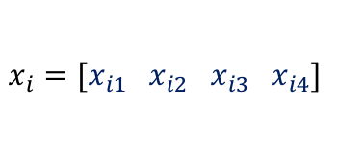


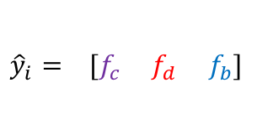

Supervised Learning – Linear Softmax
$$x_{i}=[x_{i1} { x}_{i2} x_{i3} { x}_{i4}]$$
$$y_{i}=$$
[1 0 0]
$${\hat{y}}_{i}= [f_{c} f_{d} f_{b}]$$
$$g_{c}=w_{c1}x_{i1}+w_{c2}x_{i2}+w_{c3}x_{i3}+w_{c4}x_{i4}+b_{c}$$
$$g_{d}=w_{d1}x_{i1}+w_{d2}x_{i2}+w_{d3}x_{i3}+w_{d4}x_{i4}+b_{d}$$
$$g_{b}=w_{b1}x_{i1}+w_{b2}x_{i2}+w_{b3}x_{i3}+w_{b4}x_{i4}+b_{b}$$
$$f_{c}=e^{g_{c}}/{(e}^{g_{c}}+e^{g_{d}}+e^{g_{b}})$$
$$f_{d}=e^{g_{d}}/{(e}^{g_{c}}+e^{g_{d}}+e^{g_{b}})$$
$$f_{b}=e^{g_{b}}/{(e}^{g_{c}}+e^{g_{d}}+e^{g_{b}})$$

Slide 31
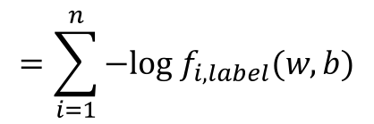
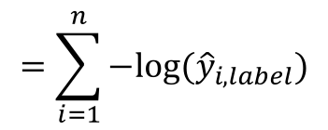
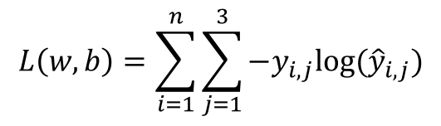
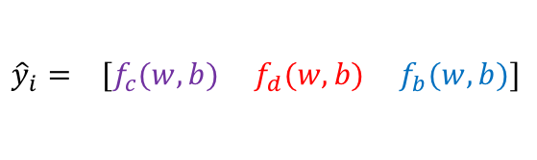
How do we find a good w and b?
$$x_{i}=[x_{i1} { x}_{i2} x_{i3} { x}_{i4}]$$
$$y_{i}=$$
[1 0 0]
$${\hat{y}}_{i}= [f_{c}(w,b) f_{d}(w,b) f_{b}(w,b)]$$
We need to find w, and b that minimize the following:
$$L\left(w,b\right)=\sum_{i=1}^{n}{\sum_{j=1}^{3}{−y_{i,j}log⁡({\hat{y}}_{i,j})}}$$
$$=\sum_{i=1}^{n}{−log⁡({\hat{y}}_{i,label})}$$
$$=\sum_{i=1}^{n}{−log f_{i,label}(w,b)}$$
Why?

Slide 32


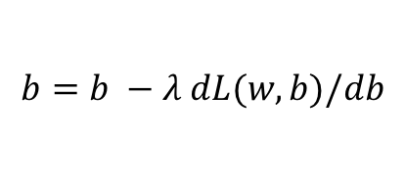
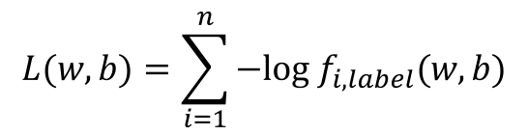
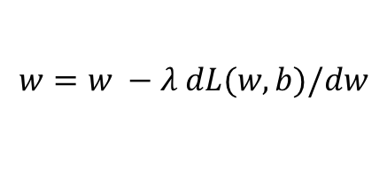


Gradient Descent (GD)
$$λ=0.01$$
$$L(w,b)=\sum_{i=1}^{n}{−log f_{i,label}(w,b)}$$
Initialize w and b randomly
for e = 0, num_epochs do
Compute:
$$dL(w,b)/dw$$
and
$$dL(w,b)/db$$
Update w:
$$w=w −λ dL(w,b)/dw$$
Update b:
$$b=b −λ dL(w,b)/db$$
Print:
$$L(w,b)$$
// Useful to see if this is becoming smaller or not.
end

Slide 33


Gradient Descent (GD) (idea)
1. Start with a random value of w (e.g. w = 12)
$$L\left(w\right)$$
2. Compute the gradient (derivative) of L(w) at point w = 12. (e.g. dL/dw = 6)
3. Recompute w as:
w = w – lambda * (dL / dw)
w=12
$$w$$

Slide 34
Gradient Descent (GD) (idea)
$$L\left(w\right)$$
2. Compute the gradient (derivative) of L(w) at point w = 12. (e.g. dL/dw = 6)
3. Recompute w as:
w = w – lambda * (dL / dw)
w=10
$$w$$

Slide 35
Gradient Descent (GD) (idea)
$$L\left(w\right)$$
2. Compute the gradient (derivative) of L(w) at point w = 12. (e.g. dL/dw = 6)
3. Recompute w as:
w = w – lambda * (dL / dw)
w=8
$$w$$

Slide 36
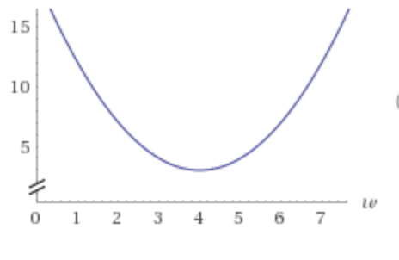

Our function L(w)
$$L\left(w\right)={3+(1 − w)}^{2}$$

Slide 37
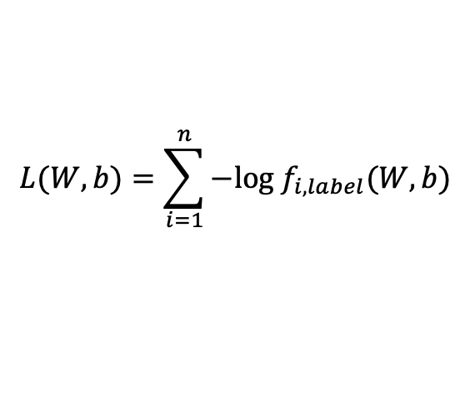
Our function L(w)
$$L\left(w\right)={3+(1 − w)}^{2}$$
$$L(W,b)=\sum_{i=1}^{n}{−log f_{i,label}(W,b)}$$

Slide 38
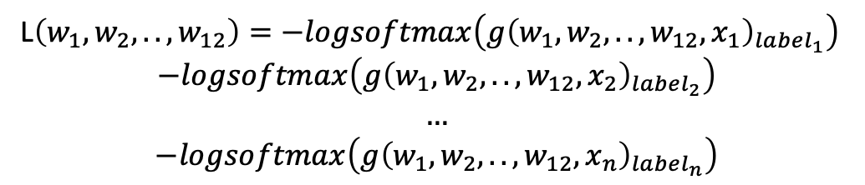
Our function L(w)
$$L\left(w\right)={3+(1 − w)}^{2}$$
L$\left(w_{1},w_{2},.., w_{12}\right)=−logsoftmax\left(g{\left(w_{1},w_{2},..,w_{12}, x_{1}\right)}_{label_{1}}\right)$ $$−logsoftmax\left(g{\left(w_{1},w_{2},..,w_{12}, x_{2}\right)}_{label_{2}}\right) \\ …$$
$$−logsoftmax\left(g{\left(w_{1},w_{2},..,w_{12}, x_{n}\right)}_{label_{n}}\right)$$

Slide 39
Gradient Descent (GD)
expensive
$$λ=0.01$$
$$L(w,b)=\sum_{i=1}^{n}{−log f_{i,label}(w,b)}$$
Initialize w and b randomly
for e = 0, num_epochs do
Compute:
$$dL(w,b)/dw$$
and
$$dL(w,b)/db$$
Update w:
$$w=w −λ dL(w,b)/dw$$
Update b:
$$b=b −λ dL(w,b)/db$$
Print:
$$L(w,b)$$
// Useful to see if this is becoming smaller or not.
end

Slide 40

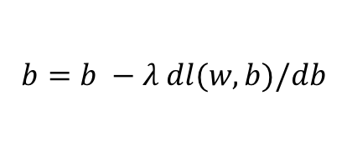
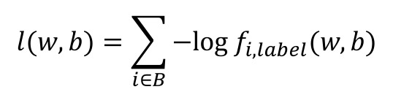
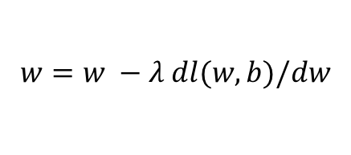


(mini-batch) Stochastic Gradient Descent (SGD)
$$λ=0.01$$
$$l(w,b)=\sum_{i∈B}{−log f_{i,label}(w,b)}$$
Initialize w and b randomly
for e = 0, num_epochs do
for b = 0, num_batches do
Compute:
$$dl(w,b)/dw$$
and
$$dl(w,b)/db$$
Update w:
$$w=w −λ dl(w,b)/dw$$
Update b:
$$b=b −λ dl(w,b)/db$$
Print:
$$l(w,b)$$
// Useful to see if this is becoming smaller or not.
end
end

Slide 41
Source: Andrew Ng

Slide 42
(mini-batch) Stochastic Gradient Descent (SGD)
$$λ=0.01$$
$$l(w,b)=\sum_{i∈B}{−log f_{i,label}(w,b)}$$
Initialize w and b randomly
for e = 0, num_epochs do
for b = 0, num_batches do
Compute:
$$dl(w,b)/dw$$
and
$$dl(w,b)/db$$
for |B| = 1
Update w:
$$w=w −λ dl(w,b)/dw$$
Update b:
$$b=b −λ dl(w,b)/db$$
Print:
$$l(w,b)$$
// Useful to see if this is becoming smaller or not.
end
end

Slide 43
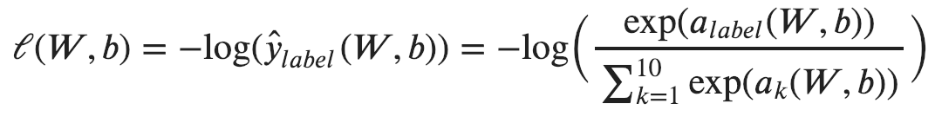
Computing Analytic Gradients
This is what we have:

Slide 44
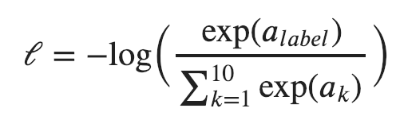

Computing Analytic Gradients
This is what we have:
Reminder:
$$a_{i}=(w_{i,1}x_{1}+w_{i,2}+w_{i,3}+w_{i,4})+b_{i}$$

Slide 45
Computing Analytic Gradients
This is what we have:

Slide 46
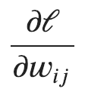

Computing Analytic Gradients
This is what we have:
This is what we need:
for each
for each

Slide 47
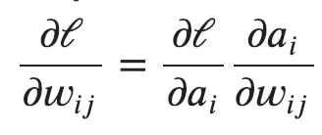
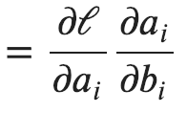
Computing Analytic Gradients
This is what we have:
Step 1: Chain Rule of Calculus

Slide 48
Computing Analytic Gradients
This is what we have:
Step 1: Chain Rule of Calculus
Let’s do these first

Slide 49
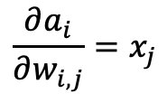
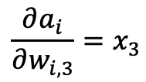
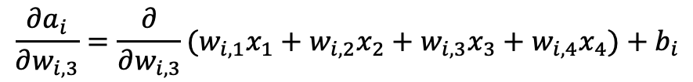
Computing Analytic Gradients
$$a_{i}=(w_{i,1}x_{1}+w_{i,2}x_{2}+w_{i,3}x_{3}+w_{i,4}x_{4})+b_{i}$$
$$\frac{∂a_{i}}{∂w_{i, 3}}=\frac{∂}{∂w_{i, 3}}(w_{i,1}x_{1}+w_{i,2}x_{2}+w_{i,3}x_{3}+w_{i,4}x_{4})+b_{i}$$
$$\frac{∂a_{i}}{∂w_{i, 3}}=x_{3}$$
$$\frac{∂a_{i}}{∂w_{i, j}}=x_{j}$$

Slide 50
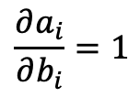
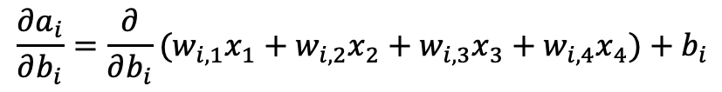

Computing Analytic Gradients
$$\frac{∂a_{i}}{∂w_{i, j}}=x_{j}$$
$$a_{i}=(w_{i,1}x_{1}+w_{i,2}x_{2}+w_{i,3}x_{3}+w_{i,4}x_{4})+b_{i}$$
$$\frac{∂a_{i}}{∂b_{i}}=\frac{∂}{∂b_{i}}(w_{i,1}x_{1}+w_{i,2}x_{2}+w_{i,3}x_{3}+w_{i,4}x_{4})+b_{i}$$
$$\frac{∂a_{i}}{∂b_{i}}=1$$

Slide 51

Computing Analytic Gradients
$$\frac{∂a_{i}}{∂w_{i, j}}=x_{j}$$
$$\frac{∂a_{i}}{∂b_{i}}=1$$

Slide 52
Computing Analytic Gradients
This is what we have:
Step 1: Chain Rule of Calculus
Now let’s do this one (same for both!)

Slide 53


Computing Analytic Gradients
In our cat, dog, bear classification example: i = {0, 1, 2}

Slide 54



Computing Analytic Gradients
In our cat, dog, bear classification example: i = {0, 1, 2}
$$\frac{∂ℓ}{∂a_{0}}$$
$$\frac{∂ℓ}{∂a_{1}}$$
$$\frac{∂ℓ}{∂a_{2}}$$
Let’s say: label = 1
We need:

Slide 55




Computing Analytic Gradients
$$\frac{∂ℓ}{∂a_{0}}$$
$$\frac{∂ℓ}{∂a_{2}}$$
$$={\hat{y}}_{i}$$

Slide 56
Remember this slide?
$$x_{i}=[x_{i1} { x}_{i2} x_{i3} { x}_{i4}]$$
$$y_{i}=$$
[1 0 0]
$${\hat{y}}_{i}= [f_{c} f_{d} f_{b}]$$
$$g_{c}=w_{c1}x_{i1}+w_{c2}x_{i2}+w_{c3}x_{i3}+w_{c4}x_{i4}+b_{c}$$
$$g_{d}=w_{d1}x_{i1}+w_{d2}x_{i2}+w_{d3}x_{i3}+w_{d4}x_{i4}+b_{d}$$
$$g_{b}=w_{b1}x_{i1}+w_{b2}x_{i2}+w_{b3}x_{i3}+w_{b4}x_{i4}+b_{b}$$
$$f_{c}=e^{g_{c}}/{(e}^{g_{c}}+e^{g_{d}}+e^{g_{b}})$$
$$f_{d}=e^{g_{d}}/{(e}^{g_{c}}+e^{g_{d}}+e^{g_{b}})$$
$$f_{b}=e^{g_{b}}/{(e}^{g_{c}}+e^{g_{d}}+e^{g_{b}})$$

Slide 57
Computing Analytic Gradients
$$\frac{∂ℓ}{∂a_{0}}$$
$$\frac{∂ℓ}{∂a_{2}}$$
$$={\hat{y}}_{i}$$

Slide 58


Computing Analytic Gradients
$$\frac{∂ℓ}{∂a_{1}}$$
$$={\hat{y}}_{i}−1$$

Slide 59





Computing Analytic Gradients
label = 1
$$\frac{∂ℓ}{∂a_{0}}={\hat{y}}_{0}$$
$$\frac{∂ℓ}{∂a_{1}}={\hat{y}}_{1}−1$$
$$\frac{∂ℓ}{∂a_{1}}={\hat{y}}_{2}$$
$\frac{∂ℓ}{∂a}=\left[\begin{aligned}\frac{∂ℓ}{∂a_{0}} \\ \frac{∂ℓ}{∂a_{1}} \\ \frac{∂ℓ}{∂a_{2}}\end{aligned}\right]$= $\left[\begin{aligned}{\hat{y}}_{0} \\ {\hat{y}}_{1}−1 \\ {\hat{y}}_{2}\end{aligned}\right]=\left[\begin{aligned}{\hat{y}}_{0} \\ {\hat{y}}_{1} \\ {\hat{y}}_{2}\end{aligned}\right]−\left[\begin{aligned}0 \\ 1 \\ 0\end{aligned}\right]=\hat{y}−y$
$$\frac{∂ℓ}{∂a_{i}}={\hat{y}}_{i}−y_{i}$$

Slide 60





Computing Analytic Gradients
$$\frac{∂a_{i}}{∂w_{i, j}}=x_{j}$$
$$\frac{∂a_{i}}{∂b_{i}}=1$$
$$\frac{∂ℓ}{∂a_{i}}={\hat{y}}_{i}−y_{i}$$
$$\frac{∂ℓ}{∂w_{i, j}}=\left({\hat{y}}_{i}−y_{i}\right)x_{j}$$
$$\frac{∂ℓ}{∂b_{i}}=\left({\hat{y}}_{i}−y_{i}\right)$$

Slide 61





Supervised Learning –Softmax Classifier
$${\hat{y}}_{i}= [f_{c} f_{d} f_{b}]$$
Extract features
$$x_{i}=[x_{i1} { x}_{i2} x_{i3} { x}_{i4}]$$
Run features through classifier
$$g_{c}=w_{c1}x_{i1}+w_{c2}x_{i2}+w_{c3}x_{i3}+w_{c4}x_{i4}+b_{c}$$
$$g_{d}=w_{d1}x_{i1}+w_{d2}x_{i2}+w_{d3}x_{i3}+w_{d4}x_{i4}+b_{d}$$
$$g_{b}=w_{b1}x_{i1}+w_{b2}x_{i2}+w_{b3}x_{i3}+w_{b4}x_{i4}+b_{b}$$
Get predictions
$$f_{c}=e^{g_{c}}/{(e}^{g_{c}}+e^{g_{d}}+e^{g_{b}})$$
$$f_{d}=e^{g_{d}}/{(e}^{g_{c}}+e^{g_{d}}+e^{g_{b}})$$
$$f_{b}=e^{g_{b}}/{(e}^{g_{c}}+e^{g_{d}}+e^{g_{b}})$$

Slide 62
More …
Regularization
Momentum updates
Hinge Loss, Least Squares Loss, Logistic Regression Loss

Slide 63
Assignment 2 – Linear Margin-Classifier
Training Data
targets /
labels /
ground truth
inputs
predictions
$$x_{1}=[x_{11} { x}_{12} x_{13} { x}_{14}]$$
$$y_{1}=$$
[1 0 0]
$${\hat{y}}_{1}=$$
[4.3 -1.3 1.1]
$$x_{2}=[x_{21} { x}_{22} x_{23} { x}_{24}]$$
$$y_{2}=$$
[0 1 0]
$${\hat{y}}_{2}=$$
[0.5 5.6 -4.2]
$$x_{3}=[x_{31} { x}_{32} x_{33} { x}_{34}]$$
$$y_{3}=$$
[1 0 0]
$${\hat{y}}_{3}=$$
[3.3 3.5 1.1]
.
.
.
$$x_{n}=[x_{n1} { x}_{n2} x_{n3} { x}_{n4}]$$
$$y_{n}=$$
[0 0 1]
$${\hat{y}}_{n}=$$
[1.1 -5.3 -9.4]

Slide 64

Supervised Learning – Linear Softmax
$$x_{i}=[x_{i1} { x}_{i2} x_{i3} { x}_{i4}]$$
$$y_{i}=$$
[1 0 0]
$${\hat{y}}_{i}= [f_{c} f_{d} f_{b}]$$
$$f_{c}=w_{c1}x_{i1}+w_{c2}x_{i2}+w_{c3}x_{i3}+w_{c4}x_{i4}+b_{c}$$
$$f_{d}=w_{d1}x_{i1}+w_{d2}x_{i2}+w_{d3}x_{i3}+w_{d4}x_{i4}+b_{d}$$
$$f_{b}=w_{b1}x_{i1}+w_{b2}x_{i2}+w_{b3}x_{i3}+w_{b4}x_{i4}+b_{b}$$

Slide 65

How do we find a good w and b?
$$x_{i}=[x_{i1} { x}_{i2} x_{i3} { x}_{i4}]$$
$$y_{i}=$$
[1 0 0]
$${\hat{y}}_{i}= [f_{c}(w,b) f_{d}(w,b) f_{b}(w,b)]$$
We need to find w, and b that minimize the following:
$$L\left(w,b\right)=\sum_{i=1}^{n}{\sum_{j≠label}{max⁡({0, \hat{y}}_{ij}−{\hat{y}}_{i,label}+Δ)}}$$
Why?

Slide 66
Regression vs Classification
Regression
Labels are continuous variables – e.g. distance.
Losses: Distance-based losses, e.g. sum of distances to true values.
Evaluation: Mean distances, correlation coefficients, etc.
Classification
Labels are discrete variables (1 out of K categories)
Losses: Cross-entropy loss, margin losses, logistic regression (binary cross entropy)
Evaluation: Classification accuracy, etc.

Slide 67










Linear Regression – 1 output, 1 input
$$y$$
$$(x_{8},y_{8})$$
$$(x_{6},y_{6})$$
$$(x_{7},y_{7})$$
$$(x_{4},y_{4})$$
$$(x_{5},y_{5})$$
$$(x_{2},y_{2})$$
$$(x_{3},y_{3})$$
$$(x_{1},y_{1})$$
$$x$$

Slide 68

Linear Regression – 1 output, 1 input
$$y$$
$$(x_{8},y_{8})$$
$$(x_{6},y_{6})$$
$$(x_{7},y_{7})$$
$$(x_{4},y_{4})$$
$$(x_{5},y_{5})$$
$$(x_{2},y_{2})$$
$$(x_{3},y_{3})$$
$$(x_{1},y_{1})$$
$$x$$
Model:
$$\hat{y}=wx+b$$

Slide 69
Linear Regression – 1 output, 1 input
$$y$$
$$(x_{8},y_{8})$$
$$(x_{6},y_{6})$$
$$(x_{7},y_{7})$$
$$(x_{4},y_{4})$$
$$(x_{5},y_{5})$$
$$(x_{2},y_{2})$$
$$(x_{3},y_{3})$$
$$(x_{1},y_{1})$$
$$x$$
Model:
$$\hat{y}=wx+b$$

Slide 70

Linear Regression – 1 output, 1 input
$$y$$
$$(x_{8},y_{8})$$
$$(x_{6},y_{6})$$
$$(x_{7},y_{7})$$
$$(x_{4},y_{4})$$
$$(x_{5},y_{5})$$
$$(x_{2},y_{2})$$
$$(x_{3},y_{3})$$
$$(x_{1},y_{1})$$
$$x$$
$$L\left(w,b\right)=\sum_{i=1}^{i=8}{{\left({\hat{y}}_{i}−y_{i}\right)}^{2}}$$
Model:
$$\hat{y}=wx+b$$
Loss:

Slide 71

Quadratic Regression
$$y$$
$$(x_{8},y_{8})$$
$$(x_{6},y_{6})$$
$$(x_{7},y_{7})$$
$$(x_{4},y_{4})$$
$$(x_{5},y_{5})$$
$$(x_{2},y_{2})$$
$$(x_{3},y_{3})$$
$$(x_{1},y_{1})$$
$$x$$
$$L\left(w,b\right)=\sum_{i=1}^{i=8}{{\left({\hat{y}}_{i}−y_{i}\right)}^{2}}$$
Model:
$$\hat{y}=w_{1}x^{2}+w_{2}x+b$$
Loss:

Slide 72

n-polynomial Regression
$$y$$
$$(x_{8},y_{8})$$
$$(x_{6},y_{6})$$
$$(x_{7},y_{7})$$
$$(x_{4},y_{4})$$
$$(x_{5},y_{5})$$
$$(x_{2},y_{2})$$
$$(x_{3},y_{3})$$
$$(x_{1},y_{1})$$
$$x$$
$$L\left(w,b\right)=\sum_{i=1}^{i=8}{{\left({\hat{y}}_{i}−y_{i}\right)}^{2}}$$
Model:
$$\hat{y}=w_{n}x^{n}+…+w_{1}x+b$$
Loss:

Slide 73









Overfitting
$f$ is a polynomial of degree 9
$f$ is linear
$f$ is cubic
$Loss\left(w\right)$ is high
$Loss\left(w\right)$ is low
$Loss\left(w\right)$ is zero!
Underfitting
Overfitting
High Bias
High Variance
Christopher M. Bishop – Pattern Recognition and Machine Learning
Credit: C. Bishop. Pattern Recognition and Mach. Learning.

Slide 74

Regularization
Large weights lead to large variance. i.e. model fits to the training data too strongly.
Solution: Minimize the loss but also try to keep the weight values small by doing the following:
$$L\left(w,b\right)+\sum_{i}{{|w_{i}|}^{2}}$$
minimize
Credit: C. Bishop. Pattern Recognition and Mach. Learning.

Slide 75

Regularization
Large weights lead to large variance. i.e. model fits to the training data too strongly.
Solution: Minimize the loss but also try to keep the weight values small by doing the following:
$$L\left(w,b\right)+α\sum_{i}{{|w_{i}|}^{2}}$$
minimize
Regularizer term
e.g. L2- regularizer
Credit: C. Bishop. Pattern Recognition and Mach. Learning.

Slide 76



SGD with Regularization (L-2)
$$λ=0.01$$
$l\left(w,b\right)=l\left(w,b\right)+α$ $\sum_{i}{{|w_{i}|}^{2}}$
Initialize w and b randomly
for e = 0, num_epochs do
for b = 0, num_batches do
Compute:
$$dl(w,b)/dw$$
and
$$dl(w,b)/db$$
Update w:
$$w=w −λ dl(w,b)/dw−λαw$$
Update b:
$$b=b −λ dl(w,b)/db−λαw$$
Print:
$$l(w,b)$$
// Useful to see if this is becoming smaller or not.
end
end

Slide 77

Revisiting Another Problem with SGD
$$λ=0.01$$
$l\left(w,b\right)=l\left(w,b\right)+α$ $\sum_{i}{{|w_{i}|}^{2}}$
Initialize w and b randomly
for e = 0, num_epochs do
These are only approximations to the true gradient with respect to $L(w,b)$
for b = 0, num_batches do
Compute:
$$dl(w,b)/dw$$
and
$$dl(w,b)/db$$
Update w:
$$w=w −λ dl(w,b)/dw−λαw$$
Update b:
$$b=b −λ dl(w,b)/db−λαw$$
Print:
$$l(w,b)$$
// Useful to see if this is becoming smaller or not.
end
end

Slide 78
Revisiting Another Problem with SGD
$$λ=0.01$$
$l\left(w,b\right)=l\left(w,b\right)+α$ $\sum_{i}{{|w_{i}|}^{2}}$
Initialize w and b randomly
for e = 0, num_epochs do
This could lead to “un-learning” what has been learned in some previous steps of training.
for b = 0, num_batches do
Compute:
$$dl(w,b)/dw$$
and
$$dl(w,b)/db$$
Update w:
$$w=w −λ dl(w,b)/dw−λαw$$
Update b:
$$b=b −λ dl(w,b)/db−λαw$$
Print:
$$l(w,b)$$
// Useful to see if this is becoming smaller or not.
end
end

Slide 79
Solution: Momentum Updates
$$λ=0.01$$
$l\left(w,b\right)=l\left(w,b\right)+α$ $\sum_{i}{{|w_{i}|}^{2}}$
Initialize w and b randomly
for e = 0, num_epochs do
Keep track of previous gradients in an accumulator variable! and use a weighted average with current gradient.
for b = 0, num_batches do
Compute:
$$dl(w,b)/dw$$
and
$$dl(w,b)/db$$
Update w:
$$w=w −λ dl(w,b)/dw−λαw$$
Update b:
$$b=b −λ dl(w,b)/db−λαw$$
Print:
$$l(w,b)$$
// Useful to see if this is becoming smaller or not.
end
end

Slide 80







Solution: Momentum Updates
$$λ=0.01$$
$$τ=0.9$$
Initialize w and b randomly
$l\left(w,b\right)=l\left(w,b\right)+α$ $\sum_{i}{{|w_{i}|}^{2}}$
global $v$
for e = 0, num_epochs do
for b = 0, num_batches do
Keep track of previous gradients in an accumulator variable! and use a weighted average with current gradient.
Compute:
$$dl(w,b)/dw$$
Compute:
$$v=τv+dl(w,b)/dw+αw$$
Update w:
$$w=w −λ v$$
Print:
$$l(w,b)$$
// Useful to see if this is becoming smaller or not.
end
end

Slide 81

More on Momentum
https://distill.pub/2017/momentum/

Slide 82



Image Features: HoG
Compute gradients
$$\sqrt{I_{x}^{2}+I_{y}^{2}}$$
$$I_{x}$$
$$I_{y}$$
*
Paper by Navneet Dalal & Bill Triggs presented at CVPR 2005 for detecting people.
Scikit-image implementation
Images by Satya Mallick https://www.learnopencv.com/histogram-of-oriented-gradients/

Slide 83
Image Features: HoG
Paper by Navneet Dalal & Bill Triggs presented at CVPR 2005 for detecting people.
Scikit-image implementation
Images by Satya Mallick https://www.learnopencv.com/histogram-of-oriented-gradients/

Slide 84
Image Features: HoG
We will aggregate
gradient magnitude
and directions
in 8x8 pixel regions
Paper by Navneet Dalal & Bill Triggs presented at CVPR 2005 for detecting people.
Scikit-image implementation
Images by Satya Mallick https://www.learnopencv.com/histogram-of-oriented-gradients/

Slide 85
Image Features: HoG
Compute a histogram
with 9 bins for angles from 0 to 180
Paper by Navneet Dalal & Bill Triggs presented at CVPR 2005 for detecting people.
Scikit-image implementation
Images by Satya Mallick https://www.learnopencv.com/histogram-of-oriented-gradients/

Slide 86
Image Features: HoG
Normalize histograms with respect to histograms of adjacent neighbors.
Paper by Navneet Dalal & Bill Triggs presented at CVPR 2005 for detecting people.
Scikit-image implementation
Images by Satya Mallick https://www.learnopencv.com/histogram-of-oriented-gradients/

Slide 87
Image Features: HoG
Image (or image region) represented by a vector containing all the histograms.
In this case how long is that vector?
Paper by Navneet Dalal & Bill Triggs presented at CVPR 2005 for detecting people.
Scikit-image implementation
Images by Satya Mallick https://www.learnopencv.com/histogram-of-oriented-gradients/

Slide 88

Image Features: HoG
+ Block Normalization
Paper by Navneet Dalal & Bill Triggs presented at CVPR 2005 for detecting people. Figure from Zhuolin Jiang, Zhe Lin, Larry S. Davis, ICCV 2009 for human action recognition.

Slide 89
Extract SIFT Feature Descriptors
Compute Histograms of Features
slide by Fei-fei Li

Slide 90
Summary: Image Features
Largely replaced by Neural networks
Still useful to study for inspiration in designing neural networks that compute features.
Many other features proposed
LBP: Local Binary Patterns: Useful for recognizing faces.
Dense SIFT: SIFT features computed on a grid similar to the HOG features.
etc.

Slide 91
Questions?

