Slide 1
Shallow Learning + Image Features

Slide 2
Today’s Class
Classifying Images
Color Based Features
Gradient Based Features
Bag of Visual Words

Slide 3
Also…
Assignment 2 due on Sunday 5pm. Don’t miss it.
Subscribe and check Piazza regularly, important information about assignments will go there. Please use Piazza.

Slide 4
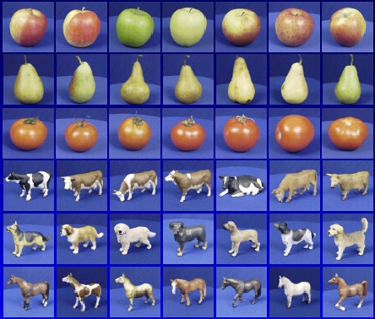

Supervised Machine Learning Steps
Training
Training Labels
Training Images
Image Features
Training
Learned model
Learned model
Testing
Image Features
Prediction
Test Image
Slide credit: D. Hoiem

Slide 5

Generalization
Generalization refers to the ability to correctly classify never before seen examples
Can be controlled by turning “knobs” that affect the complexity of the model
Test set (labels unknown)
Training set (labels known)

Slide 6
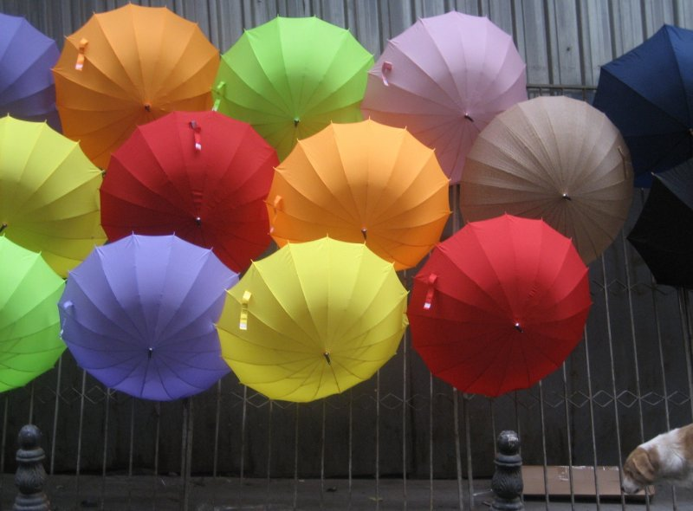

Image Features: Color
Photo by: marielito
slide by Tamara L. Berg

Slide 7
Image Features: Color
Concat(
…
)
Photo by: marielito
You can convert the image into a vector as in Assignment 2

Slide 8
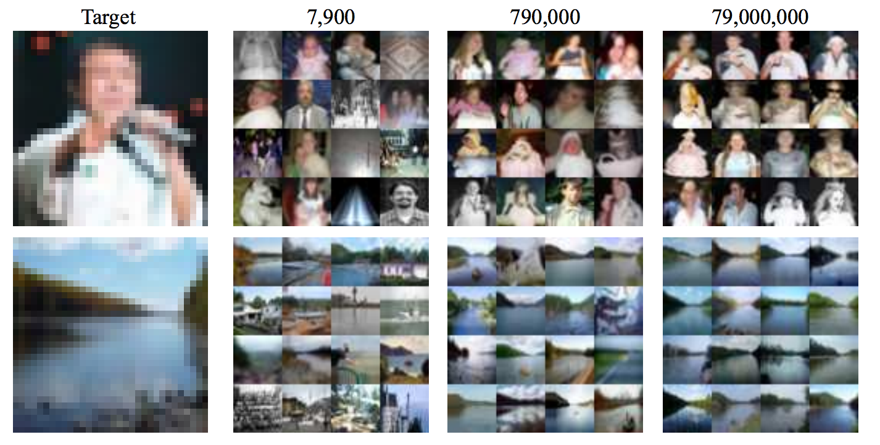
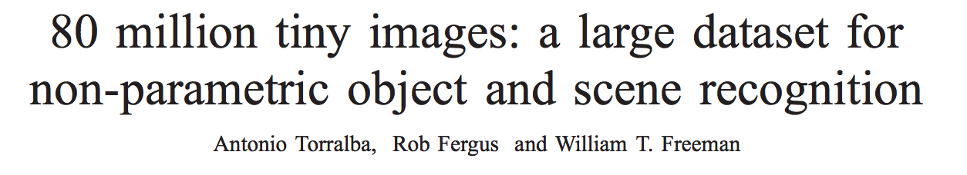
Image Features: Color

Slide 9
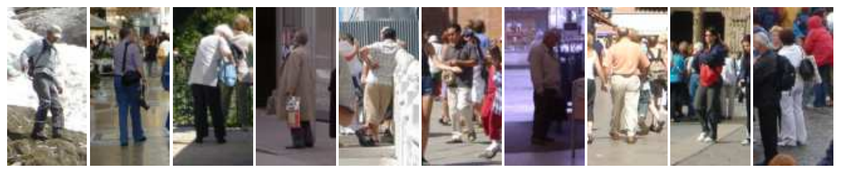
Image Features: Color
However, these are all images of people but the
colors in each image are very different.

Slide 10
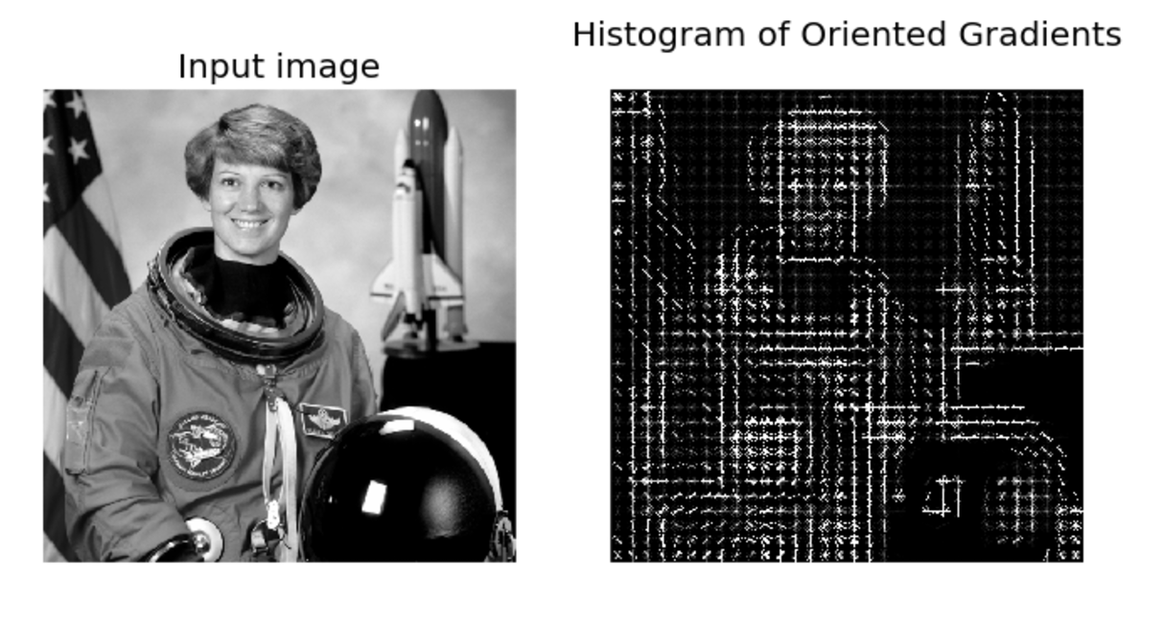
Image Features: HoG
Paper by Navneet Dalal & Bill Triggs presented at CVPR 2005 for detecting people.
Scikit-image implementation

Slide 11



Image Features: HoG
Compute gradients
$$\sqrt{I_{x}^{2}+I_{y}^{2}}$$
$$I_{x}$$
$$I_{y}$$
*
Paper by Navneet Dalal & Bill Triggs presented at CVPR 2005 for detecting people.
Scikit-image implementation
Images by Satya Mallick https://www.learnopencv.com/histogram-of-oriented-gradients/

Slide 12
Image Features: HoG
Paper by Navneet Dalal & Bill Triggs presented at CVPR 2005 for detecting people.
Scikit-image implementation
Images by Satya Mallick https://www.learnopencv.com/histogram-of-oriented-gradients/

Slide 13
Image Features: HoG
We will aggregate
gradient magnitude
and directions
in 8x8 pixel regions
Paper by Navneet Dalal & Bill Triggs presented at CVPR 2005 for detecting people.
Scikit-image implementation
Images by Satya Mallick https://www.learnopencv.com/histogram-of-oriented-gradients/

Slide 14
Image Features: HoG
Compute a histogram
with 9 bins for angles from 0 to 180
Paper by Navneet Dalal & Bill Triggs presented at CVPR 2005 for detecting people.
Scikit-image implementation
Images by Satya Mallick https://www.learnopencv.com/histogram-of-oriented-gradients/

Slide 15
Image Features: HoG
Normalize histograms with respect to histograms of adjacent neighbors.
Paper by Navneet Dalal & Bill Triggs presented at CVPR 2005 for detecting people.
Scikit-image implementation
Images by Satya Mallick https://www.learnopencv.com/histogram-of-oriented-gradients/

Slide 16
Image Features: HoG
Image (or image region) represented by a vector containing all the histograms.
In this case how long is that vector?
Paper by Navneet Dalal & Bill Triggs presented at CVPR 2005 for detecting people.
Scikit-image implementation
Images by Satya Mallick https://www.learnopencv.com/histogram-of-oriented-gradients/

Slide 17
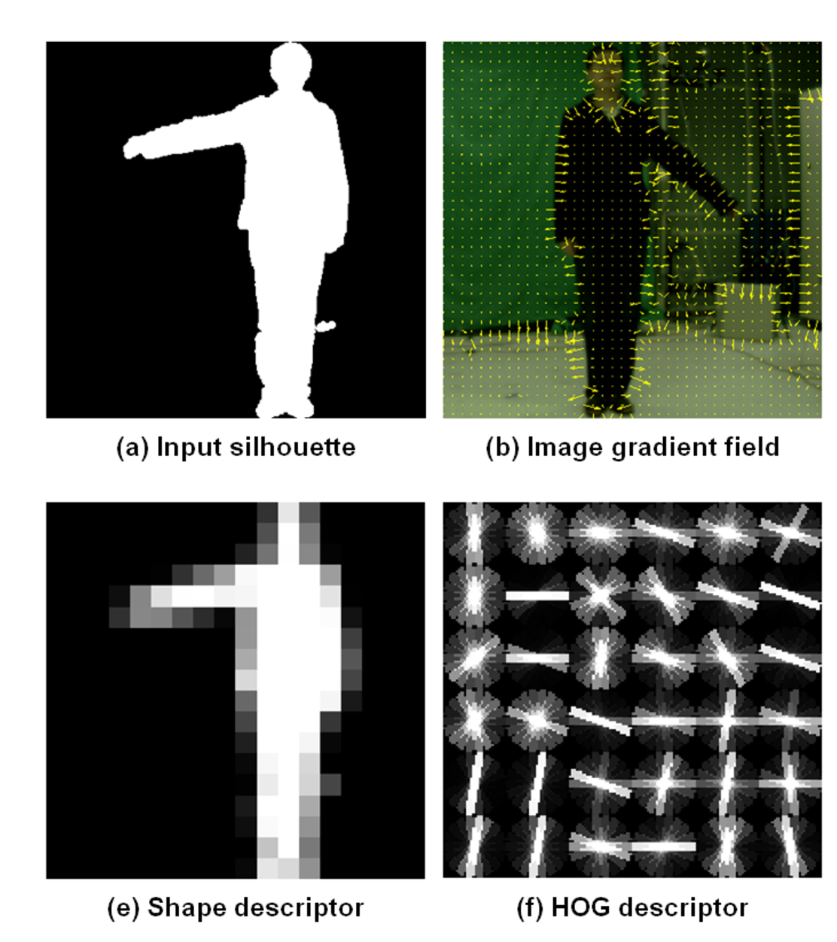
Image Features: HoG
+ Block Normalization
Paper by Navneet Dalal & Bill Triggs presented at CVPR 2005 for detecting people.
Figure from Zhuolin Jiang, Zhe Lin, Larry S. Davis, ICCV 2009 for human action recognition.

Slide 18
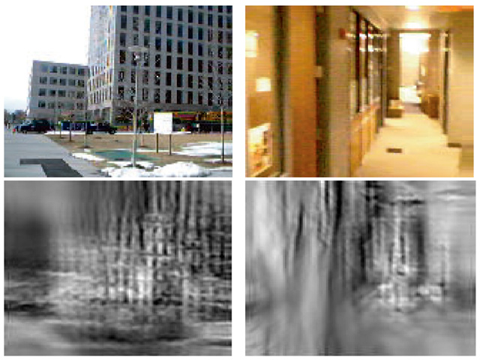
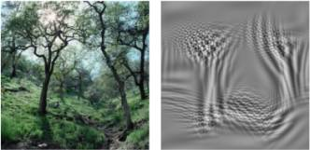
Image Features: GIST
The “gist” of a scene: Oliva & Torralba, 2001

Slide 20
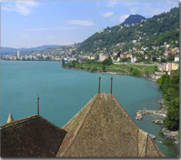
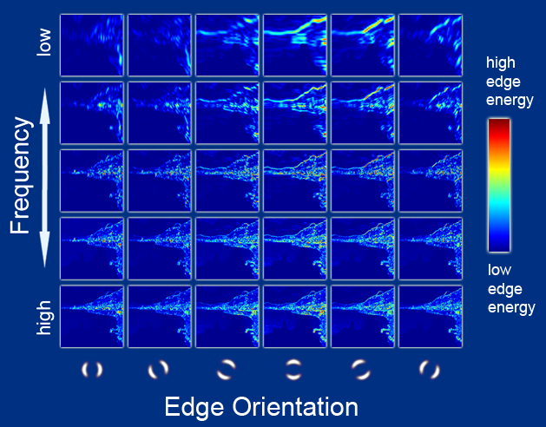
Image Features: GIST
Oriented edge response at multiple scales (5 spatial scales, 6 edge orientations)
Hays and Efros, SIGGRAPH 2007

Slide 21
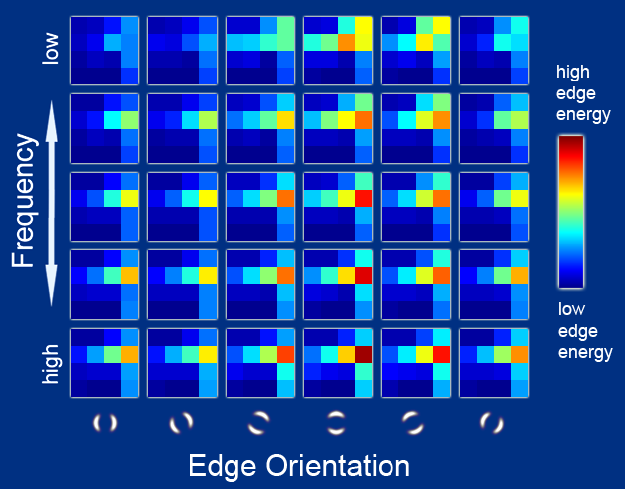
Image Features: GIST
Aggregated edge responses over 4x4 windows
Hays and Efros, SIGGRAPH 2007

Slide 22
Extract SIFT Feature Descriptors
Compute Histograms of Features
slide by Fei-fei Li

Slide 23
SIFT + SVM (or softmax)
Feature
extraction
(HoG)
Classification
(SVM or softmax)
Deep Learning
Convolutional Network
(includes both feature extraction and classifier)

Slide 24
Summary: Image Features
Largely replaced by Neural networks
Still useful to study for inspiration in designing neural networks that compute features.
Many other features proposed
  LBP: Local Binary Patterns: Useful for recognizing faces.
  Dense SIFT: Similar to HoG features but different normalization and other details. Also relies on gradients.

Slide 25
Questions?

