Slide 1
Neural Networks / Multi-layer Perceptron

Slide 2
Today’s Class
Neural Networks
The Perceptron Model
The Multi-layer Perceptron (MLP)
Forward-pass in an MLP (Inference)
Backward-pass in an MLP (Backpropagation)

Slide 3
Perceptron Model
Frank Rosenblatt (1957) - Cornell University
Activation function
$$x_{1}$$
$$w_{1}$$
$$f\left(x\right)=\left\{\begin{aligned}1, if \sum_{i=0}^{n}{w_{i}x_{i}}+b>0 \\ &0, otherwise \end{aligned}\right.$$
$$x_{2}$$
$$w_{2}$$
$$w_{3}$$
$$x_{3}$$
$$w_{4}$$
$$x_{4}$$
More: https://en.wikipedia.org/wiki/Perceptron

Slide 4
Perceptron Model
Frank Rosenblatt (1957) - Cornell University
!?
$$x_{1}$$
$$w_{1}$$
$$f\left(x\right)=\left\{\begin{aligned}1, if \sum_{i=0}^{n}{w_{i}x_{i}}+b>0 \\ &0, otherwise \end{aligned}\right.$$
$$x_{2}$$
$$w_{2}$$
$$w_{3}$$
$$x_{3}$$
$$w_{4}$$
$$x_{4}$$
More: https://en.wikipedia.org/wiki/Perceptron

Slide 5
Perceptron Model
Frank Rosenblatt (1957) - Cornell University
Activation function
$$x_{1}$$
$$w_{1}$$
$$f\left(x\right)=\left\{\begin{aligned}1, if \sum_{i=0}^{n}{w_{i}x_{i}}+b>0 \\ &0, otherwise \end{aligned}\right.$$
$$x_{2}$$
$$w_{2}$$
$$w_{3}$$
$$x_{3}$$
$$w_{4}$$
$$x_{4}$$
More: https://en.wikipedia.org/wiki/Perceptron

Slide 6
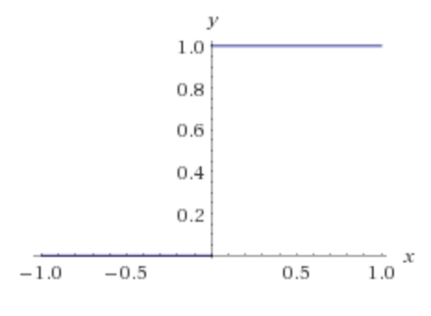
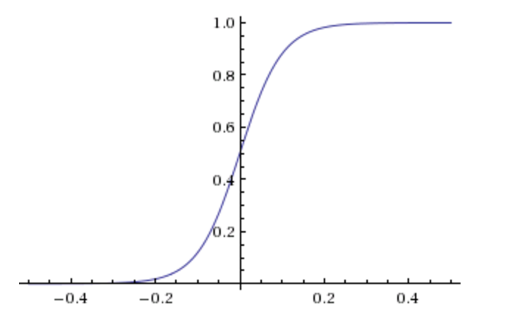
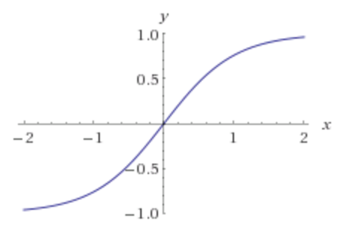
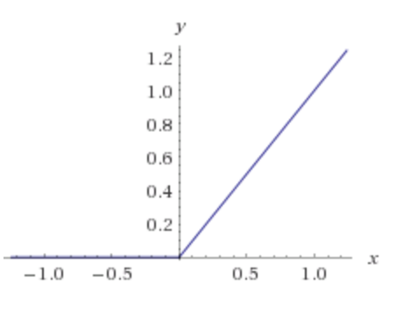
Activation Functions
Step(x)
Sigmoid(x)
Tanh(x)
ReLU(x) = max(0, x)

Slide 7
Two-layer Multi-layer Perceptron (MLP)
”hidden" layer
Loss / Criterion
$$x_{1}$$
$$a_{1}$$
$$x_{2}$$
$$a_{2}$$
$${\hat{y}}_{1}$$
$$y_{1}$$
$$x_{3}$$
$$a_{3}$$
$$x_{4}$$
$$a_{4}$$

Slide 8
Linear Softmax
$$x_{i}=[x_{i1} { x}_{i2} x_{i3} { x}_{i4}]$$
$$y_{i}=$$
[1 0 0]
$${\hat{y}}_{i}= [f_{c} f_{d} f_{b}]$$
$$g_{c}=w_{c1}x_{i1}+w_{c2}x_{i2}+w_{c3}x_{i3}+w_{c4}x_{i4}+b_{c}$$
$$g_{d}=w_{d1}x_{i1}+w_{d2}x_{i2}+w_{d3}x_{i3}+w_{d4}x_{i4}+b_{d}$$
$$g_{b}=w_{b1}x_{i1}+w_{b2}x_{i2}+w_{b3}x_{i3}+w_{b4}x_{i4}+b_{b}$$
$$f_{c}=e^{g_{c}}/{(e}^{g_{c}}+e^{g_{d}}+e^{g_{b}})$$
$$f_{d}=e^{g_{d}}/{(e}^{g_{c}}+e^{g_{d}}+e^{g_{b}})$$
$$f_{b}=e^{g_{b}}/{(e}^{g_{c}}+e^{g_{d}}+e^{g_{b}})$$

Slide 9
Linear Softmax
$$x_{i}=[x_{i1} { x}_{i2} x_{i3} { x}_{i4}]$$
$$y_{i}=$$
[1 0 0]
$${\hat{y}}_{i}= [f_{c} f_{d} f_{b}]$$
$$g_{c}=w_{c1}x_{i1}+w_{c2}x_{i2}+w_{c3}x_{i3}+w_{c4}x_{i4}+b_{c}$$
$$w=\left[\begin{matrix}w_{c1} & w_{c2} & w_{c3} & w_{c4} \\ w_{d1} & w_{d2} & w_{d3} & w_{d4} \\ w_{b1} & w_{b2} & w_{b3} & w_{b4}\end{matrix}\right]$$
$$g_{d}=w_{d1}x_{i1}+w_{d2}x_{i2}+w_{d3}x_{i3}+w_{d4}x_{i4}+b_{d}$$
$$g_{b}=w_{b1}x_{i1}+w_{b2}x_{i2}+w_{b3}x_{i3}+w_{b4}x_{i4}+b_{b}$$
$$b=\left[\begin{matrix}b_{c} & b_{d} & b_{b}\end{matrix}\right]$$
$$f_{c}=e^{g_{c}}/{(e}^{g_{c}}+e^{g_{d}}+e^{g_{b}})$$
$$f_{d}=e^{g_{d}}/{(e}^{g_{c}}+e^{g_{d}}+e^{g_{b}})$$
$$f_{b}=e^{g_{b}}/{(e}^{g_{c}}+e^{g_{d}}+e^{g_{b}})$$

Slide 10
Linear Softmax
$$x_{i}=[x_{i1} { x}_{i2} x_{i3} { x}_{i4}]$$
$$y_{i}=$$
[1 0 0]
$${\hat{y}}_{i}= [f_{c} f_{d} f_{b}]$$
$$w=\left[\begin{matrix}w_{c1} & w_{c2} & w_{c3} & w_{c4} \\ w_{d1} & w_{d2} & w_{d3} & w_{d4} \\ w_{b1} & w_{b2} & w_{b3} & w_{b4}\end{matrix}\right]$$
$$g=wx^{T}+b^{T}$$
$$b=\left[\begin{matrix}b_{c} & b_{d} & b_{b}\end{matrix}\right]$$
$$f_{c}=e^{g_{c}}/{(e}^{g_{c}}+e^{g_{d}}+e^{g_{b}})$$
$$f_{d}=e^{g_{d}}/{(e}^{g_{c}}+e^{g_{d}}+e^{g_{b}})$$
$$f_{b}=e^{g_{b}}/{(e}^{g_{c}}+e^{g_{d}}+e^{g_{b}})$$

Slide 11
Linear Softmax
$$x_{i}=[x_{i1} { x}_{i2} x_{i3} { x}_{i4}]$$
$$y_{i}=$$
[1 0 0]
$${\hat{y}}_{i}= [f_{c} f_{d} f_{b}]$$
$$w=\left[\begin{matrix}w_{c1} & w_{c2} & w_{c3} & w_{c4} \\ w_{d1} & w_{d2} & w_{d3} & w_{d4} \\ w_{b1} & w_{b2} & w_{b3} & w_{b4}\end{matrix}\right]$$
$$g=wx^{T}+b^{T}$$
$$b=\left[\begin{matrix}b_{c} & b_{d} & b_{b}\end{matrix}\right]$$
$$f=softmax(g)$$

Slide 12
Linear Softmax
$$x_{i}=[x_{i1} { x}_{i2} x_{i3} { x}_{i4}]$$
$$y_{i}=$$
[1 0 0]
$${\hat{y}}_{i}= [f_{c} f_{d} f_{b}]$$
$$f=softmax(wx^{T}+b^{T})$$

Slide 13
Two-layer MLP + Softmax
$$x_{i}=[x_{i1} { x}_{i2} x_{i3} { x}_{i4}]$$
$$y_{i}=$$
[1 0 0]
$${\hat{y}}_{i}= [f_{c} f_{d} f_{b}]$$
$$a_{1}=sigmoid(w_{[1]}x^{T}+b_{[1]}^{T})$$
$$f=softmax(w_{[2]}x^{T}+b_{[2]}^{T})$$

Slide 14
N-layer MLP + Softmax
$$x_{i}=[x_{i1} { x}_{i2} x_{i3} { x}_{i4}]$$
$$y_{i}=$$
[1 0 0]
$${\hat{y}}_{i}= [f_{c} f_{d} f_{b}]$$
$$a_{1}=sigmoid(w_{[1]}x^{T}+b_{[1]}^{T})$$
$$a_{2}=sigmoid(w_{[2]}a_{1}^{T}+b_{[2]}^{T})$$
$$…$$
$$a_{k}=sigmoid(w_{[k]}a_{k−1}^{T}+b_{[k]}^{T})$$
$$…$$
$$f=softmax(w_{[n]}a_{n−1}^{T}+b_{[n]}^{T})$$

Slide 15
How to train the parameters?
$$x_{i}=[x_{i1} { x}_{i2} x_{i3} { x}_{i4}]$$
$$y_{i}=$$
[1 0 0]
$${\hat{y}}_{i}= [f_{c} f_{d} f_{b}]$$
$$a_{1}=sigmoid(w_{[1]}x^{T}+b_{[1]}^{T})$$
$$a_{2}=sigmoid(w_{[2]}a_{1}^{T}+b_{[2]}^{T})$$
$$…$$
$$a_{k}=sigmoid(w_{[k]}a_{k−1}^{T}+b_{[k]}^{T})$$
$$…$$
$$f=softmax(w_{[n]}a_{n−1}^{T}+b_{[n]}^{T})$$

Slide 16
Forward pass (Forward-propagation)
$${\hat{y}}_{1}$$
$$x_{1}$$
$$a_{1}$$
$$x_{2}$$
$$a_{2}$$
$${\hat{y}}_{2}$$
$$y_{1}$$
$$x_{3}$$
$$a_{3}$$
$$x_{4}$$
$$a_{4}$$

Slide 17
Forward pass (Forward-propagation)
$$z_{i}=\sum_{i=0}^{n}{w_{1ij}x_{i}}+b_{1}$$
$$a_{i}= Sigmoid(z_{i})$$
$$p_{1}=\sum_{i=0}^{n}{w_{2i}a_{i}}+b_{2}$$
$$y_{1}= Sigmoid(p_{i})$$
$$x_{1}$$
$$a_{1}$$
$$x_{2}$$
$$a_{2}$$
$${\hat{y}}_{1}$$
$$y_{1}$$
$$x_{3}$$
$$a_{3}$$
$$x_{4}$$
$$a_{4}$$
$Loss=L(y_{1},$ ${\hat{y}}_{1})$

Slide 18
How to train the parameters?
$$x_{i}=[x_{i1} { x}_{i2} x_{i3} { x}_{i4}]$$
$$y_{i}=$$
[1 0 0]
$${\hat{y}}_{i}= [f_{c} f_{d} f_{b}]$$
$$a_{1}=sigmoid(w_{[1]}x^{T}+b_{[1]}^{T})$$
$$a_{2}=sigmoid(w_{[2]}a_{1}^{T}+b_{[2]}^{T})$$
$$…$$
We can still use SGD
$$a_{k}=sigmoid(w_{[k]}a_{k−1}^{T}+b_{[i]}^{T})$$
$$…$$
We need!
$$\frac{∂l}{∂w_{[k]ij}}$$
$$\frac{∂l}{∂b_{\left[k\right]i}}$$
$$f=softmax(w_{[n]}a_{n−1}^{T}+b_{[n]}^{T})$$

Slide 19
How to train the parameters?
$$x_{i}=[x_{i1} { x}_{i2} x_{i3} { x}_{i4}]$$
$$y_{i}=$$
[1 0 0]
$${\hat{y}}_{i}= [f_{c} f_{d} f_{b}]$$
$$a_{1}=sigmoid(w_{[1]}x^{T}+b_{[1]}^{T})$$
$$a_{2}=sigmoid(w_{[2]}a_{1}^{T}+b_{[2]}^{T})$$
$$…$$
We can still use SGD
$$a_{i}=sigmoid(w_{[k]}a_{k−1}^{T}+b_{[k]}^{T})$$
$$…$$
We need!
$$f=softmax(w_{[n]}a_{n−1}^{T}+b_{[n]}^{T})$$
$$\frac{∂l}{∂w_{[k]ij}}$$
$$\frac{∂l}{∂b_{\left[k\right]i}}$$
$$l=loss(f, y)$$

Slide 20
How to train the parameters?
$$x_{i}=[x_{i1} { x}_{i2} x_{i3} { x}_{i4}]$$
$$y_{i}=$$
[1 0 0]
$${\hat{y}}_{i}= [f_{c} f_{d} f_{b}]$$
$$a_{1}=sigmoid(w_{[1]}x^{T}+b_{[1]}^{T})$$
$$a_{2}=sigmoid(w_{[2]}a_{1}^{T}+b_{[2]}^{T})$$
$$…$$
We can still use SGD
$$a_{i}=sigmoid(w_{[k]}a_{k−1}^{T}+b_{[k]}^{T})$$
$$…$$
We need!
$$f=softmax(w_{[n]}a_{n−1}^{T}+b_{[n]}^{T})$$
$$\frac{∂l}{∂w_{[k]ij}}$$
$$\frac{∂l}{∂b_{\left[k\right]i}}$$
$$l=loss(f, y)$$

Slide 21
How to train the parameters?
$$x_{i}=[x_{i1} { x}_{i2} x_{i3} { x}_{i4}]$$
$$y_{i}=$$
[1 0 0]
$${\hat{y}}_{i}= [f_{c} f_{d} f_{b}]$$
$$a_{1}=sigmoid(w_{[1]}x^{T}+b_{[1]}^{T})$$
$$a_{2}=sigmoid(w_{[2]}a_{1}^{T}+b_{[2]}^{T})$$
$$…$$
$$\frac{∂l}{∂w_{[k]ij}}=\frac{∂l}{∂a_{n−1}} \frac{∂a_{n−1}}{∂a_{n−2}}…\frac{∂a_{k−2}}{∂a_{k−1}}\frac{∂a_{k−1}}{∂w_{\left[k\right]ij}}$$
$$a_{i}=sigmoid(w_{[k]}a_{k−1}^{T}+b_{[k]}^{T})$$
$$…$$
$$f=softmax(w_{[n]}a_{n−1}^{T}+b_{[n]}^{T})$$
$$l=loss(f, y)$$

Slide 22
Backward pass (Back-propagation)
$${\frac{∂L}{∂x_{k}}}_{}=(\frac{∂}{∂x_{k}}\sum_{i=0}^{n}{w_{1ij}x_{i}}+b_{1})\frac{∂L}{∂z_{i}}$$
$${\frac{∂L}{∂z_{i}}}_{}=\frac{∂}{∂z_{i}}Sigmoid(z_{i})\frac{∂L}{∂a_{k}}$$
$${\frac{∂L}{∂a_{k}}}_{}=(\frac{∂}{∂a_{k}}\sum_{i=0}^{n}{w_{2i}a_{i}}+b_{2})\frac{∂L}{∂p_{1}}$$
${\frac{∂L}{∂p_{1}}}_{}=\frac{∂}{∂p_{1}}Sigmoid(p_{i})$ $\frac{∂L}{∂{\hat{y}}_{1}}$
$$x_{1}$$
$$a_{1}$$
$$x_{2}$$
$$a_{2}$$
$${\hat{y}}_{1}$$
$$y_{1}$$
$$x_{3}$$
$$a_{3}$$
$$x_{4}$$
$$a_{4}$$
$${\frac{∂L}{∂w_{2i}}=\frac{∂p_{1}}{∂w_{2i}}\frac{∂L}{∂p}}_{1}$$
$\frac{∂L}{∂{\hat{y}}_{1}}=\frac{∂}{∂{\hat{y}}_{1}}L(y_{1},$ ${\hat{y}}_{1})$
$${\frac{∂L}{∂w_{1ij}}=\frac{∂z_{i}}{∂w_{1ij}}\frac{∂L}{∂z}}_{i}$$

Slide 23
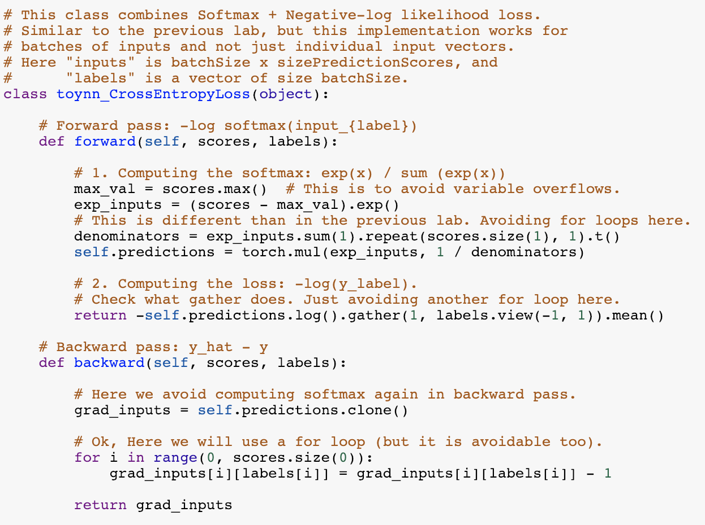
Softmax
+ Negative Log
Likelihood

Slide 24
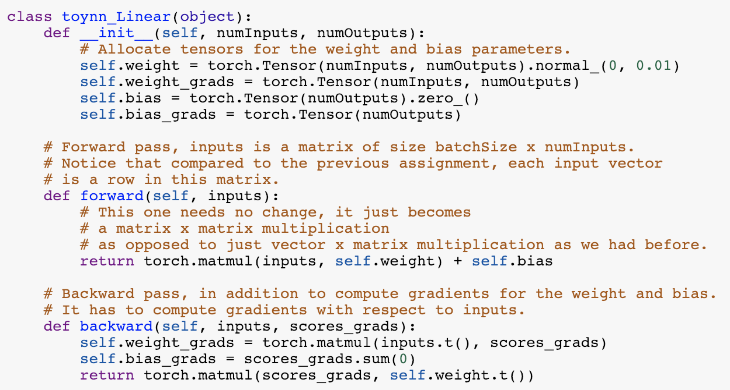
Linear
layer

Slide 25
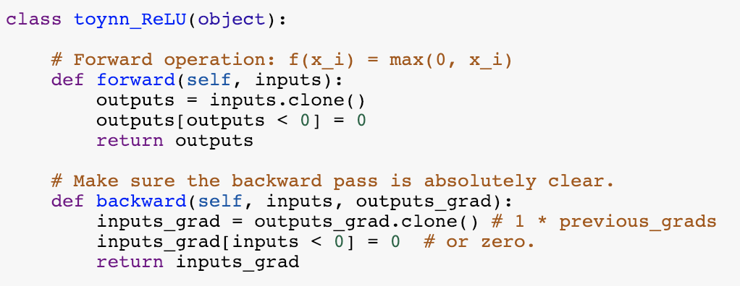
ReLU
layer

Slide 26
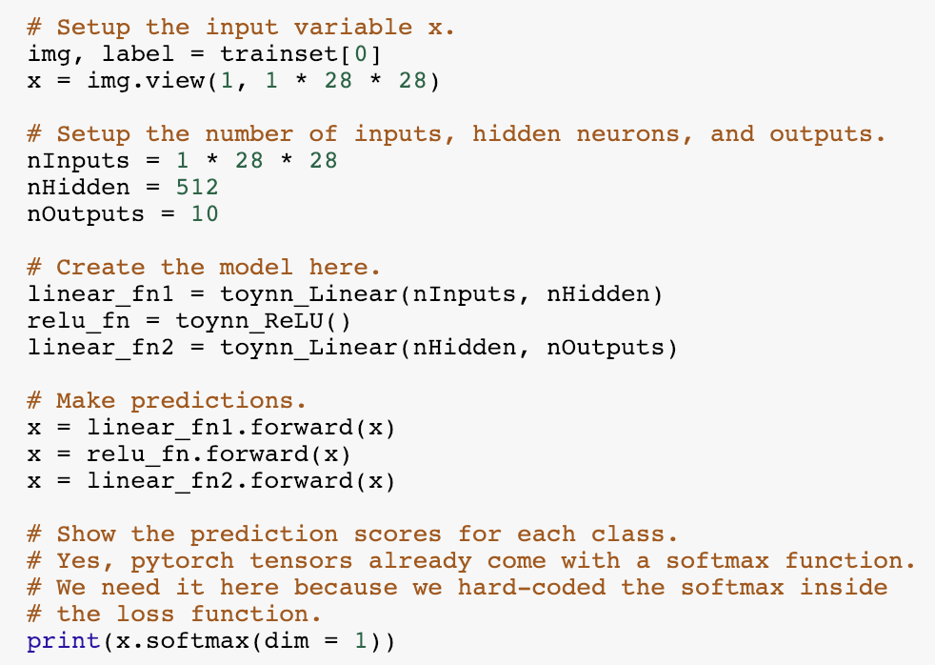
Two-layer Neural Network – Forward Pass

Slide 27
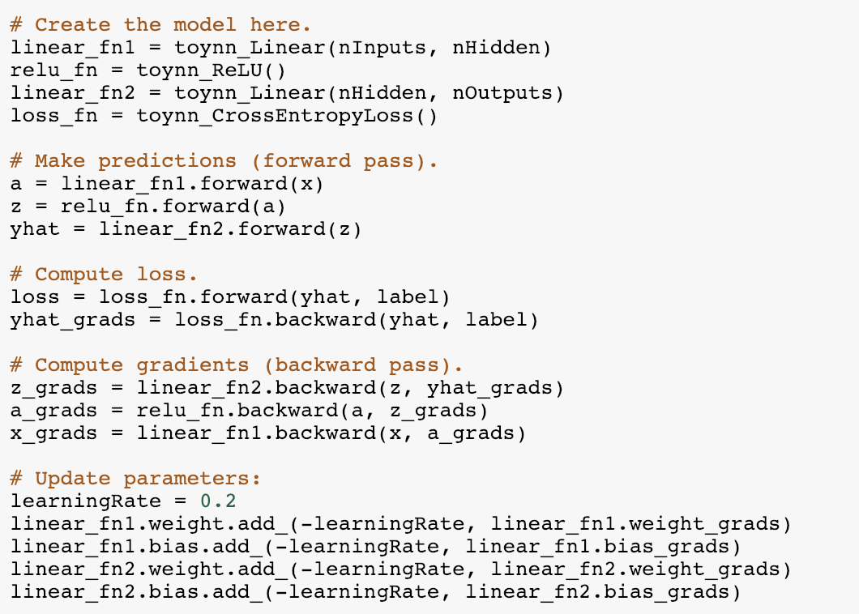
Two-layer Neural Network – Backward Pass

Slide 28
Automatic Differentiation
You only need to write code for the forward pass,
backward pass is computed automatically.
Pytorch (Facebook -- mostly):
Tensorflow (Google -- mostly):
DyNet (team includes UVA Prof. Yangfeng Ji):
https://pytorch.org/
https://www.tensorflow.org/
http://dynet.io/

Slide 29
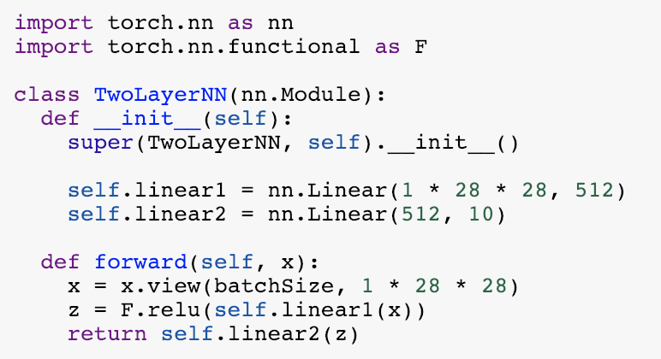
Defining a Model in Pytorch (Two Layer NN)

Slide 30
1. Creating Model, Loss, Optimizer

Slide 31
2. Running forward and backward on a batch
Compare this to what we had to do for toynn

Slide 32
Questions?

