Slide 1
Convolutional Neural Networks

Slide 2
Today’s Class
Automatic Differentiation (AutoGrad)
Convolutional Neural Networks
Revisiting Convolutions
The Convolutional Layer
Strided Convolutions / Grouped Convolutions / Dilated Convolutions
Spatial Pooling Operations

Slide 3
Automatic Differentiation
You only need to write code for the forward pass,
backward pass is computed automatically.
Pytorch (Facebook -- mostly):
Tensorflow (Google -- mostly):
DyNet (team includes UVA Prof. Yangfeng Ji):
https://pytorch.org/
https://www.tensorflow.org/
http://dynet.io/

Slide 4
Convolutional Layer

Slide 5
Convolutional Layer

Slide 6
Convolutional Layer
Weights

Slide 7
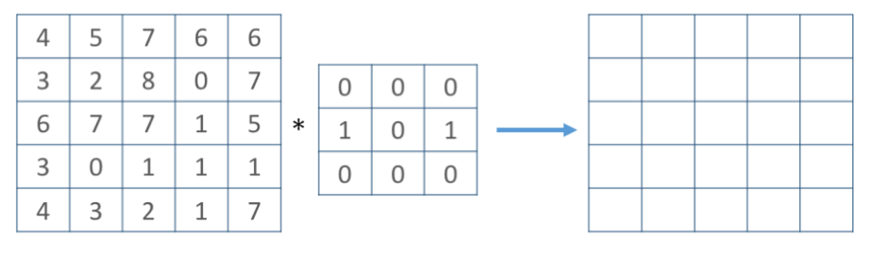
Convolutional Layer
Weights
4

Slide 8
Convolutional Layer
Weights
4
1

Slide 9
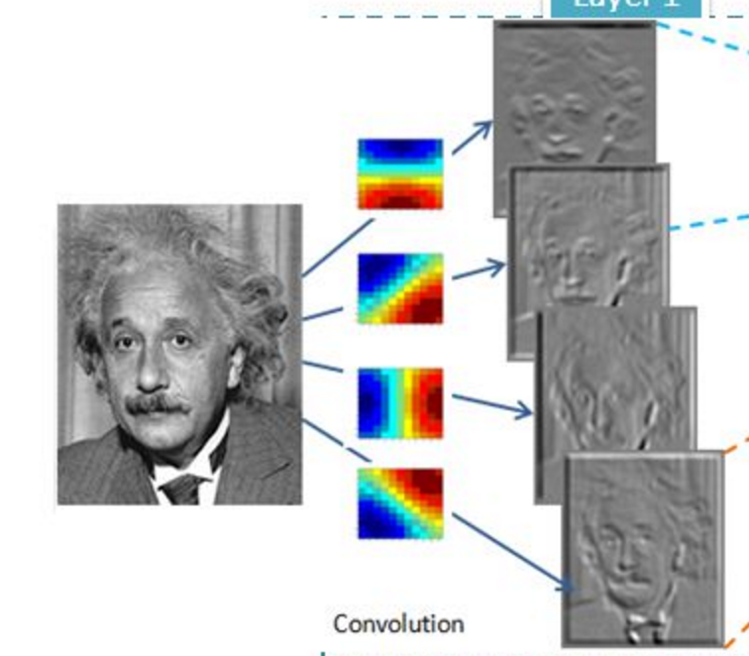
Convolutional Layer (with 4 filters)
weights:
4x1x9x9
Input: 1x224x224
Output: 4x224x224
if zero padding,
and stride = 1

Slide 10
Convolutional Layer (with 4 filters)
weights:
4x1x9x9
Input: 1x224x224
Output: 4x112x112
if zero padding,
but stride = 2

Slide 11
Convolutional Layer in pytorch
kernel_size
Input
out_channels x
Output
kernel_size
in_channels
out_channels (equals the number of
convolutional filters for this layer)
in_channels (e.g. 3 for RGB inputs)

Slide 12
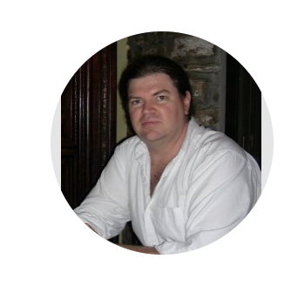
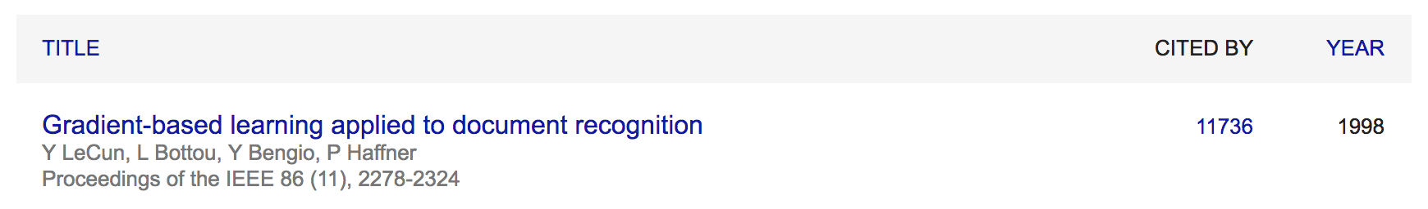
Convolutional Network: LeNet
Yann LeCun

Slide 13
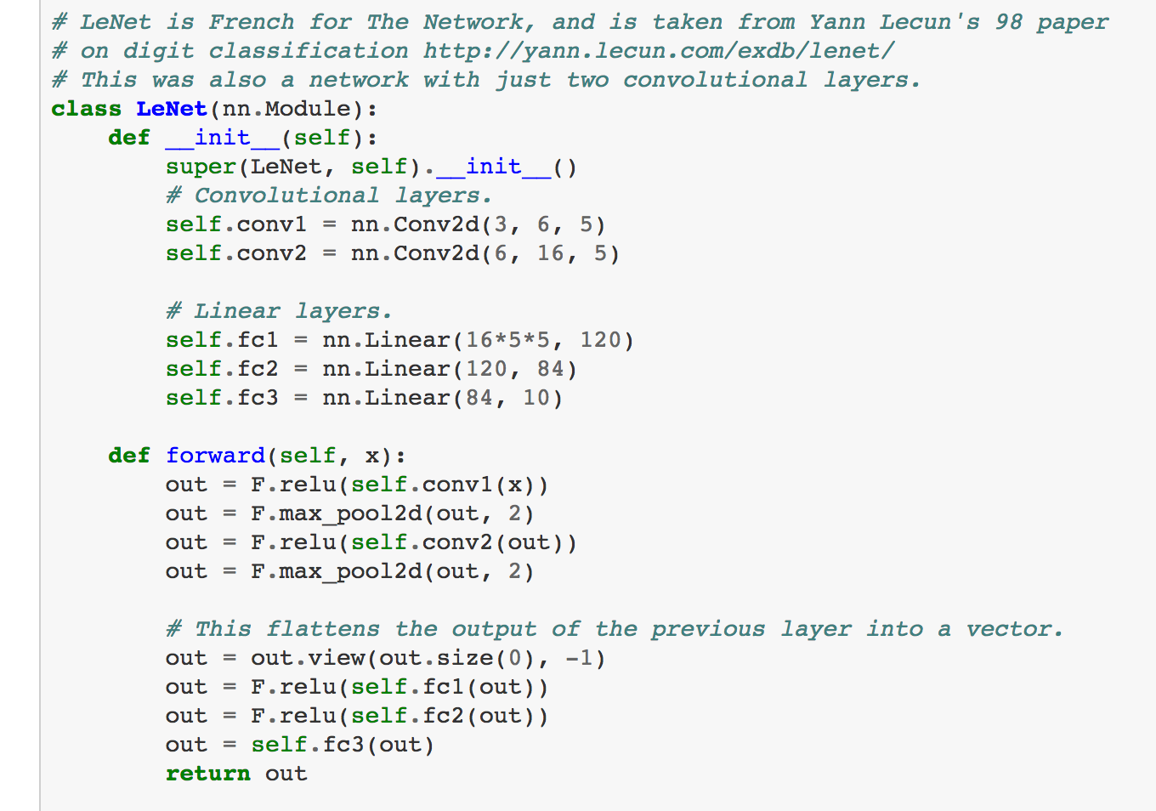
LeNet in Pytorch

Slide 14
SpatialMaxPooling Layer
take the max in this neighborhood
8
8
8
8
8

Slide 15
LeNet Summary
2 Convolutional Layers + 3 Linear Layers
+ Non-linear functions: ReLUs or Sigmoids
+ Max-pooling operations

Slide 16
New Architectures Proposed
Alexnet (Kriszhevsky et al NIPS 2012) [Required Reading]
VGG (Simonyan and Zisserman 2014)
GoogLeNet (Szegedy et al CVPR 2015)
ResNet (He et al CVPR 2016)
DenseNet (Huang et al CVPR 2017)

Slide 17
Convolutional Layers as Matrix Multiplication
https://petewarden.com/2015/04/20/why-gemm-is-at-the-heart-of-deep-learning/

Slide 18
Convolutional Layers as Matrix Multiplication
https://petewarden.com/2015/04/20/why-gemm-is-at-the-heart-of-deep-learning/

Slide 19
Convolutional Layers as Matrix Multiplication
Pros?
Cons?
https://petewarden.com/2015/04/20/why-gemm-is-at-the-heart-of-deep-learning/

Slide 20
CNN Computations are Computationally Expensive
However highly parallelizable
GPU Computing is used in practice
CPU Computing in fact is prohibitive for training these models

Slide 21
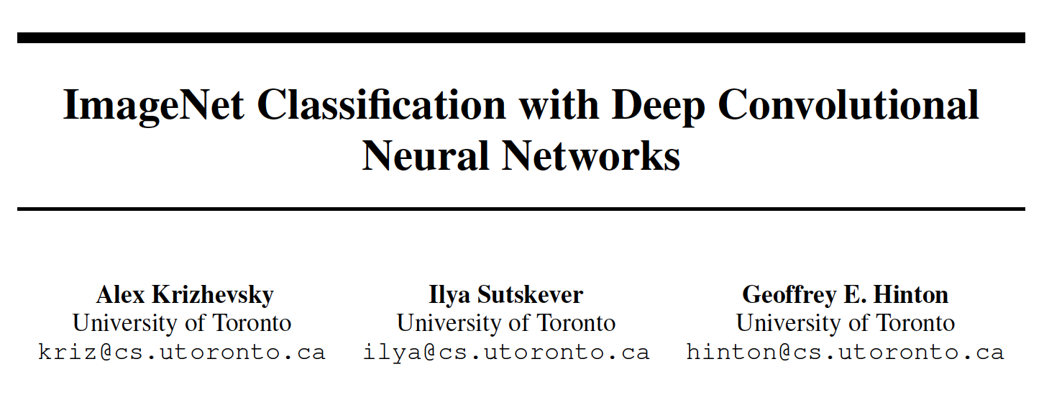
The Alexnet network (Krizhevsky et al NIPS 2012)

Slide 22
The Problem: Classification
Classify an image into 1000 possible classes:
e.g. Abyssinian cat, Bulldog, French Terrier, Cormorant, Chickadee,
red fox, banjo, barbell, hourglass, knot, maze, viaduct, etc.
cat, tabby cat (0.71)
Egyptian cat (0.22)
red fox (0.11)
…..

Slide 23
The Data: ILSVRC
Imagenet Large Scale Visual Recognition Challenge (ILSVRC): Annual Competition
1000 Categories
~1000 training images per Category
~1 million images in total for training
~50k images for validation
Only images released for the test set but no annotations,
evaluation is performed centrally by the organizers (max 2 per week)

Slide 24
The Evaluation Metric: Top K-error
Top-1 error: 1.0
Top-1 accuracy: 0.0
Top-2 error: 1.0
Top-2 accuracy: 0.0
True label: Abyssinian cat
Top-3 error: 1.0
Top-3 accuracy: 0.0
Top-4 error: 0.0
Top-4 accuracy: 1.0
Top-5 error: 0.0
Top-5 accuracy: 1.0
cat, tabby cat (0.61)
Egyptian cat (0.22)
red fox (0.11)
Abyssinian cat (0.10)
French terrier (0.03)
…..

Slide 25
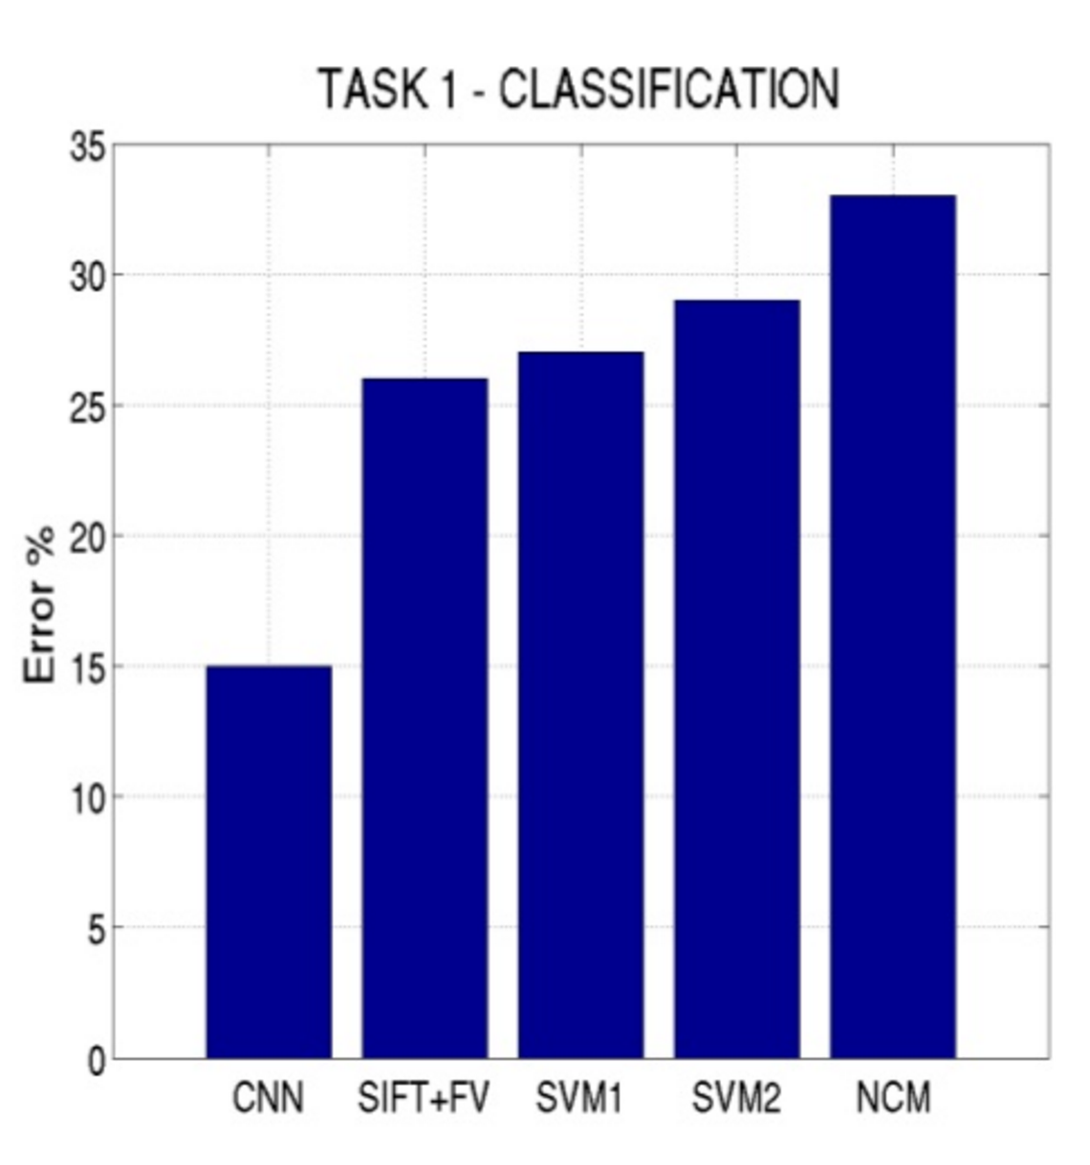
Top-5 error on this competition (2012)

Slide 26
Alexnet
https://www.saagie.com/fr/blog/object-detection-part1

Slide 27
Pytorch Code for Alexnet
In-class analysis
https://github.com/pytorch/vision/blob/master/torchvision/models/alexnet.py

Slide 28
Dropout Layer
Srivastava et al 2014

Slide 29
What is happening?
https://www.saagie.com/fr/blog/object-detection-part1

Slide 30
SIFT + FV + SVM (or softmax)
Feature
extraction
(SIFT)
Feature
encoding
(Fisher vectors)
Classification
(SVM or softmax)
Deep Learning
Convolutional Network
(includes both feature extraction and classifier)

Slide 31
Preprocessing and Data Augmentation

Slide 32
Preprocessing and Data Augmentation
256
256

Slide 33
Preprocessing and Data Augmentation
224x224

Slide 34
Preprocessing and Data Augmentation
224x224

Slide 35
True label: Abyssinian cat

Slide 36
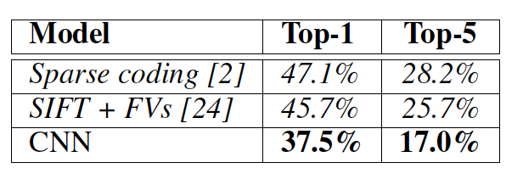
Other Important Aspects
Using ReLUs instead of Sigmoid or Tanh
Momentum + Weight Decay
Dropout (Randomly sets Unit outputs to zero during training)
GPU Computation!

Slide 37
Questions?

