Slide 1
CNN Architectures

Slide 2
ILSVRC: Imagenet Large Scale Visual Recognition Challenge [Russakovsky et al 2014]

Slide 3
The Problem: Classification
Classify an image into 1000 possible classes: e.g. Abyssinian cat, Bulldog, French Terrier, Cormorant, Chickadee,
red fox, banjo, barbell, hourglass, knot, maze, viaduct, etc.
cat, tabby cat (0.71) Egyptian cat (0.22)
red fox (0.11)
…..

Slide 4
The Data: ILSVRC
Imagenet Large Scale Visual Recognition Challenge (ILSVRC): Annual Competition
1000 Categories
~1000 training images per Category
~1 million images in total for training
~50k images for validation
Only images released for the test set but no annotations, evaluation is performed centrally by the organizers (max 2 per week)

Slide 5
The Evaluation Metric: Top K-error
Top-1 error: 1.0
Top-1 accuracy: 0.0
Top-2 error: 1.0
Top-2 accuracy: 0.0
True label: Abyssinian cat
Top-3 error: 1.0
Top-3 accuracy: 0.0
Top-4 error: 0.0
Top-4 accuracy: 1.0
Top-5 error: 0.0
Top-5 accuracy: 1.0
cat, tabby cat (0.61) Egyptian cat (0.22)
red fox (0.11)
Abyssinian cat (0.10)
French terrier (0.03)
…..

Slide 6
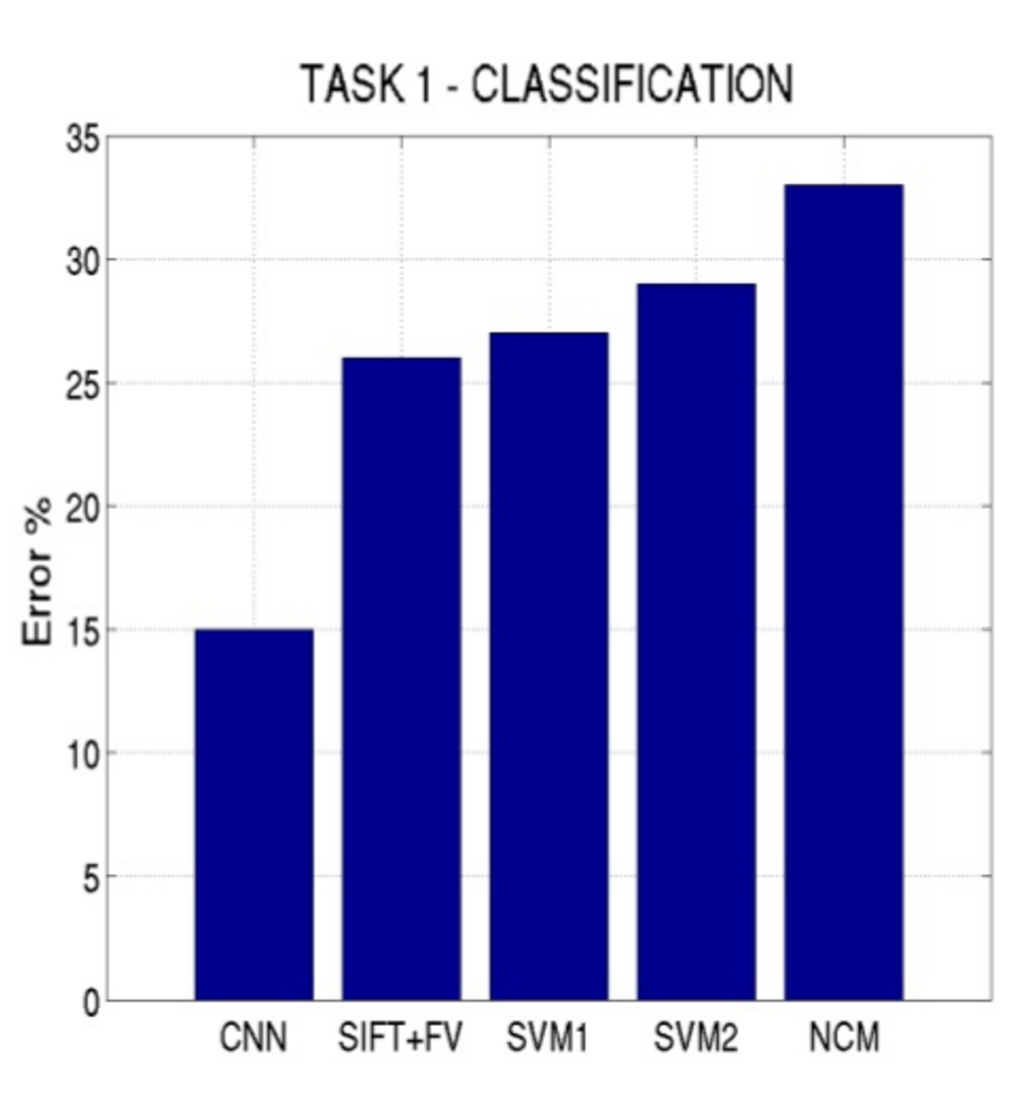
Top-5 error on this competition (2012)

Slide 7
Alexnet (Krizhevsky et al NIPS 2012)

Slide 8
Alexnet
https://www.saagie.com/fr/blog/object-detection-part1

Slide 9
Pytorch Code for Alexnet
In-class analysis https://github.com/pytorch/vision/blob/master/torchvision/models/alexnet.py

Slide 10
Dropout Layer
Happens for every batch for a different set of connections only during training
Important
model.train()
model.eval()
Srivastava et al 2014

Slide 11
Preprocessing and Data Augmentation

Slide 12
Preprocessing and Data Augmentation
256
256

Slide 13
Preprocessing and Data Augmentation
224x224

Slide 14
Preprocessing and Data Augmentation
224x224

Slide 15
True label: Abyssinian cat

Slide 16
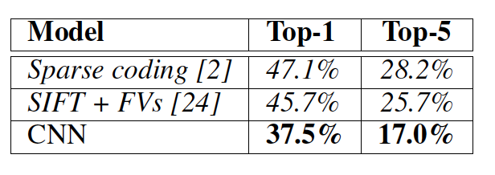
Some Important Aspects
Using ReLUs instead of Sigmoid or Tanh
Momentum + Weight Decay
Dropout (Randomly sets Unit outputs to zero during training)
GPU Computation!

Slide 17
What is happening?
https://www.saagie.com/fr/blog/object-detection-part1

Slide 18
SIFT + FV + SVM (or softmax)
Feature extraction (SIFT)
Feature encoding (Fisher vectors)
Classification (SVM or softmax)
Deep Learning
Convolutional Network
(includes both feature extraction and classifier)

Slide 19
VGG Network
Top-5:
https://github.com/pytorch/vision/blob/master/torchvision/models/vgg.py
Simonyan and Zisserman, 2014.
https://arxiv.org/pdf/1409.1556.pdf

Slide 20
BatchNormalization Layer
https://arxiv.org/abs/1502.03167

Slide 21
GoogLeNet
https://github.com/kuangliu/pytorch-cifar/blob/master/models/googlenet.py
Szegedy et al. 2014
https://www.cs.unc.edu/~wliu/papers/GoogLeNet.pdf

Slide 22
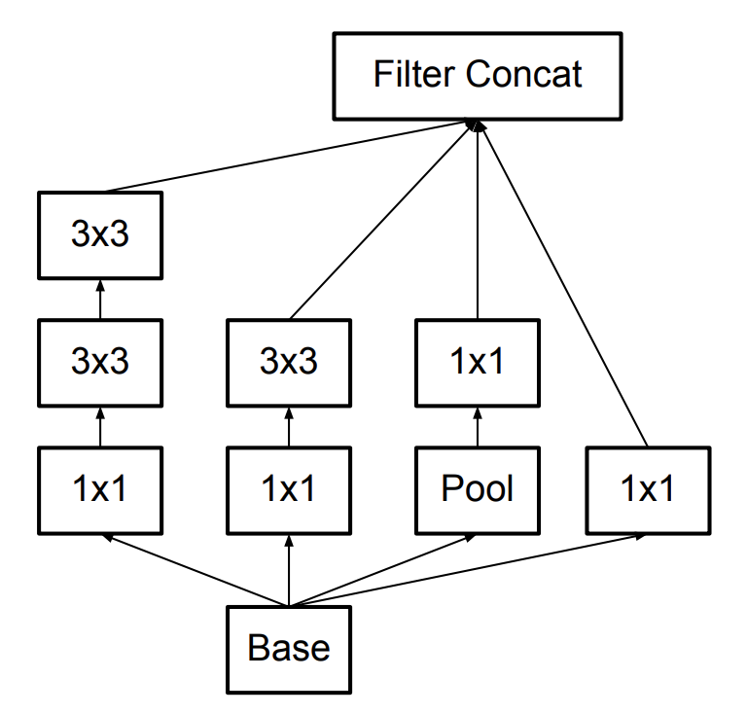
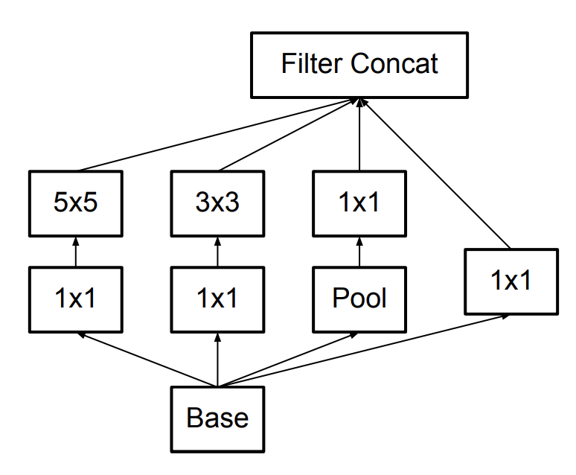
Further Refinements – Inception v3, e.g.
GoogLeNet (Inceptionv1)
Inception v3

Slide 23
ResNet (He et al CVPR 2016)
Sorry, does not fit in slide.
http://felixlaumon.github.io/assets/kaggle-right-whale/resnet.png
https://github.com/pytorch/vision/blob/master/torchvision/models/resnet.py

Slide 24
Slide by Mohammad Rastegari

Slide 25
Densenet

Slide 26
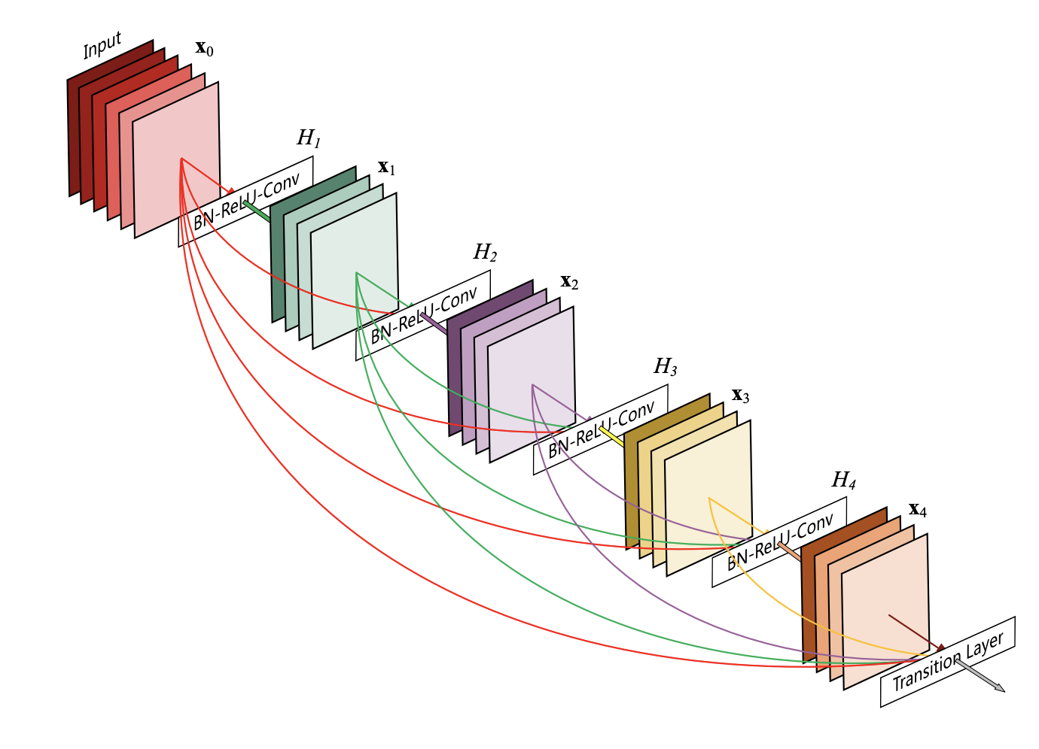
Densenet
https://arxiv.org/pdf/1608.06993.pdf

Slide 27
Densenet
https://arxiv.org/pdf/1608.06993.pdf

Slide 28
Object Detection
deer
cat

Slide 29
Object Detection as Classification
deer?
CNN
cat?
background?

Slide 30
Object Detection as Classification
deer?
CNN
cat?
background?

Slide 31
Object Detection as Classification
deer?
CNN
cat?
background?

Slide 32
Object Detection as Classification with Sliding Window
deer?
CNN
cat?
background?

Slide 33
Object Detection as Classification with Box Proposals

Slide 34
Box Proposal Method – SS: Selective Search
Segmentation As Selective Search for Object Recognition. van de Sande et al. ICCV 2011

Slide 35
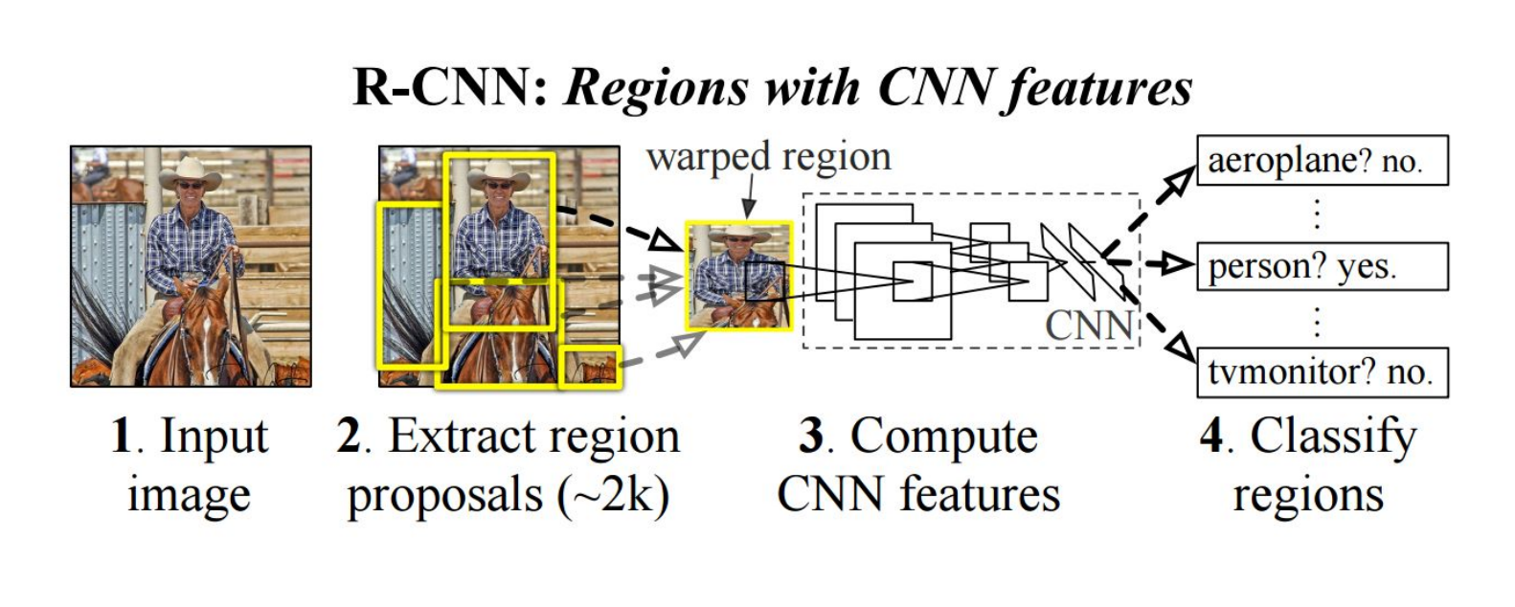
RCNN
https://people.eecs.berkeley.edu/~rbg/papers/r-cnn-cvpr.pdf
Rich feature hierarchies for accurate object detection and semantic segmentation. Girshick et al. CVPR 2014.

Slide 36
Questions?

