Slide 1
Generative Adversarial Networks (GANs)

Slide 2
Today’s Class
Adversarial Examples – Input Optimization
Generative Adversarial Networks (GANs)
Conditional GANs
Style-Transfer Networks

Slide 3
What we have been doing: Optimize weights in the network to predict bus (correct class).
$$I$$
$$y=f(I;w)$$
$$L(y, bus)$$
bus
$$w=w −λ\frac{∂L}{∂w}$$

Slide 4
New Idea: Create Adversarial Inputs by optimizing the input image to predict ostrich (wrong class).
$$I$$
$$y=f(I;w)$$
$$L(y, ostrich)$$
ostrich
$$I=I −λ\frac{∂L}{∂I}$$
Work on Adversarial examples by Goodfellow et al. , Szegedy et. al., etc.

Slide 5
Convnets (optimize input to predict ostrich)
ostrich
Work on Adversarial examples by Goodfellow et al. , Szegedy et. al., etc.

Slide 7
All get predicted as ostrich

Slide 8
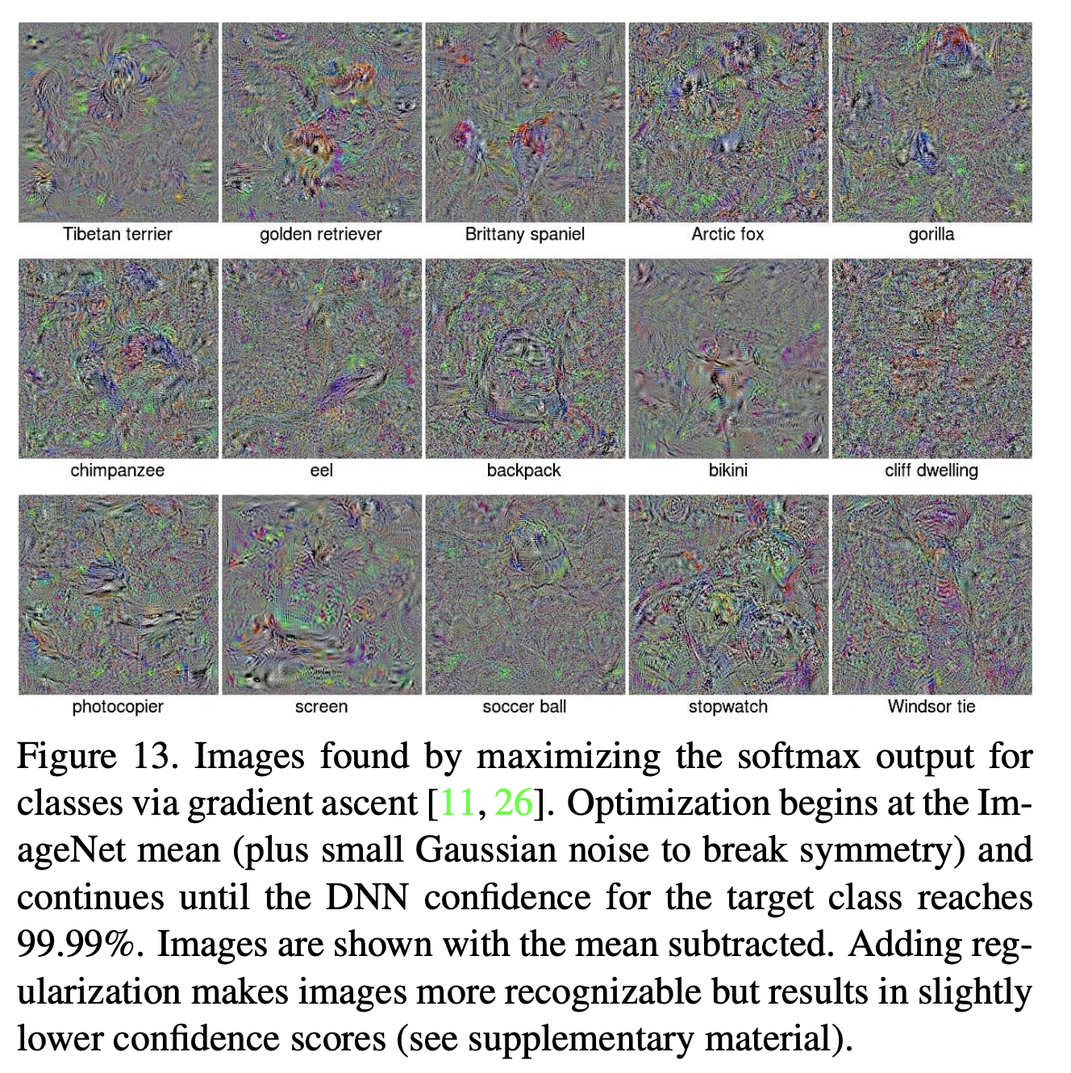
Deep Neural Networks are Easily Fooled: High Confidence Predictions for Unrecognizable Images
Anh Nguyen, Jason Yosinski, Jeff Clune, 2014

Slide 9
New Idea: Create Adversarial Inputs by optimizing the input image to predict ostrich (wrong class).
$$I$$
$$y=f(I;w)$$
$$L(y, parking meter)$$
parking meter
$$I=I −λ\frac{∂L}{∂I}$$
Work on Adversarial examples by Goodfellow et al. , Szegedy et. al., etc.

Slide 10
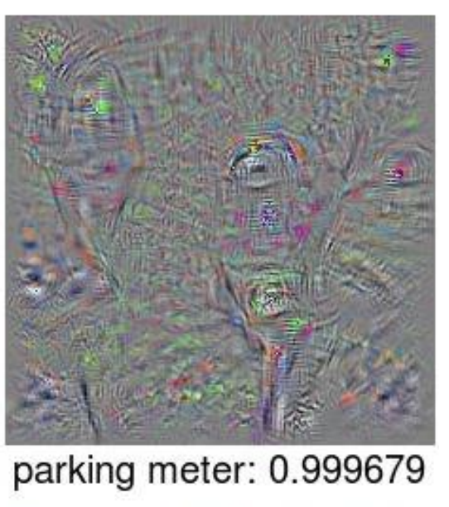

Slide 11
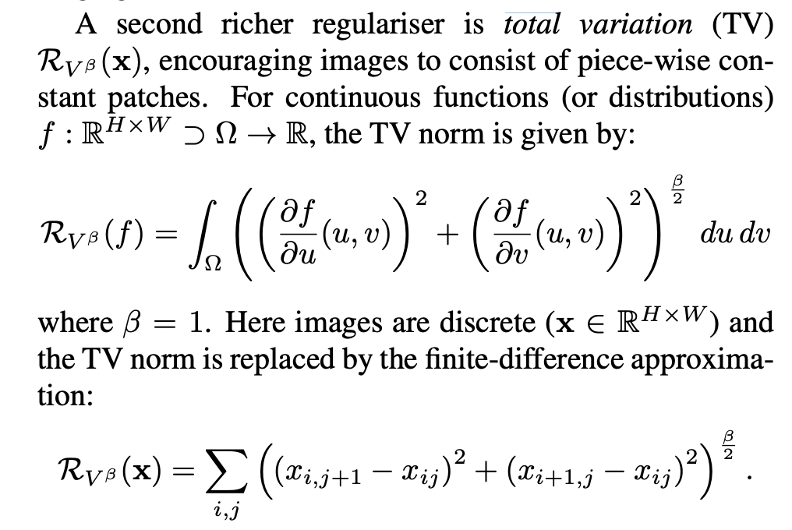
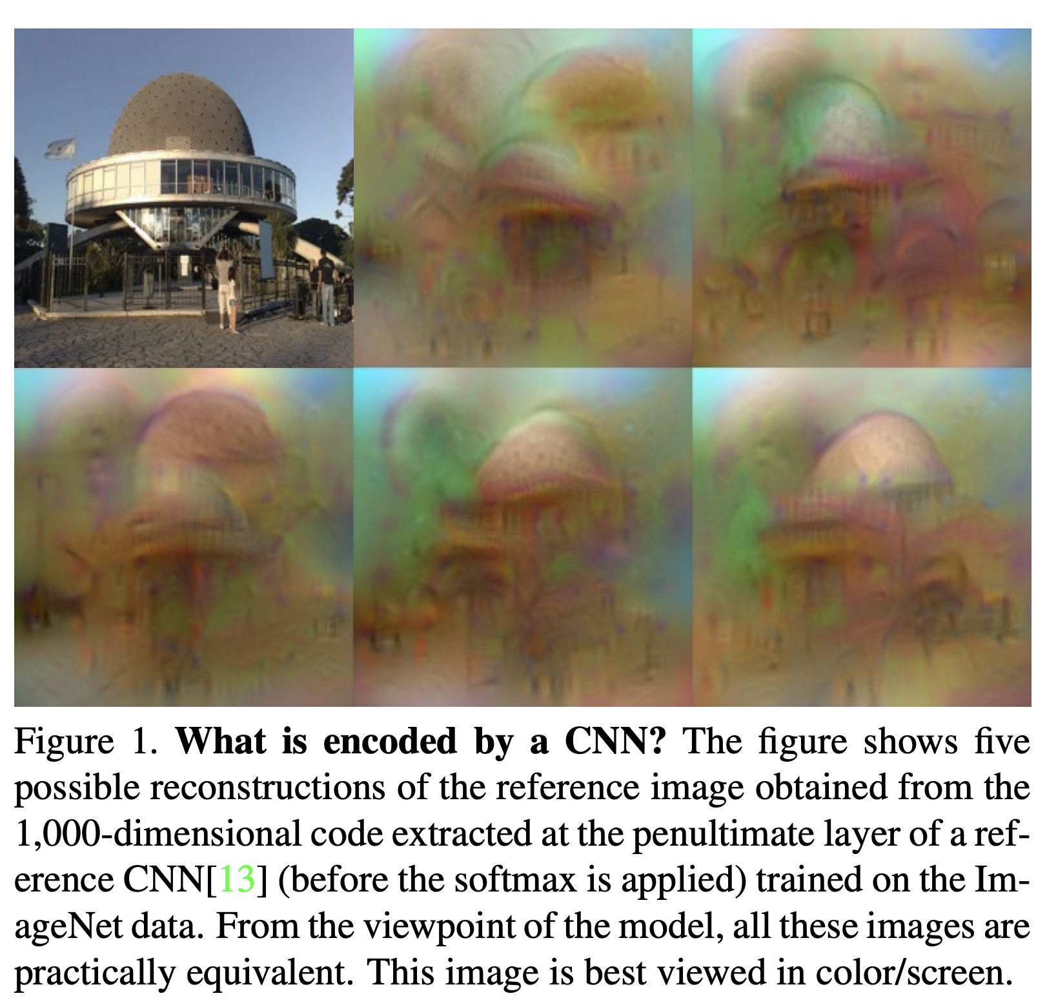
Total Variation Regularization
Mahendran and Vedaldi, Understanding Deep Image Representations by Inverting Them, 2014

Slide 12
Taking the idea to the extreme: Google’s DeepDream
https://research.googleblog.com/2015/06/inceptionism-going-deeper-into-neural.html
Generate your own in Pytorch:
https://github.com/XavierLinNow/deepdream_pytorch

Slide 13
Generative Adversarial Networks (GAN) [Goodfellow et al 2014]
https://deeplearning4j.org/generative-adversarial-network

Slide 14
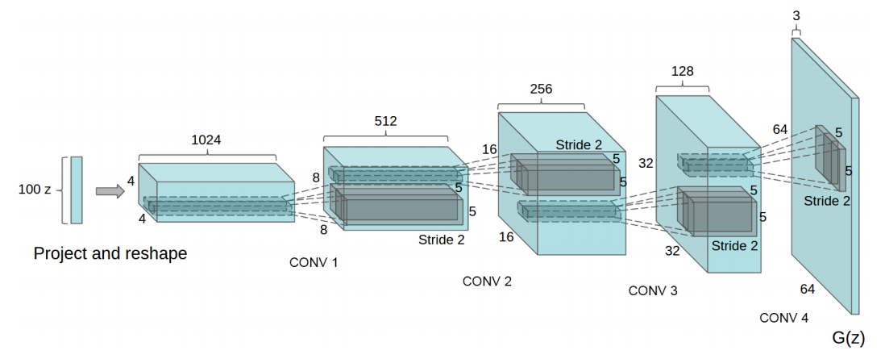
Generative Network (closer look)
Radford et. al. Unsupervised Representation Learning with Deep Convolutional Generative Adversarial Networks. ICLR 2016

Slide 15
Generative Network (closer look)
Deconvolutional Layers
Upconvolutional Layers
Backwards Strided Convolutional Layers
Fractionally Strided Convolutional Layers
Transposed Convolutional Layers
Spatial Full Convolutional Layers
Radford et. al. Unsupervised Representation Learning with Deep Convolutional Generative Adversarial Networks. ICLR 2016

Slide 16
Generative Adversarial Networks (GAN) [Goodfellow et al.]
https://deeplearning4j.org/generative-adversarial-network

Slide 17
Generative Adversarial Networks (GAN) [Goodfellow et al.]
https://deeplearning4j.org/generative-adversarial-network

Slide 18
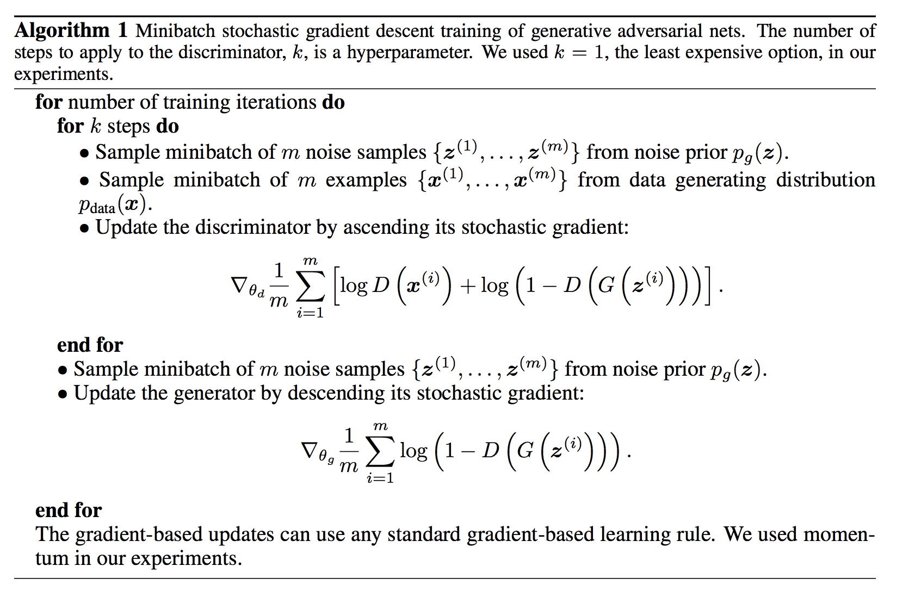
Goodfellow et al. NeurIPS 2014

Slide 19
Update Discriminator D
Goodfellow et al. NeurIPS 2014

Slide 20
Update Generator G
Goodfellow et al. NeurIPS 2014

Slide 21
Until Desirable Results are Achieved?
Goodfellow et al. NeurIPS 2014

Slide 22
Generative Adversarial Networks (GAN) [Goodfellow et al.]
https://deeplearning4j.org/generative-adversarial-network

Slide 23
Generative Adversarial Networks (GAN) [Goodfellow et al.]
GANs are hard to train, loss for the discriminator and generator might fluctuate.
There are many choices for loss, and other auxiliary signals.
Training of these models is even less well understood than for other deep models.
https://deeplearning4j.org/generative-adversarial-network

Slide 24
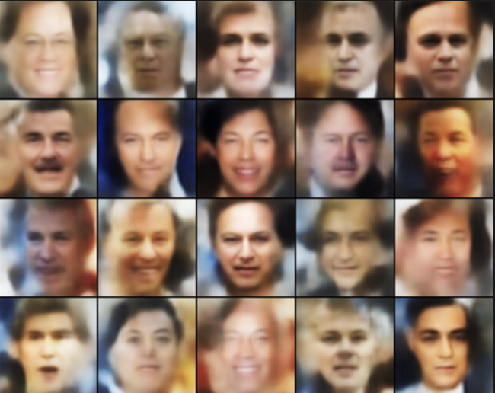
Basic GAN Results (Example implementation is provided in Pytorch’s examples)
http://torch.ch/blog/2015/11/13/gan.html

Slide 25
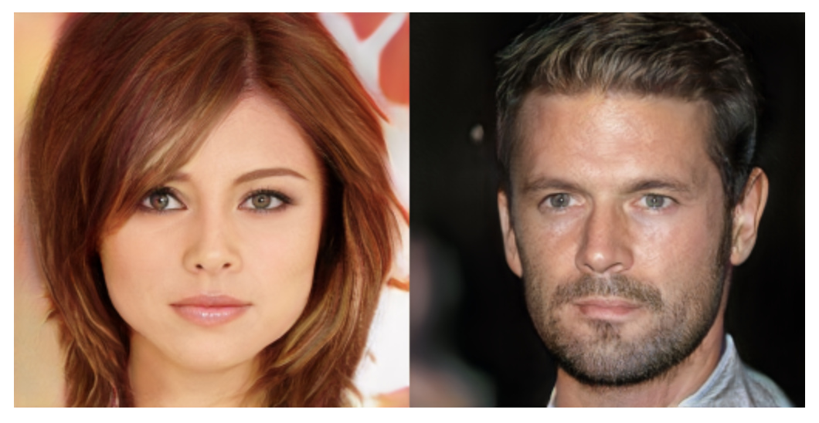
NVidia’s progressive GANs ICLR 2018

Slide 26
Google’s BigGAN

Slide 27
Google’s BigGAN
Teddy Bear
Microphone
http://aiweirdness.com/post/179626595787/the-creepiest-images-generated-by-biggan

Slide 28
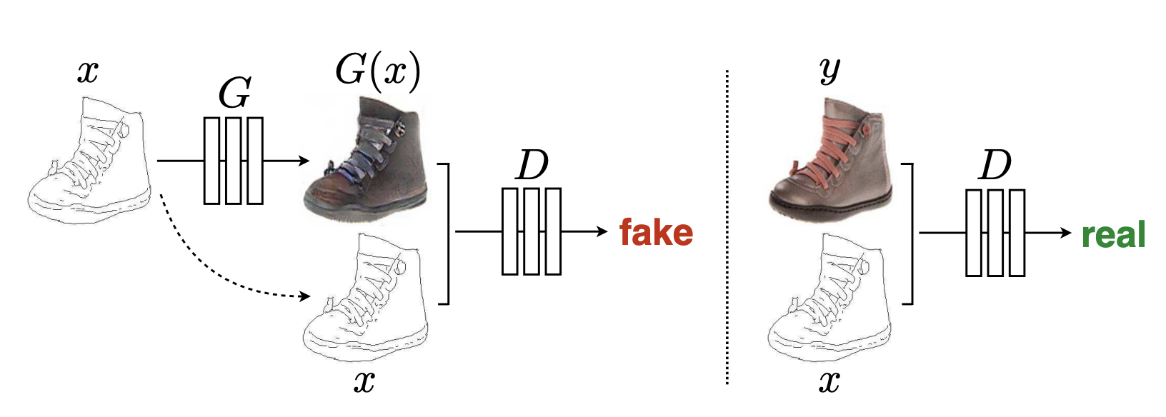
Conditional GANs: Input is not just Noise
Isola et al. CVPR 2017: Image-to-Image Translation with Conditional Adversarial Networks

Slide 29
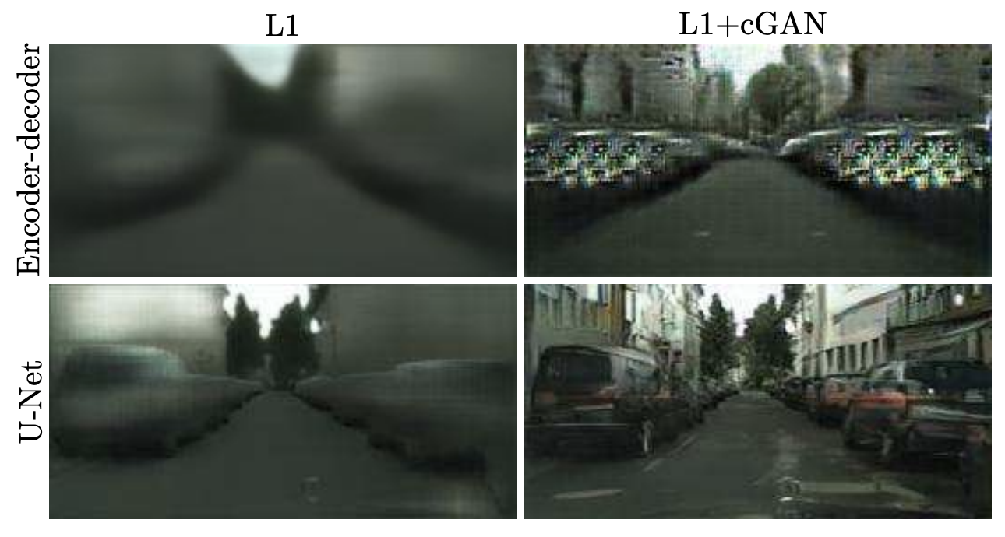
Conditional GANs: Also Hard to Train
Result they obtained with a regular Fully Convolutional Network
Result they obtained with a U-Net network (with skip-connections)
Isola et al. CVPR 2017: Image-to-Image Translation with Conditional Adversarial Networks

Slide 30
Conditional GANs: Also Hard to Train
Ronneberger et al. MICCAI 2015. U-Net: Convolutional Networks for Biomedical Image Segmentation

Slide 31
Questions?

