Slide 1
Recurrent Neural Networks (RNNs)

Slide 2
Today’s Class
Recurrent Neural Network Cell
Recurrent Neural Networks (RNNs)
Bi-Directional Recurrent Neural Networks (Bi-RNNs)
Multiple-layer / Stacked / Deep Bi-Direction Recurrent Neural Networks
LSTMs and GRUs.
Applications in Vision: Caption Generation.

Slide 3




Recurrent Neural Network Cell
$$h_{0}$$
$$RNN$$
$$h_{1}$$
$$x_{1}$$

Slide 4
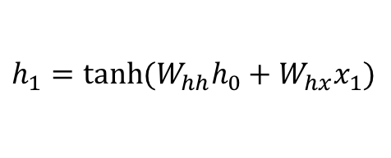
Recurrent Neural Network Cell
$$h_{1}=tanh⁡(W_{hh}h_{0}+W_{hx}x_{1})$$
$$h_{0}$$
$$RNN$$
$$h_{1}$$
$$x_{1}$$

Slide 5

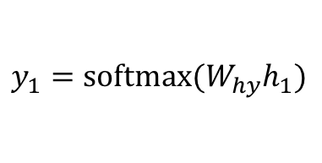
Recurrent Neural Network Cell
$$y_{1}$$
$$h_{1}$$
$$h_{0}$$
$$RNN$$
$$h_{1}$$
$$h_{1}=tanh⁡(W_{hh}h_{0}+W_{hx}x_{1})$$
$$x_{1}$$
$$y_{1}=softmax⁡(W_{hy}h_{1})$$

Slide 6


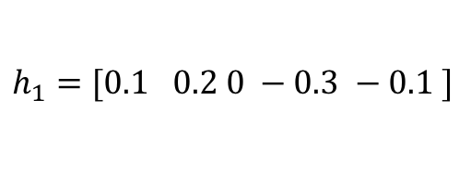
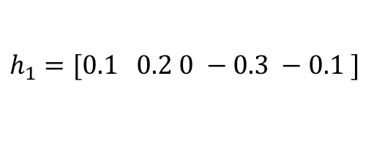

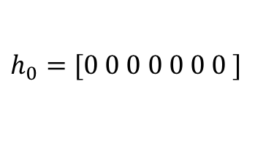

Recurrent Neural Network Cell
$$y_{1}=[0.1, 0.05, 0.05, 0.1, 0.7]$$
$$h_{1}=[0.1 0.2 0 −0.3 −0.1 ]$$
$$h_{0}=[0 0 0 0 0 0 0 ]$$
$$RNN$$
$$h_{1}=[0.1 0.2 0 −0.3 −0.1 ]$$
$$h_{1}=tanh⁡(W_{hh}h_{0}+W_{hx}x_{1})$$
$$x_{1}= [0 0 1 0 0]$$
$$y_{1}=softmax⁡(W_{hy}h_{1})$$

Slide 7
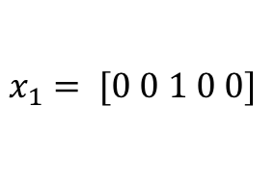
Recurrent Neural Network Cell
$$y_{1}=[0.1, 0.05, 0.05, 0.1, 0.7]$$
e (0.7)
$$h_{1}=[0.1 0.2 0 −0.3 −0.1 ]$$
$$h_{0}=[0 0 0 0 0 0 0 ]$$
$$RNN$$
$$h_{1}=[0.1 0.2 0 −0.3 −0.1 ]$$
$$x_{1}= [0 0 1 0 0]$$
c
a b c d e

Slide 8
Recurrent Neural Network Cell
$$y_{1}$$
$$h_{1}$$
$$h_{0}$$
$$RNN$$
$$h_{1}$$
$$h_{1}=tanh⁡(W_{hh}h_{0}+W_{hx}x_{1})$$
$$x_{1}$$
$$y_{1}=softmax⁡(W_{hy}h_{1})$$

Slide 9
Recurrent Neural Network Cell
$$h_{1}$$
$$h_{0}$$
$$RNN$$
$$h_{1}$$
$$h_{1}=tanh⁡(W_{hh}h_{0}+W_{hx}x_{1})$$
$$x_{1}$$

Slide 10
Recurrent Neural Network Cell
$$h_{0}$$
$$RNN$$
$$h_{1}$$
$$h_{1}=tanh⁡(W_{hh}h_{0}+W_{hx}x_{1})$$
$$x_{1}$$

Slide 11






(Unrolled) Recurrent Neural Network
$$h_{0}$$
$$RNN$$
$$h_{1}$$
$$h_{2}$$
$$h_{3}$$
$$RNN$$
$$RNN$$
$$x_{1}$$
$$x_{2}$$
$$x_{3}$$

Slide 12





How can it be used? – e.g. Tagging a Text Sequence One-to-one Sequence Mapping Problems
<<possessive>>
<<noun>>
<<verb>>
$$y_{1}$$
$$y_{2}$$
$$y_{3}$$
$$h_{1}$$
$$h_{2}$$
$$h_{3}$$
$$h_{0}$$
$$RNN$$
$$h_{1}$$
$$h_{2}$$
$$h_{3}$$
$$RNN$$
$$RNN$$
$$x_{1}$$
$$x_{2}$$
$$x_{3}$$
my
car
works

Slide 13
How can it be used? – e.g. Tagging a Text Sequence One-to-one Sequence Mapping Problems
Training examples don’t need to be the same length!
input
output
my car works
<<possessive>> <<noun>> <<verb>>
my dog ate the assignment
<<possessive>> <<noun>> <<verb>> <<pronoun>> <<noun>>
my mother saved the day
<<possessive>> <<noun>> <<verb>> <<pronoun>> <<noun>>
the smart kid solved the problem
<<pronoun>> <<qualifier>> <<noun>> <<verb>> <<pronoun>> <<noun>>

Slide 14
How can it be used? – e.g. Tagging a Text Sequence One-to-one Sequence Mapping Problems
Training examples don’t need to be the same length!
input
output
L(my car works) = 3
L (<<possessive>> <<noun>> <<verb>>) = 3
L( my dog ate the assignment ) = 5
L (<<possessive>> <<noun>> <<verb>> <<pronoun>> <<noun>>) = 5
L( my mother saved the day ) = 5
L (<<possessive>> <<noun>> <<verb>> <<pronoun>> <<noun>>) = 5
L( the smart kid solved the problem ) = 6
L (<<pronoun>> <<qualifier>> <<noun>> <<verb>> <<pronoun>> <<noun>>) = 6

Slide 15
How can it be used? – e.g. Tagging a Text Sequence One-to-one Sequence Mapping Problems
Training examples don’t need to be the same length!
If we assume a vocabulary of a 1000 possible words and 20 possible output tags
input
output
T: 1000 x 3
T: 20 x 3
T: 1000 x 5
T: 20 x 5
T: 1000 x 5
T: 20 x 5
T: 1000 x 6
T: 20 x 6

Slide 16
How can it be used? – e.g. Tagging a Text Sequence One-to-one Sequence Mapping Problems
Training examples don’t need to be the same length!
If we assume a vocabulary of a 1000 possible words and 20 possible output tags
input
output
T: 1000 x 3
T: 20 x 3
T: 1000 x 5
T: 20 x 5
T: 1000 x 5
T: 20 x 5
T: 1000 x 6
T: 20 x 6
How do we create batches if inputs and outputs have different shapes?

Slide 17
How can it be used? – e.g. Tagging a Text Sequence One-to-one Sequence Mapping Problems
Training examples don’t need to be the same length!
If we assume a vocabulary of a 1000 possible words and 20 possible output tags
input
output
T: 1000 x 3
T: 20 x 3
T: 1000 x 5
T: 20 x 5
T: 1000 x 5
T: 20 x 5
T: 1000 x 6
T: 20 x 6
How do we create batches if inputs and outputs have different shapes?
Solution 1: Forget about batches, just process things one by one.

Slide 18
How can it be used? – e.g. Tagging a Text Sequence One-to-one Sequence Mapping Problems
Training examples don’t need to be the same length!
If we assume a vocabulary of a 1000 possible words and 20 possible output tags
input
output
T: 1000 x 3
T: 20 x 3
T: 1000 x 5
T: 20 x 5
T: 1000 x 5
T: 20 x 5
T: 1000 x 6
T: 20 x 6
How do we create batches if inputs and outputs have different shapes?
Solution 2: Zero padding.
We can put the above vectors in
T: 4 x 1000 x 6

Slide 19
How can it be used? – e.g. Tagging a Text Sequence One-to-one Sequence Mapping Problems
Training examples don’t need to be the same length!
If we assume a vocabulary of a 1000 possible words and 20 possible output tags
input
output
T: 1000 x 3
T: 20 x 3
T: 1000 x 5
T: 20 x 5
T: 1000 x 5
T: 20 x 5
T: 1000 x 6
T: 20 x 6
How do we create batches if inputs and outputs have different shapes?
Solution 3: Advanced. Dynamic Batching or Auto-batching
https://dynet.readthedocs.io/en/latest/tutorials_notebooks/Autobatching.html

Slide 20
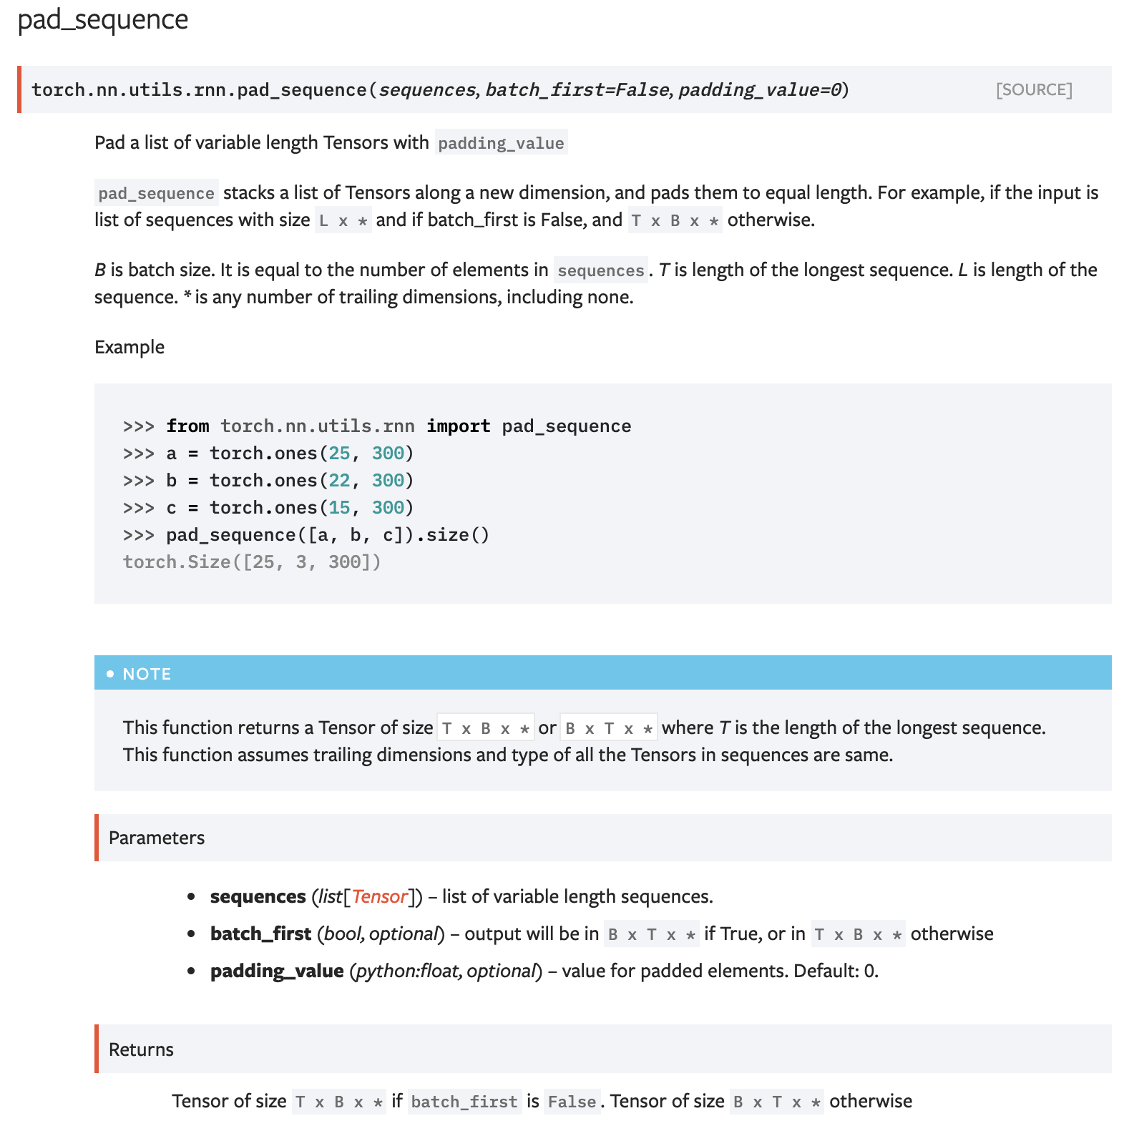
How can it be used? – e.g. Tagging a Text Sequence One-to-one Sequence Mapping Problems
Solution 4: Pytorch stacking, padding, and sorting combination

Slide 21
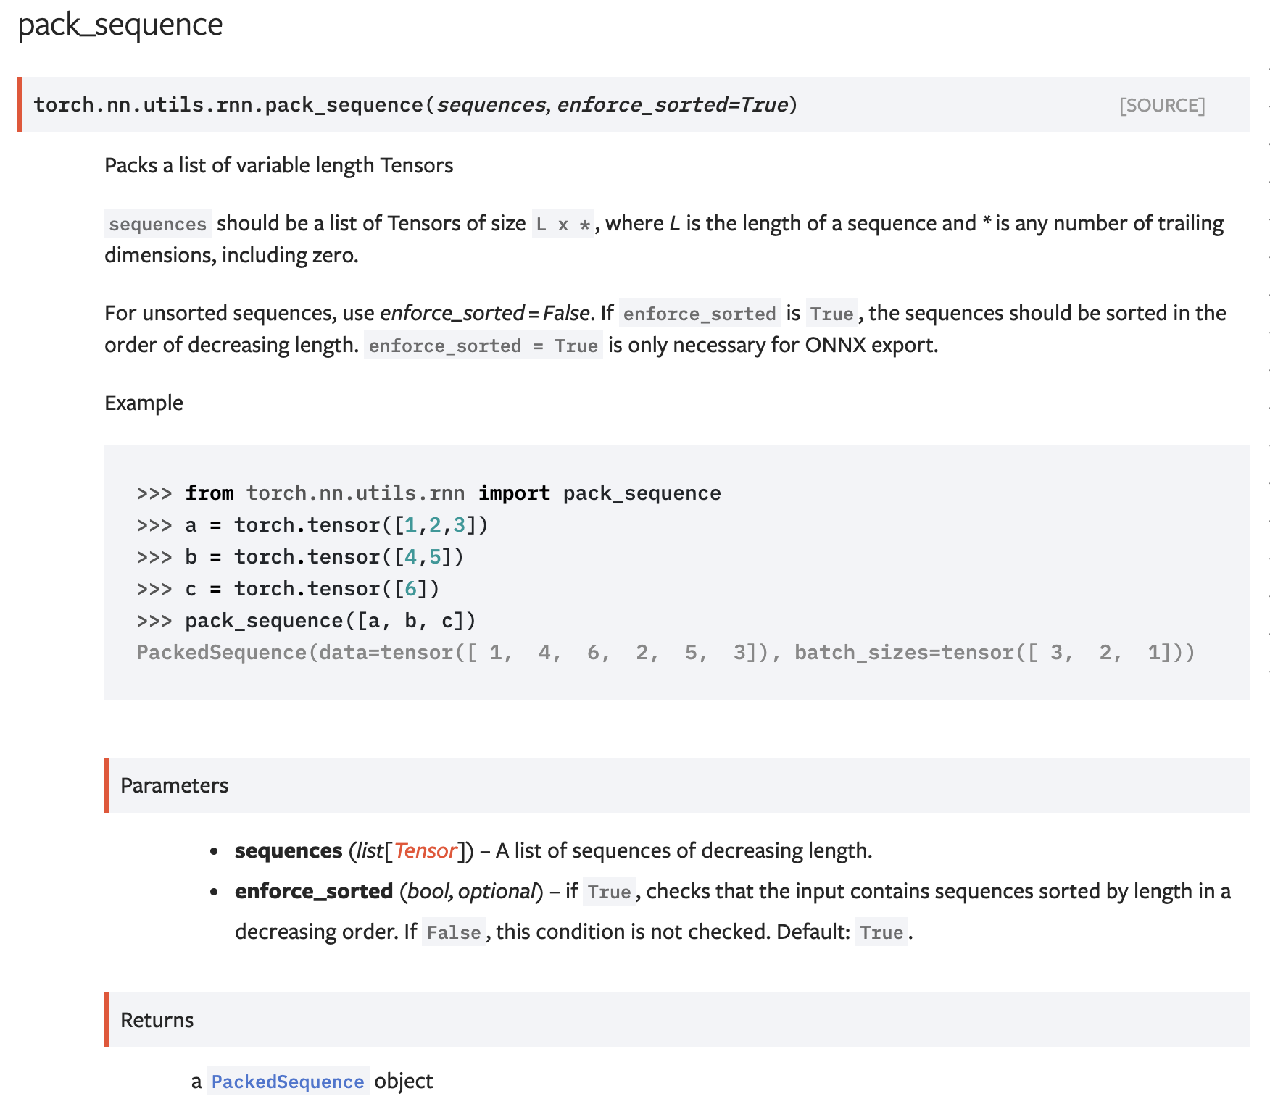
How can it be used? – e.g. Tagging a Text Sequence One-to-one Sequence Mapping Problems
Solution 4: Pytorch stacking, padding, and sorting combination

Slide 22
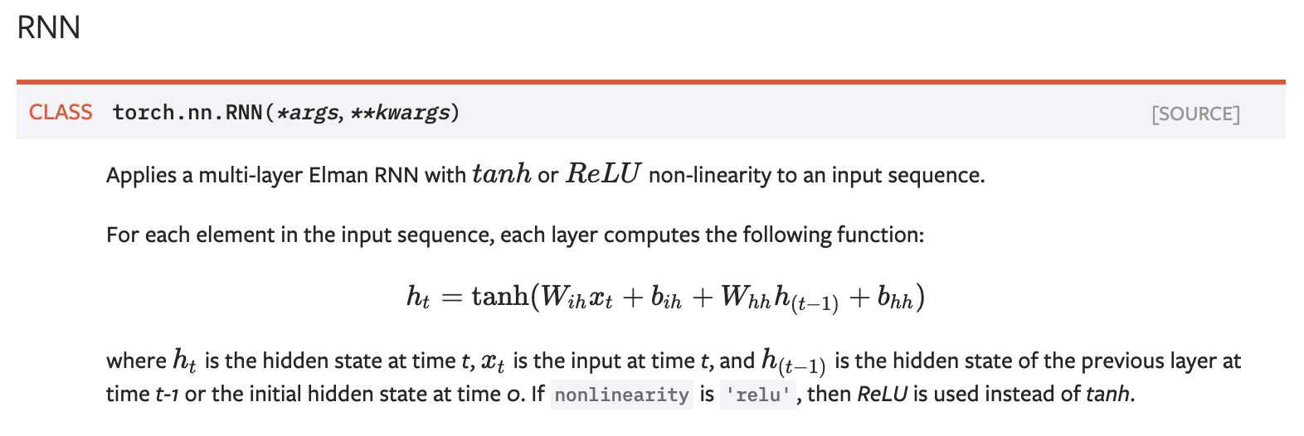
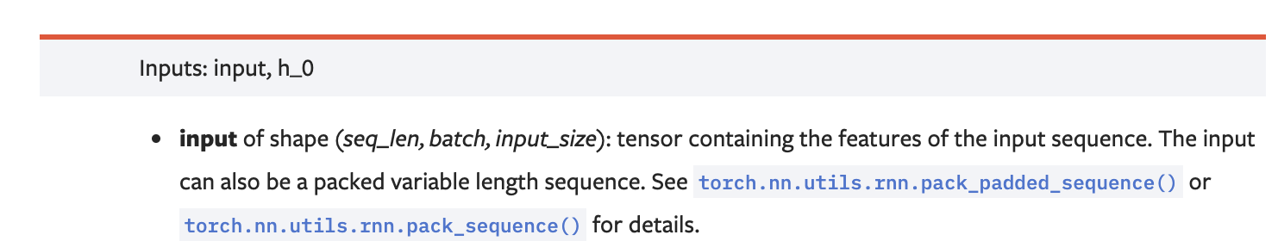
Pytorch RNN

Slide 23





How can it be used? – e.g. Scoring the Sentiment of a Text Sequence Many-to-one Sequence to score problems
positive / negative sentiment rating
$$y_{}$$
$$h_{n}$$
$$h_{0}$$
$$RNN$$
$$h_{1}$$
$$h_{2}$$
…
$$RNN$$
$$h_{n}$$
$$RNN$$
$$RNN$$
$$x_{1}$$
$$x_{2}$$
$$x_{3}$$
$$x_{n}$$
the
cat
likes
<<EOS>>

Slide 24
How can it be used? – e.g. Sentiment Scoring Many to one Mapping Problems
Input training examples don’t need to be the same length! In this case outputs can be.
input
output
this restaurant has good food
Positive
this restaurant is bad
Negative
this restaurant is the worst
Negative
this restaurant is well recommended
Positive

Slide 25
























How can it be used? – e.g. Text Generation Auto-regressive model – Sequence to Sequence during Training, Auto-regressive during test
DURING TRAINING
The
world
is
not
enough
<END>
$$y_{1}$$
$$y_{2}$$
$$y_{3}$$
$$y_{4}$$
$$y_{5}$$
$$y_{6}$$
$$h_{1}$$
$$h_{2}$$
$$h_{3}$$
$$h_{4}$$
$$h_{5}$$
$$h_{6}$$
$$h_{0}$$
RNN
$$h_{1}$$
RNN
$$h_{2}$$
RNN
$$h_{3}$$
RNN
$$h_{4}$$
RNN
$$h_{5}$$
RNN
$$x_{1}$$
$$x_{2}$$
$$x_{3}$$
$$x_{4}$$
$$x_{5}$$
$$x_{6}$$
<START>
The
world
is
not
enough

Slide 26
How can it be used? – e.g. Text Generation Auto-regressive Models
Input training examples don’t need to be the same length! In this case outputs can be.
input
output
<START> this restaurant has good food
this restaurant has good food <END>
<START> this restaurant is bad
this restaurant is bad <END>
<START> this restaurant is the worst
this restaurant is the worst <END>
<START> this restaurant is well recommended
this restaurant is well recommended <END>

Slide 27
How can it be used? – e.g. Text Generation Auto-regressive model – Sequence to Sequence during Training, Auto-regressive during test
DURING TESTING
$$h_{0}$$
RNN
$$x_{1}$$
<START>

Slide 28
How can it be used? – e.g. Text Generation Auto-regressive model – Sequence to Sequence during Training, Auto-regressive during test
DURING TESTING
The
$$y_{1}$$
$$h_{1}$$
$$h_{0}$$
RNN
$$h_{1}$$
$$x_{1}$$
<START>

Slide 29
How can it be used? – e.g. Text Generation Auto-regressive model – Sequence to Sequence during Training, Auto-regressive during test
DURING TESTING
The
$$y_{1}$$
$$h_{1}$$
$$h_{0}$$
RNN
$$h_{1}$$
RNN
$$x_{1}$$
$$x_{2}$$
<START>

Slide 30
How can it be used? – e.g. Text Generation Auto-regressive model – Sequence to Sequence during Training, Auto-regressive during test
DURING TESTING
The
world
$$y_{1}$$
$$y_{2}$$
$$h_{1}$$
$$h_{2}$$
$$h_{0}$$
RNN
$$h_{1}$$
RNN
$$h_{2}$$
$$x_{1}$$
$$x_{2}$$
<START>

Slide 31
How can it be used? – e.g. Text Generation Auto-regressive model – Sequence to Sequence during Training, Auto-regressive during test
DURING TESTING
The
world
is
not
enough
<END>
$$y_{1}$$
$$y_{2}$$
$$y_{3}$$
$$y_{4}$$
$$y_{5}$$
$$y_{6}$$
$$h_{1}$$
$$h_{2}$$
$$h_{3}$$
$$h_{4}$$
$$h_{5}$$
$$h_{6}$$
$$h_{0}$$
RNN
$$h_{1}$$
RNN
$$h_{2}$$
RNN
$$h_{3}$$
RNN
$$h_{4}$$
RNN
$$h_{5}$$
RNN
$$x_{1}$$
$$x_{2}$$
$$x_{3}$$
$$x_{4}$$
$$x_{5}$$
$$x_{6}$$
<START>

Slide 32
Character-level Models
a
t
<<space>>
$$y_{1}$$
$$y_{2}$$
$$y_{3}$$
$$h_{1}$$
$$h_{2}$$
$$h_{3}$$
$$h_{0}$$
$$RNN$$
$$h_{1}$$
$$h_{2}$$
$$h_{3}$$
$$RNN$$
$$RNN$$
$$x_{1}$$
$$x_{2}$$
$$x_{3}$$
c
a
t

Slide 33
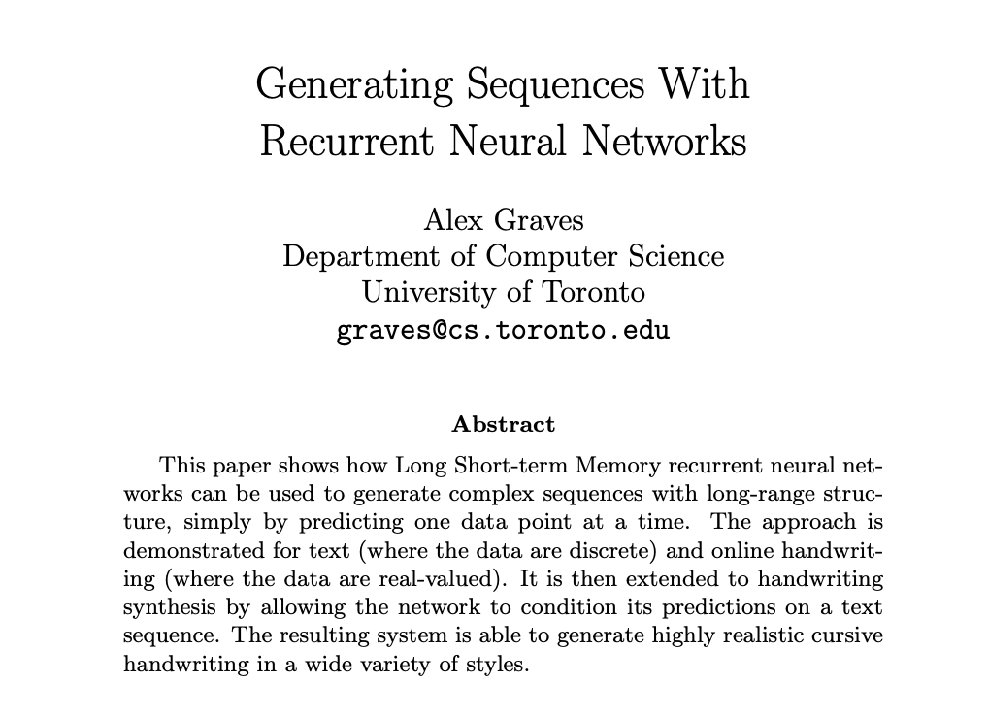


Slide 34
How can it be used? – e.g. Machine Translation Sequence to Sequence – Encoding – Decoding – Many to Many mapping
DURING TRAINING
The
world
is
not
enough
<END>
$$y_{1}$$
$$y_{2}$$
$$y_{3}$$
$$y_{4}$$
$$y_{5}$$
$$y_{6}$$
$$h_{1}$$
$$h_{2}$$
$$h_{3}$$
$$h_{4}$$
$$h_{5}$$
$$h_{6}$$
$$h_{0}$$
RNN
$$h_{1}$$
RNN
$$h_{2}$$
RNN
$$h_{3}$$
RNN
$$h_{4}$$
RNN
$$h_{5}$$
RNN
$$h_{0}$$
RNN
$$h_{1}$$
RNN
$$h_{2}$$
RNN
$$h_{3}$$
RNN
$$h_{4}$$
RNN
$$h_{5}$$
RNN
$$x_{1}$$
$$x_{2}$$
$$x_{3}$$
$$x_{4}$$
$$x_{5}$$
$$x_{6}$$
$$x_{1}$$
$$x_{2}$$
$$x_{3}$$
$$x_{4}$$
$$x_{5}$$
$$x_{6}$$
<START>
El
mundo
no
es
suficiente
<START>
The
world
is
not
enough

Slide 35
How can it be used? – e.g. Machine Translation
Sequence to Sequence Models
Input training examples don’t need to be the same length! In this case outputs can be.
input
output
<START> este restaurante tiene buena comida
this restaurant has good food <END>
<START> this restaurant has good food
<START> el mundo no es suficiente
the world is not enough <END>
<START> the world is not enough

Slide 36
How can it be used? – e.g. Machine Translation Sequence to Sequence – Encoding – Decoding – Many to Many mapping
DURING TRAINING – (Alternative)
The
world
is
not
enough
<END>
$$y_{1}$$
$$y_{2}$$
$$y_{3}$$
$$y_{4}$$
$$y_{5}$$
$$y_{6}$$
$$h_{1}$$
$$h_{2}$$
$$h_{3}$$
$$h_{4}$$
$$h_{5}$$
$$h_{6}$$
$$h_{0}$$
RNN
$$h_{1}$$
RNN
$$h_{2}$$
RNN
$$h_{3}$$
RNN
$$h_{4}$$
RNN
$$h_{5}$$
RNN
$$x_{1}$$
$$x_{2}$$
$$x_{3}$$
$$x_{4}$$
$$x_{5}$$
$$x_{6}$$
The
world
is
not
enough
$$h_{0}$$
RNN
$$h_{1}$$
RNN
$$h_{2}$$
RNN
$$h_{3}$$
RNN
$$h_{4}$$
RNN
$$h_{5}$$
RNN
$$x_{1}$$
$$x_{2}$$
$$x_{3}$$
$$x_{4}$$
$$x_{5}$$
$$x_{6}$$
<START>
El
mundo
no
es
suficiente

Slide 37
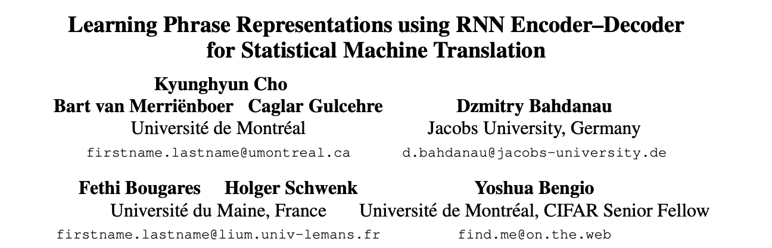
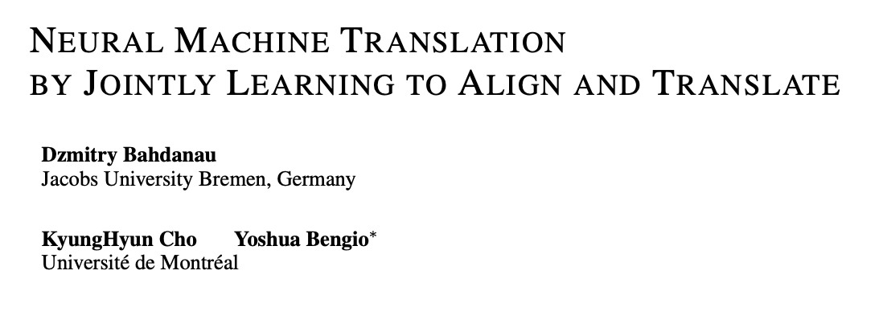

Slide 38














Bidirectional Recurrent Neural Network
<<pronoun>>
<<noun>>
<<verb>>
$$y_{1}$$
$$y_{2}$$
$$y_{3}$$
$$h_{1}$$
$$h_{2}$$
$$h_{3}$$
$$h_{0}$$
$$BRNN$$
$$h_{1}$$
$$BRNN$$
$$h_{2}$$
$$BRNN$$
$$h_{3}$$
$$x_{1}$$
$$x_{2}$$
$$x_{3}$$
the
cat
wants

Slide 39






















Stacked Recurrent Neural Network
$$y_{1}$$
$$y_{2}$$
$$y_{3}$$
$$h_{1}$$
$$h_{2}$$
$$h_{3}$$
$$h_{0}$$
$$RNN$$
$$h_{1}$$
$$RNN$$
$$h_{2}$$
$$RNN$$
$$h_{3}$$
$${\check{h}}_{1}$$
$${\check{h}}_{2}$$
$${\check{h}}_{3}$$
$${\check{h}}_{0}$$
$$RNN$$
$${\check{h}}_{1}$$
$$RNN$$
$${\check{h}}_{2}$$
$$RNN$$
$${\check{h}}_{3}$$
$$x_{1}$$
$$x_{2}$$
$$x_{3}$$
c
a
t

Slide 40
Stacked Bidirectional Recurrent Neural Network
$$y_{1}$$
$$y_{2}$$
$$y_{3}$$
$$h_{1}$$
$$h_{2}$$
$$h_{3}$$
$$h_{0}$$
$$RNN$$
$$h_{1}$$
$$RNN$$
$$h_{2}$$
$$RNN$$
$$h_{3}$$
$${\check{h}}_{1}$$
$${\check{h}}_{2}$$
$${\check{h}}_{3}$$
$${\check{h}}_{0}$$
$$RNN$$
$${\check{h}}_{1}$$
$$RNN$$
$${\check{h}}_{2}$$
$$RNN$$
$${\check{h}}_{3}$$
$$x_{1}$$
$$x_{2}$$
$$x_{3}$$
c
a
t

Slide 41
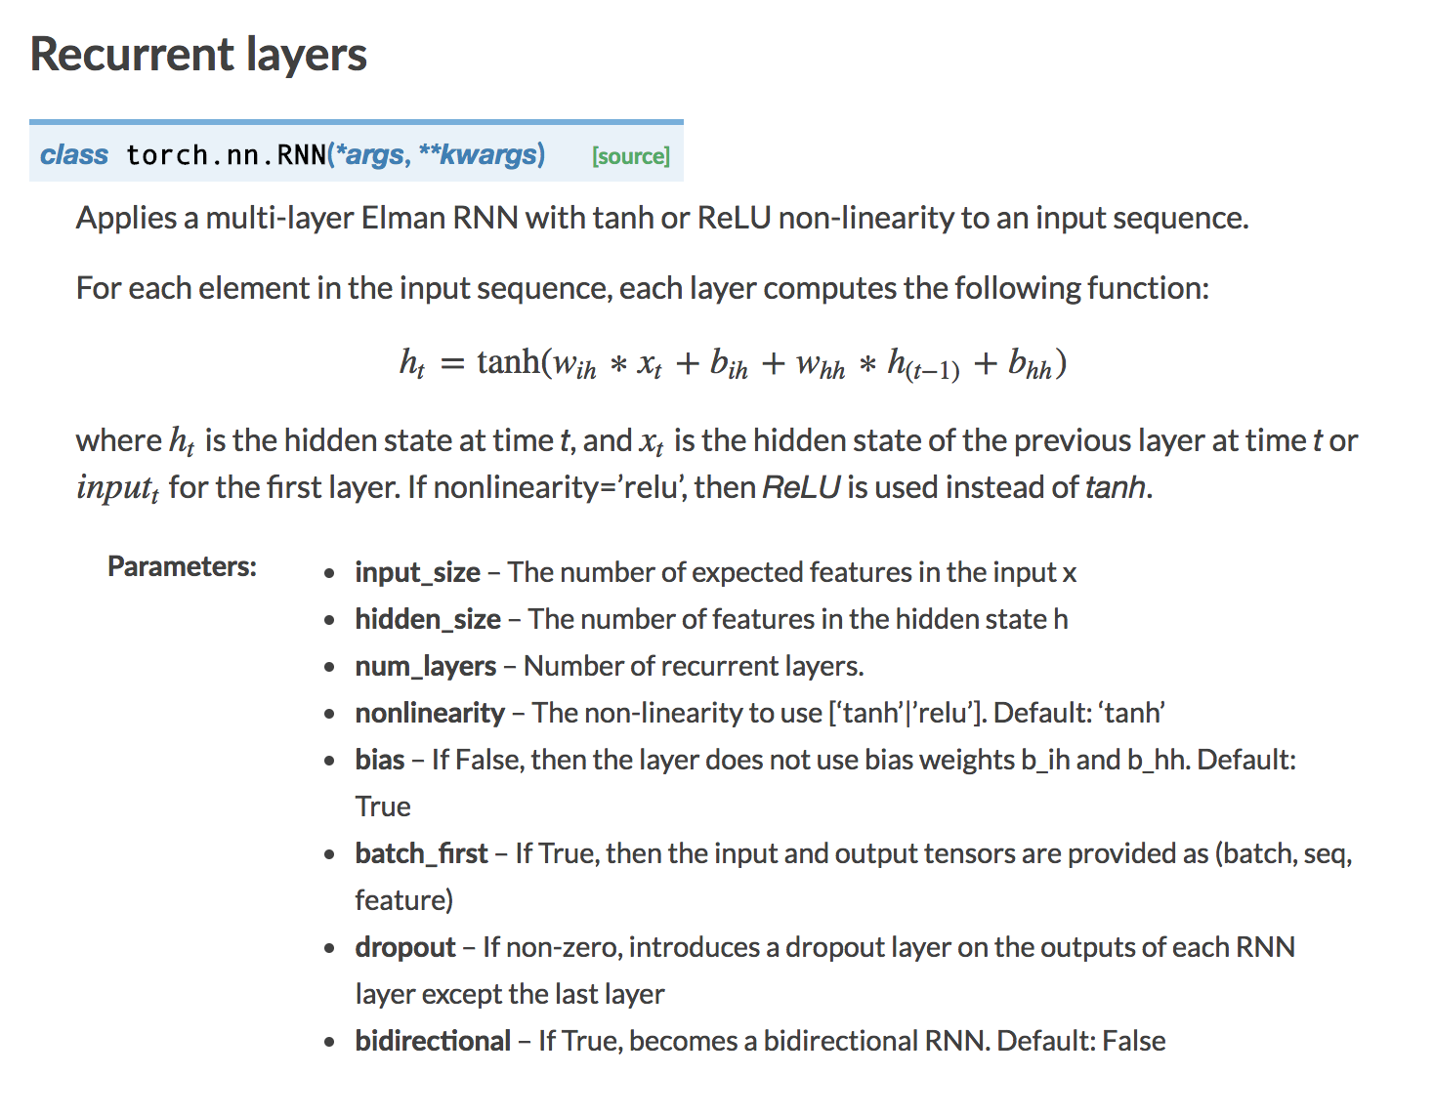
RNN in Pytorch

Slide 42



LSTM Cell (Long Short-Term Memory)
$$h_{0}$$
$$h_{1}$$
$$LSTM$$
$$c_{0}$$
$$c_{1}$$
$$x_{1}$$

Slide 43
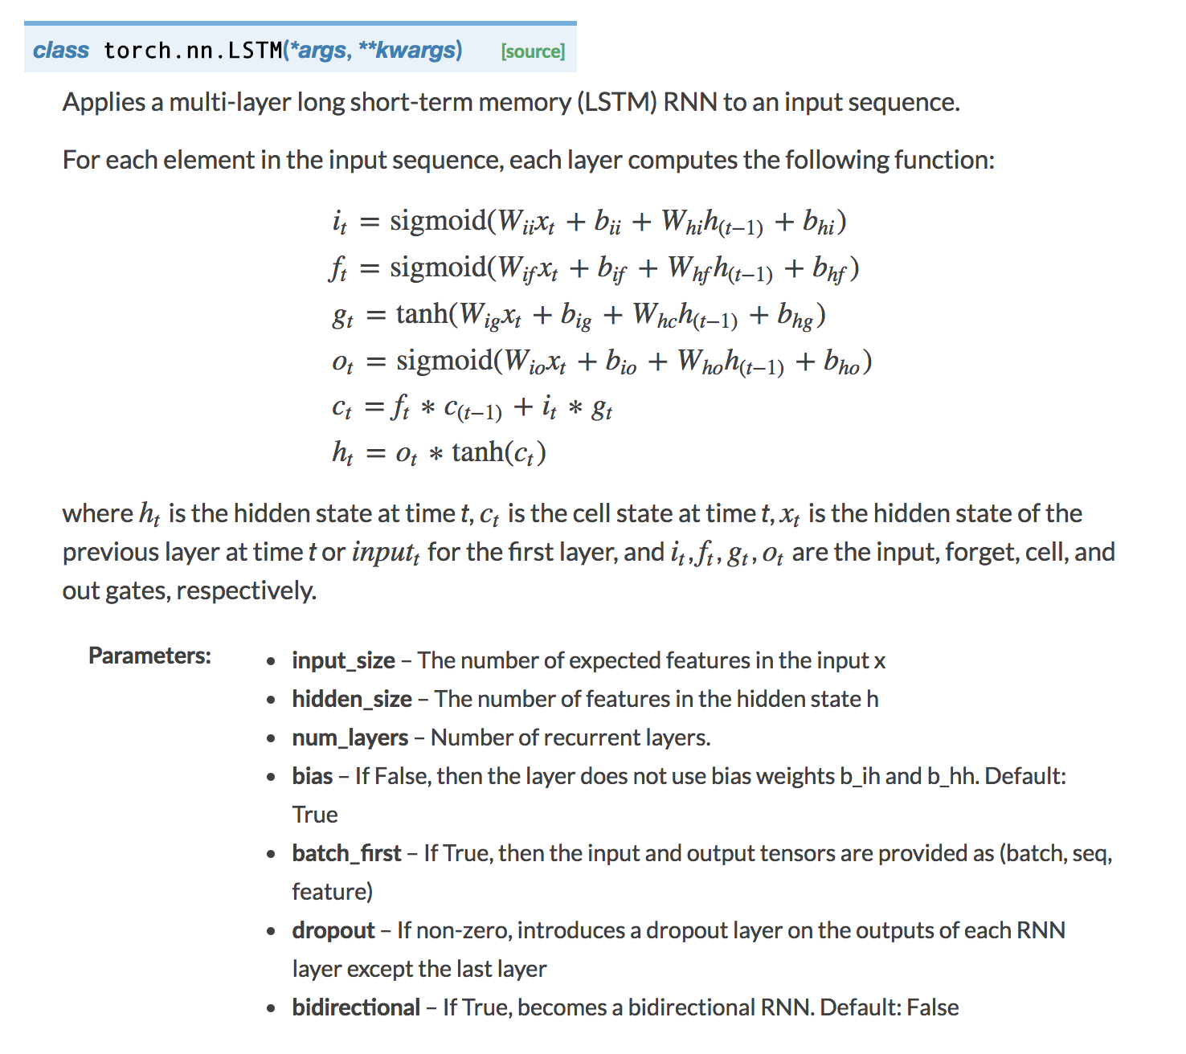
LSTM in Pytorch

Slide 44
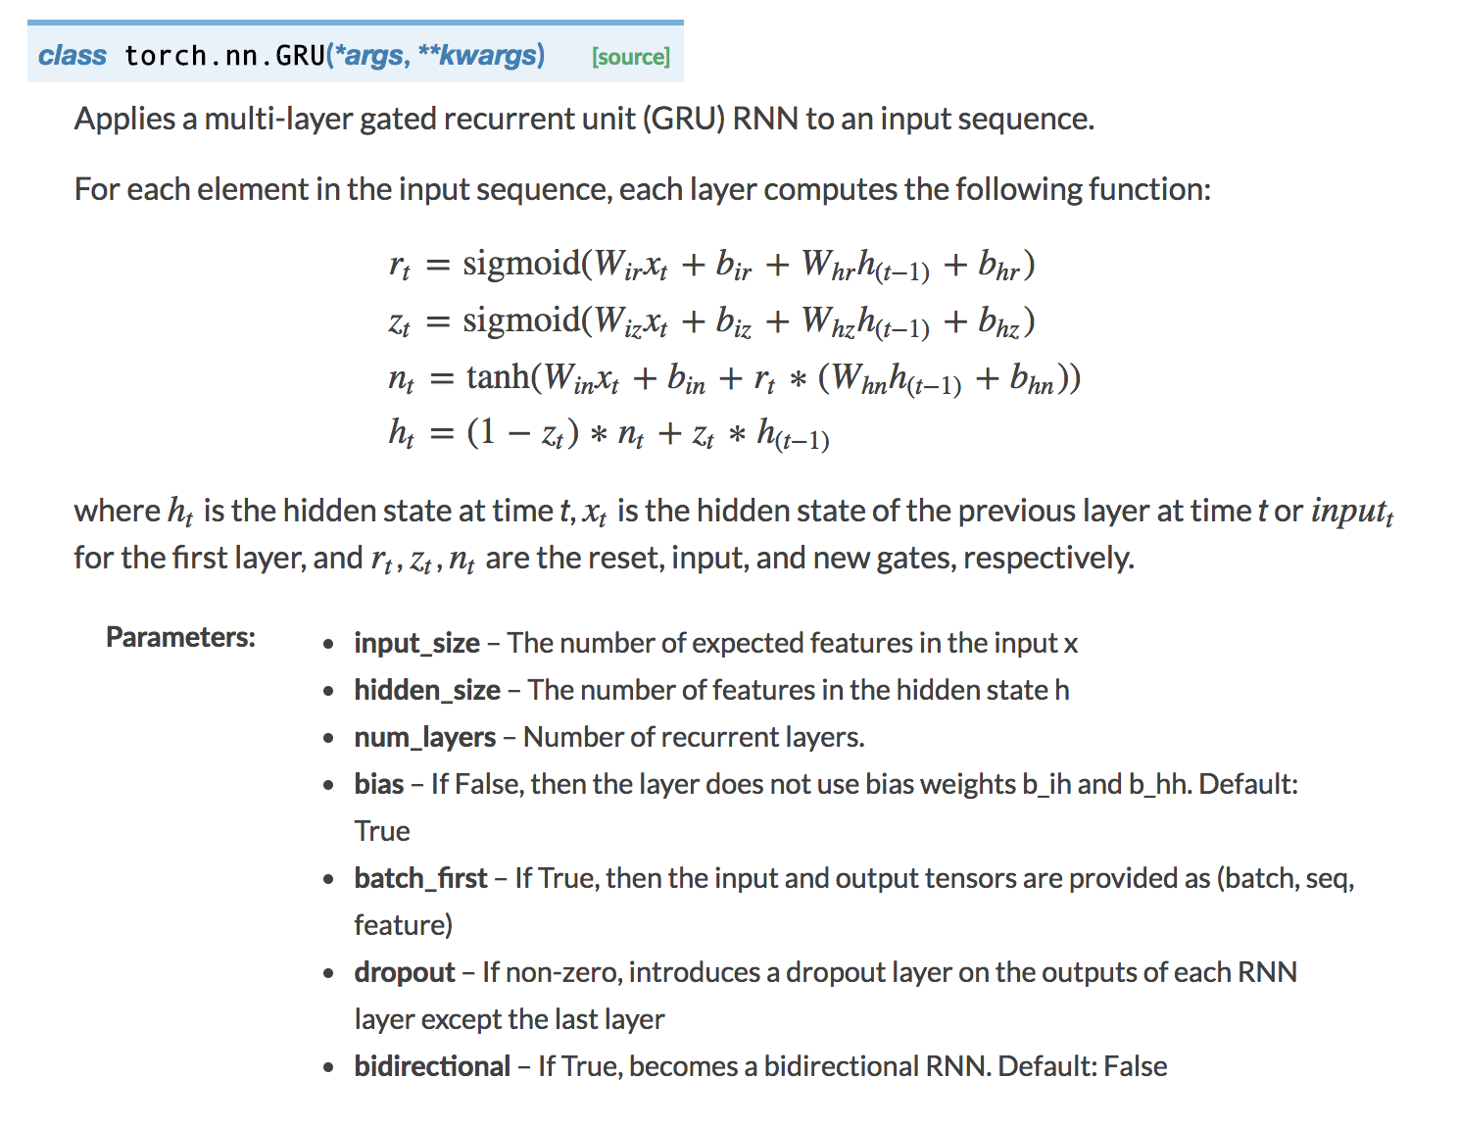
GRU in Pytorch

Slide 45
Tomorrow: RNNs for Image Caption Generation
The
world
is
not
enough
<END>
$$y_{1}$$
$$y_{2}$$
$$y_{3}$$
$$y_{4}$$
$$y_{5}$$
$$y_{6}$$
$$h_{1}$$
$$h_{2}$$
$$h_{3}$$
$$h_{4}$$
$$h_{5}$$
$$h_{6}$$
$$h_{0}$$
RNN
$$h_{1}$$
RNN
$$h_{2}$$
RNN
$$h_{3}$$
RNN
$$h_{4}$$
RNN
$$h_{5}$$
RNN
$$x_{1}$$
$$x_{2}$$
$$x_{3}$$
$$x_{4}$$
$$x_{5}$$
$$x_{6}$$
The
world
is
not
enough
$$h_{0}$$
RNN
$$h_{1}$$
RNN
$$h_{2}$$
RNN
$$h_{3}$$
RNN
$$h_{4}$$
RNN
$$h_{5}$$
RNN
$$x_{1}$$
$$x_{2}$$
$$x_{3}$$
$$x_{4}$$
$$x_{5}$$
$$x_{6}$$
<START>
El
mundo
no
es
suficiente

Slide 46
Tomorrow: RNNs for Image Caption Generation
Nice
view
of
sunny
beach
<END>
$$y_{1}$$
$$y_{2}$$
$$y_{3}$$
$$y_{4}$$
$$y_{5}$$
$$y_{6}$$
$$h_{1}$$
$$h_{2}$$
$$h_{3}$$
$$h_{4}$$
$$h_{5}$$
$$h_{6}$$
$$h_{0}$$
RNN
$$h_{1}$$
RNN
$$h_{2}$$
RNN
$$h_{3}$$
RNN
$$h_{4}$$
RNN
$$h_{5}$$
RNN
$$x_{1}$$
$$x_{2}$$
$$x_{3}$$
$$x_{4}$$
$$x_{5}$$
$$x_{6}$$
The
world
is
not
enough
CNN

Slide 47
Questions?

