Slide 1
Basic Image Processing &
Image Features

Slide 2
About the Course
CS6501: Computational Visual Recognition
Instructor: Vicente Ordonez
Email: vicente@virginia.edu
Office Hour: 310 Rice Hall, Tuesday 3pm to 4pm.
Website: http://www.cs.virginia.edu/~vicente/recognition
Class Location: Olsson Hall, 005
Class Times: Tuesday-Thursday 11:00am – 12:15pm
Piazza: http://piazza.com/virginia/fall2017/cs6501009/home

Slide 3
Teaching Assistants
Tianlu Wang
PhD Student
Office Hours: Wednesdays 5 to 6pm.
Location: Rice 430, desk 12
Siva Sitaraman
MSc Student
Office Hours: Fridays 3 to 4pm.
Location: Rice 304
Piazza: http://piazza.com/virginia/fall2017/cs6501009/home

Slide 4
Grading
Labs: 30% (4 labs [5%, 5%, 10%, 10%])
Paper presentation + Paper summaries: 10%
Quiz: 20%
Final project: 40%
  No Late Assignments / Honor Code Reminder

Slide 5
Lab 1. Image Processing Lab (5%)
Posted on course website
Recommended setup:
Anaconda (with python 2.7)
- This installs python + lots of libraries
Jupyter (with python 2.7)
- This is the interactive environment we will use for development.
pytorch (with python 2.7)
- This is the main library we will learn how to use but you are free
to use others for your project: Keras, Tensorflow, Torch, Chainer,
MXNET, Lasagne, CNTK, Theano, Caffe, etc.

Slide 6
Objectives for Today
Computer Vision / Overview
How to implement basic image processing routines: brightness, saturation, blurring.
The convolution operator, image gradients, corner detection.
Image feature descriptors.

Slide 7
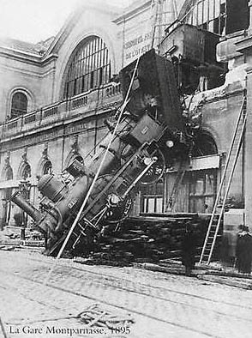

Reminder of what is an image for a computer.
What we see
What a computer sees
Source: S. Narasimhan

Slide 8

Images as Functions
$$z=f(x, y)$$

Slide 9
Images as Functions
$$z=f(x, y)$$
The domain of x and y is [0, img-width) and [0 and img-height)
x, and y are discretized into integer values.

Slide 10
Images as Matrices

Slide 11
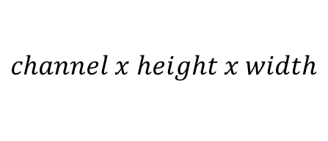
Color Images as Tensors
$$channel x height x width$$

Slide 12
Color Images as Tensors
$$channel x height x width$$
Channels are usually RGB: Red, Green, and Blue
Other color spaces: HSV, HSL, LUV, XYZ, Lab, CMYK, etc

Slide 13
Review the following notebook
http://www.cs.virginia.edu/~vicente/recognition/notebooks/image_processing_lab.html

Slide 14
Image filtering

Slide 15
Image filtering
Image Credit: http://what-when-how.com/introduction-to-video-and-image-processing/neighborhood-processing-introduction-to-video-and-image-processing-part-1/

Slide 16
Image filtering
Image Credit: http://what-when-how.com/introduction-to-video-and-image-processing/neighborhood-processing-introduction-to-video-and-image-processing-part-1/

Slide 17
Image filtering: e.g. Mean Filter

Slide 18
Image filtering: e.g. Mean Filter

Slide 19
Image filtering: e.g. Median Filter
Image Credit: http://what-when-how.com/introduction-to-video-and-image-processing/neighborhood-processing-introduction-to-video-and-image-processing-part-1/

Slide 20

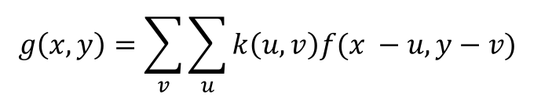
Image filtering: Convolution operator
$$k(x, y)$$
$$g\left(x, y\right)=\sum_{v}{\sum_{u}{k\left(u,v\right)f(x −u, y−v) }}$$
Image Credit: http://what-when-how.com/introduction-to-video-and-image-processing/neighborhood-processing-introduction-to-video-and-image-processing-part-1/

Slide 21
(filter, kernel)
http://www.cs.virginia.edu/~vicente/recognition/animation.gif

Slide 22


Image filtering: Convolution operator
e.g. mean filter
1/9 | 1/9 | 1/9
1/9 | 1/9 | 1/9
1/9 | 1/9 | 1/9
$k(x, y)$ =
$k(x, y)$
Image Credit: http://what-when-how.com/introduction-to-video-and-image-processing/neighborhood-processing-introduction-to-video-and-image-processing-part-1/

Slide 23
Image filtering: Convolution operator
e.g. mean filter
1/9 | 1/9 | 1/9
1/9 | 1/9 | 1/9
1/9 | 1/9 | 1/9
$k(x, y)$ =
$k(x, y)$
Image Credit: http://what-when-how.com/introduction-to-video-and-image-processing/neighborhood-processing-introduction-to-video-and-image-processing-part-1/

Slide 24
Image filtering: e.g. Mean Filter

Slide 25
Image filtering: Convolution operator
e.g. gaussian filter (gaussian blur)
1/16 | 1/8 | 1/16
1/8 | 1/4 | 1/8
1/16 | 1/8 | 1/16
$k(x, y)$ =
$k(x, y)$
Image Credit: http://what-when-how.com/introduction-to-video-and-image-processing/neighborhood-processing-introduction-to-video-and-image-processing-part-1/

Slide 26
Image filtering: Convolution operator
e.g. gaussian filter (gaussian blur)
Image Credit: http://what-when-how.com/introduction-to-video-and-image-processing/neighborhood-processing-introduction-to-video-and-image-processing-part-1/

Slide 27
Image filtering: Convolution operator
e.g. sobel operator
1 | 0 | -1
2 | 0 | -2
1 | 0 | -1
$k(x, y)$ =
$k(x, y)$
Image Credit: http://what-when-how.com/introduction-to-video-and-image-processing/neighborhood-processing-introduction-to-video-and-image-processing-part-1/

Slide 28
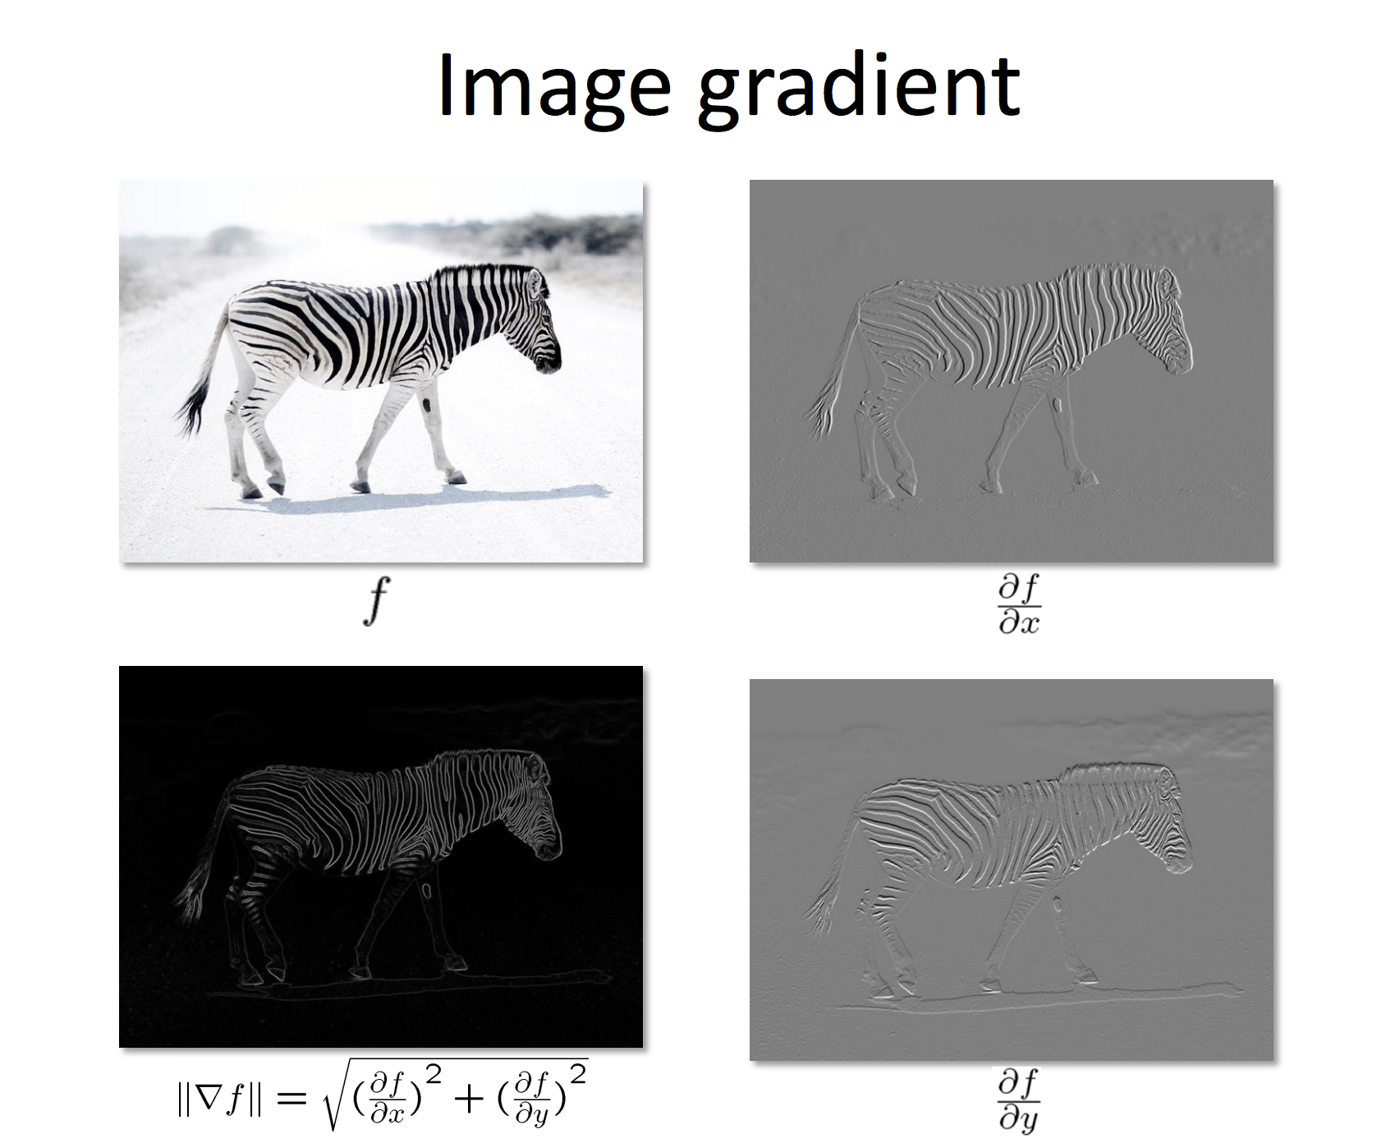
Slide by Bharat Hariharan

Slide 29
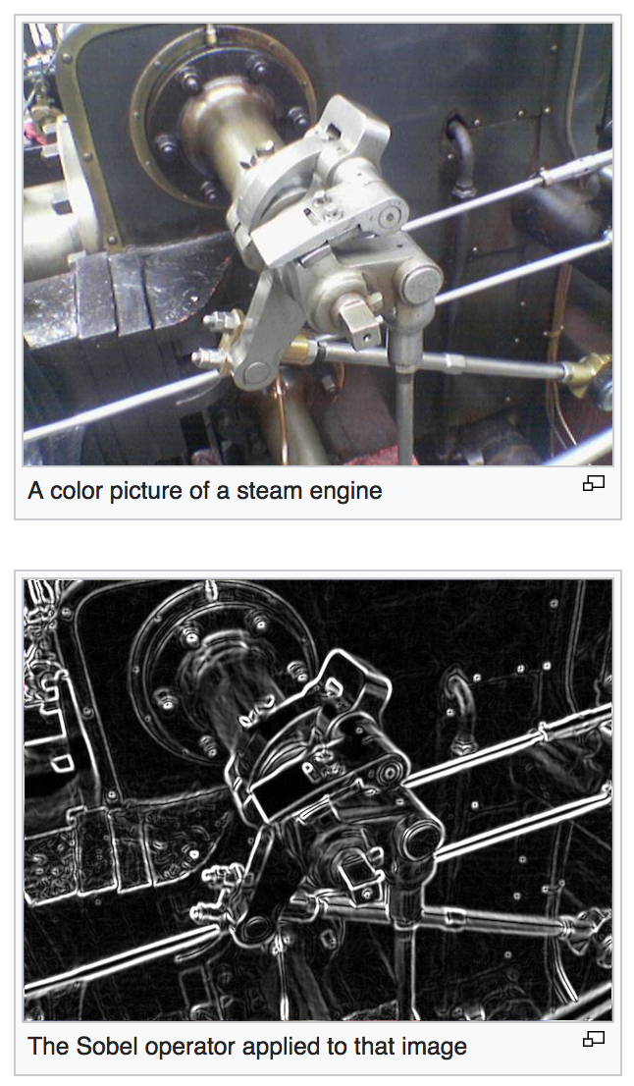

Slide 30
Image Features

Slide 31
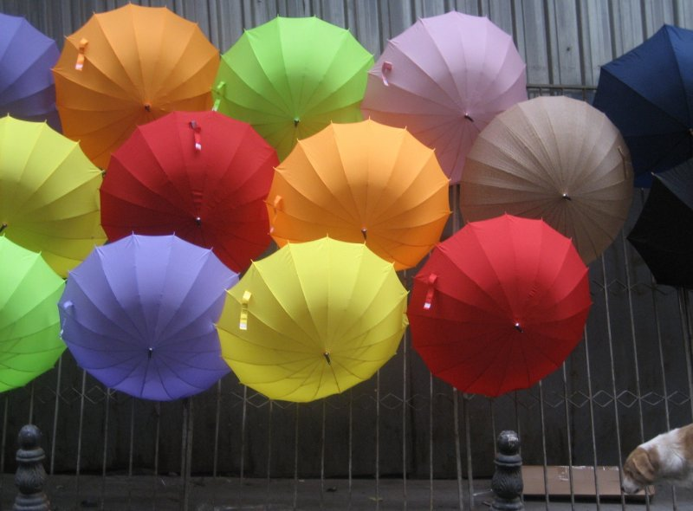

Image Features: Color
Photo by: marielito
slide by Tamara L. Berg

Slide 32
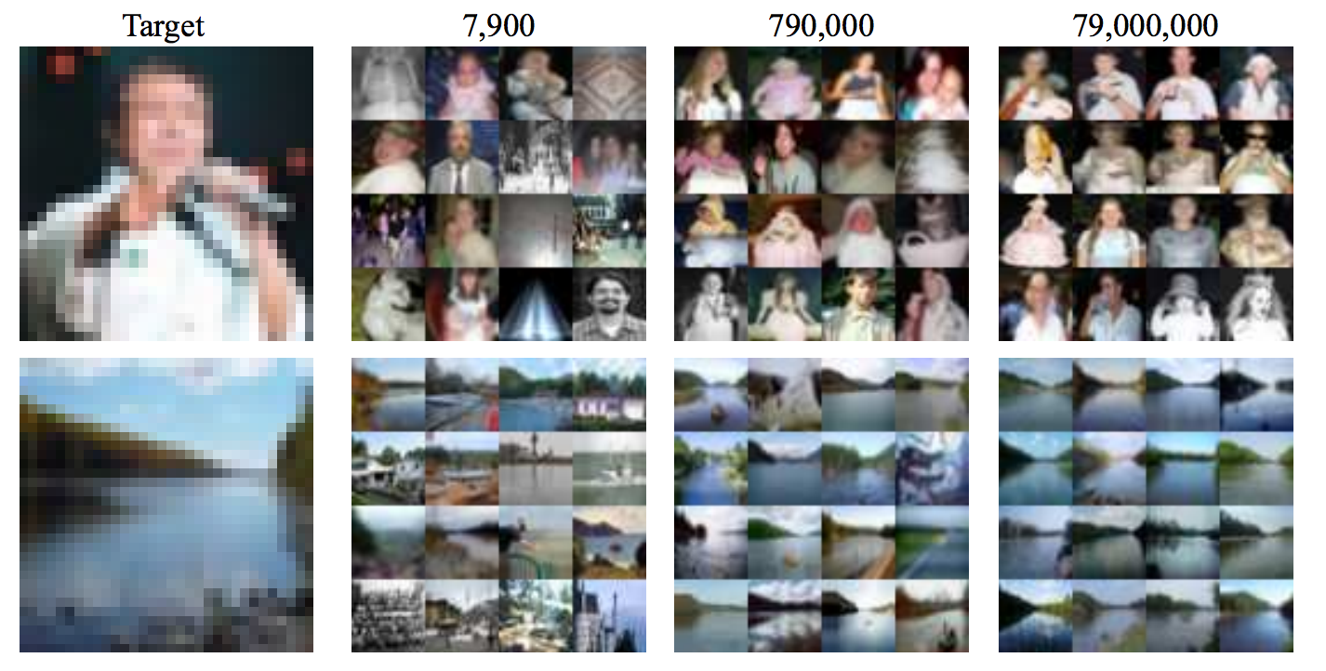
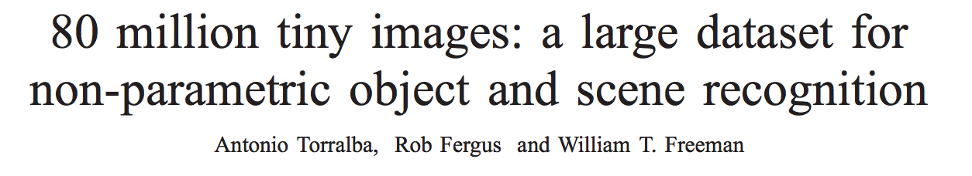
Image Features: Color

Slide 33
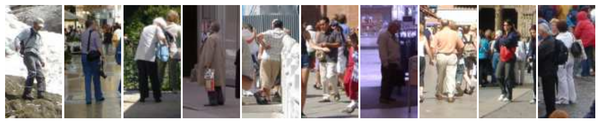
Image Features: Color
However, these are all images of people but the
colors in each image are very different.

Slide 34
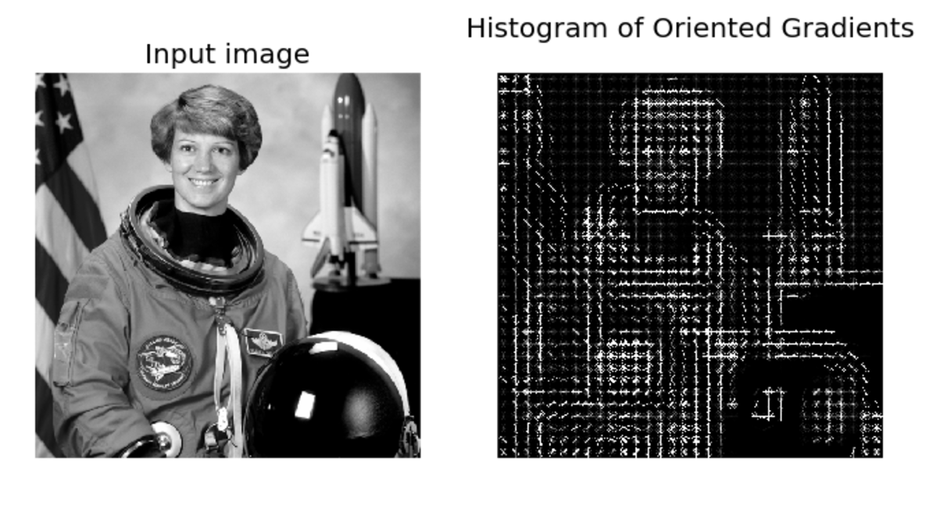
Image Features: HoG
Paper by Navneet Dalal & Bill Triggs presented at CVPR 2005 for detecting people.
Scikit-image implementation

Slide 35
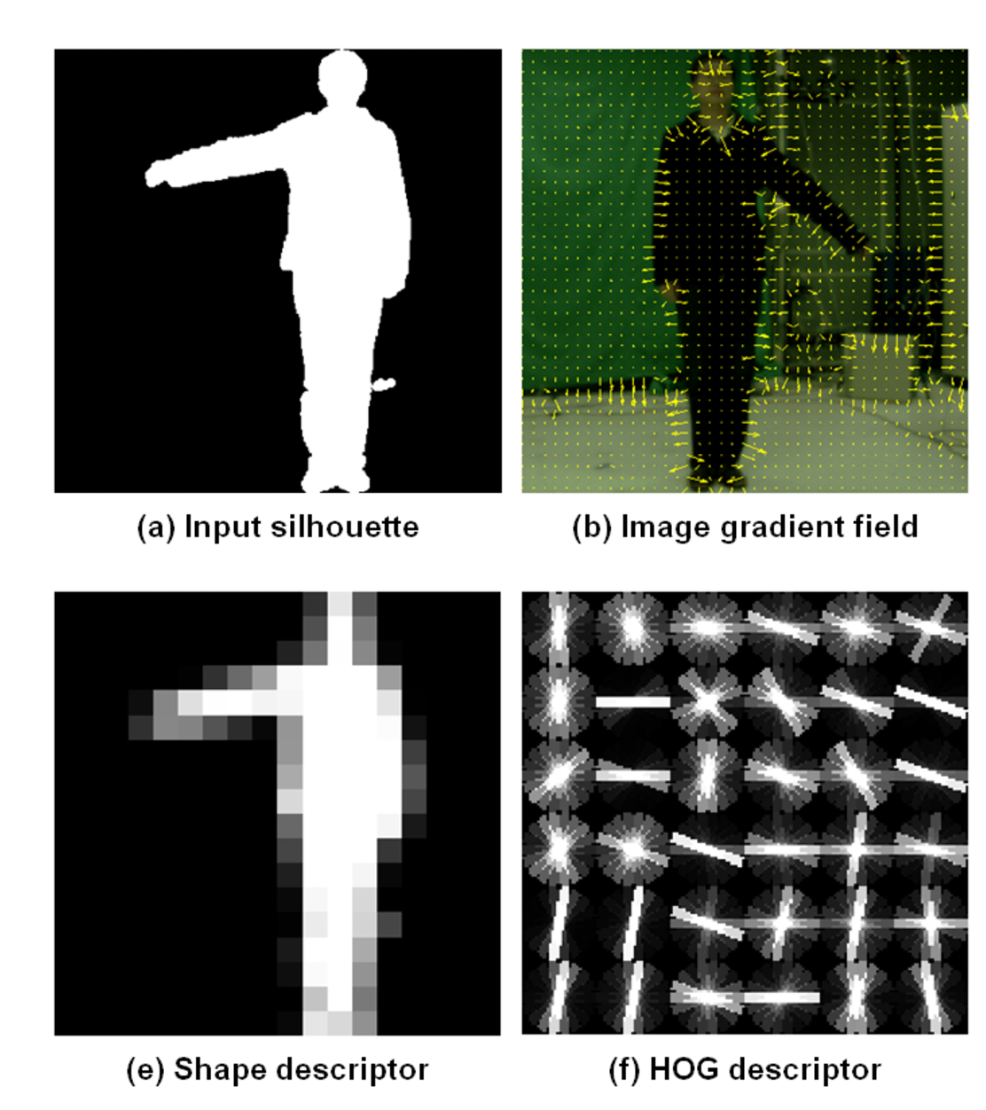
Image Features: HoG
+ Block Normalization
Paper by Navneet Dalal & Bill Triggs presented at CVPR 2005 for detecting people.
Figure from Zhuolin Jiang, Zhe Lin, Larry S. Davis, ICCV 2009 for human action recognition.

Slide 36
https://sensblogs.wordpress.com/2011/08/23/quick-reviews-on-local-descriptors-sift-and-single-object-recognition-by-fei-fei-li/

Slide 37
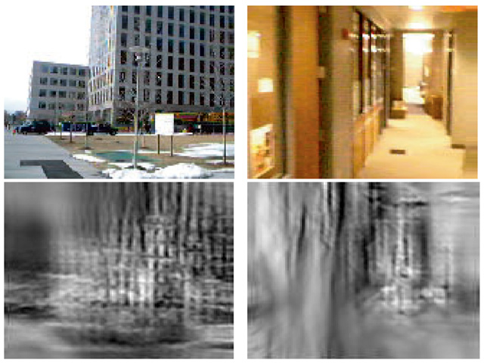
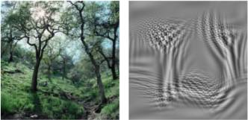
Image Features: GIST
The “gist” of a scene: Oliva & Torralba, 2001

Slide 39
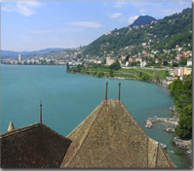
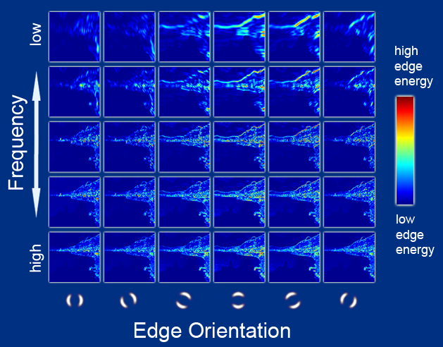
Image Features: GIST
Oriented edge response at multiple scales (5 spatial scales, 6 edge orientations)
Hays and Efros, SIGGRAPH 2007

Slide 40
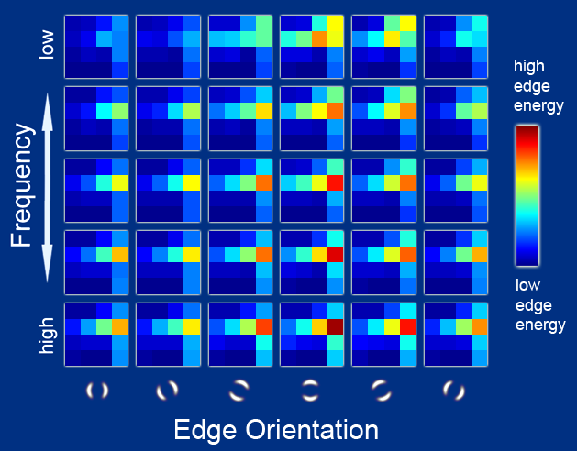
Image Features: GIST
Aggregated edge responses over 4x4 windows
Hays and Efros, SIGGRAPH 2007

Slide 41
HoG, SIFT, GIST, SURF
What do they have in common?
How can we use them?

Slide 42
Questions?

