Slide 1
Deep Learning for Vision + Convolutional Networks

Slide 2
About the Course
CS6501: Computational Visual Recognition
Instructor: Vicente Ordonez
Email: vicente@virginia.edu
Office Hour: 310 Rice Hall, Tuesday 3pm to 4pm.
Website: http://www.cs.virginia.edu/~vicente/recognition
Class Location: Olsson Hall, 005
Class Times: Tuesday-Thursday 11:00am – 12:15pm
Piazza: http://piazza.com/virginia/fall2017/cs6501009/home

Slide 3
Teaching Assistants
Tianlu Wang
PhD Student Office Hours: Wednesdays 5 to 6pm.
Location: Rice 430, desk 12
Siva Sitaraman
MSc Student Office Hours: Fridays 3 to 4pm.
Location: Rice 204
Piazza: http://piazza.com/virginia/fall2017/cs6501009/home

Slide 4
Outline for Today
The Perceptron Model
(Artificial) Neural Networks (ANNs, NNs) / Multi-layer Perceptron (MLP)
Backpropagation
Convolutional (Neural) Networks (CNNs, Convnets)

Slide 5
Perceptron Model
Frank Rosenblatt (1957) - Cornell University
Activation function
$$x_{1}$$
$$w_{1}$$
$$f\left(x\right)=\left\{\begin{aligned}1, if \sum_{i=0}^{n}{w_{i}x_{i}}+b>0 \\ &0, otherwise \end{aligned}\right.$$
$$x_{2}$$
$$w_{2}$$
$$w_{3}$$
$$x_{3}$$
$$w_{4}$$
$$x_{4}$$
More: https://en.wikipedia.org/wiki/Perceptron

Slide 6
Perceptron Model
Frank Rosenblatt (1957) - Cornell University
!?
$$x_{1}$$
$$w_{1}$$
$$f\left(x\right)=\left\{\begin{aligned}1, if \sum_{i=0}^{n}{w_{i}x_{i}}+b>0 \\ &0, otherwise \end{aligned}\right.$$
$$x_{2}$$
$$w_{2}$$
$$w_{3}$$
$$x_{3}$$
$$w_{4}$$
$$x_{4}$$
More: https://en.wikipedia.org/wiki/Perceptron

Slide 7
Perceptron Model
Frank Rosenblatt (1957) - Cornell University
Activation function
$$x_{1}$$
$$w_{1}$$
$$f\left(x\right)=\left\{\begin{aligned}1, if \sum_{i=0}^{n}{w_{i}x_{i}}+b>0 \\ &0, otherwise \end{aligned}\right.$$
$$x_{2}$$
$$w_{2}$$
$$w_{3}$$
$$x_{3}$$
$$w_{4}$$
$$x_{4}$$
More: https://en.wikipedia.org/wiki/Perceptron

Slide 8
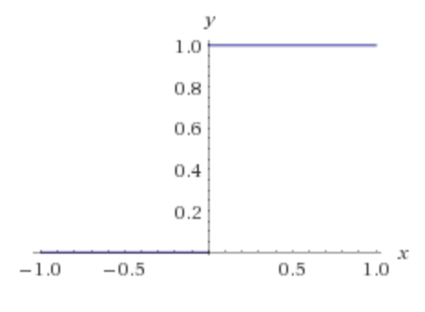
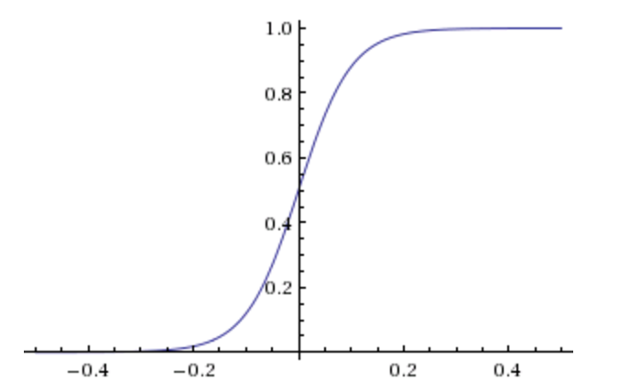
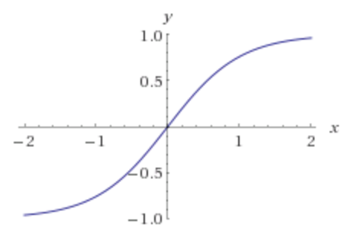
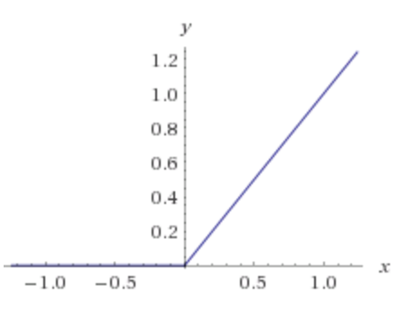
Activation Functions
Step(x)
Sigmoid(x)
Tanh(x)
ReLU(x) = max(0, x)

Slide 9
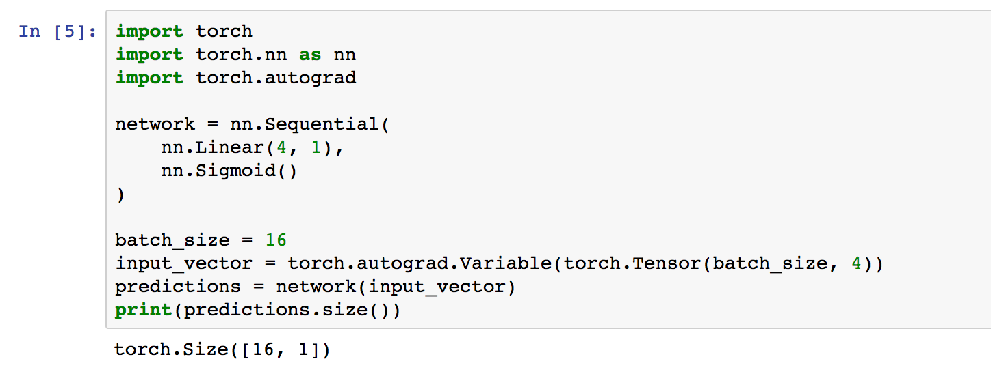
Pytorch - Perceptron

Slide 10
Two-layer Multi-layer Perceptron (MLP)
”hidden" layer
Loss / Criterion
$$x_{1}$$
$$a_{1}$$
$$x_{2}$$
$$a_{2}$$
$${\hat{y}}_{1}$$
$$y_{1}$$
$$x_{3}$$
$$a_{3}$$
$$x_{4}$$
$$a_{4}$$

Slide 11
Forward pass
$$z_{i}=\sum_{i=0}^{n}{w_{1ij}x_{i}}+b_{1}$$
$$a_{i}= Sigmoid(z_{i})$$
$$p_{1}=\sum_{i=0}^{n}{w_{2i}a_{i}}+b_{2}$$
$$y_{1}= Sigmoid(p_{i})$$
$$x_{1}$$
$$a_{1}$$
$$x_{2}$$
$$a_{2}$$
$${\hat{y}}_{1}$$
$$y_{1}$$
$$x_{3}$$
$$a_{3}$$
$$x_{4}$$
$$a_{4}$$
$Loss=L(y_{1},$ ${\hat{y}}_{1})$

Slide 12
Backward pass
$${\frac{∂L}{∂x_{k}}}_{}=(\frac{∂}{∂x_{k}}\sum_{i=0}^{n}{w_{1ij}x_{i}}+b_{1})\frac{∂L}{∂z_{i}}$$
$${\frac{∂L}{∂z_{i}}}_{}=\frac{∂}{∂z_{i}}Sigmoid(z_{i})\frac{∂L}{∂a_{k}}$$
GradInputs
$${\frac{∂L}{∂a_{k}}}_{}=(\frac{∂}{∂a_{k}}\sum_{i=0}^{n}{w_{2i}a_{i}}+b_{2})\frac{∂L}{∂p_{1}}$$
${\frac{∂L}{∂p_{1}}}_{}=\frac{∂}{∂p_{1}}Sigmoid(p_{i})$ $\frac{∂L}{∂{\hat{y}}_{1}}$
$$x_{1}$$
$$a_{1}$$
$$x_{2}$$
$$a_{2}$$
$${\hat{y}}_{1}$$
$$y_{1}$$
$$x_{3}$$
$$a_{3}$$
$$x_{4}$$
$$a_{4}$$
$${\frac{∂L}{∂w_{2i}}=\frac{∂a_{k}}{∂w_{2i}}\frac{∂L}{∂a_{k}}}_{}$$
$\frac{∂L}{∂{\hat{y}}_{1}}=\frac{∂}{∂{\hat{y}}_{1}}L(y_{1},$ ${\hat{y}}_{1})$
$${\frac{∂L}{∂w_{1ij}}=\frac{∂x_{k}}{∂w_{1ij}}\frac{∂L}{∂x_{k}}}_{}$$
GradParams

Slide 13
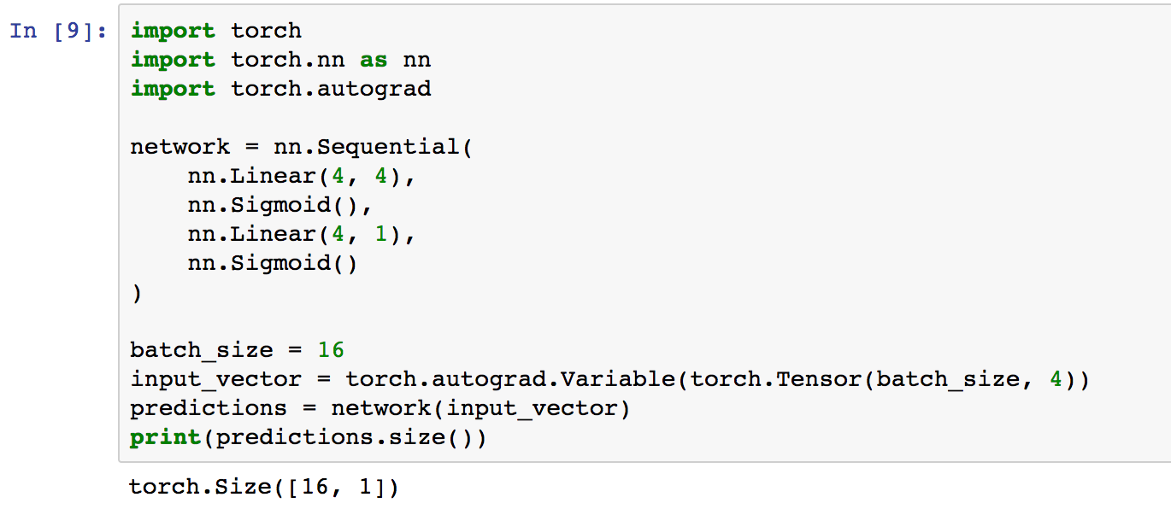
Pytorch – Two-layer MLP + Regression

Slide 14
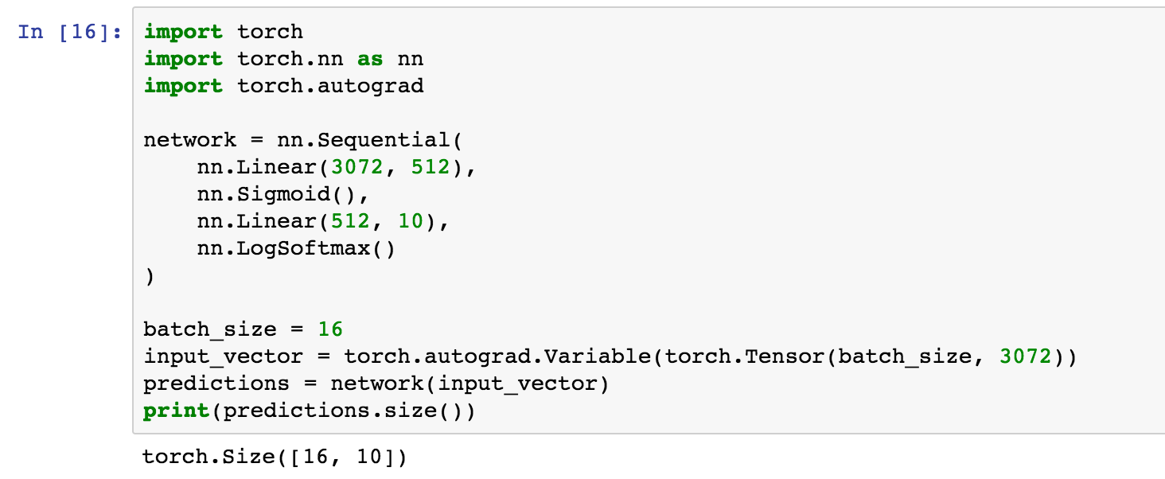
Pytorch – Two-layer MLP + LogSoftmax
# of Hidden Units

Slide 15
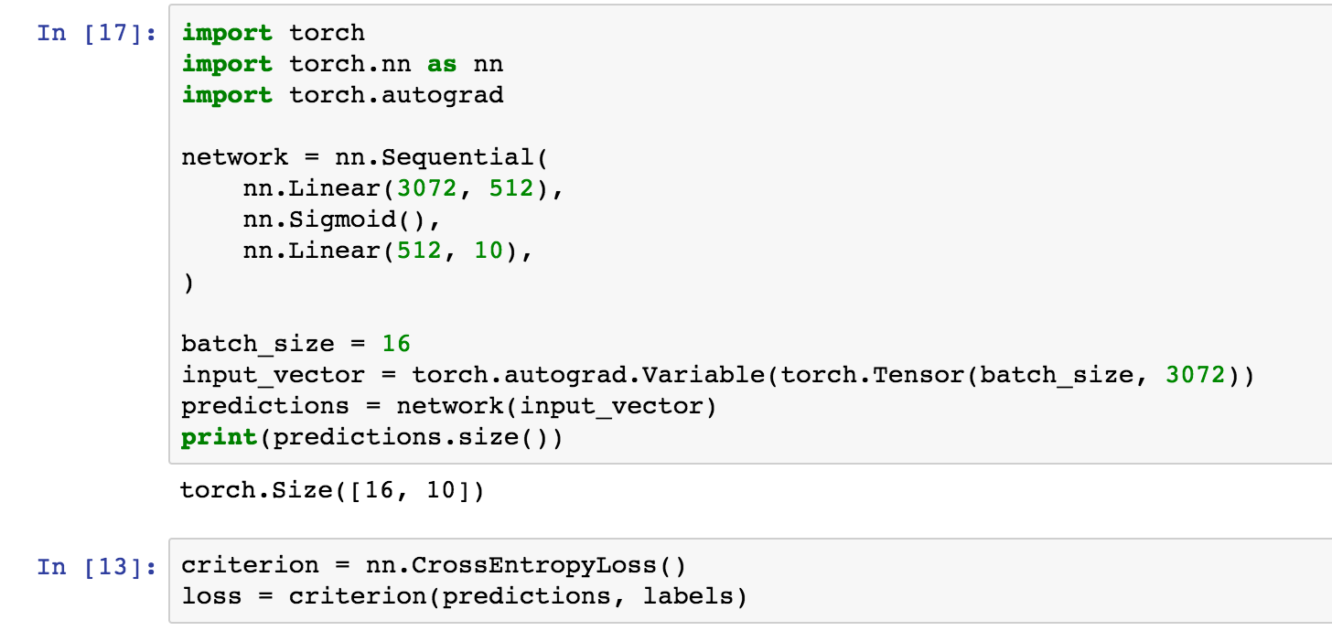
Pytorch – Two-layer MLP + LogSoftmax
LogSoftmax + Negative Likelihood Loss

Slide 16
Bookmark Opportunity!

Slide 17
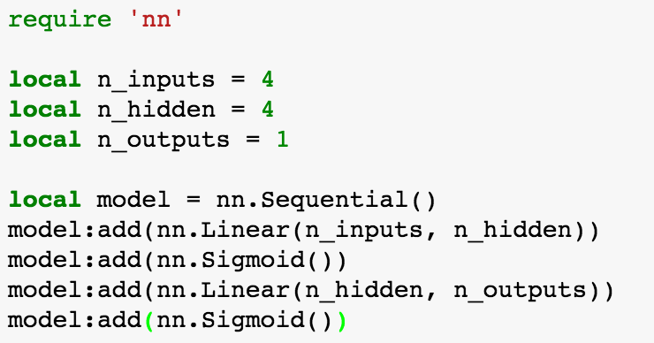
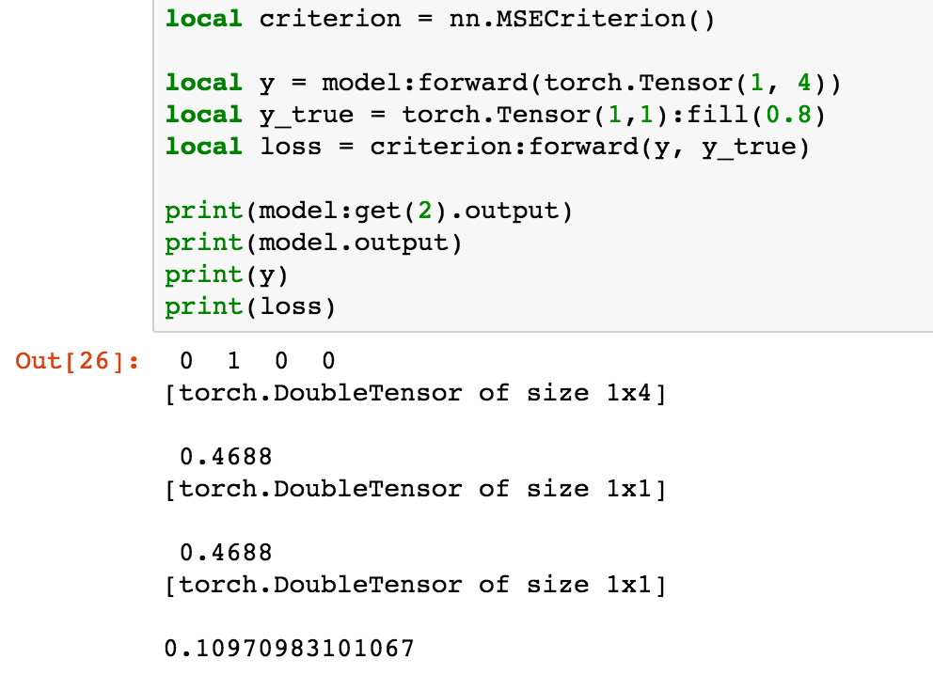
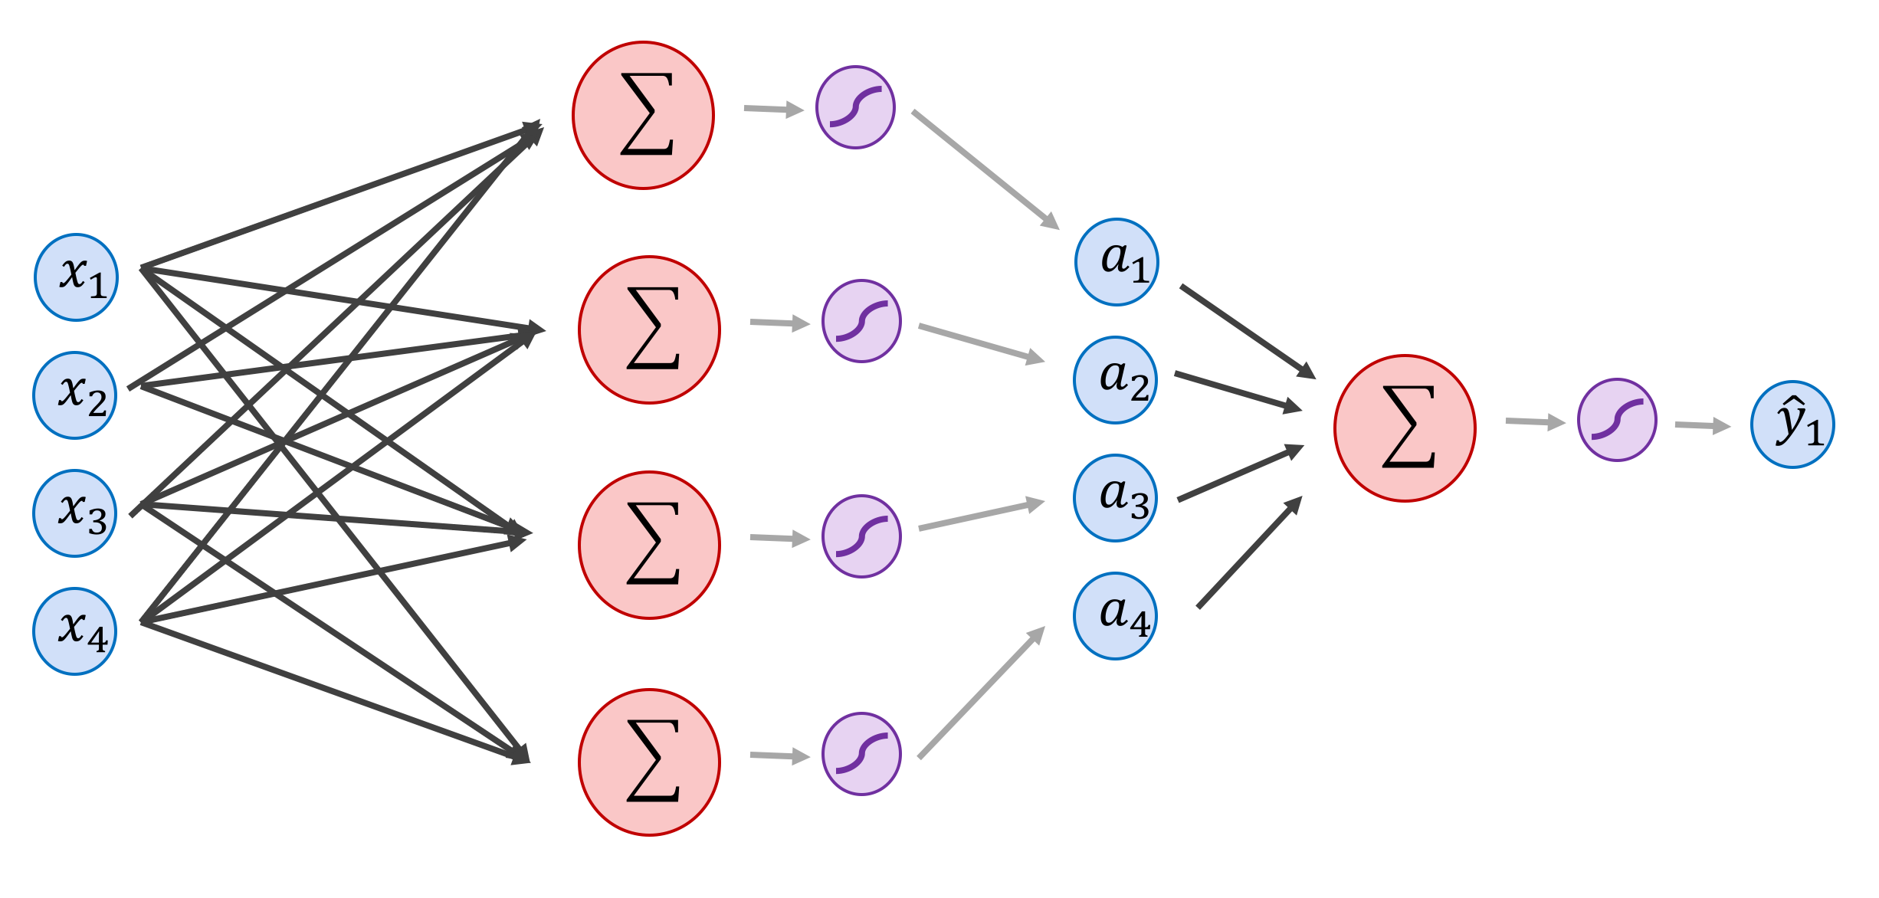
Torch – Two-layer MLP Forward

Slide 18
Torch – Two-layer MLP Forward

Slide 19
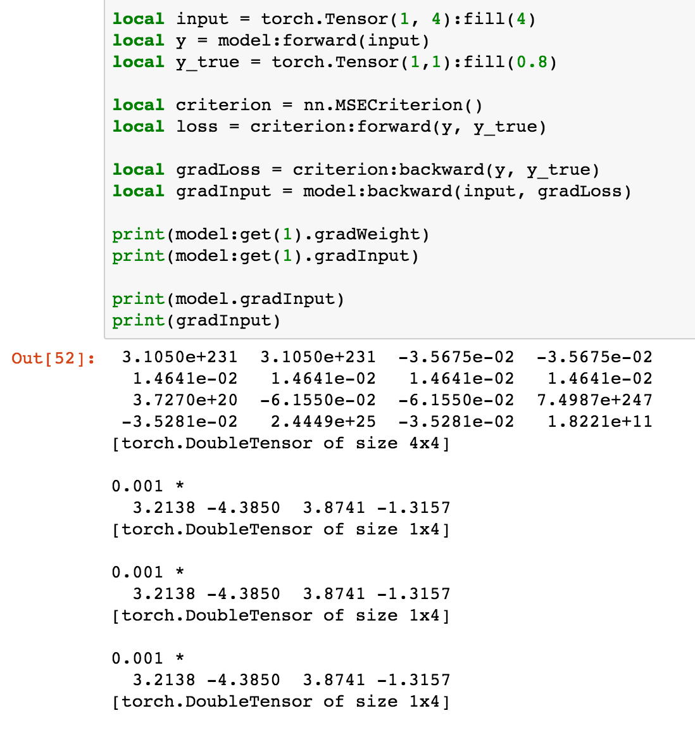
Torch – Two-layer MLP Backward
$${\frac{∂L}{∂x_{k}}}_{}$$

Slide 20
Torch – Two-layer MLP Backward
$${\frac{∂L}{∂x_{k}}}_{}$$
$${\frac{∂z_{i}}{∂w_{1ij}}=\frac{∂x_{k}}{∂w_{1ij}}\frac{∂z_{i}}{∂x_{k}}}_{}$$

Slide 21
Torch Layer variables
output (all layers)
gradInput (all layers)
param (e.g. bias and weight for nn.Linear)
gradParam (e.g. gradBias and gradWeight for nn.Linear)

Slide 22
Convolutional Layer

Slide 23
Convolutional Layer

Slide 24
Convolutional Layer
Weights

Slide 25
Convolutional Layer
Weights
4

Slide 26
Convolutional Layer
Weights
4
1

Slide 27
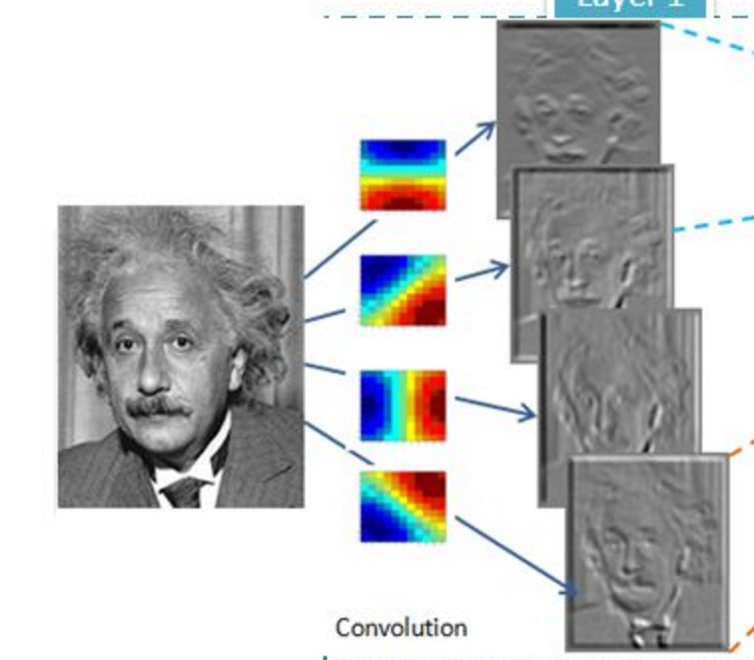
Convolutional Layer (with 4 filters)
weights: 4x1x9x9
Input: 1x224x224
Output: 4x224x224
if zero padding,
and stride = 1

Slide 28
Convolutional Layer (with 4 filters)
weights: 4x1x9x9
Input: 1x224x224
Output: 4x112x112
if zero padding,
but stride = 2

Slide 29
Convolutional Layer in Torch
kW
Input
nOutputPlane x
Output
kH
nInputPlane
nOutputPlane (equals the number of convolutional filters for this layer)
nInputPlane (e.g. 3 for RGB inputs)

Slide 30
Convolutional Layer in Keras
Convolution2D(nOutputPlane, kW, kH, input_shape = (3, 224, 224), subsample = 2, border_mode = valid)
kW
Input
nOutputPlane x
Output
kH
nInputPlane
nOutputPlane (equals the number of convolutional filters for this layer)
nInputPlane (e.g. 3 for RGB inputs)

Slide 31
Convolutional Layer in pytorch
kernel_size
Input
out_channels x
Output
kernel_size
in_channels
out_channels (equals the number of convolutional filters for this layer)
in_channels (e.g. 3 for RGB inputs)

Slide 32
Convolutional Layers as Matrix Multiplication
https://petewarden.com/2015/04/20/why-gemm-is-at-the-heart-of-deep-learning/

Slide 33
Convolutional Layers as Matrix Multiplication
https://petewarden.com/2015/04/20/why-gemm-is-at-the-heart-of-deep-learning/

Slide 34
Convolutional Layers as Matrix Multiplication
Pros?
Cons?
https://petewarden.com/2015/04/20/why-gemm-is-at-the-heart-of-deep-learning/

Slide 35
Convolutional Network: LeNet

Slide 36
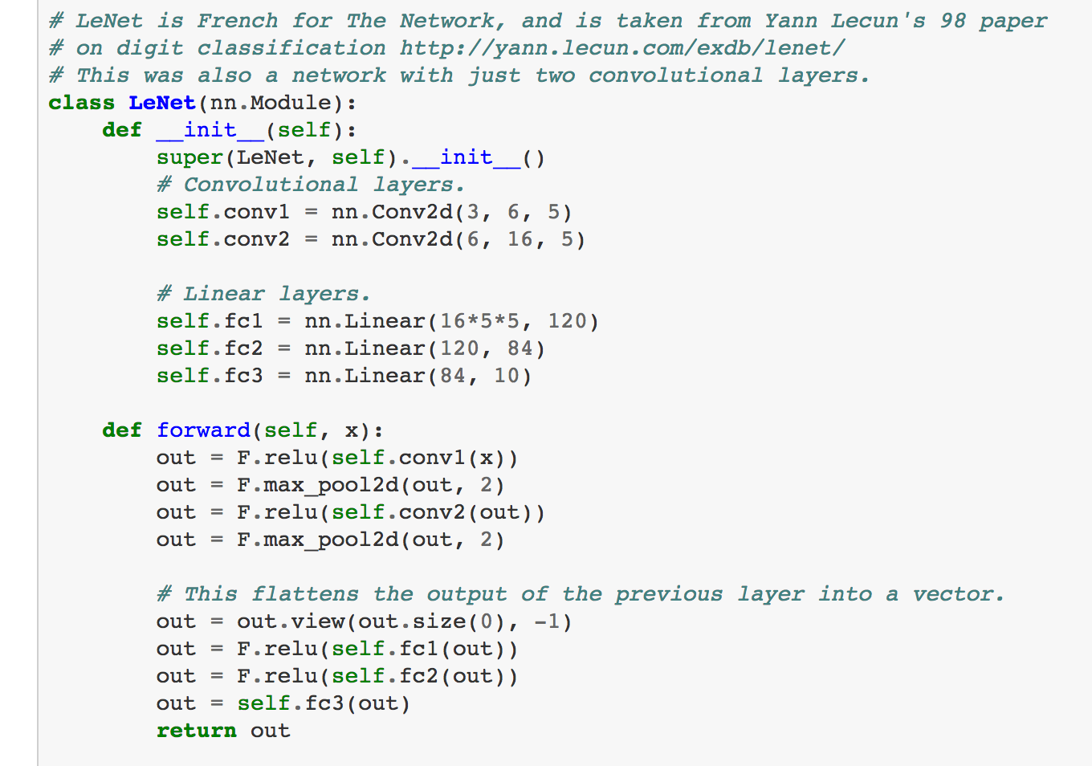
LeNet in Pytorch

Slide 37
SpatialMaxPooling Layer
take the max in this neighborhood
8
8
8
8
8

