Slide 2
The Problem: Classification
Classify an image into 1000 possible classes: e.g. Abyssinian cat, Bulldog, French Terrier, Cormorant, Chickadee,
red fox, banjo, barbell, hourglass, knot, maze, viaduct, etc.
cat, tabby cat (0.71) Egyptian cat (0.22)
red fox (0.11)
…..

Slide 3
The Data: ILSVRC
Imagenet Large Scale Visual Recognition Challenge (ILSVRC): Annual Competition
1000 Categories
~1000 training images per Category
~1 million images in total for training
~50k images for validation
Only images released for the test set but no annotations, evaluation is performed centrally by the organizers (max 2 per week)

Slide 4
The Evaluation Metric: Top K-error
Top-1 error: 1.0
Top-1 accuracy: 0.0
Top-2 error: 1.0
Top-2 accuracy: 0.0
True label: Abyssinian cat
Top-3 error: 1.0
Top-3 accuracy: 0.0
Top-4 error: 0.0
Top-4 accuracy: 1.0
Top-5 error: 0.0
Top-5 accuracy: 1.0
cat, tabby cat (0.61) Egyptian cat (0.22)
red fox (0.11)
Abyssinian cat (0.10)
French terrier (0.03)
…..

Slide 5
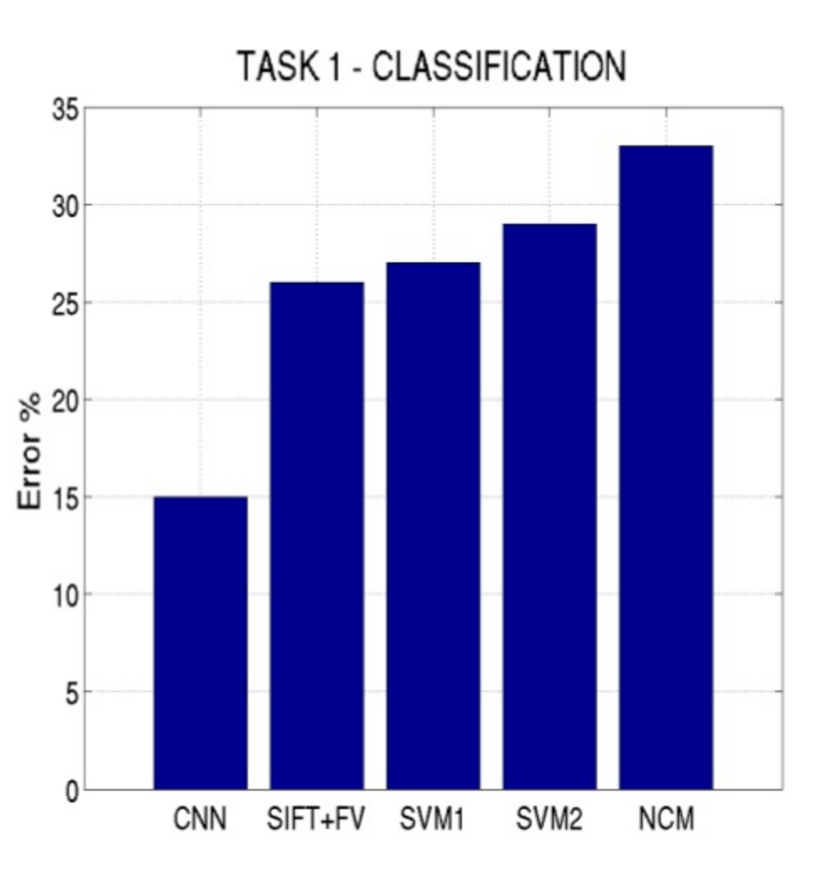
Top-5 error on this competition (2012)

Slide 6
Alexnet
https://www.saagie.com/fr/blog/object-detection-part1

Slide 7
What is happening?
https://www.saagie.com/fr/blog/object-detection-part1

Slide 8
SIFT + FV + SVM (or softmax)
Feature extraction (SIFT)
Feature encoding (Fisher vectors)
Classification (SVM or softmax)
Deep Learning
Convolutional Network
(includes both feature extraction and classifier)

Slide 9
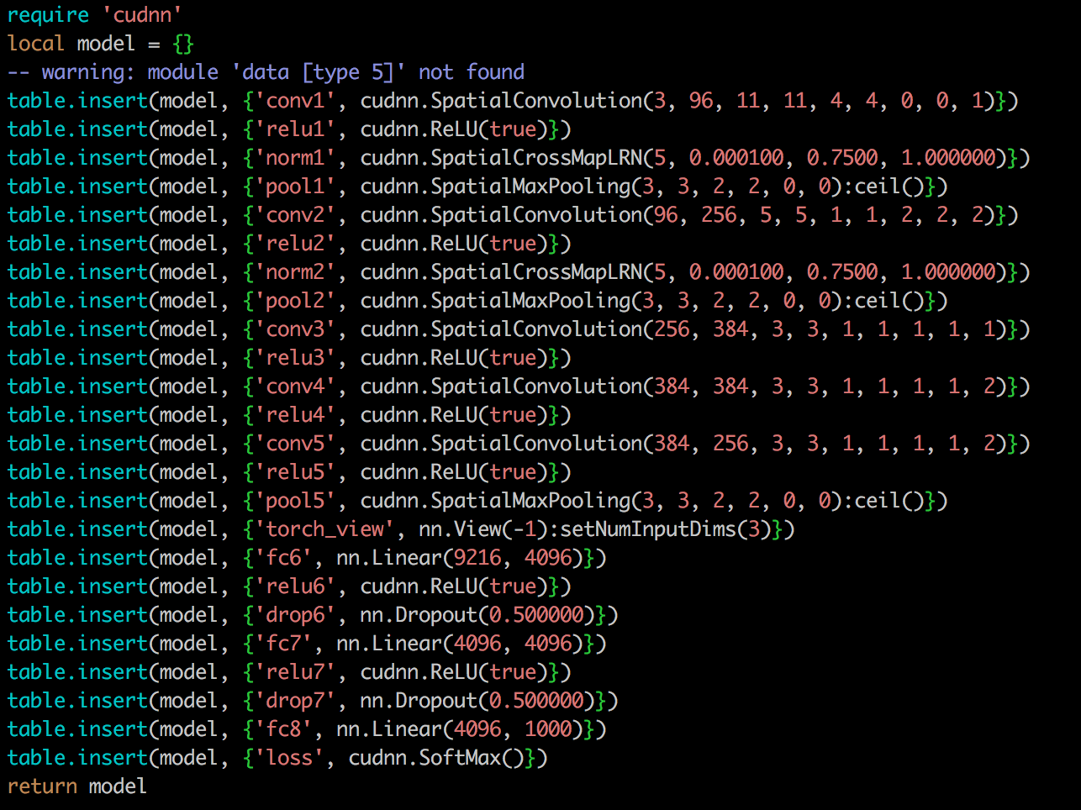
The Model: Convolutional Network

Slide 10
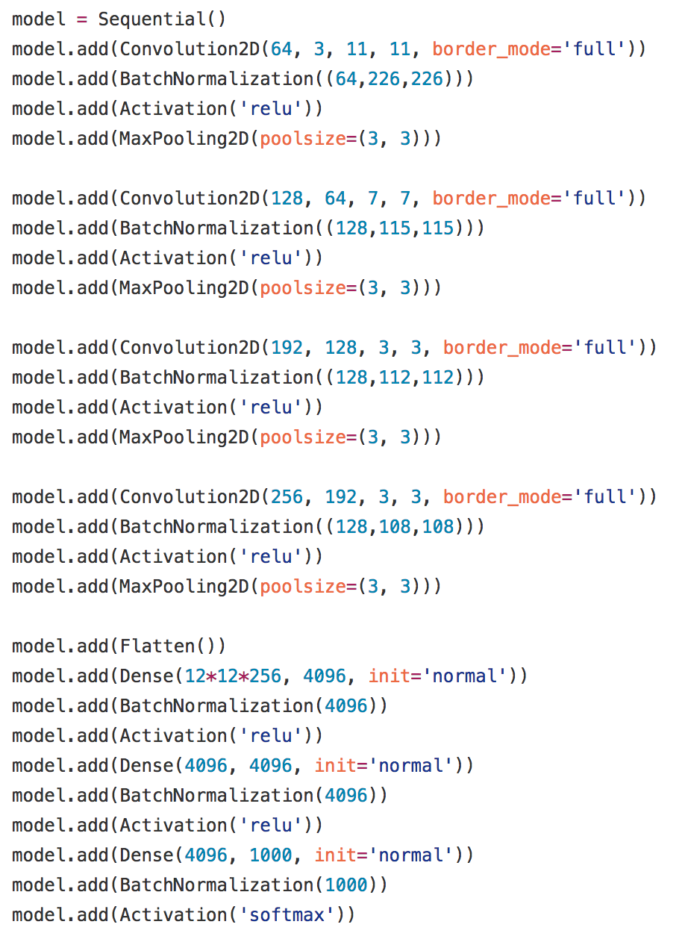
Alexnet in Keras

Slide 11
Preprocessing and Data Augmentation

Slide 12
Preprocessing and Data Augmentation
256
256

Slide 13
Preprocessing and Data Augmentation
224x224

Slide 14
Preprocessing and Data Augmentation
224x224

Slide 15
True label: Abyssinian cat

Slide 16
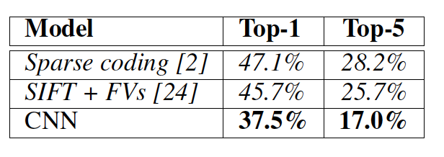
Other Important Aspects
Using ReLUs instead of Sigmoid or Tanh
Momentum + Weight Decay
Dropout (Randomly sets Unit outputs to zero during training)
GPU Computation!

Slide 17
Other Important Aspects
Using ReLUs instead of Sigmoid or Tanh
Momentum + Weight Decay
Dropout (Randomly sets Unit outputs to zero during training)
GPU Computation!

Slide 18
VGG Network
Top-5:
Keras: https://gist.github.com/baraldilorenzo/07d7802847aaad0a35d3
Simonyan and Zisserman, 2014.

Slide 19
GoogLeNet
Keras: https://gist.github.com/joelouismarino/a2ede9ab3928f999575423b9887abd14
Szegedy et al. 2014

Slide 20
BatchNormalization Layer

Slide 21
ResNet
Sorry, does not fit in slide.
http://felixlaumon.github.io/assets/kaggle-right-whale/resnet.png
Keras: https://github.com/raghakot/keras-resnet/blob/master/resnet.py

Slide 22
Slide by Mohammad Rastegari

