Slide 1
Light and Image Processing
Various slides from previous courses by: D.A. Forsyth (Berkeley / UIUC), I. Kokkinos (Ecole Centrale / UCL). S. Lazebnik (UNC / UIUC), S. Seitz (MSR / Facebook), J. Hays (Brown / Georgia Tech), A. Berg (Stony Brook / UNC), D. Samaras (Stony Brook) . J. M. Frahm (UNC), V. Ordonez (UVA).

Slide 2
Last Class
Practical Advice on Photography
Camera Parameters
Brief Introduction to Projective Geometry (Computer Graphics)
Intro to Light (BRDF)

Slide 3
About the Course
CS4501-008: Introduction to Computer Vision
Instructor: Vicente Ordonez
Email: vicente@virginia.edu
Website: http://vicenteordonez.com/vision/
Class Location: Thornton Hall E316
Class Times: Monday-Wednesday 2pm - 3:15pm
Piazza: http://piazza.com/virginia/spring2018/cs4501008/home

Slide 4

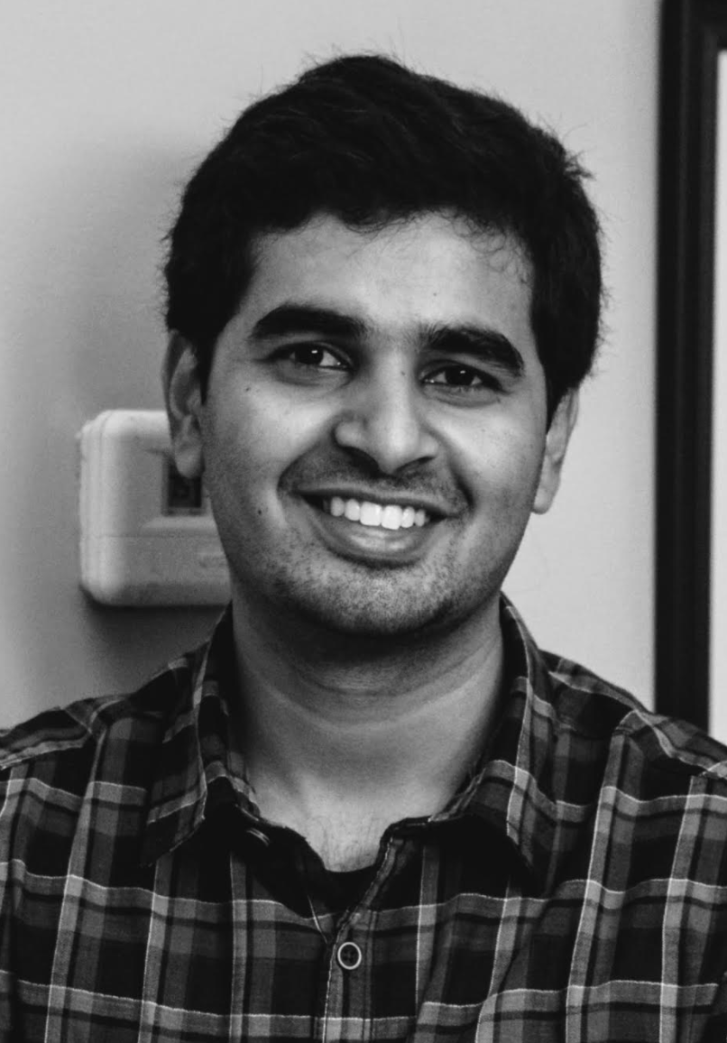

Teaching Assistants + Office Hours
Fengyang Zhang Tuesday 3pm to 4pm (Rice 340) Thursday 3pm to 4pm (Rice 340)
Gautam Somappa
Monday 4pm to 5pm (Rice 436) Tuesday 2pm to 3pm (Rice 436)
Siva Sivaraman Wednesday 3:30 to 4:30pm (Rice 436) Thursday 2pm to 3pm (Rice 340)

Slide 5
Things to Remember for Quiz
Pinhole camera model
Focal length in the pinhole camera model
Shutter Time / Aperture / ISO
Homogeneous Coordinates
Extrinsic Camera Properties and Intrinsic Camera Properties
Describe mathematically (and intuitively) the conversion process from World Coordinates to Image Coordinates (Should be easy after completing the first programming assignment)

Slide 6
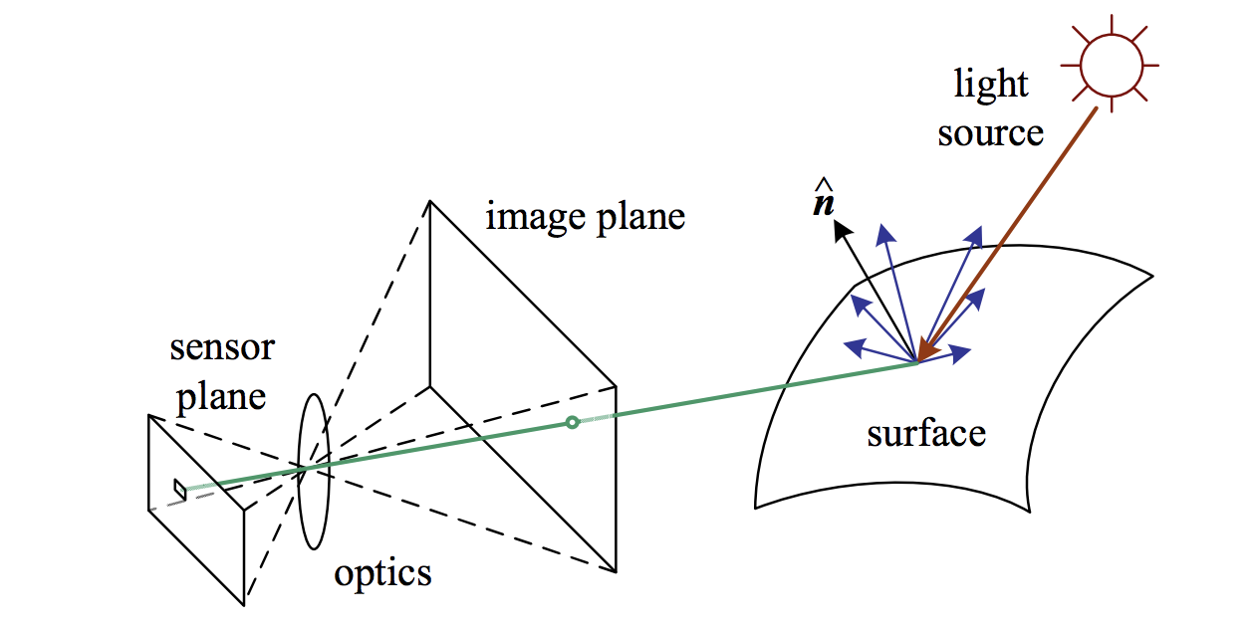
Light
What determines the color of a pixel?
Figure from Szeliski

Slide 7
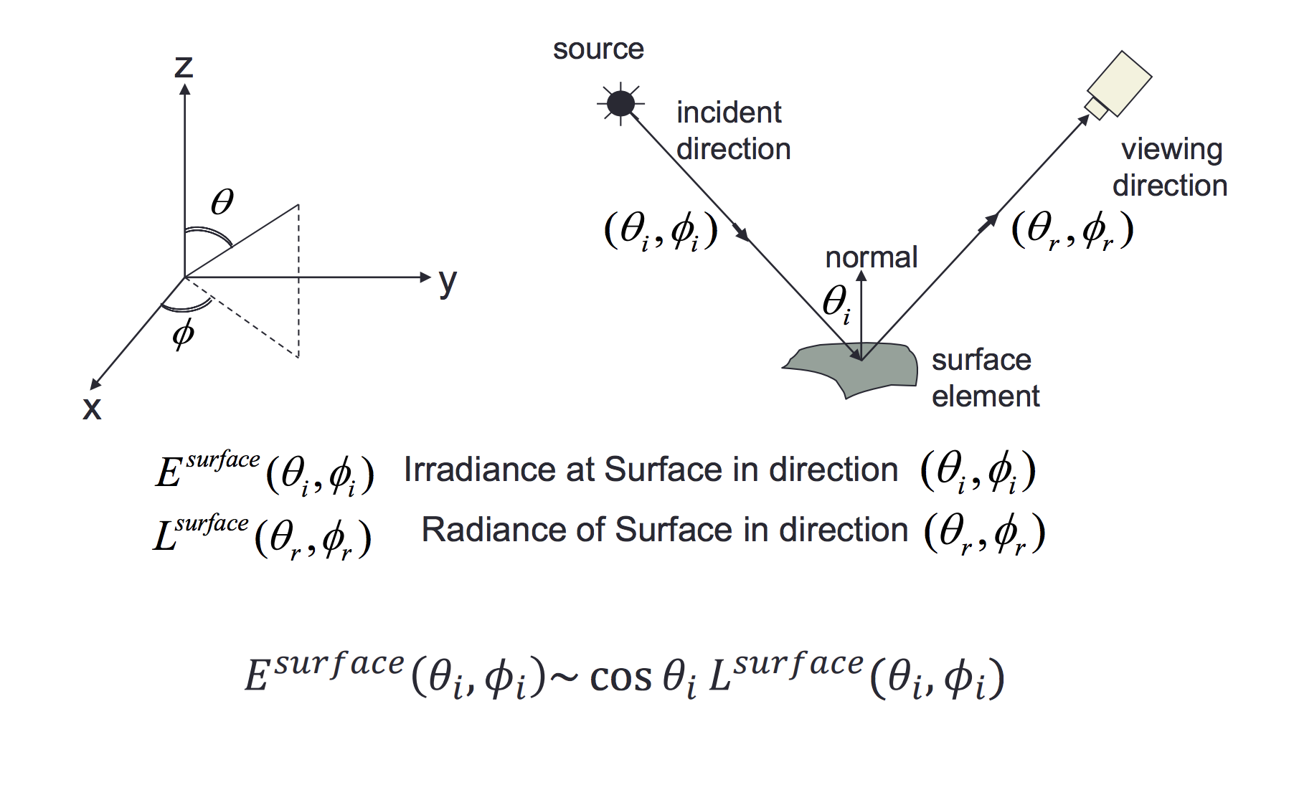
BRDF (Bidirectional reflectance distribution function)
Slide by Aaron Bobick

Slide 8
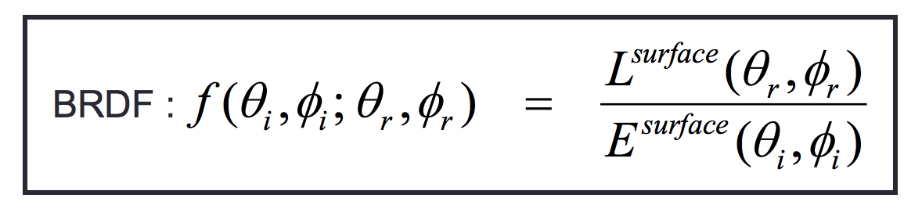
BRDF (Bidirectional reflectance distribution function)
Slide by Aaron Bobick

Slide 9
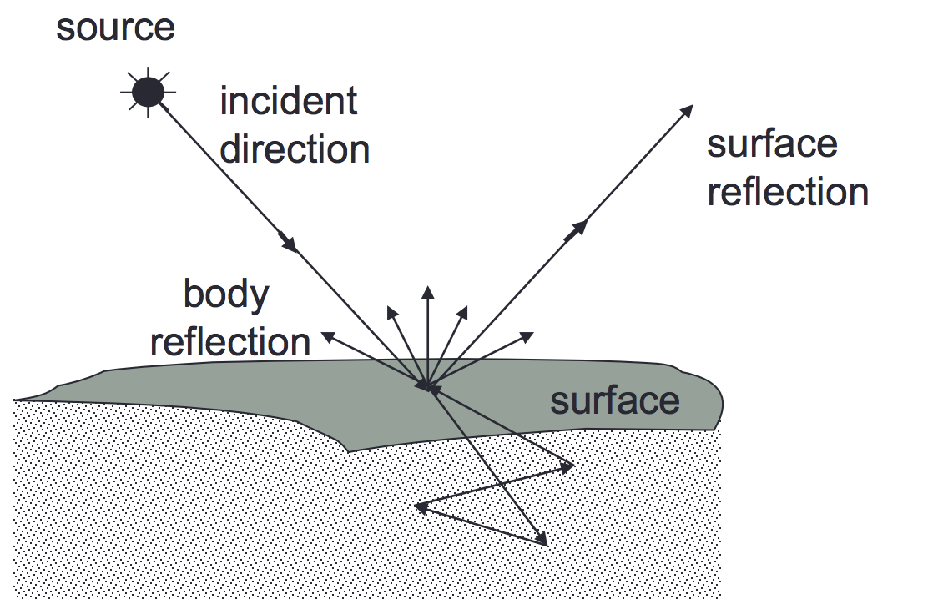
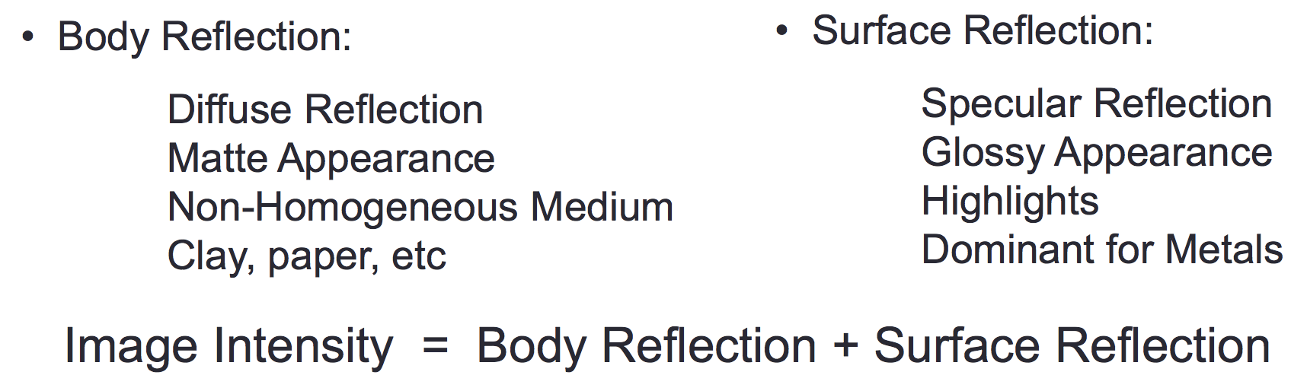
Reflection
Slide by Aaron Bobick

Slide 10
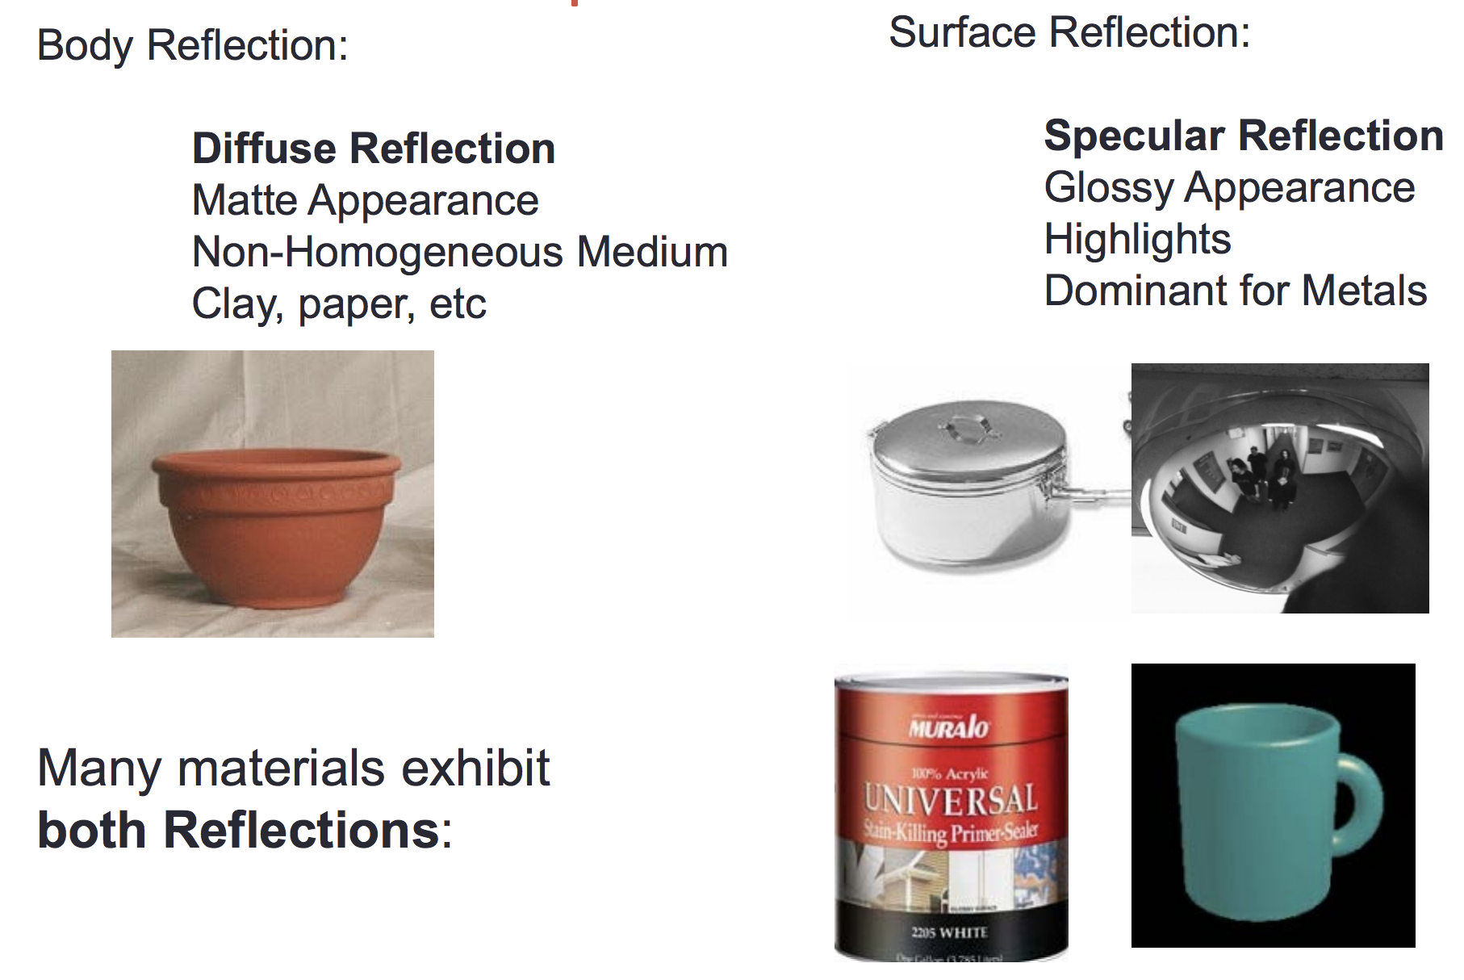
Reflection
Slide by Aaron Bobick

Slide 11
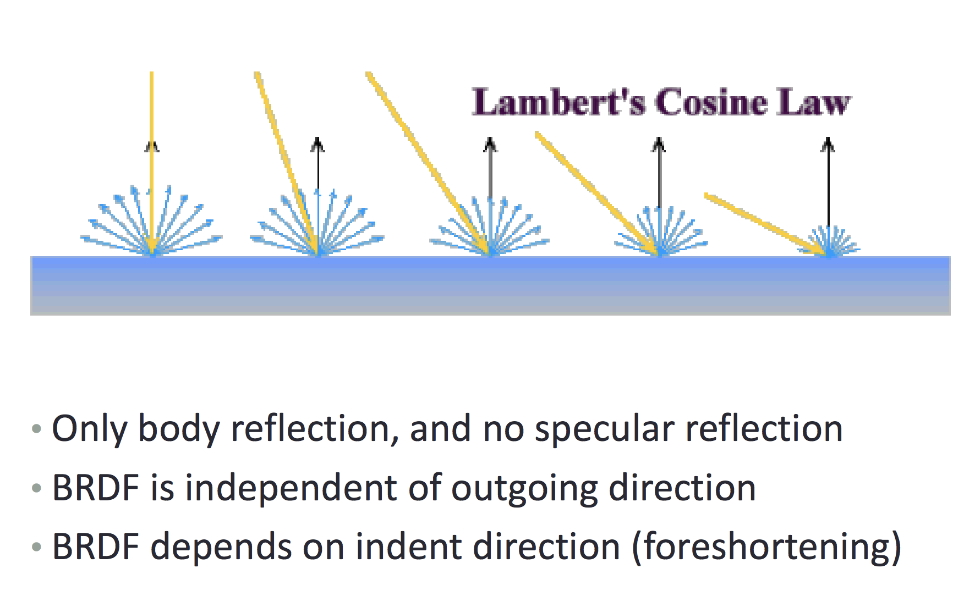
Diffuse Reflection – Lambertian Surface / BRDF
Light intensity does not depend on the outgoing direction. Only incoming.
It is independent of where the viewer stands.
Smooth surface, not glossy. Can think of any examples?
Slide by Aaron Bobick

Slide 12
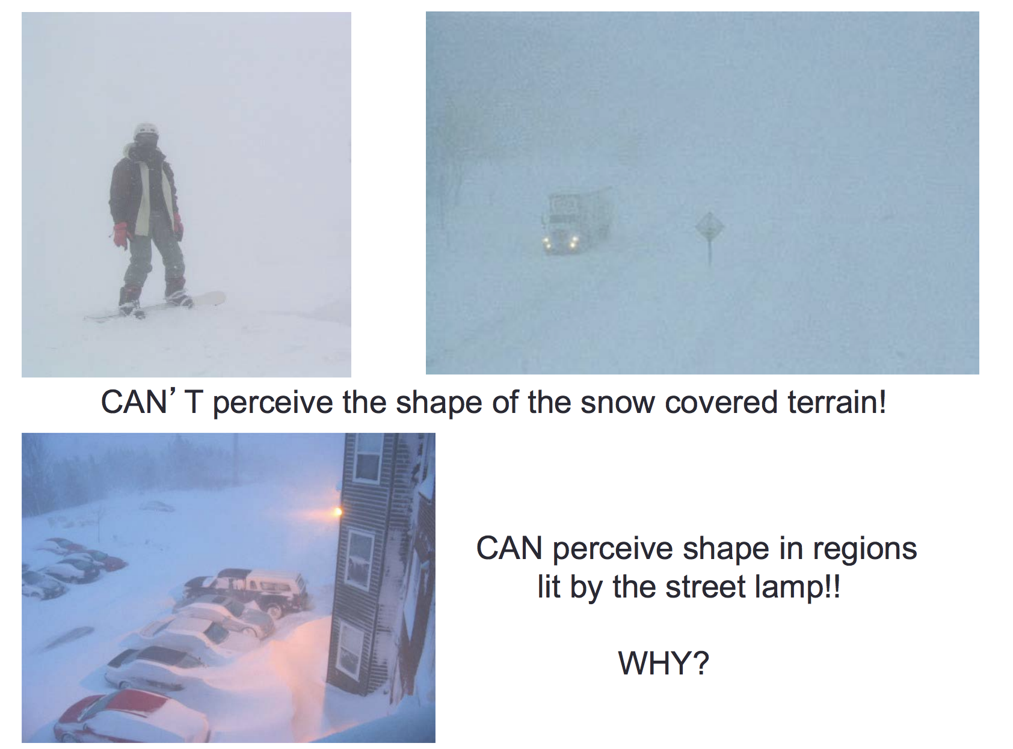
Slide by Aaron Bobick

Slide 13
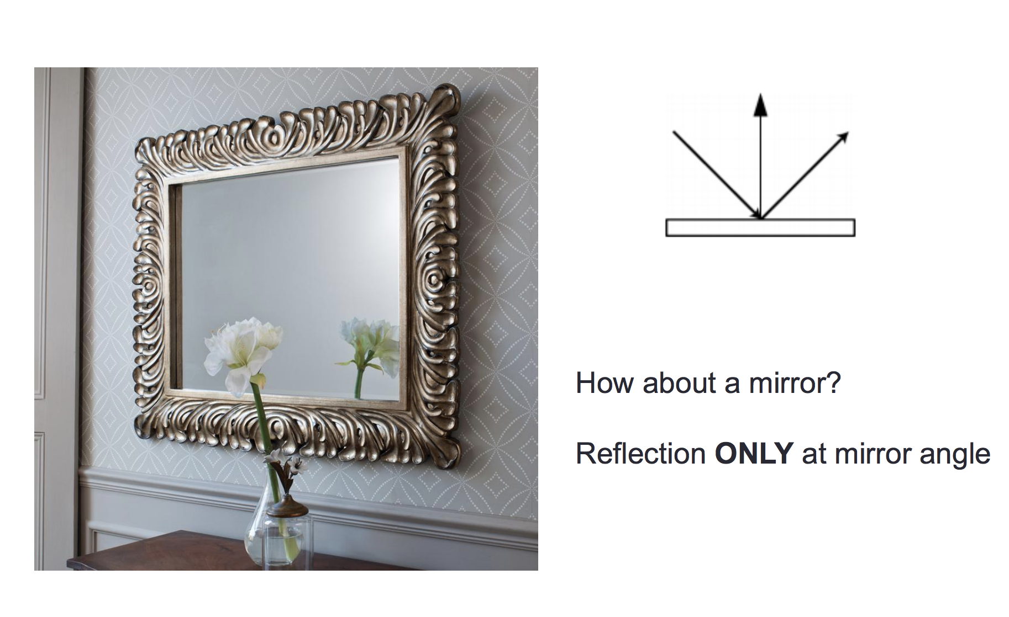
The other extreme – Only Specular Reflection
https://wonderopolis.org/wonder/how-do-mirrors-work
Slide by Aaron Bobick

Slide 14
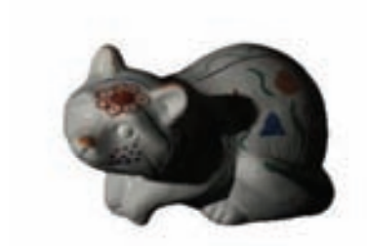
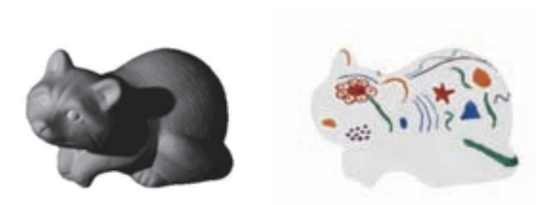
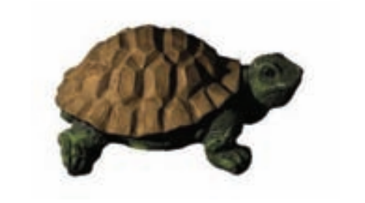
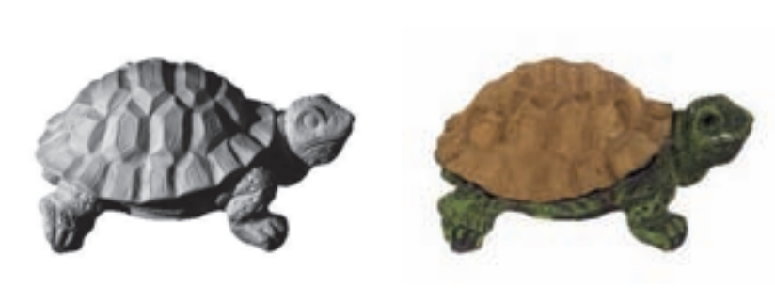
Problem in Computer Vision: Intrinsic Image Decomposition
Given this
Extract this
Images by Marc Serra

Slide 15
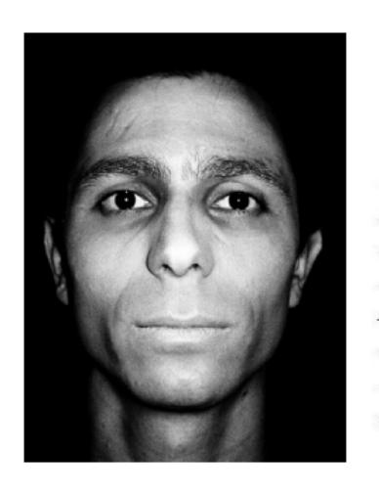
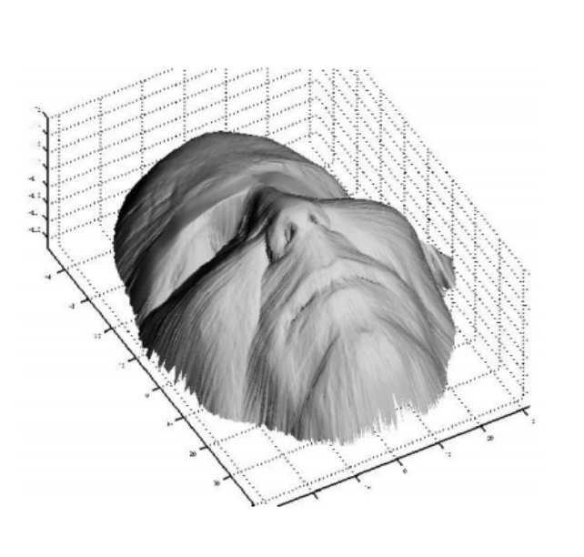
Problem in Computer Vision: Shape from Shading
Given this
Extract this
Images by Aaron Bobick

Slide 16
Same ideas used in Computer Graphics
Ray Tracing
Radiosity
Photon Mapping

Slide 17
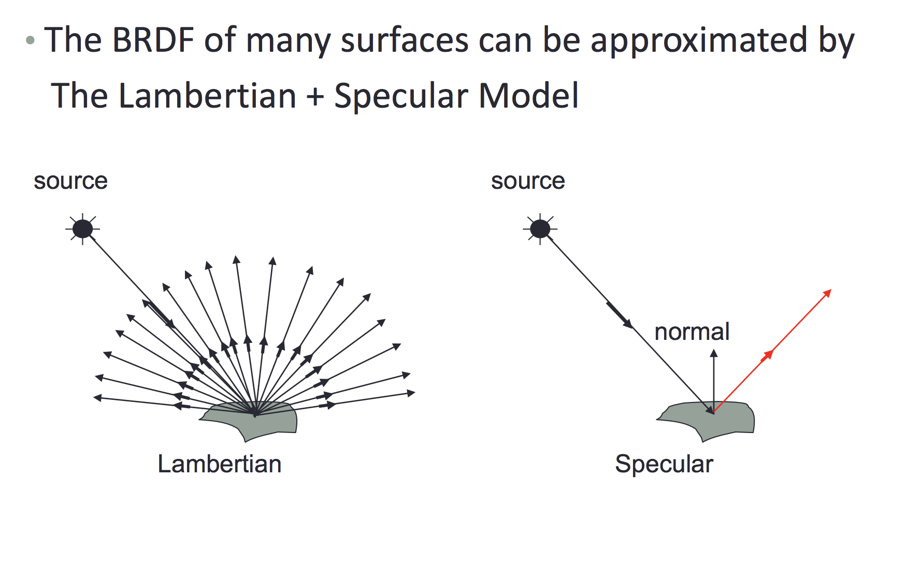
Phong Reflection Model
Slide by Aaron Bobick

Slide 18
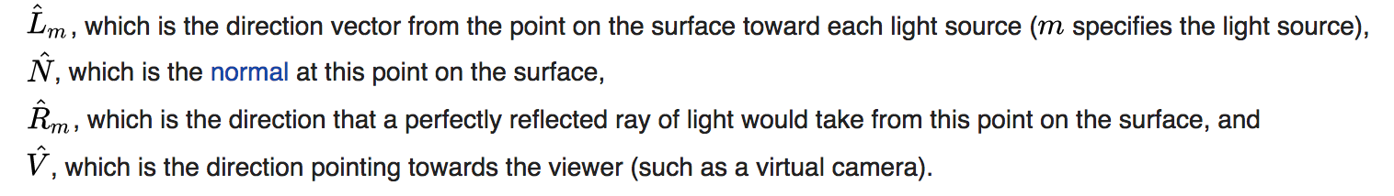
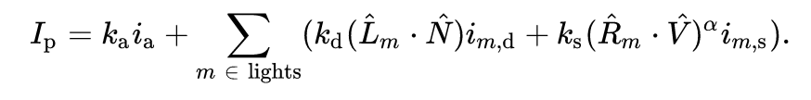
Phong Reflection Model
https://en.wikipedia.org/wiki/Phong_reflection_model

Slide 19
Phong Reflection Model - Recap
https://en.wikipedia.org/wiki/Phong_reflection_model

Slide 20
Phong Reflection Model - Recap
https://en.wikipedia.org/wiki/Phong_reflection_model

Slide 21
Phong Reflection Model - Recap
https://en.wikipedia.org/wiki/Phong_reflection_model

Slide 22
Phong Reflection Model - Recap
https://en.wikipedia.org/wiki/Phong_reflection_model

Slide 23
Phong’s Shading / Illumination Model
Originally from Vietnam / PhD from Utah, Professor at Utah, and later Stanford.
Died at age 32 from leukemia
Phong’s professor Ivan Sutherland went on to win the Turing Award (Nobel Prize in CS) for lifelong contributions to Computer Graphics

Slide 24
A photon’s life choices
Absorption
Diffusion
Reflection
Transparency
Refraction
Fluorescence
Subsurface scattering
Phosphorescence
Interreflection
light source
λ
?
Slide by James Hays

Slide 25
A photon’s life choices
Absorption
Diffusion
Reflection
Transparency
Refraction
Fluorescence
Subsurface scattering
Phosphorescence
Interreflection
light source
λ
Slide by James Hays

Slide 26
A photon’s life choices
Absorption
Diffuse Reflection
Reflection
Transparency
Refraction
Fluorescence
Subsurface scattering
Phosphorescence
Interreflection
light source
λ
Slide by James Hays

Slide 27
A photon’s life choices
Absorption
Diffusion
Specular Reflection
Transparency
Refraction
Fluorescence
Subsurface scattering
Phosphorescence
Interreflection
light source
λ
Slide by James Hays

Slide 28
A photon’s life choices
Absorption
Diffusion
Reflection
Transparency
Refraction
Fluorescence
Subsurface scattering
Phosphorescence
Interreflection
light source
λ
Slide by James Hays

Slide 29
A photon’s life choices
Absorption
Diffusion
Reflection
Transparency
Refraction
Fluorescence
Subsurface scattering
Phosphorescence
Interreflection
light source
λ
Slide by James Hays

Slide 30
A photon’s life choices
Absorption
Diffusion
Reflection
Transparency
Refraction
Fluorescence
Subsurface scattering
Phosphorescence
Interreflection
light source
λ₁
λ₂
Slide by James Hays

Slide 31
A photon’s life choices
Absorption
Diffusion
Reflection
Transparency
Refraction
Fluorescence
Subsurface scattering
Phosphorescence
Interreflection
light source
λ
Slide by James Hays

Slide 32
A photon’s life choices
Absorption
Diffusion
Reflection
Transparency
Refraction
Fluorescence
Subsurface scattering
Phosphorescence
Interreflection
light source
t=1
t=n
Slide by James Hays

Slide 33
A photon’s life choices
Absorption
Diffusion
Reflection
Transparency
Refraction
Fluorescence
Subsurface scattering
Phosphorescence
Interreflection
light source
λ
(Specular Interreflection)
Slide by James Hays

Slide 34
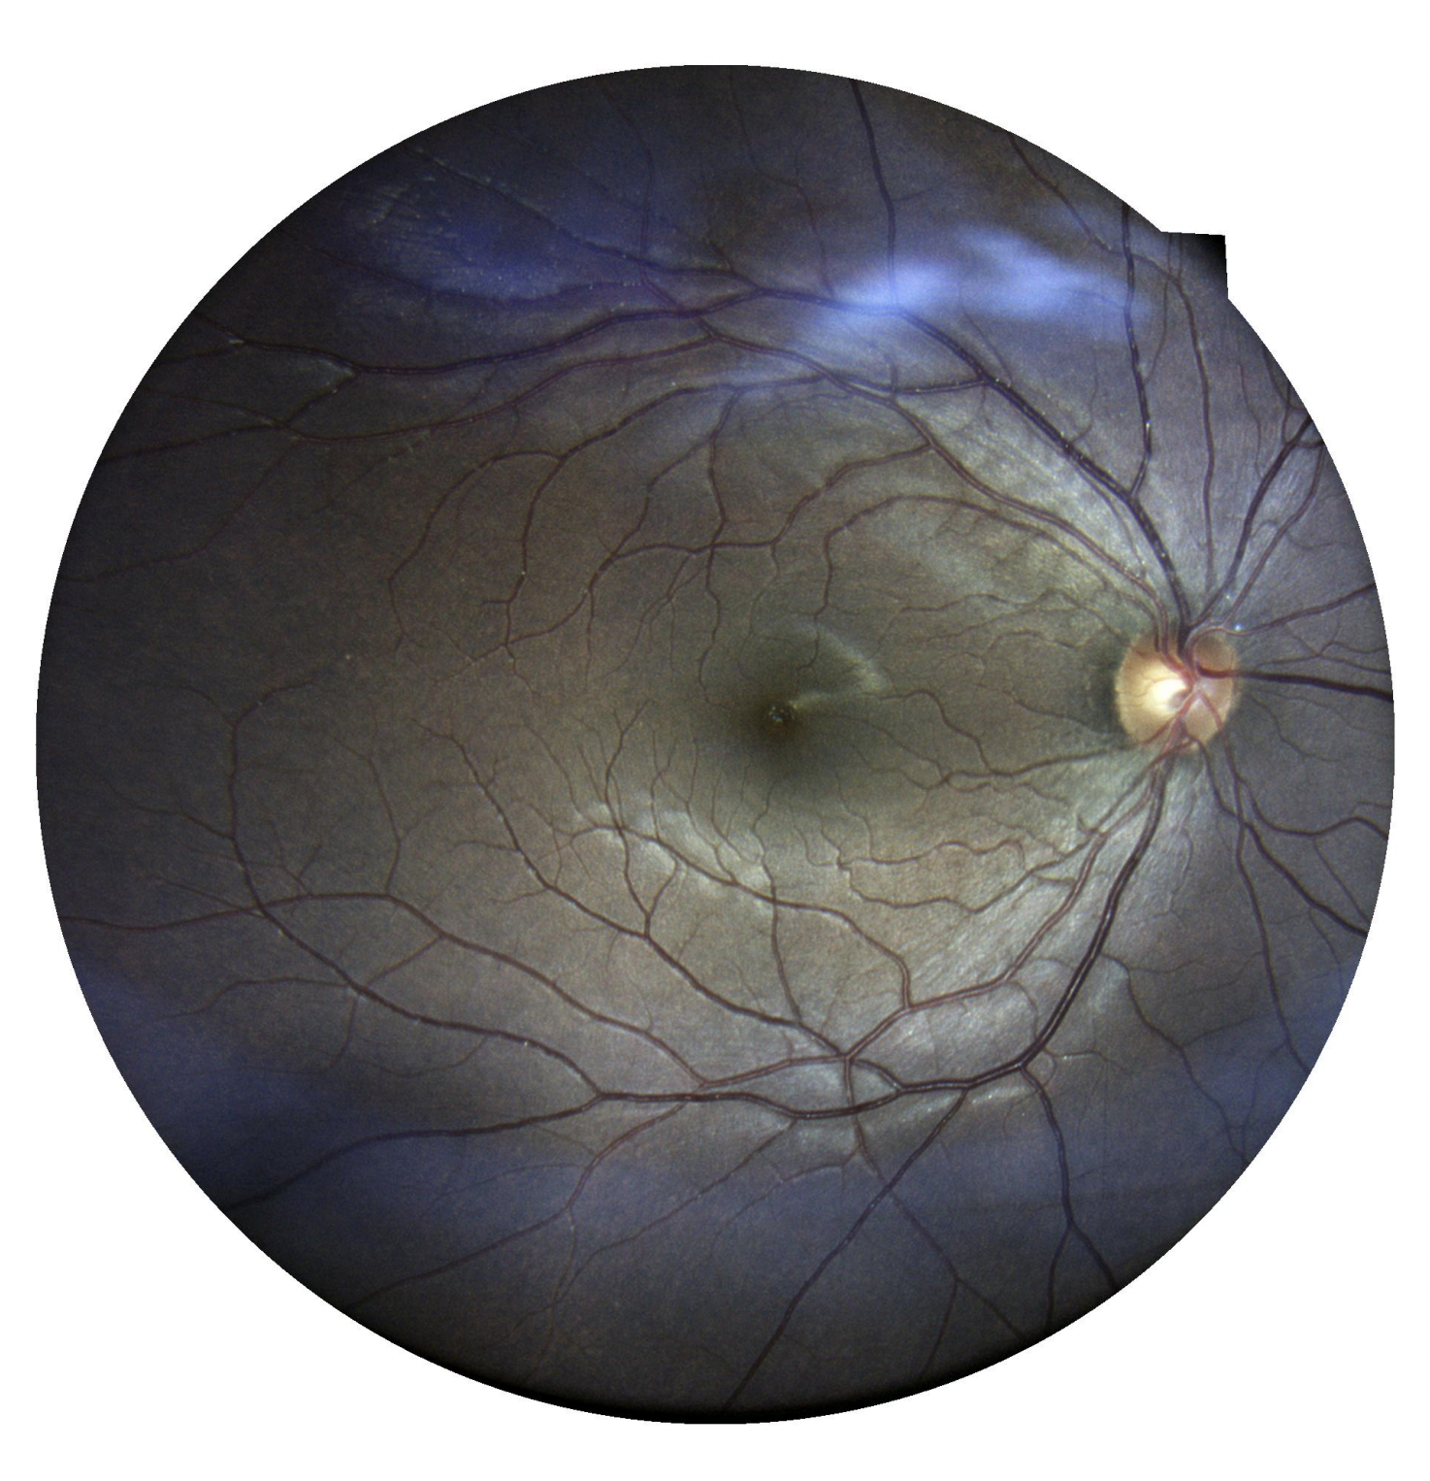
Vicente’s eye

Slide 35
Our own Camera as a species: The Human Eye

Slide 36
Vicente’s eye

Slide 37
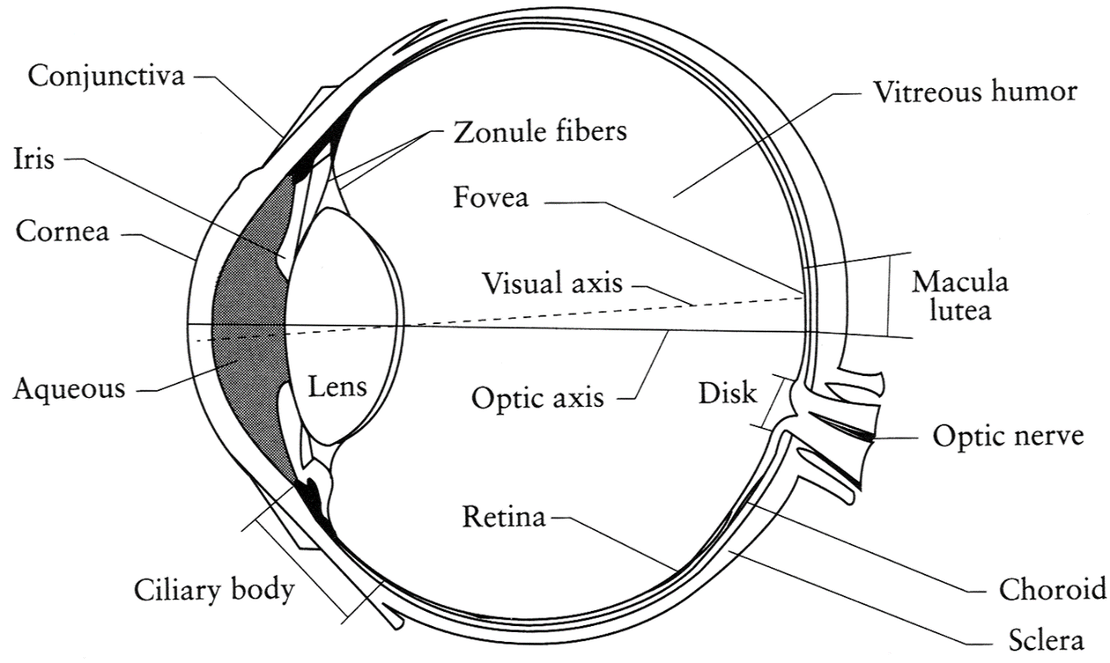
The Eye
The human eye is a camera!
Iris - colored annulus with radial muscles
Pupil - the hole (aperture) whose size is controlled by the iris
What’s the “film”?
photoreceptor cells (rods and cones) in the retina
Slide by Steve Seitz

Slide 38
Vicente’s eye

Slide 39
The Retina

Slide 40
Two types of light-sensitive receptors
Cones
cone-shaped
less sensitive
operate in high light
color vision
Rods
rod-shaped
highly sensitive
operate at night
gray-scale vision
© Stephen E. Palmer, 2002

Slide 41
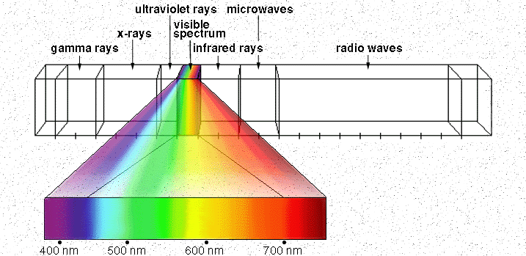
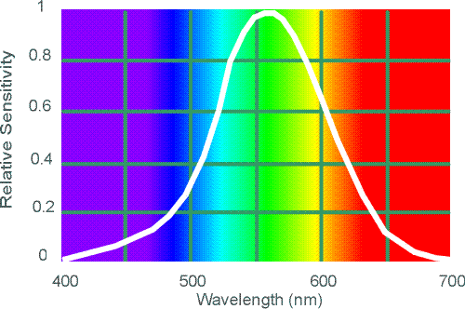
Electromagnetic Spectrum
Human Luminance Sensitivity Function
http://www.yorku.ca/eye/photopik.htm
Notes:
At least 3 spectral bands required (e.g. R,G,B)

Slide 42
Vicente’s eye

Slide 43
More about the eye
https://www.youtube.com/watch?v=L_W-IXqoxHA

Slide 44
What you need to know for a Quiz
Describe the various factors that modify object’s lighting
Camera position (viewer position)
Light positions
Object shape (surface normals) and material properties (BRDF)
Understanding the effect of the following:
Ambient Light
Diffuse Light
Specular Light

Slide 45
Image Processing & Image Filtering

Slide 46
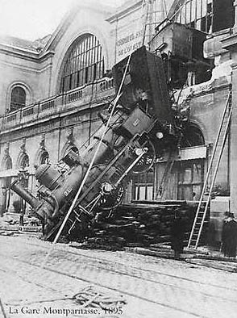
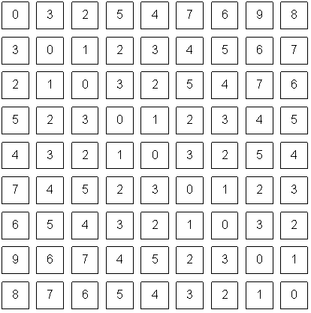
Reminder of what is an image for a computer.
What we see
What a computer sees
Source: S. Narasimhan

Slide 47

Images as Functions
$$z=f(x, y)$$

Slide 48
Images as Functions
$$z=f(x, y)$$
The domain of x and y is [0, img-width) and [0 and img-height)
x, and y are discretized into integer values.

Slide 49
Images as Matrices

Slide 50
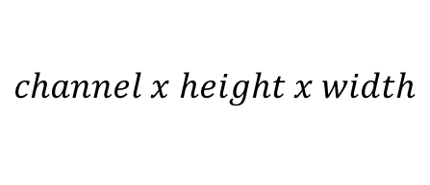
Color Images as Tensors
$$channel x height x width$$

Slide 51
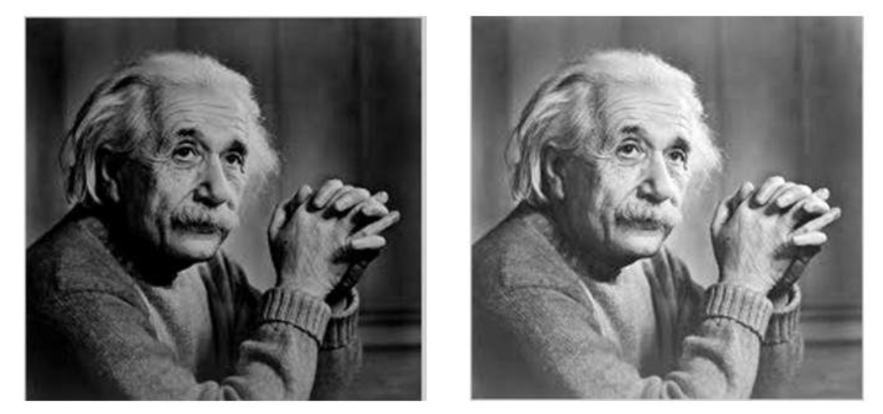



Basic Image Processing
$$I$$
$$αI$$
$$α>1$$

Slide 52
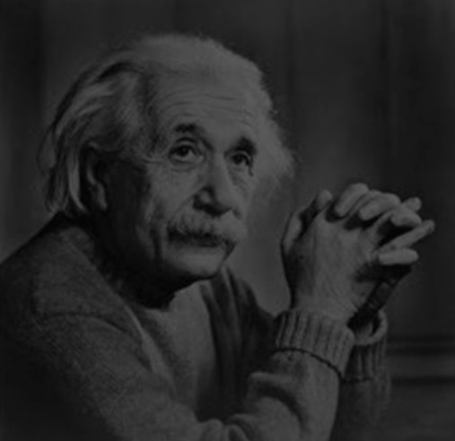

Basic Image Processing
$$I$$
$$αI$$
$$0<α<1$$

Slide 53
Color Images as Tensors
$$channel x height x width$$
Channels are usually RGB: Red, Green, and Blue
Other color spaces: HSV, HSL, LUV, XYZ, Lab, CMYK, etc

Slide 54
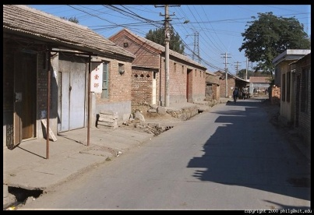
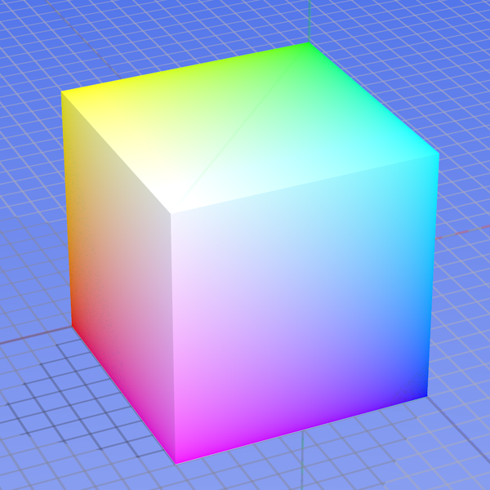
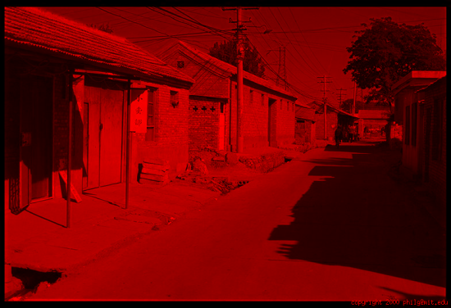
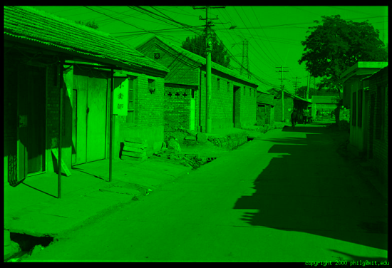
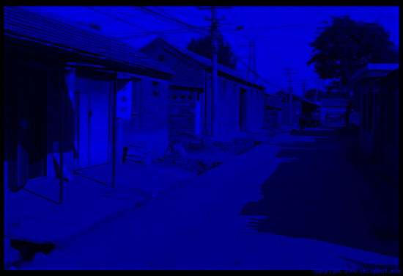
Color spaces: RGB
0,1,0
R
(G=0,B=0)
1,0,0
G
(R=0,B=0)
0,0,1
B
(R=0,G=0)
Some drawbacks
Strongly correlated channels
Non-perceptual
Default color space
Slide by James Hays
Image from: http://en.wikipedia.org/wiki/File:RGB_color_solid_cube.png

Slide 55
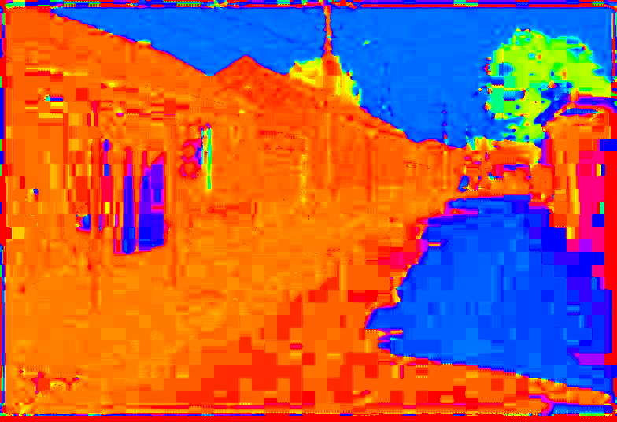
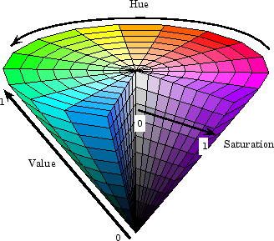
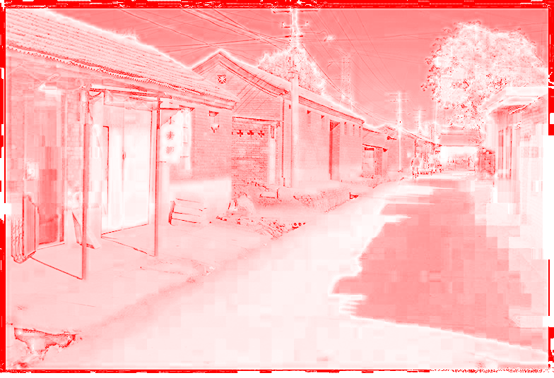
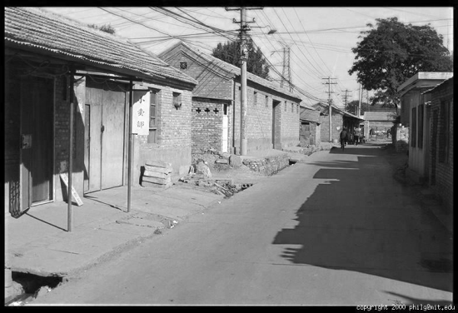
Color spaces: HSV
Intuitive color space
H
(S=1,V=1)
S
(H=1,V=1)
V
(H=1,S=0)
Slide by James Hays

Slide 56
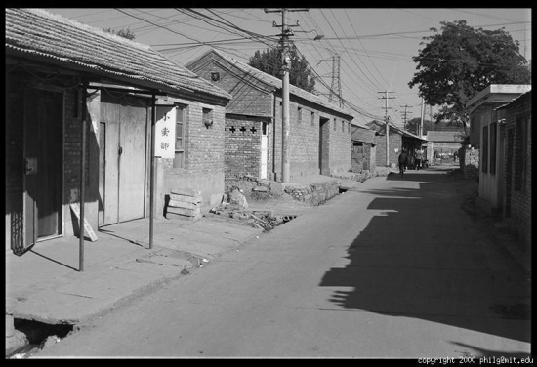
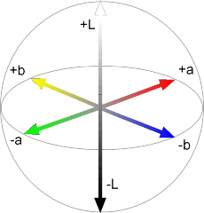
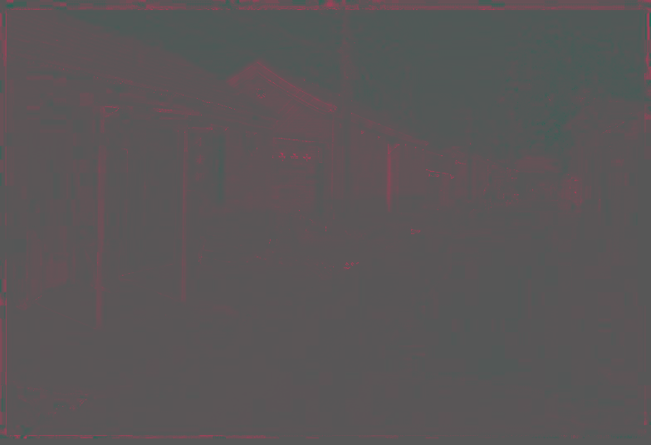

Color spaces: L*a*b*
“Perceptually uniform”* color space
L
(a=0,b=0)
a
(L=65,b=0)
b
(L=65,a=0)
Slide by James Hays

Slide 57
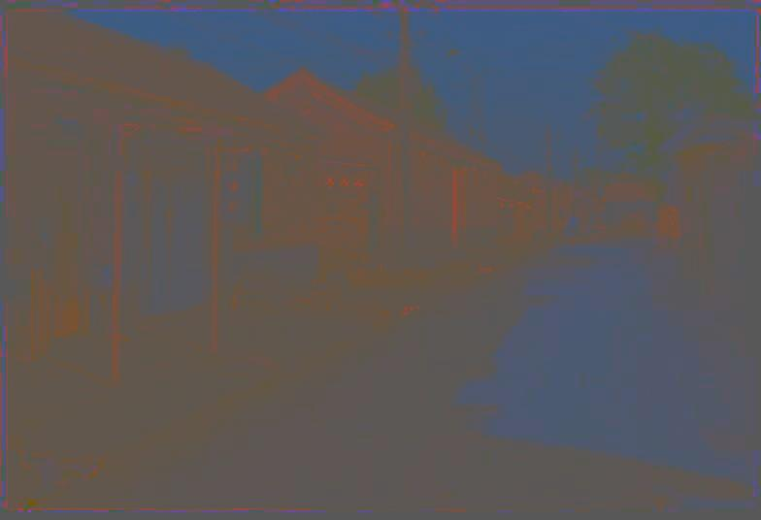
Most information in intensity
Only color shown – constant intensity
Slide by James Hays

Slide 58

Most information in intensity
Only intensity shown – constant color
Slide by James Hays

Slide 59

Most information in intensity
Original image
Slide by James Hays

Slide 60
Image filtering

Slide 61
Image filtering
Image Credit: http://what-when-how.com/introduction-to-video-and-image-processing/neighborhood-processing-introduction-to-video-and-image-processing-part-1/

Slide 62
Image filtering
Image Credit: http://what-when-how.com/introduction-to-video-and-image-processing/neighborhood-processing-introduction-to-video-and-image-processing-part-1/

Slide 63
Image filtering: e.g. Mean Filter

Slide 64
Image filtering: e.g. Mean Filter

Slide 65
Image filtering: e.g. Median Filter
Image Credit: http://what-when-how.com/introduction-to-video-and-image-processing/neighborhood-processing-introduction-to-video-and-image-processing-part-1/

Slide 66

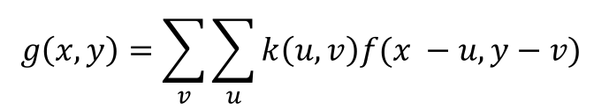
Image filtering: Convolution operator
$$k(x, y)$$
$$g\left(x, y\right)=\sum_{v}{\sum_{u}{k\left(u,v\right)f(x −u, y−v) }}$$
Image Credit: http://what-when-how.com/introduction-to-video-and-image-processing/neighborhood-processing-introduction-to-video-and-image-processing-part-1/

Slide 67
(filter, kernel)
http://www.cs.virginia.edu/~vicente/recognition/animation.gif

Slide 68


Image filtering: Convolution operator e.g. mean filter
1/9 | 1/9 | 1/9
1/9 | 1/9 | 1/9
1/9 | 1/9 | 1/9
$k(x, y)$ =
$k(x, y)$
Image Credit: http://what-when-how.com/introduction-to-video-and-image-processing/neighborhood-processing-introduction-to-video-and-image-processing-part-1/

Slide 69
Image filtering: Convolution operator e.g. mean filter
1/9 | 1/9 | 1/9
1/9 | 1/9 | 1/9
1/9 | 1/9 | 1/9
$k(x, y)$ =
$k(x, y)$
Image Credit: http://what-when-how.com/introduction-to-video-and-image-processing/neighborhood-processing-introduction-to-video-and-image-processing-part-1/

Slide 70
Image filtering: e.g. Mean Filter

Slide 71
Image filtering: Convolution operator e.g. gaussian filter (gaussian blur)
1/16 | 1/8 | 1/16
1/8 | 1/4 | 1/8
1/16 | 1/8 | 1/16
$k(x, y)$ =
$k(x, y)$
Image Credit: http://what-when-how.com/introduction-to-video-and-image-processing/neighborhood-processing-introduction-to-video-and-image-processing-part-1/

Slide 72
Image filtering: Convolution operator e.g. gaussian filter (gaussian blur)
Image Credit: http://what-when-how.com/introduction-to-video-and-image-processing/neighborhood-processing-introduction-to-video-and-image-processing-part-1/

Slide 73
Image filtering: Convolution operator e.g. sobel operator
1 | 0 | -1
2 | 0 | -2
1 | 0 | -1
$k(x, y)$ =
$k(x, y)$
Image Credit: http://what-when-how.com/introduction-to-video-and-image-processing/neighborhood-processing-introduction-to-video-and-image-processing-part-1/

Slide 74
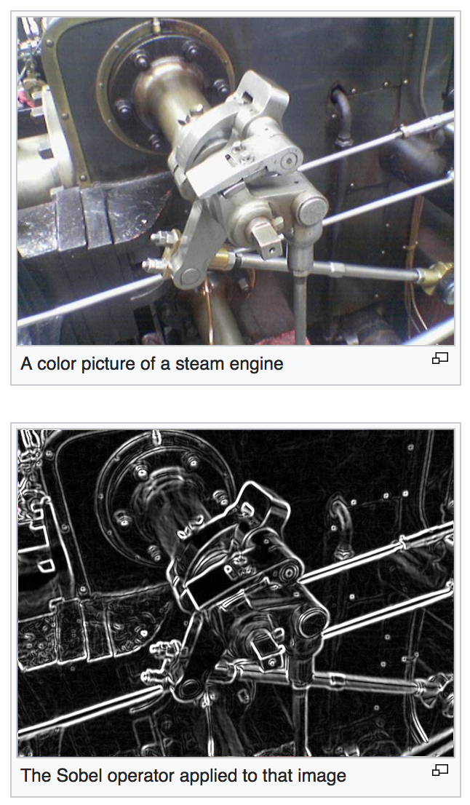

Slide 75
Next Class: More on Image Filters

Slide 76
Questions?

