Slide 1
Image Filtering and Image Frequencies
Various slides from previous courses by:
D.A. Forsyth (Berkeley / UIUC), I. Kokkinos (Ecole Centrale / UCL). S. Lazebnik (UNC / UIUC), S. Seitz (MSR / Facebook), J. Hays (Brown / Georgia Tech), A. Berg (Stony Brook / UNC), D. Samaras (Stony Brook) . J. M. Frahm (UNC), V. Ordonez (UVA).

Slide 2
Last Class
Light (BRDF)
Diffuse Reflection, Specular Reflection
Phong model: Ambient + Diffuse + Specular
The Human Eye as a Camera
Images as Matrices
Images as Functions

Slide 3
Today’s Class
Image Processing: Brightness
Image Filtering: Mean Filter
Image Blurring
Image Gradients: The Sobel Operator

Slide 4
Image Processing & Image Filtering

Slide 5
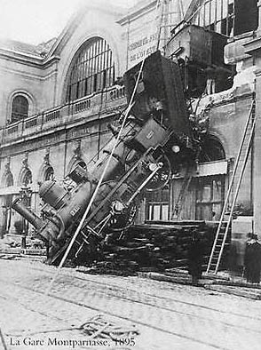

Reminder of what is an image for a computer.
What we see
What a computer sees
Source: S. Narasimhan

Slide 6

Images as Functions
$$z=f(x, y)$$

Slide 7
Images as Functions
$$z=f(x, y)$$
The domain of x and y is [0, img-width) and [0 and img-height)
x, and y are discretized into integer values.

Slide 8
Images as Matrices

Slide 9
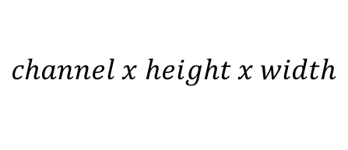
Color Images as Tensors
$$channel x height x width$$

Slide 10
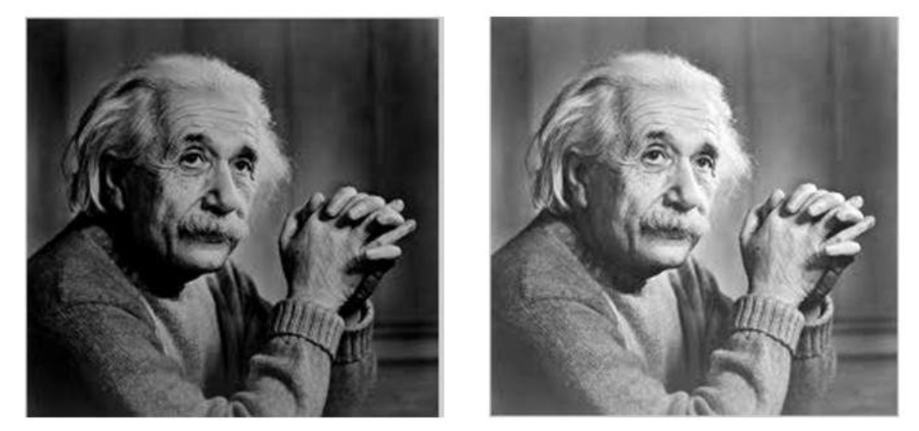



Basic Image Processing
$$I$$
$$αI$$
$$α>1$$

Slide 11
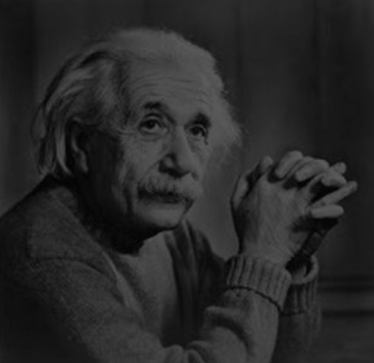

Basic Image Processing
$$I$$
$$αI$$
$$0<α<1$$

Slide 12
Color Images as Tensors
$$channel x height x width$$
Channels are usually RGB: Red, Green, and Blue
Other color spaces: HSV, HSL, LUV, XYZ, Lab, CMYK, etc

Slide 13
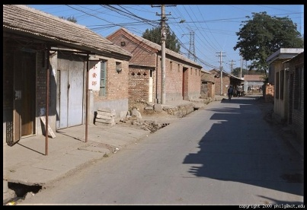
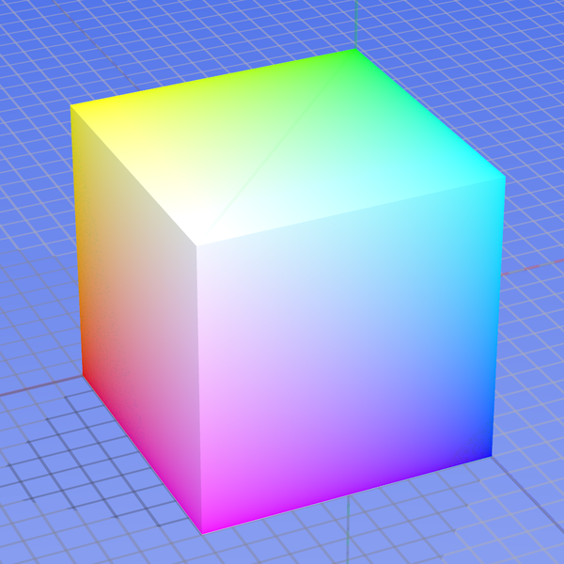
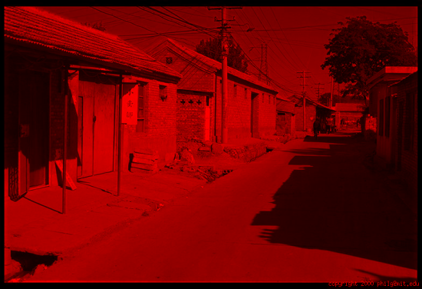
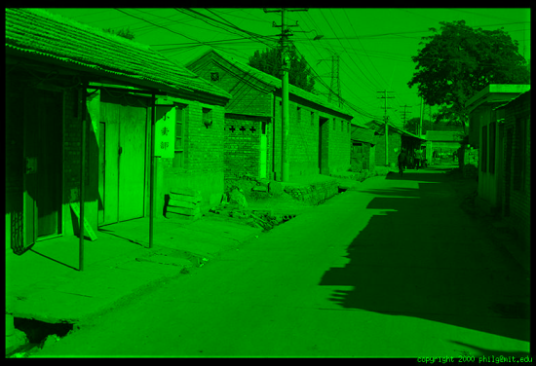
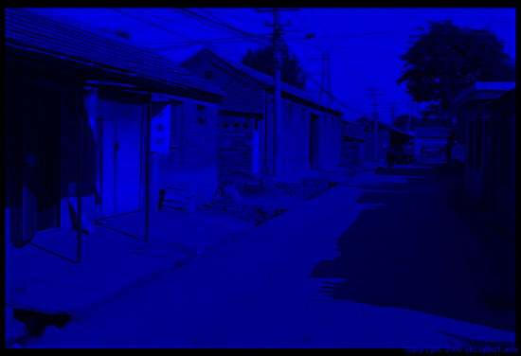
Color spaces: RGB
0,1,0
R
(G=0,B=0)
1,0,0
G
(R=0,B=0)
0,0,1
B
(R=0,G=0)
Some drawbacks
Strongly correlated channels
Non-perceptual
Default color space
Slide by James Hays
Image from: http://en.wikipedia.org/wiki/File:RGB_color_solid_cube.png

Slide 14
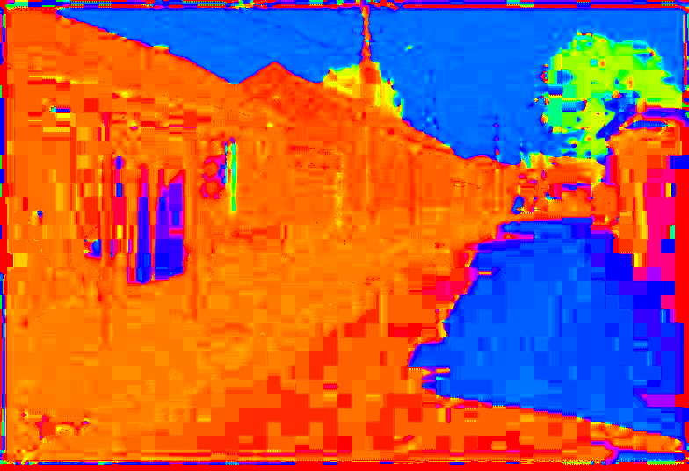
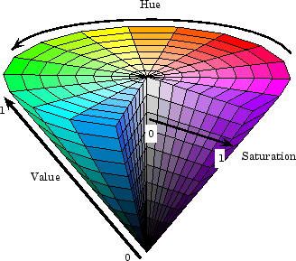
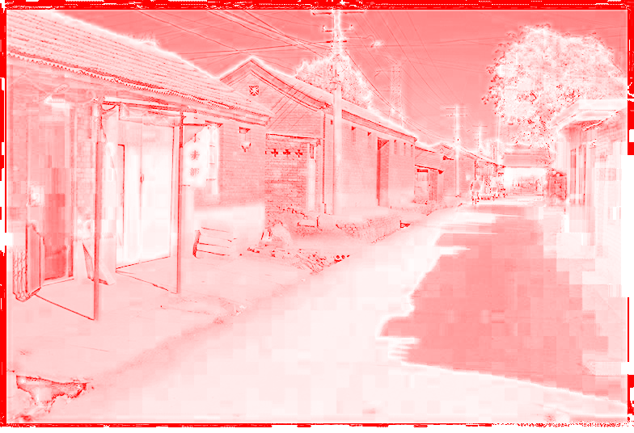
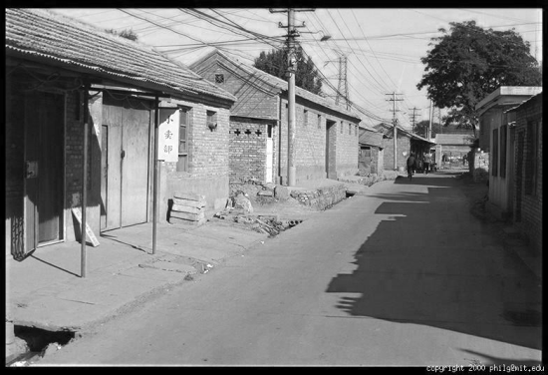
Color spaces: HSV
Intuitive color space
H
(S=1,V=1)
S
(H=1,V=1)
V
(H=1,S=0)
Slide by James Hays

Slide 15
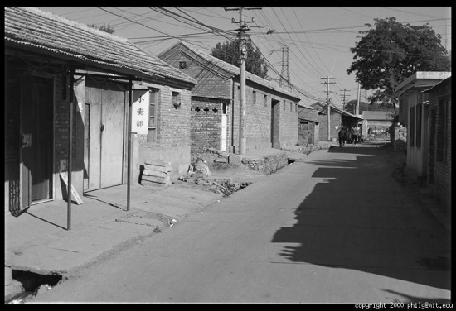
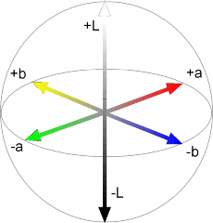
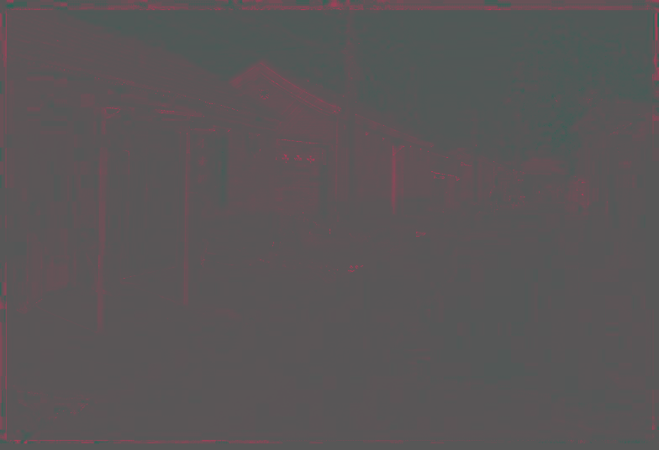
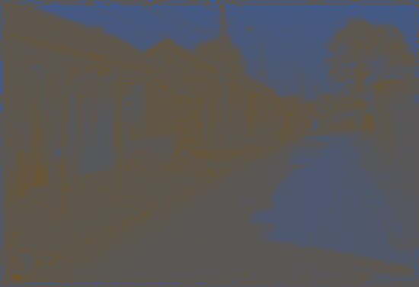
Color spaces: L*a*b*
L
(a=0,b=0)
a
(L=65,b=0)
b
(L=65,a=0)
Slide by James Hays

Slide 16
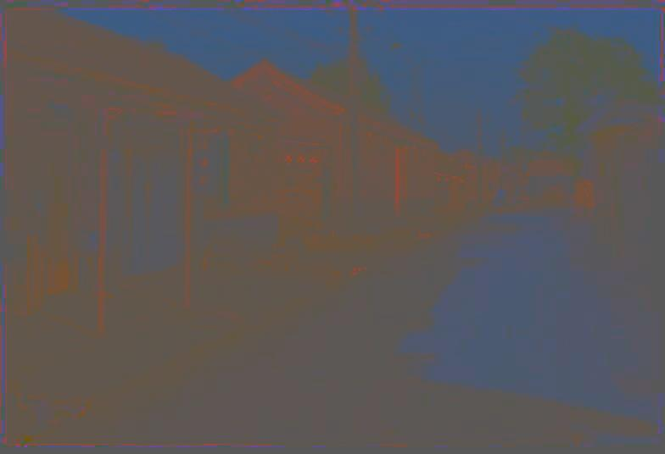
Most information in intensity
Only color shown – constant intensity
Slide by James Hays

Slide 17

Most information in intensity
Only intensity shown – constant color
Slide by James Hays

Slide 18

Most information in intensity
Original image
Slide by James Hays

Slide 19
Image filtering

Slide 20
Image filtering
Image Credit: http://what-when-how.com/introduction-to-video-and-image-processing/neighborhood-processing-introduction-to-video-and-image-processing-part-1/

Slide 21
Image filtering
Image Credit: http://what-when-how.com/introduction-to-video-and-image-processing/neighborhood-processing-introduction-to-video-and-image-processing-part-1/

Slide 22
Image filtering: e.g. Mean Filter

Slide 23
Image filtering: e.g. Mean Filter

Slide 24
Image filtering: e.g. Median Filter
Image Credit: http://what-when-how.com/introduction-to-video-and-image-processing/neighborhood-processing-introduction-to-video-and-image-processing-part-1/

Slide 25

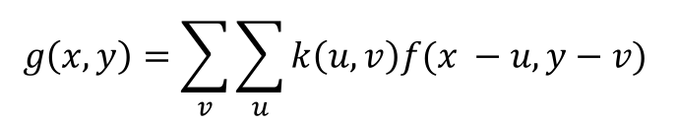
Image filtering: Convolution operator
$$k(x, y)$$
$$g\left(x, y\right)=\sum_{v}{\sum_{u}{k\left(u,v\right)f(x −u, y−v) }}$$
Image Credit: http://what-when-how.com/introduction-to-video-and-image-processing/neighborhood-processing-introduction-to-video-and-image-processing-part-1/

Slide 26
(filter, kernel)
http://www.cs.virginia.edu/~vicente/recognition/animation.gif

Slide 27


Image filtering: Convolution operator
e.g. mean filter
1/9 | 1/9 | 1/9
1/9 | 1/9 | 1/9
1/9 | 1/9 | 1/9
$k(x, y)$ =
$k(x, y)$
Image Credit: http://what-when-how.com/introduction-to-video-and-image-processing/neighborhood-processing-introduction-to-video-and-image-processing-part-1/

Slide 28
Image filtering: Convolution operator
e.g. mean filter
1/9 | 1/9 | 1/9
1/9 | 1/9 | 1/9
1/9 | 1/9 | 1/9
$k(x, y)$ =
$k(x, y)$
Image Credit: http://what-when-how.com/introduction-to-video-and-image-processing/neighborhood-processing-introduction-to-video-and-image-processing-part-1/

Slide 29

Example: box filter
1
1
1
1
1
1
1
1
1
Slide credit: David Lowe (UBC)

Slide 30
Image filtering
1
1
1
1
1
1
1
1
1
0 | 0 | 0 | 0 | 0 | 0 | 0 | 0 | 0 | 0
0 | 0 | 0 | 0 | 0 | 0 | 0 | 0 | 0 | 0
0 | 0 | 0 | 90 | 90 | 90 | 90 | 90 | 0 | 0
0 | 0 | 0 | 90 | 90 | 90 | 90 | 90 | 0 | 0
0 | 0 | 0 | 90 | 90 | 90 | 90 | 90 | 0 | 0
0 | 0 | 0 | 90 | 0 | 90 | 90 | 90 | 0 | 0
0 | 0 | 0 | 90 | 90 | 90 | 90 | 90 | 0 | 0
0 | 0 | 0 | 0 | 0 | 0 | 0 | 0 | 0 | 0
0 | 0 | 90 | 0 | 0 | 0 | 0 | 0 | 0 | 0
0 | 0 | 0 | 0 | 0 | 0 | 0 | 0 | 0 | 0
 | 0
0 | 0 | 0 | 0 | 0 | 0 | 0 | 0 | 0 | 0
0 | 0 | 0 | 0 | 0 | 0 | 0 | 0 | 0 | 0
0 | 0 | 0 | 90 | 90 | 90 | 90 | 90 | 0 | 0
0 | 0 | 0 | 90 | 90 | 90 | 90 | 90 | 0 | 0
0 | 0 | 0 | 90 | 90 | 90 | 90 | 90 | 0 | 0
0 | 0 | 0 | 90 | 0 | 90 | 90 | 90 | 0 | 0
0 | 0 | 0 | 90 | 90 | 90 | 90 | 90 | 0 | 0
0 | 0 | 0 | 0 | 0 | 0 | 0 | 0 | 0 | 0
0 | 0 | 90 | 0 | 0 | 0 | 0 | 0 | 0 | 0
0 | 0 | 0 | 0 | 0 | 0 | 0 | 0 | 0 | 0
Credit: S. Seitz
Notes:
ones, divide by 9

Slide 31
Image filtering
1
1
1
1
1
1
1
1
1
0 | 0 | 0 | 0 | 0 | 0 | 0 | 0 | 0 | 0
0 | 0 | 0 | 0 | 0 | 0 | 0 | 0 | 0 | 0
0 | 0 | 0 | 90 | 90 | 90 | 90 | 90 | 0 | 0
0 | 0 | 0 | 90 | 90 | 90 | 90 | 90 | 0 | 0
0 | 0 | 0 | 90 | 90 | 90 | 90 | 90 | 0 | 0
0 | 0 | 0 | 90 | 0 | 90 | 90 | 90 | 0 | 0
0 | 0 | 0 | 90 | 90 | 90 | 90 | 90 | 0 | 0
0 | 0 | 0 | 0 | 0 | 0 | 0 | 0 | 0 | 0
0 | 0 | 90 | 0 | 0 | 0 | 0 | 0 | 0 | 0
0 | 0 | 0 | 0 | 0 | 0 | 0 | 0 | 0 | 0
 | 0 | 10
0 | 0 | 0 | 0 | 0 | 0 | 0 | 0 | 0 | 0
0 | 0 | 0 | 0 | 0 | 0 | 0 | 0 | 0 | 0
0 | 0 | 0 | 90 | 90 | 90 | 90 | 90 | 0 | 0
0 | 0 | 0 | 90 | 90 | 90 | 90 | 90 | 0 | 0
0 | 0 | 0 | 90 | 90 | 90 | 90 | 90 | 0 | 0
0 | 0 | 0 | 90 | 0 | 90 | 90 | 90 | 0 | 0
0 | 0 | 0 | 90 | 90 | 90 | 90 | 90 | 0 | 0
0 | 0 | 0 | 0 | 0 | 0 | 0 | 0 | 0 | 0
0 | 0 | 90 | 0 | 0 | 0 | 0 | 0 | 0 | 0
0 | 0 | 0 | 0 | 0 | 0 | 0 | 0 | 0 | 0
Credit: S. Seitz
Notes:
ones, divide by 9

Slide 32
Image filtering
1
1
1
1
1
1
1
1
1
0 | 0 | 0 | 0 | 0 | 0 | 0 | 0 | 0 | 0
0 | 0 | 0 | 0 | 0 | 0 | 0 | 0 | 0 | 0
0 | 0 | 0 | 90 | 90 | 90 | 90 | 90 | 0 | 0
0 | 0 | 0 | 90 | 90 | 90 | 90 | 90 | 0 | 0
0 | 0 | 0 | 90 | 90 | 90 | 90 | 90 | 0 | 0
0 | 0 | 0 | 90 | 0 | 90 | 90 | 90 | 0 | 0
0 | 0 | 0 | 90 | 90 | 90 | 90 | 90 | 0 | 0
0 | 0 | 0 | 0 | 0 | 0 | 0 | 0 | 0 | 0
0 | 0 | 90 | 0 | 0 | 0 | 0 | 0 | 0 | 0
0 | 0 | 0 | 0 | 0 | 0 | 0 | 0 | 0 | 0
 | 0 | 10 | 20
0 | 0 | 0 | 0 | 0 | 0 | 0 | 0 | 0 | 0
0 | 0 | 0 | 0 | 0 | 0 | 0 | 0 | 0 | 0
0 | 0 | 0 | 90 | 90 | 90 | 90 | 90 | 0 | 0
0 | 0 | 0 | 90 | 90 | 90 | 90 | 90 | 0 | 0
0 | 0 | 0 | 90 | 90 | 90 | 90 | 90 | 0 | 0
0 | 0 | 0 | 90 | 0 | 90 | 90 | 90 | 0 | 0
0 | 0 | 0 | 90 | 90 | 90 | 90 | 90 | 0 | 0
0 | 0 | 0 | 0 | 0 | 0 | 0 | 0 | 0 | 0
0 | 0 | 90 | 0 | 0 | 0 | 0 | 0 | 0 | 0
0 | 0 | 0 | 0 | 0 | 0 | 0 | 0 | 0 | 0
Credit: S. Seitz
Notes:
ones, divide by 9

Slide 33
Image filtering
1
1
1
1
1
1
1
1
1
0 | 0 | 0 | 0 | 0 | 0 | 0 | 0 | 0 | 0
0 | 0 | 0 | 0 | 0 | 0 | 0 | 0 | 0 | 0
0 | 0 | 0 | 90 | 90 | 90 | 90 | 90 | 0 | 0
0 | 0 | 0 | 90 | 90 | 90 | 90 | 90 | 0 | 0
0 | 0 | 0 | 90 | 90 | 90 | 90 | 90 | 0 | 0
0 | 0 | 0 | 90 | 0 | 90 | 90 | 90 | 0 | 0
0 | 0 | 0 | 90 | 90 | 90 | 90 | 90 | 0 | 0
0 | 0 | 0 | 0 | 0 | 0 | 0 | 0 | 0 | 0
0 | 0 | 90 | 0 | 0 | 0 | 0 | 0 | 0 | 0
0 | 0 | 0 | 0 | 0 | 0 | 0 | 0 | 0 | 0
 | 0 | 10 | 20 | 30
0 | 0 | 0 | 0 | 0 | 0 | 0 | 0 | 0 | 0
0 | 0 | 0 | 0 | 0 | 0 | 0 | 0 | 0 | 0
0 | 0 | 0 | 90 | 90 | 90 | 90 | 90 | 0 | 0
0 | 0 | 0 | 90 | 90 | 90 | 90 | 90 | 0 | 0
0 | 0 | 0 | 90 | 90 | 90 | 90 | 90 | 0 | 0
0 | 0 | 0 | 90 | 0 | 90 | 90 | 90 | 0 | 0
0 | 0 | 0 | 90 | 90 | 90 | 90 | 90 | 0 | 0
0 | 0 | 0 | 0 | 0 | 0 | 0 | 0 | 0 | 0
0 | 0 | 90 | 0 | 0 | 0 | 0 | 0 | 0 | 0
0 | 0 | 0 | 0 | 0 | 0 | 0 | 0 | 0 | 0
Credit: S. Seitz
Notes:
ones, divide by 9

Slide 34
Image filtering
1
1
1
1
1
1
1
1
1
0 | 0 | 0 | 0 | 0 | 0 | 0 | 0 | 0 | 0
0 | 0 | 0 | 0 | 0 | 0 | 0 | 0 | 0 | 0
0 | 0 | 0 | 90 | 90 | 90 | 90 | 90 | 0 | 0
0 | 0 | 0 | 90 | 90 | 90 | 90 | 90 | 0 | 0
0 | 0 | 0 | 90 | 90 | 90 | 90 | 90 | 0 | 0
0 | 0 | 0 | 90 | 0 | 90 | 90 | 90 | 0 | 0
0 | 0 | 0 | 90 | 90 | 90 | 90 | 90 | 0 | 0
0 | 0 | 0 | 0 | 0 | 0 | 0 | 0 | 0 | 0
0 | 0 | 90 | 0 | 0 | 0 | 0 | 0 | 0 | 0
0 | 0 | 0 | 0 | 0 | 0 | 0 | 0 | 0 | 0
 | 0 | 10 | 20 | 30 | 30
Credit: S. Seitz
Notes:
ones, divide by 9

Slide 35
Image filtering
1
1
1
1
1
1
1
1
1
0 | 0 | 0 | 0 | 0 | 0 | 0 | 0 | 0 | 0
0 | 0 | 0 | 0 | 0 | 0 | 0 | 0 | 0 | 0
0 | 0 | 0 | 90 | 90 | 90 | 90 | 90 | 0 | 0
0 | 0 | 0 | 90 | 90 | 90 | 90 | 90 | 0 | 0
0 | 0 | 0 | 90 | 90 | 90 | 90 | 90 | 0 | 0
0 | 0 | 0 | 90 | 0 | 90 | 90 | 90 | 0 | 0
0 | 0 | 0 | 90 | 90 | 90 | 90 | 90 | 0 | 0
0 | 0 | 0 | 0 | 0 | 0 | 0 | 0 | 0 | 0
0 | 0 | 90 | 0 | 0 | 0 | 0 | 0 | 0 | 0
0 | 0 | 0 | 0 | 0 | 0 | 0 | 0 | 0 | 0
 | 0 | 10 | 20 | 30 | 30
?
Credit: S. Seitz
Notes:
ones, divide by 9

Slide 36
Image filtering
1
1
1
1
1
1
1
1
1
0 | 0 | 0 | 0 | 0 | 0 | 0 | 0 | 0 | 0
0 | 0 | 0 | 0 | 0 | 0 | 0 | 0 | 0 | 0
0 | 0 | 0 | 90 | 90 | 90 | 90 | 90 | 0 | 0
0 | 0 | 0 | 90 | 90 | 90 | 90 | 90 | 0 | 0
0 | 0 | 0 | 90 | 90 | 90 | 90 | 90 | 0 | 0
0 | 0 | 0 | 90 | 0 | 90 | 90 | 90 | 0 | 0
0 | 0 | 0 | 90 | 90 | 90 | 90 | 90 | 0 | 0
0 | 0 | 0 | 0 | 0 | 0 | 0 | 0 | 0 | 0
0 | 0 | 90 | 0 | 0 | 0 | 0 | 0 | 0 | 0
0 | 0 | 0 | 0 | 0 | 0 | 0 | 0 | 0 | 0
 | 0 | 10 | 20 | 30 | 30
 |  |  |  | 50
?
Credit: S. Seitz
Notes:
ones, divide by 9

Slide 37
Image filtering
1
1
1
1
1
1
1
1
1
0 | 0 | 0 | 0 | 0 | 0 | 0 | 0 | 0 | 0
0 | 0 | 0 | 0 | 0 | 0 | 0 | 0 | 0 | 0
0 | 0 | 0 | 90 | 90 | 90 | 90 | 90 | 0 | 0
0 | 0 | 0 | 90 | 90 | 90 | 90 | 90 | 0 | 0
0 | 0 | 0 | 90 | 90 | 90 | 90 | 90 | 0 | 0
0 | 0 | 0 | 90 | 0 | 90 | 90 | 90 | 0 | 0
0 | 0 | 0 | 90 | 90 | 90 | 90 | 90 | 0 | 0
0 | 0 | 0 | 0 | 0 | 0 | 0 | 0 | 0 | 0
0 | 0 | 90 | 0 | 0 | 0 | 0 | 0 | 0 | 0
0 | 0 | 0 | 0 | 0 | 0 | 0 | 0 | 0 | 0
 | 0 | 10 | 20 | 30 | 30 | 30 | 20 | 10
 | 0 | 20 | 40 | 60 | 60 | 60 | 40 | 20
 | 0 | 30 | 60 | 90 | 90 | 90 | 60 | 30
 | 0 | 30 | 50 | 80 | 80 | 90 | 60 | 30
 | 0 | 30 | 50 | 80 | 80 | 90 | 60 | 30
 | 0 | 20 | 30 | 50 | 50 | 60 | 40 | 20
 | 10 | 20 | 30 | 30 | 30 | 30 | 20 | 10
 | 10 | 10 | 10 | 0 | 0 | 0 | 0 | 0
Credit: S. Seitz

Slide 38
Box Filter
What does it do?
Replaces each pixel with an average of its neighborhood
Achieve smoothing effect (remove sharp features)
1
1
1
1
1
1
1
1
1
Slide credit: David Lowe (UBC)

Slide 39
Image filtering: e.g. Mean Filter

Slide 40
Image filtering: Convolution operator
Important filter: gaussian filter (gaussian blur)
1/16 | 1/8 | 1/16
1/8 | 1/4 | 1/8
1/16 | 1/8 | 1/16
$k(x, y)$ =
$k(x, y)$
Image Credit: http://what-when-how.com/introduction-to-video-and-image-processing/neighborhood-processing-introduction-to-video-and-image-processing-part-1/

Slide 41

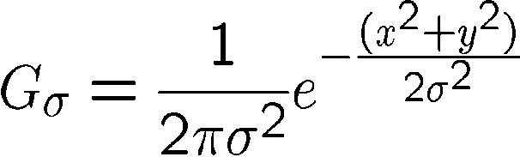
Important filter: Gaussian
Weight contributions of neighboring pixels by nearness
0.003 0.013 0.022 0.013 0.003
0.013 0.059 0.097 0.059 0.013
0.022 0.097 0.159 0.097 0.022
0.013 0.059 0.097 0.059 0.013
0.003 0.013 0.022 0.013 0.003
5 x 5, σ = 1
Slide credit: Christopher Rasmussen
Notes:
e^0 = 1, e^-1 = .37, e^-2 = .14, etc.

Slide 42
Image filtering: Convolution operator
e.g. gaussian filter (gaussian blur)
Image Credit: http://what-when-how.com/introduction-to-video-and-image-processing/neighborhood-processing-introduction-to-video-and-image-processing-part-1/

Slide 43
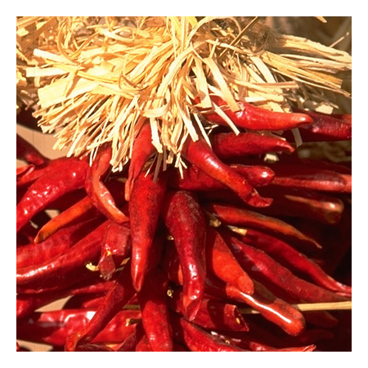
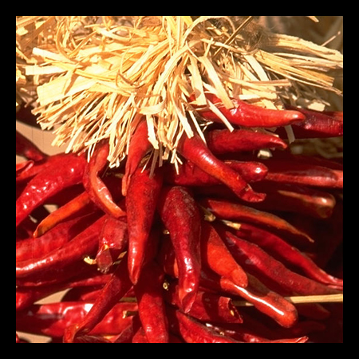


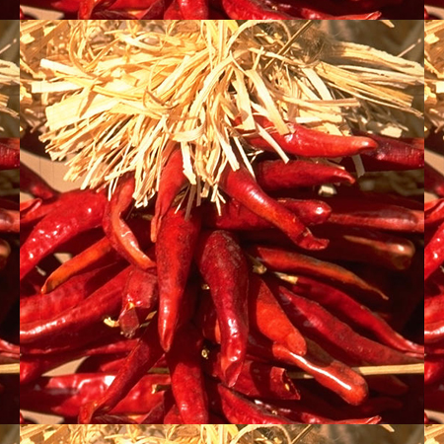





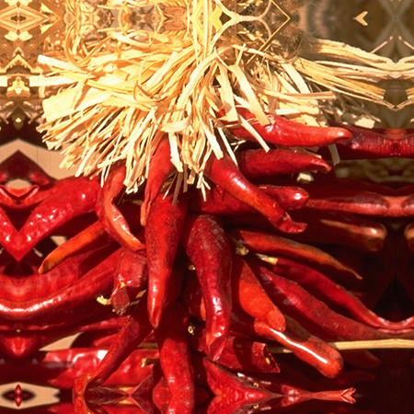


Practical matters
What about near the edge?
  the filter window falls off the edge of the image
  need to extrapolate
  methods:
    clip filter (black)
    wrap around
    copy edge
    reflect across edge
Source: S. Marschner

Slide 44

Practice with linear filters
0
0
0
?
0
1
0
0
0
0
Original
Source: D. Lowe

Slide 45
Practice with linear filters
0
0
0
0
1
0
0
0
0
Original
Filtered
(no change)
Source: D. Lowe

Slide 46
Practice with linear filters
0
0
0
?
0
0
1
0
0
0
Original
Source: D. Lowe

Slide 47
Practice with linear filters
0
0
0
0
0
1
0
0
0
Original
Shifted left
By 1 pixel
Source: D. Lowe

Slide 48

Practice with linear filters
0
0
0
-
1
1
1
?
0
2
0
1
1
1
0
0
0
1
1
1
(Note that filter sums to 1)
Original
Source: D. Lowe

Slide 49
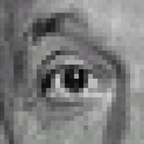
Practice with linear filters
0
0
0
-
1
1
1
0
2
0
1
1
1
0
0
0
1
1
1
Original
Sharpening filter
  Accentuates differences with local average
Source: D. Lowe

Slide 50

Sharpening
Source: D. Lowe

Slide 51
Key properties of linear filters
Linearity:
imfilter(I, f₁ + f₂) =
imfilter(I,f₁) + imfilter(I,f₂)
Shift invariance: same behavior regardless of pixel location
imfilter(I,shift(f)) = shift(imfilter(I,f))
Any linear, shift-invariant operator can be represented as a convolution
Source: S. Lazebnik
Notes:
f is image

Slide 52
Image filtering: Convolution operator
  Enhance images
    Denoise, resize, increase contrast, etc.
  Extract information from images
    Texture, edges, distinctive points, etc.
  Detect patterns
    Template matching
  Deep Convolutional Networks

Slide 53
Image filtering: Convolution operator
Important Filter: Sobel operator
1 | 0 | -1
2 | 0 | -2
1 | 0 | -1
$k(x, y)$ =
$k(x, y)$
Image Credit: http://what-when-how.com/introduction-to-video-and-image-processing/neighborhood-processing-introduction-to-video-and-image-processing-part-1/

Slide 54


Other filters
1
0
-1
2
0
-2
1
0
-1
Sobel
Vertical Edge
(absolute value)
Slide by James Hays

Slide 55

Other filters
1
2
1
0
0
0
-1
-2
-1
Sobel
Horizontal Edge
(absolute value)
Slide by James Hays
Notes:
Questions at this point?

Slide 56
Sobel operators are equivalent to 2D partial derivatives of the image
Vertical sobel operator – Partial derivative in X (width)
Horizontal sobel operator – Partial derivative in Y (height)
Can compute magnitude and phase at each location.
Useful for detecting edges

Slide 57
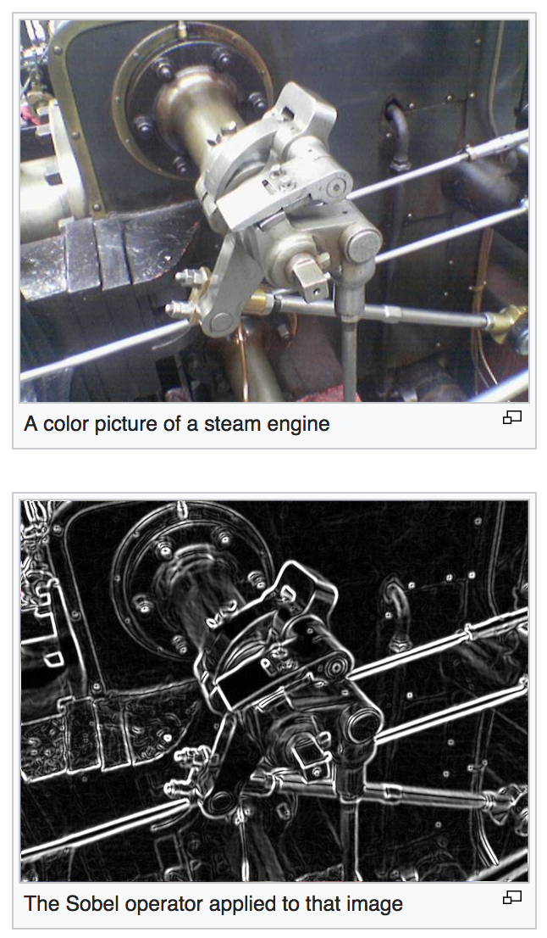
https://en.wikipedia.org/wiki/Sobel_operator

Slide 58



Sobel filters are (approximate) partial derivatives of the image
Let
$$f(x,y)$$
be your input image, then the partial derivative is:
$$\frac{∂f(x,y)}{∂x}=\lim_{h→0}{\frac{f\left(x+h, y\right)−f(x,y)}{h}}$$
Also:
$$\frac{∂f(x,y)}{∂x}=\lim_{h→0}{\frac{f\left(x+h,y\right)−f(x−h,y)}{2h}}$$

Slide 59



But digital images are not continuous, they are discrete
Let
$$f[x,y]$$
be your input image, then the partial derivative is:
$$Δ_{x}f[x,y]=f[x+1,y]−f[x,y]$$
Also:
$$Δ_{x}f[x,y]=f[x+1,y]−f[x−1,y]$$

Slide 60
But digital images are not continuous, they are discrete
Let
$$f[x,y]$$
be your input image, then the partial derivative is:
k(x, y) =
-1 | 1
$$Δ_{x}f[x,y]=f[x+1,y]−f[x,y]$$
Also:
-1 | 0 | 1
$$Δ_{x}f[x,y]=f[x+1,y]−f[x−1,y]$$
k(x, y) =

Slide 61
Sobel Operators Smooth in Y and then Differentiate in X
1
2
1
1 | 0 | -1
2 | 0 | -2
1 | 0 | -1
1 | 0 | -1
k(x, y) =
*
=
Similarly to differentiate in Y

Slide 62
Next Class: More on Image Filters and Edge Detection

Slide 63
Questions?

