Slide 1
Corners and Interest Points
Various slides from previous courses by:
D.A. Forsyth (Berkeley / UIUC), I. Kokkinos (Ecole Centrale / UCL). S. Lazebnik (UNC / UIUC), S. Seitz (MSR / Facebook), J. Hays (Brown / Georgia Tech), A. Berg (Stony Brook / UNC), D. Samaras (Stony Brook) . J. M. Frahm (UNC), V. Ordonez (UVA).

Slide 2
Last Class
Frequency Domain
Filtering in Frequency
Edge Detection - Canny

Slide 3
Today’s Class
Corner Detection - Harris
Interest Points
Local Feature Descriptors

Slide 4
Edge Detection

Slide 5
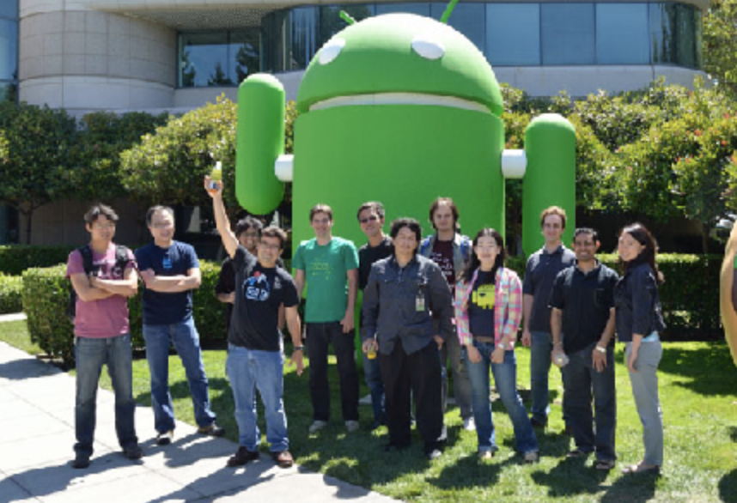
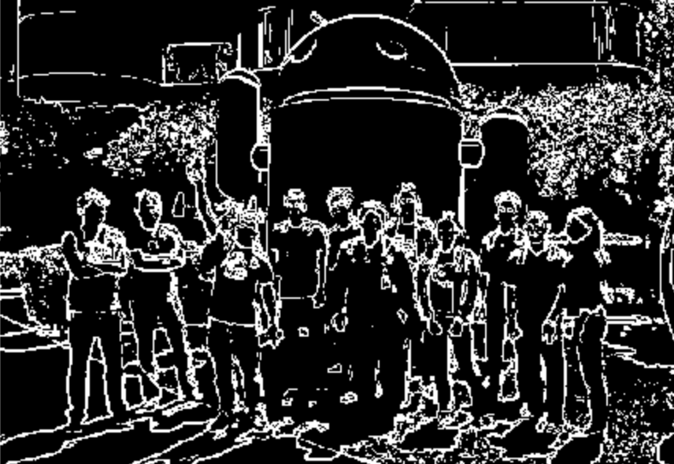
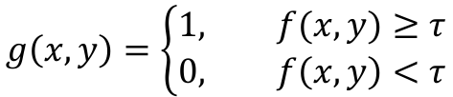
Edge Detection
$$g\left(x,y\right)=\left\{\begin{aligned}1, f(x,y)≥τ \\ &0, f\left(x,y\right)<τ\end{aligned}\right.$$
Sobel + Thresholding

Slide 6
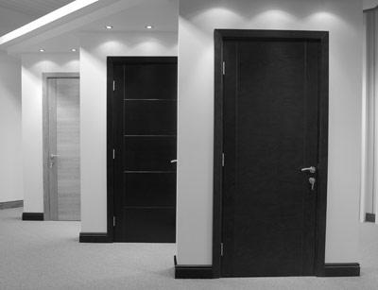
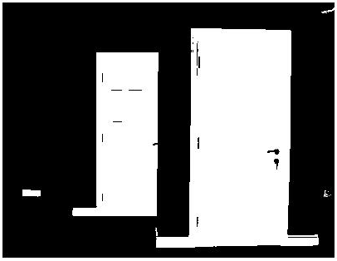
Digression
Thresholding is often the most under-rated but effective Computer Vision technique. Sometimes this is all you need!
Example: intensity-based detection. Warning when door is opened or closed.
fg_pix = find(im < 65);
Looking for dark pixels
Example by Kristen Grauman, UT-Austin

Slide 7
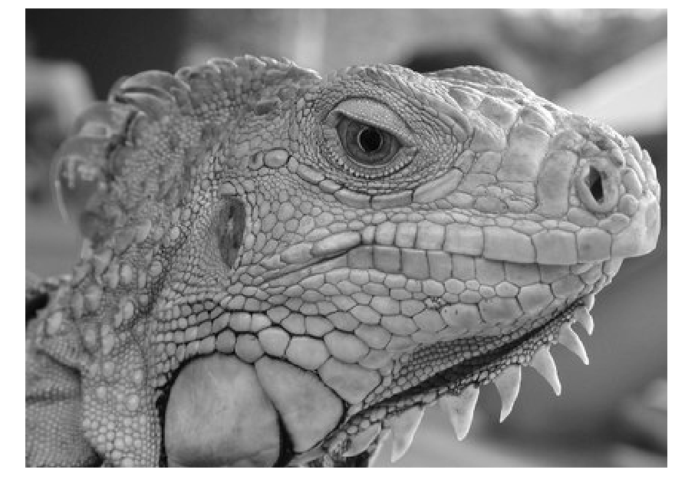
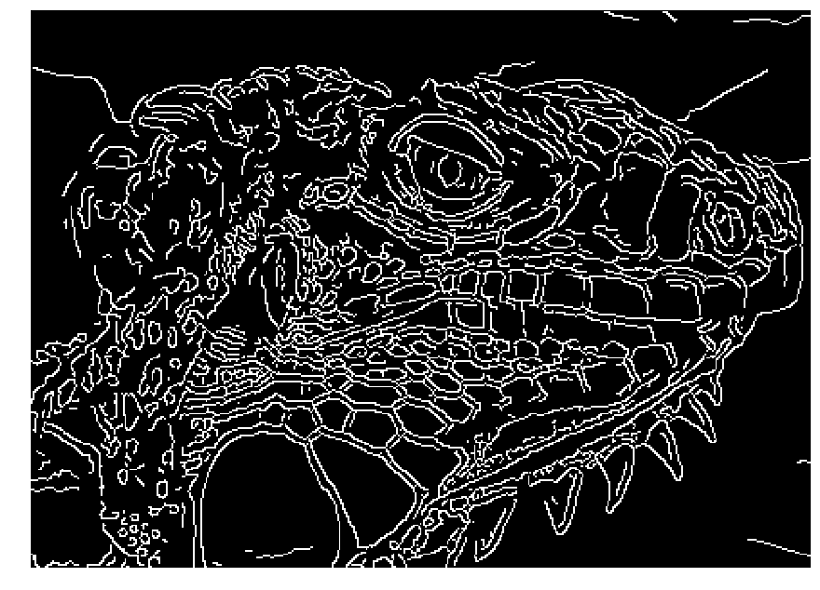
Canny Edge Detector
Obtains thin edges (1px wide)
Tries to preserve edge connectivity.
Source: Juan C. Niebles and Ranjay Krishna.

Slide 8
Canny edge detector
Filter image with x, y derivatives of Gaussian
Find magnitude and orientation of gradient
Non-maximum suppression:
  Thin multi-pixel wide “ridges” down to single pixel width
Thresholding and linking (hysteresis):
  Define two thresholds: low and high
  Use the high threshold to start edge curves and the low threshold to continue them
Source: Juan C. Niebles and Ranjay Krishna.

Slide 9
Canny Edge Detector
Classic algorithm in Computer Vision / Image Analysis
Commonly implemented in most libraries
e.g. in Python you can find it in the skimage package.
OpenCV also has an implementation with python bindings.
Canny, J., A Computational Approach To Edge Detection, IEEE Trans. Pattern Analysis and Machine Intelligence, 8(6):679–698, 1986.

Slide 10
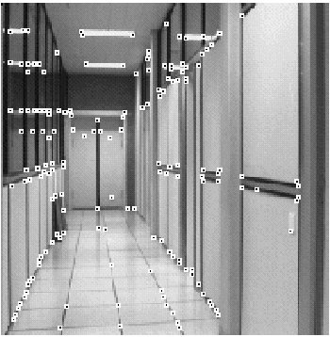
Corners (and Interest Points)
How to find corners?
What is a corner?

Slide 11
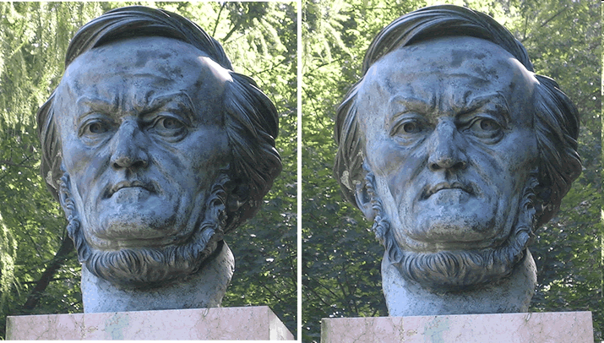
Corners: Why “Interest” Points?
If we can find them,
then maybe we can
“match” images belonging to the same object!
Then maybe we can also “triangulate” the 3D coordinates of the image.
Example from Silvio Savarese

Slide 12

Corner Detection: Basic Idea
We should easily recognize the point by looking through a small window
Shifting a window in any direction should give a large change in intensity
“flat” region:
no change in all directions
“edge”:
no change along the edge direction
“corner”:
significant change in all directions
Source: A. Efros

Slide 13



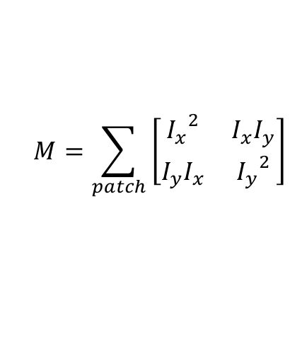



Harris Corner Detection
Compute the following matrix of squared gradients for every pixel.
$$I_{x}$$
are gradients computed using Sobel or some other approximation.
$$M=\sum_{patch}{\left[\begin{matrix}{I_{x}}^{2} & I_{x}I_{y} \\ I_{y}I_{x} & {I_{y}}^{2}\end{matrix}\right]}$$
and
$$I_{y}$$
$$M=\left[\begin{matrix}0 & 0 \\ 0 & 0\end{matrix}\right]$$
$$M=\left[\begin{matrix}0 & 0 \\ 0 & b\end{matrix}\right]$$
$$M=\left[\begin{matrix}a & 0 \\ 0 & 0\end{matrix}\right]$$
$$M=\left[\begin{matrix}a & 0 \\ 0 & b\end{matrix}\right]$$

Slide 14





Harris Corner Detection
$$M=\left[\begin{matrix}0 & 0 \\ 0 & 0\end{matrix}\right]$$
$$M=\left[\begin{matrix}0 & 0 \\ 0 & b\end{matrix}\right]$$
$$M=\left[\begin{matrix}a & 0 \\ 0 & 0\end{matrix}\right]$$
$$M=\left[\begin{matrix}a & 0 \\ 0 & b\end{matrix}\right]$$
If both a, and b are large then this is a corner, otherwise it is not. Set a threshold and this should detect corners.
Problem: Doesn’t work for these corners:

Slide 15
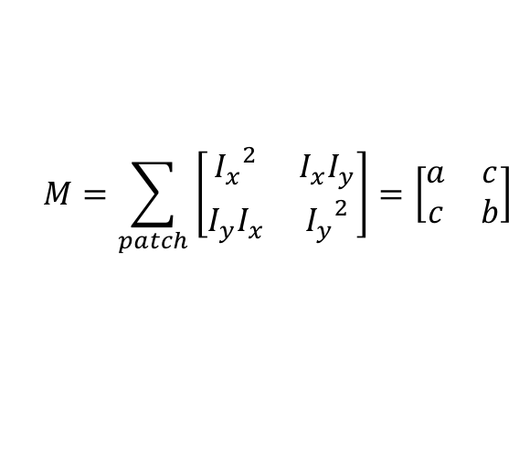



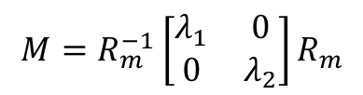
Harris Corner Detection
$$M=\sum_{patch}{\left[\begin{matrix}{I_{x}}^{2} & I_{x}I_{y} \\ I_{y}I_{x} & {I_{y}}^{2}\end{matrix}\right]=\left[\begin{matrix}a & c \\ c & b\end{matrix}\right]}$$
$$M=R_{m}^{−1}\left[\begin{matrix}λ_{1} & 0 \\ 0 & λ_{2}\end{matrix}\right]R_{m}$$
Under a rotation M can be diagonalized
$$λ_{1}$$
and
$$λ_{2}$$
are the eigenvalues of M
From your linear algebra class finding them requires solving
$$\det\left(M−λI\right)=0$$

Slide 16
However no need to solve det(M-lambda I)=0

Slide 17
Corner response function
α: constant (0.04 to 0.06)
“Edge”
R < 0
“Corner”
R > 0
|R| small
“Flat” region
“Edge”
R < 0

Slide 18

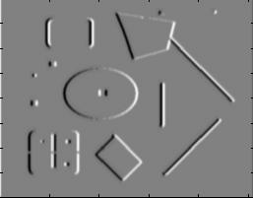
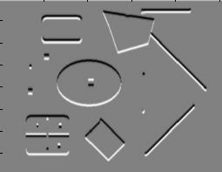
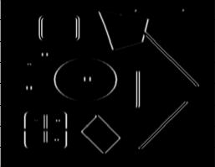
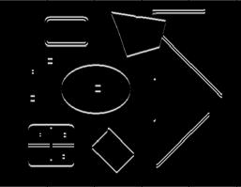
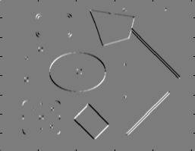
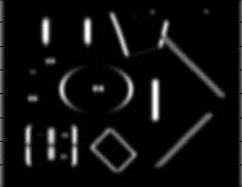
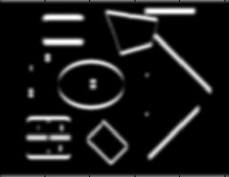
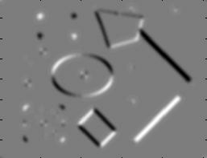
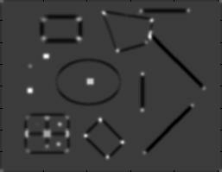
Harris Detector Summary [Harris88]
Second moment matrix
1. Image derivatives
I_{x}
I_{y}
(optionally, blur first)
I_{x}²
I_{y}²
I_{x}I_{y}
2. Square of derivatives
3. Gaussian
filter g(σ_{I})
g(I_{x}²)
g(I_{y}²)
g(I_{x}I_{y})
4. Cornerness function – both eigenvalues are strong
5. Non-maxima suppression
har

Slide 19
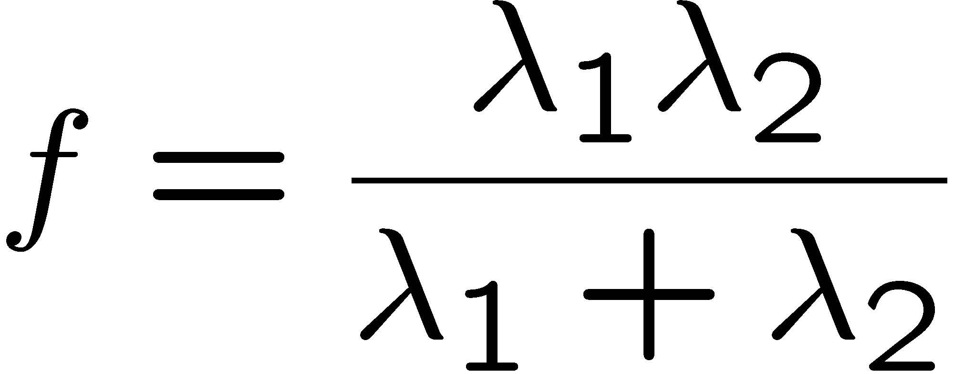
Alternative Corner response function
“edge”:
“corner”:
“flat” region
λ₁ >> λ₂
λ₁ and λ₂ are large,
λ₁ ~ λ₂;
λ₁ and λ₂ are small;
λ₂ >> λ₁
Szeliski
Harmonic mean

Slide 20

Harris Detector: Steps

Slide 21

Harris Detector: Steps
Compute corner response R

Slide 22

Harris Detector: Steps
Find points with large corner response: R>threshold

Slide 23
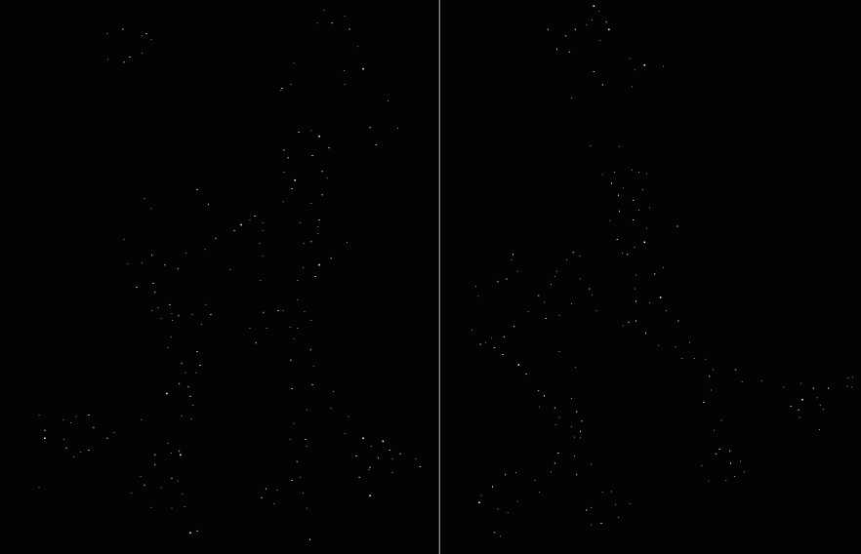
Harris Detector: Steps
Take only the points of local maxima of R

Slide 24

Harris Detector: Steps

Slide 25
Invariance and covariance
We want corner locations to be invariant to photometric transformations and covariant to geometric transformations
  Invariance: image is transformed and corner locations do not change
  Covariance: if we have two transformed versions of the same image, features should be detected in corresponding locations
Slide by James Hays

Slide 26
Keypoint detection with scale selection
We want to extract keypoints with characteristic scale that is covariant with the image transformation
Slide by Svetlana Lazebnik

Slide 27
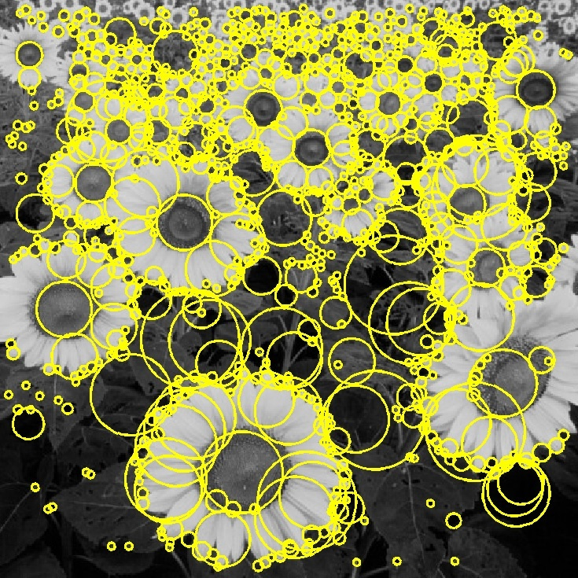

Basic idea
Convolve the image with a “blob filter” at multiple scales and look for extrema of filter response in the resulting scale space
T. Lindeberg. Feature detection with automatic scale selection.
IJCV 30(2), pp 77-116, 1998.
Slide by Svetlana Lazebnik

Slide 28
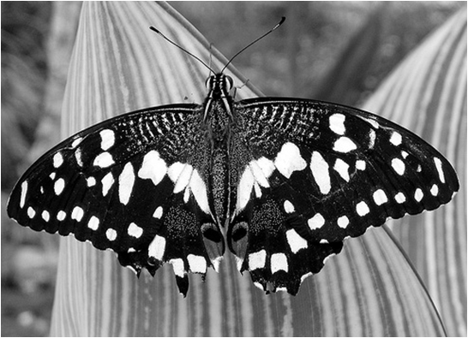
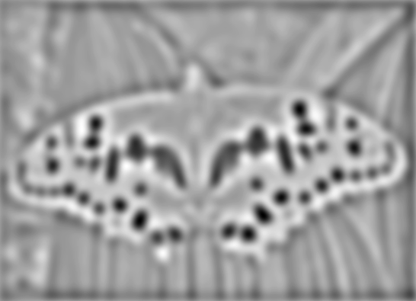

Blob detection
minima
*
=
maxima
Find maxima and minima of blob filter response in space and scale
Source: N. Snavely

Slide 29

Blob filter
Laplacian of Gaussian: Circularly symmetric operator for blob detection in 2D

Slide 30

Recall: Edge detection
Edge
f
Derivative
of Gaussian
Edge = maximum
of derivative
Source: S. Seitz

Slide 31

Edge detection, Take 2
f
Edge
Second derivative
of Gaussian
(Laplacian)
Edge = zero crossing
of second derivative
Source: S. Seitz
Notes:
An edge filtered with the Laplacian of Gaussian is the difference between the blurry edge and the original edge.

Slide 32
Scale-space blob detector
Convolve image with scale-normalized Laplacian at several scales

Slide 33
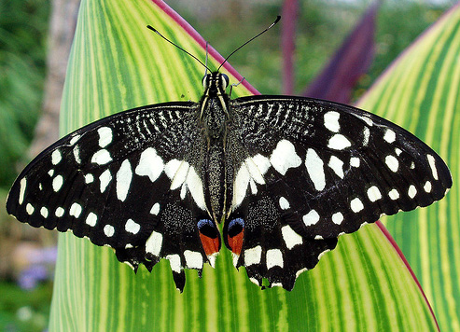
Scale-space blob detector: Example
Slide by Svetlana Lazebnik

Slide 34
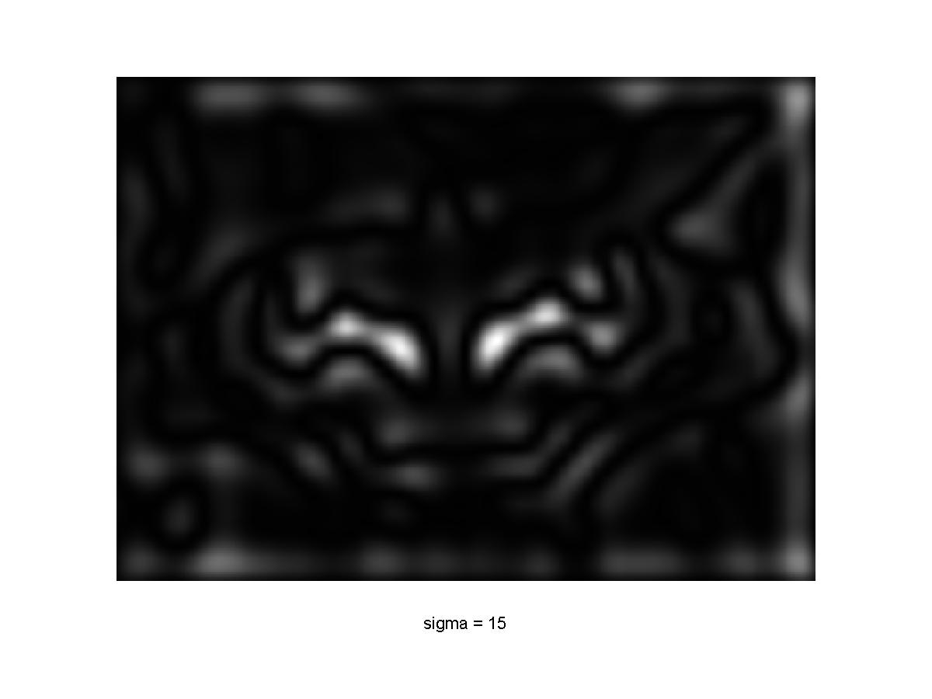
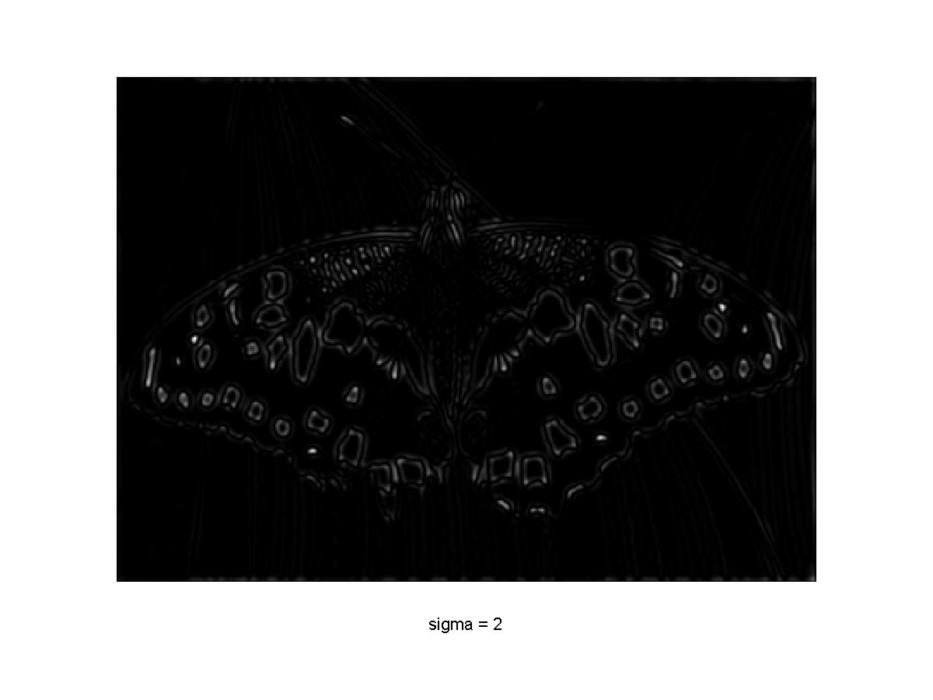
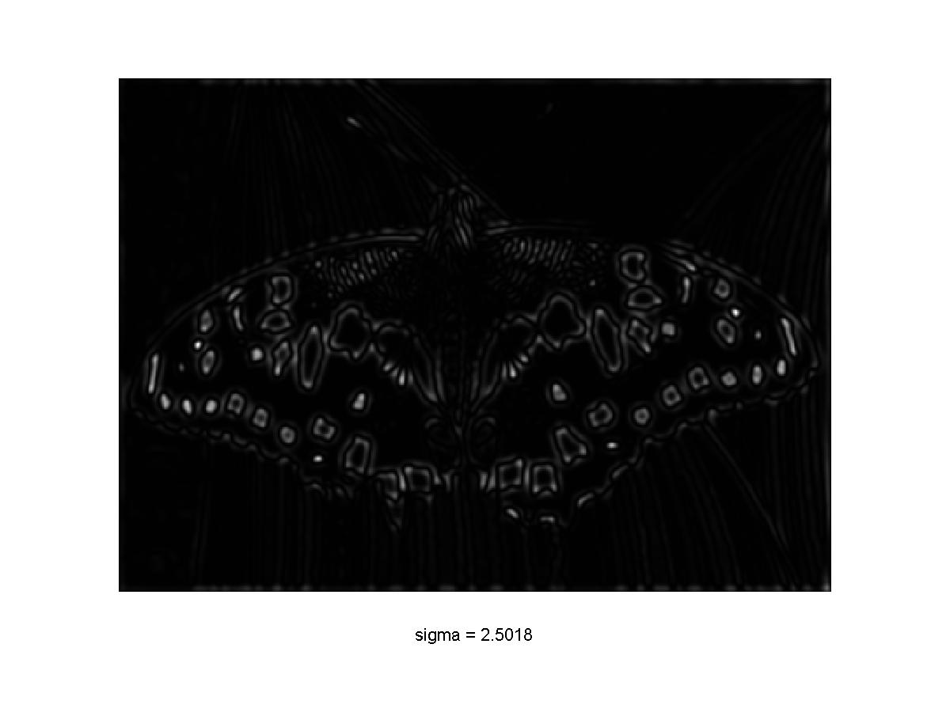
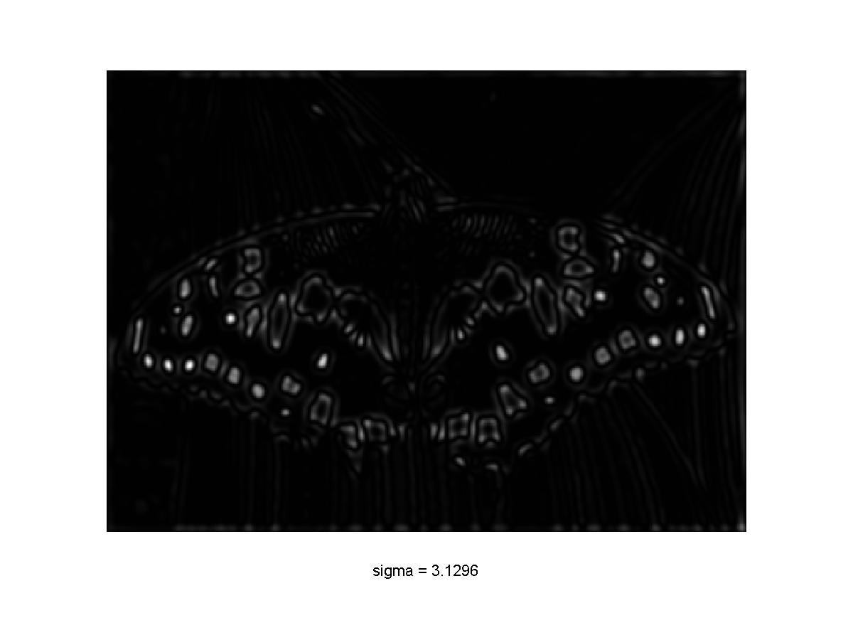
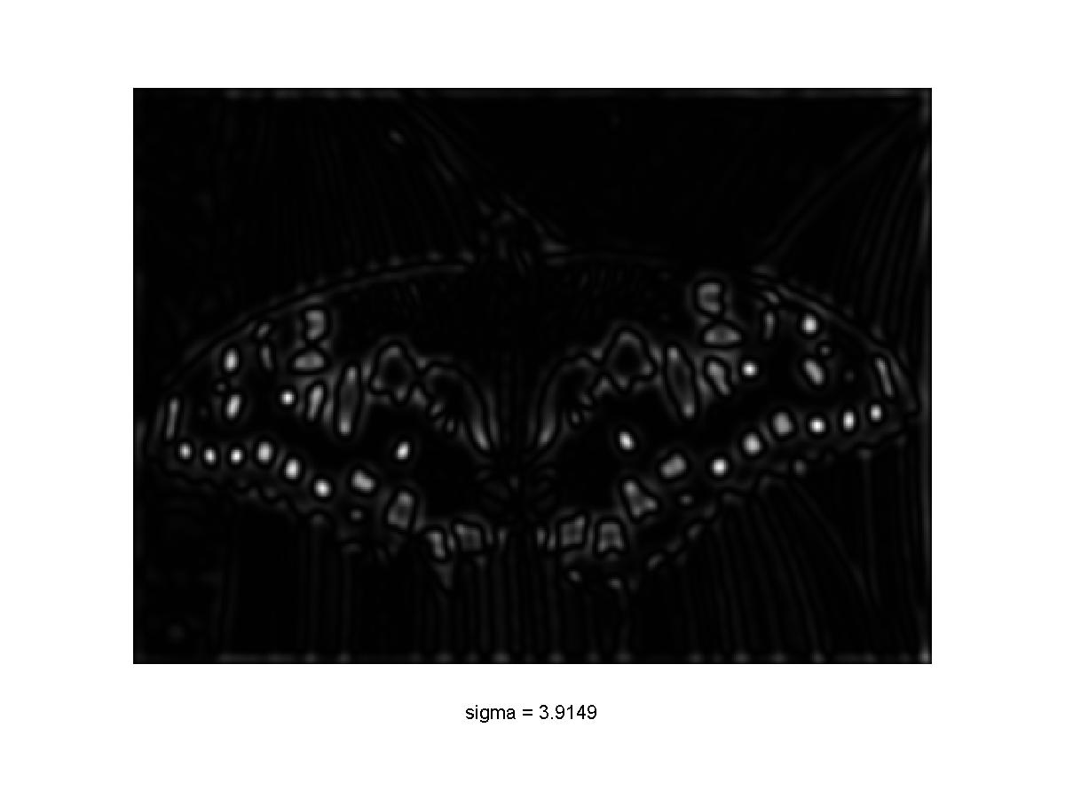
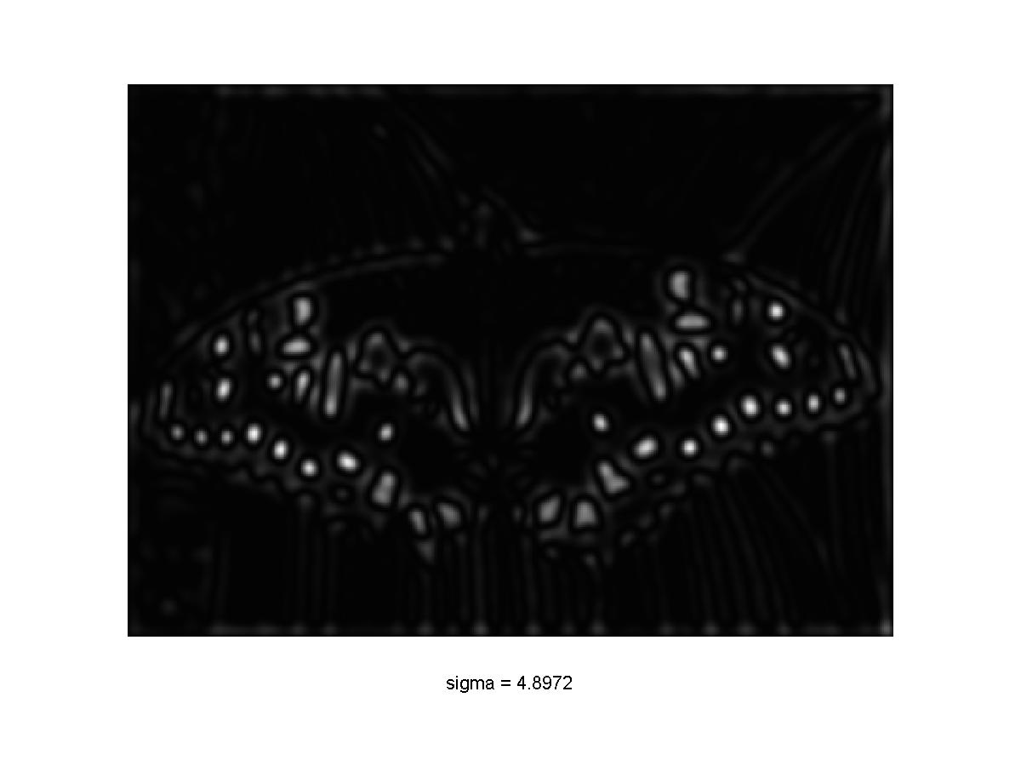

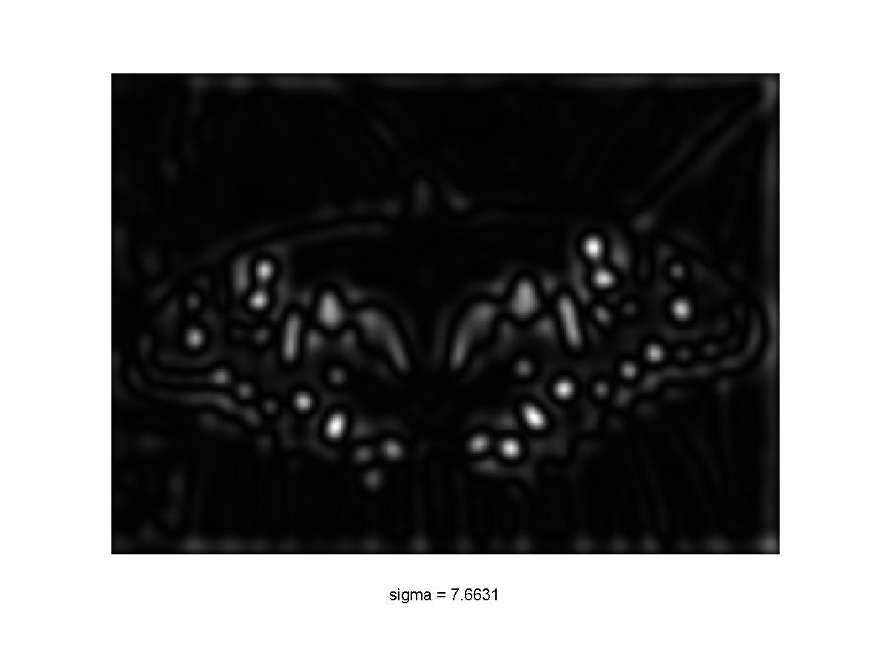
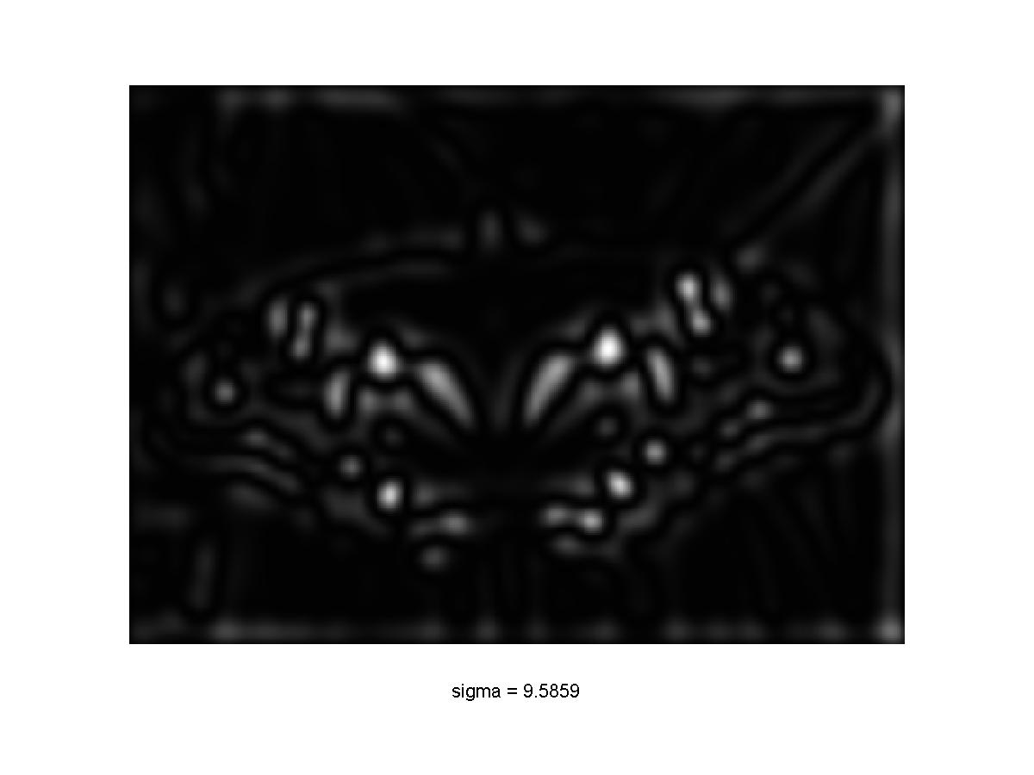
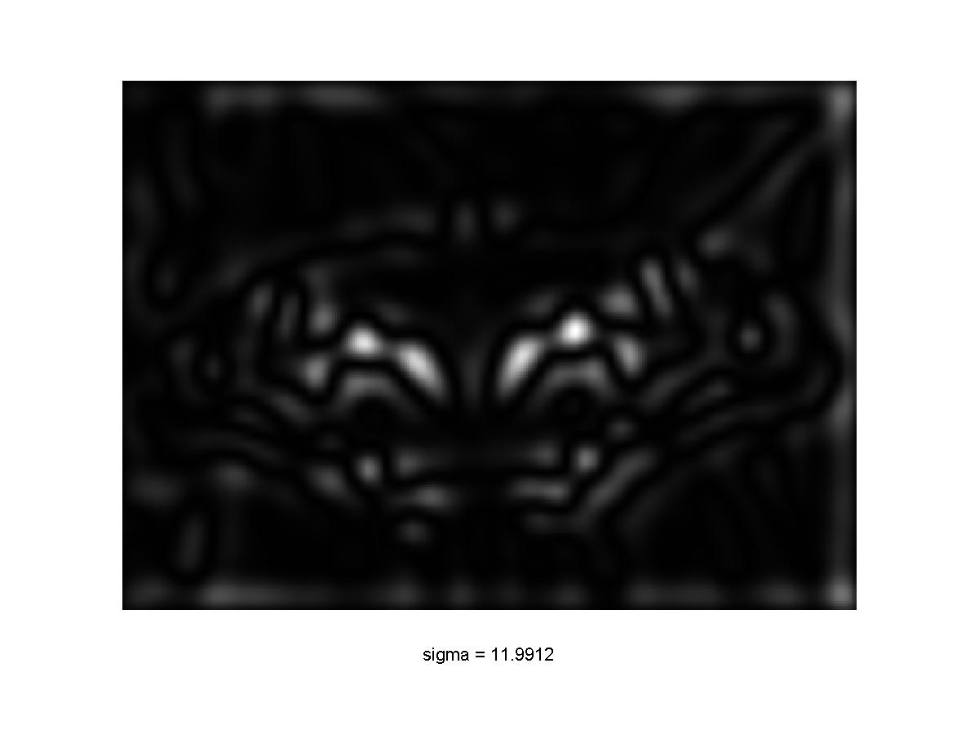
Scale-space blob detector: Example
Slide by Svetlana Lazebnik

Slide 35
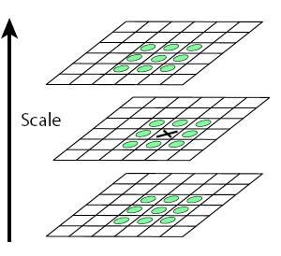
Scale-space blob detector
Convolve image with scale-normalized Laplacian at several scales
Find maxima of squared Laplacian response in scale-space
Slide by Svetlana Lazebnik

Slide 36
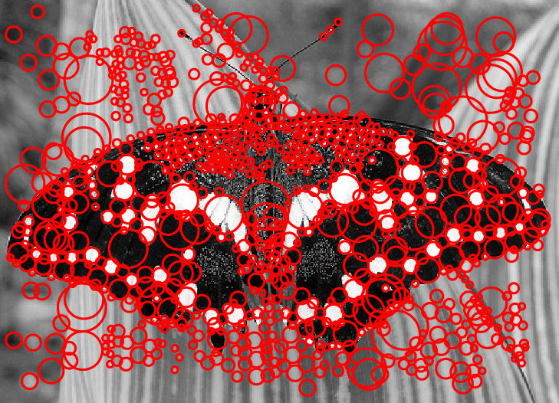
Scale-space blob detector: Example
Slide by Svetlana Lazebnik

Slide 37
Eliminating edge responses
Laplacian has strong response along edge
Slide by Svetlana Lazebnik

Slide 38
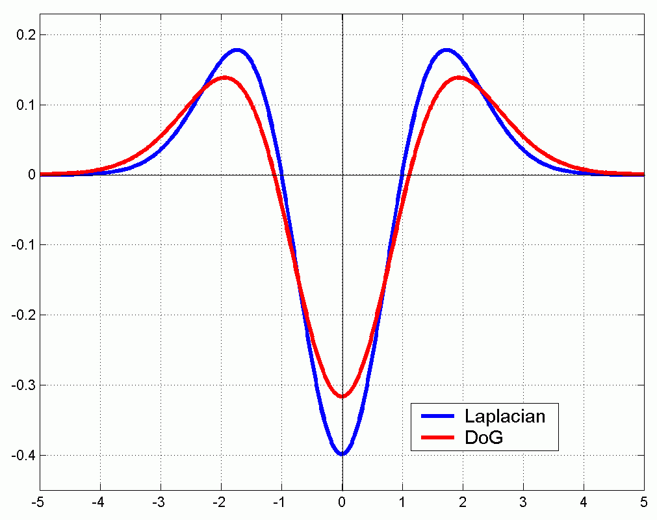
Efficient implementation
Approximating the Laplacian with a difference of Gaussians:
(Laplacian)
(Difference of Gaussians)
Slide by Svetlana Lazebnik

Slide 39
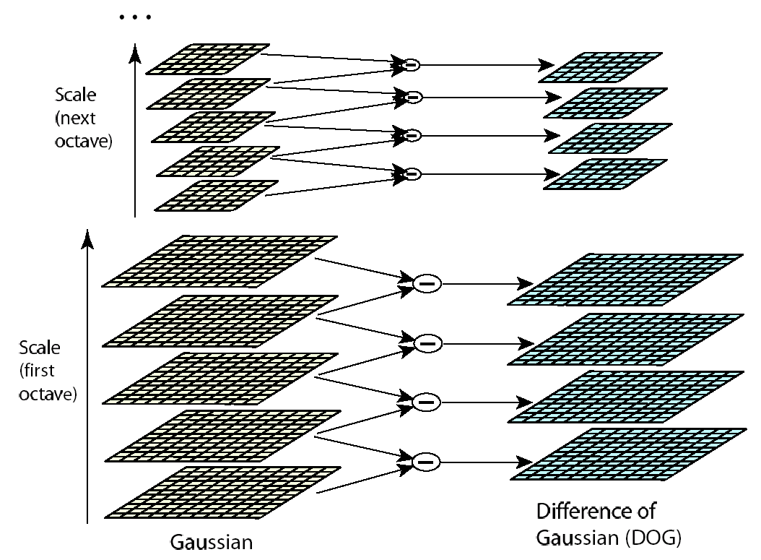
Efficient implementation
David G. Lowe. "Distinctive image features from scale-invariant keypoints.” IJCV 60 (2), pp. 91-110, 2004.

Slide 40
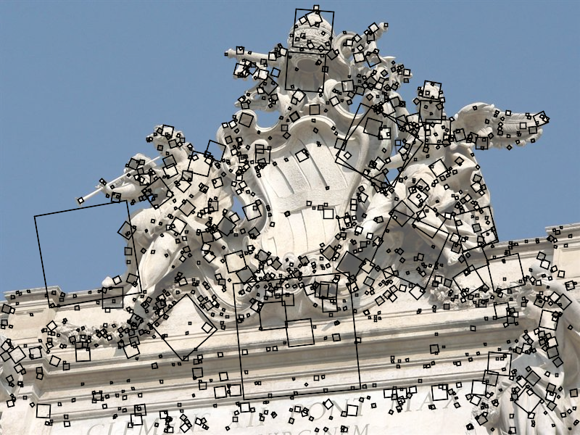
SIFT keypoint detection
D. Lowe, Distinctive image features from scale-invariant keypoints, IJCV 60 (2), pp. 91-110, 2004.

Slide 41
Questions?

