Slide 1
Hough Transform and RANSAC
Various slides from previous courses by:
D.A. Forsyth (Berkeley / UIUC), I. Kokkinos (Ecole Centrale / UCL). S. Lazebnik (UNC / UIUC), S. Seitz (MSR / Facebook), J. Hays (Brown / Georgia Tech), A. Berg (Stony Brook / UNC), D. Samaras (Stony Brook) . J. M. Frahm (UNC), V. Ordonez (UVA).

Slide 2
Last Class
Interest Points (DoG extrema operator)
SIFT Feature descriptor
Feature matching

Slide 3
Today’s Class
Line Detection using the Hough Transform
Least Squares / Hough Transform / RANSAC

Slide 4

Line Detection
Pixels in input image
$$y=β_{1}x+β_{0}$$
Have you encountered this problem before?

Slide 5







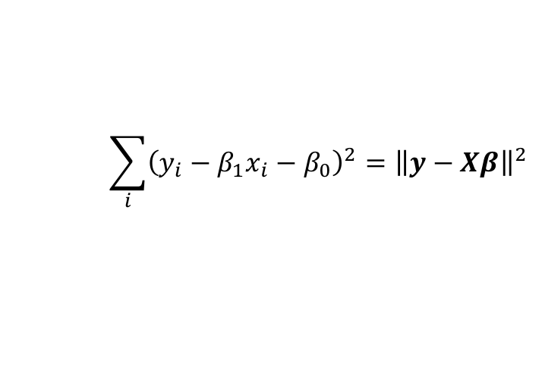
Line Detection – Least Squares Regression
$$(x_{5},y_{5})$$
$$(x_{4},y_{4})$$
$$(x_{3},y_{3})$$
$$(x_{2},y_{2})$$
$$(x_{1},y_{1})$$
$$(x_{0},y_{0})$$
Pixels in input image
$$y=β_{1}x+β_{0}$$
Have you encountered this problem before?
Find betas that minimize:
$$\sum_{i}{{\left(y_{i}−β_{1}x_{i}−β_{0}\right)}^{2}}={\left\|y−Xβ\right\|}^{2}$$
Solution:
$$β={\left(X^{T}X\right)}^{−1}X^{T}y$$

Slide 6
However Least Squares is not Ideal under Outliers
Pixels in input image

Slide 7
Solution: Voting schemes
Let each feature vote for all the models that are compatible with it
Hopefully the noise features will not vote consistently for any single model
Missing data doesn’t matter as long as there are enough features remaining to agree on a good model
Slides by Svetlana Lazebnik

Slide 8
Hough transform
An early type of voting scheme
General outline:
  Discretize parameter space into bins
  For each feature point in the image, put a vote in every bin in the parameter space that could have generated this point
  Find bins that have the most votes
Image space
Hough parameter space
P.V.C. Hough, Machine Analysis of Bubble Chamber Pictures, Proc. Int. Conf. High Energy Accelerators and Instrumentation, 1959
Slides by Svetlana Lazebnik

Slide 9
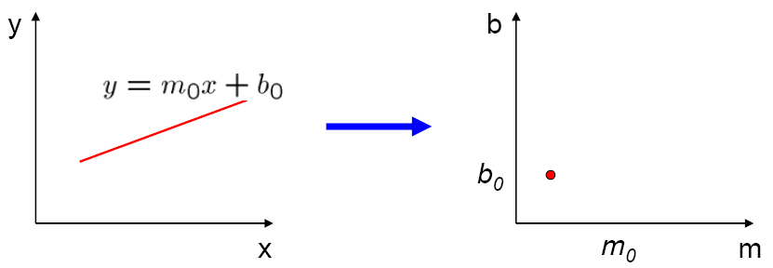
Parameter space representation
A line in the image corresponds to a point in Hough space
Image space
Hough parameter space
Source: S. Seitz

Slide 10
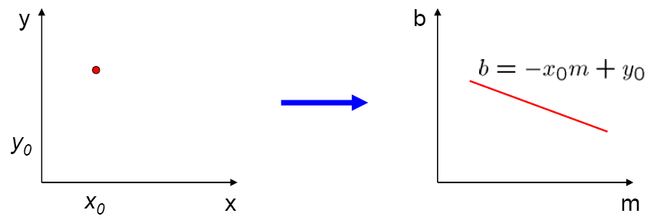
Parameter space representation
What does a point (x₀, y₀) in the image space map to in the Hough space?
Image space
Hough parameter space

Slide 11
Parameter space representation
What does a point (x₀, y₀) in the image space map to in the Hough space?
  Answer: the solutions of b = –x₀m + y₀
  This is a line in Hough space
Image space
Hough parameter space

Slide 12
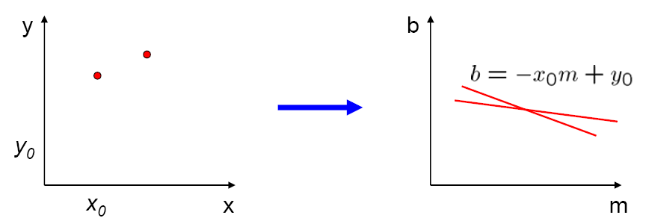
Parameter space representation
Where is the line that contains both (x₀, y₀) and (x₁, y₁)?
Image space
Hough parameter space
(x₁, y₁)
(x₀, y₀)
b = –x₁m + y₁

Slide 13
Parameter space representation
Where is the line that contains both (x₀, y₀) and (x₁, y₁)?
  It is the intersection of the lines b = –x₀m + y₀ and b = –x₁m + y₁
Image space
Hough parameter space
(x₁, y₁)
(x₀, y₀)
b = –x₁m + y₁

Slide 14
Parameter space representation
Problems with the (m,b) space:
  Unbounded parameter domains
  Vertical lines require infinite m

Slide 15
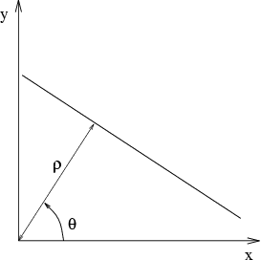
Parameter space representation
Problems with the (m,b) space:
  Unbounded parameter domains
  Vertical lines require infinite m
Alternative: polar representation
Each point (x,y) will add a sinusoid in the (θ,ρ) parameter space

Slide 16
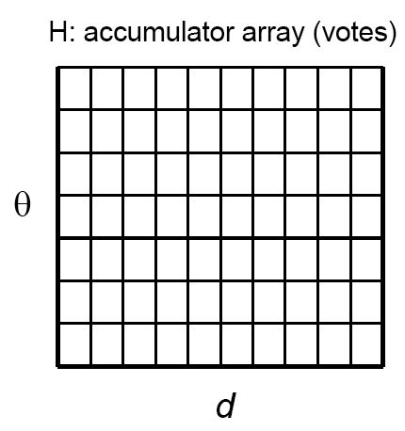
Algorithm outline
Initialize accumulator H to all zeros
For each feature point (x,y)
in the image
For θ = 0 to 180
ρ = x cos θ + y sin θ
H(θ, ρ) = H(θ, ρ) + 1
end
end
Find the value(s) of (θ, ρ) where H(θ, ρ) is a local maximum
  The detected line in the image is given by
  ρ = x cos θ + y sin θ
ρ
θ
Slide by Svetlana Lazebnik

Slide 17
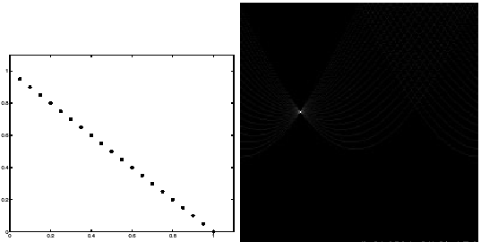
Basic illustration
features
votes
Notes:
Figure 15.1, top half. Note that most points in the vote array are very dark, because they
get only one vote.

Slide 18
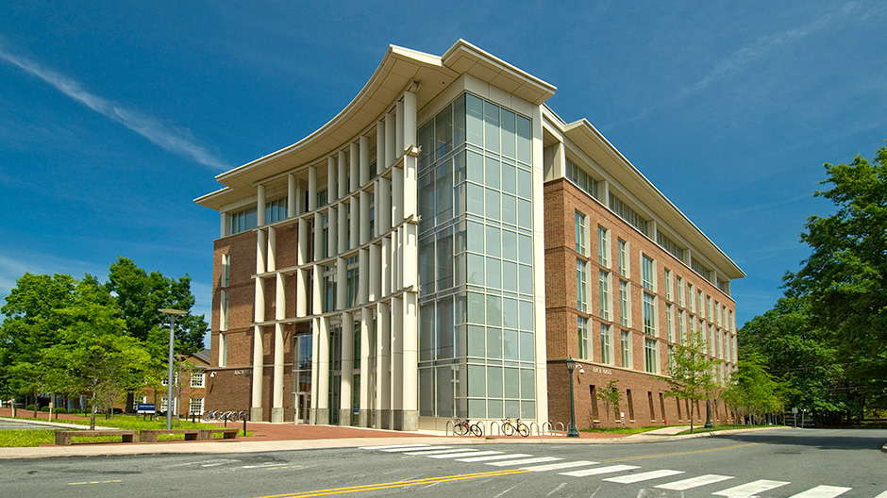
Hough Transform for an Actual Image

Slide 19
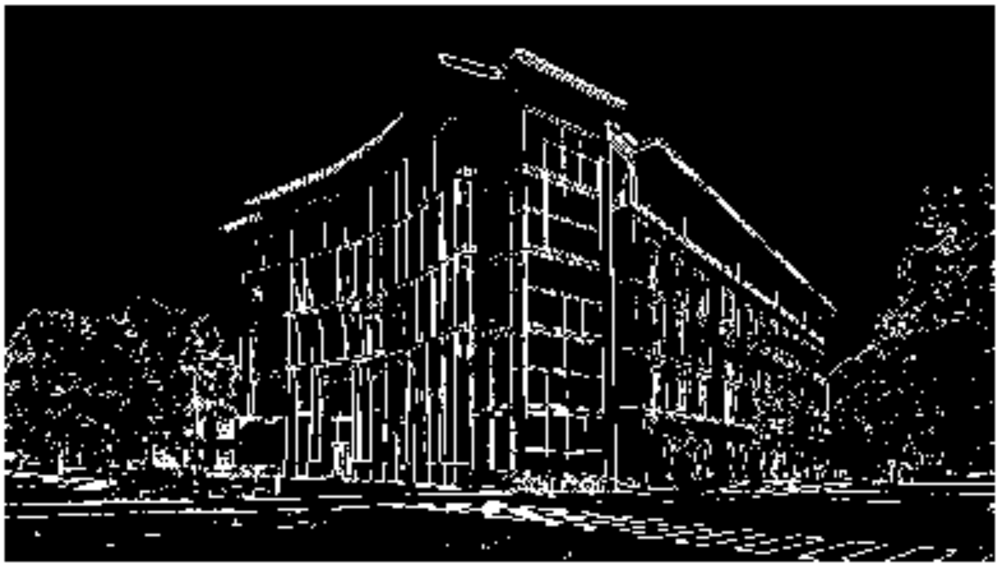
Edges using threshold on Sobel’s magnitude

Slide 20
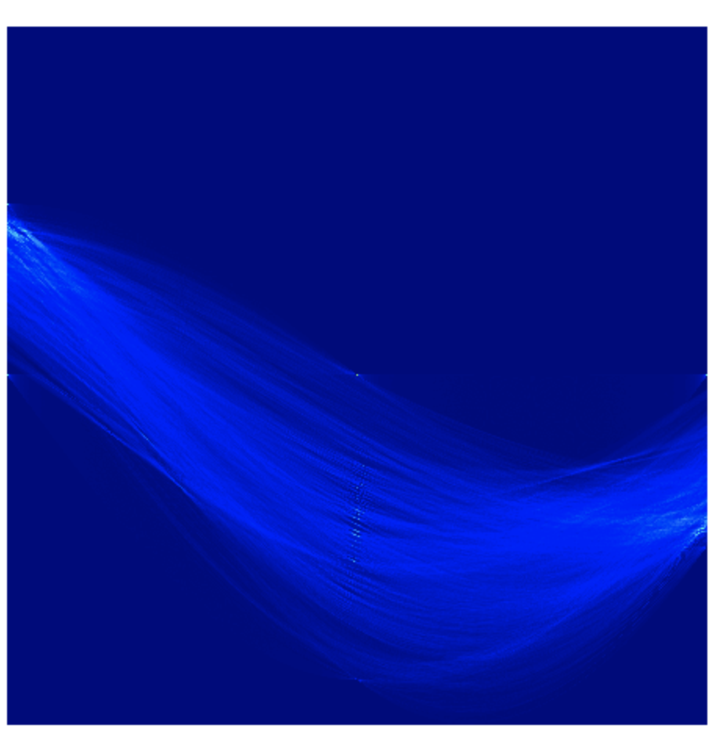






Hough Transform (High Resolution)
$$ρ=−\sqrt{h^{2}+w^{2}}$$
$$ρ=0$$
$$ρ=\sqrt{h^{2}+w^{2}}$$
$$θ=−{90}^{0}$$
$$θ=0$$
$$θ={90}^{0}$$

Slide 21
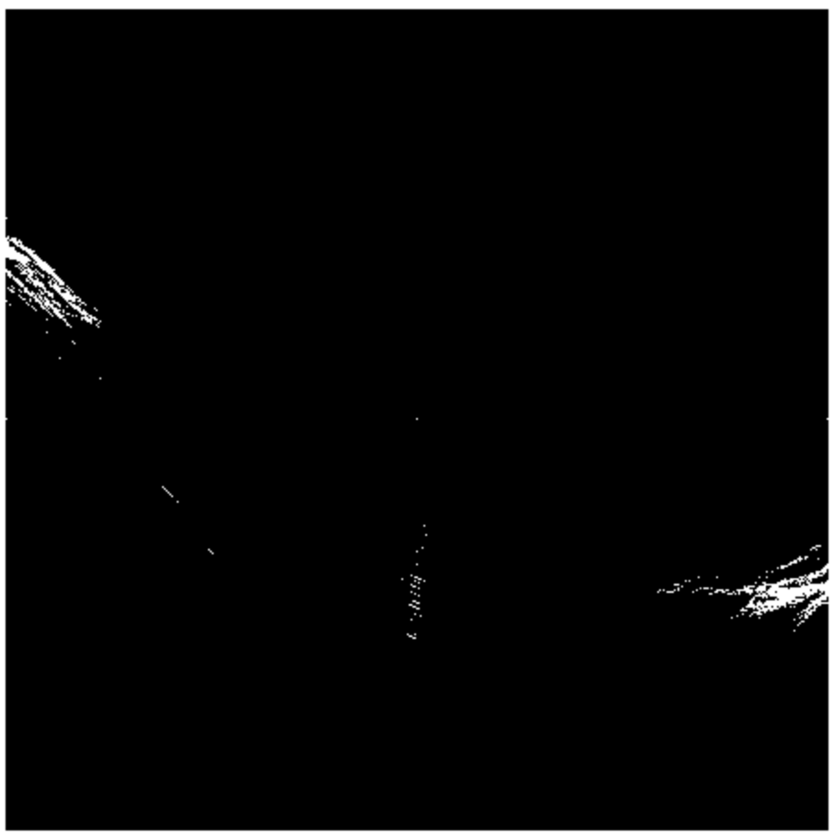
Hough Transform (After threshold)
$$ρ=−\sqrt{h^{2}+w^{2}}$$
$$ρ=0$$
$$ρ=\sqrt{h^{2}+w^{2}}$$
$$θ=−{90}^{0}$$
$$θ=0$$
$$θ={90}^{0}$$

Slide 22
Hough Transform (After threshold)
$$ρ=−\sqrt{h^{2}+w^{2}}$$
Vertical lines
$$ρ=0$$
$$ρ=\sqrt{h^{2}+w^{2}}$$
$$θ=−{90}^{0}$$
$$θ=0$$
$$θ={90}^{0}$$

Slide 23
Hough Transform (After threshold)
$$ρ=−\sqrt{h^{2}+w^{2}}$$
Vertical lines
$$ρ=0$$
$$ρ=\sqrt{h^{2}+w^{2}}$$
$$θ=−{90}^{0}$$
$$θ=0$$
$$θ={90}^{0}$$

Slide 24
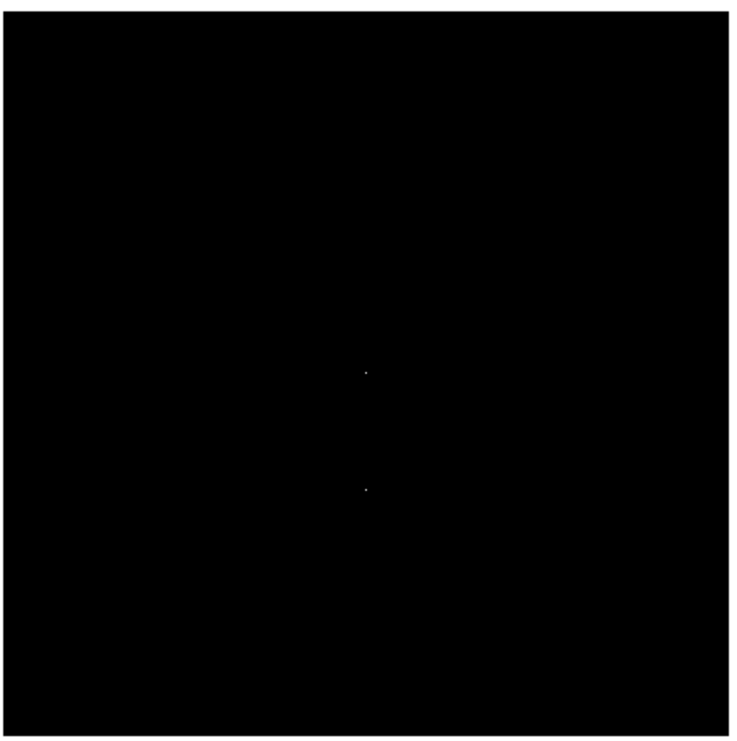
Hough Transform with Non-max Suppression
$$ρ=−\sqrt{h^{2}+w^{2}}$$
$$ρ=0$$
$$ρ=\sqrt{h^{2}+w^{2}}$$
$$θ=−{90}^{0}$$
$$θ=0$$
$$θ={90}^{0}$$

Slide 25
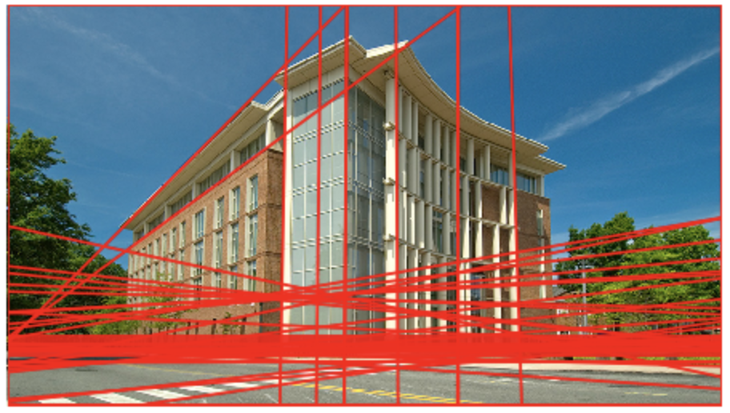
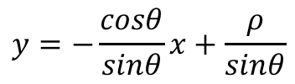
Back to Image Space – with lines detected
$$y=−\frac{cosθ}{sinθ}x+\frac{ρ}{sinθ}$$

Slide 26
Hough transform demo

Slide 27



Incorporating image gradients
Recall: when we detect an
edge point, we also know its
gradient direction
But this means that the line
is uniquely determined!
Modified Hough transform:
For each edge point (x,y)
θ = gradient orientation at (x,y)
ρ = x cos θ + y sin θ
H(θ, ρ) = H(θ, ρ) + 1
end
Slide by Svetlana Lazebnik

Slide 28
Hough transform for circles
image space
Hough parameter space
r
y
(x,y)
x
x
y
Slide by Svetlana Lazebnik

Slide 29
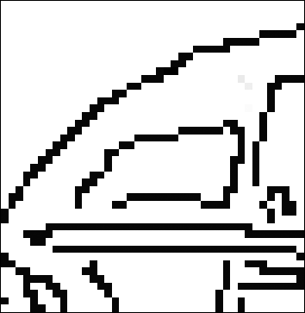
Hough transform for circles
Conceptually equivalent procedure: for each (x,y,r), draw the corresponding circle in the image and compute its “support”
r
x
y
Is this more or less efficient than voting with features?
Slide by Svetlana Lazebnik

Slide 30
RANSAC – Random Sample Consensus
Another Voting Scheme
Idea: Maybe you do not need to have all samples have a vote.
  Only a random subset of samples (points) vote.

Slide 31

Generalized Hough Transform
You can make voting work for any type of shape / geometrical configuration. Even irregular ones.
visual codeword with
displacement vectors
training image
B. Leibe, A. Leonardis, and B. Schiele, Combined Object Categorization and Segmentation with an Implicit Shape Model, ECCV Workshop on Statistical Learning in Computer Vision 2004

Slide 32
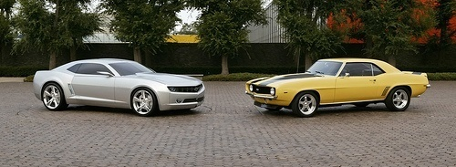
Generalized Hough Transform
You can make voting work for any type of shape / geometrical configuration. Even irregular ones.
test image
B. Leibe, A. Leonardis, and B. Schiele, Combined Object Categorization and Segmentation with an Implicit Shape Model, ECCV Workshop on Statistical Learning in Computer Vision 2004

Slide 33
RANSAC
_{(RANdom SAmple Consensus) :}
Fischler & Bolles in ‘81.
Algorithm:
Sample (randomly) the number of points required to fit the model
Solve for model parameters using samples
Score by the fraction of inliers within a preset threshold of the model
Repeat 1-3 until the best model is found with high confidence
Notes:
Let me give you an intuition of what is going on. Suppose we have the standard line fitting problem in presence of outliers.
We can formulate this problem as follows: want to find the best partition of points in inlier set and outlier set such that…
The objective consists of adjusting the parameters of a model function so as to best fit a data set.
"best" is defined by a function f that needs to be minimized.
Such that the best parameter of fitting the line give rise to a residual error lower that delta
as when the sum, S, of squared residuals

Slide 34
RANSAC
Line fitting example
Algorithm:
Sample (randomly) the number of points required to fit the model (#=2)
Solve for model parameters using samples
Score by the fraction of inliers within a preset threshold of the model
Repeat 1-3 until the best model is found with high confidence
Illustration by Savarese
Notes:
Let me give you an intuition of what is going on. Suppose we have the standard line fitting problem in presence of outliers.
We can formulate this problem as follows: want to find the best partition of points in inlier set and outlier set such that…
The objective consists of adjusting the parameters of a model function so as to best fit a data set.
"best" is defined by a function f that needs to be minimized.
Such that the best parameter of fitting the line give rise to a residual error lower that delta
as when the sum, S, of squared residuals

Slide 35
RANSAC
Line fitting example
Algorithm:
Sample (randomly) the number of points required to fit the model (#=2)
Solve for model parameters using samples
Score by the fraction of inliers within a preset threshold of the model
Repeat 1-3 until the best model is found with high confidence
Notes:
Let me give you an intuition of what is going on. Suppose we have the standard line fitting problem in presence of outliers.
We can formulate this problem as follows: want to find the best partition of points in inlier set and outlier set such that…
The objective consists of adjusting the parameters of a model function so as to best fit a data set.
"best" is defined by a function f that needs to be minimized.
Such that the best parameter of fitting the line give rise to a residual error lower that delta
as when the sum, S, of squared residuals

Slide 36
RANSAC
Line fitting example
Algorithm:
Sample (randomly) the number of points required to fit the model (#=2)
Solve for model parameters using samples
Score by the fraction of inliers within a preset threshold of the model
Repeat 1-3 until the best model is found with high confidence
Notes:
Let me give you an intuition of what is going on. Suppose we have the standard line fitting problem in presence of outliers.
We can formulate this problem as follows: want to find the best partition of points in inlier set and outlier set such that…
The objective consists of adjusting the parameters of a model function so as to best fit a data set.
"best" is defined by a function f that needs to be minimized.
Such that the best parameter of fitting the line give rise to a residual error lower that delta
as when the sum, S, of squared residuals

Slide 37
RANSAC
Algorithm:
Sample (randomly) the number of points required to fit the model (#=2)
Solve for model parameters using samples
Score by the fraction of inliers within a preset threshold of the model
Repeat 1-3 until the best model is found with high confidence
Notes:
Let me give you an intuition of what is going on. Suppose we have the standard line fitting problem in presence of outliers.
We can formulate this problem as follows: want to find the best partition of points in inlier set and outlier set such that…
The objective consists of adjusting the parameters of a model function so as to best fit a data set.
"best" is defined by a function f that needs to be minimized.
Such that the best parameter of fitting the line give rise to a residual error lower that delta
as when the sum, S, of squared residuals

Slide 38
How to choose parameters?
Number of samples N
  Choose N so that, with probability p, at least one random sample is free from outliers (e.g. p=0.99) (outlier ratio: e )
Number of sampled points s
  Minimum number needed to fit the model
Distance threshold δ
  Choose δ so that a good point with noise is likely (e.g., prob=0.95) within threshold
  Zero-mean Gaussian noise with std. dev. σ: t²=3.84σ²
 | proportion of outliers e
s | 5% | 10% | 20% | 25% | 30% | 40% | 50%
2 | 2 | 3 | 5 | 6 | 7 | 11 | 17
3 | 3 | 4 | 7 | 9 | 11 | 19 | 35
4 | 3 | 5 | 9 | 13 | 17 | 34 | 72
5 | 4 | 6 | 12 | 17 | 26 | 57 | 146
6 | 4 | 7 | 16 | 24 | 37 | 97 | 293
7 | 4 | 8 | 20 | 33 | 54 | 163 | 588
8 | 5 | 9 | 26 | 44 | 78 | 272 | 1177
For p = 0.99
modified from M. Pollefeys

Slide 39
RANSAC conclusions
Good
Robust to outliers
Applicable for larger number of model parameters than Hough transform
Optimization parameters are easier to choose than Hough transform
Bad
Computational time grows quickly with fraction of outliers and number of parameters
Not good for getting multiple fits
Common applications
Computing a homography (e.g., image stitching)
Estimating fundamental matrix (relating two views)

Slide 40
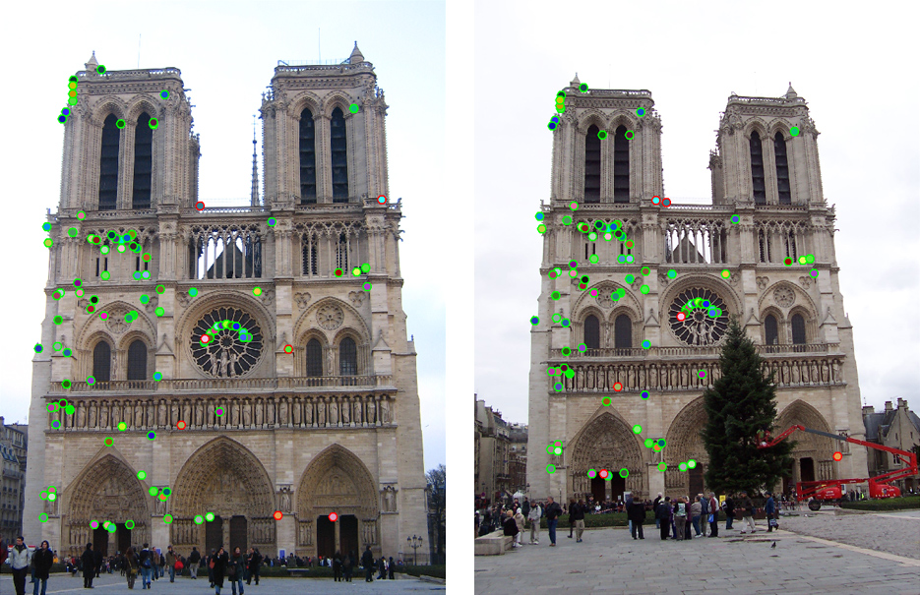
How do we fit the best alignment?
How many points do you need?

Slide 41
Questions?

