Slide 1
Camera Calibration and Stereo
Various slides from previous courses by:
D.A. Forsyth (Berkeley / UIUC), I. Kokkinos (Ecole Centrale / UCL). S. Lazebnik (UNC / UIUC), S. Seitz (MSR / Facebook), J. Hays (Brown / Georgia Tech), A. Berg (Stony Brook / UNC), D. Samaras (Stony Brook) . J. M. Frahm (UNC), V. Ordonez (UVA).

Slide 2
Last Class
Line Detection using the Hough Transform
Least Squares / Hough Transform / RANSAC

Slide 3
Today’s Class
Camera Calibration
Stereo Vision

Slide 4
Hough transform
An early type of voting scheme
General outline:
  Discretize parameter space into bins
  For each feature point in the image, put a vote in every bin in the parameter space that could have generated this point
  Find bins that have the most votes
Image space
Hough parameter space
P.V.C. Hough, Machine Analysis of Bubble Chamber Pictures, Proc. Int. Conf. High Energy Accelerators and Instrumentation, 1959
Slide by Svetlana Lazebnik

Slide 5
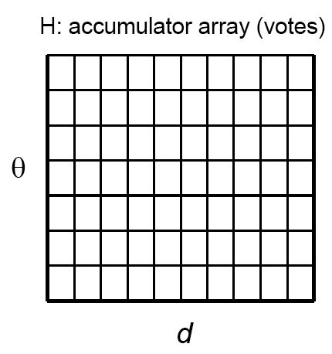
Algorithm outline
Initialize accumulator H to all zeros
For each feature point (x,y)
in the image
For θ = 0 to 180
ρ = x cos θ + y sin θ
H(θ, ρ) = H(θ, ρ) + 1
end
end
Find the value(s) of (θ, ρ) where H(θ, ρ) is a local maximum
  The detected line in the image is given by
  ρ = x cos θ + y sin θ
ρ
θ
Slide by Svetlana Lazebnik

Slide 6
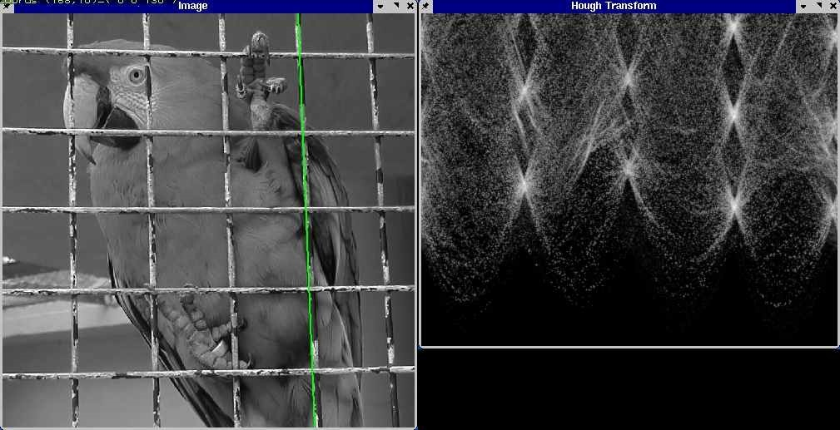
Hough Transform Example

Slide 7
RANSAC
_{(RANdom SAmple Consensus) :}
Fischler & Bolles in ‘81.
Algorithm:
Sample (randomly) the number of points required to fit the model
Solve for model parameters using samples
Score by the fraction of inliers within a preset threshold of the model
Repeat 1-3 until the best model is found with high confidence
Notes:
Let me give you an intuition of what is going on. Suppose we have the standard line fitting problem in presence of outliers.
We can formulate this problem as follows: want to find the best partition of points in inlier set and outlier set such that…
The objective consists of adjusting the parameters of a model function so as to best fit a data set.
"best" is defined by a function f that needs to be minimized.
Such that the best parameter of fitting the line give rise to a residual error lower that delta
as when the sum, S, of squared residuals

Slide 8
RANSAC
Line fitting example
Algorithm:
Sample (randomly) the number of points required to fit the model (#=2)
Solve for model parameters using samples
Score by the fraction of inliers within a preset threshold of the model
Repeat 1-3 until the best model is found with high confidence
Illustration by Savarese
Notes:
Let me give you an intuition of what is going on. Suppose we have the standard line fitting problem in presence of outliers.
We can formulate this problem as follows: want to find the best partition of points in inlier set and outlier set such that…
The objective consists of adjusting the parameters of a model function so as to best fit a data set.
"best" is defined by a function f that needs to be minimized.
Such that the best parameter of fitting the line give rise to a residual error lower that delta
as when the sum, S, of squared residuals

Slide 9
RANSAC
Line fitting example
Algorithm:
Sample (randomly) the number of points required to fit the model (#=2)
Solve for model parameters using samples
Score by the fraction of inliers within a preset threshold of the model
Repeat 1-3 until the best model is found with high confidence
Notes:
Let me give you an intuition of what is going on. Suppose we have the standard line fitting problem in presence of outliers.
We can formulate this problem as follows: want to find the best partition of points in inlier set and outlier set such that…
The objective consists of adjusting the parameters of a model function so as to best fit a data set.
"best" is defined by a function f that needs to be minimized.
Such that the best parameter of fitting the line give rise to a residual error lower that delta
as when the sum, S, of squared residuals

Slide 10
RANSAC
Line fitting example
Algorithm:
Sample (randomly) the number of points required to fit the model (#=2)
Solve for model parameters using samples
Score by the fraction of inliers within a preset threshold of the model
Repeat 1-3 until the best model is found with high confidence
Notes:
Let me give you an intuition of what is going on. Suppose we have the standard line fitting problem in presence of outliers.
We can formulate this problem as follows: want to find the best partition of points in inlier set and outlier set such that…
The objective consists of adjusting the parameters of a model function so as to best fit a data set.
"best" is defined by a function f that needs to be minimized.
Such that the best parameter of fitting the line give rise to a residual error lower that delta
as when the sum, S, of squared residuals

Slide 11
RANSAC
Algorithm:
Sample (randomly) the number of points required to fit the model (#=2)
Solve for model parameters using samples
Score by the fraction of inliers within a preset threshold of the model
Repeat 1-3 until the best model is found with high confidence
Notes:
Let me give you an intuition of what is going on. Suppose we have the standard line fitting problem in presence of outliers.
We can formulate this problem as follows: want to find the best partition of points in inlier set and outlier set such that…
The objective consists of adjusting the parameters of a model function so as to best fit a data set.
"best" is defined by a function f that needs to be minimized.
Such that the best parameter of fitting the line give rise to a residual error lower that delta
as when the sum, S, of squared residuals

Slide 12
Camera Calibration
What does it mean?

Slide 13

Slide Credit: Silvio Saverese
Recall the Projection matrix
R,T
j_{w}
k_{w}
O_{w}
i_{w}
x: Image Coordinates: (u,v,1)
K: Intrinsic Matrix (3x3)
R: Rotation (3x3)
t: Translation (3x1)
X: World Coordinates: (X,Y,Z,1)
Notes:
We can use homogeneous coordinates to write camera matrix in linear form.

Slide 14
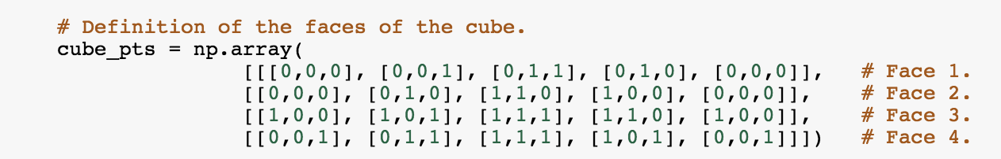
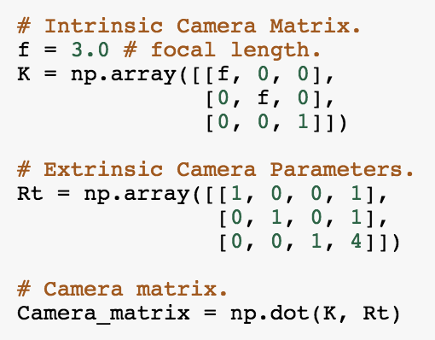


Recall the Projection matrix
$$X=$$
$$K[R t]=$$
Notes:
We can use homogeneous coordinates to write camera matrix in linear form.

Slide 15
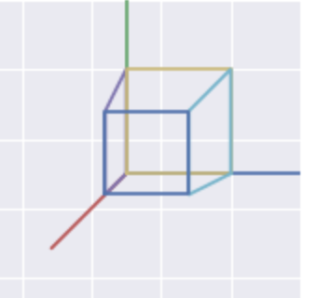

Recall the Projection matrix
$$X=$$
Goal: Find
$$x$$
$$K[R t]=$$
Notes:
We can use homogeneous coordinates to write camera matrix in linear form.

Slide 16

Camera Calibration
$$X=$$
$$x=$$
Notes:
We can use homogeneous coordinates to write camera matrix in linear form.

Slide 17

Camera Calibration
$$X=$$
Goal: Find
$$x=$$
$$K[R t]$$
Notes:
We can use homogeneous coordinates to write camera matrix in linear form.

Slide 18

Calibrating the Camera
Slide Credit: James Hays
Use an scene with known geometry
  Correspond image points to 3d points
  Get least squares solution (or non-linear solution)
Known 2d image coords
Known 3d locations
Unknown Camera Parameters

Slide 19
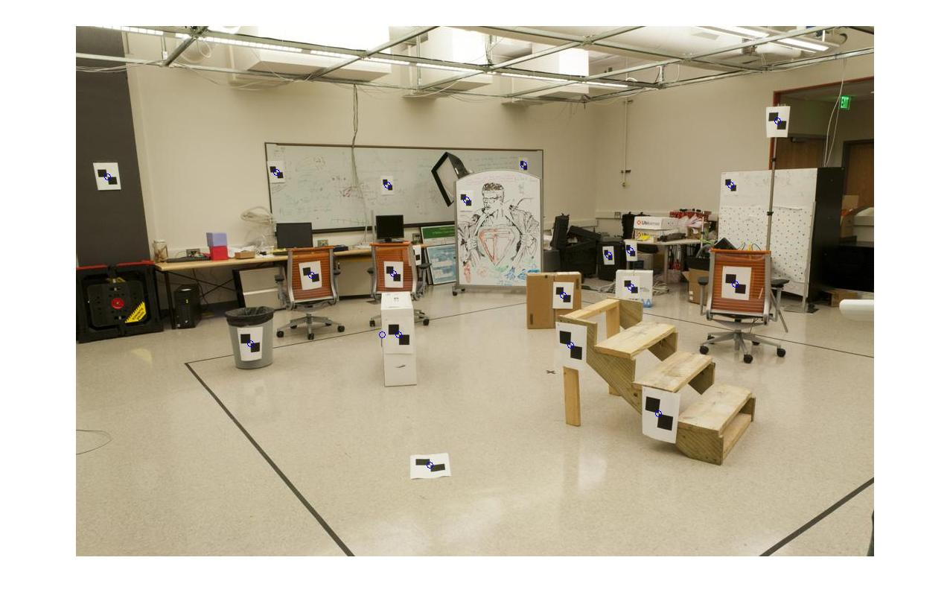
How do we calibrate a camera?
Slide Credit: James Hays
Known 2d image coords
Known 3d locations
880 214
43 203
270 197
886 347
745 302
943 128
476 590
419 214
317 335
783 521
235 427
665 429
655 362
427 333
412 415
746 351
434 415
525 234
716 308
602 187
312.747 309.140 30.086
305.796 311.649 30.356
307.694 312.358 30.418
310.149 307.186 29.298
311.937 310.105 29.216
311.202 307.572 30.682
307.106 306.876 28.660
309.317 312.490 30.230
307.435 310.151 29.318
308.253 306.300 28.881
306.650 309.301 28.905
308.069 306.831 29.189
309.671 308.834 29.029
308.255 309.955 29.267
307.546 308.613 28.963
311.036 309.206 28.913
307.518 308.175 29.069
309.950 311.262 29.990
312.160 310.772 29.080
311.988 312.709 30.514

Slide 20
Unknown Camera Parameters
Slide Credit: James Hays
Known 2d image coords
Known 3d locations

Slide 21
Unknown Camera Parameters
Slide Credit: James Hays
Known 2d image coords
Known 3d locations

Slide 22
Unknown Camera Parameters
Slide Credit: James Hays
Known 2d image coords
Known 3d locations

Slide 23
Unknown Camera Parameters
Slide Credit: James Hays
Known 2d image coords
Known 3d locations
Method 1 – homogeneous linear system. Solve for m’s entries using linear least squares
[U, S, V] = svd(A);
M = V(:,end);
M = reshape(M,[],3)';

Slide 24
Unknown Camera Parameters
Slide Credit: James Hays
Known 2d image coords
Known 3d locations
Method 2 – nonhomogeneous linear system. Solve for m’s entries using linear least squares
Ax=b form
M = A\Y;
M = [M;1];
M = reshape(M,[],3)';

Slide 25
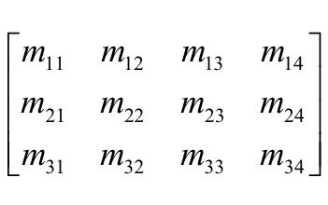
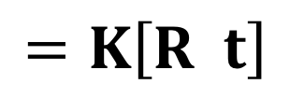
Can we factorize M back to K [R | T]?
$$=K\left[R t\right]$$
Yes!
You can use RQ factorization (note – not the more familiar QR factorization). R (right diagonal) is K, and Q (orthogonal basis) is R. T, the last column of [R | T], is inv(K) * last column of M.
  But you need to do a bit of post-processing to make sure that the matrices are valid. See http://ksimek.github.io/2012/08/14/decompose/
Credit: James Hays

Slide 26

Stereo:
Epipolar geometry
Vicente Ordonez
University of Virginia
Slides by Kristen Grauman

Slide 27
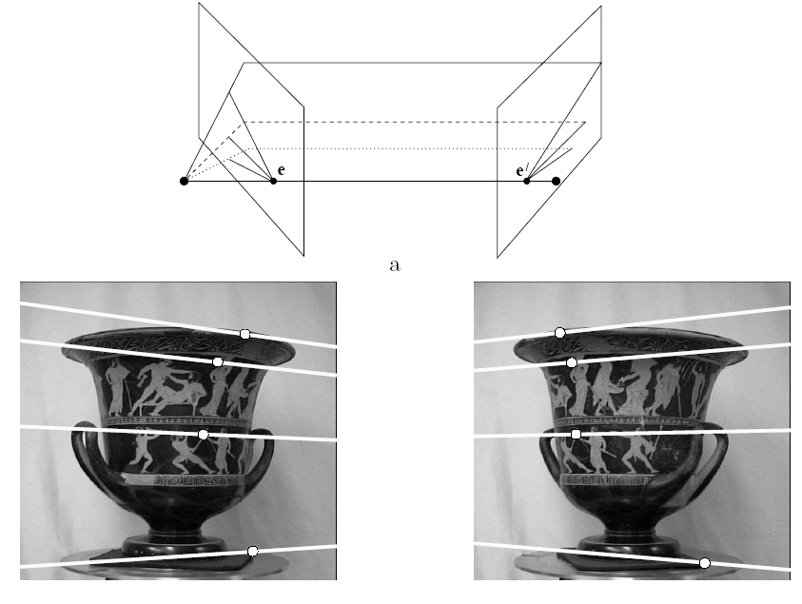
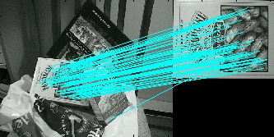
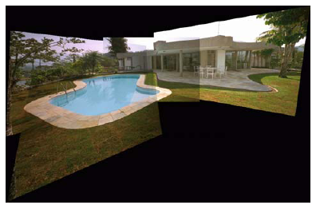
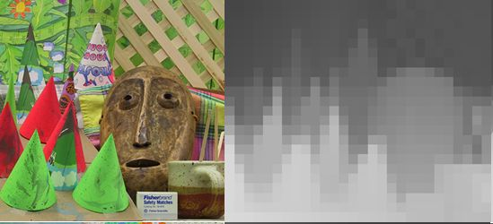
Multiple views
Multi-view geometry, matching, invariant features, stereo vision
Lowe
Hartley and Zisserman

Slide 28
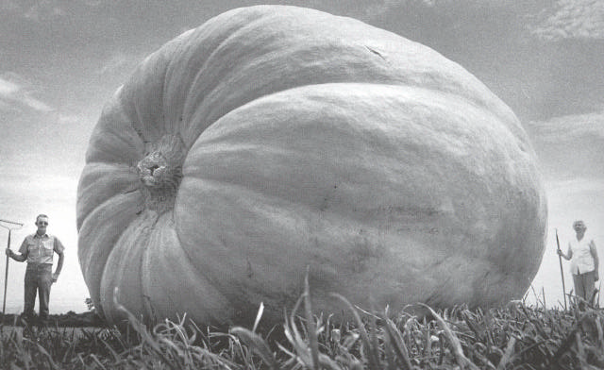
Why multiple views?
Structure and depth are inherently ambiguous from single views.
Images from Lana Lazebnik

Slide 29
Why multiple views?
Structure and depth are inherently ambiguous from single views.
P1
P2
P1’=P2’
Optical center

Slide 30
What cues help us to perceive 3d shape and depth?

Slide 31
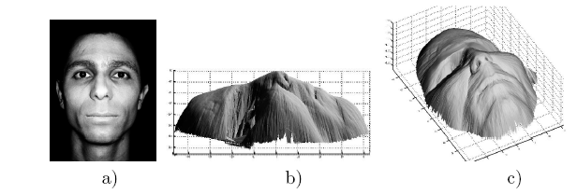
Shading
[Figure from Prados & Faugeras 2006]
Notes:
31

Slide 32
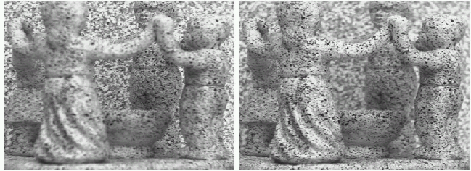
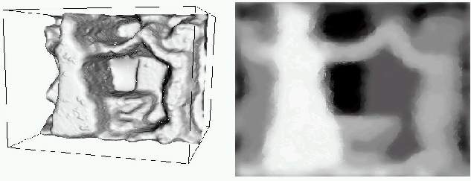
Focus/defocus
Images from same point of view, different camera parameters
3d shape / depth estimates
[figs from H. Jin and P. Favaro, 2002]

Slide 33
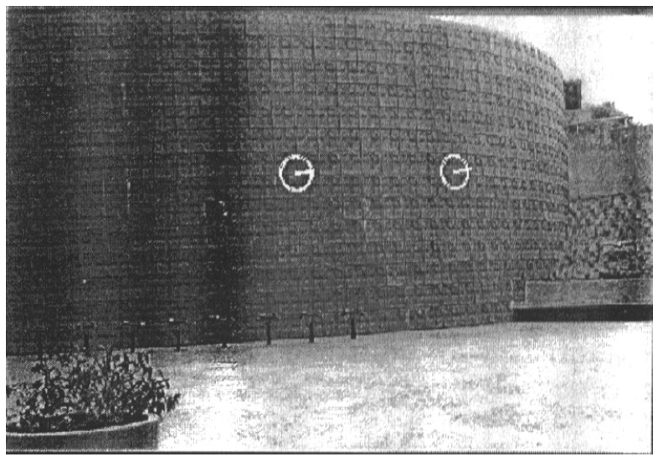
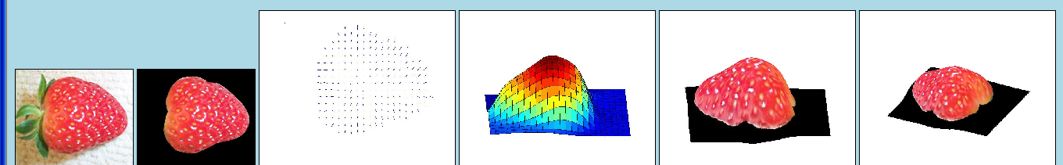
Texture
[From A.M. Loh. The recovery of 3-D structure using visual texture patterns. PhD thesis]
Notes:
33

Slide 34
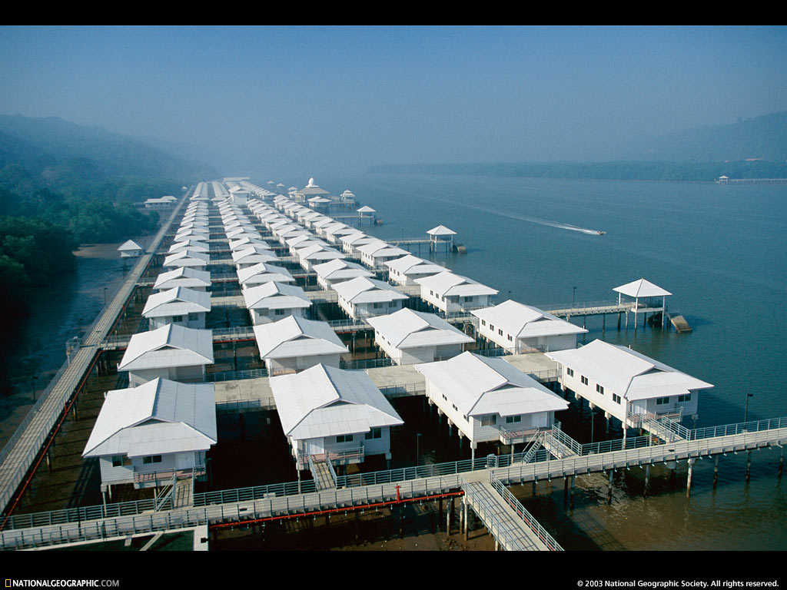
Perspective effects
Image credit: S. Seitz

Slide 35
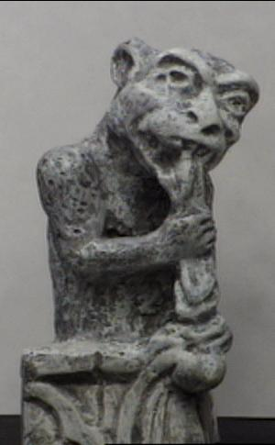
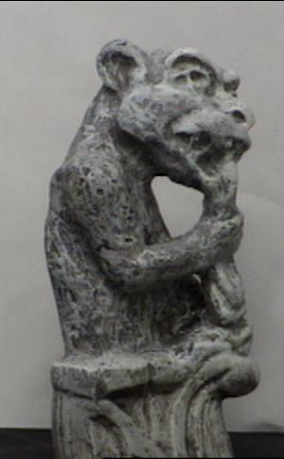
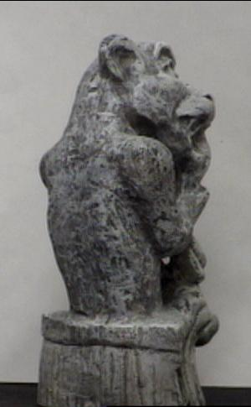
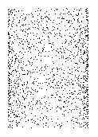
Motion
Figures from L. Zhang
http://www.brainconnection.com/teasers/?main=illusion/motion-shape

Slide 36
Estimating scene shape
“Shape from X”: Shading, Texture, Focus, Motion…
Stereo:
  shape from “motion” between two views
  infer 3d shape of scene from two (multiple) images from different viewpoints
Main idea:
scene point
image plane
optical center
Notes:
36

Slide 37
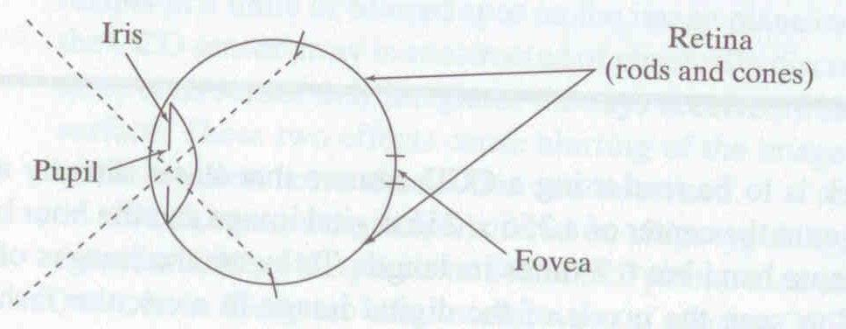
Human eye
Rough analogy with human visual system:
Pupil/Iris – control amount of light passing through lens
Retina - contains sensor cells, where image is formed
Fovea – highest concentration of cones
Fig from Shapiro and Stockman

Slide 38
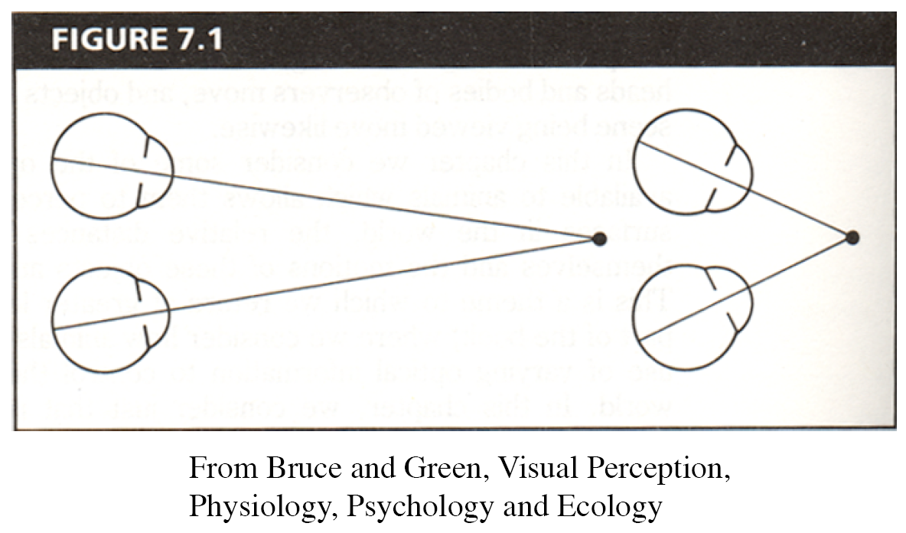
Human eyes fixate on point in space – rotate so that corresponding images form in centers of fovea.
Human stereopsis: disparity
Notes:
38

Slide 39
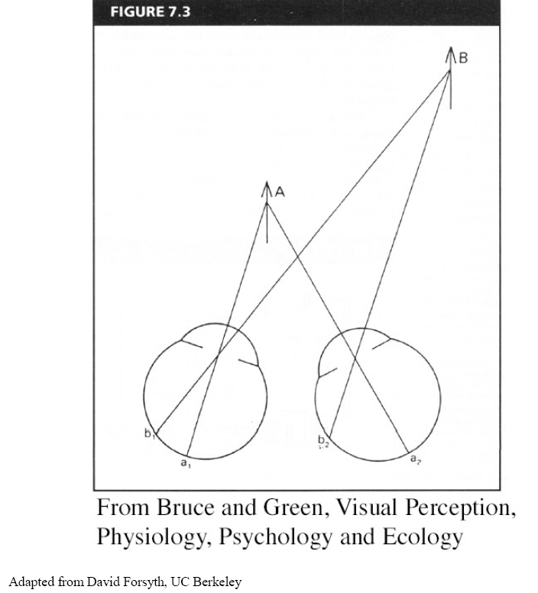
Human stereopsis: disparity
Disparity occurs when eyes fixate on one object; others appear at different visual angles
Notes:
39

Slide 40
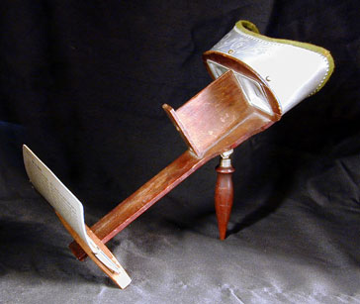
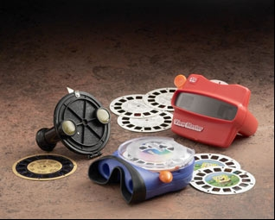
Stereo photography and stereo viewers
Take two pictures of the same subject from two slightly different viewpoints and display so that each eye sees only one of the images.
Image from fisher-price.com
Invented by Sir Charles Wheatstone, 1838

Slide 41
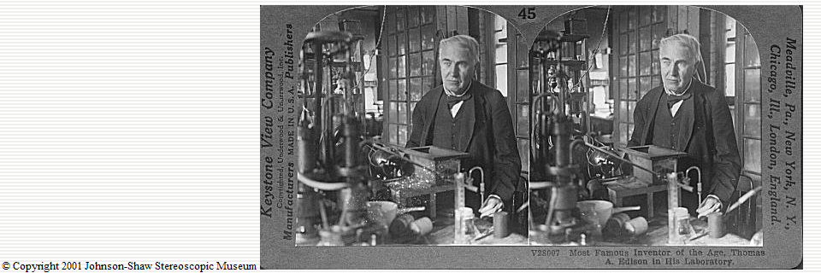
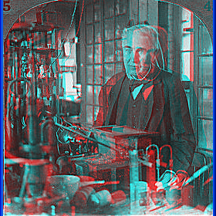
http://www.johnsonshawmuseum.org
Notes:
41

Slide 42
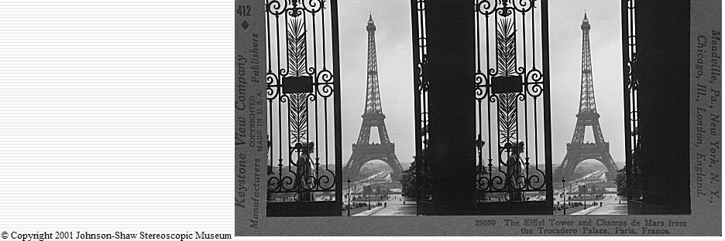
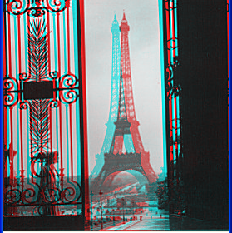
http://www.johnsonshawmuseum.org
Notes:
42

Slide 43
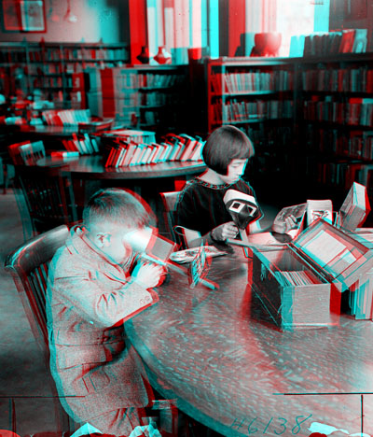

Public Library, Stereoscopic Looking Room, Chicago, by Phillips, 1923
Notes:
43

Slide 44
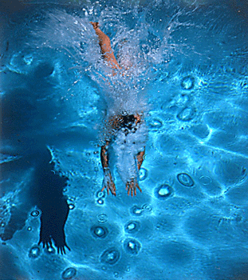
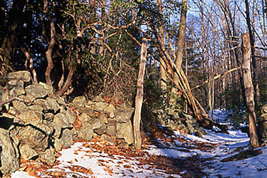
http://www.well.com/~jimg/stereo/stereo_list.html
Notes:
44

Slide 45
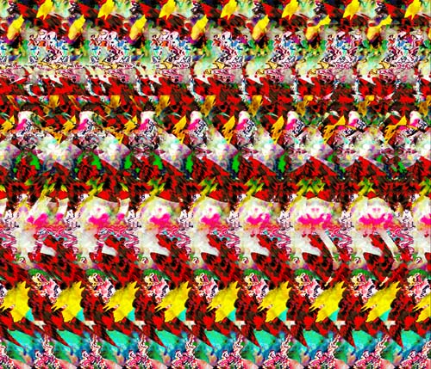
Autostereograms
Exploit disparity as depth cue using single image.
(Single image random dot stereogram, Single image stereogram)
Images from magiceye.com
Notes:
45

Slide 46
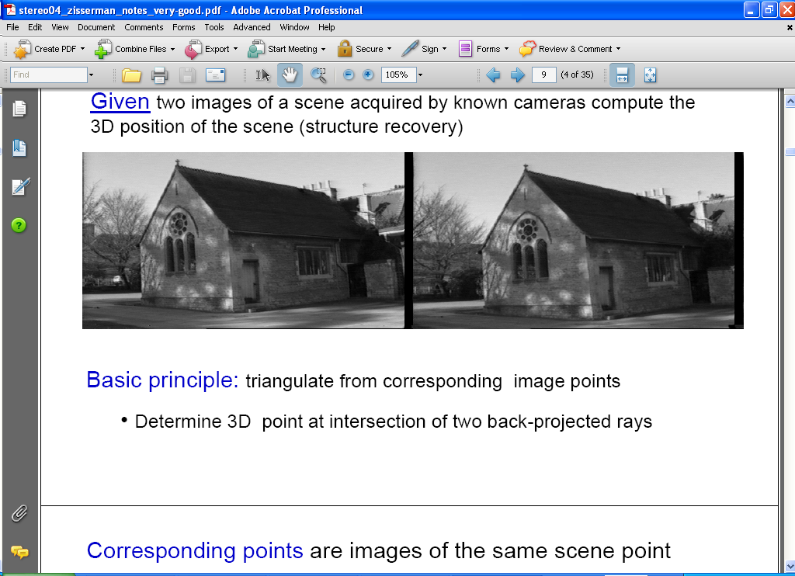
Estimating depth with stereo
Stereo: shape from “motion” between two views
We’ll need to consider:
Info on camera pose (“calibration”)
Image point correspondences
scene point
image plane
optical center
Notes:
46

Slide 47
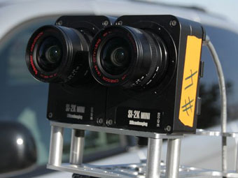
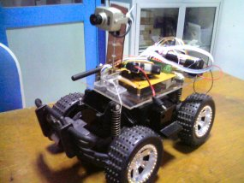
Stereo vision
Two cameras, simultaneous views
Single moving camera and static scene

Slide 48
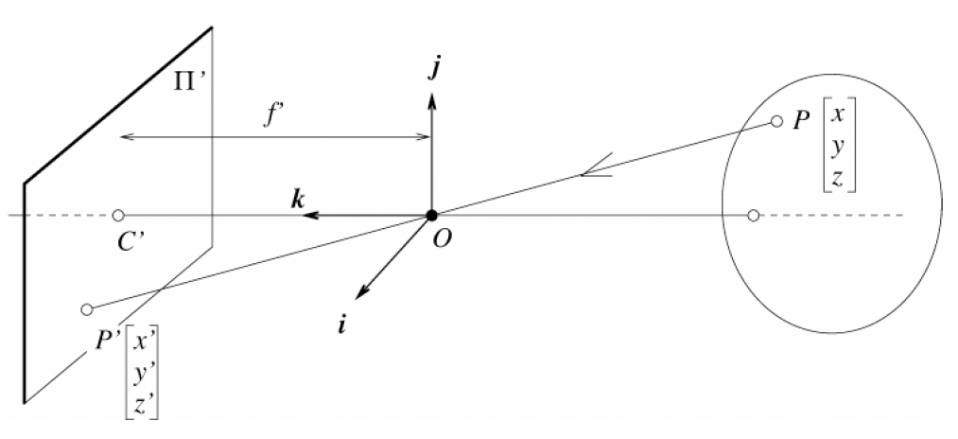
Camera parameters
Camera frame 2
Extrinsic parameters:
Camera frame 1 ←→ Camera frame 2
Intrinsic parameters:
Image coordinates relative to camera ←→ Pixel coordinates
Camera frame 1
Extrinsic params: rotation matrix and translation vector
Intrinsic params: focal length, pixel sizes (mm), image center point, radial distortion parameters
We’ll assume for now that these parameters are given and fixed.
Notes:
48

Slide 49
Geometry for a simple stereo system
First, assuming parallel optical axes, known camera parameters (i.e., calibrated cameras):

Slide 50
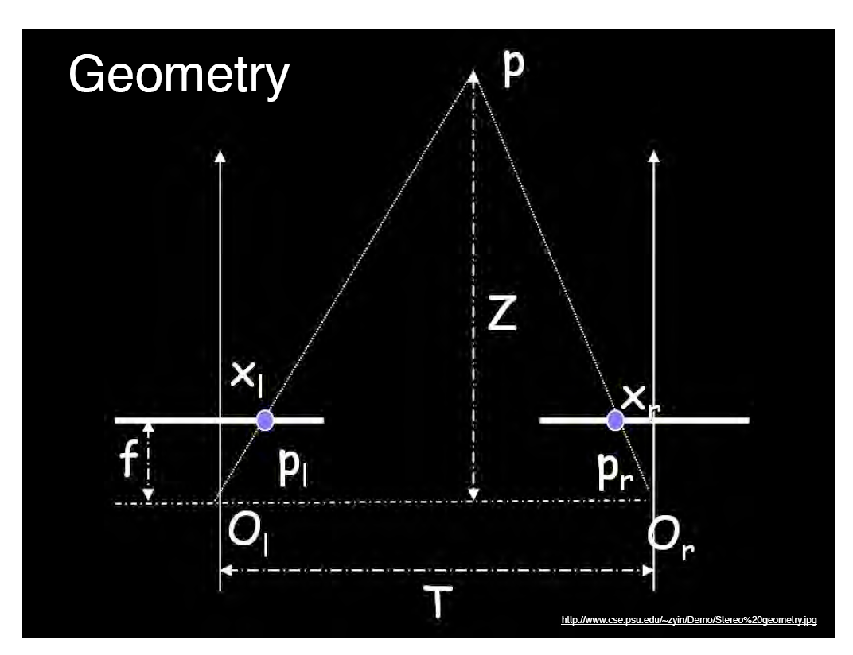
World point
Depth of p
image point (left)
image point (right)
Focal length
optical center (right)
optical center (left)
baseline
Notes:
50

Slide 51
Geometry for a simple stereo system
Assume parallel optical axes, known camera parameters (i.e., calibrated cameras). What is expression for Z?
Similar triangles (p_{l}, P, p_{r}) and (O_{l}, P, O_{r}):
disparity
Notes:
51

Slide 52


Depth from disparity
image I(x,y)
Disparity map D(x,y)
image I´(x´,y´)
(x´,y´)=(x+D(x,y), y)
So if we could find the corresponding points in two images, we could estimate relative depth…

Slide 53
Questions?

