Slide 1
Generalization + Global Image Features
Various slides from previous courses by: D.A. Forsyth (Berkeley / UIUC), I. Kokkinos (Ecole Centrale / UCL). S. Lazebnik (UNC / UIUC), S. Seitz (MSR / Facebook), J. Hays (Brown / Georgia Tech), A. Berg (Stony Brook / UNC), D. Samaras (Stony Brook) . J. M. Frahm (UNC), V. Ordonez (UVA), Steve Seitz (UW).

Slide 2
Last Class
Softmax Classifier (Linear Classifiers)
Stochastic Gradient Descent

Slide 3
Today’s Class
Generalization / Overfitting / Regularization
Global Image Features

Slide 4
Supervised Learning - Classification
Training Data
cat
$$x_{1}=[ ]$$
$$y_{1}=[ ]$$
dog
$$x_{2}=[ ]$$
$$y_{2}=[ ]$$
cat
$$x_{3}=[ ]$$
$$y_{3}=[ ]$$
.
.
.
bear
$$x_{n}=[ ]$$
$$y_{n}=[ ]$$

Slide 5
Supervised Learning - Classification
Training Data
targets /
labels /
ground truth
We need to find a function that
maps x and y for any of them.
inputs
predictions
$$x_{1}=[x_{11} { x}_{12} x_{13} { x}_{14}]$$
$$y_{1}=$$
1
$${\hat{y}}_{1}=$$
1
$$\hat{y_{i}}=f(x_{i};θ)$$
$$x_{2}=[x_{21} { x}_{22} x_{23} { x}_{24}]$$
$$y_{2}=$$
2
$${\hat{y}}_{2}=$$
2
$$x_{3}=[x_{31} { x}_{32} x_{33} { x}_{34}]$$
$$y_{3}=$$
1
$${\hat{y}}_{3}=$$
2
How do we ”learn” the parameters
of this function?
.
.
.
We choose ones that makes the
following quantity small:
$$\sum_{i=1}^{n}{Cost(\hat{y_{i}}, y_{i})}$$
$$x_{n}=[x_{n1} { x}_{n2} x_{n3} { x}_{n4}]$$
$$y_{n}=$$
3
$${\hat{y}}_{n}=$$
1

Slide 6
Supervised Learning –Softmax Classifier
Training Data
targets /
labels /
ground truth
inputs
$$x_{1}=[x_{11} { x}_{12} x_{13} { x}_{14}]$$
$$y_{1}=$$
1
$$x_{2}=[x_{21} { x}_{22} x_{23} { x}_{24}]$$
$$y_{2}=$$
2
$$x_{3}=[x_{31} { x}_{32} x_{33} { x}_{34}]$$
$$y_{3}=$$
1
.
.
.
$$x_{n}=[x_{n1} { x}_{n2} x_{n3} { x}_{n4}]$$
$$y_{n}=$$
3

Slide 7
Supervised Learning –Softmax Classifier
Training Data
targets /
labels /
ground truth
inputs
predictions
$$x_{1}=[x_{11} { x}_{12} x_{13} { x}_{14}]$$
$$y_{1}=$$
[1 0 0]
$${\hat{y}}_{1}=$$
[0.85 0.10 0.05]
$$x_{2}=[x_{21} { x}_{22} x_{23} { x}_{24}]$$
$$y_{2}=$$
[0 1 0]
$${\hat{y}}_{2}=$$
[0.20 0.70 0.10]
$$x_{3}=[x_{31} { x}_{32} x_{33} { x}_{34}]$$
$$y_{3}=$$
[1 0 0]
$${\hat{y}}_{3}=$$
[0.40 0.45 0.05]
.
.
.
$$x_{n}=[x_{n1} { x}_{n2} x_{n3} { x}_{n4}]$$
$$y_{n}=$$
[0 0 1]
$${\hat{y}}_{n}=$$
[0.40 0.25 0.35]

Slide 8
Supervised Learning –Softmax Classifier
$$x_{i}=[x_{i1} { x}_{i2} x_{i3} { x}_{i4}]$$
$$y_{i}=$$
[1 0 0]
$${\hat{y}}_{i}= [f_{c} f_{d} f_{b}]$$
$$g_{c}=w_{c1}x_{i1}+w_{c2}x_{i2}+w_{c3}x_{i3}+w_{c4}x_{i4}+b_{c}$$
$$g_{d}=w_{d1}x_{i1}+w_{d2}x_{i2}+w_{d3}x_{i3}+w_{d4}x_{i4}+b_{d}$$
$$g_{b}=w_{b1}x_{i1}+w_{b2}x_{i2}+w_{b3}x_{i3}+w_{b4}x_{i4}+b_{b}$$
$$f_{c}=e^{g_{c}}/{(e}^{g_{c}}+e^{g_{d}}+e^{g_{b}})$$
$$f_{d}=e^{g_{d}}/{(e}^{g_{c}}+e^{g_{d}}+e^{g_{b}})$$
$$f_{b}=e^{g_{b}}/{(e}^{g_{c}}+e^{g_{d}}+e^{g_{b}})$$

Slide 9
How do we find a good w and b?
$$x_{i}=[x_{i1} { x}_{i2} x_{i3} { x}_{i4}]$$
$$y_{i}=$$
[1 0 0]
$${\hat{y}}_{i}= [f_{c}(w,b) f_{d}(w,b) f_{b}(w,b)]$$
We need to find w, and b that minimize the following function L:
$$L\left(w,b\right)=\sum_{i=1}^{n}{\sum_{j=1}^{3}{−y_{i,j}log⁡({\hat{y}}_{i,j})}}$$
$$=\sum_{i=1}^{n}{−log⁡({\hat{y}}_{i,label})}$$
$$=\sum_{i=1}^{n}{−log f_{i,label}(w,b)}$$
Why?

Slide 10
Gradient Descent (GD)
Problem: expensive!
$$λ=0.01$$
$$L(w,b)=\sum_{i=1}^{n}{−log f_{i,label}(w,b)}$$
Initialize w and b randomly
for e = 0, num_epochs do
Compute:
$$dL(w,b)/dw$$
and
$$dL(w,b)/db$$
Update w:
$$w=w −λ dL(w,b)/dw$$
Update b:
$$b=b −λ dL(w,b)/db$$
Print:
$$L(w,b)$$
// Useful to see if this is becoming smaller or not.
end

Slide 11
Solution: (mini-batch) Stochastic Gradient Descent (SGD)
$$λ=0.01$$
$$l(w,b)=\sum_{i∈B}{−log f_{i,label}(w,b)}$$
Initialize w and b randomly
for e = 0, num_epochs do
B is a small
set of training
examples.
for b = 0, num_batches do
Compute:
$$dl(w,b)/dw$$
and
$$dl(w,b)/db$$
Update w:
$$w=w −λ dl(w,b)/dw$$
Update b:
$$b=b −λ dl(w,b)/db$$
Print:
$$l(w,b)$$
// Useful to see if this is becoming smaller or not.
end
end

Slide 12
Source: Andrew Ng

Slide 13
Three more things
How to compute the gradient
Regularization
Momentum updates

Slide 14
SGD Gradient for the Softmax Function

Slide 15
SGD Gradient for the Softmax Function

Slide 16
SGD Gradient for the Softmax Function

Slide 17
Supervised Learning –Softmax Classifier
$${\hat{y}}_{i}= [f_{c} f_{d} f_{b}]$$
Extract features
$$x_{i}=[x_{i1} { x}_{i2} x_{i3} { x}_{i4}]$$
Run features through classifier
$$g_{c}=w_{c1}x_{i1}+w_{c2}x_{i2}+w_{c3}x_{i3}+w_{c4}x_{i4}+b_{c}$$
$$g_{d}=w_{d1}x_{i1}+w_{d2}x_{i2}+w_{d3}x_{i3}+w_{d4}x_{i4}+b_{d}$$
$$g_{b}=w_{b1}x_{i1}+w_{b2}x_{i2}+w_{b3}x_{i3}+w_{b4}x_{i4}+b_{b}$$
Get predictions
$$f_{c}=e^{g_{c}}/{(e}^{g_{c}}+e^{g_{d}}+e^{g_{b}})$$
$$f_{d}=e^{g_{d}}/{(e}^{g_{c}}+e^{g_{d}}+e^{g_{b}})$$
$$f_{b}=e^{g_{b}}/{(e}^{g_{c}}+e^{g_{d}}+e^{g_{b}})$$

Slide 18
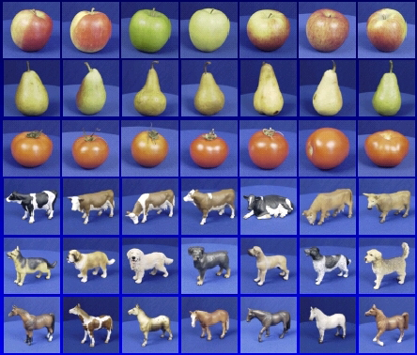
Supervised Machine Learning Steps
Training
Training Labels
Training Images
Image Features
Training
Learned model
Learned model
Testing
Image Features
Prediction
Test Image
Slide credit: D. Hoiem

Slide 19
Generalization
Generalization refers to the ability to correctly classify never before seen examples
Can be controlled by turning “knobs” that affect the complexity of the model
Test set (labels unknown)
Training set (labels known)

Slide 20
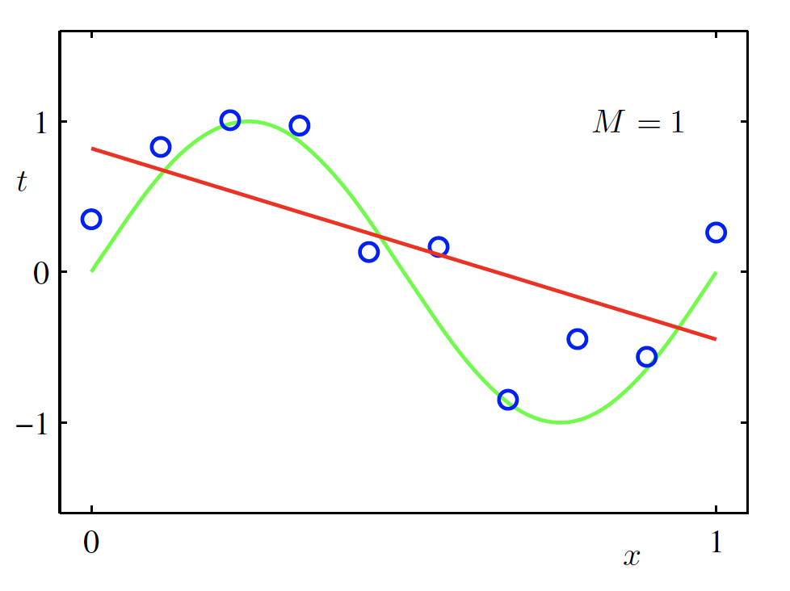
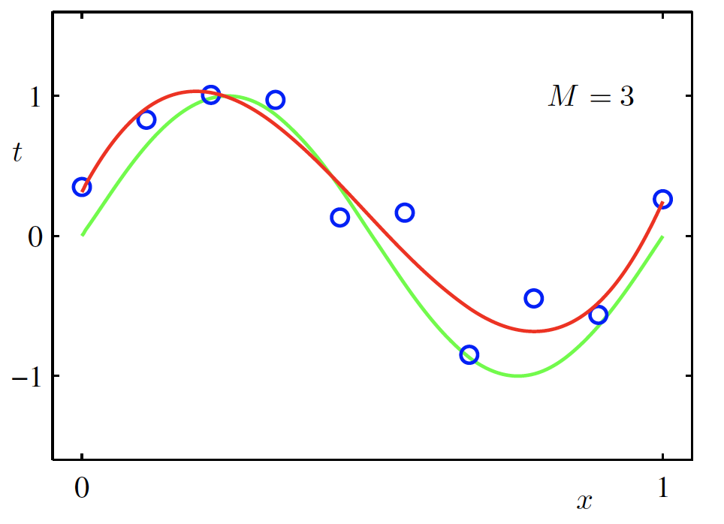
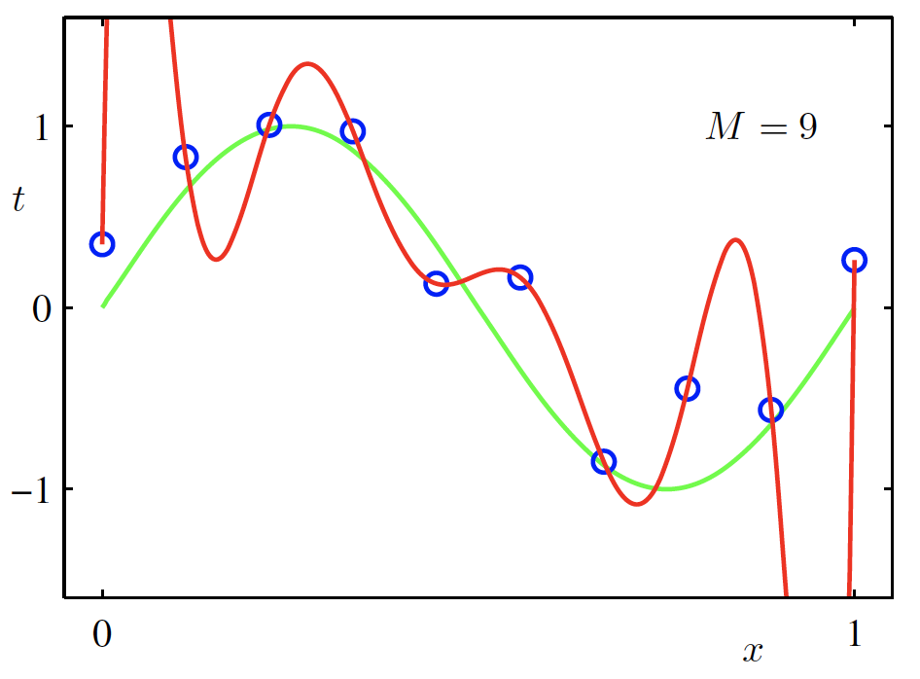
Overfitting
$f$ is a polynomial of degree 9
$f$ is linear
$f$ is cubic
$Loss\left(w\right)$ is high
$Loss\left(w\right)$ is low
$Loss\left(w\right)$ is zero!
Underfitting
Overfitting
High Bias
High Variance
Credit: C. Bishop. Pattern Recognition and Mach. Learning.

Slide 21
Pytorch: Project Assignment 4
http://vicenteordonez.com/vision/

Slide 22
Supervised Machine Learning Steps
Training
Training Labels
Training Images
Image Features
Training
Learned model
Learned model
Testing
Image Features
Prediction
Test Image
Slide credit: D. Hoiem

Slide 23
Image Features
In your Project 4: Nearest Neighbors + Softmax Classifier features are:
Feature: 3072-dim vector
Image: 3x32x32

Slide 24
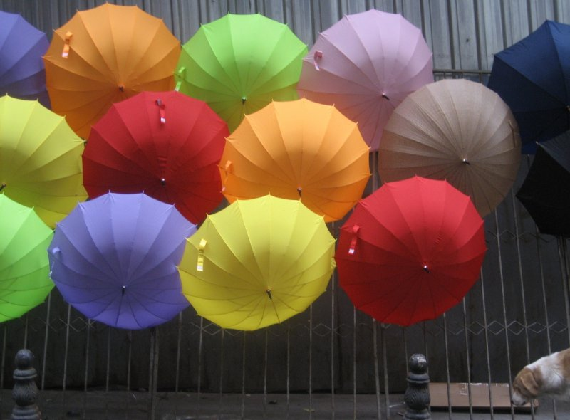
Image Features: Color
Photo by: marielito
slide by Tamara L. Berg

Slide 25
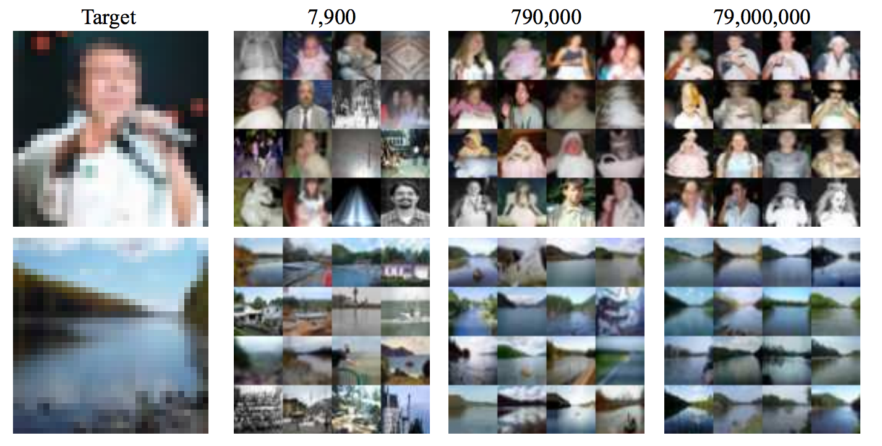
Image Features: Color

Slide 26
Image Features: Color
However, these are all images of people but the colors in each image are very different.

Slide 27
Image Features: HoG
Paper by Navneet Dalal & Bill Triggs presented at CVPR 2005 for detecting people.
Scikit-image implementation

Slide 28
Image Features: HoG
+ Block Normalization
Paper by Navneet Dalal & Bill Triggs presented at CVPR 2005 for detecting people. Figure from Zhuolin Jiang, Zhe Lin, Larry S. Davis, ICCV 2009 for human action recognition.

Slide 29
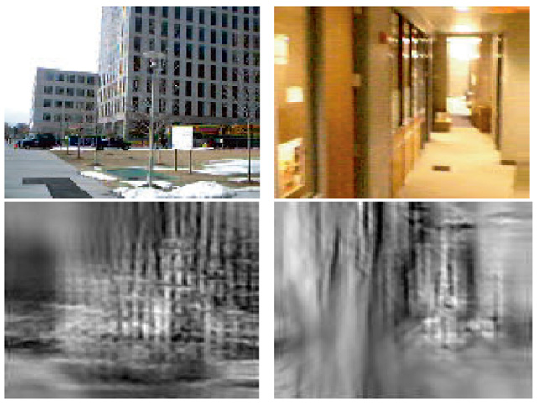
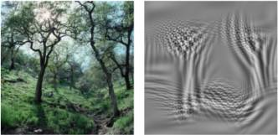
Image Features: GIST
The “gist” of a scene: Oliva & Torralba, 2001

Slide 30
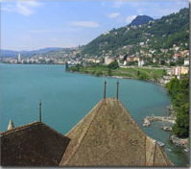
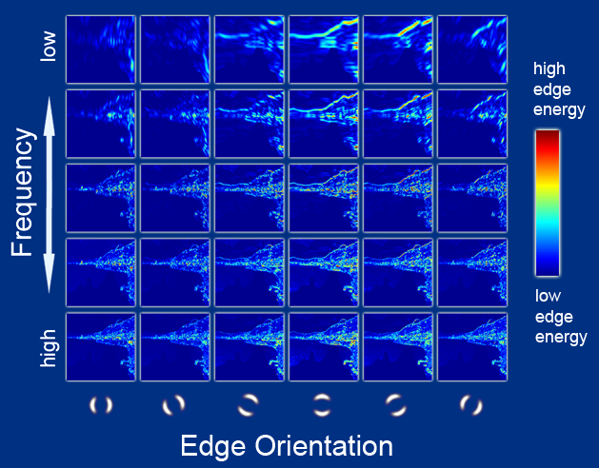
Image Features: GIST
Oriented edge response at multiple scales (5 spatial scales, 6 edge orientations)
Hays and Efros, SIGGRAPH 2007

Slide 31
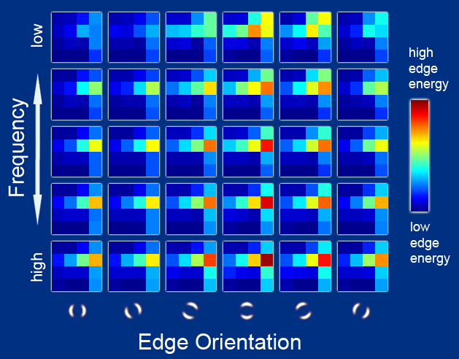
Image Features: GIST
Aggregated edge responses over 4x4 windows
Hays and Efros, SIGGRAPH 2007

Slide 32
Image Features: Bag of (Visual) Words Representation
slide by Fei-fei Li

Slide 33
slide by Fei-fei Li

Slide 34
Questions?

