Slide 1
Neural Networks + Convolutional Neural Networks

Slide 2
Last Class
Global Features
The perceptron model
Neural Networks – multilayer perceptron model (MLP)
Backpropagation

Slide 3
Today’s Class
Neural Networks – multilayer perceptron model (MLP)
Backpropagation
Convolutional Neural Networks

Slide 4
Perceptron Model
Frank Rosenblatt (1957) - Cornell University
Activation function
$$x_{1}$$
$$w_{1}$$
$$f\left(x\right)=\left\{\begin{aligned}1, if \sum_{i=0}^{n}{w_{i}x_{i}}+b>0 \\ &0, otherwise \end{aligned}\right.$$
$$x_{2}$$
$$w_{2}$$
$$w_{3}$$
$$x_{3}$$
$$w_{4}$$
$$x_{4}$$
More: https://en.wikipedia.org/wiki/Perceptron

Slide 5
Perceptron Model
Frank Rosenblatt (1957) - Cornell University
!?
$$x_{1}$$
$$w_{1}$$
$$f\left(x\right)=\left\{\begin{aligned}1, if \sum_{i=0}^{n}{w_{i}x_{i}}+b>0 \\ &0, otherwise \end{aligned}\right.$$
$$x_{2}$$
$$w_{2}$$
$$w_{3}$$
$$x_{3}$$
$$w_{4}$$
$$x_{4}$$
More: https://en.wikipedia.org/wiki/Perceptron

Slide 6
Perceptron Model
Frank Rosenblatt (1957) - Cornell University
Activation function
$$x_{1}$$
$$w_{1}$$
$$f\left(x\right)=\left\{\begin{aligned}1, if \sum_{i=0}^{n}{w_{i}x_{i}}+b>0 \\ &0, otherwise \end{aligned}\right.$$
$$x_{2}$$
$$w_{2}$$
$$w_{3}$$
$$x_{3}$$
$$w_{4}$$
$$x_{4}$$
More: https://en.wikipedia.org/wiki/Perceptron

Slide 7
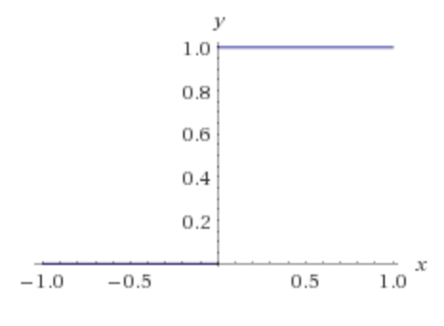
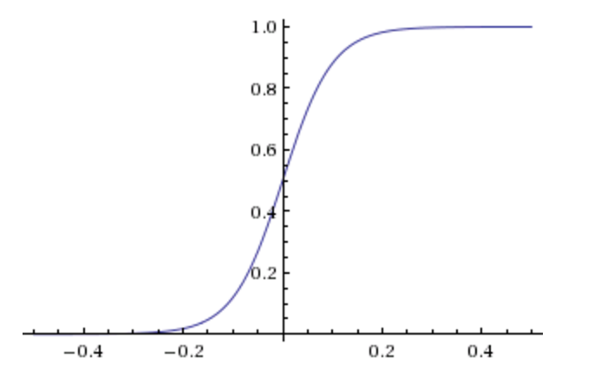
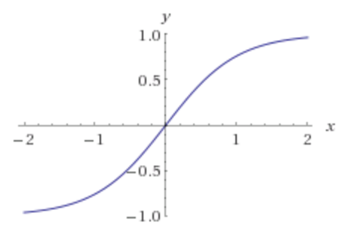
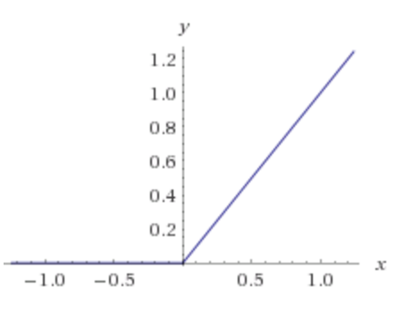
Activation Functions
Step(x)
Sigmoid(x)
Tanh(x)
ReLU(x) = max(0, x)

Slide 8
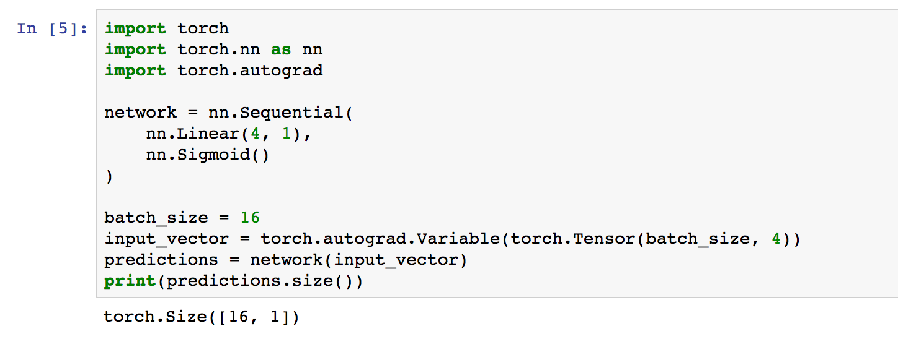
Pytorch - Perceptron

Slide 9
Two-layer Multi-layer Perceptron (MLP)
”hidden" layer
Loss / Criterion
$$x_{1}$$
$$a_{1}$$
$$x_{2}$$
$$a_{2}$$
$${\hat{y}}_{1}$$
$$y_{1}$$
$$x_{3}$$
$$a_{3}$$
$$x_{4}$$
$$a_{4}$$

Slide 10
Forward pass
$$z_{i}=\sum_{i=0}^{n}{w_{1ij}x_{i}}+b_{1}$$
$$a_{i}= Sigmoid(z_{i})$$
$$p_{1}=\sum_{i=0}^{n}{w_{2i}a_{i}}+b_{2}$$
$$y_{1}= Sigmoid(p_{i})$$
$$x_{1}$$
$$a_{1}$$
$$x_{2}$$
$$a_{2}$$
$${\hat{y}}_{1}$$
$$y_{1}$$
$$x_{3}$$
$$a_{3}$$
$$x_{4}$$
$$a_{4}$$
$Loss=L(y_{1},$ ${\hat{y}}_{1})$

Slide 11
Backward pass
$${\frac{∂L}{∂x_{k}}}_{}=(\frac{∂}{∂x_{k}}\sum_{i=0}^{n}{w_{1ik}x_{i}}+b_{k})\frac{∂L}{∂z_{i}}$$
$${\frac{∂L}{∂z_{i}}}_{}=\frac{∂}{∂z_{i}}Sigmoid(z_{i})\frac{∂L}{∂a_{k}}$$
GradInputs
$${\frac{∂L}{∂a_{k}}}_{}=(\frac{∂}{∂a_{k}}\sum_{i=0}^{n}{w_{2i}a_{i}}+b_{2})\frac{∂L}{∂p_{1}}$$
${\frac{∂L}{∂p_{1}}}_{}=\frac{∂}{∂p_{1}}Sigmoid(p_{i})$ $\frac{∂L}{∂{\hat{y}}_{1}}$
$$x_{1}$$
$$a_{1}$$
$$x_{2}$$
$$a_{2}$$
$${\hat{y}}_{1}$$
$$y_{1}$$
$$x_{3}$$
$$a_{3}$$
$$x_{4}$$
$$a_{4}$$
$${\frac{∂L}{∂w_{2i}}=\frac{∂a_{k}}{∂w_{2i}}\frac{∂L}{∂a_{k}}}_{}$$
$\frac{∂L}{∂{\hat{y}}_{1}}=\frac{∂}{∂{\hat{y}}_{1}}L(y_{1},$ ${\hat{y}}_{1})$
$${\frac{∂L}{∂w_{1ij}}=\frac{∂x_{k}}{∂w_{1ij}}\frac{∂L}{∂x_{k}}}_{}$$
GradParams

Slide 12
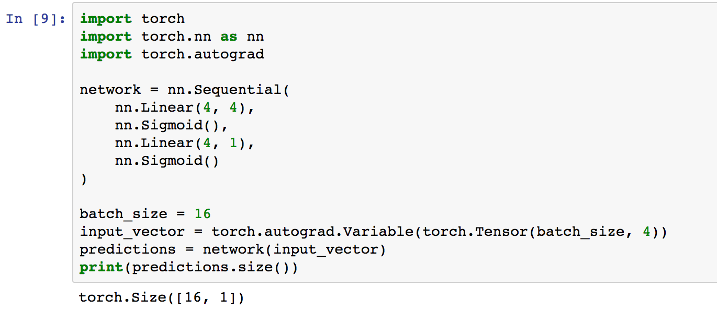
Pytorch – Two-layer MLP + Regression

Slide 13
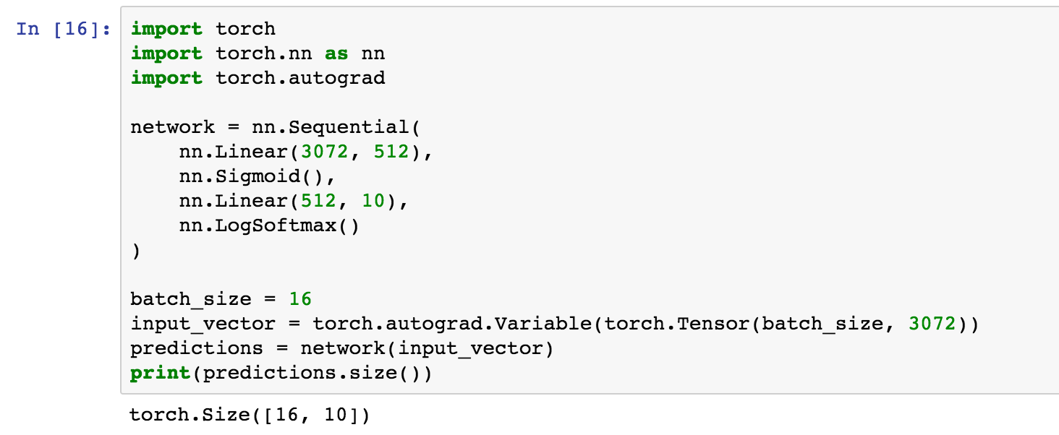
Pytorch – Two-layer MLP + LogSoftmax
# of Hidden Units

Slide 14
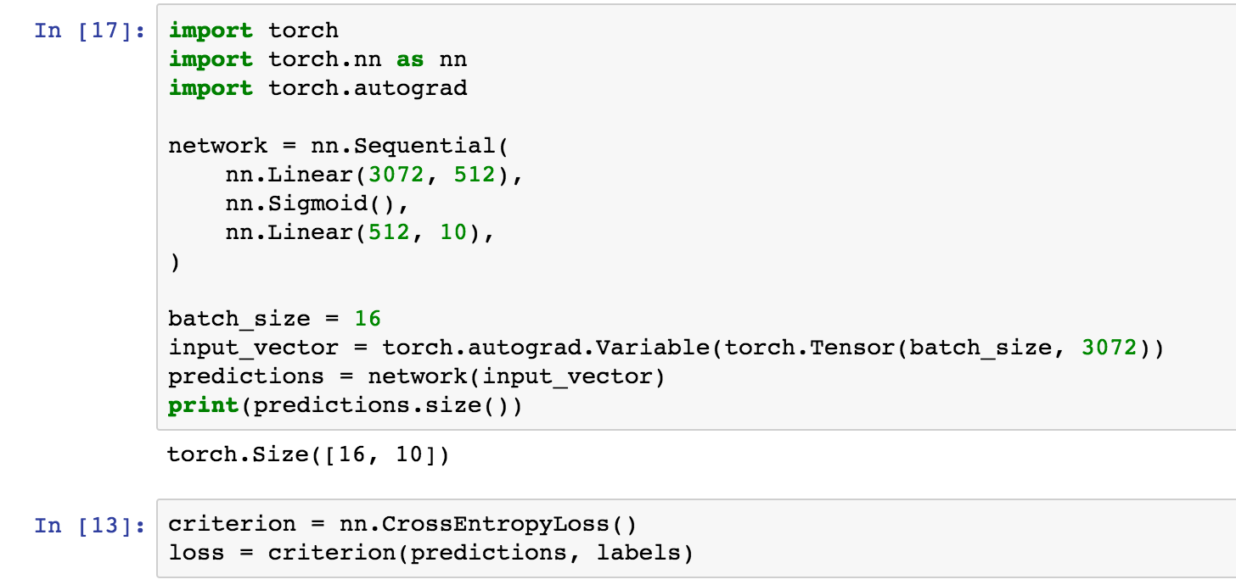
Pytorch – Two-layer MLP + LogSoftmax
LogSoftmax + Negative Likelihood Loss

Slide 15
Bookmark Opportunity!

Slide 16
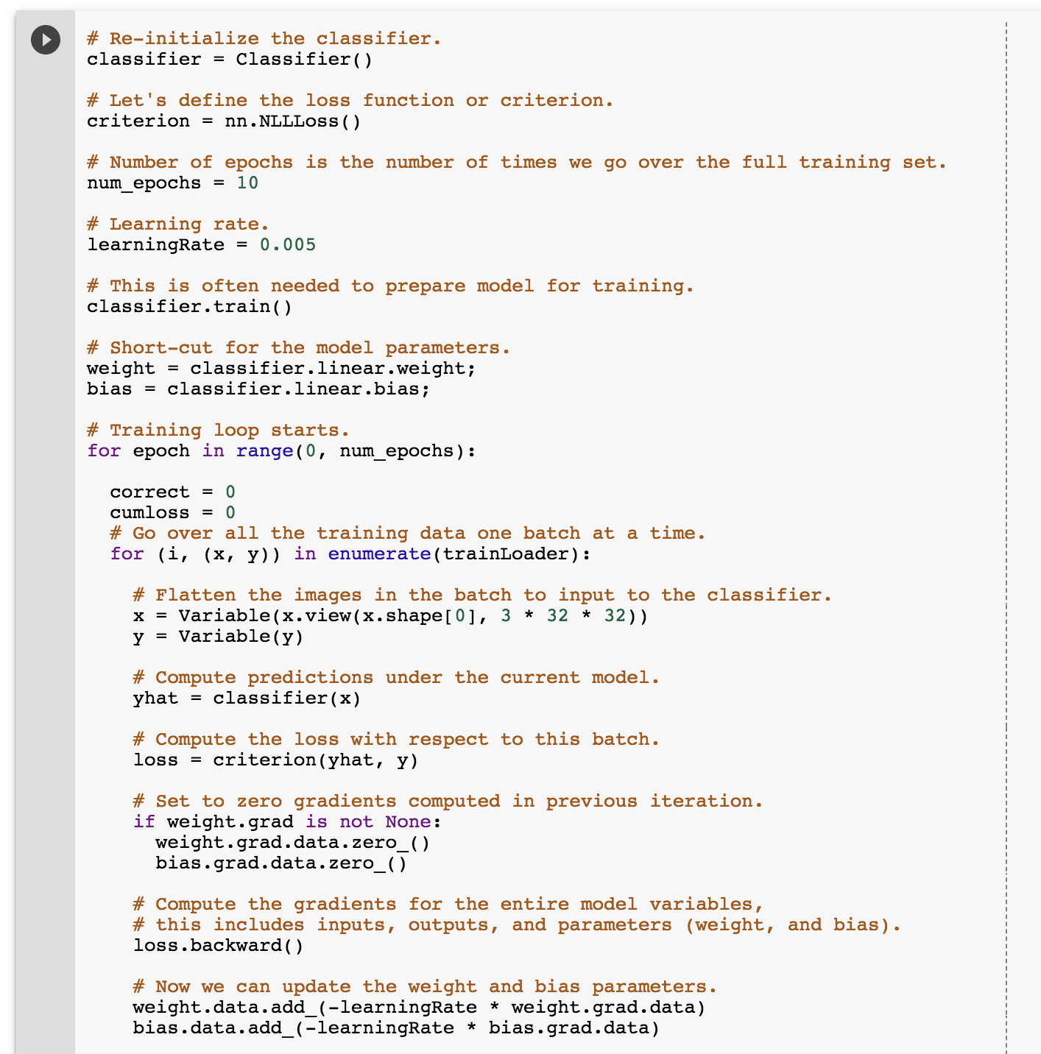
SGD training code (Project 4)

Slide 17
Convolutional (Neural) Networks

Slide 18
Convolutional Layer

Slide 19
Convolutional Layer

Slide 20
Convolutional Layer
Weights

Slide 21
Convolutional Layer
Weights
4

Slide 22
Convolutional Layer
Weights
4
1

Slide 23
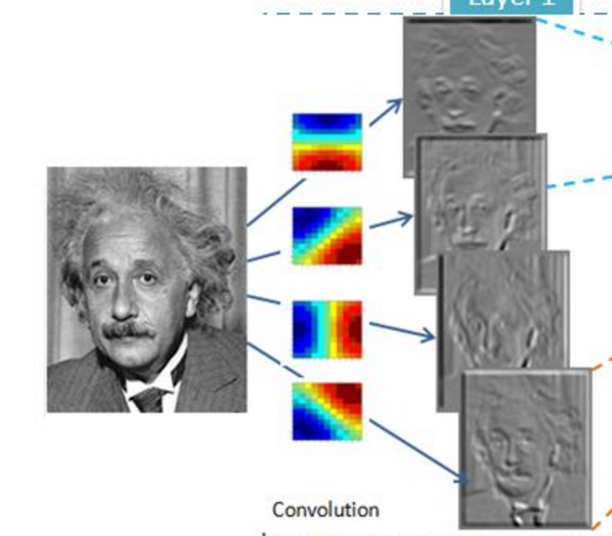
Convolutional Layer (with 4 filters)
weights: 4x1x9x9
Input: 1x224x224
Output: 4x224x224
if zero padding,
and stride = 1

Slide 24
Convolutional Layer (with 4 filters)
weights: 4x1x9x9
Input: 1x224x224
Output: 4x112x112
if zero padding,
but stride = 2

Slide 25
Convolutional Layer in Torch
kW
Input
nOutputPlane x
Output
kH
nInputPlane
nOutputPlane (equals the number of convolutional filters for this layer)
nInputPlane (e.g. 3 for RGB inputs)

Slide 26
Convolutional Layer in Keras
Convolution2D(nOutputPlane, kW, kH, input_shape = (3, 224, 224), subsample = 2, border_mode = valid)
kW
Input
nOutputPlane x
Output
kH
nInputPlane
nOutputPlane (equals the number of convolutional filters for this layer)
nInputPlane (e.g. 3 for RGB inputs)

Slide 27
Convolutional Layer in pytorch
kernel_size
Input
out_channels x
Output
kernel_size
in_channels
out_channels (equals the number of convolutional filters for this layer)
in_channels (e.g. 3 for RGB inputs)

Slide 28
Convolutional Network: LeNet

Slide 29
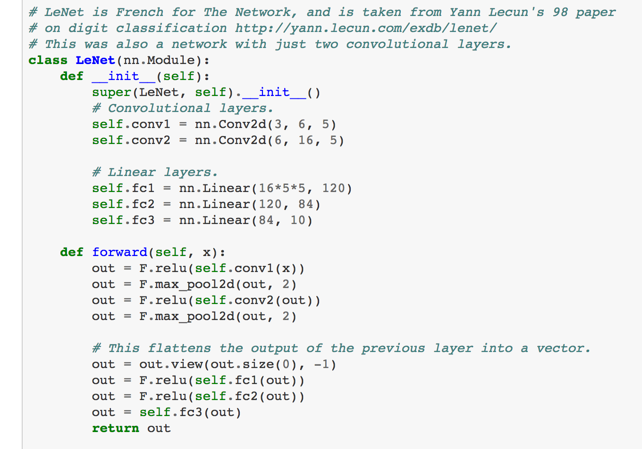
LeNet in Pytorch

Slide 30
SpatialMaxPooling Layer
take the max in this neighborhood
8
8
8
8
8

Slide 31
Convolutional Layers as Matrix Multiplication
https://petewarden.com/2015/04/20/why-gemm-is-at-the-heart-of-deep-learning/

Slide 32
Convolutional Layers as Matrix Multiplication
https://petewarden.com/2015/04/20/why-gemm-is-at-the-heart-of-deep-learning/

Slide 33
Convolutional Layers as Matrix Multiplication
Pros?
Cons?
https://petewarden.com/2015/04/20/why-gemm-is-at-the-heart-of-deep-learning/

Slide 34
Questions?

