Slide 1
Human Vision and Image Processing
Various slides from previous courses by:
D.A. Forsyth (Berkeley / UIUC), I. Kokkinos (Ecole Centrale / UCL). S. Lazebnik (UNC / UIUC), S. Seitz (MSR / Facebook), J. Hays (Brown / Georgia Tech), A. Berg (Stony Brook / UNC), D. Samaras (Stony Brook) . J. M. Frahm (UNC), V. Ordonez (UVA).

Slide 2
Last Class
Practical Advice on Photography
Camera Parameters
Brief Introduction to Projective Geometry
(Computer Graphics)
Introduction to Light (BRDF)

Slide 3
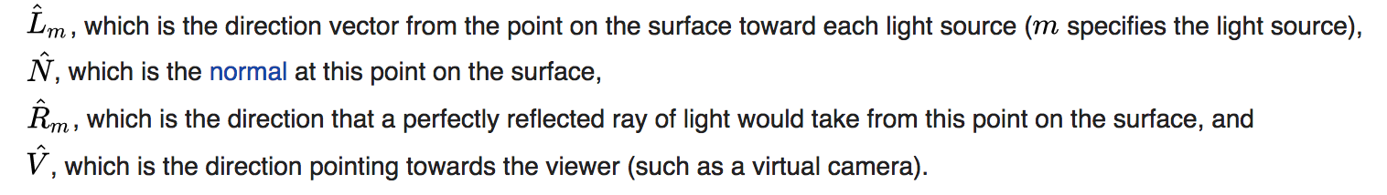
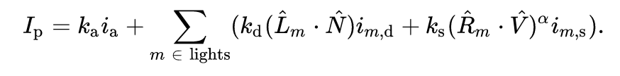
Phong Reflection Model
https://en.wikipedia.org/wiki/Phong_reflection_model

Slide 4
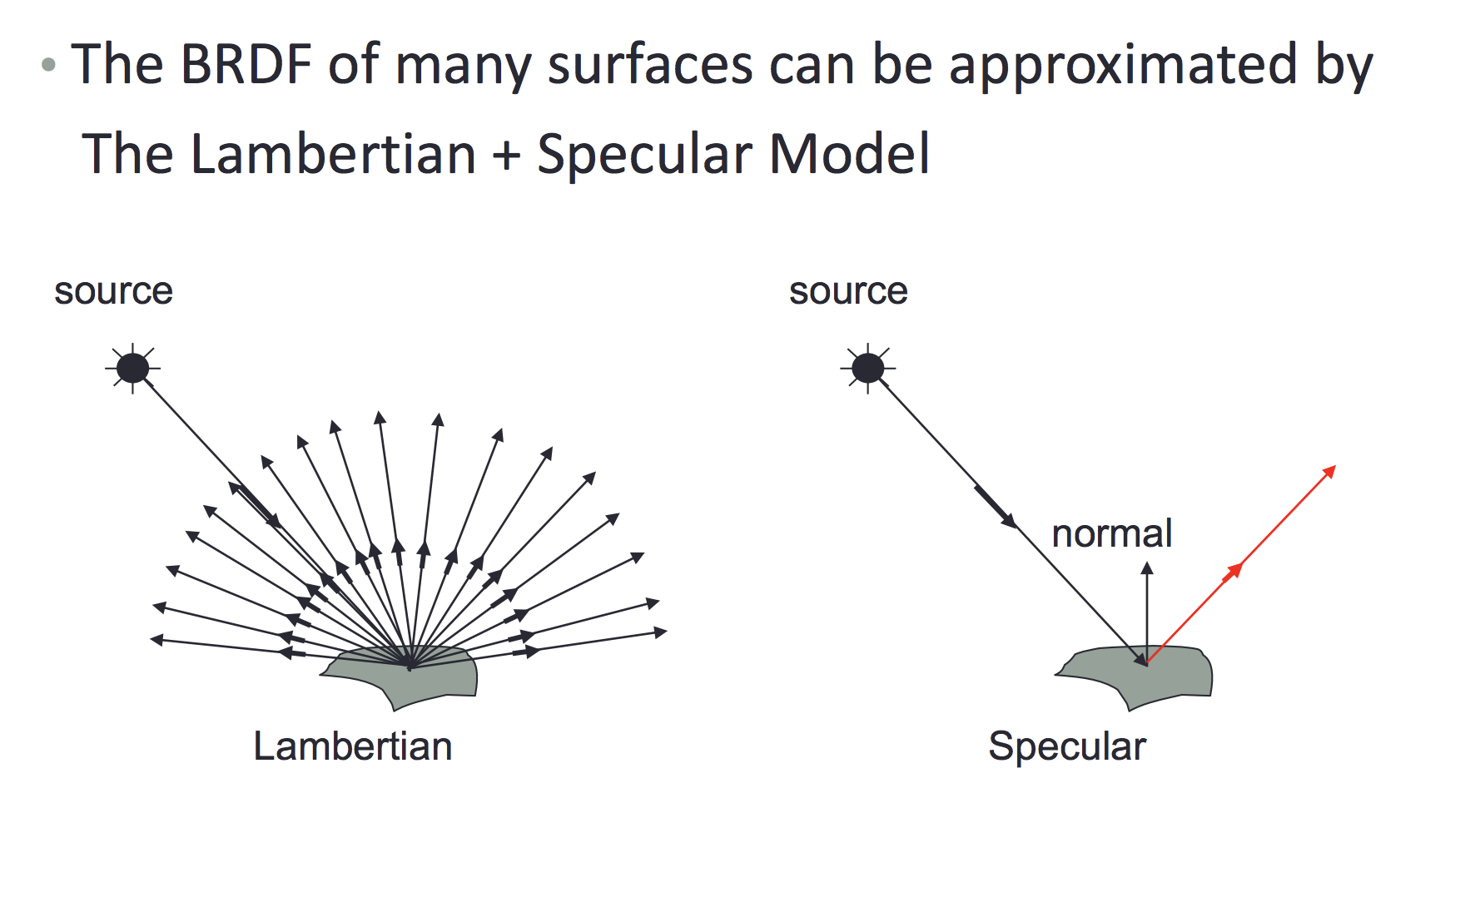
Phong Reflection Model
Slide by Aaron Bobick

Slide 5
Our own Camera as a species:
The Human Eye

Slide 6
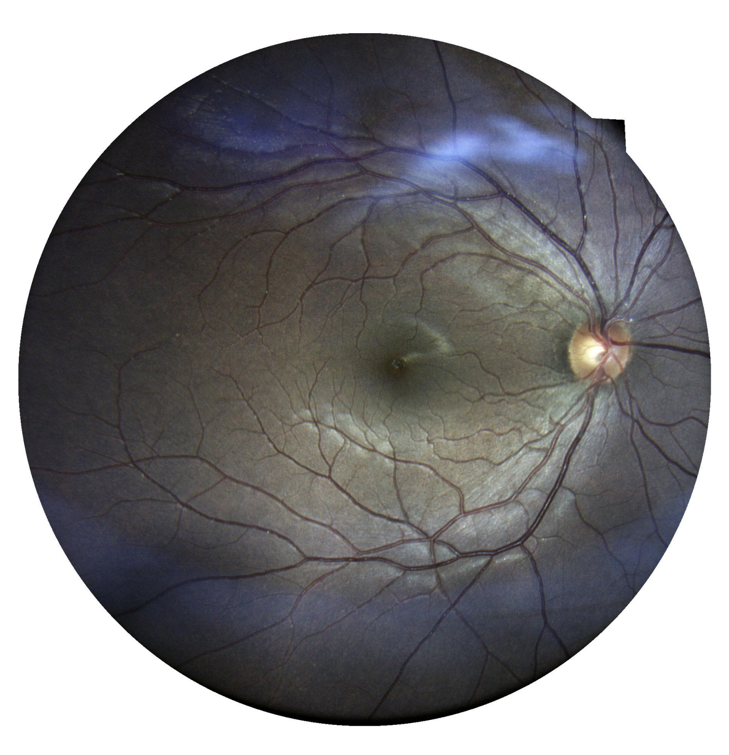
Vicente’s eye

Slide 7
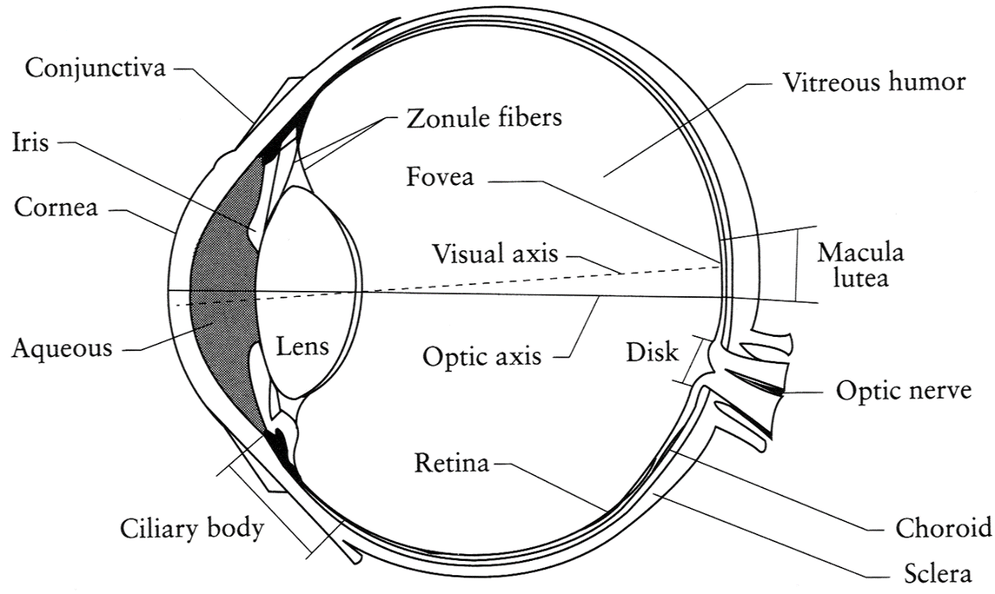
The Eye
The human eye is sort of a camera!
  Iris - colored annulus with radial muscles
  Pupil - the hole (aperture) whose size is controlled by the iris
  What’s the “film”?
    photoreceptor cells (rods and cones) in the retina
Slide by Steve Seitz

Slide 8
https://www.findlight.net/blog/2018/03/16/artificial-photoreceptors/

Slide 9
More about the eye
https://www.youtube.com/watch?v=L_W-IXqoxHA

Slide 10
Two types of light-sensitive receptors
Cones
cone-shaped
less sensitive
operate in high light
color vision
Rods
rod-shaped
highly sensitive
operate at night
gray-scale vision
© Stephen E. Palmer, 2002

Slide 11
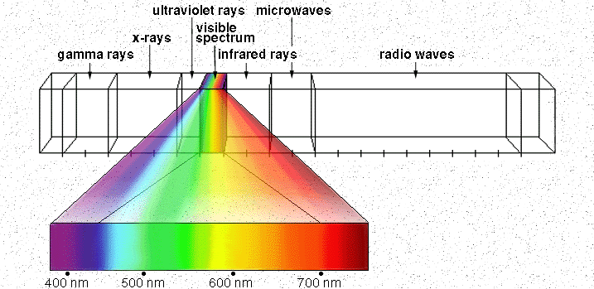

Electromagnetic Spectrum
Human Luminance Sensitivity Function
http://www.yorku.ca/eye/photopik.htm
Notes:
At least 3 spectral bands required (e.g. R,G,B)

Slide 12
The Eye
The human eye is sort of a camera!
  Iris - colored annulus with radial muscles
  Pupil - the hole (aperture) whose size is controlled by the iris
  What’s the “film”?
    photoreceptor cells (rods and cones) in the retina
Slide by Steve Seitz

Slide 13
Eye Evolution
Ayala 2007. Darwin's greatest discovery: Design without designer. Proceedings of the National Academy of Sciences. USA.

Slide 14


Slide 15
Hubel and Wiesel
https://www.youtube.com/watch?v=IOHayh06LJ4
http://www.informit.com/articles/article.aspx?p=1431818

Slide 16
Image Processing & Image Filtering

Slide 17
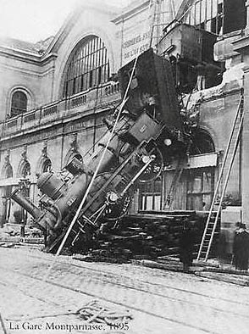

Reminder of what is an image for a computer.
What we see
What a computer sees
Source: S. Narasimhan

Slide 18

Images as Functions
$$z=f(x, y)$$

Slide 19
Images as Functions
$$z=f(x, y)$$
The domain of x and y is [0, img-width) and [0 and img-height)
x, and y are discretized into integer values.

Slide 20
Images as Matrices

Slide 21
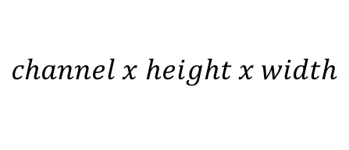
Color Images as Tensors
$$channel x height x width$$

Slide 22
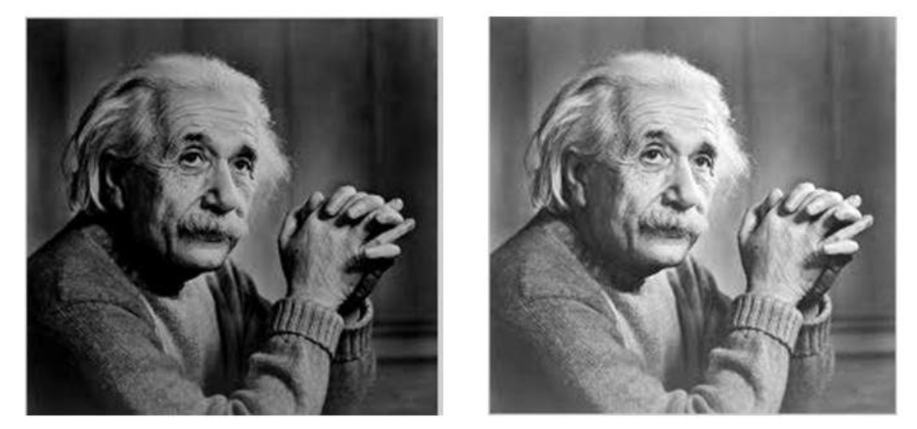



Basic Image Processing
$$I$$
$$αI$$
$$α>1$$

Slide 23
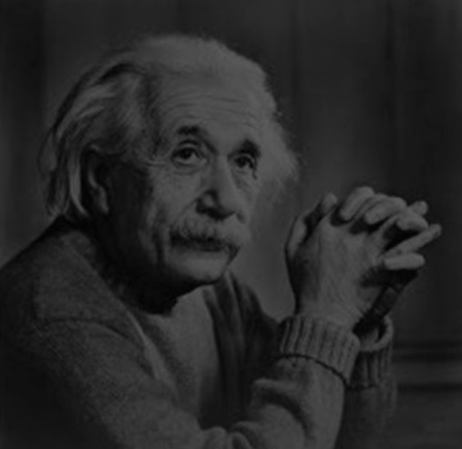

Basic Image Processing
$$I$$
$$αI$$
$$0<α<1$$

Slide 24
Color Images as Tensors
$$channel x height x width$$
Channels are usually RGB: Red, Green, and Blue
Other color spaces: HSV, HSL, LUV, XYZ, Lab, CMYK, etc

Slide 25
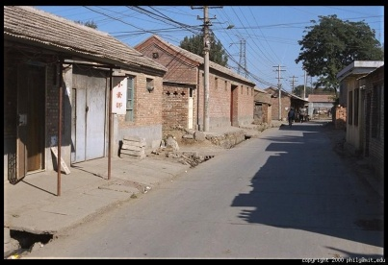
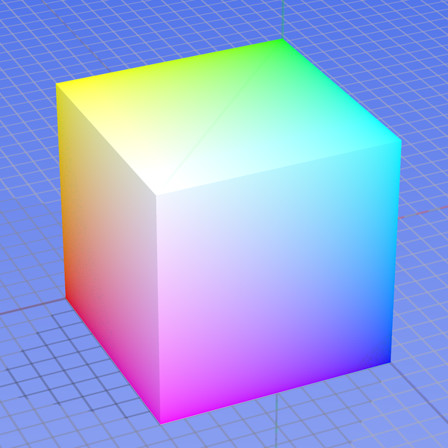
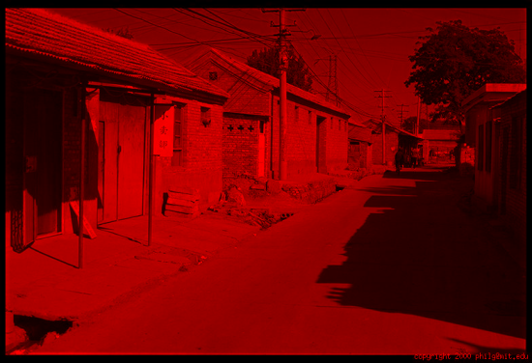
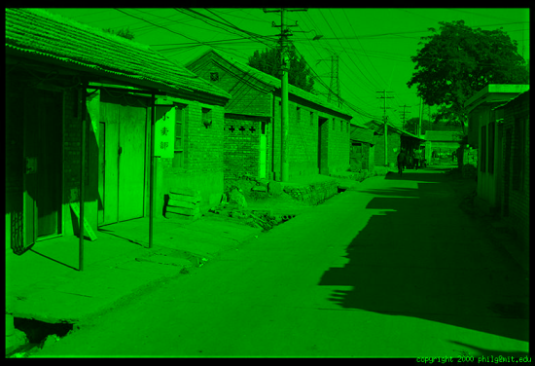
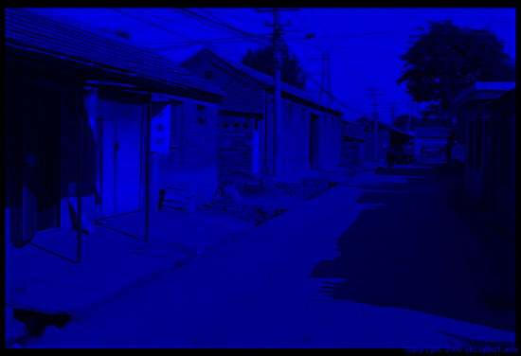
Color spaces: RGB
0,1,0
R
(G=0,B=0)
1,0,0
G
(R=0,B=0)
0,0,1
B
(R=0,G=0)
Some drawbacks
Strongly correlated channels
Non-perceptual
Default color space
Slide by James Hays
Image from: http://en.wikipedia.org/wiki/File:RGB_color_solid_cube.png

Slide 26
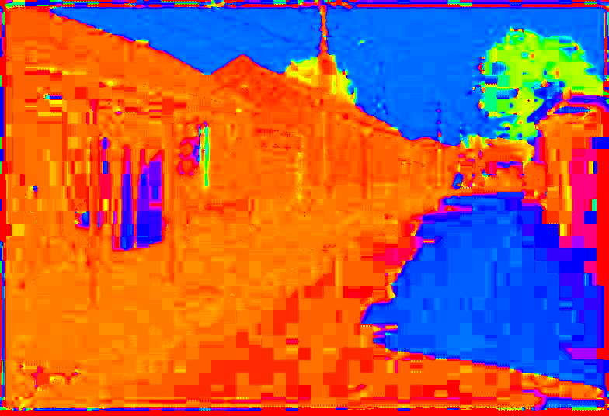
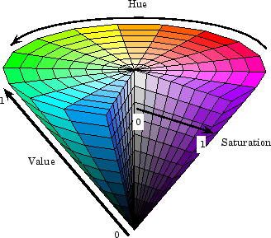
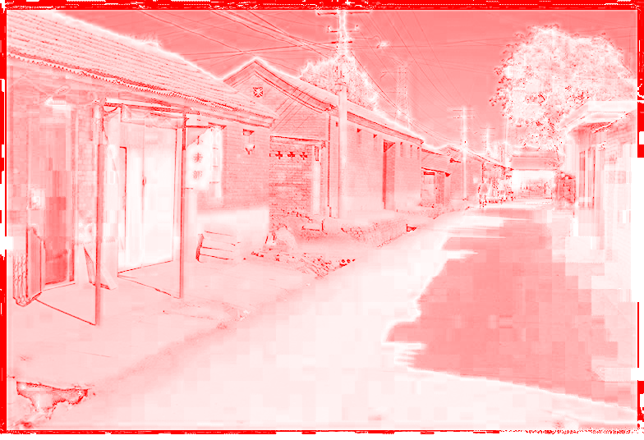
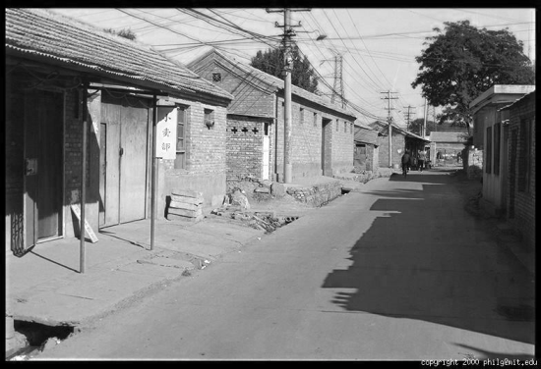
Color spaces: HSV
Intuitive color space
H
(S=1,V=1)
S
(H=1,V=1)
V
(H=1,S=0)
Slide by James Hays

Slide 27
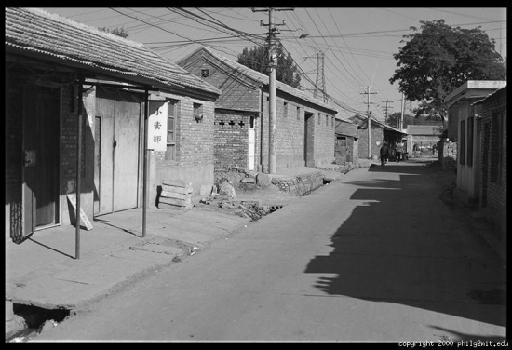
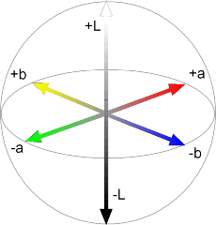


Color spaces: L*a*b*
“Perceptually uniform”* color space
L
(a=0,b=0)
a
(L=65,b=0)
b
(L=65,a=0)
Slide by James Hays

Slide 28
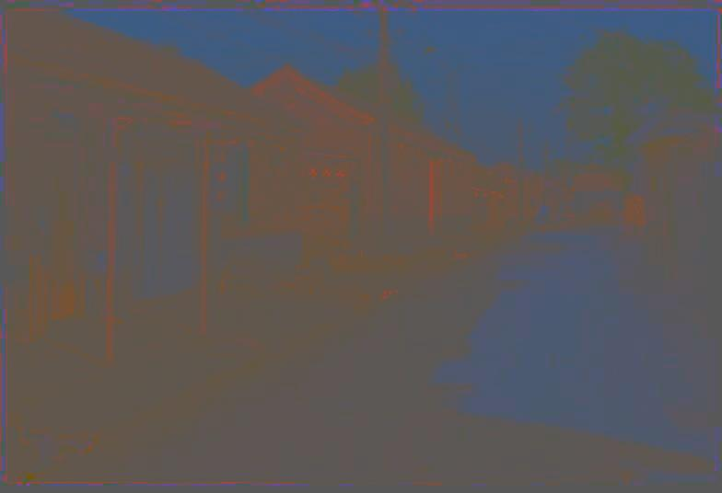
Most information in intensity
Only color shown – constant intensity
Slide by James Hays

Slide 29

Most information in intensity
Only intensity shown – constant color
Slide by James Hays

Slide 30

Most information in intensity
Original image
Slide by James Hays

Slide 31
Image filtering

Slide 32
Image filtering
Image Credit: http://what-when-how.com/introduction-to-video-and-image-processing/neighborhood-processing-introduction-to-video-and-image-processing-part-1/

Slide 33
Image filtering
Image Credit: http://what-when-how.com/introduction-to-video-and-image-processing/neighborhood-processing-introduction-to-video-and-image-processing-part-1/

Slide 34
Image filtering: e.g. Mean Filter

Slide 35
Image filtering: e.g. Mean Filter

Slide 36
Image filtering: e.g. Median Filter
Image Credit: http://what-when-how.com/introduction-to-video-and-image-processing/neighborhood-processing-introduction-to-video-and-image-processing-part-1/

Slide 37

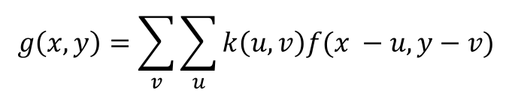
Image filtering: Convolution operator
$$k(x, y)$$
$$g\left(x, y\right)=\sum_{v}{\sum_{u}{k\left(u,v\right)f(x −u, y−v) }}$$
Image Credit: http://what-when-how.com/introduction-to-video-and-image-processing/neighborhood-processing-introduction-to-video-and-image-processing-part-1/

Slide 38
(filter, kernel)
http://www.cs.virginia.edu/~vicente/recognition/animation.gif

Slide 39


Image filtering: Convolution operator
e.g. mean filter
1/9 | 1/9 | 1/9
1/9 | 1/9 | 1/9
1/9 | 1/9 | 1/9
$k(x, y)$ =
$k(x, y)$
Image Credit: http://what-when-how.com/introduction-to-video-and-image-processing/neighborhood-processing-introduction-to-video-and-image-processing-part-1/

Slide 40
Image filtering: Convolution operator
e.g. mean filter
1/9 | 1/9 | 1/9
1/9 | 1/9 | 1/9
1/9 | 1/9 | 1/9
$k(x, y)$ =
$k(x, y)$
Image Credit: http://what-when-how.com/introduction-to-video-and-image-processing/neighborhood-processing-introduction-to-video-and-image-processing-part-1/

Slide 41
Image filtering: e.g. Mean Filter

Slide 42
Image filtering: Convolution operator
e.g. gaussian filter (gaussian blur)
1/16 | 1/8 | 1/16
1/8 | 1/4 | 1/8
1/16 | 1/8 | 1/16
$k(x, y)$ =
$k(x, y)$
Image Credit: http://what-when-how.com/introduction-to-video-and-image-processing/neighborhood-processing-introduction-to-video-and-image-processing-part-1/

Slide 43
Image filtering: Convolution operator
e.g. gaussian filter (gaussian blur)
Image Credit: http://what-when-how.com/introduction-to-video-and-image-processing/neighborhood-processing-introduction-to-video-and-image-processing-part-1/

Slide 44
Image filtering: Convolution operator
e.g. sobel operator
1 | 0 | -1
2 | 0 | -2
1 | 0 | -1
$k(x, y)$ =
$k(x, y)$
Image Credit: http://what-when-how.com/introduction-to-video-and-image-processing/neighborhood-processing-introduction-to-video-and-image-processing-part-1/

Slide 45
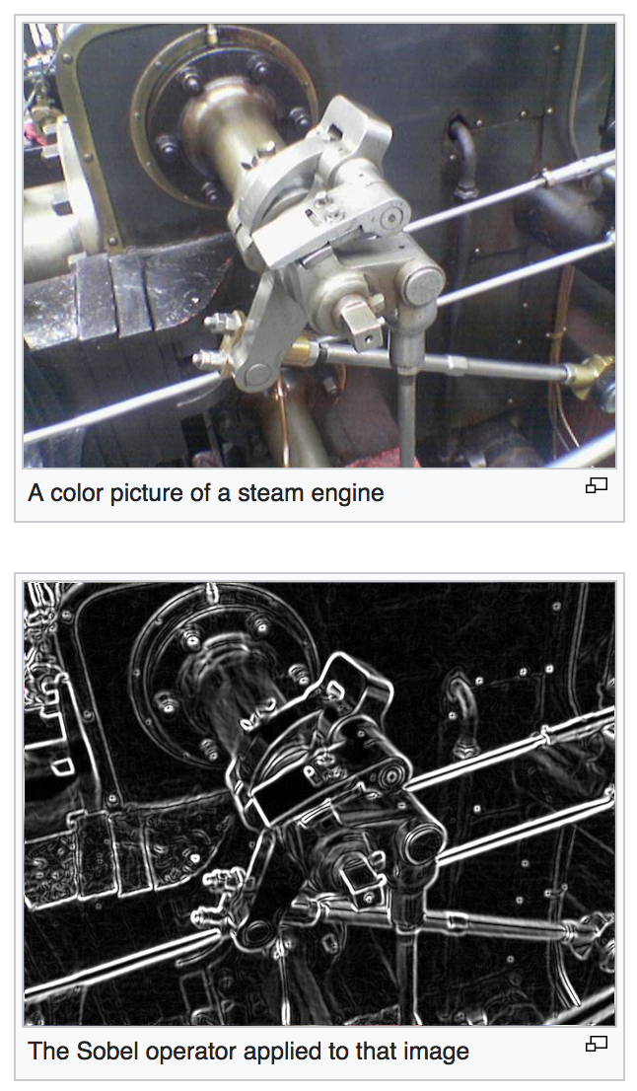

Slide 46
Next Class: More on Image Filters

Slide 47
Questions?

