Slide 1
Interest Points: Corners and Blobs
Various slides from previous courses by:
D.A. Forsyth (Berkeley / UIUC), I. Kokkinos (Ecole Centrale / UCL). S. Lazebnik (UNC / UIUC), S. Seitz (MSR / Facebook), J. Hays (Brown / Georgia Tech), A. Berg (Stony Brook / UNC), D. Samaras (Stony Brook) . J. M. Frahm (UNC), V. Ordonez (UVA).

Slide 2
Last Class
Frequency Domain
Filtering in Frequency
Edge Detection – Canny (+ Practical Session on Canny Edge Detection)

Slide 3
Today’s Class
Corner Detection - Harris
Interest Points
Local Feature Descriptors

Slide 4
Edge Detection

Slide 5
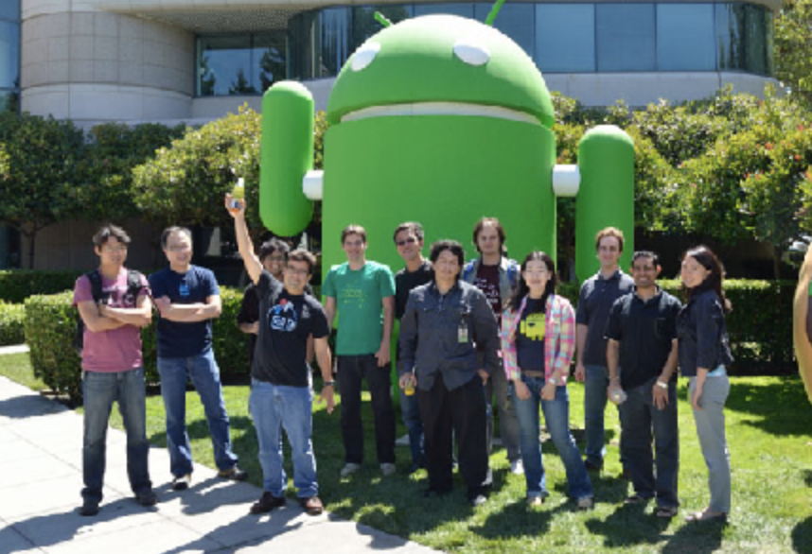
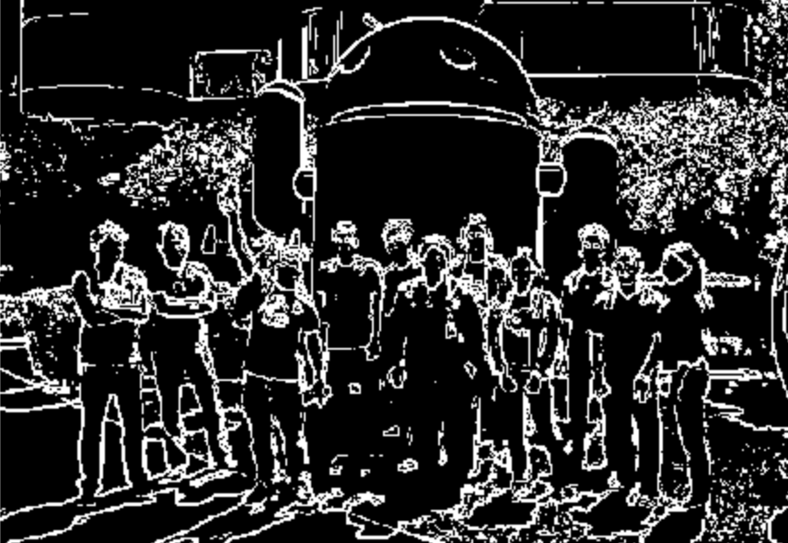
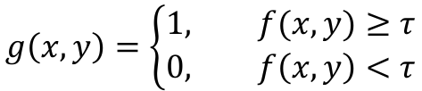
Edge Detection
$$g\left(x,y\right)=\left\{\begin{aligned}1, f(x,y)≥τ \\ &0, f\left(x,y\right)<τ\end{aligned}\right.$$
Sobel + Thresholding

Slide 6
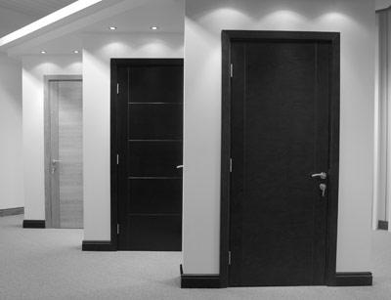
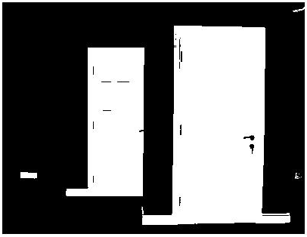
Digression
Thresholding is often the most under-rated but effective Computer Vision technique. Sometimes this is all you need!
Example: intensity-based detection. Warning when door is opened or closed.
fg_pix = find(im < 65);
Looking for dark pixels
Example by Kristen Grauman, UT-Austin

Slide 7
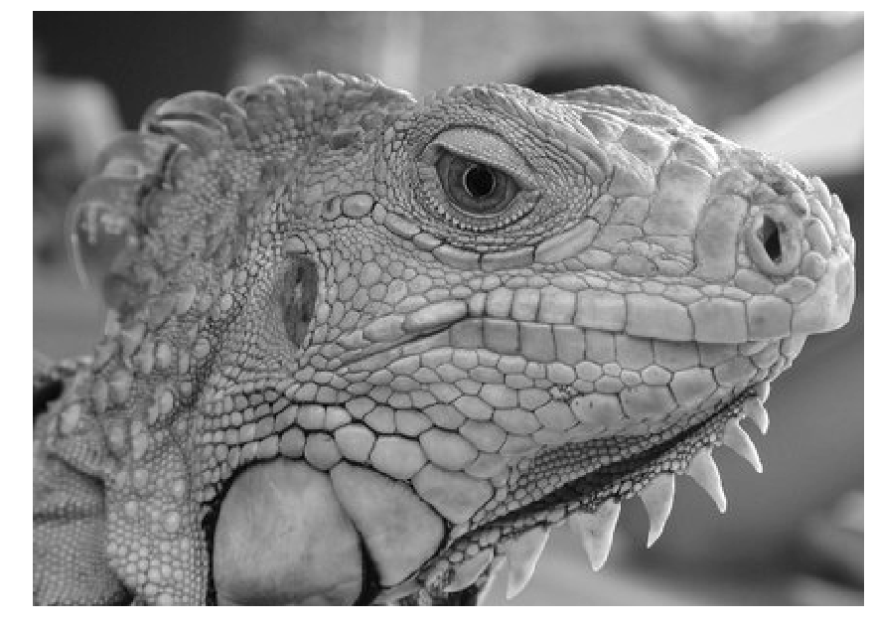
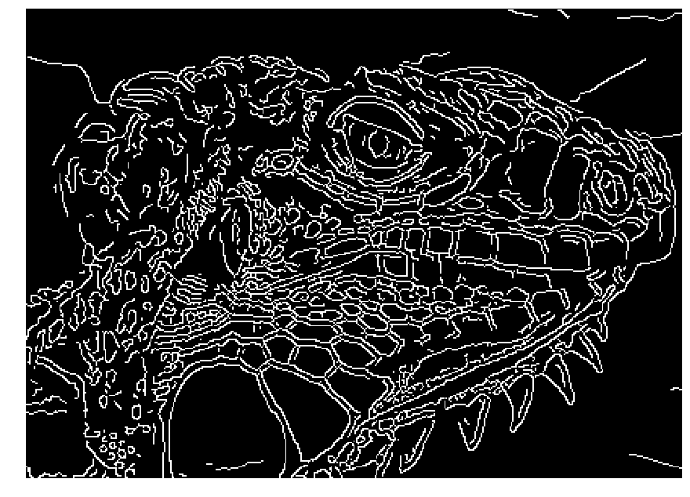
Canny Edge Detector
Obtains thin edges (1px wide)
Tries to preserve edge connectivity.
Source: Juan C. Niebles and Ranjay Krishna.

Slide 8
Canny edge detector
Filter image with x, y derivatives of Gaussian
Find magnitude and orientation of gradient
Non-maximum suppression:
  Thin multi-pixel wide “ridges” down to single pixel width
Thresholding and linking (hysteresis):
  Define two thresholds: low and high
  Use the high threshold to start edge curves and the low threshold to continue them
Source: Juan C. Niebles and Ranjay Krishna.

Slide 9
Canny Edge Detector
Classic algorithm in Computer Vision / Image Analysis
Commonly implemented in most libraries
e.g. in Python you can find it in the skimage package.
OpenCV also has an implementation with python bindings.
Canny, J., A Computational Approach To Edge Detection, IEEE Trans. Pattern Analysis and Machine Intelligence, 8(6):679–698, 1986.

Slide 10
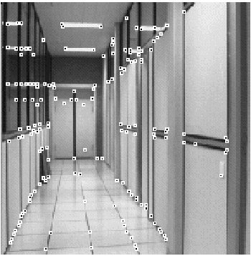
Corners (and Interest Points)
How to find corners?
What is a corner?

Slide 11
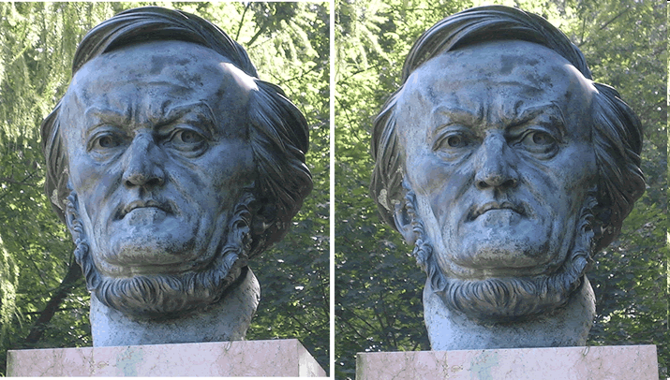
Corners: Why “Interest” Points?
If we can find them,
then maybe we can
“match” images belonging to the same object!
Then maybe we can also “triangulate” the 3D coordinates of the image.
Example from Silvio Savarese

Slide 12

Corner Detection: Basic Idea
We should easily recognize the point by looking through a small window
Shifting a window in any direction should give a large change in intensity
“flat” region:
no change in all directions
“edge”:
no change along the edge direction
“corner”:
significant change in all directions
Source: A. Efros

Slide 13



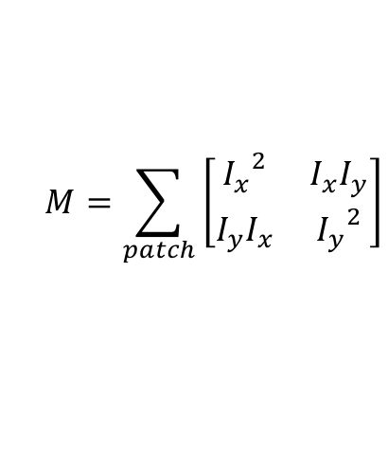



Harris Corner Detection
Compute the following matrix of squared gradients for every pixel.
$$I_{x}$$
are gradients computed using Sobel or some other approximation.
$$M=\sum_{patch}{\left[\begin{matrix}{I_{x}}^{2} & I_{x}I_{y} \\ I_{y}I_{x} & {I_{y}}^{2}\end{matrix}\right]}$$
and
$$I_{y}$$
$$M=\left[\begin{matrix}0 & 0 \\ 0 & 0\end{matrix}\right]$$
$$M=\left[\begin{matrix}0 & 0 \\ 0 & b\end{matrix}\right]$$
$$M=\left[\begin{matrix}a & 0 \\ 0 & 0\end{matrix}\right]$$
$$M=\left[\begin{matrix}a & 0 \\ 0 & b\end{matrix}\right]$$

Slide 14





Simple Corner Detection
$$M=\left[\begin{matrix}0 & 0 \\ 0 & 0\end{matrix}\right]$$
$$M=\left[\begin{matrix}0 & 0 \\ 0 & b\end{matrix}\right]$$
$$M=\left[\begin{matrix}a & 0 \\ 0 & 0\end{matrix}\right]$$
$$M=\left[\begin{matrix}a & 0 \\ 0 & b\end{matrix}\right]$$
If both a, and b are large then this is a corner, otherwise it is not. Set a threshold and this should detect corners.
Compute det M for every pixel and if bigger than tau it is a corner, otherwise not
$$\det{(M)>τ}$$

Slide 15

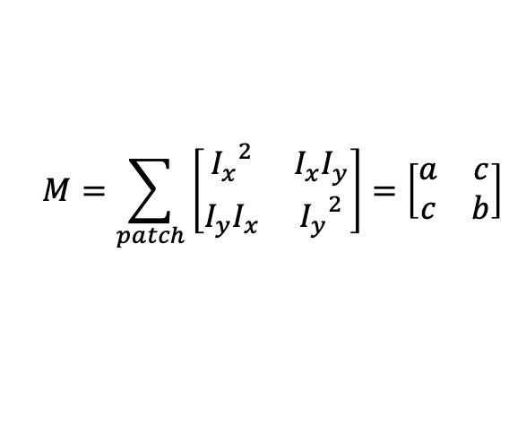
Simple Corner Detection
Problem: Doesn’t work for these corners:
$$M=\sum_{patch}{\left[\begin{matrix}{I_{x}}^{2} & I_{x}I_{y} \\ I_{y}I_{x} & {I_{y}}^{2}\end{matrix}\right]=\left[\begin{matrix}a & c \\ c & b\end{matrix}\right]}$$

Slide 16
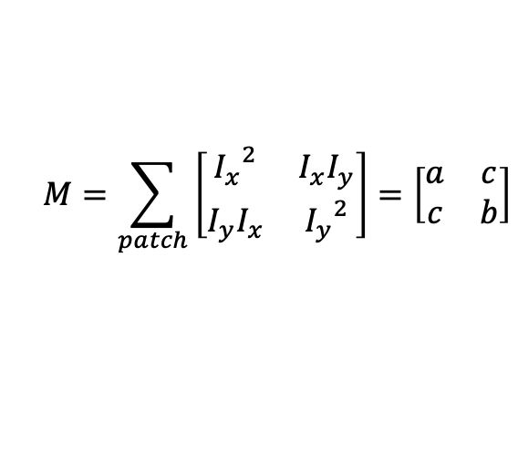

Harris Corner Detection!
Works for these corners!
$$M=\sum_{patch}{\left[\begin{matrix}{I_{x}}^{2} & I_{x}I_{y} \\ I_{y}I_{x} & {I_{y}}^{2}\end{matrix}\right]=\left[\begin{matrix}a & c \\ c & b\end{matrix}\right]}$$
Use the following criteria to decide if it is a corner instead
$$\det\left(M\right)−0.06 trace{\left(M\right)}^{2}>τ$$

Slide 17
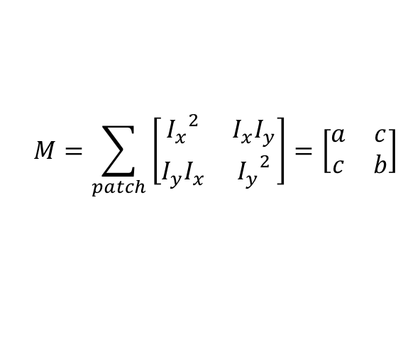



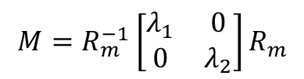
Why det(M) – 0.06 * trace(M) ?
$$M=\sum_{patch}{\left[\begin{matrix}{I_{x}}^{2} & I_{x}I_{y} \\ I_{y}I_{x} & {I_{y}}^{2}\end{matrix}\right]=\left[\begin{matrix}a & c \\ c & b\end{matrix}\right]}$$
$$M=R_{m}^{−1}\left[\begin{matrix}λ_{1} & 0 \\ 0 & λ_{2}\end{matrix}\right]R_{m}$$
Under a rotation M can be diagonalized
$$λ_{1}$$
and
$$λ_{2}$$
are the eigenvalues of M
From your linear algebra class finding them requires solving
$$\det\left(M−λI\right)=0$$

Slide 18
However Harris argues that there’s no need to find lambdas (the eigenvalues), instead it is enough to know the following:

Slide 19
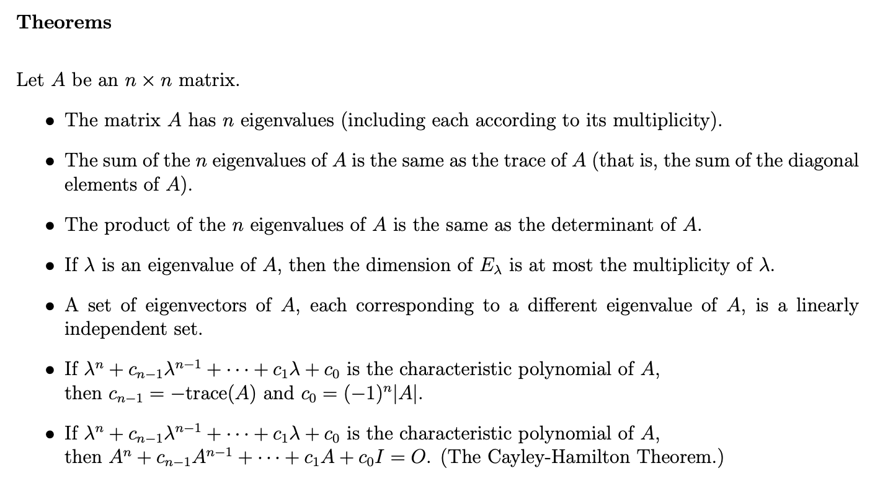
https://www.adelaide.edu.au/mathslearning/play/seminars/evalue-magic-tricks-handout.pdf

Slide 20
Corner response function
α: constant (0.04 to 0.06)
“Edge”
R < 0
“Corner”
R > 0
|R| small
“Flat” region
“Edge”
R < 0

Slide 21
If you still think you need more details
You can look up the original published work with the Harris Corner Detector from 1988.
http://www.bmva.org/bmvc/1988/avc-88-023.pdf

Slide 22
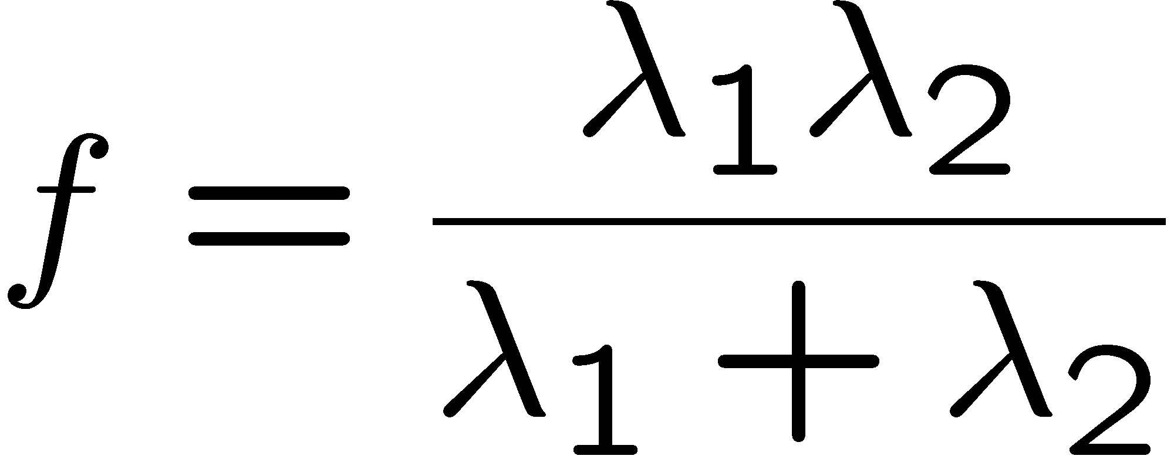
Alternative Corner response function
“edge”:
“corner”:
“flat” region
λ₁ >> λ₂
λ₁ and λ₂ are large,
λ₁ ~ λ₂;
λ₁ and λ₂ are small;
λ₂ >> λ₁
Szeliski
Harmonic mean

Slide 23

Harris Detector: Steps

Slide 24

Harris Detector: Steps
Compute corner response R = det(M) - 0.06 * trace(M)^2

Slide 25

Harris Detector: Steps
Find points with large corner response: R>threshold (not a good idea as you can see)

Slide 26
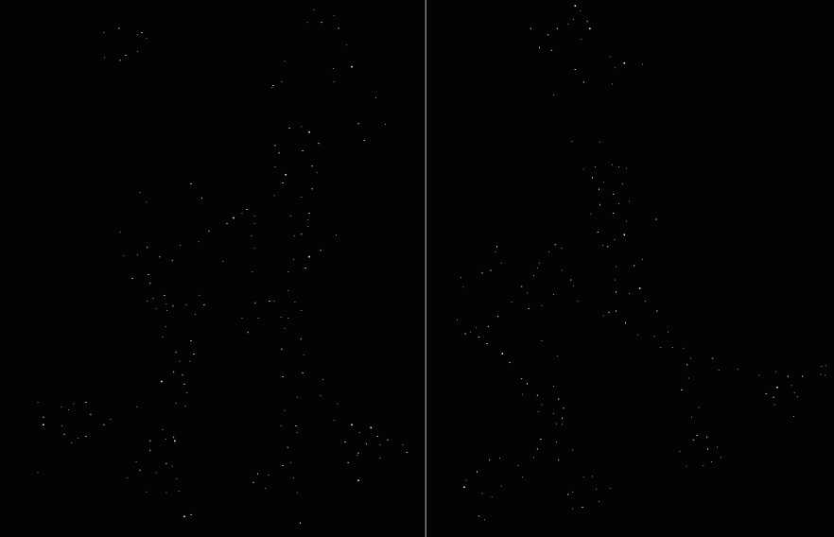
Harris Detector: Steps
Instead threshold but take only the points of local maxima of R (non-max suppression)

Slide 27

Harris Detector: Steps

Slide 28
Next topic: Keypoint detection with scale selection
We want to extract keypoints with characteristic scale that is covariant with the image transformation
Slide by Svetlana Lazebnik

Slide 29


Blob filter
Laplacian of Gaussian: Circularly symmetric operator for blob detection in 2D

Slide 30
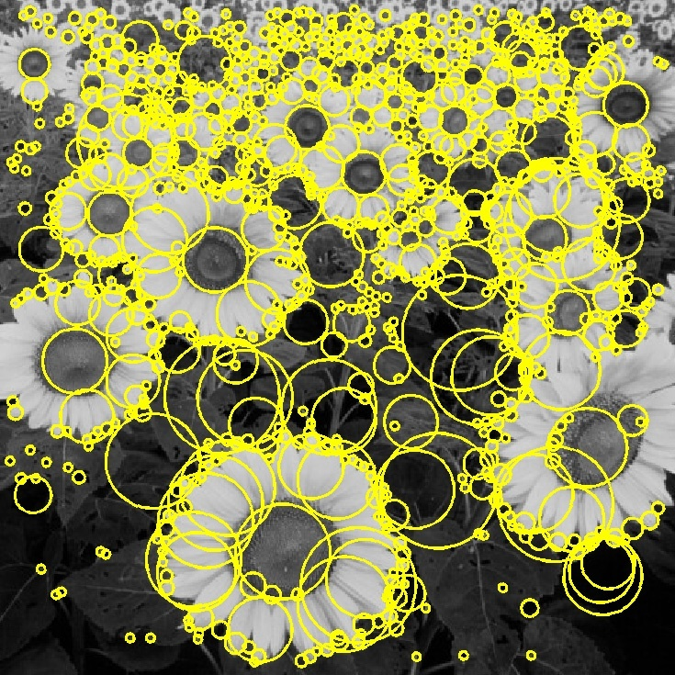
Basic idea
Convolve the image with a “blob filter” at multiple scales and look for extrema of filter response in the resulting scale space
T. Lindeberg. Feature detection with automatic scale selection.
IJCV 30(2), pp 77-116, 1998.
Slide by Svetlana Lazebnik

Slide 31
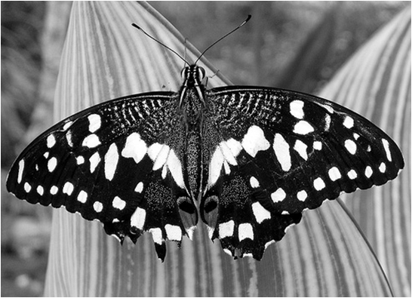
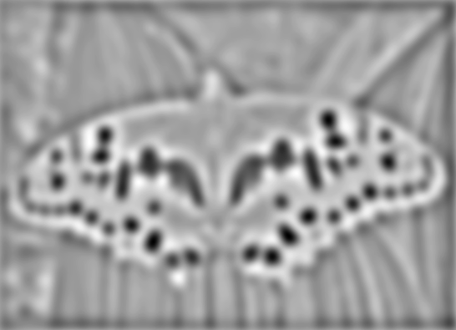

Blob detection
minima
*
=
maxima
Find maxima and minima of blob filter response in space and scale
Source: N. Snavely

Slide 32
Scale-space blob detector
Convolve image with scale-normalized Laplacian at several scales

Slide 33
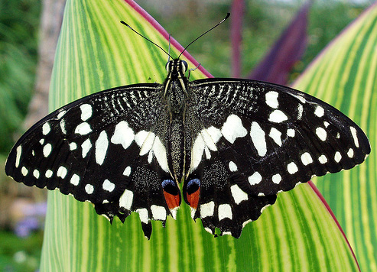
Scale-space blob detector: Example
Slide by Svetlana Lazebnik

Slide 34
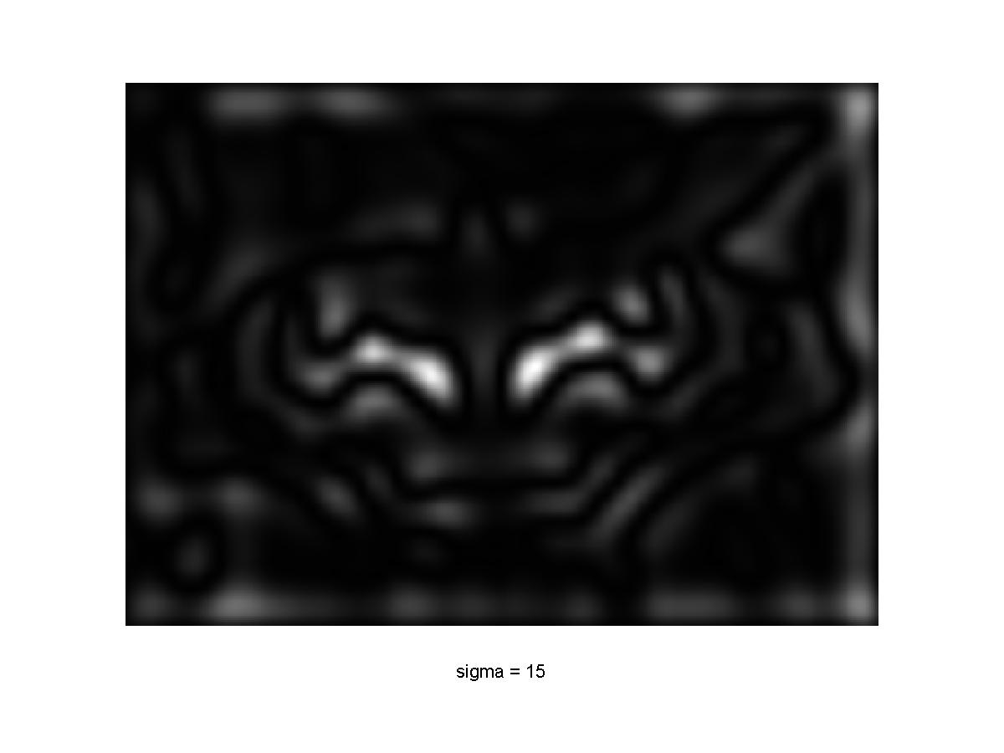
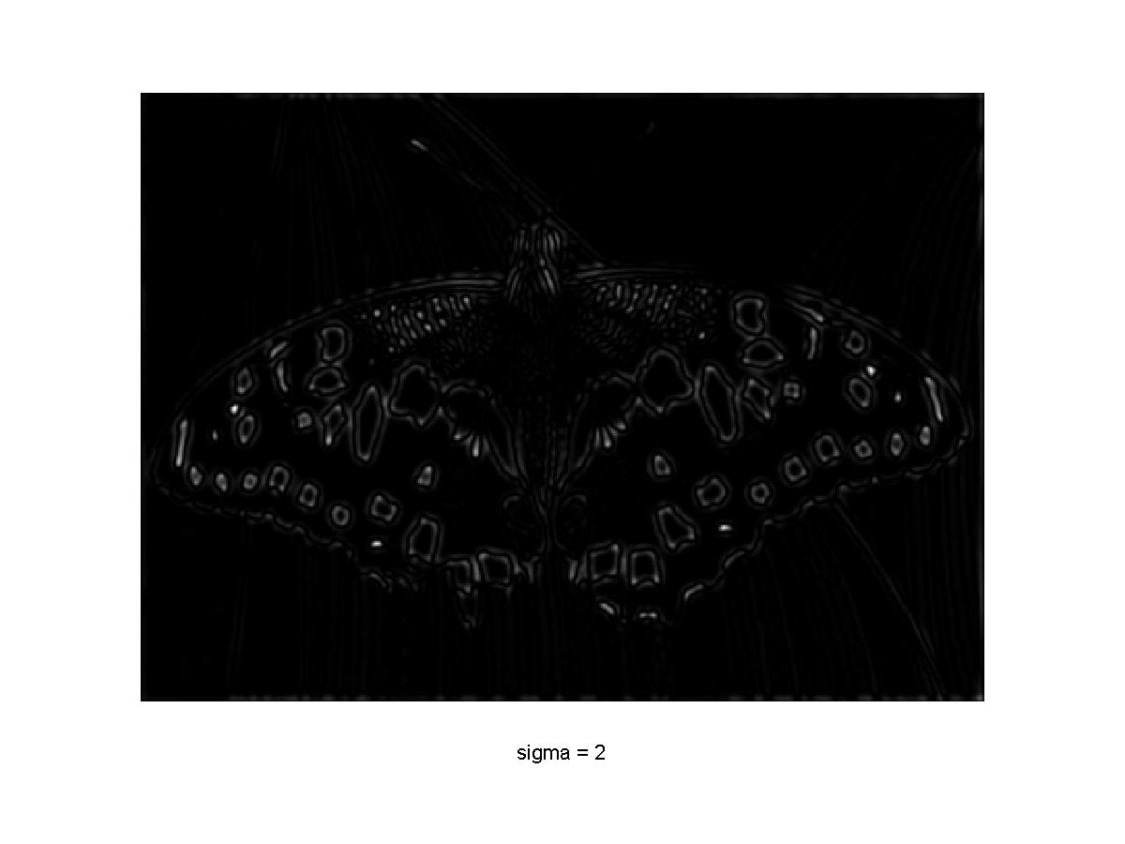
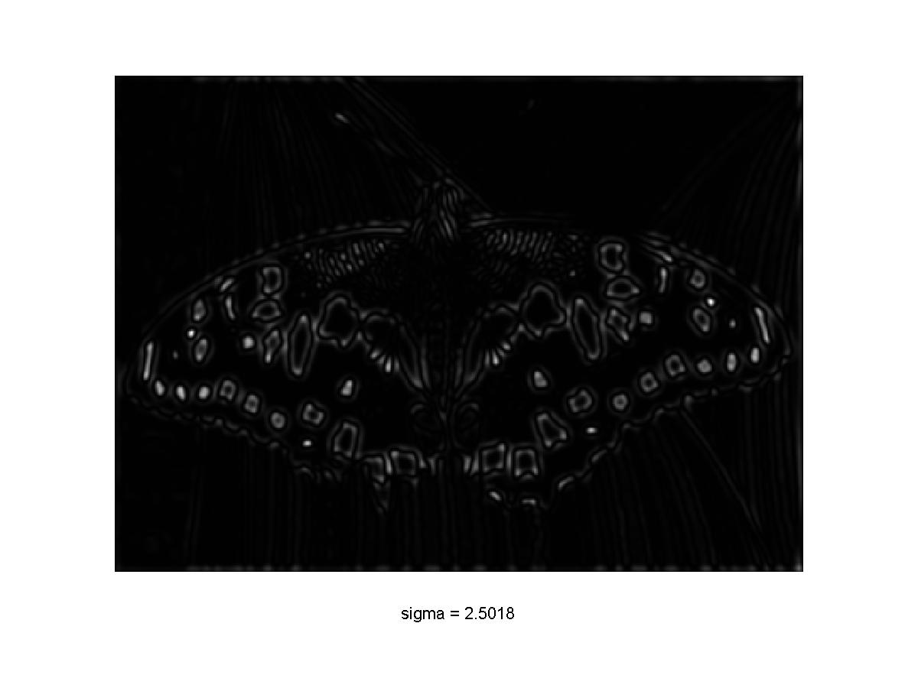
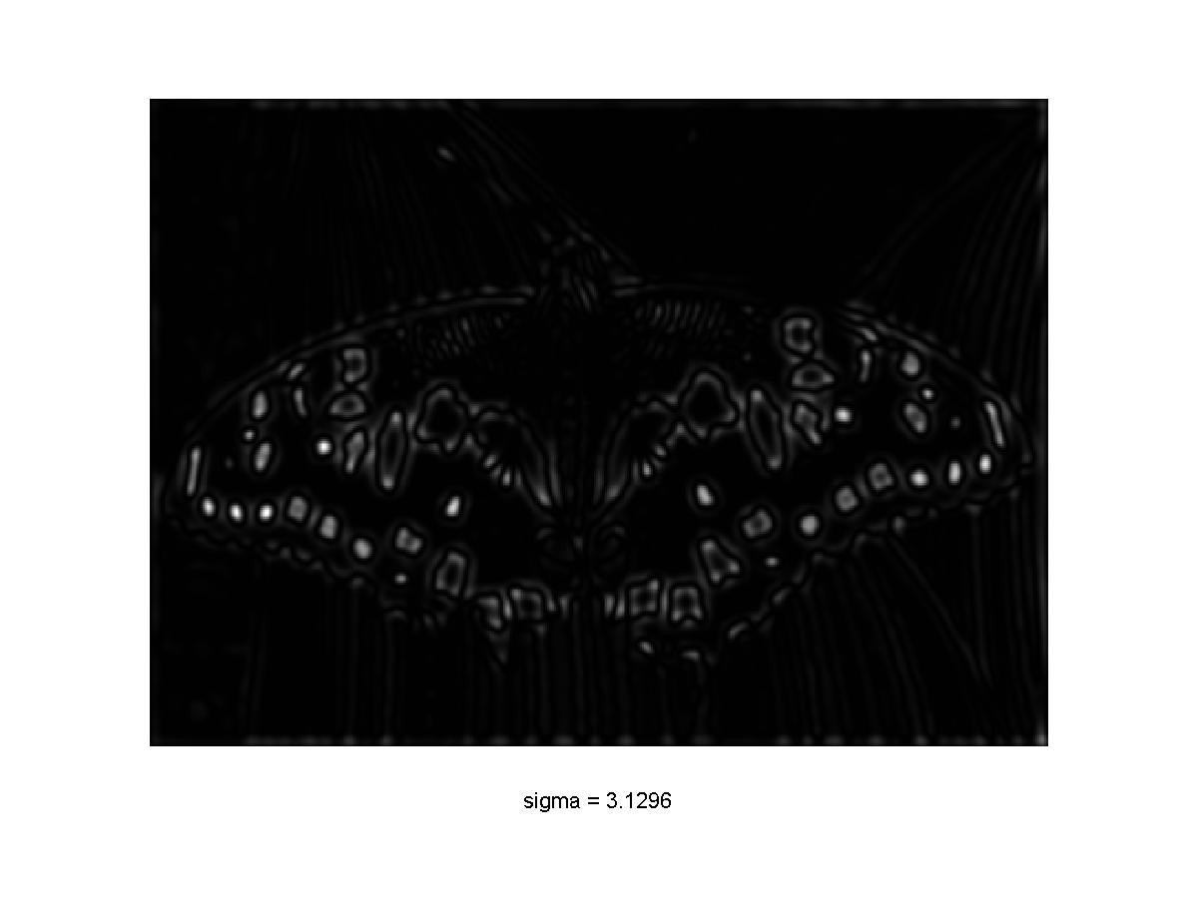
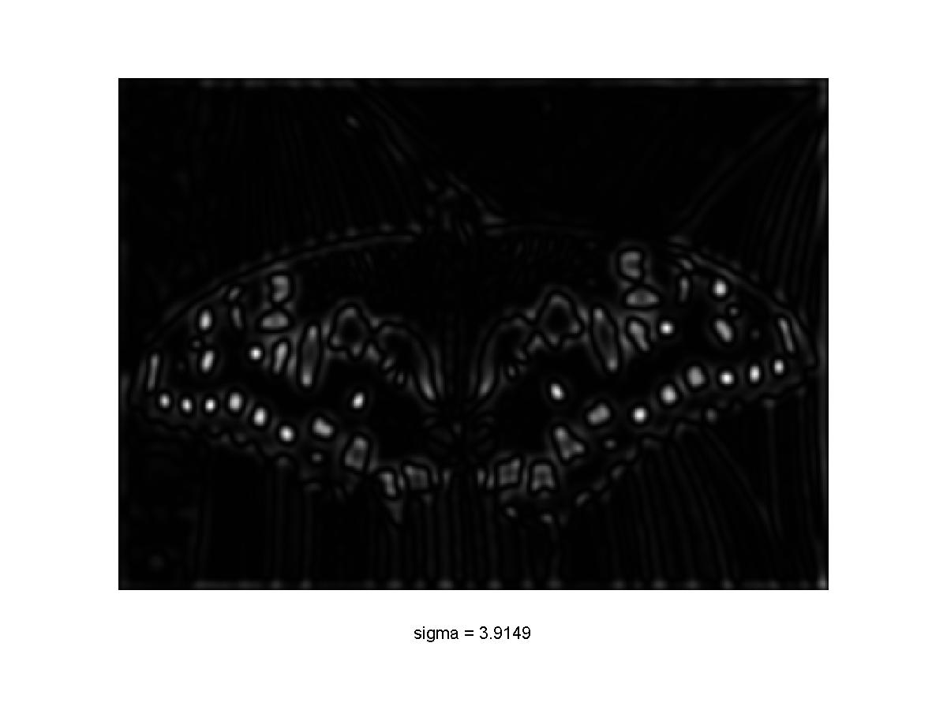
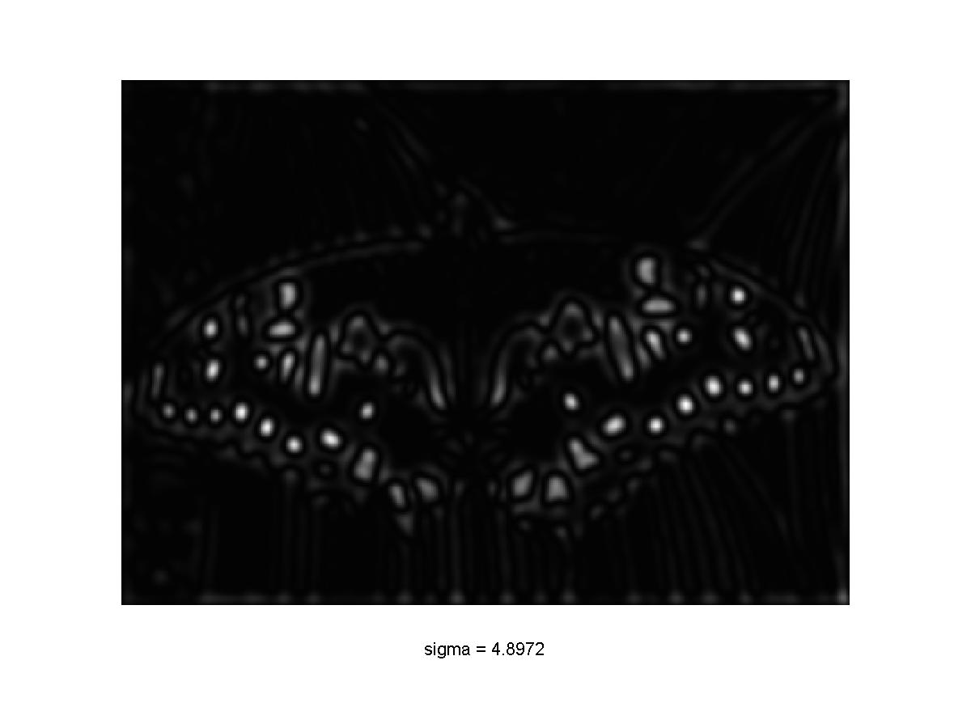

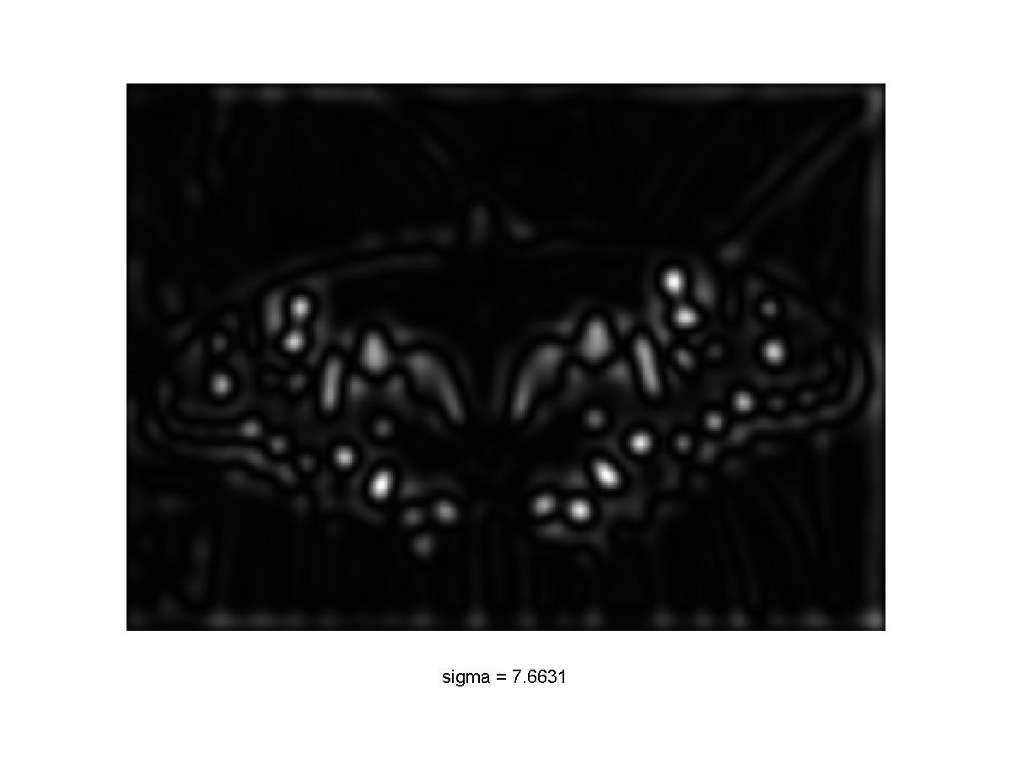
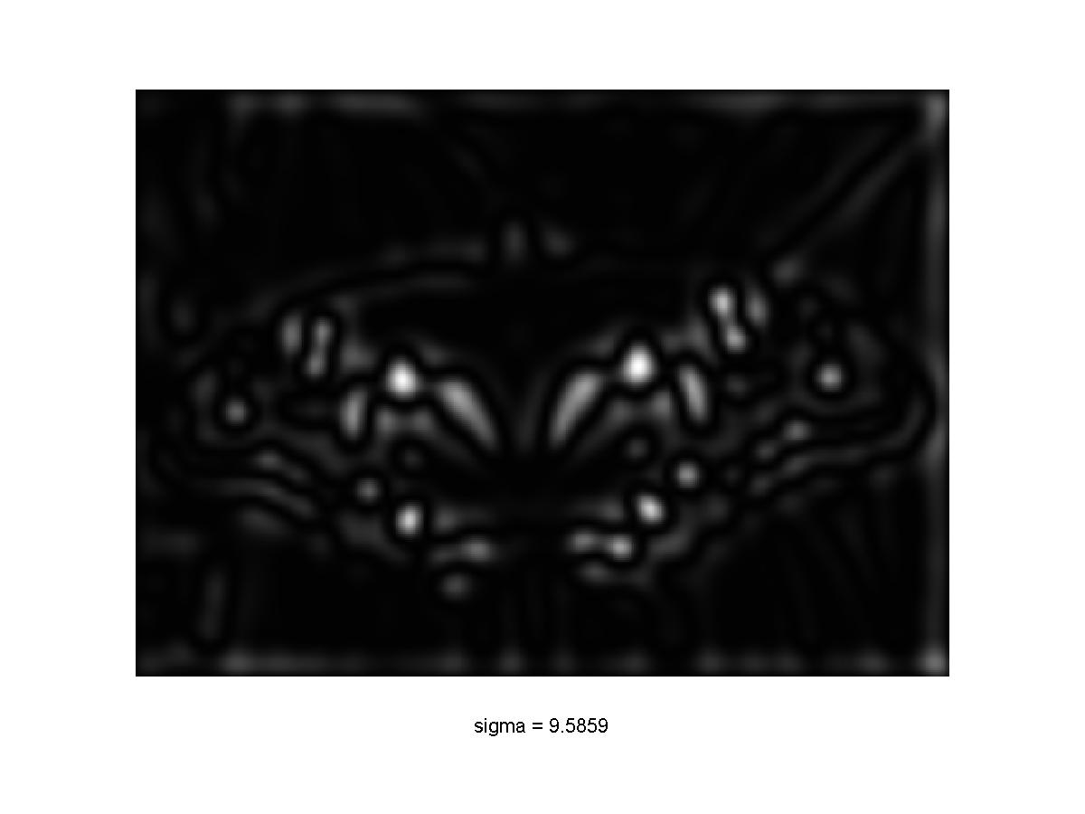
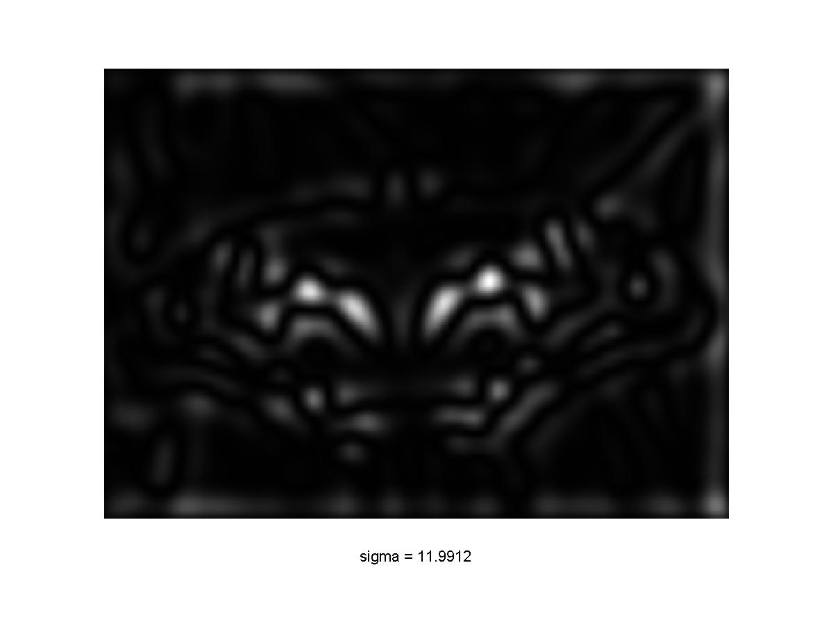
Scale-space blob detector: Example
Slide by Svetlana Lazebnik

Slide 35
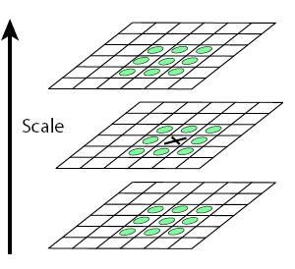
Scale-space blob detector
Convolve image with scale-normalized Laplacian at several scales
Find maxima of squared Laplacian response in scale-space
Slide by Svetlana Lazebnik

Slide 36
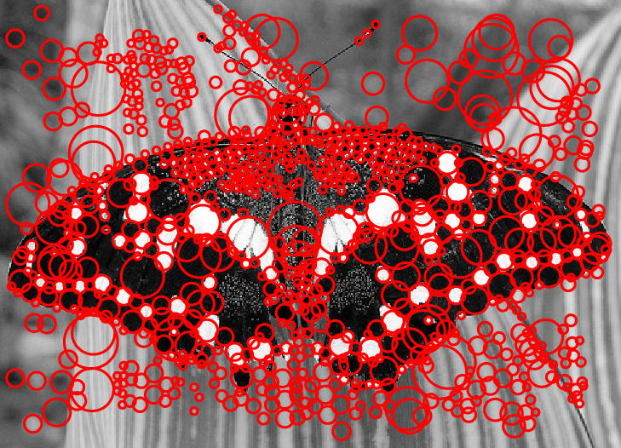
Scale-space blob detector: Example
Slide by Svetlana Lazebnik

Slide 37
Eliminating edge responses
Laplacian has strong response along edge
Slide by Svetlana Lazebnik

Slide 38
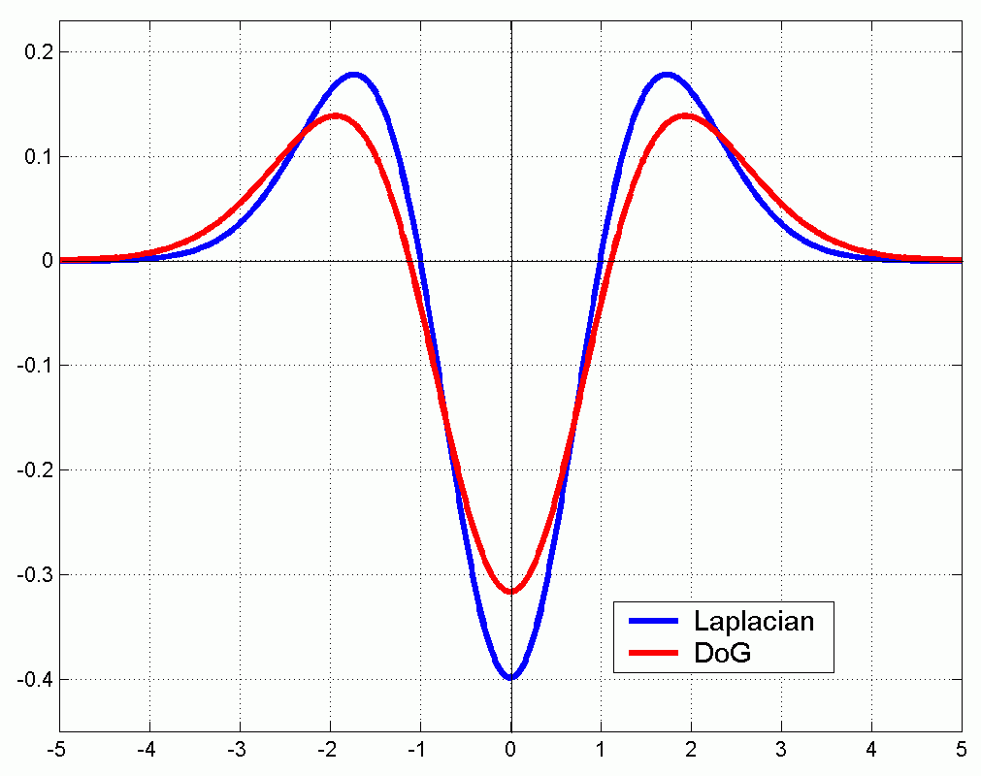
Efficient implementation
Approximating the Laplacian with a difference of Gaussians:
(Laplacian)
(Difference of Gaussians)
Slide by Svetlana Lazebnik

Slide 39
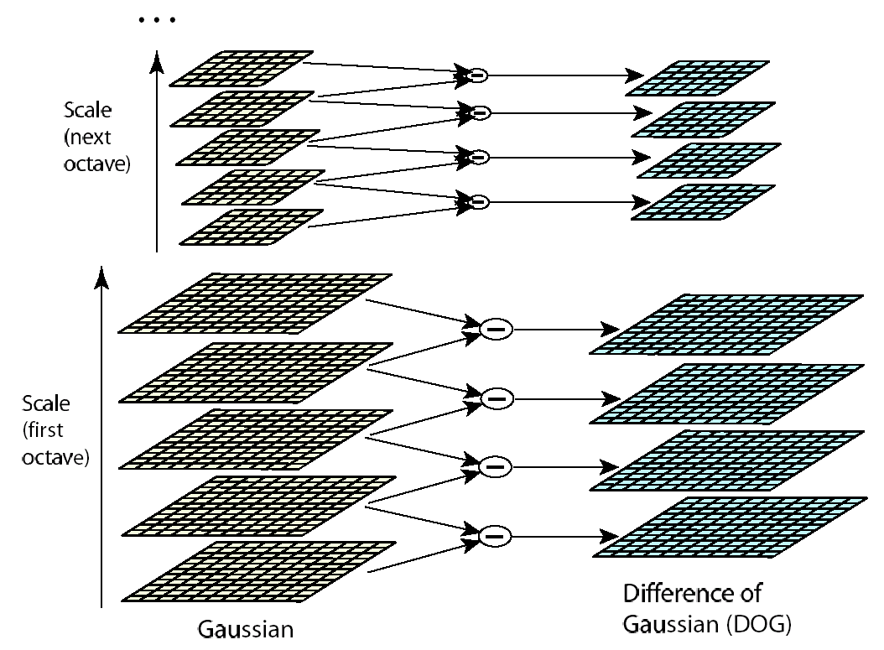
Efficient implementation
David G. Lowe. "Distinctive image features from scale-invariant keypoints.” IJCV 60 (2), pp. 91-110, 2004.

Slide 40
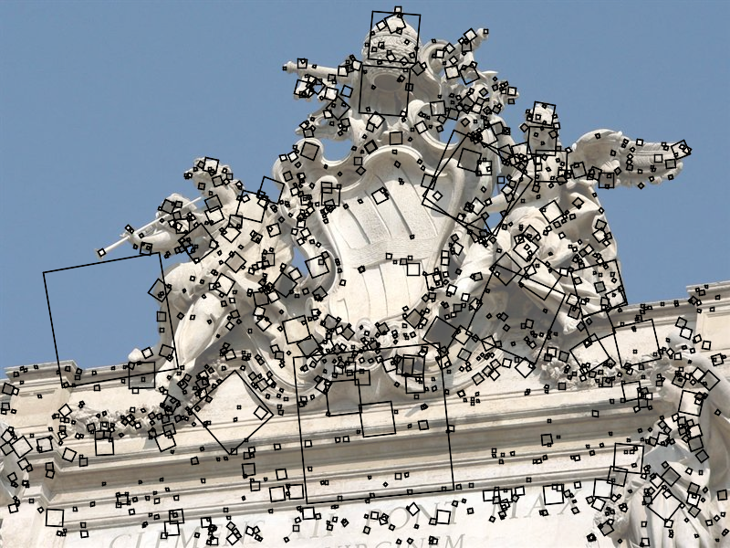
SIFT keypoint detection
D. Lowe, Distinctive image features from scale-invariant keypoints, IJCV 60 (2), pp. 91-110, 2004.

Slide 41
Questions?

