Slide 1
Neural Networks (NNs) Artificial Neural Networks (ANNs) Multi-layer Perceptrons (MLPs

Slide 2
Previous
Softmax Classifier
Inference vs Training
Gradient Descent (GD)
Stochastic Gradient Descent (SGD)
mini-batch Stochastic Gradient Descent (SGD)
Max-Margin Classifier
Regression vs Classification
Issues with Generalization / Overfitting
Regularization / momentum

Slide 3
Today’s Class
Neural Networks
The Perceptron Model
The Multi-layer Perceptron (MLP)
Forward-pass in an MLP (Inference)
Backward-pass in an MLP (Backpropagation)

Slide 4



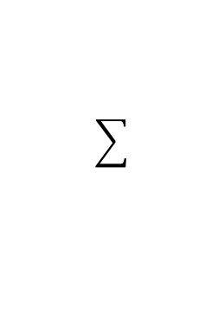
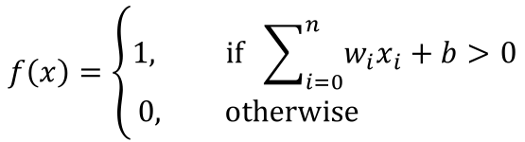






Perceptron Model
Frank Rosenblatt (1957) - Cornell University
Activation function
$$x_{1}$$
$$w_{1}$$
$$f\left(x\right)=\left\{\begin{aligned}1, if \sum_{i=0}^{n}{w_{i}x_{i}}+b>0 \\ &0, otherwise \end{aligned}\right.$$
$$x_{2}$$
$$w_{2}$$
$$w_{3}$$
$$x_{3}$$
$$w_{4}$$
$$x_{4}$$
More: https://en.wikipedia.org/wiki/Perceptron

Slide 5
Perceptron Model
Frank Rosenblatt (1957) - Cornell University
!?
$$x_{1}$$
$$w_{1}$$
$$f\left(x\right)=\left\{\begin{aligned}1, if \sum_{i=0}^{n}{w_{i}x_{i}}+b>0 \\ &0, otherwise \end{aligned}\right.$$
$$x_{2}$$
$$w_{2}$$
$$w_{3}$$
$$x_{3}$$
$$w_{4}$$
$$x_{4}$$
More: https://en.wikipedia.org/wiki/Perceptron

Slide 6
Perceptron Model
Frank Rosenblatt (1957) - Cornell University
Activation function
$$x_{1}$$
$$w_{1}$$
$$f\left(x\right)=\left\{\begin{aligned}1, if \sum_{i=0}^{n}{w_{i}x_{i}}+b>0 \\ &0, otherwise \end{aligned}\right.$$
$$x_{2}$$
$$w_{2}$$
$$w_{3}$$
$$x_{3}$$
$$w_{4}$$
$$x_{4}$$
More: https://en.wikipedia.org/wiki/Perceptron

Slide 7
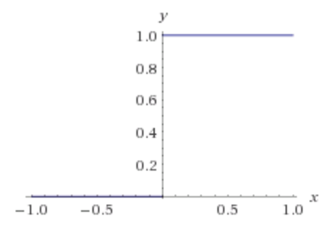
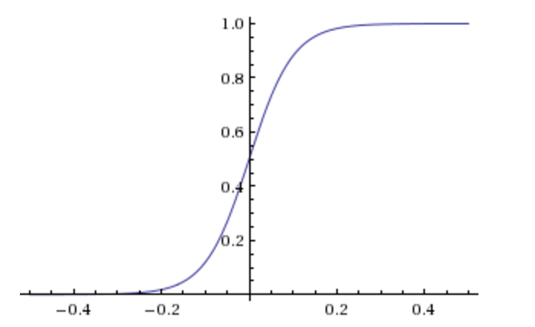
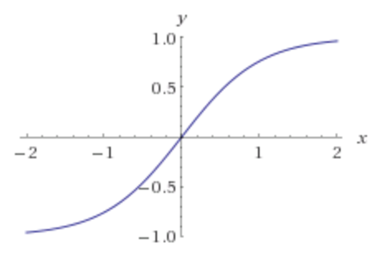
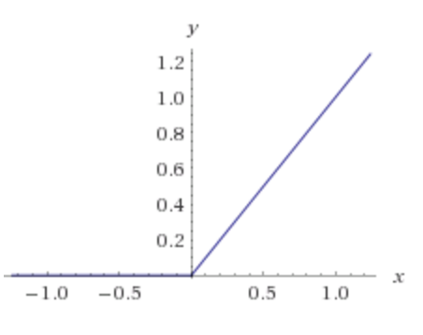
Activation Functions
Step(x)
Sigmoid(x)
Tanh(x)
ReLU(x) = max(0, x)

Slide 8






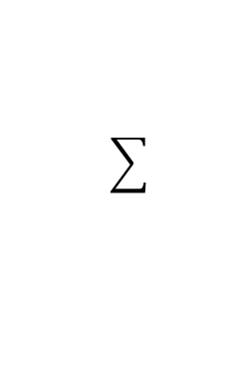




Two-layer Multi-layer Perceptron (MLP)
”hidden" layer
Loss / Criterion
$$x_{1}$$
$$a_{1}$$
$$x_{2}$$
$$a_{2}$$
$${\hat{y}}_{1}$$
$$y_{1}$$
$$x_{3}$$
$$a_{3}$$
$$x_{4}$$
$$a_{4}$$

Slide 9






Linear Softmax
$$x_{i}=[x_{i1} { x}_{i2} x_{i3} { x}_{i4}]$$
$$y_{i}=$$
[1 0 0]
$${\hat{y}}_{i}= [f_{c} f_{d} f_{b}]$$
$$g_{c}=w_{c1}x_{i1}+w_{c2}x_{i2}+w_{c3}x_{i3}+w_{c4}x_{i4}+b_{c}$$
$$g_{d}=w_{d1}x_{i1}+w_{d2}x_{i2}+w_{d3}x_{i3}+w_{d4}x_{i4}+b_{d}$$
$$g_{b}=w_{b1}x_{i1}+w_{b2}x_{i2}+w_{b3}x_{i3}+w_{b4}x_{i4}+b_{b}$$
$$f_{c}=e^{g_{c}}/{(e}^{g_{c}}+e^{g_{d}}+e^{g_{b}})$$
$$f_{d}=e^{g_{d}}/{(e}^{g_{c}}+e^{g_{d}}+e^{g_{b}})$$
$$f_{b}=e^{g_{b}}/{(e}^{g_{c}}+e^{g_{d}}+e^{g_{b}})$$

Slide 10

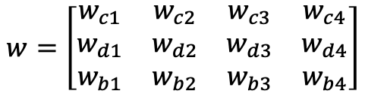
Linear Softmax
$$x_{i}=[x_{i1} { x}_{i2} x_{i3} { x}_{i4}]$$
$$y_{i}=$$
[1 0 0]
$${\hat{y}}_{i}= [f_{c} f_{d} f_{b}]$$
$$g_{c}=w_{c1}x_{i1}+w_{c2}x_{i2}+w_{c3}x_{i3}+w_{c4}x_{i4}+b_{c}$$
$$w=\left[\begin{matrix}w_{c1} & w_{c2} & w_{c3} & w_{c4} \\ w_{d1} & w_{d2} & w_{d3} & w_{d4} \\ w_{b1} & w_{b2} & w_{b3} & w_{b4}\end{matrix}\right]$$
$$g_{d}=w_{d1}x_{i1}+w_{d2}x_{i2}+w_{d3}x_{i3}+w_{d4}x_{i4}+b_{d}$$
$$g_{b}=w_{b1}x_{i1}+w_{b2}x_{i2}+w_{b3}x_{i3}+w_{b4}x_{i4}+b_{b}$$
$$b=\left[\begin{matrix}b_{c} & b_{d} & b_{b}\end{matrix}\right]$$
$$f_{c}=e^{g_{c}}/{(e}^{g_{c}}+e^{g_{d}}+e^{g_{b}})$$
$$f_{d}=e^{g_{d}}/{(e}^{g_{c}}+e^{g_{d}}+e^{g_{b}})$$
$$f_{b}=e^{g_{b}}/{(e}^{g_{c}}+e^{g_{d}}+e^{g_{b}})$$

Slide 11

Linear Softmax
$$x_{i}=[x_{i1} { x}_{i2} x_{i3} { x}_{i4}]$$
$$y_{i}=$$
[1 0 0]
$${\hat{y}}_{i}= [f_{c} f_{d} f_{b}]$$
$$w=\left[\begin{matrix}w_{c1} & w_{c2} & w_{c3} & w_{c4} \\ w_{d1} & w_{d2} & w_{d3} & w_{d4} \\ w_{b1} & w_{b2} & w_{b3} & w_{b4}\end{matrix}\right]$$
$$g=wx^{T}+b^{T}$$
$$b=\left[\begin{matrix}b_{c} & b_{d} & b_{b}\end{matrix}\right]$$
$$f_{c}=e^{g_{c}}/{(e}^{g_{c}}+e^{g_{d}}+e^{g_{b}})$$
$$f_{d}=e^{g_{d}}/{(e}^{g_{c}}+e^{g_{d}}+e^{g_{b}})$$
$$f_{b}=e^{g_{b}}/{(e}^{g_{c}}+e^{g_{d}}+e^{g_{b}})$$

Slide 12

Linear Softmax
$$x_{i}=[x_{i1} { x}_{i2} x_{i3} { x}_{i4}]$$
$$y_{i}=$$
[1 0 0]
$${\hat{y}}_{i}= [f_{c} f_{d} f_{b}]$$
$$w=\left[\begin{matrix}w_{c1} & w_{c2} & w_{c3} & w_{c4} \\ w_{d1} & w_{d2} & w_{d3} & w_{d4} \\ w_{b1} & w_{b2} & w_{b3} & w_{b4}\end{matrix}\right]$$
$$g=wx^{T}+b^{T}$$
$$b=\left[\begin{matrix}b_{c} & b_{d} & b_{b}\end{matrix}\right]$$
$$f=softmax(g)$$

Slide 13

Linear Softmax
$$x_{i}=[x_{i1} { x}_{i2} x_{i3} { x}_{i4}]$$
$$y_{i}=$$
[1 0 0]
$${\hat{y}}_{i}= [f_{c} f_{d} f_{b}]$$
$$f=softmax(wx^{T}+b^{T})$$

Slide 14


Two-layer MLP + Softmax
$$x_{i}=[x_{i1} { x}_{i2} x_{i3} { x}_{i4}]$$
$$y_{i}=$$
[1 0 0]
$${\hat{y}}_{i}= [f_{c} f_{d} f_{b}]$$
$$a_{1}=sigmoid(w_{[1]}x^{T}+b_{[1]}^{T})$$
$$f=softmax(w_{[2]}x^{T}+b_{[2]}^{T})$$

Slide 15





N-layer MLP + Softmax
$$x_{i}=[x_{i1} { x}_{i2} x_{i3} { x}_{i4}]$$
$$y_{i}=$$
[1 0 0]
$${\hat{y}}_{i}= [f_{c} f_{d} f_{b}]$$
$$a_{1}=sigmoid(w_{[1]}x^{T}+b_{[1]}^{T})$$
$$a_{2}=sigmoid(w_{[2]}a_{1}^{T}+b_{[2]}^{T})$$
$$…$$
$$a_{k}=sigmoid(w_{[k]}a_{k−1}^{T}+b_{[k]}^{T})$$
$$…$$
$$f=softmax(w_{[n]}a_{n−1}^{T}+b_{[n]}^{T})$$

Slide 16





How to train the parameters?
$$x_{i}=[x_{i1} { x}_{i2} x_{i3} { x}_{i4}]$$
$$y_{i}=$$
[1 0 0]
$${\hat{y}}_{i}= [f_{c} f_{d} f_{b}]$$
$$a_{1}=sigmoid(w_{[1]}x^{T}+b_{[1]}^{T})$$
$$a_{2}=sigmoid(w_{[2]}a_{1}^{T}+b_{[2]}^{T})$$
$$…$$
$$a_{k}=sigmoid(w_{[k]}a_{k−1}^{T}+b_{[k]}^{T})$$
$$…$$
$$f=softmax(w_{[n]}a_{n−1}^{T}+b_{[n]}^{T})$$

Slide 17

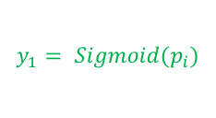
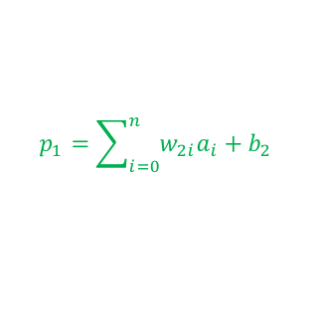
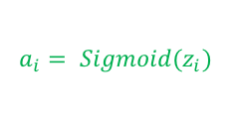
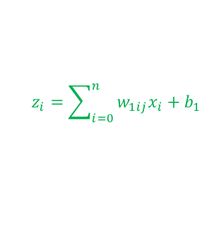
Forward pass (Forward-propagation)
$$z_{i}=\sum_{i=0}^{n}{w_{1ij}x_{i}}+b_{1}$$
$$a_{i}= Sigmoid(z_{i})$$
$$p_{1}=\sum_{i=0}^{n}{w_{2i}a_{i}}+b_{2}$$
$$y_{1}= Sigmoid(p_{i})$$
$$x_{1}$$
$$a_{1}$$
$$x_{2}$$
$$a_{2}$$
$${\hat{y}}_{1}$$
$$y_{1}$$
$$x_{3}$$
$$a_{3}$$
$$x_{4}$$
$$a_{4}$$
$Loss=L(y_{1},$ ${\hat{y}}_{1})$

Slide 18
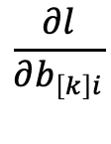
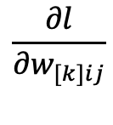

How to train the parameters?
$$x_{i}=[x_{i1} { x}_{i2} x_{i3} { x}_{i4}]$$
$$y_{i}=$$
[1 0 0]
$${\hat{y}}_{i}= [f_{c} f_{d} f_{b}]$$
$$a_{1}=sigmoid(w_{[1]}x^{T}+b_{[1]}^{T})$$
$$a_{2}=sigmoid(w_{[2]}a_{1}^{T}+b_{[2]}^{T})$$
$$…$$
We can still use SGD
$$a_{k}=sigmoid(w_{[k]}a_{k−1}^{T}+b_{[i]}^{T})$$
$$…$$
We need!
$$\frac{∂l}{∂w_{[k]ij}}$$
$$\frac{∂l}{∂b_{\left[k\right]i}}$$
$$f=softmax(w_{[n]}a_{n−1}^{T}+b_{[n]}^{T})$$

Slide 19



How to train the parameters?
$$x_{i}=[x_{i1} { x}_{i2} x_{i3} { x}_{i4}]$$
$$y_{i}=$$
[1 0 0]
$${\hat{y}}_{i}= [f_{c} f_{d} f_{b}]$$
$$a_{1}=sigmoid(w_{[1]}x^{T}+b_{[1]}^{T})$$
$$a_{2}=sigmoid(w_{[2]}a_{1}^{T}+b_{[2]}^{T})$$
$$…$$
We can still use SGD
$$a_{i}=sigmoid(w_{[k]}a_{k−1}^{T}+b_{[k]}^{T})$$
$$…$$
We need!
$$f=softmax(w_{[n]}a_{n−1}^{T}+b_{[n]}^{T})$$
$$\frac{∂l}{∂w_{[k]ij}}$$
$$\frac{∂l}{∂b_{\left[k\right]i}}$$
$$l=loss(f, y)$$

Slide 20
How to train the parameters?
$$x_{i}=[x_{i1} { x}_{i2} x_{i3} { x}_{i4}]$$
$$y_{i}=$$
[1 0 0]
$${\hat{y}}_{i}= [f_{c} f_{d} f_{b}]$$
$$a_{1}=sigmoid(w_{[1]}x^{T}+b_{[1]}^{T})$$
$$a_{2}=sigmoid(w_{[2]}a_{1}^{T}+b_{[2]}^{T})$$
$$…$$
We can still use SGD
$$a_{i}=sigmoid(w_{[k]}a_{k−1}^{T}+b_{[k]}^{T})$$
$$…$$
We need!
$$f=softmax(w_{[n]}a_{n−1}^{T}+b_{[n]}^{T})$$
$$\frac{∂l}{∂w_{[k]ij}}$$
$$\frac{∂l}{∂b_{\left[k\right]i}}$$
$$l=loss(f, y)$$

Slide 21
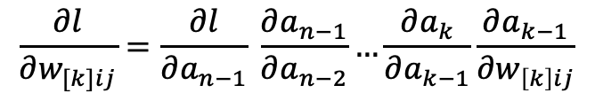
How to train the parameters?
$$x_{i}=[x_{i1} { x}_{i2} x_{i3} { x}_{i4}]$$
$$y_{i}=$$
[1 0 0]
$${\hat{y}}_{i}= [f_{c} f_{d} f_{b}]$$
$$a_{1}=sigmoid(w_{[1]}x^{T}+b_{[1]}^{T})$$
$$a_{2}=sigmoid(w_{[2]}a_{1}^{T}+b_{[2]}^{T})$$
$$…$$
$$\frac{∂l}{∂w_{[k]ij}}=\frac{∂l}{∂a_{n−1}} \frac{∂a_{n−1}}{∂a_{n−2}}…\frac{∂a_{k}}{∂a_{k−1}}\frac{∂a_{k−1}}{∂w_{\left[k\right]ij}}$$
$$a_{i}=sigmoid(w_{[k]}a_{k−1}^{T}+b_{[k]}^{T})$$
$$…$$
$$f=softmax(w_{[n]}a_{n−1}^{T}+b_{[n]}^{T})$$
$$l=loss(f, y)$$

Slide 22







Backward pass (Back-propagation)
$${\frac{∂L}{∂x_{k}}}_{}=(\frac{∂}{∂x_{k}}\sum_{i=0}^{n}{w_{1ij}x_{i}}+b_{1})\frac{∂L}{∂z_{i}}$$
$${\frac{∂L}{∂z_{i}}}_{}=\frac{∂}{∂z_{i}}Sigmoid(z_{i})\frac{∂L}{∂a_{k}}$$
$${\frac{∂L}{∂a_{k}}}_{}=(\frac{∂}{∂a_{k}}\sum_{i=0}^{n}{w_{2i}a_{i}}+b_{2})\frac{∂L}{∂p_{1}}$$
${\frac{∂L}{∂p_{1}}}_{}=\frac{∂}{∂p_{1}}Sigmoid(p_{i})$ $\frac{∂L}{∂{\hat{y}}_{1}}$
$$x_{1}$$
$$a_{1}$$
$$x_{2}$$
$$a_{2}$$
$${\hat{y}}_{1}$$
$$y_{1}$$
$$x_{3}$$
$$a_{3}$$
$$x_{4}$$
$$a_{4}$$
$${\frac{∂L}{∂w_{2i}}=\frac{∂a_{k}}{∂w_{2i}}\frac{∂L}{∂a_{k}}}_{}$$
$\frac{∂L}{∂{\hat{y}}_{1}}=\frac{∂}{∂{\hat{y}}_{1}}L(y_{1},$ ${\hat{y}}_{1})$
$${\frac{∂L}{∂w_{1ij}}=\frac{∂x_{k}}{∂w_{1ij}}\frac{∂L}{∂x_{k}}}_{}$$

Slide 23


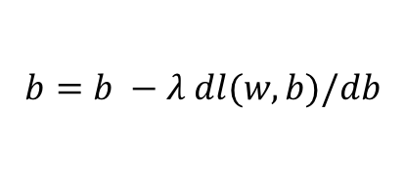
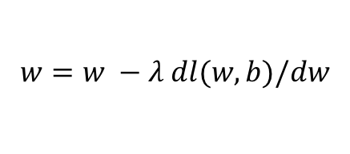


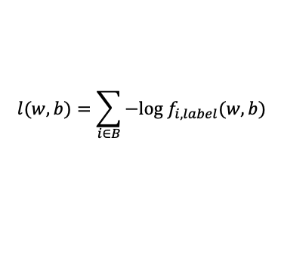
(mini-batch) Stochastic Gradient Descent (SGD)
$$l(w,b)=\sum_{i∈B}{−log f_{i,label}(w,b)}$$
$$λ=0.01$$
Initialize w and b randomly
For Softmax Classifier
for e = 0, num_epochs do
for b = 0, num_batches do
Compute:
$$dl(w,b)/dw$$
and
$$dl(w,b)/db$$
Update w:
$$w=w −λ dl(w,b)/dw$$
Update b:
$$b=b −λ dl(w,b)/db$$
Print:
$$l(w,b)$$
// Useful to see if this is becoming smaller or not.
end
end

Slide 24
Automatic Differentiation
You only need to write code for the forward pass,
backward pass is computed automatically.
Frameworks such as Pytorch will “record” the operations performed on tensors and compute gradients through the “recorded” operations when requested.
Pytorch (Facebook -- mostly):
Tensorflow (Google -- mostly):
DyNet (team includes UVA Prof. Yangfeng Ji):
https://pytorch.org/
https://www.tensorflow.org/
http://dynet.io/

Slide 25
Example
Provided in Assignments 3 and Assignment 4.
Let’s dissect Assignment 3…

Slide 26
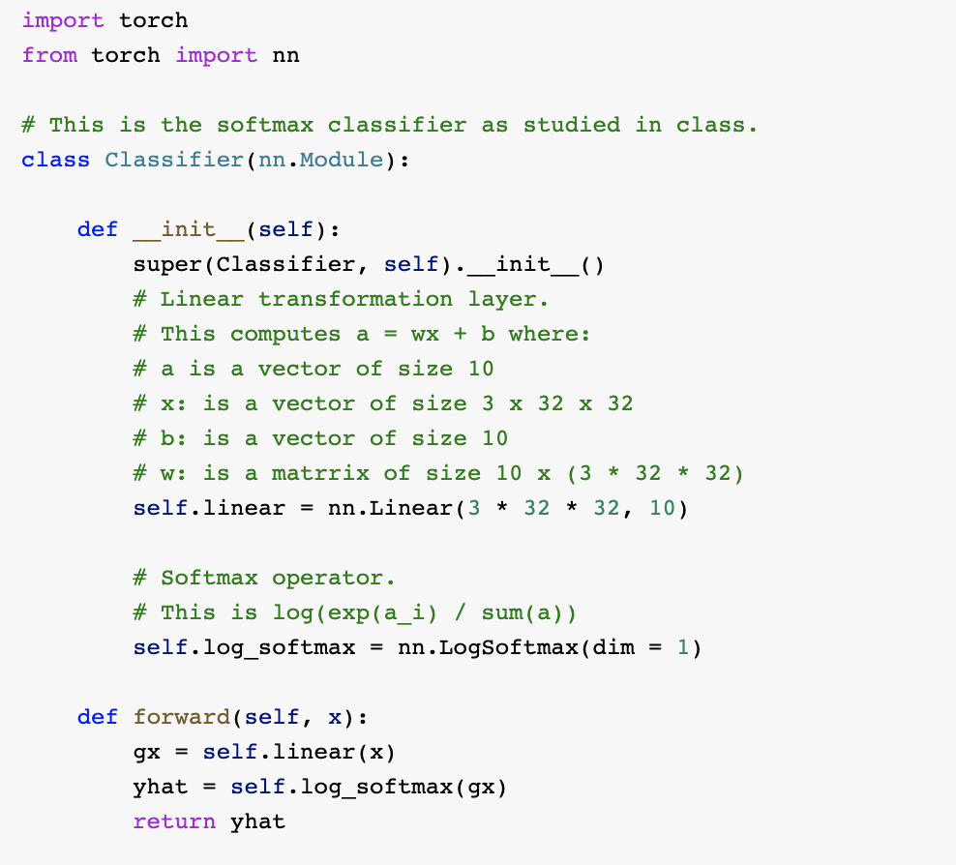
Defining a Linear Softmax classifier

Slide 27
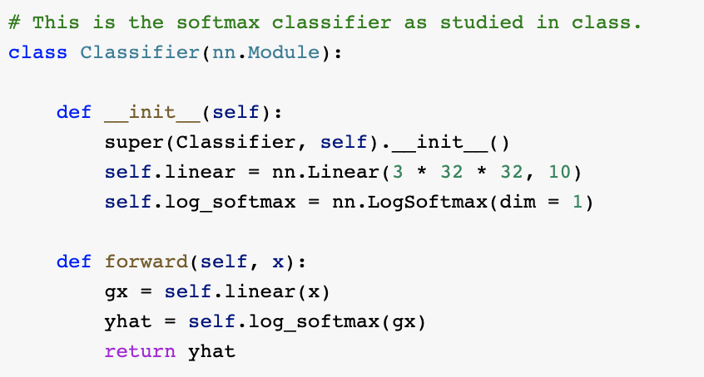
Defining a Linear Softmax classifier

Slide 28
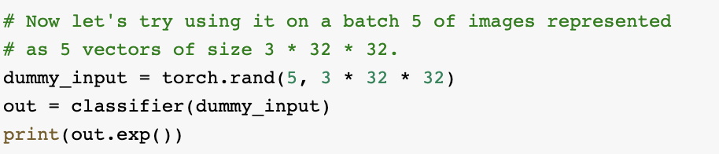
Using a Linear Softmax classifier

Slide 29
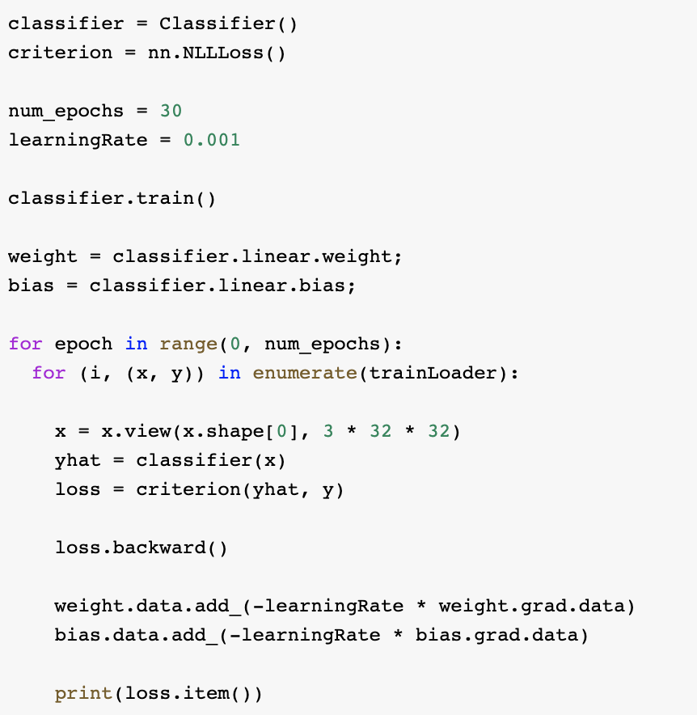
Training a Linear Softmax classifier

Slide 30
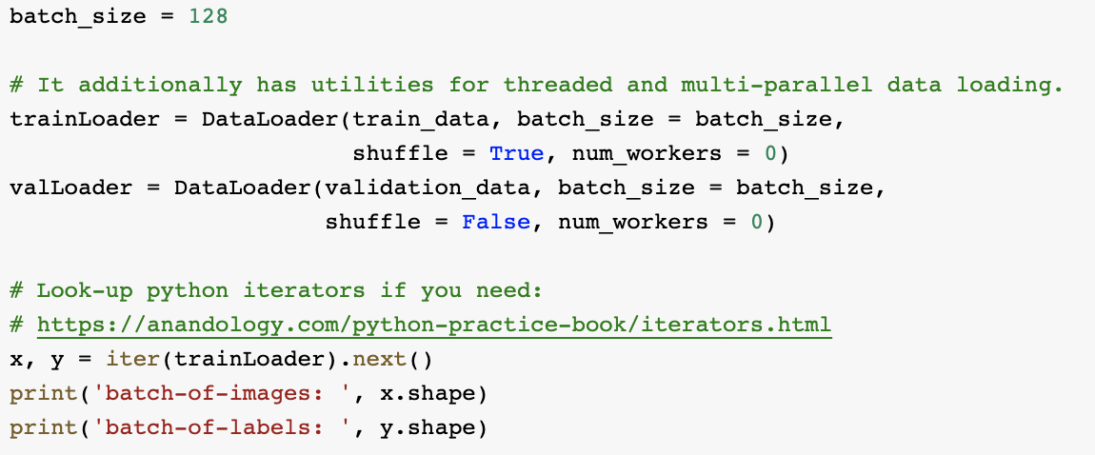
What is trainLoader?

Slide 31
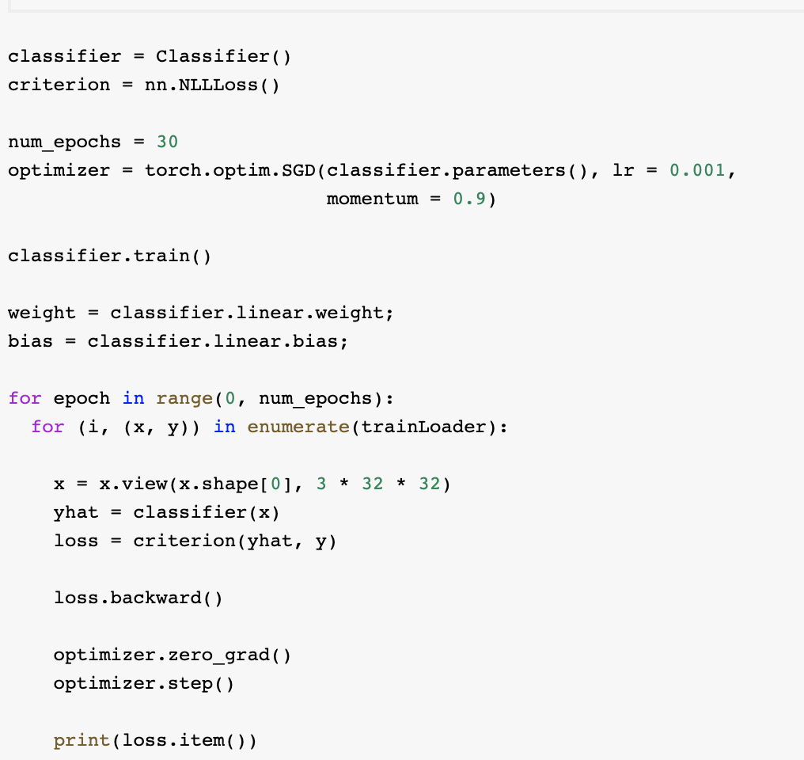
Training a Linear Softmax classifier (improved)
This depends on the model but we don’t need it anymore

Slide 32
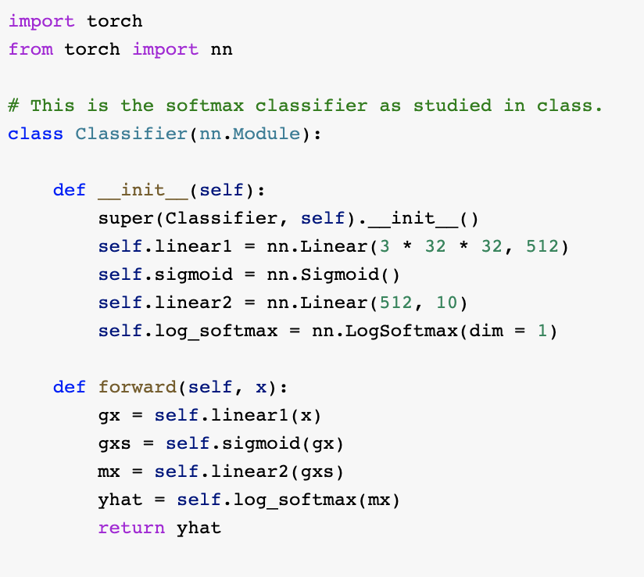
Defining a Two-layer Neural Network

Slide 33
Questions?

