Slide 1
3D Vision: Camera Calibration and Dense Stereo
Various slides from previous courses by:
D.A. Forsyth (Berkeley / UIUC), I. Kokkinos (Ecole Centrale / UCL). S. Lazebnik (UNC / UIUC), S. Seitz (MSR / Facebook), J. Hays (Brown / Georgia Tech), A. Berg (Stony Brook / UNC), D. Samaras (Stony Brook) . J. M. Frahm (UNC), V. Ordonez (UVA), Steve Seitz (UW).

Slide 2
Today’s Class
Camera Calibration
Stereo Vision – Dense Stereo / Stereo Matching

Slide 3
Camera Calibration
What does it mean?

Slide 4

Slide Credit: Silvio Saverese
Recall the Projection matrix
R,T
j_{w}
k_{w}
O_{w}
i_{w}
x: Image Coordinates: (u,v,1)
K: Intrinsic Matrix (3x3)
R: Rotation (3x3)
t: Translation (3x1)
X: World Coordinates: (X,Y,Z,1)
Notes:
We can use homogeneous coordinates to write camera matrix in linear form.

Slide 5
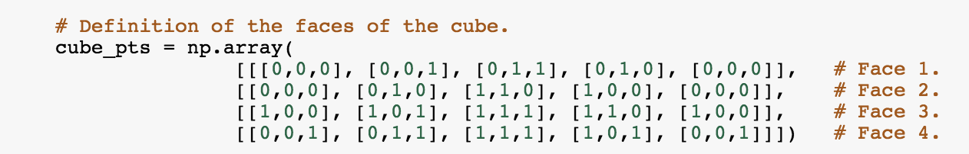
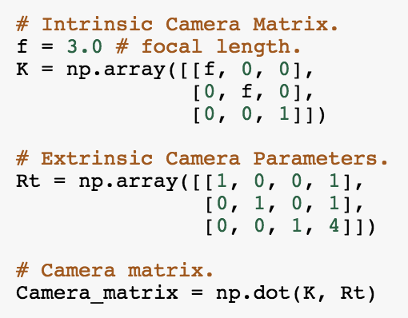


Recall the Projection matrix
$$X=$$
$$K[R t]=$$
Notes:
We can use homogeneous coordinates to write camera matrix in linear form.

Slide 6
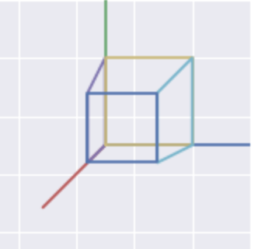

Recall the Projection matrix
$$X=$$
Goal: Find
$$x$$
$$K[R t]=$$
Notes:
We can use homogeneous coordinates to write camera matrix in linear form.

Slide 7

Camera Calibration
$$X=$$
$$x=$$
Notes:
We can use homogeneous coordinates to write camera matrix in linear form.

Slide 8

Camera Calibration
$$X=$$
Goal: Find
$$x=$$
$$K[R t]$$
Notes:
We can use homogeneous coordinates to write camera matrix in linear form.

Slide 9

Calibrating the Camera
Slide Credit: James Hays
Use an scene with known geometry
  Correspond image points to 3d points
  Get least squares solution (or non-linear solution)
Known 2d image coords
Known 3d locations
Unknown Camera Parameters

Slide 10
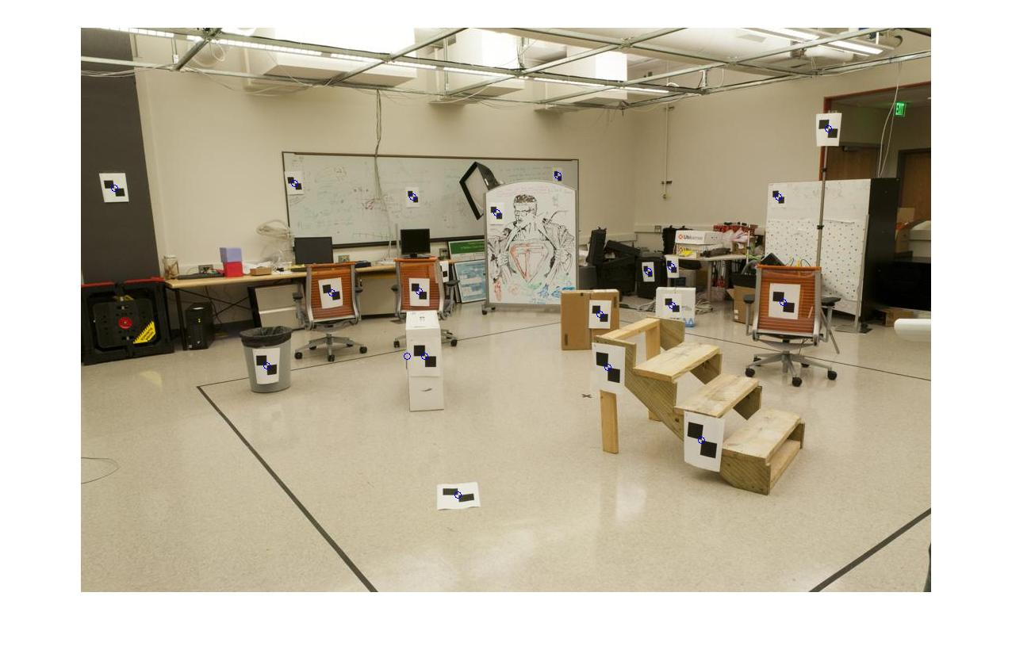
How do we calibrate a camera?
Slide Credit: James Hays
Known 2d image coords
Known 3d locations
880 214
43 203
270 197
886 347
745 302
943 128
476 590
419 214
317 335
783 521
235 427
665 429
655 362
427 333
412 415
746 351
434 415
525 234
716 308
602 187
312.747 309.140 30.086
305.796 311.649 30.356
307.694 312.358 30.418
310.149 307.186 29.298
311.937 310.105 29.216
311.202 307.572 30.682
307.106 306.876 28.660
309.317 312.490 30.230
307.435 310.151 29.318
308.253 306.300 28.881
306.650 309.301 28.905
308.069 306.831 29.189
309.671 308.834 29.029
308.255 309.955 29.267
307.546 308.613 28.963
311.036 309.206 28.913
307.518 308.175 29.069
309.950 311.262 29.990
312.160 310.772 29.080
311.988 312.709 30.514

Slide 11
Unknown Camera Parameters
Slide Credit: James Hays
Known 2d image coords
Known 3d locations

Slide 12
Unknown Camera Parameters
Slide Credit: James Hays
Known 2d image coords
Known 3d locations

Slide 13
Unknown Camera Parameters
Slide Credit: James Hays
Known 2d image coords
Known 3d locations

Slide 14
Unknown Camera Parameters
Slide Credit: James Hays
Known 2d image coords
Known 3d locations
Method 1 – homogeneous linear system. Solve for m’s entries using linear least squares
[U, S, V] = svd(A);
M = V(:,end);
M = reshape(M,[],3)';

Slide 15
Unknown Camera Parameters
Slide Credit: James Hays
Known 2d image coords
Known 3d locations
Method 2 – nonhomogeneous linear system. Solve for m’s entries using linear least squares
Ax=b form
M = A\Y;
M = [M;1];
M = reshape(M,[],3)';

Slide 16
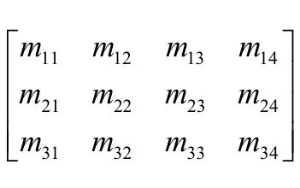
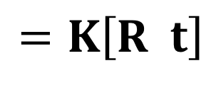
Can we factorize M back to K [R | T]?
$$=K\left[R t\right]$$
Yes!
You can use RQ factorization (note – not the more familiar QR factorization). R (right diagonal) is K, and Q (orthogonal basis) is R. T, the last column of [R | T], is inv(K) * last column of M.
  But you need to do a bit of post-processing to make sure that the matrices are valid. See http://ksimek.github.io/2012/08/14/decompose/
Credit: James Hays

Slide 17

Stereo:
Epipolar geometry
Vicente Ordonez
University of Virginia
Slides by Kristen Grauman

Slide 18
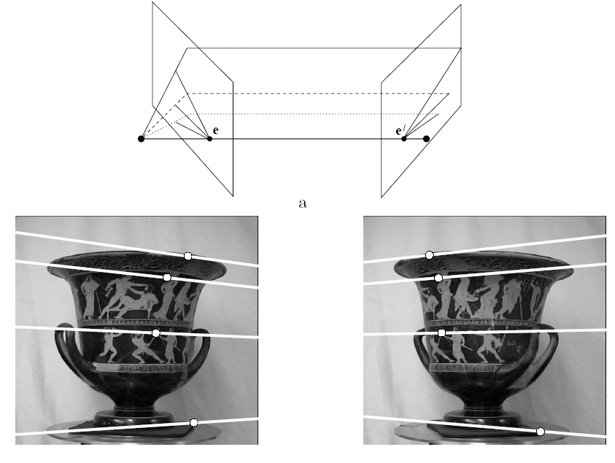
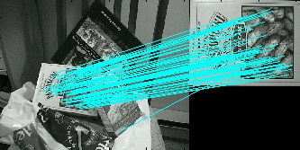
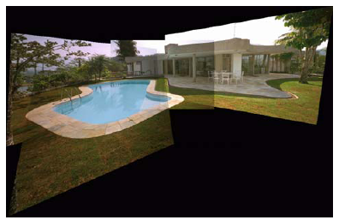
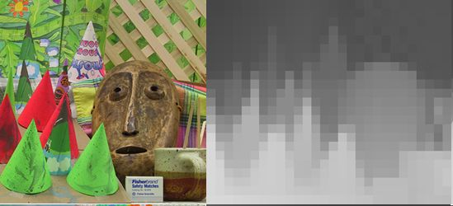
Multiple views
Multi-view geometry, matching, invariant features, stereo vision
Lowe
Hartley and Zisserman

Slide 19
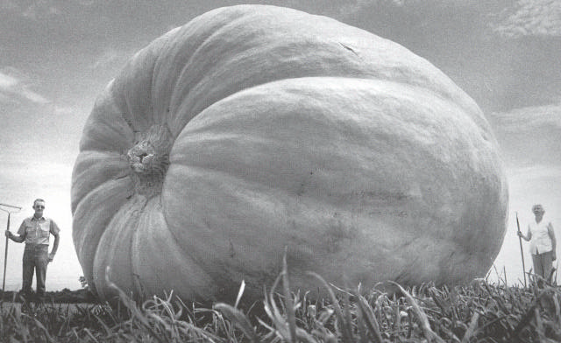
Why multiple views?
Structure and depth are inherently ambiguous from single views.
Images from Lana Lazebnik

Slide 20
Why multiple views?
Structure and depth are inherently ambiguous from single views.
P1
P2
P1’=P2’
Optical center

Slide 21
What cues help us to perceive 3d shape and depth?

Slide 22
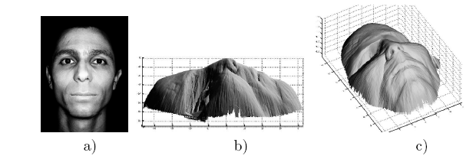
Shading
[Figure from Prados & Faugeras 2006]
Notes:
22

Slide 23
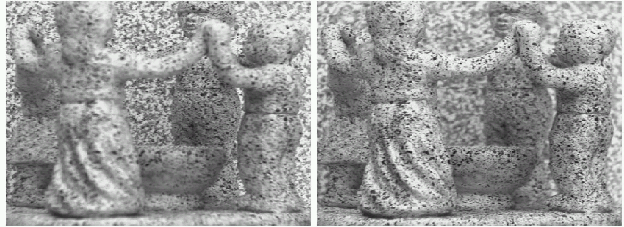
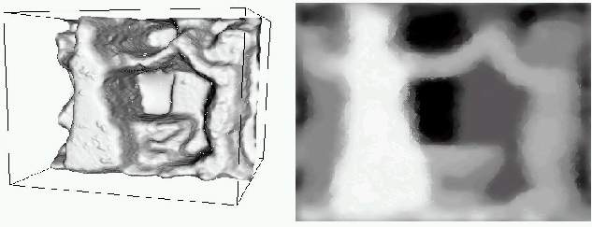
Focus/defocus
Images from same point of view, different camera parameters
3d shape / depth estimates
[figs from H. Jin and P. Favaro, 2002]

Slide 24
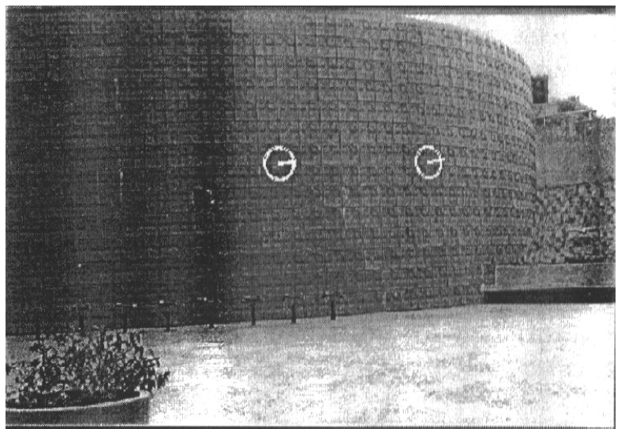
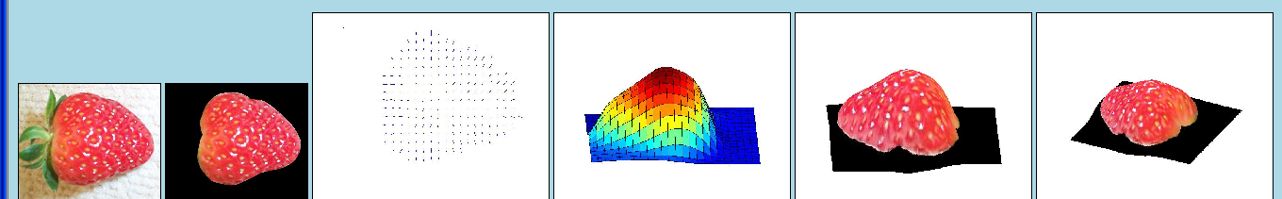
Texture
[From A.M. Loh. The recovery of 3-D structure using visual texture patterns. PhD thesis]
Notes:
24

Slide 25

Perspective effects
Image credit: S. Seitz

Slide 26
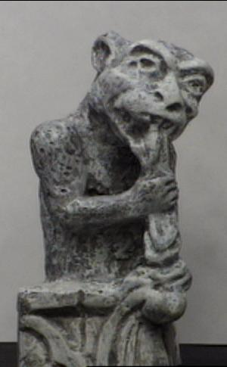
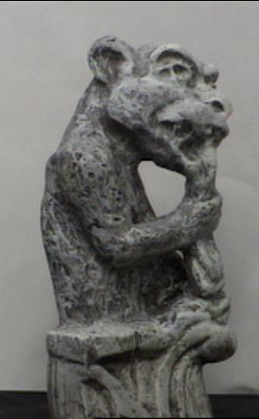
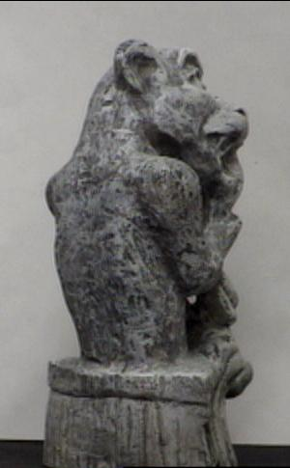
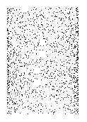
Motion
Figures from L. Zhang
http://www.brainconnection.com/teasers/?main=illusion/motion-shape

Slide 27
Estimating scene shape
“Shape from X”: Shading, Texture, Focus, Motion…
Stereo:
  shape from “motion” between two views
  infer 3d shape of scene from two (multiple) images from different viewpoints
Main idea:
scene point
image plane
optical center
Notes:
27

Slide 28
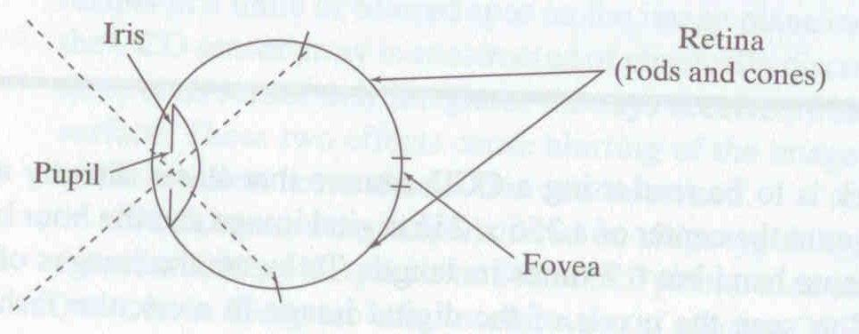
Human eye
Rough analogy with human visual system:
Pupil/Iris – control amount of light passing through lens
Retina - contains sensor cells, where image is formed
Fovea – highest concentration of cones
Fig from Shapiro and Stockman

Slide 29
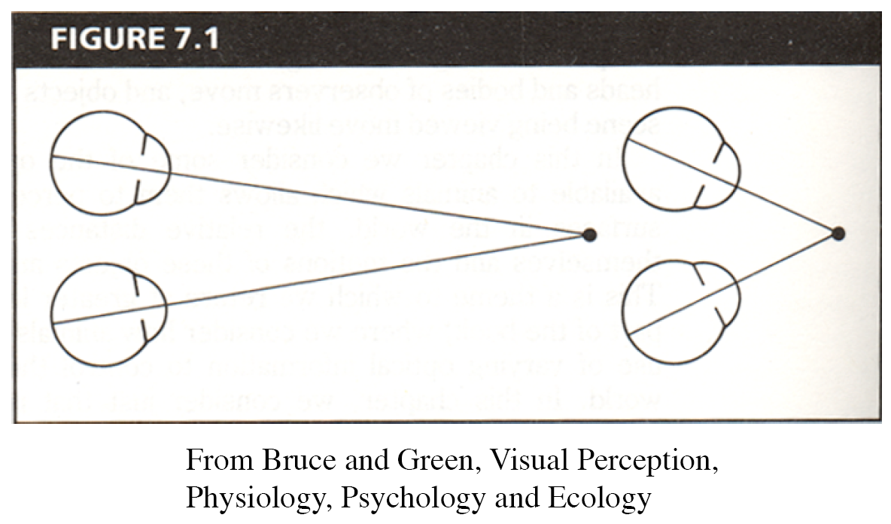
Human eyes fixate on point in space – rotate so that corresponding images form in centers of fovea.
Human stereopsis: disparity
Notes:
29

Slide 30
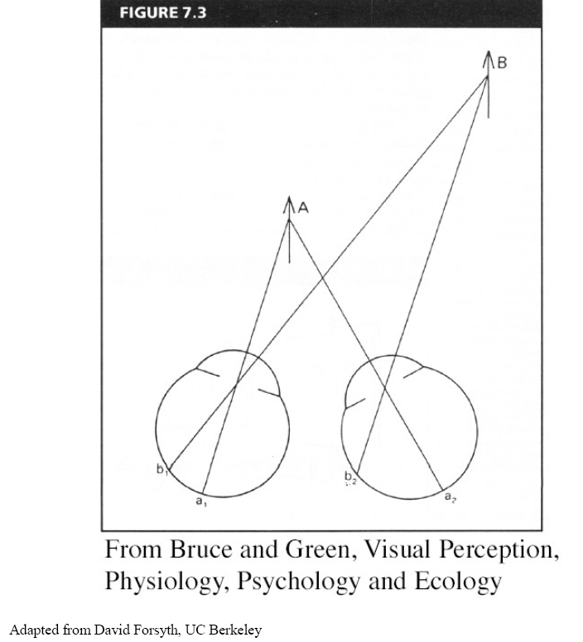
Human stereopsis: disparity
Disparity occurs when eyes fixate on one object; others appear at different visual angles
Notes:
30

Slide 31
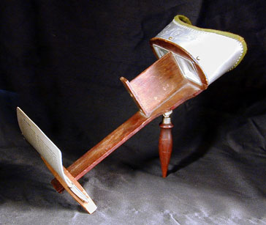
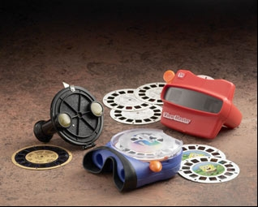
Stereo photography and stereo viewers
Take two pictures of the same subject from two slightly different viewpoints and display so that each eye sees only one of the images.
Image from fisher-price.com
Invented by Sir Charles Wheatstone, 1838

Slide 32
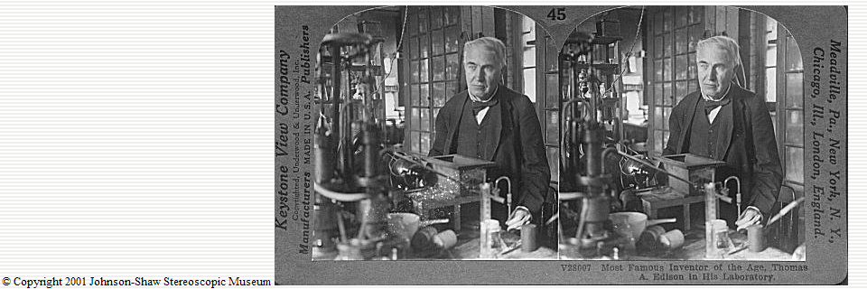
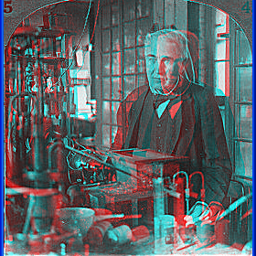
http://www.johnsonshawmuseum.org
Notes:
32

Slide 33
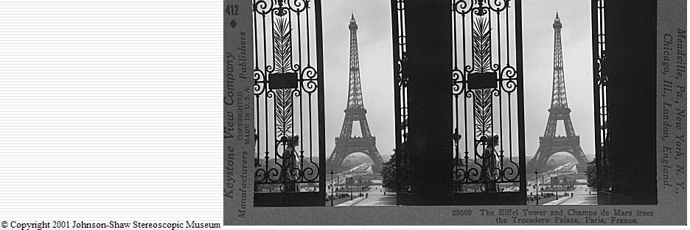
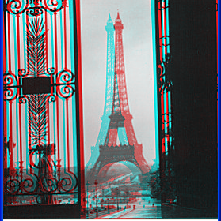
http://www.johnsonshawmuseum.org
Notes:
33

Slide 34


Public Library, Stereoscopic Looking Room, Chicago, by Phillips, 1923
Notes:
34

Slide 35
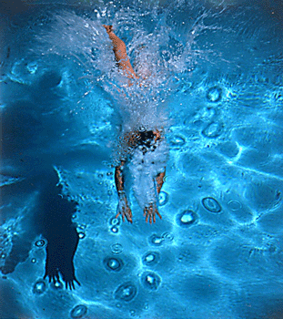
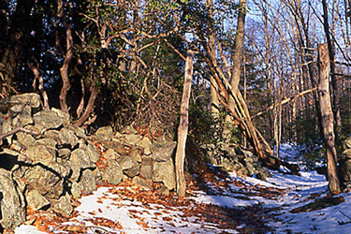
http://www.well.com/~jimg/stereo/stereo_list.html
Notes:
35

Slide 36
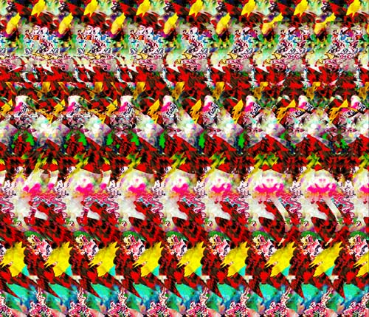
Autostereograms
Exploit disparity as depth cue using single image.
(Single image random dot stereogram, Single image stereogram)
Images from magiceye.com
Notes:
36

Slide 37
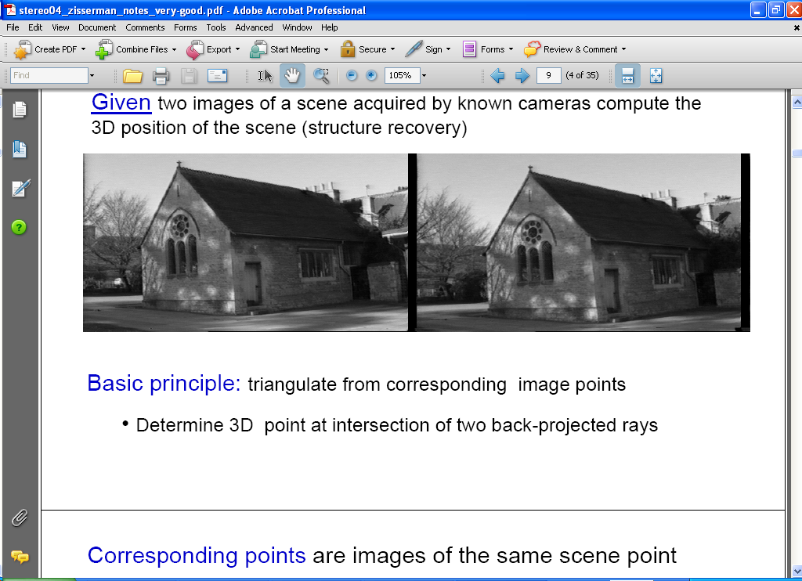
Estimating depth with stereo
Stereo: shape from “motion” between two views
We’ll need to consider:
Info on camera pose (“calibration”)
Image point correspondences
scene point
image plane
optical center
Notes:
37

Slide 38

Key idea: Epipolar constraint
X
X
X
x
x’
x’
x’
Potential matches for x have to lie on the corresponding line l’.
Potential matches for x’ have to lie on the corresponding line l.

Slide 39

Epipolar geometry: notation
X
x
x’
Baseline – line connecting the two camera centers
Epipoles
= intersections of baseline with image planes
= projections of the other camera center
Epipolar Plane – plane containing baseline (1D family)

Slide 40
Epipolar geometry: notation
X
x
x’
Baseline – line connecting the two camera centers
Epipoles
= intersections of baseline with image planes
= projections of the other camera center
Epipolar Plane – plane containing baseline (1D family)
Epipolar Lines - intersections of epipolar plane with image
planes (always come in corresponding pairs)

Slide 41



Example: Converging cameras

Slide 42
Geometry for a simple stereo system
First, assuming parallel optical axes, known camera parameters (i.e., calibrated cameras):

Slide 43
Simplest Case: Parallel images
Image planes of cameras are parallel to each other and to the baseline
Camera centers are at same height
Focal lengths are the same
Then epipolar lines fall along the horizontal scan lines of the images

Slide 44


Slide 45
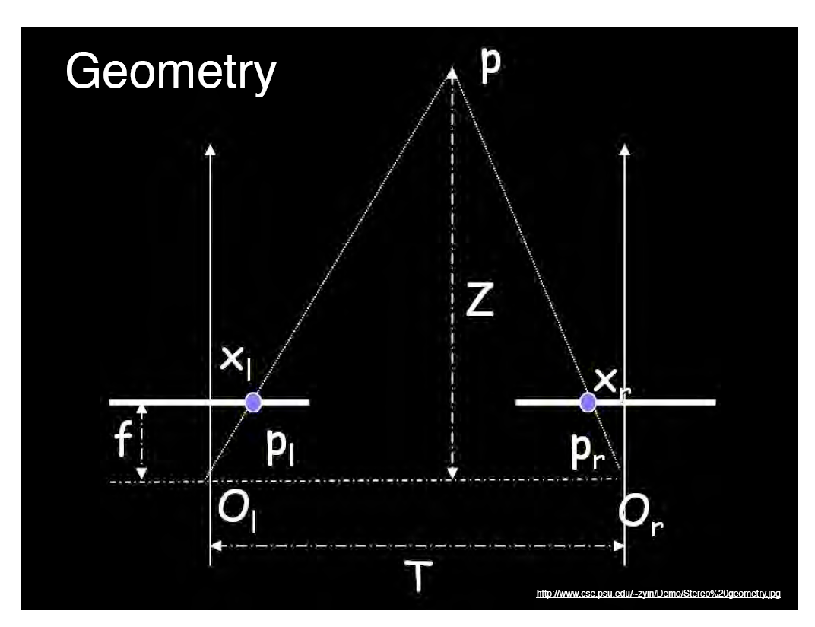
World point
Depth of p
image point (left)
image point (right)
Focal length
optical center (right)
optical center (left)
baseline
Notes:
45

Slide 46
Geometry for a simple stereo system
Assume parallel optical axes, known camera parameters (i.e., calibrated cameras). What is expression for Z?
Similar triangles (p_{l}, P, p_{r}) and (O_{l}, P, O_{r}):
disparity
Notes:
46

Slide 47


Depth from disparity
image I(x,y)
Disparity map D(x,y)
image I´(x´,y´)
(x´,y´)=(x+D(x,y), y)
So if we could find the corresponding points in two images, we could estimate relative depth…

Slide 48


Correspondence search
Left
Right
scanline
Matching cost
disparity
Slide a window along the right scanline and compare contents of that window with the reference window in the left image
Matching cost: SSD or normalized correlation

Slide 49
Correspondence search
Left
Right
scanline
SSD

Slide 50
Correspondence search
Left
Right
scanline
Norm. corr

Slide 51
Basic stereo matching algorithm
If necessary, rectify the two stereo images to transform epipolar lines into scanlines
For each pixel x in the first image
  Find corresponding epipolar scanline in the right image
  Examine all pixels on the scanline and pick the best match x’
  Compute disparity x–x’ and set depth(x) = B*f/(x–x’)

Slide 52


Failures of correspondence search
Textureless surfaces
Occlusions, repetition
Non-Lambertian surfaces, specularities

Slide 53


Effect of window size
W = 3
W = 20
  Smaller window
    More detail
    More noise
  Larger window
    Smoother disparity maps
    Less detail
Notes:
smaller window: more detail, more noise
bigger window: less noise, more detail

Slide 54



Results with window search
Data
Window-based matching
Ground truth

Slide 55

Better methods exist...
Graph cuts
Ground truth
  Y. Boykov, O. Veksler, and R. Zabih, Fast Approximate Energy Minimization via Graph Cuts, PAMI 2001
    For the latest and greatest: http://www.middlebury.edu/stereo/

Slide 56
When cameras are not aligned:
Stereo image rectification
Reproject image planes onto a common
plane parallel to the line between optical centers
Pixel motion is horizontal after this transformation
Two homographies (3x3 transform), one for each input image reprojection
C. Loop and Z. Zhang. Computing Rectifying Homographies for Stereo Vision. IEEE Conf. Computer Vision and Pattern Recognition, 1999.

Slide 57
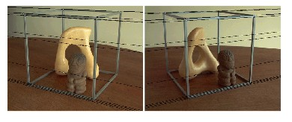
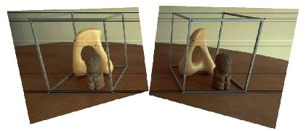
Rectification example

Slide 58
Questions?

