Slide 1
Max-Margin Classifier, Regularization, Generalization, Momentum, Regression, Multi-label Classification / Tagging

Slide 2
Previous Class
Softmax Classifier
Inference vs Training
Gradient Descent (GD)
Stochastic Gradient Descent (SGD)
mini-batch Stochastic Gradient Descent (SGD)

Slide 3
Previous Class
Softmax Classifier
Inference vs Training
Gradient Descent (GD)
Stochastic Gradient Descent (SGD)
mini-batch Stochastic Gradient Descent (SGD)
Generalization
Regularization / Momentum
Max-Margin Classifier
Regression / Tagging

Slide 4
(mini-batch) Stochastic Gradient Descent (SGD)
$$l(w,b)=\sum_{i∈B}{−log f_{i,label}(w,b)}$$
$$λ=0.01$$
Initialize w and b randomly
For Softmax Classifier
for e = 0, num_epochs do
for b = 0, num_batches do
Compute:
$$dl(w,b)/dw$$
and
$$dl(w,b)/db$$
Update w:
$$w=w −λ dl(w,b)/dw$$
Update b:
$$b=b −λ dl(w,b)/db$$
Print:
$$l(w,b)$$
// Useful to see if this is becoming smaller or not.
end
end

Slide 5
Supervised Learning –Softmax Classifier
$${\hat{y}}_{i}= [f_{c} f_{d} f_{b}]$$
Extract features
$$x_{i}=[x_{i1} { x}_{i2} x_{i3} { x}_{i4}]$$
Run features through classifier
$$g_{c}=w_{c1}x_{i1}+w_{c2}x_{i2}+w_{c3}x_{i3}+w_{c4}x_{i4}+b_{c}$$
$$g_{d}=w_{d1}x_{i1}+w_{d2}x_{i2}+w_{d3}x_{i3}+w_{d4}x_{i4}+b_{d}$$
$$g_{b}=w_{b1}x_{i1}+w_{b2}x_{i2}+w_{b3}x_{i3}+w_{b4}x_{i4}+b_{b}$$
Get predictions
$$f_{c}=e^{g_{c}}/{(e}^{g_{c}}+e^{g_{d}}+e^{g_{b}})$$
$$f_{d}=e^{g_{d}}/{(e}^{g_{c}}+e^{g_{d}}+e^{g_{b}})$$
$$f_{b}=e^{g_{b}}/{(e}^{g_{c}}+e^{g_{d}}+e^{g_{b}})$$

Slide 6
Linear Max Margin-Classifier
Training Data
targets /
labels /
ground truth
inputs
predictions
$$x_{1}=[x_{11} { x}_{12} x_{13} { x}_{14}]$$
$$y_{1}=$$
[1 0 0]
$${\hat{y}}_{1}=$$
[4.3 -1.3 1.1]
$$x_{2}=[x_{21} { x}_{22} x_{23} { x}_{24}]$$
$$y_{2}=$$
[0 1 0]
$${\hat{y}}_{2}=$$
[0.5 5.6 -4.2]
$$x_{3}=[x_{31} { x}_{32} x_{33} { x}_{34}]$$
$$y_{3}=$$
[1 0 0]
$${\hat{y}}_{3}=$$
[3.3 3.5 1.1]
.
.
.
$$x_{n}=[x_{n1} { x}_{n2} x_{n3} { x}_{n4}]$$
$$y_{n}=$$
[0 0 1]
$${\hat{y}}_{n}=$$
[1.1 -5.3 -9.4]

Slide 7
Linear – Max Margin Classifier - Inference
$$x_{i}=[x_{i1} { x}_{i2} x_{i3} { x}_{i4}]$$
$$y_{i}=$$
[1 0 0]
$${\hat{y}}_{i}= [f_{c} f_{d} f_{b}]$$
$$f_{c}=w_{c1}x_{i1}+w_{c2}x_{i2}+w_{c3}x_{i3}+w_{c4}x_{i4}+b_{c}$$
$$f_{d}=w_{d1}x_{i1}+w_{d2}x_{i2}+w_{d3}x_{i3}+w_{d4}x_{i4}+b_{d}$$
$$f_{b}=w_{b1}x_{i1}+w_{b2}x_{i2}+w_{b3}x_{i3}+w_{b4}x_{i4}+b_{b}$$

Slide 8
Training: How do we find a good w and b?
$$x_{i}=[x_{i1} { x}_{i2} x_{i3} { x}_{i4}]$$
$$y_{i}=$$
[1 0 0]
$${\hat{y}}_{i}= [f_{c}(w,b) f_{d}(w,b) f_{b}(w,b)]$$
We need to find w, and b that minimize the following:
$$L\left(w,b\right)=\sum_{i=1}^{n}{\sum_{j≠label}{max⁡({0, \hat{y}}_{ij}−{\hat{y}}_{i,label}+Δ)}}$$
Why this might be good compared to softmax?

Slide 9
Regression vs Classification
Regression
Labels are continuous variables – e.g. distance.
Losses: Distance-based losses, e.g. sum of distances to true values.
Evaluation: Mean distances, correlation coefficients, etc.
Classification
Labels are discrete variables (1 out of K categories)
Losses: Cross-entropy loss, margin losses, logistic regression (binary cross entropy)
Evaluation: Classification accuracy, etc.

Slide 10
Linear Regression – 1 output, 1 input
$$y$$
$$(x_{8},y_{8})$$
$$(x_{6},y_{6})$$
$$(x_{7},y_{7})$$
$$(x_{4},y_{4})$$
$$(x_{5},y_{5})$$
$$(x_{2},y_{2})$$
$$(x_{3},y_{3})$$
$$(x_{1},y_{1})$$
$$x$$

Slide 11
Linear Regression – 1 output, 1 input
$$y$$
$$(x_{8},y_{8})$$
$$(x_{6},y_{6})$$
$$(x_{7},y_{7})$$
$$(x_{4},y_{4})$$
$$(x_{5},y_{5})$$
$$(x_{2},y_{2})$$
$$(x_{3},y_{3})$$
$$(x_{1},y_{1})$$
$$x$$
Model:
$$\hat{y}=wx+b$$

Slide 12
Linear Regression – 1 output, 1 input
$$y$$
$$(x_{8},y_{8})$$
$$(x_{6},y_{6})$$
$$(x_{7},y_{7})$$
$$(x_{4},y_{4})$$
$$(x_{5},y_{5})$$
$$(x_{2},y_{2})$$
$$(x_{3},y_{3})$$
$$(x_{1},y_{1})$$
$$x$$
Model:
$$\hat{y}=wx+b$$

Slide 13
Linear Regression – 1 output, 1 input
$$y$$
$$(x_{8},y_{8})$$
$$(x_{6},y_{6})$$
$$(x_{7},y_{7})$$
$$(x_{4},y_{4})$$
$$(x_{5},y_{5})$$
$$(x_{2},y_{2})$$
$$(x_{3},y_{3})$$
$$(x_{1},y_{1})$$
$$x$$
$$L\left(w,b\right)=\sum_{i=1}^{i=8}{{\left({\hat{y}}_{i}−y_{i}\right)}^{2}}$$
Model:
$$\hat{y}=wx+b$$
Loss:

Slide 14
Quadratic Regression
$$y$$
$$(x_{8},y_{8})$$
$$(x_{6},y_{6})$$
$$(x_{7},y_{7})$$
$$(x_{4},y_{4})$$
$$(x_{5},y_{5})$$
$$(x_{2},y_{2})$$
$$(x_{3},y_{3})$$
$$(x_{1},y_{1})$$
$$x$$
$$L\left(w,b\right)=\sum_{i=1}^{i=8}{{\left({\hat{y}}_{i}−y_{i}\right)}^{2}}$$
Model:
$$\hat{y}=w_{1}x^{2}+w_{2}x+b$$
Loss:

Slide 15
n-polynomial Regression
$$y$$
$$(x_{8},y_{8})$$
$$(x_{6},y_{6})$$
$$(x_{7},y_{7})$$
$$(x_{4},y_{4})$$
$$(x_{5},y_{5})$$
$$(x_{2},y_{2})$$
$$(x_{3},y_{3})$$
$$(x_{1},y_{1})$$
$$x$$
$$L\left(w,b\right)=\sum_{i=1}^{i=8}{{\left({\hat{y}}_{i}−y_{i}\right)}^{2}}$$
Model:
$$\hat{y}=w_{n}x^{n}+…+w_{1}x+b$$
Loss:

Slide 16
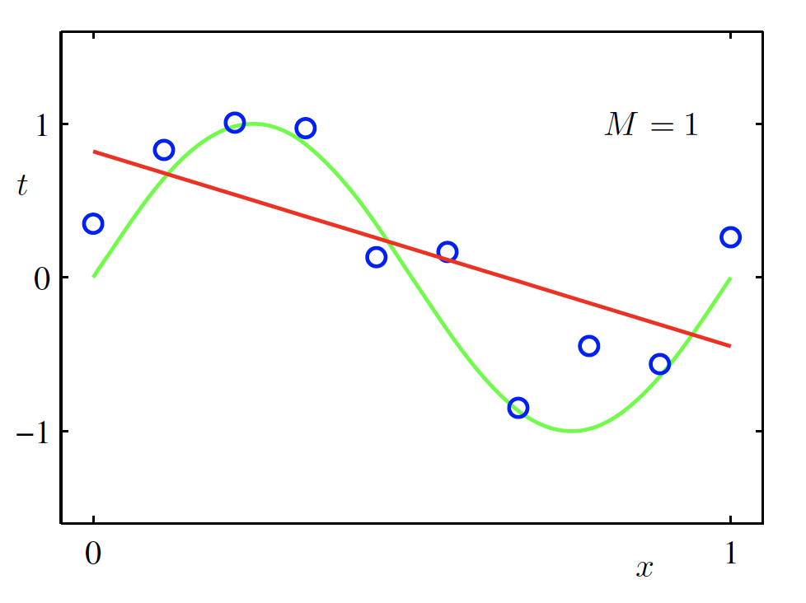
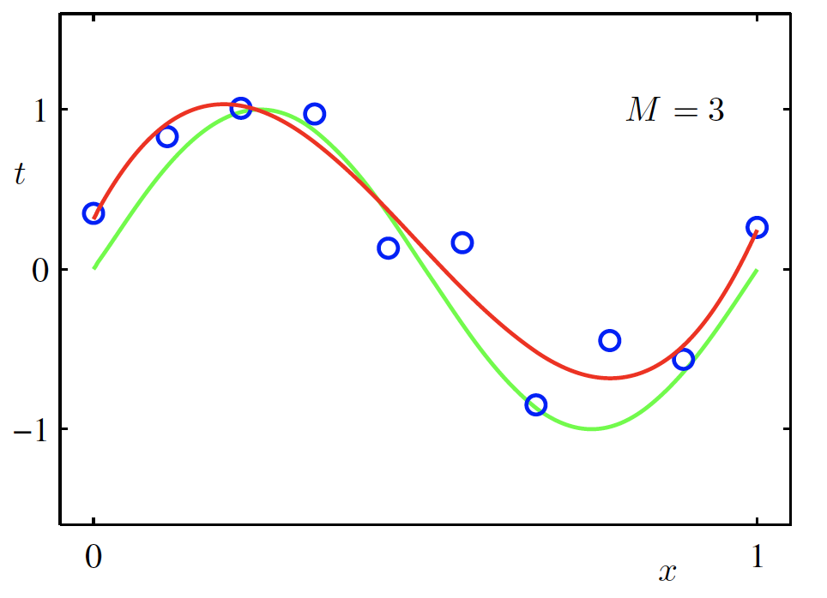
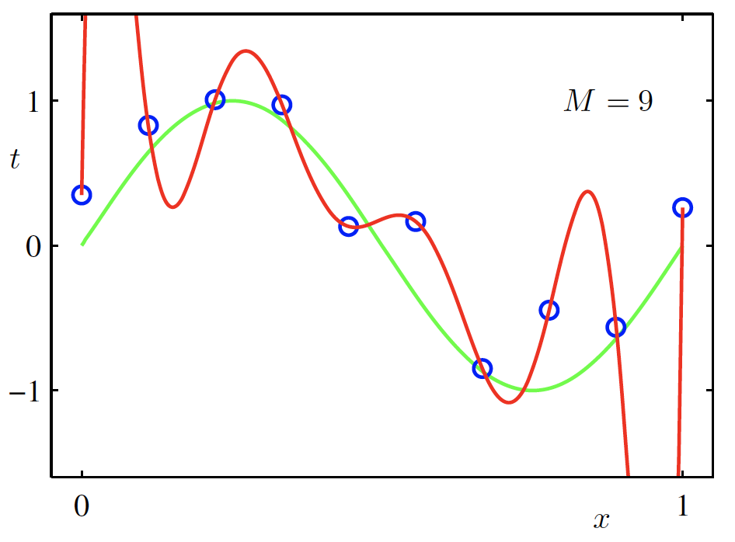
Overfitting
Taken from Christopher Bishop’s Machine Learning and Pattern Recognition Book.
$f$ is a polynomial of degree 9
$f$ is linear
$f$ is cubic
$Loss\left(w\right)$ is high
$Loss\left(w\right)$ is low
$Loss\left(w\right)$ is zero!
Underfitting
Overfitting
High Bias
High Variance
Credit: C. Bishop. Pattern Recognition and Mach. Learning.

Slide 17
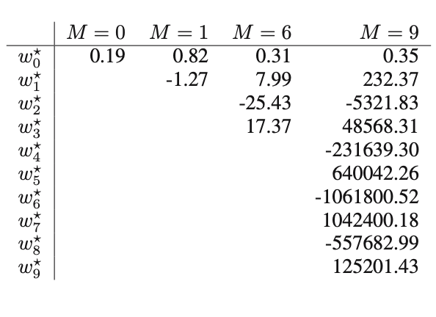
Detecting Overfitting
Look at the values of the weights in the polynomial

Slide 18
Recommended Reading
http://users.isr.ist.utl.pt/~wurmd/Livros/school/Bishop%20-%20Pattern%20Recognition%20And%20Machine%20Learning%20-%20Springer%20%202006.pdf
Print and Read Chapter 1
(at minimum)

Slide 19
More …
Regularization
Momentum updates

Slide 20
Regularization
Large weights lead to large variance. i.e. model fits to the training data too strongly.
Solution: Minimize the loss but also try to keep the weight values small by doing the following:
$$L\left(w,b\right)+α\sum_{i}{{|w_{i}|}^{2}}$$
minimize
Regularizer term
e.g. L2- regularizer
Credit: C. Bishop. Pattern Recognition and Mach. Learning.

Slide 21
SGD with Regularization (L-2)
$$λ=0.01$$
$l\left(w,b\right)=l\left(w,b\right)+α$ $\sum_{i}{{|w_{i}|}^{2}}$
Initialize w and b randomly
for e = 0, num_epochs do
for b = 0, num_batches do
Compute:
$$dl(w,b)/dw$$
and
$$dl(w,b)/db$$
Update w:
$$w=w −λ dl(w,b)/dw−λαw$$
Update b:
$$b=b −λ dl(w,b)/db−λαw$$
Print:
$$l(w,b)$$
// Useful to see if this is becoming smaller or not.
end
end

Slide 22
Revisiting Another Problem with SGD
$$λ=0.01$$
$l\left(w,b\right)=l\left(w,b\right)+α$ $\sum_{i}{{|w_{i}|}^{2}}$
Initialize w and b randomly
for e = 0, num_epochs do
These are only approximations to the true gradient with respect to $L(w,b)$
for b = 0, num_batches do
Compute:
$$dl(w,b)/dw$$
and
$$dl(w,b)/db$$
Update w:
$$w=w −λ dl(w,b)/dw−λαw$$
Update b:
$$b=b −λ dl(w,b)/db−λαw$$
Print:
$$l(w,b)$$
// Useful to see if this is becoming smaller or not.
end
end

Slide 23
Revisiting Another Problem with SGD
$$λ=0.01$$
$l\left(w,b\right)=l\left(w,b\right)+α$ $\sum_{i}{{|w_{i}|}^{2}}$
Initialize w and b randomly
for e = 0, num_epochs do
This could lead to “un-learning” what has been learned in some previous steps of training.
for b = 0, num_batches do
Compute:
$$dl(w,b)/dw$$
and
$$dl(w,b)/db$$
Update w:
$$w=w −λ dl(w,b)/dw−λαw$$
Update b:
$$b=b −λ dl(w,b)/db−λαw$$
Print:
$$l(w,b)$$
// Useful to see if this is becoming smaller or not.
end
end

Slide 24
Solution: Momentum Updates
$$λ=0.01$$
$l\left(w,b\right)=l\left(w,b\right)+α$ $\sum_{i}{{|w_{i}|}^{2}}$
Initialize w and b randomly
for e = 0, num_epochs do
Keep track of previous gradients in an accumulator variable! and use a weighted average with current gradient.
for b = 0, num_batches do
Compute:
$$dl(w,b)/dw$$
and
$$dl(w,b)/db$$
Update w:
$$w=w −λ dl(w,b)/dw−λαw$$
Update b:
$$b=b −λ dl(w,b)/db−λαw$$
Print:
$$l(w,b)$$
// Useful to see if this is becoming smaller or not.
end
end

Slide 25
Solution: Momentum Updates
$$λ=0.01$$
$$τ=0.9$$
Initialize w and b randomly
$l\left(w,b\right)=l\left(w,b\right)+α$ $\sum_{i}{{|w_{i}|}^{2}}$
global $v$
for e = 0, num_epochs do
for b = 0, num_batches do
Keep track of previous gradients in an accumulator variable! and use a weighted average with current gradient.
Compute:
$$dl(w,b)/dw$$
Compute:
$$v=τv+dl(w,b)/dw+αw$$
Update w:
$$w=w −λ v$$
Print:
$$l(w,b)$$
// Useful to see if this is becoming smaller or not.
end
end

Slide 26
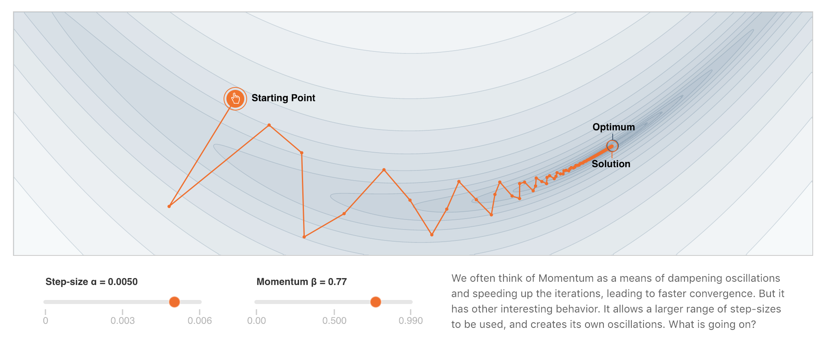
More on Momentum
https://distill.pub/2017/momentum/

Slide 28
Questions?

