Slide 1
Convolutional Neural Networks (CNNs)

Slide 2
Previous
Linear Classifier (Softmax / Max-margin)
Generalization / Regularization / Overfitting / Underfitting
Neural Networks
The Perceptron Model
The Multi-layer Perceptron (MLP)
Forward-pass in an MLP (Inference)
Backward-pass in an MLP (Backpropagation)

Slide 3
Today’s Class
The Convolutional Layer
Convolutional Neural Networks
The LeNet Network
The AlexNet Network and the ImageNet Dataset and Challenge

Slide 4
Convolutional Layer

Slide 5
Convolutional Layer

Slide 6
Convolutional Layer
Weights

Slide 7
Convolutional Layer
Weights
4

Slide 8
Convolutional Layer
Weights
4
1

Slide 9
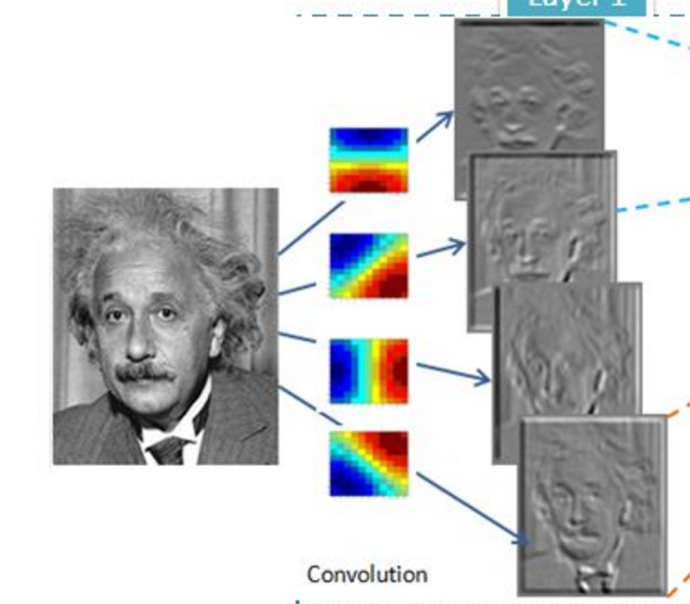
Convolutional Layer (with 4 filters)
weights: 4x1x9x9
Input: 1x224x224
Output: 4x224x224
if zero padding,
and stride = 1

Slide 10
Convolutional Layer (with 4 filters)
weights: 4x1x9x9
Input: 1x224x224
Output: 4x112x112
if zero padding,
but stride = 2

Slide 11
Convolutional Layer in pytorch
kernel_size
Input
out_channels x
Output
kernel_size
in_channels
out_channels (equals the number of convolutional filters for this layer)
in_channels (e.g. 3 for RGB inputs)

Slide 12
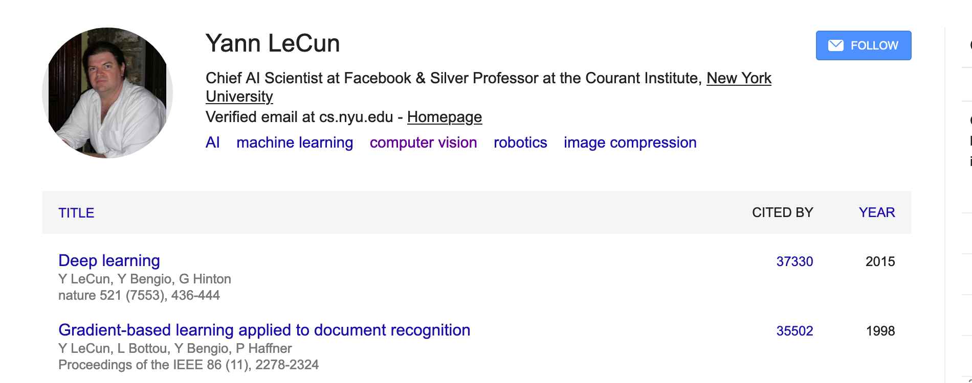
Convolutional Network: LeNet

Slide 13
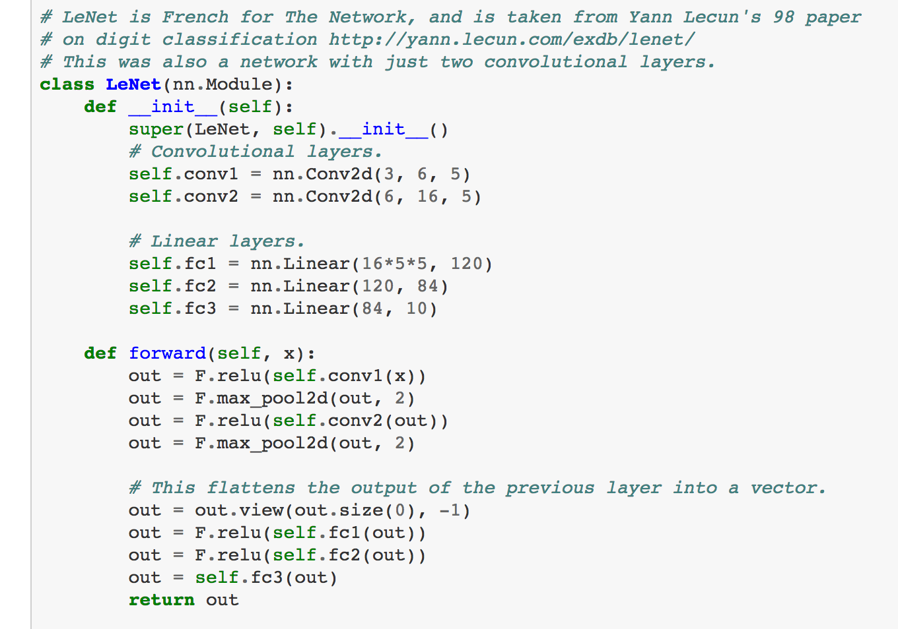
LeNet in Pytorch

Slide 14
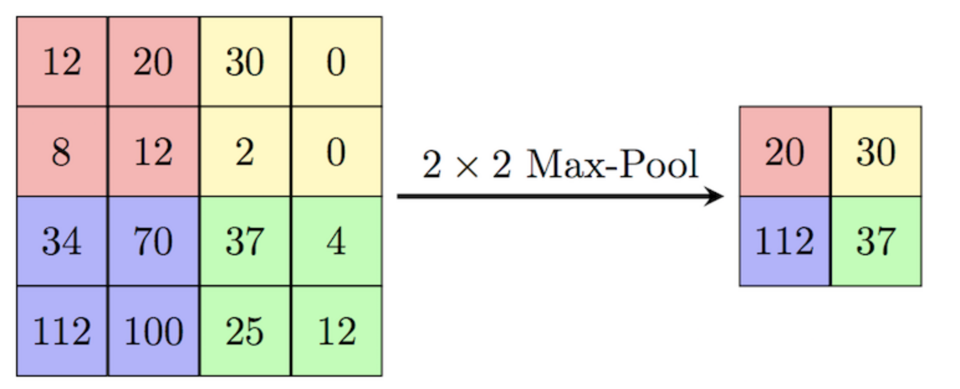
SpatialMaxPooling Layer
Take the max in a neighborhood and replace such neighborhood.
https://computersciencewiki.org/index.php/Max-pooling_/_Pooling

Slide 15
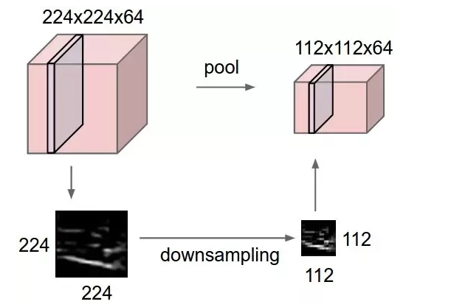
SpatialMaxPooling Layer
Take the max in a neighborhood and replace such neighborhood.
https://computersciencewiki.org/index.php/Max-pooling_/_Pooling

Slide 16
LeNet Summary
2 Convolutional Layers + 3 Linear Layers
+ Non-linear functions: ReLUs or Sigmoids + Max-pooling operations

Slide 17
New Architectures Proposed
Alexnet (Kriszhevsky et al NeurIPS 2012)
VGG (Simonyan and Zisserman 2014)
GoogLeNet (Szegedy et al CVPR 2015)
ResNet (He et al CVPR 2016)
DenseNet (Huang et al CVPR 2017)
Inception-v4 (https://arxiv.org/abs/1602.07261)
EfficientNet (Tan and Le ICML 2019)

Slide 18
Convolutional Layers as Matrix Multiplication
https://petewarden.com/2015/04/20/why-gemm-is-at-the-heart-of-deep-learning/

Slide 19
Convolutional Layers as Matrix Multiplication
https://petewarden.com/2015/04/20/why-gemm-is-at-the-heart-of-deep-learning/

Slide 20
Convolutional Layers as Matrix Multiplication
Pros?
Cons?
https://petewarden.com/2015/04/20/why-gemm-is-at-the-heart-of-deep-learning/

Slide 21
CNN Computations are Computationally Expensive
However highly parallelizable
GPU Computing is used in practice
CPU Computing in fact is prohibitive for training these models

Slide 22
ILSVRC: Imagenet Large Scale Visual Recognition Challenge [Russakovsky et al 2014]

Slide 23
The Problem: Classification
Classify an image into 1000 possible classes: e.g. Abyssinian cat, Bulldog, French Terrier, Cormorant, Chickadee,
red fox, banjo, barbell, hourglass, knot, maze, viaduct, etc.
cat, tabby cat (0.71) Egyptian cat (0.22)
red fox (0.11)
…..

Slide 24
The Data: ILSVRC
Imagenet Large Scale Visual Recognition Challenge (ILSVRC): Annual Competition
1000 Categories
~1000 training images per Category
~1 million images in total for training
~50k images for validation
Only images released for the test set but no annotations, evaluation is performed centrally by the organizers (max 2 per week)

Slide 25
The Evaluation Metric: Top K-error
Top-1 error: 1.0
Top-1 accuracy: 0.0
Top-2 error: 1.0
Top-2 accuracy: 0.0
True label: Abyssinian cat
Top-3 error: 1.0
Top-3 accuracy: 0.0
Top-4 error: 0.0
Top-4 accuracy: 1.0
Top-5 error: 0.0
Top-5 accuracy: 1.0
cat, tabby cat (0.61) Egyptian cat (0.22)
red fox (0.11)
Abyssinian cat (0.10)
French terrier (0.03)
…..

Slide 26
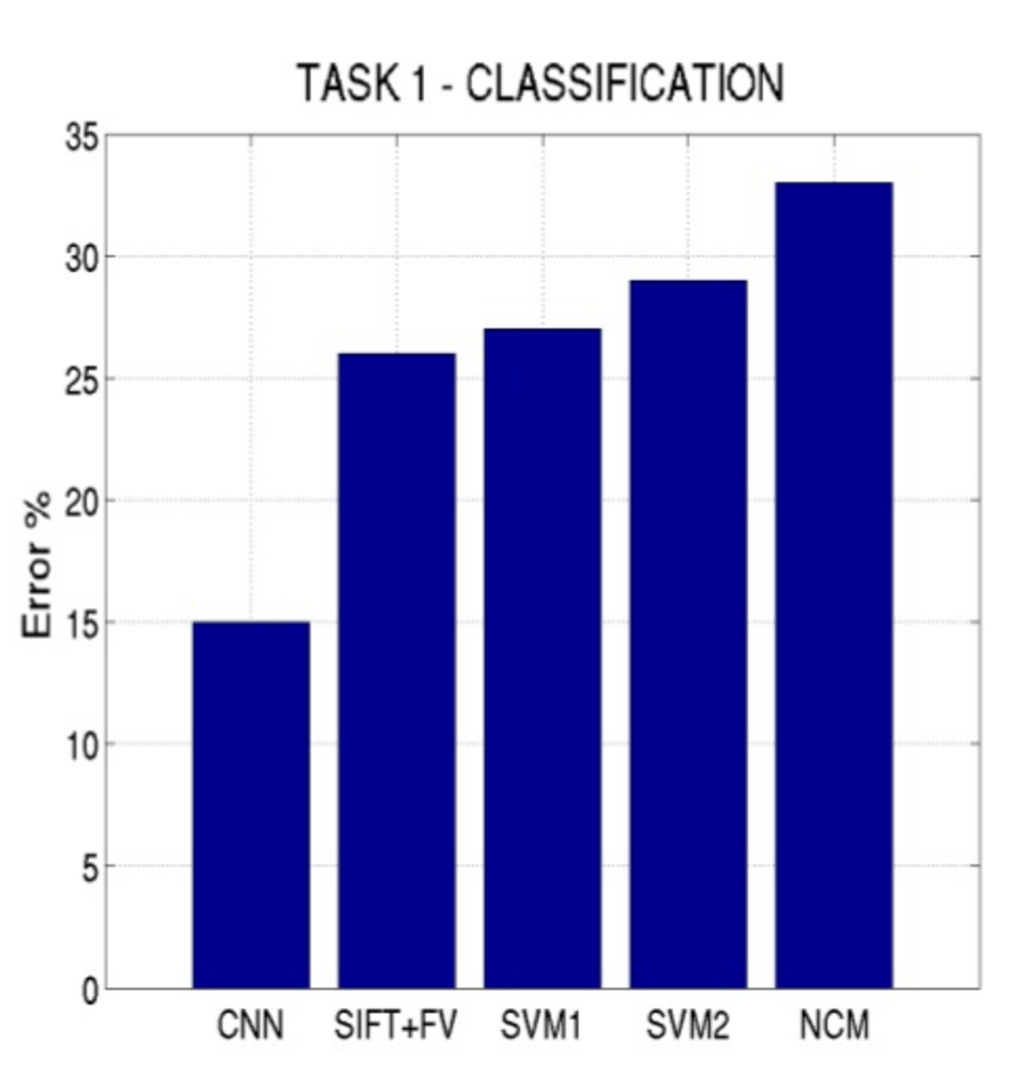
Top-5 error on this competition (2012)

Slide 27
Alexnet (Krizhevsky et al NIPS 2012)

Slide 28
Alexnet
https://www.saagie.com/fr/blog/object-detection-part1

Slide 29
Pytorch Code for Alexnet
In-class analysis https://github.com/pytorch/vision/blob/master/torchvision/models/alexnet.py

Slide 30
Dropout Layer
Srivastava et al 2014

Slide 31
What is happening?
https://www.saagie.com/fr/blog/object-detection-part1

Slide 32
SIFT + FV + SVM (or softmax)
Feature extraction (SIFT)
Feature encoding (Fisher vectors)
Classification (SVM or softmax)
Deep Learning
Convolutional Network
(includes both feature extraction and classifier)

Slide 33
Preprocessing and Data Augmentation

Slide 34
Preprocessing and Data Augmentation
256
256

Slide 35
Preprocessing and Data Augmentation
224x224

Slide 36
Preprocessing and Data Augmentation
224x224

Slide 37
True label: Abyssinian cat

Slide 38
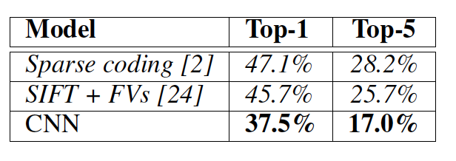
Other Important Aspects
Using ReLUs instead of Sigmoid or Tanh
Momentum + Weight Decay
Dropout (Randomly sets Unit outputs to zero during training)
GPU Computation!

Slide 39
VGG Network
Top-5:
https://github.com/pytorch/vision/blob/master/torchvision/models/vgg.py
Simonyan and Zisserman, 2014.
https://arxiv.org/pdf/1409.1556.pdf

Slide 40
Questions?

