Slide 1
Recent Work (2020 and Beyond)

Slide 2
Last Class
Practical Issues with Deployment
Web/Mobile Interface
Web Browser / Web Server / HTTP (POST and GET requests)
HTML/CSS/Bootstrap
Javascript / Asynchronous Calls -- AJAX / DOM
Flask / Jinja2 / Python for Web Development
Integration with Pytorch (and potentially other python-based toolkits)

Slide 3
Today
A quick tour on some recently proposed research and directions

Slide 4
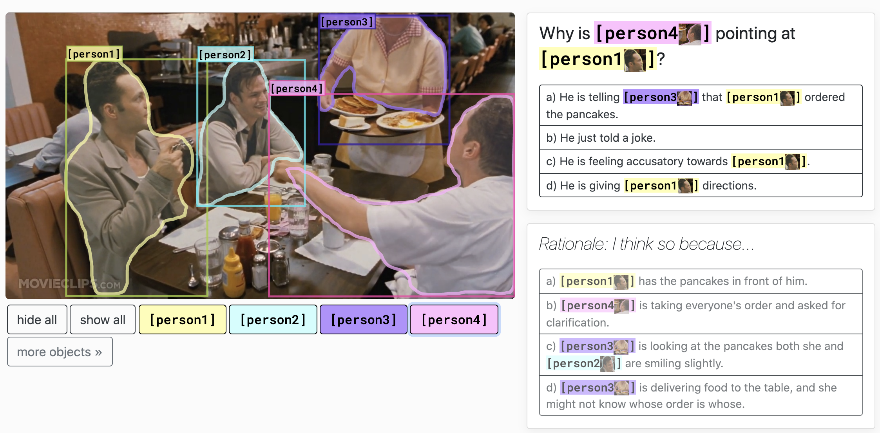
Visual Common Sense Reasoning
https://visualcommonsense.com/

Slide 5
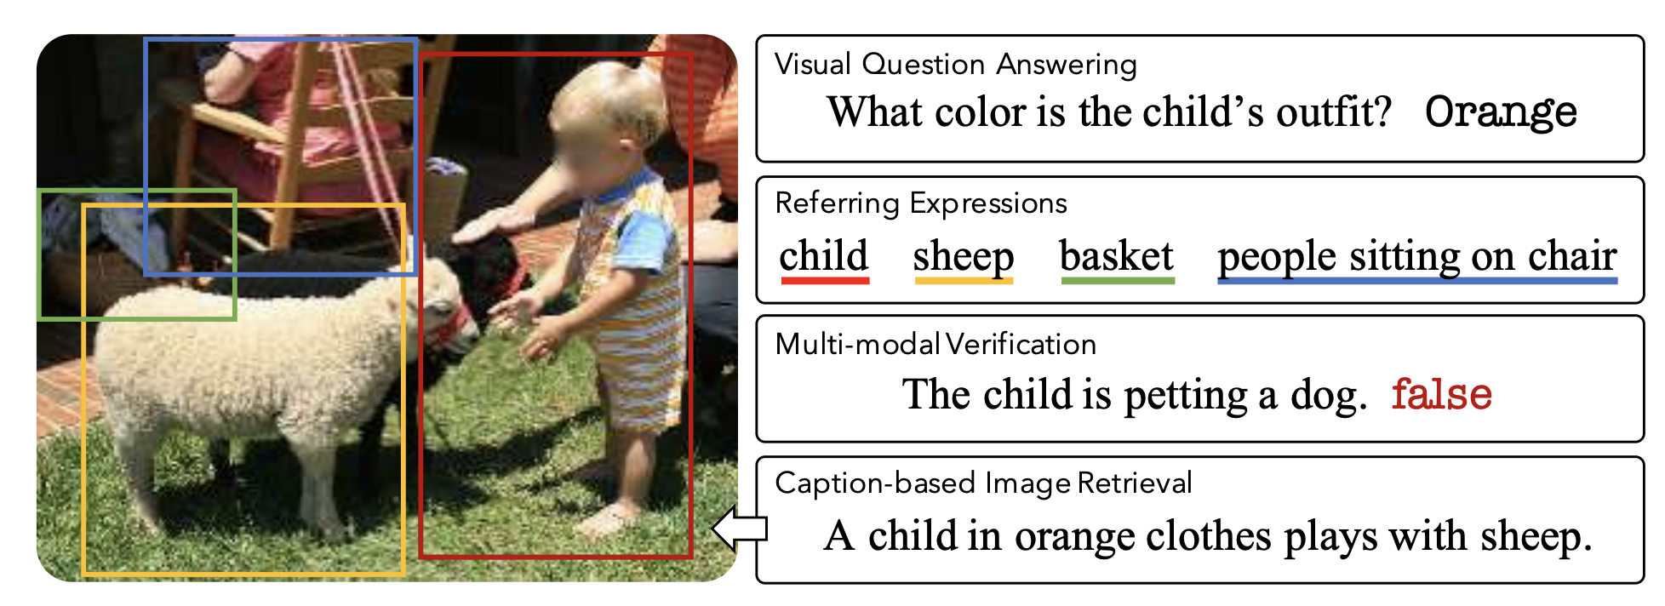
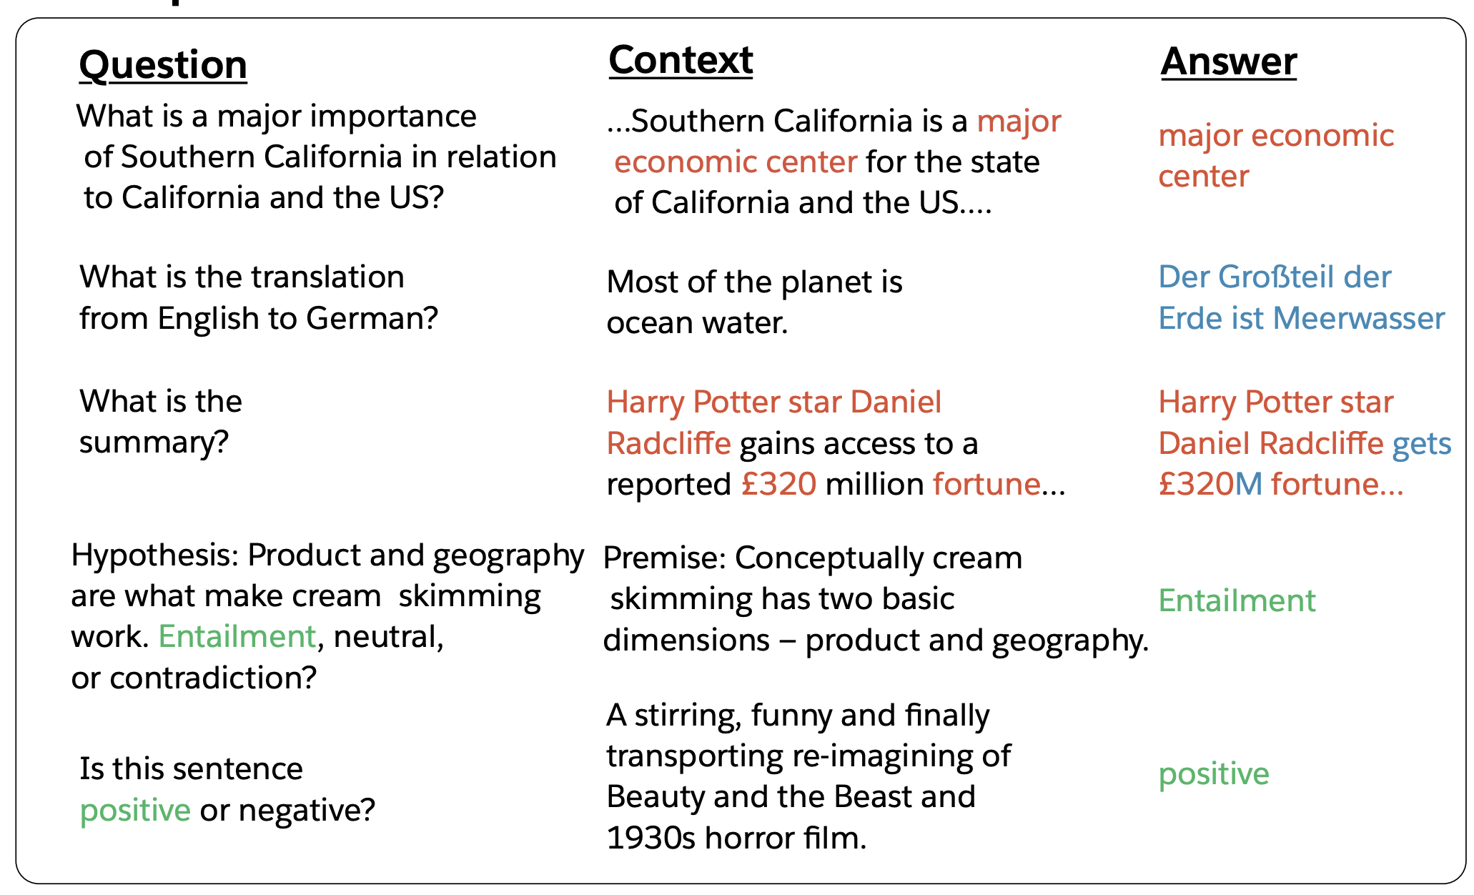
Multi-task Learning / More General Models
Salesforce DecaNLP
https://arxiv.org/pdf/1806.08730.pdf
12-in-1: Multi-task Vision and Language
https://arxiv.org/abs/1912.02315

Slide 6
Interactivity + Language and Vision
https://arxiv.org/abs/1911.03826

Slide 7
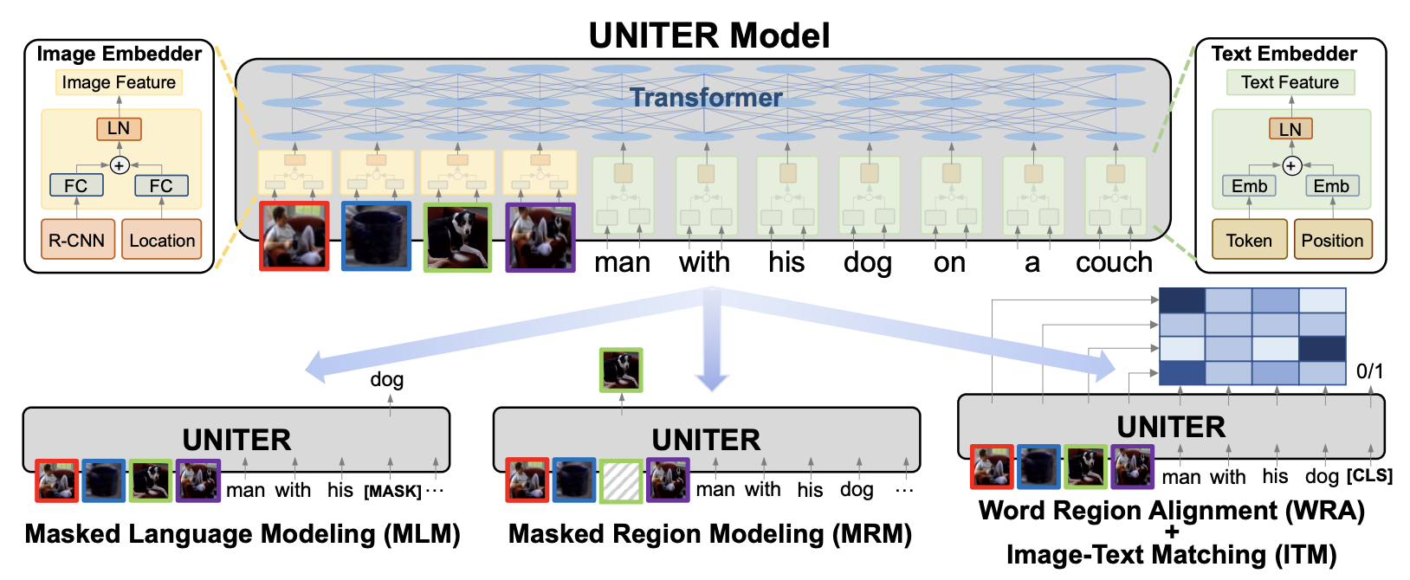
General models for Vision and Language - UNITER

Slide 8
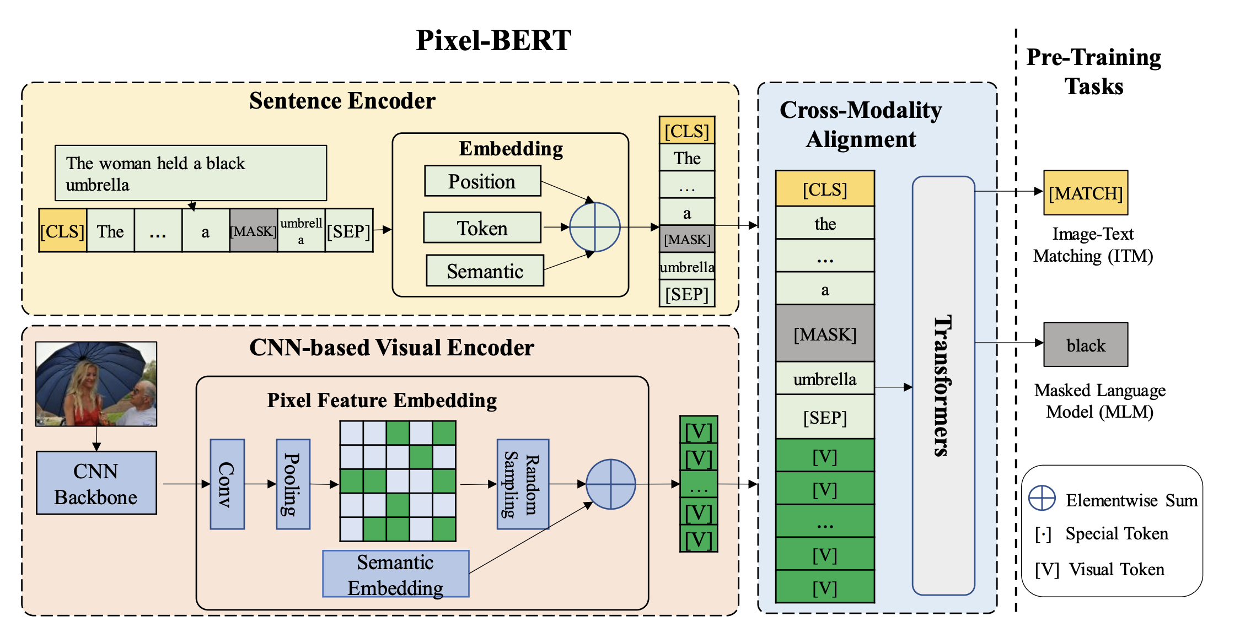
Grid Features – Pixel BERT
https://arxiv.org/pdf/2004.00849.pdf

Slide 9
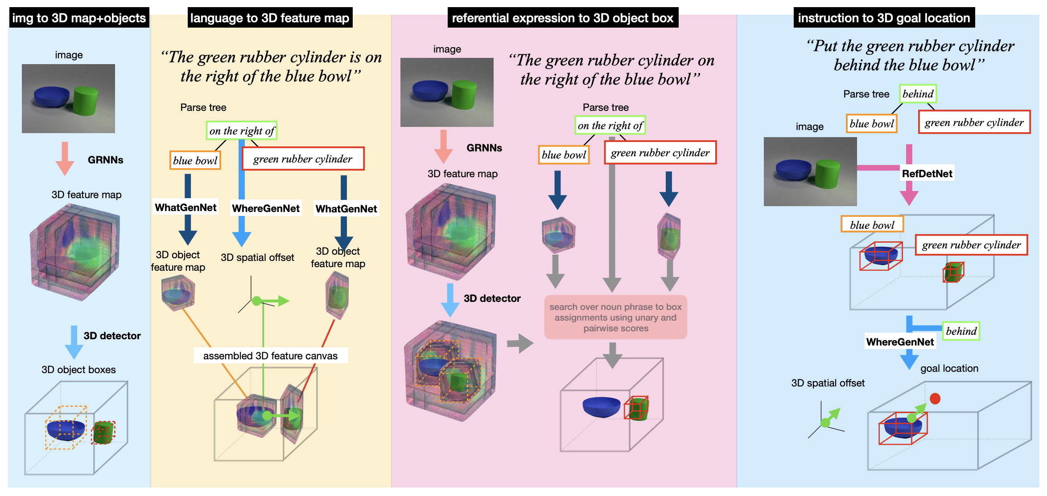
Vision + Language + 3D
https://arxiv.org/abs/1910.01210

Slide 10
Multiple Languages and Vision
https://arxiv.org/abs/2003.05078

Slide 11
Video + Language Tasks
https://openaccess.thecvf.com/content_CVPR_2020/papers/Liu_Violin_A_Large-Scale_Dataset_for_Video-and-Language_Inference_CVPR_2020_paper.pdf

Slide 12
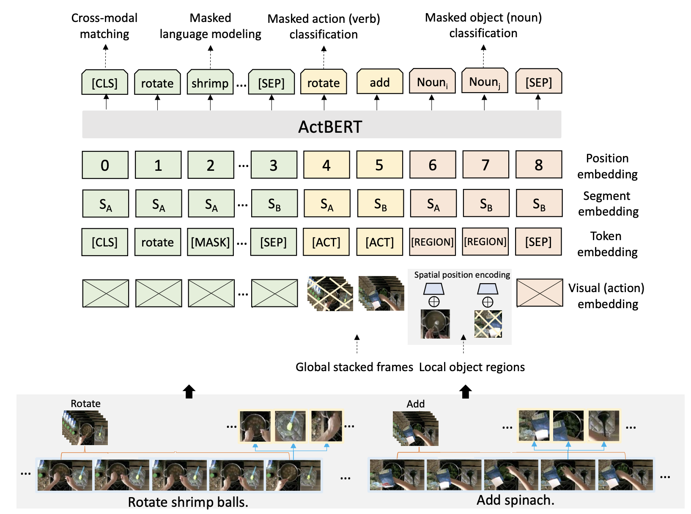
Video + Language: ActBert
https://arxiv.org/abs/2011.07231

Slide 13
Counterfactuals in Vision and Language
https://openaccess.thecvf.com/content_CVPR_2020/papers/Abbasnejad_Counterfactual_Vision_and_Language_Learning_CVPR_2020_paper.pdf

Slide 14
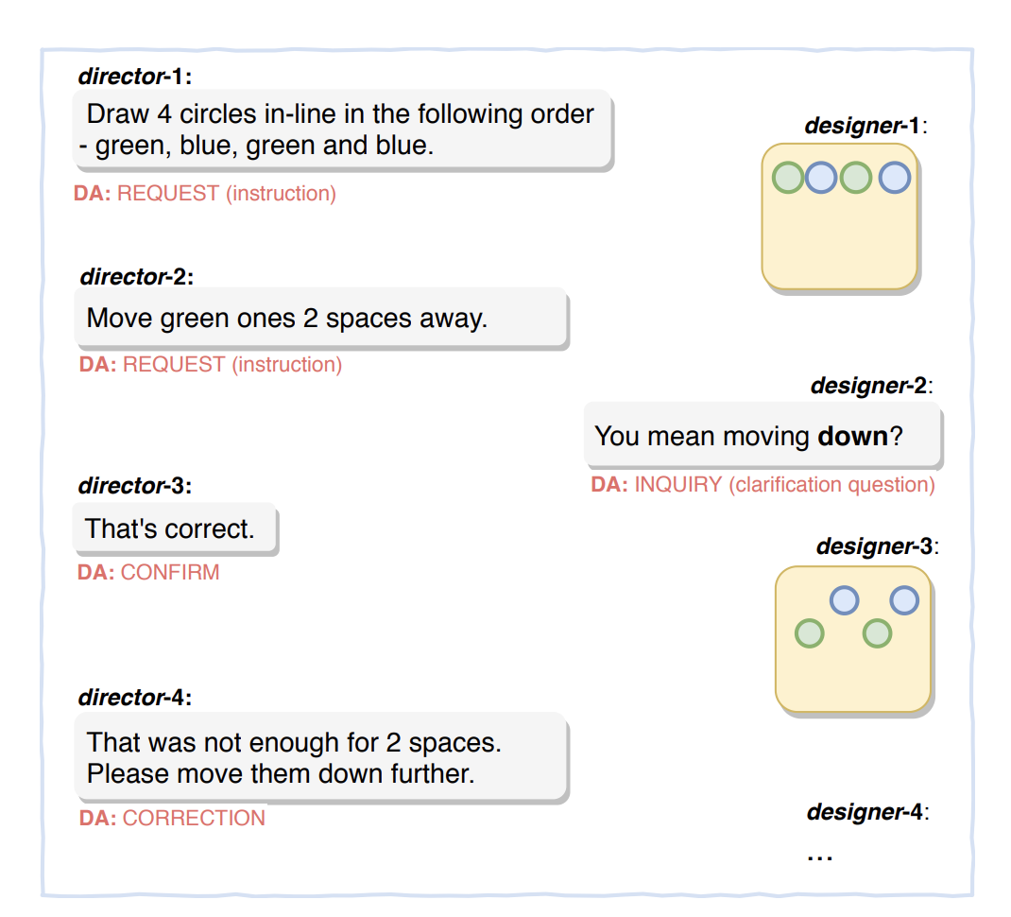
Computer Assisted Visual Design and Language
https://arxiv.org/pdf/1812.04081.pdf

Slide 15
Any other ideas?

