Slide 1
Large Scale Search: Inverted Index, etc.
Comp: 441/552 Large Scale Machine Learning

Slide 2
Classical Search Problem
Given: A (giant) set of text documents
Assume it is a static collection for the moment
Task: Retrieve documents that is relevant to the user’s query

Slide 3
The Measures: Precision and Recall
Precision : Fraction of retrieved docs that are relevant to the user’s information need
$Precision=\frac{\left|\left\{relevant Docs\right\}∩\left\{retrieved docs\right\}\right|}{\left|\left\{retrieved docs\right\}\right|}$
Recall : Fraction of relevant docs in collection that are retrieved
$Recall=\frac{\left|\left\{relevant Docs\right\}∩\left\{retrieved docs\right\}\right|}{\left|\left\{relevant docs\right\}\right|}$
There is usually a tradeoff between these two. For example if we report everything, recall is 1.
$F1Score=2 \frac{precision× recall}{precision+recall}$

Slide 4
Example
Search for Documents containing the words Brutus AND Caesar but NOT Calpurnia
Naïve Solution: grep Brutus and Caesar, then strip out lines containing Calpurnia
Problem: Won’t work for the web. Just too slow!

Slide 5
Term-document Matrix
Sec. 1.1
1 if Document contains word, 0 otherwise

Slide 6
An Efficient Solution
0/1 can be treated as bit-vector.
To answer query: take the vectors for Brutus, Caesar and Calpurnia (complemented)
BITWISE AND
110111 AND
110100 AND
101111 =
100100

Slide 7
Issue: Cant build the Matrix
Even for 1 million documents, with say 500K distinct terms.
We get around half a trillion 0s and 1s. Storage will blow up.
Every document is sparse and usually contains around 1000 terms on average, so the number of 1s is around a billion.
How to exploit sparsity ?

Slide 8
Sec. 1.2
Solutions: Inverted index or Postings
We need variable-size postings lists
On disk, a continuous run of postings is normal and best
Generally a linked list (good for insertion). Sorted (Why?)
Brutus
1
2
4
11
31
45
173
174
Caesar
1
2
4
5
6
16
57
132
Calpurnia
2
31
54
101
Dictionary
8

Slide 9
Manipulating Sorted list is linear time.

Slide 10
Some Benefits
All Boolean Operation is O(x+y).
BITWISE AND is now Intersection of Postings.
OR is MERGE
Set DIFF can also be done similarly.
Primary commercial retrieval tool for 3 decades.
Order of operation is important. X AND Y AND Z. X AND Y first or Y AND Z first ? A whole Topic in itself: Query Optimization

Slide 11
Indexer steps: Token sequence
Sec. 1.2
Sequence of (Modified token, Document ID) pairs.
Doc 1
Doc 2
I did enact Julius
Caesar I was killed
i’ the Capitol;
Brutus killed me.
So let it be with
Caesar. The noble
Brutus hath told you
Caesar was ambitious

Slide 12
Indexer steps: Sort
Sec. 1.2
Sort by terms
And then docID

Slide 13
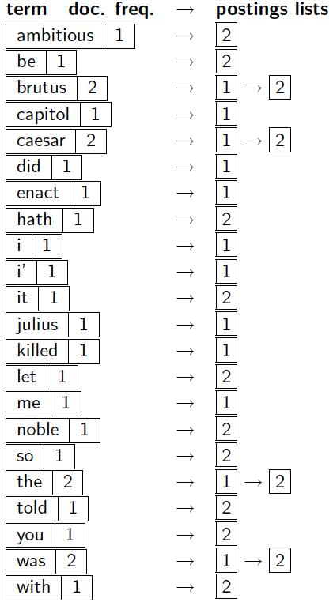
Indexer steps: Dictionary & Postings
Sec. 1.2
Multiple term entries in a single document are merged.
Split into Dictionary and Postings
Doc. frequency information is added for query optimization.
Storage ?

Slide 14
Phrase Queries ?
How about queries like “Rice University”
Solution 1: Use Bi-grams. 2-contiguous words as tokens.
“This is Rice University” gets 3 tokens “This is”, “is Rice”, and “Rice University”
Problems: Longer phrases will blow up the dimentionality. If the vocabulary is 500k, then bi-grams are (500k)*(500k). Trigrams etc. ?

Slide 15
Another Popular Solution: Positional Index
Sec. 2.4.2
<Rice: 993427;
1: 7, 18, 33, 72, 86, 231;
2: 3, 149;
4: 17, 191, 291, 430, 434;
5: 363, 367, …>
Which of docs 1,2,4,5
could contain “Rice University”?
For phrase queries, we use a merge algorithm recursively
Can now do all sorts of phrase queries, slower than bi-grams but more expressive. (An ideal solution is usually a combination)
Still needs significant memory. (2-4x more for positions)

Slide 16
Processing a phrase query
Sec. 2.4.2
Extract inverted index entries for each distinct term: Rice, University.
Merge their doc:position lists to enumerate all positions with “Rice University”.
Rice:
2:1,17,74,222,551; 4:8,16,190,429,433; 7:13,23,191; ...
University:
1:17,19; 4:17,191,291,430,434; 5:14,19,101; ...
Same general method for proximity searches

Slide 17
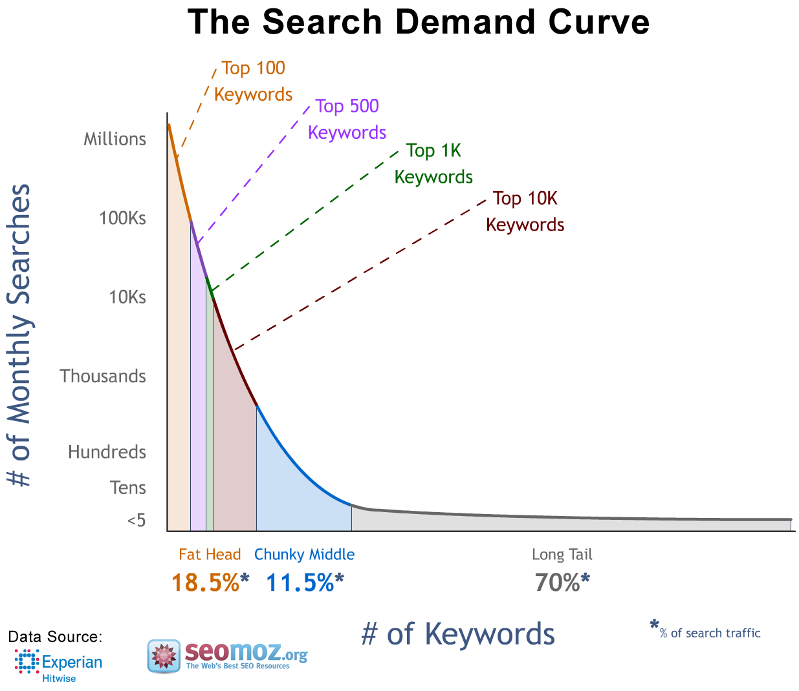
Power Law in Real World
Catching results is a very powerful idea.
Identifying Heavy-Hitters on data streams is a topic in itself.

