Slide 1
Pseudorandom number, Universal Hashing, Chaining and Linear-Probing
COMP 480/580
10th Jan 2019

Slide 2
How are sequence of random numbers generated?
Natural Experiments Based
  Start flipping real coins.
  Measure some physical phenomenon that is expected to be random and then compensates for possible biases in the measurement process. Example sources include measuring atmospheric noise, thermal noise, and other external electromagnetic and quantum phenomena.
Pseudorandom Number Generator (PNG)
  Seed based. Deterministic and will give the same sequence if the seed is same.

Slide 3
Idea behind PNG
Middle-Square method (John von Neumann in 1949)
  Start with n-digit seed. (Say 1111)
  Square it (1234321 = 01234321) . (will be 2n digits, is not pad leading zeros.)
  Report the middle n numbers as the next sequence. (2343)
Issues?
  N needs to be even.

Slide 4
Based on Weyl’s Sequence
Idea
  The sequence of all multiples of such an integer integer k,
    0, k, 2k, 3k, 4k, … is equi-distributed modulo m if m is relatively prime to k.
  That is, the sequence of the remainders of each term when divided by m will be uniformly distributed in the interval [0, m).
The following C code is an example
  d += 362437;
  In this case, the seed 362437 is an odd integer.
(Why?)

Slide 5
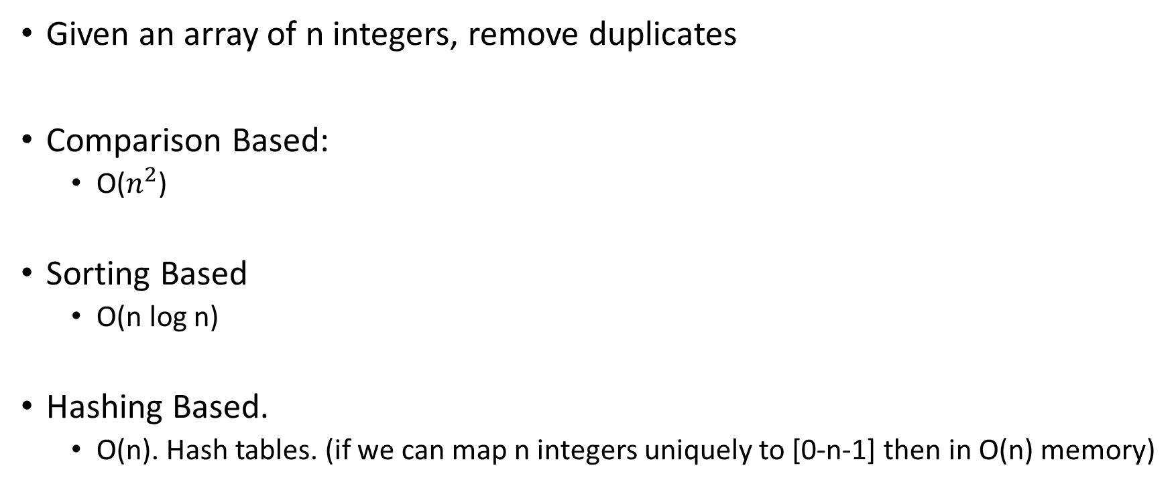
Simple Interview Question
Given an array of n integers, remove duplicates
Comparison Based:
  O($n^{2}$)
Sorting Based
  O(n log n)
Hashing Based.
  O(n). Hash tables. (if we can map n integers uniquely to [0-n-1] then in O(n) memory)

Slide 6
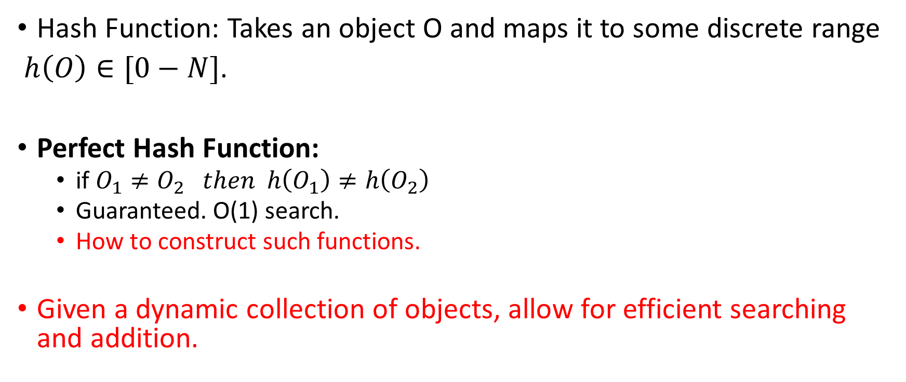
Hashing Basics
Hash Function: Takes an object O and maps it to some discrete range
$h\left(O\right)∈[0−N]$.
Perfect Hash Function:
  if $O_{1}≠O_{2} then h\left(O_{1}\right)≠h\left(O_{2}\right)$
  Guaranteed. O(1) search.
  How to construct such functions.
Given a dynamic collection of objects, allow for efficient searching and addition.

Slide 7
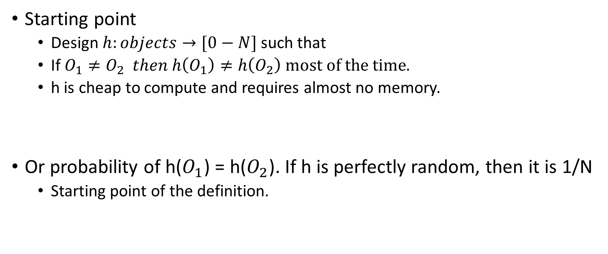
Universal Hashing (Approximate)
Starting point
  Design $h:objects→[0−N]$ such that
  If $O_{1}≠O_{2} then h\left(O_{1}\right)≠h\left(O_{2}\right) most of the time.$
  h is cheap to compute and requires almost no memory.
Or probability of h($O_{1}$) = h($O_{2}$). If h is perfectly random, then it is 1/N
  Starting point of the definition.

Slide 8

2-Universal Hashing Family.
A set (family) of hash function H is 2-universal if
  for all x, y ∈ U such that $x≠y$ we have
    $\underset{\left\{h∼H\right\}}{Pr}{(h\left(x\right)=h(y))}$ ≤ 1/N
  where h ∼ H means that h is selected uniformly at random from H.

Slide 9
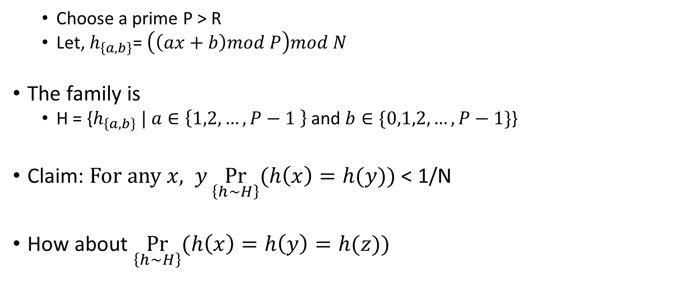
The hash family H
  Choose a prime P > R
  Let, $h_{\left\{a,b\right\}}$= $\left(\left(ax+b\right)mod P\right)mod N$
The family is
  H = {$h_{\left\{a,b\right\}} | a∈\left\{1,2,…,P−1 \right\}$ and $b∈\{0,1,2,…,P−1\}$}
Claim: $For any x, y\underset{\left\{h∼H\right\}}{Pr}{(h\left(x\right)=h(y))}$ < 1/N
How about $\underset{\left\{h∼H\right\}}{Pr}{(h\left(x\right)=h\left(y\right)=h(z))}$

Slide 10
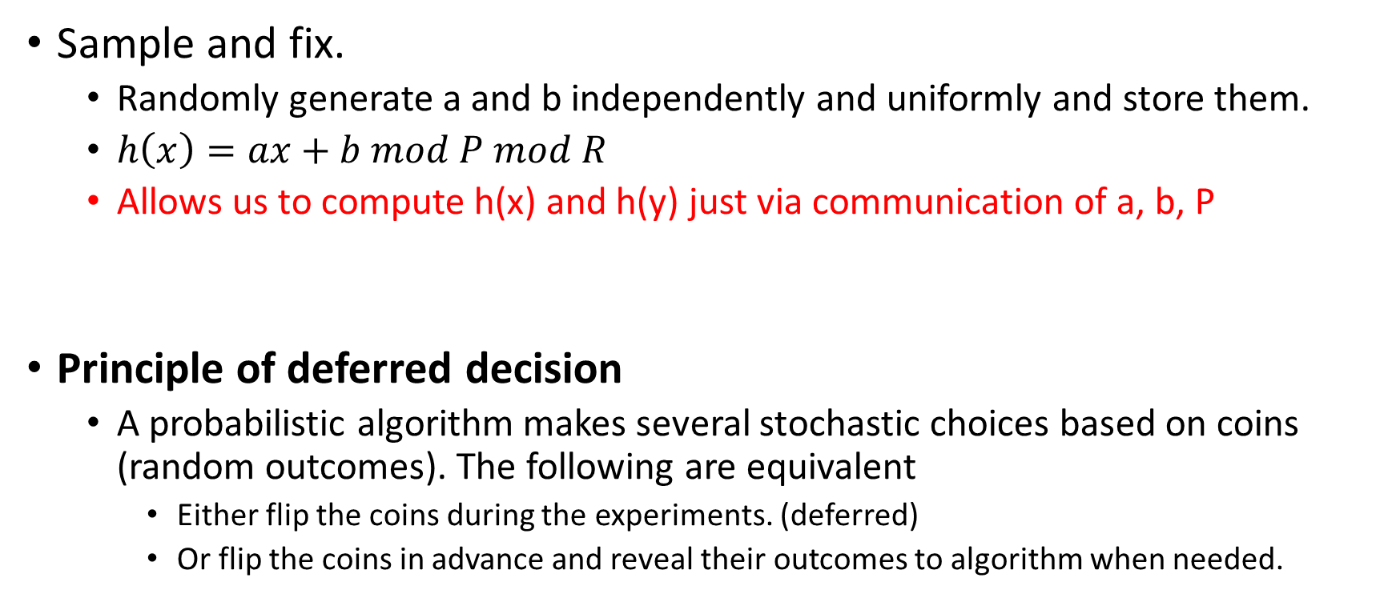
How to sample h uniformly from H
Sample and fix.
  Randomly generate a and b independently and uniformly and store them.
  $h\left(x\right)=ax+b mod P mod R$
  Allows us to compute h(x) and h(y) just via communication of a, b, P
Principle of deferred decision
  A probabilistic algorithm makes several stochastic choices based on coins (random outcomes). The following are equivalent
    Either flip the coins during the experiments. (deferred)
    Or flip the coins in advance and reveal their outcomes to algorithm when needed.

Slide 11

Class Exercise: Mod operation is slow
$h\left(x\right)=ax+b mod P mod R$
  a should not divide P
Alternatives?

Slide 12
Back to the problem of searching.

Slide 13
Example
0
1 | 41
2
3
4
5
6
7 | 7
8 | 18
9 | 94
key space = integers
TableSize = 10
h(K) = K mod 10
Insert: 7, 18, 41, 94

Slide 14
Example
0
1 | 41
2
3
4 | 94
5
6
7 | 7
8 | 18
9
key space = integers
TableSize = 10
h(K) = K mod 10
Insert: 7, 18, 41, 94

Slide 15
Collision Resolution
Collision: When two keys map to the same location in the hash table.
Two ways to resolve collisions:
Separate Chaining
Open Addressing (linear probing, quadratic probing, double hashing)

Slide 16
Example: Separate Chaining.
key space = integers
TableSize = 10
h(K) = K mod 10
Insert: 7, 41,18, 17
0
1 | ptr
2
3
4
5
6
7 | ptr
8 | ptr
9
41
7
17
18

Slide 17
Chaining with 2-universal hashing?
We insert m objects into array of size N using 2-universal hashing.
What is the worst case searching time of an object?
What is the expected value of searching time with N array size and m objects inserted?
    < 1 + m-1/N

Slide 18
Issues with Chaining?
Linked List

Slide 19
Idea behind Probing
F(i)
Probe sequence:
  0th probe = h(k) mod TableSize
  1th probe = (h(k) + f(1)) mod TableSize
  2th probe = (h(k) + f(2)) mod TableSize
  . . .
  i^{th} probe = (h(k) + i) mod TableSize
Searching
  Keep probing until you find empty spot.
  Return if match
Notes:
Add a function of I to the original hash value to resolve the collision.
Primary clustering – we notice this effect in the previous slide.
Any key that hashes into the cluster 1) will require several attempts to resolve collision and 2) will then add to the cluster. (Both 1 and 2 are bad)

Slide 20
Linear Probing
F(i) = i
Probe sequence:
  0th probe = h(k) mod TableSize
  1th probe = (h(k) + 1) mod TableSize
  2th probe = (h(k) + 2) mod TableSize
  . . .
  i^{th} probe = (h(k) + i) mod TableSize
Notes:
Add a function of I to the original hash value to resolve the collision.
Primary clustering – we notice this effect in the previous slide.
Any key that hashes into the cluster 1) will require several attempts to resolve collision and 2) will then add to the cluster. (Both 1 and 2 are bad)

Slide 21
Probing or Open Addressing
Insert:
38
19
8
109
10
0
1
2
3
4
5
6
7
8
9
Linear Probing: after checking spot h(k), try spot h(k)+1, if that is full, try h(k)+2, then h(k)+3, etc.

Slide 22
Probing or Open Addressing
Insert:
38
19
8
109
10
0 | 8
1 | 109
2 | 10
3
4
5
6
7
8 | 38
9 | 19
Linear Probing: after checking spot h(k), try spot h(k)+1, if that is full, try h(k)+2, then h(k)+3, etc.

Slide 23
Quadratic Probing
Less likely to encounter Primary Clustering
F(i) = i²
Probe sequence:
  0th probe = h(k) mod TableSize
  1th probe = (h(k) + 1) mod TableSize
  2th probe = (h(k) + 4) mod TableSize
  3th probe = (h(k) + 9) mod TableSize
  . . .
  i^{th} probe = (h(k) + i²) mod TableSize
f(i+1) = f(i) + 2i + 1
Notes:
Add a function of I to the original hash value to resolve the collision.
Less likely to encounter primary clustering, but could run into secondary clustering.
Although keys that hash to the same initial location will still use the same sequence of probes (and conflict with each other).
How big to make hash table? Lambda = ½, (hash table is twice as big as the number of elements expected.)
Note: (i +1)² – i² = 2i + 1 Thus, to get to the NEXT step, you can add 2* current value of i plus one.

Slide 24
Double Hashing
f(i) = i * g(k)
where g is a second hash function
Probe sequence:
  0th probe = h(k) mod TableSize
  1th probe = (h(k) + g(k)) mod TableSize
  2th probe = (h(k) + 2*g(k)) mod TableSize
  3th probe = (h(k) + 3*g(k)) mod TableSize
  . . .
  i^{th} probe = (h(k) + i*g(k)) mod TableSize
Notes:
So the probe sequence is a function of the key in two different ways – for the original starting location (h(k) AND for the amount of offset you move out each time you have a collision (g(k)). (as opposed to both linear probing and quadratic probing where the offset is independent of the key)
** In choosing g care must be taken so that it never evaluates to 0.
A good choice for g is to choose a prime R < TableSIze and let g(k) = R – (k mod R).
Double Hashing is Safe for λ < 1

