Slide 1
How Yahoo! use to serve millions of videos from its video library.
2011 USENIX Best Paper: Semantics of Caching with SPOCA: A Stateless, Proportional, Optimally-Consistent Addressing Algorithm
By
Chawla et al.

Slide 2
Hint for Question 1a in Assignment?

Slide 3
Data Growth

Slide 4
The Scale
The Yahoo! Video Platform has a library of over 20,000,000 video assets.
From this library, end users make about 30,000,000 requests per day for over 800,000 unique videos, which creates a low ratio of total requests to unique requests.
Also, videos are large, a typical front-end server can hold only 500 unique videos in memory and 100,000 unique videos on disk.
The low ratio of total/unique requests combined with the large size of video files make it difficult to achieve a high percentage of cache hits.

Slide 5
Requirements
Stateless Addressing: Servers are added and deleted and content should automatically route to the sever id given the video filename.
Efficiency: Request Router must recalculate the destination server on every request
Heterogeneous pool of server: Server capacities are different. Each sever $i$has capacity $c_{i}$ and the load must be balanced in proportion to the loads of the server.

Slide 6
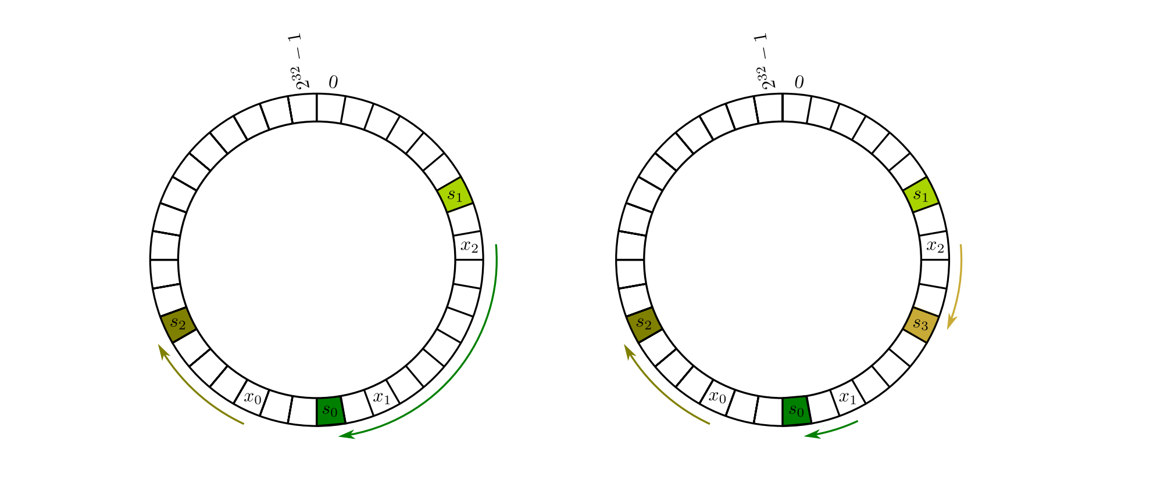
Last Class: Consistent hashing.
Hash both machines and objects in the same range.
To assign object x, compute $h_{i}$(x) and then traverse right until you find the first machine’s hash $h_{m}(Y)$. Assign x to Y.

Slide 7
What happens when servers are added/deleted?
They all share the load.
We only have to move data from one of the servers instead of all with traditional hashing!

Slide 8
Search time?
Can do log(n)
Use Binary Search trees.
Put allocated index of serves in a binary search tree. Update as needed.
Given h(x) find its successor in log(n) time.

Slide 9
Issues 1: Domino Effect

Slide 10
Issue 2: No Proportional Distribution

Slide 11
Can modify consistent hashing to achieve this?
Create multiple copies in proportion to the capacity of the machines and hash. Solves most of the problems in chawla et al.

Slide 12
The Solution proposed
Create a sparse address space and allocate a contiguous space of the size equal to the capacity of server.
The address space size should be roughly twice the total size for easily allocation and deallocation
For hashing vid1, keep hashing until reach a valid address of server and assign. So h(vid1), h(h(vid1)), etc.

Slide 13
The Solution proposed
For hashing vid1, keep hashing until reach a valid address of server and assign. So h(vid1), h(h(vid1)), etc.
The SPOCA routing function uses a hash function to map names to a point in a hash space.
Input = the name of the requested content
Output = the server that will handle the request.
Re-hashing happens till the result maps to a valid hash space.

Slide 14
Server Down

Slide 15
Server addition

Slide 16
Expected Search time?
Probability that hash lands in empty space = ½
Expected number of hash to land in valid space ?
Expected value = 2 (instead of log n with consistent hashing)
Sharp tails so decays exponentially!!

Slide 17
Handling Popularity: Zebra System
For popular content we need to route requests to multiple front-end servers.
Bloom Filters to identify popular content.
But over time anything will be popular.

Slide 18
Multiple Bloom Filter

Slide 19
Multiple Bloom Filter

Slide 20
Multiple Bloom Filter

Slide 21
Multiple Bloom Filter

Slide 22
Identifying popularity

Slide 23
Solution to Popularity
Zebra determines which serving cluster will handle a given request based on geolocality and popularity.
SPOCA determines which front-end server within that cluster will cache and serve the request
Store the hashed address of any requested content for a brief popularity window. (150 seconds was used in the case)
When the popularity window expires, the stored hash for each object is discarded.

Slide 24
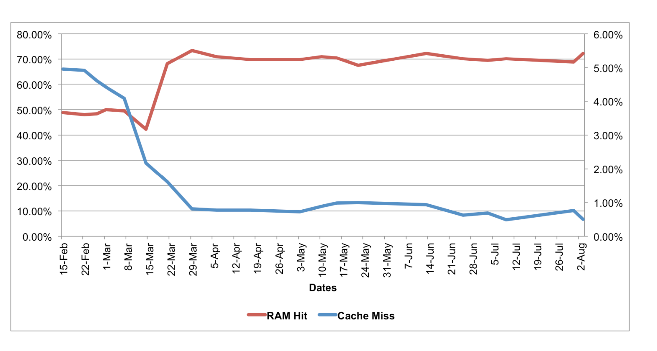
Results: What after deployment

Slide 25
Results: After Deployment

Slide 26
Impact
More than $350 million dollars in unnecessary equipment (filer costs, rack space etc) alone can be saved in five-year period of running with SPOCA. In addition to the substantial savings in filer costs, the hidden cost savings included Power savings for running the equipment's and data center utilizations.

