Slide 1
How Yahoo! use to serve millions of videos from its video library.
2011 USENIX Best Paper: Semantics of Caching with SPOCA: A Stateless, Proportional, Optimally-Consistent Addressing Algorithm
By
Chawla et al.

Slide 2
Announcements
Please see this excel sheet, I have put you names based on your emails
https://docs.google.com/spreadsheets/d/1GucaWPCGiypdj4oOPNrYcJaAtcxA-DxmWVGCAh5gJD4/edit#gid=0 (Links to an external site.)
If you have chosen a project over the final, and your name is not there, please contact me.
You can use this excel sheet to form groups if you want. (Ideal is a group of size 2). Here are the new timelines
Finalize the topic and team: 14th Feb
1-page Abstract: 21st Feb
Mid-Term Report: 20th March
Final Report: Last Day of Exam.
Details on these reports will be communicated before the deadline. Please start thinking about topics you will be excited to work on. The aim is to delve deeper into a research/programming problem and get your hands dirty with it. Let the fun begin!
I am really looking forward to exciting projects.

Slide 3
Assignments

Slide 4
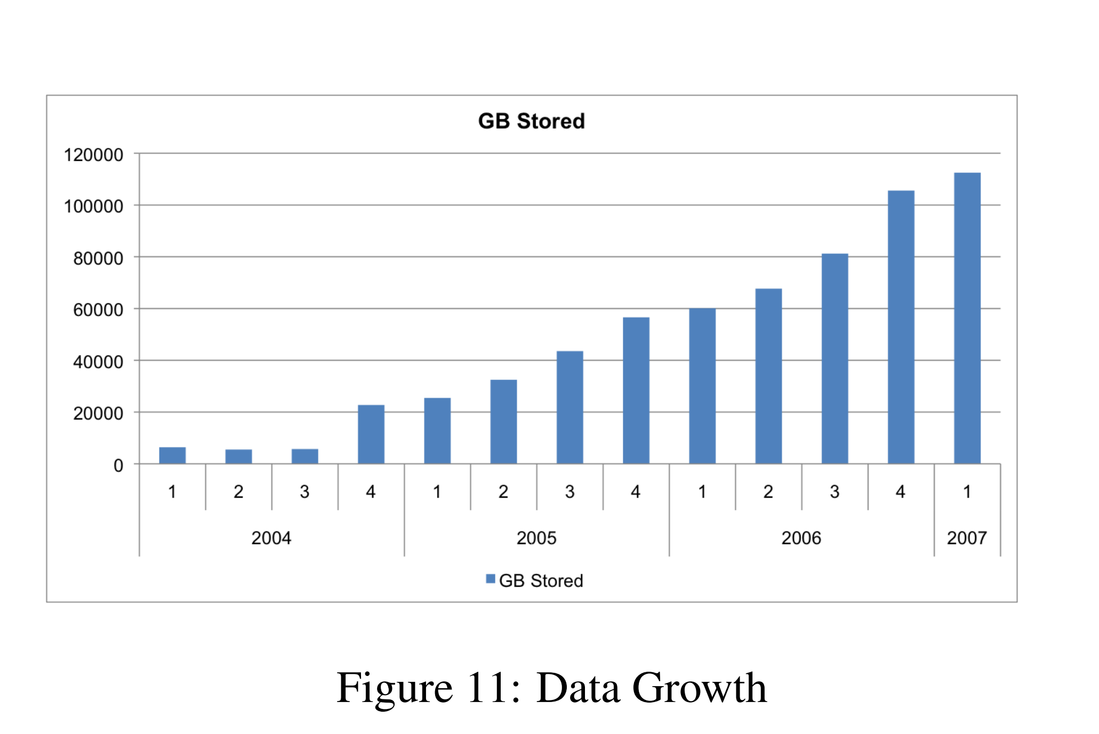
Data Growth

Slide 5
The Scale
The Yahoo! Video Platform has a library of over 20,000,000 video assets.
From this library, end users make about 30,000,000 requests per day for over 800,000 unique videos, which creates a low ratio of total requests to unique requests.
Also, videos are large, a typical front-end server can hold only 500 unique videos in memory and 100,000 unique videos on disk.
The low ratio of total/unique requests combined with the large size of video files make it difficult to achieve a high percentage of cache hits.

Slide 6
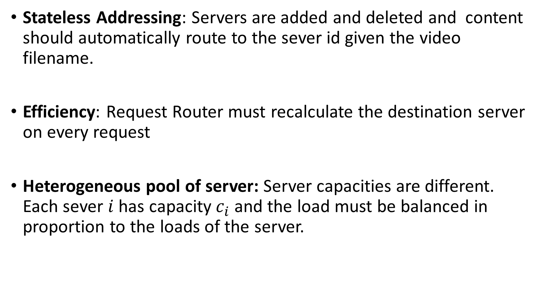
Requirements
Stateless Addressing: Servers are added and deleted and content should automatically route to the sever id given the video filename.
Efficiency: Request Router must recalculate the destination server on every request
Heterogeneous pool of server: Server capacities are different. Each sever $i$has capacity $c_{i}$ and the load must be balanced in proportion to the loads of the server.

Slide 7
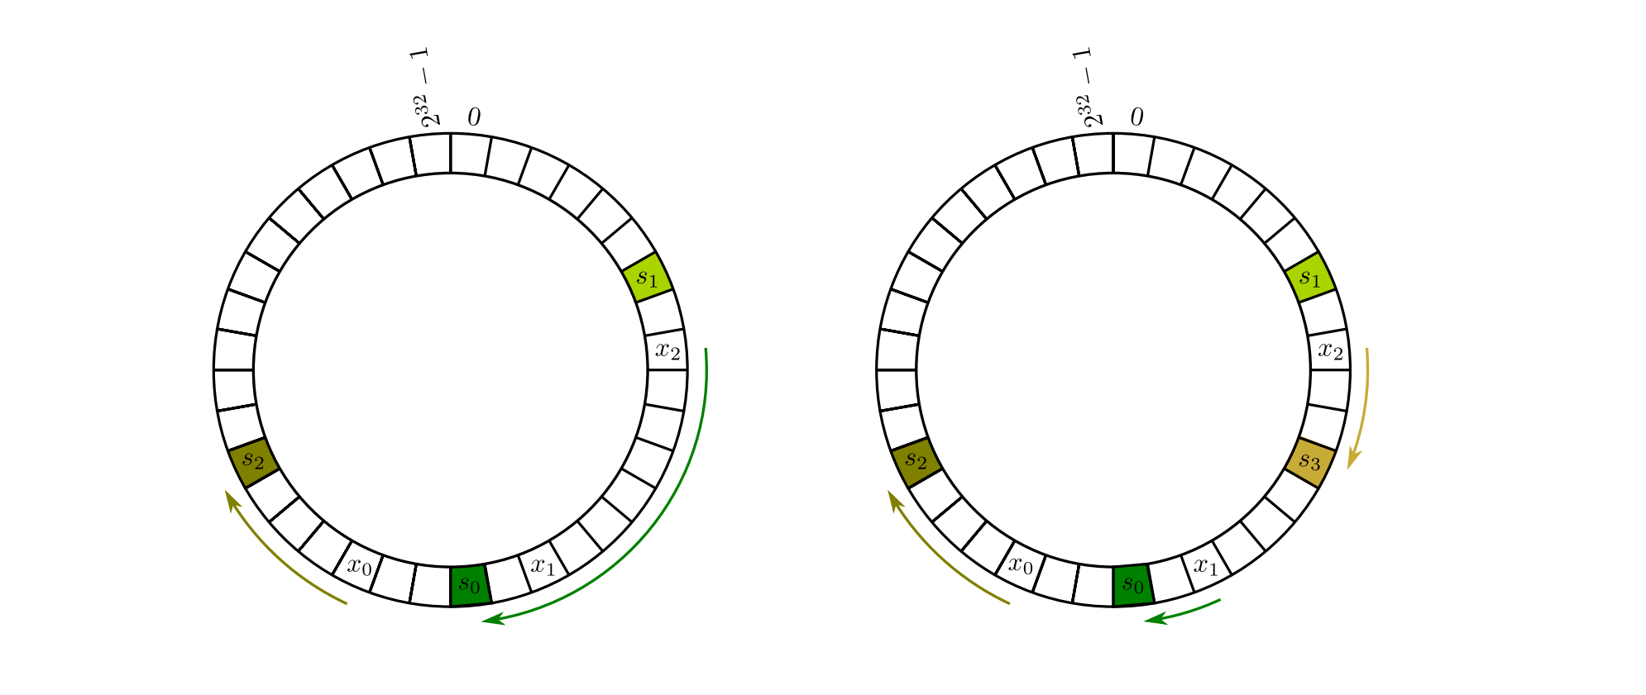

Last Class: Consistent hashing.
Hash both machines and objects in the same range.
To assign object x, compute $h_{i}$(x) and then traverse right until you find the first machine’s hash $h_{m}(Y)$. Assign x to Y.

Slide 8
What happens when servers are added/deleted?
They all share the load.
We only have to move data from one of the servers instead of all with traditional hashing!

Slide 9
Search time?
Can do log(n)
  Use Binary Search trees.
  Put allocated index of serves in a binary search tree. Update as needed.
  Given h(x) find its successor in log(n) time.

Slide 10
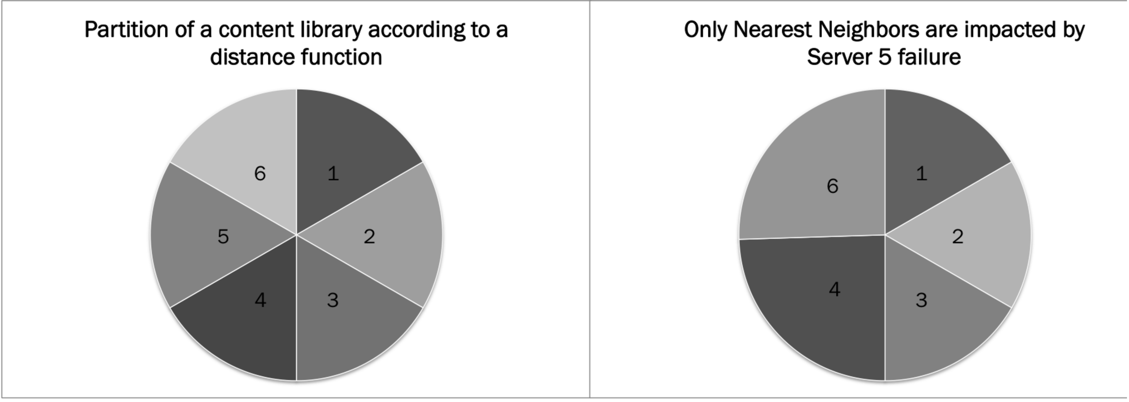
Issues 1: Domino Effect

Slide 11
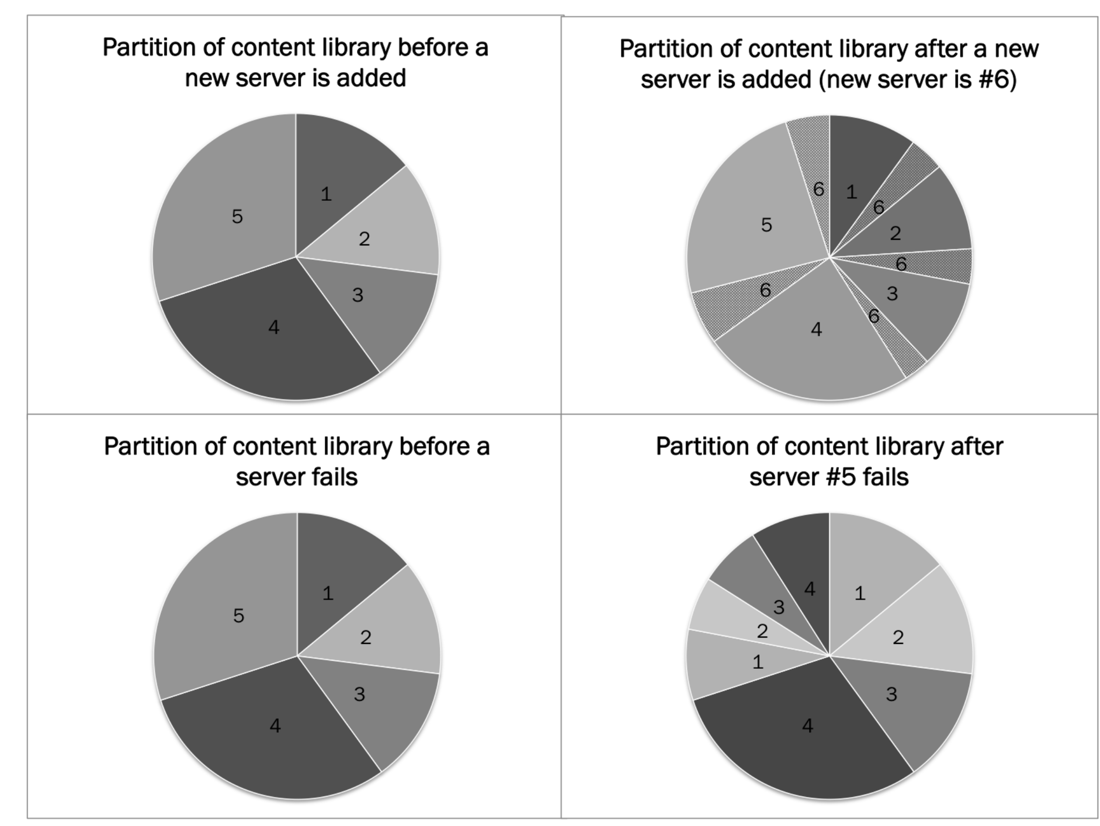
Issue 2: No Proportional Distribution

Slide 12
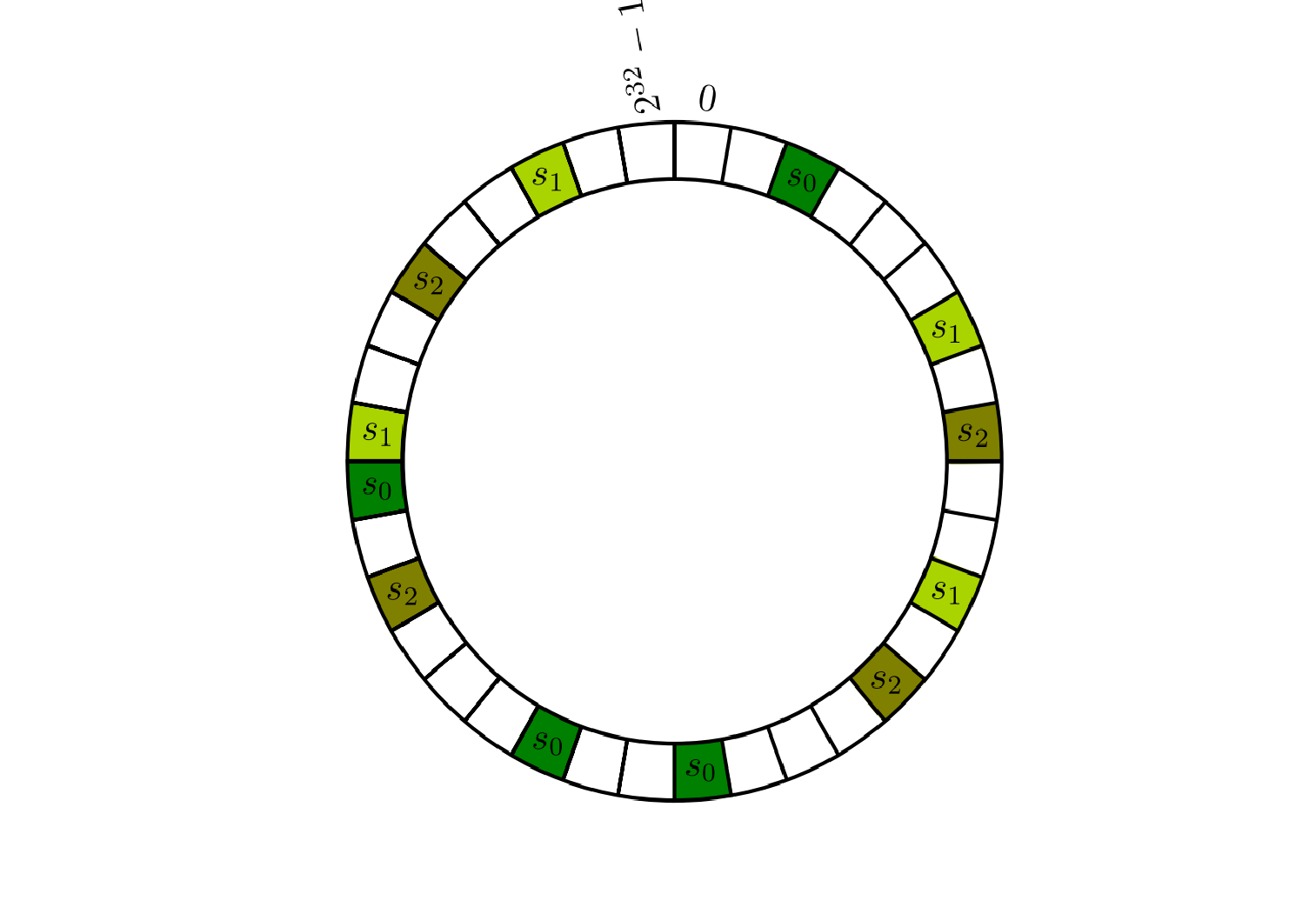
Can modify consistent hashing to achieve this?
Create multiple copies in proportion to the capacity of the machines and hash. Solves most of the problems in chawla et al.

Slide 13
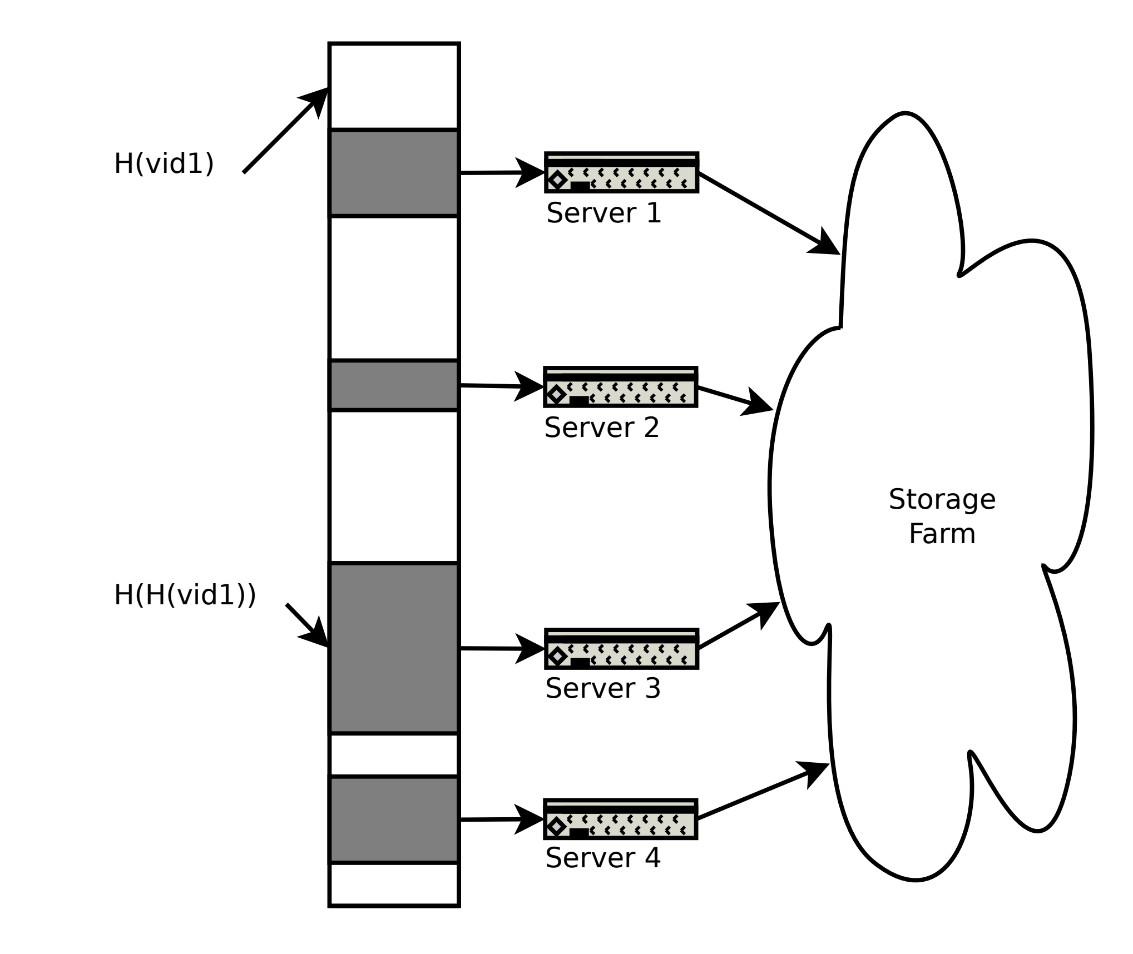
The Solution proposed
Create a sparse address space and allocate a contiguous space of the size equal to the capacity of server.
The address space size should be roughly twice the total size for easily allocation and deallocation
For hashing vid1, keep hashing until reach a valid address of server and assign. So h(vid1), h(h(vid1)), etc.

Slide 14
The Solution proposed
For hashing vid1, keep hashing until reach a valid address of server and assign. So h(vid1), h(h(vid1)), etc.
The SPOCA routing function uses a hash function to map names to a point in a hash space.
  Input = the name of the requested content
  Output = the server that will handle the request.
Re-hashing happens till the result maps to a valid hash space.

Slide 15
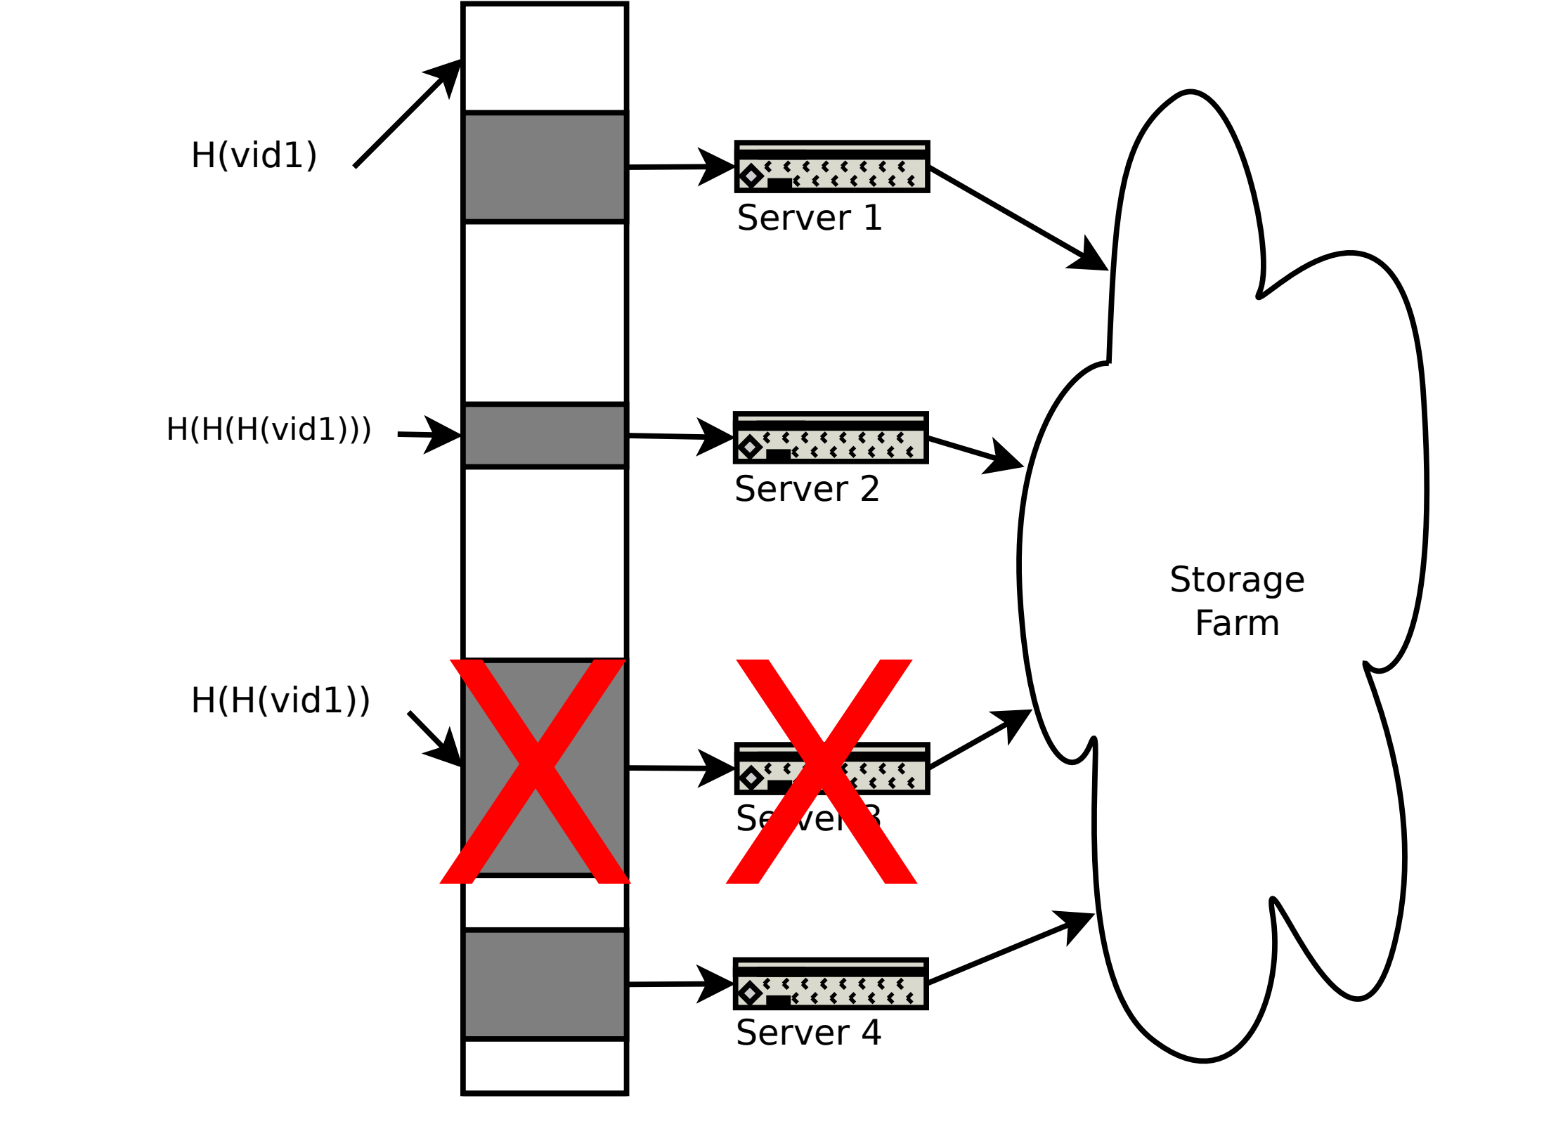
Server Down

Slide 16
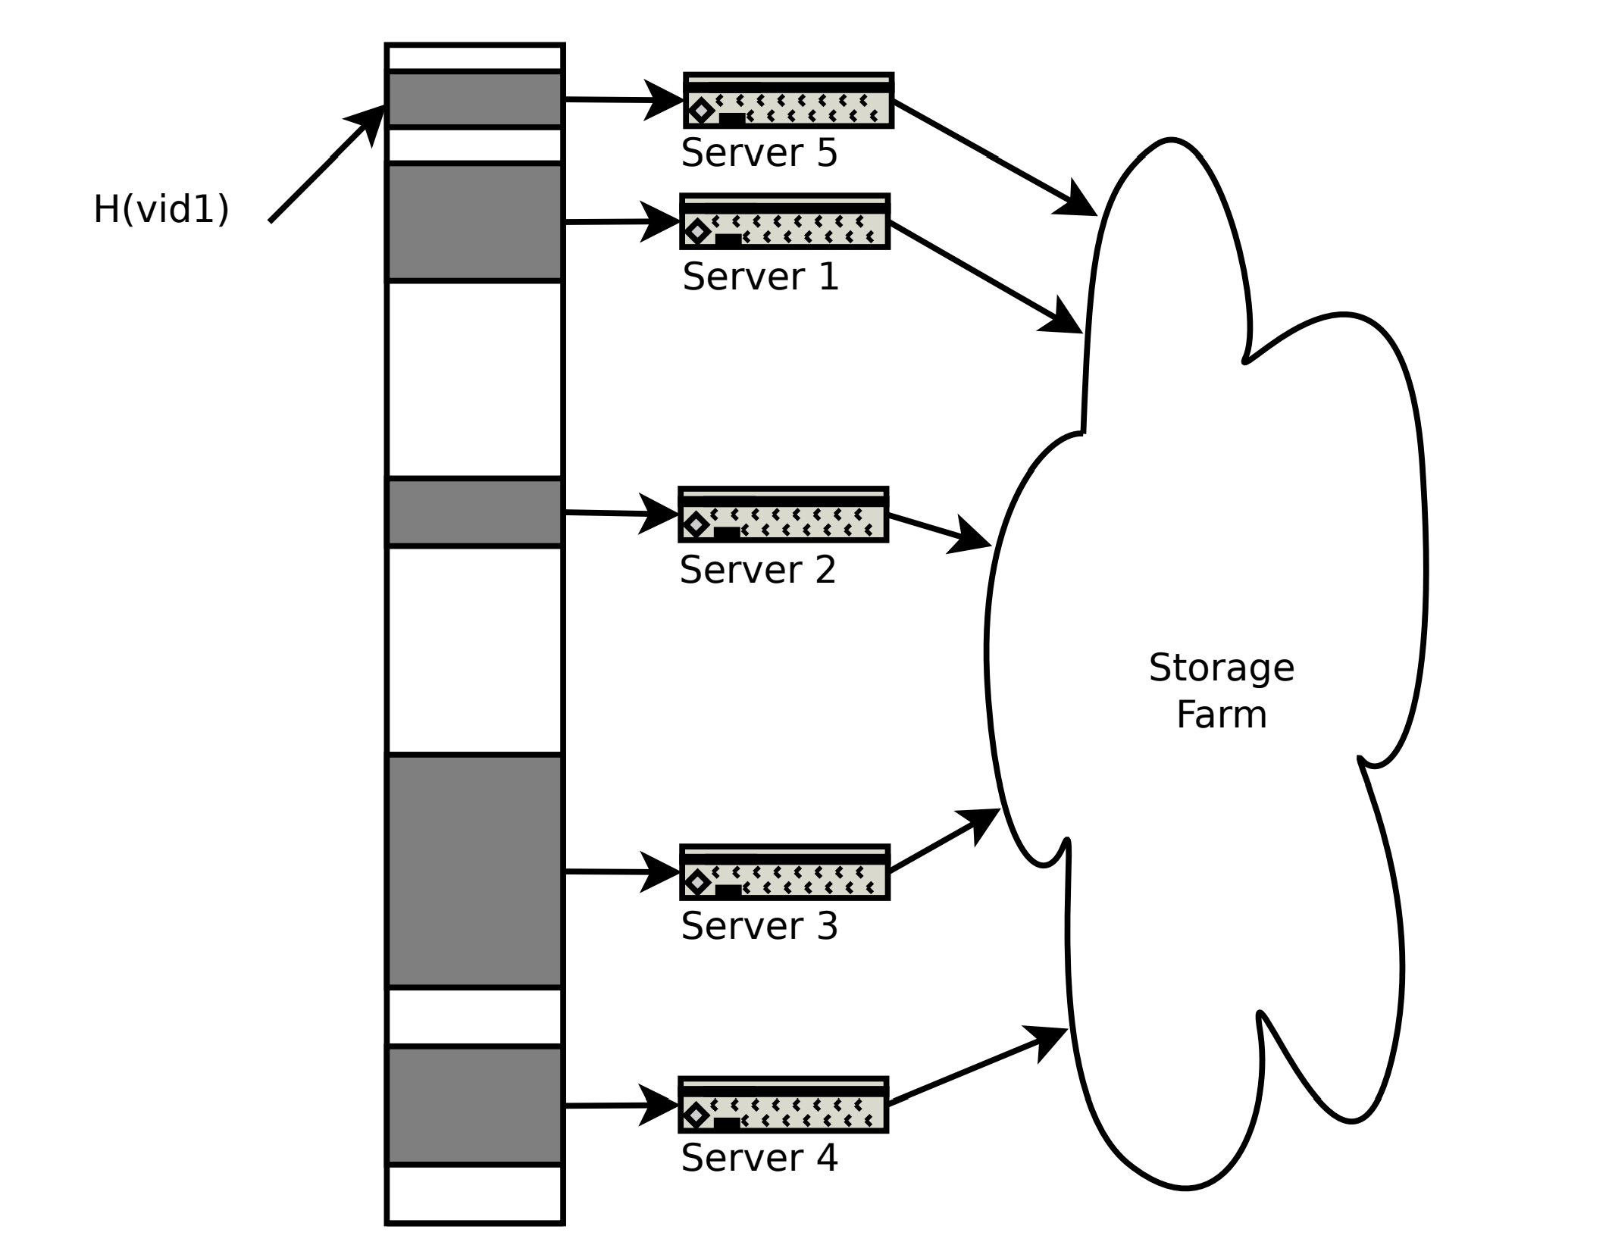
Server addition

Slide 17
Expected Search time?
Probability that hash lands in empty space = ½
Expected number of hash to land in valid space ?
Expected value = 2 (instead of log n with consistent hashing)
Sharp tails so decays exponentially!!

Slide 18
Handling Popularity: Zebra System
For popular content we need to route requests to multiple front-end servers.
Bloom Filters to identify popular content.
But over time anything will be popular.

Slide 19
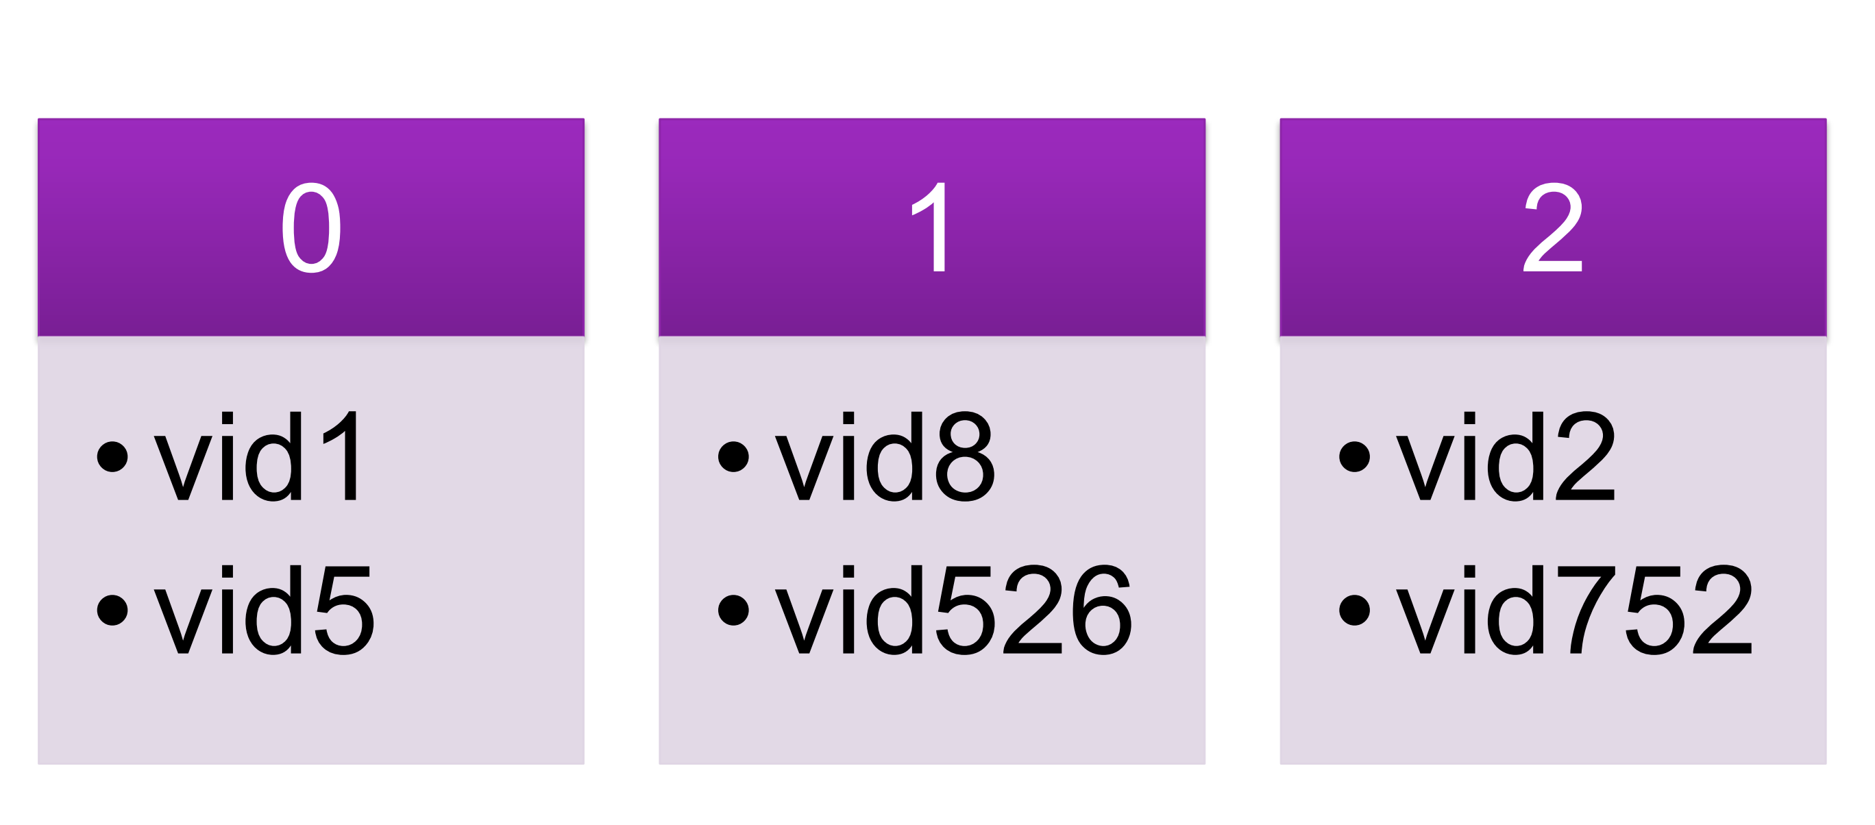
Multiple Bloom Filter

Slide 20
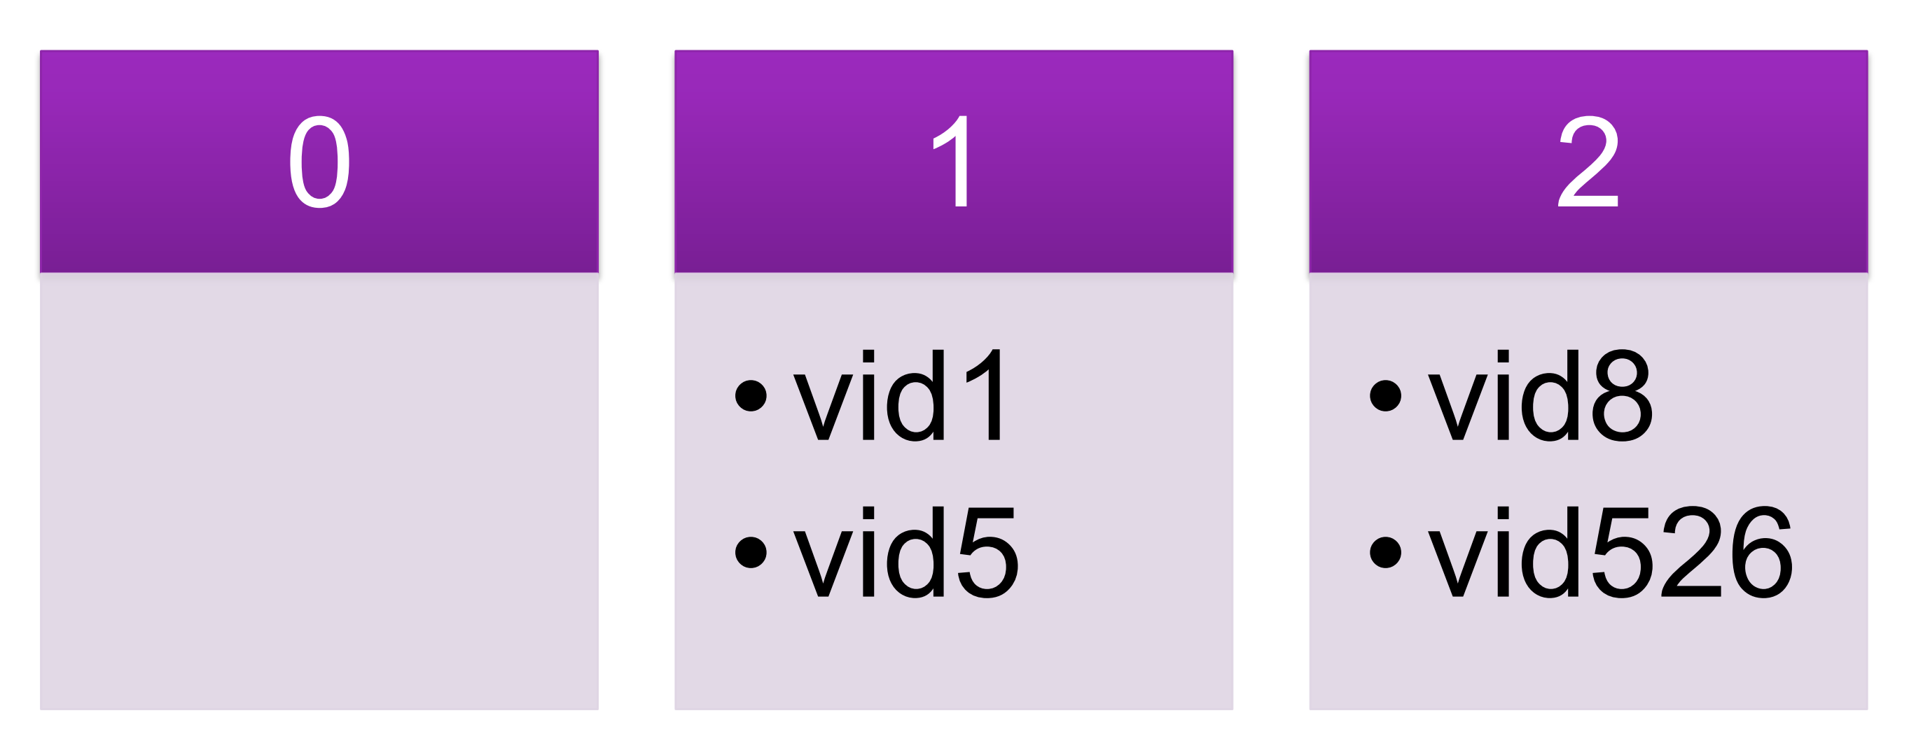
Multiple Bloom Filter

Slide 21
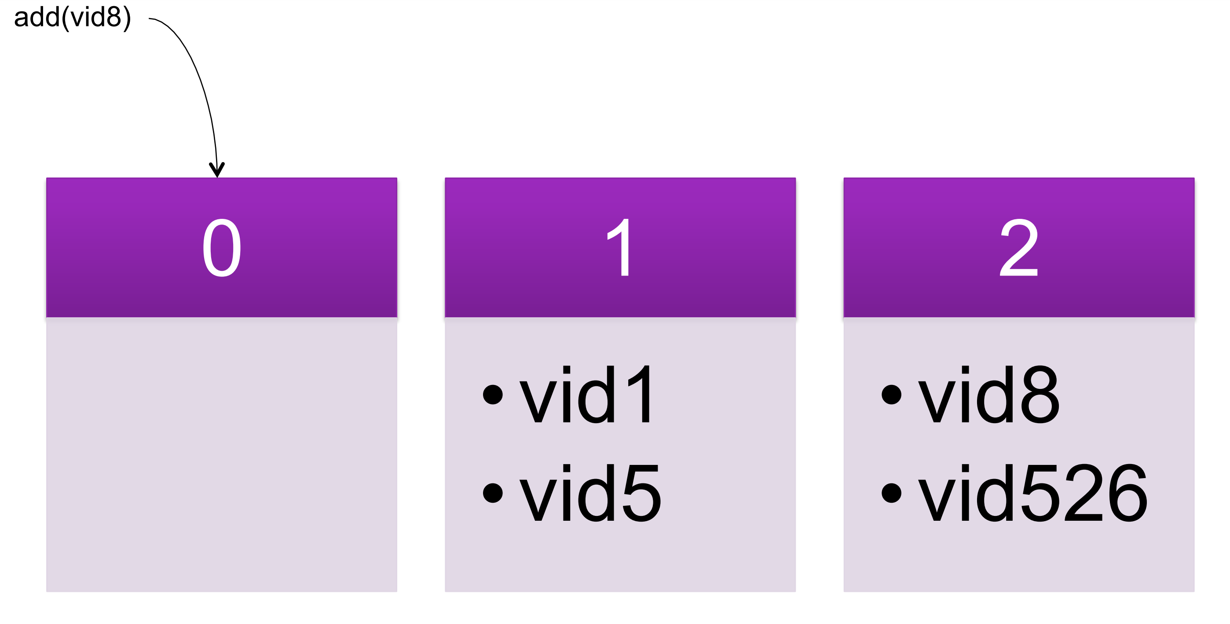
Multiple Bloom Filter

Slide 22
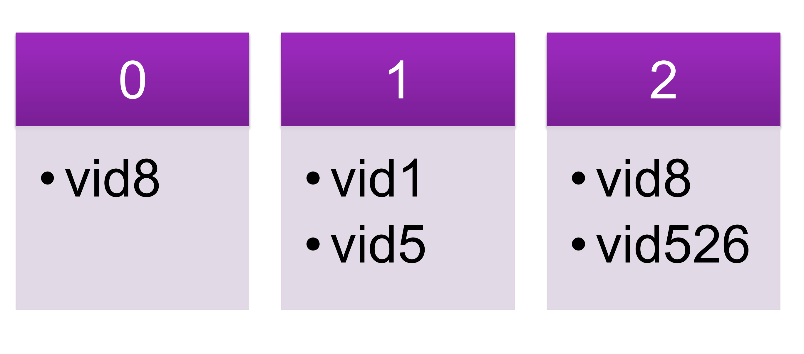
Multiple Bloom Filter

Slide 23
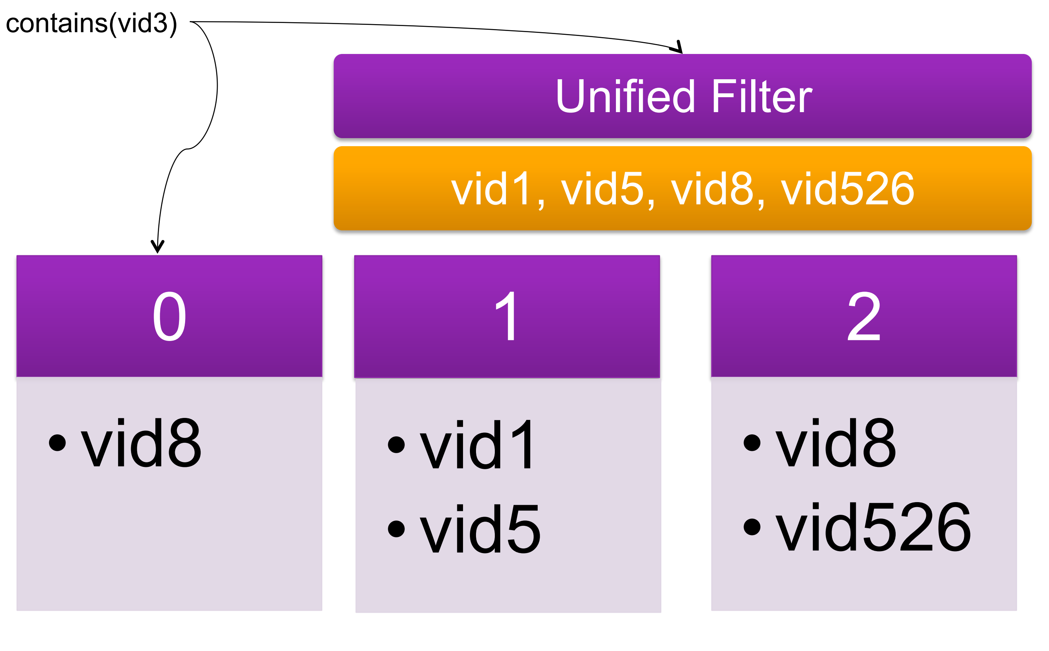
Identifying popularity

Slide 24
Solution to Popularity
Zebra determines which serving cluster will handle a given request based on geo-locality and popularity.
SPOCA determines which front-end server within that cluster will cache and serve the request
Store the hashed address of any requested content for a brief popularity window. (150 seconds was used in the case)
When the popularity window expires, the stored hash for each object is discarded.

Slide 25
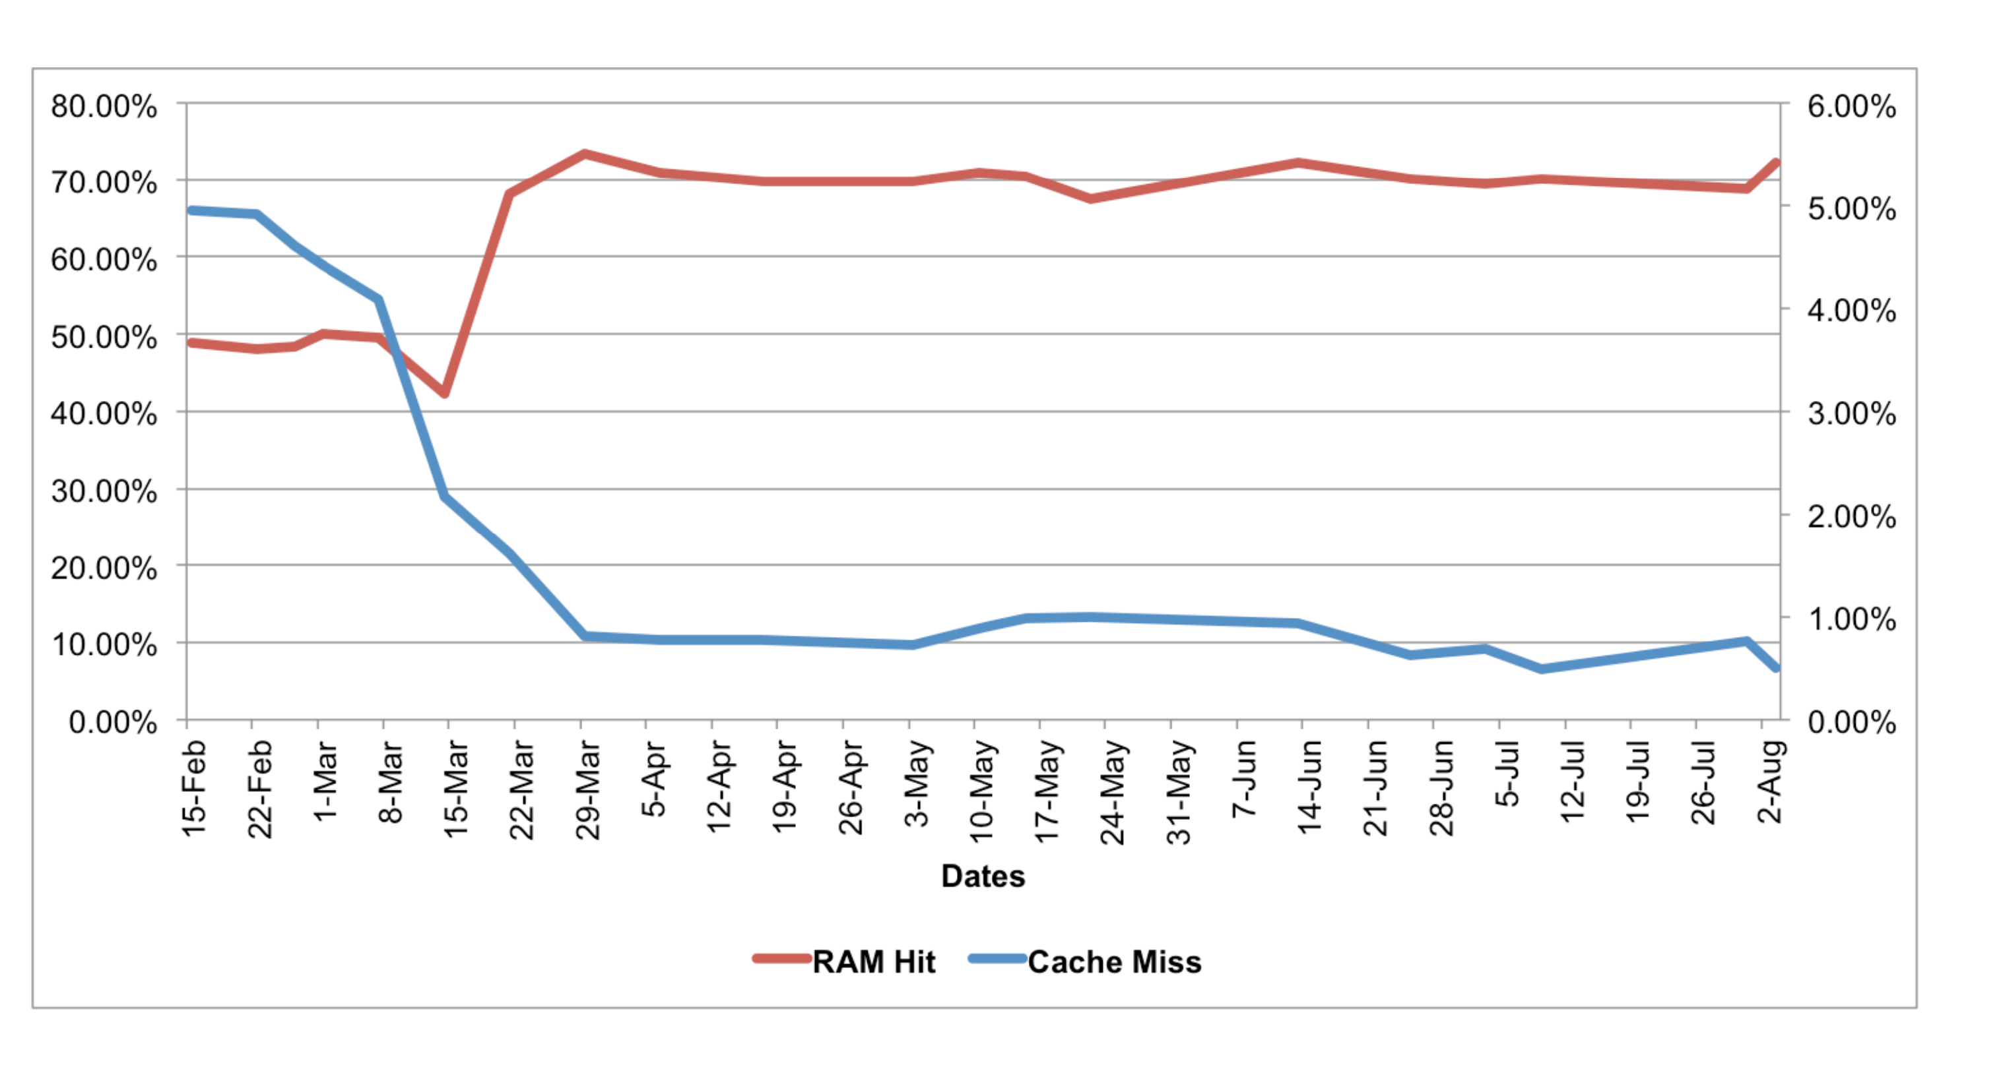
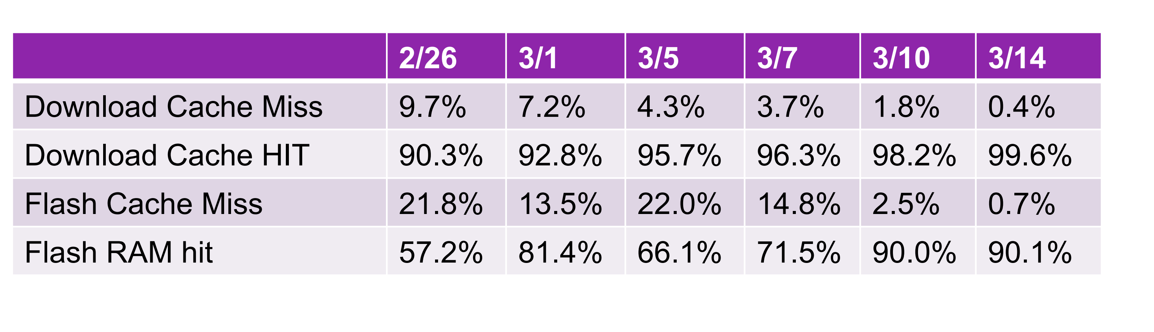
Results: What after deployment

Slide 26
Results: After Deployment

Slide 27
Impact
More than $350 million dollars in unnecessary equipment (filer costs, rack space etc) alone can be saved in five-year period of running with SPOCA. In addition to the substantial savings in filer costs, the hidden cost savings included Power savings for running the equipment's and data center utilizations.

