Slide 1
Graduate Seminar In Machine Learning
COMP 640, Fall 2017
Instructor: Anshumali Shrivastava
anshumali@rice.edu

Slide 2
Information
Location: DCH 1046
Timings: Mondays 3:00-4:30pm
Office Hours: Mondays 4:30pm -5:30pm
Website for Information: https://www.cs.rice.edu/~as143/COMP640_Fall17/index.html
Discussions: Piazza
Prerequisite: A rigorous course in ML (Ex. Comp 440 or equivalent)

Slide 3
What is This Class About?
Keeping up with cutting edge research and advancements in Machine Learning (Like AI and Deep Learning).
We will be discussing recent potentially sophisticated papers/topics in each class.
This course is for future leaders in AI. Giving presentations, leading discussions, and writing summary on very advanced topics.

Slide 4
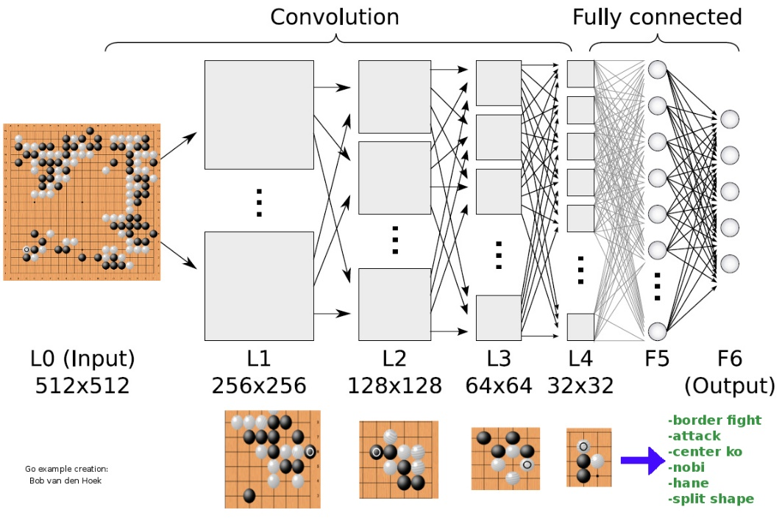
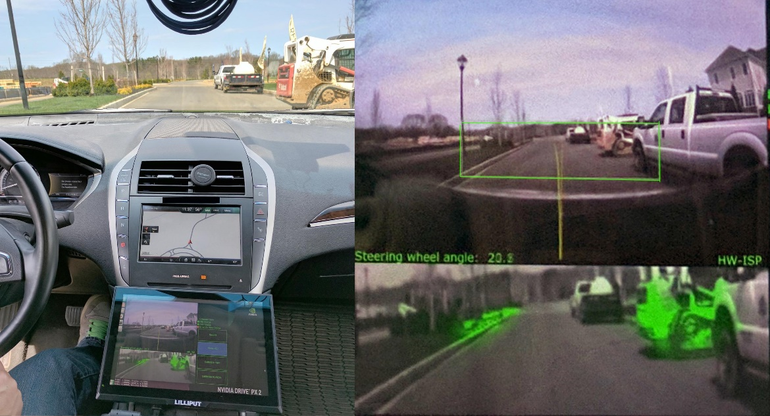
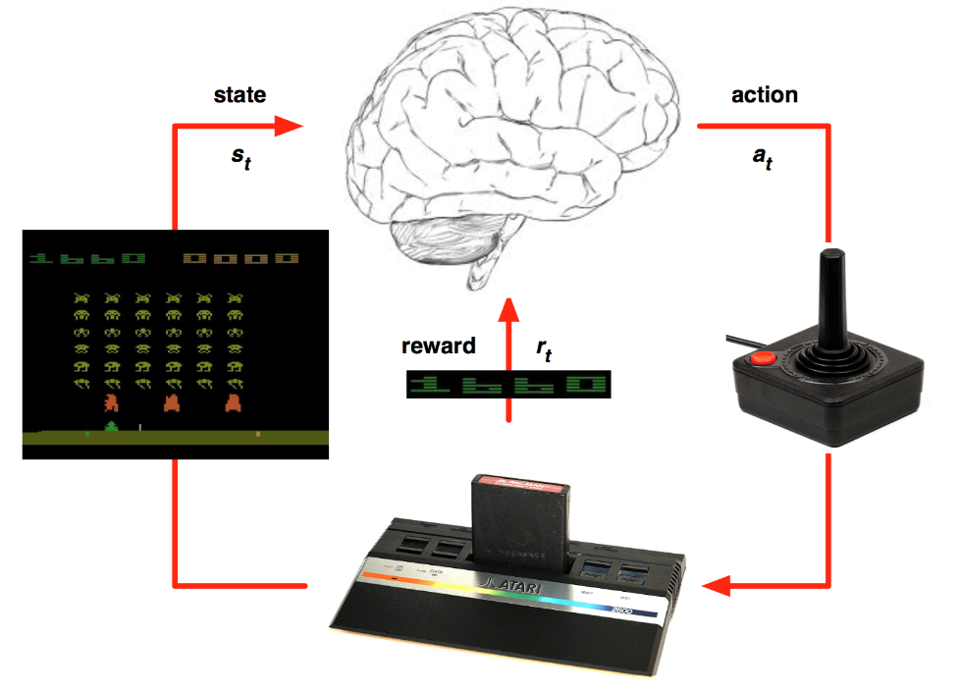

Slide 5
What we will cover
Start with basic SVMs and Kernels.
See some Basics of Large Scale SVMs via random features
Then transition from Random Features to Learned features (aka deep learning)
Look into tricks and trade of deep learning
Go to Reinforcement learning and deep reinforcement learning.
Understand self-driving cars and alpha go systems.

Slide 6
Requirements for 1 Credits
Help presenting a part of topic in 1 class (2-3 students per class)
Sign up to write a 2-3 page write-up discussion on 1 class (2-3 students per class). Cannot be same at the topic of presentation
Important
Need to collaborate and create a presentation. Dry run to instructor one week before the presentation data. (Start working early)
Submit the write-up within a week of presentation.

Slide 7
You have to read the suggested reading materials before the class. It is OK not to understand the math and proofs. It is OK to assume Oracles.
There will be quiz at the start of the class. You should be able to answer the following in one line
What is the aim of the paper?
What is the conclusion?
What were people doing before and how did this change?
How is it different from the simplest way of achieving it given your knowledge.

Slide 8
Suggestions on Reading papers
Understand the problem statement and difficulty.
Read and understand the problem (the goal).
Think how you will solve it. If you have no idea read ahead to see sub-goals. Keep reading until you arrive at a sub-goal, you have some idea of how to solve it.
See what the paper has done differently. (What is really the technical difference or maybe there isn’t any)
Asses why your own idea is superior/inferior
Outcome
Your idea is inferior: You learned something
Your idea is superior: Write a new paper
Cannot really see: Keep pondering.

Slide 9
Presentations
Your team is responsible for running the show. No Restrictions. The suggested papers can be ignored if you have better materials to present to audience from internet of elsewhere. But should be related to the topic in the papers.
The class should get to know about the topic from scratch. Do not assume any knowledge other than basic ML concepts. (cannot assume any sophisticated theorem)
Should be interactive with open discussions and questions. (not too philosophical … must be technical)

Slide 10
Summary Discussions
Ideally it should be like a technical blog on the discussion.
Only basic knowledge can be assumed. Its ok to use sophisticated ideas with citations.
Ex:
http://neuro.cs.ut.ee/demystifying-deep-reinforcement-learning/

Slide 11
For 3 credits: A Full Research Project
Talk to instructor.
Some Examples:
Take a well known algorithm and try to make it faster.
Propose a novel fast approximate version.
Identify bottlenecks and opportunities to parallelize in a novel way.
Take an interesting dataset and try to find something interesting using custom ML models.
Propose an alternative to well known models in some real environment. Propose a ML (like deep learning) algorithm/model for a novel application with real data.
Theoretical analysis of some new properties of known or proposed algorithms.
Ideally a good project should be publishable if the goals are met.
Project can be totally unrelated to topics covered in class.
START EARLY

