Slide 1
Deep Learning for Vision & Language
Machine Learning I & II: Supervised vs Unsupervised Learning
Linear Classifiers / Regressors

Slide 2
About the class
COMP 646: Deep Learning for Vision and Language
Instructor: Vicente Ordóñez (Vicente Ordóñez Román)
Website: https://www.cs.rice.edu/~vo9/deep-vislang
Location: Zoom – Rice Canvas has the links OR
Duncan Hall 1070
Times: Mondays, Wednesdays, and Fridays
from 1pm to 1:50pm Central Time
Office Hours: TBD
Teaching Assistants: TBD
Discussion Forum: Rice Canvas

Slide 3



https://www.cs.rice.edu/~vo9/deep-vislang/

Slide 4
Machine Learning
The study of algorithms that learn from data.

Slide 5



































Linear Regression
Example: Hollywood movie data
input variables x
output variables y
production
costs
promotional
costs
genre of
the movie
box office
first week
total book
sales
total revenue
USA
total revenue
international
$$x_{1}^{(1)}$$
$$x_{2}^{(1)}$$
$$x_{3}^{(1)}$$
$$x_{4}^{(1)}$$
$$x_{5}^{(1)}$$
$$x_{6}^{(1)}$$
$$x_{7}^{(1)}$$
$$x_{1}^{(2)}$$
$$x_{2}^{(2)}$$
$$x_{3}^{(2)}$$
$$x_{4}^{(2)}$$
$$x_{5}^{(2)}$$
$$x_{6}^{(2)}$$
$$x_{7}^{(2)}$$
$$x_{1}^{(3)}$$
$$x_{2}^{(3)}$$
$$x_{3}^{(3)}$$
$$x_{4}^{(3)}$$
$$x_{5}^{(3)}$$
$$x_{6}^{(3)}$$
$$x_{7}^{(3)}$$
$$x_{1}^{(4)}$$
$$x_{2}^{(4)}$$
$$x_{3}^{(4)}$$
$$x_{4}^{(4)}$$
$$x_{5}^{(4)}$$
$$x_{6}^{(4)}$$
$$x_{7}^{(4)}$$
$$x_{1}^{(5)}$$
$$x_{2}^{(5)}$$
$$x_{3}^{(5)}$$
$$x_{4}^{(5)}$$
$$x_{5}^{(5)}$$
$$x_{6}^{(5)}$$
$$x_{7}^{(5)}$$

Slide 6










Linear Regression
Example: Hollywood movie data
input variables x
output variables y
production
costs
promotional
costs
genre of
the movie
box office
first week
total book
sales
total revenue
USA
total revenue
international
$$x_{1}^{(1)}$$
$$x_{2}^{(1)}$$
$$x_{3}^{(1)}$$
$$x_{4}^{(1)}$$
$$x_{5}^{(1)}$$
$$y_{1}^{(1)}$$
$$y_{2}^{(1)}$$
$$x_{1}^{(2)}$$
$$x_{2}^{(2)}$$
$$x_{3}^{(2)}$$
$$x_{4}^{(2)}$$
$$x_{5}^{(2)}$$
$$y_{1}^{(2)}$$
$$y_{2}^{(2)}$$
$$x_{1}^{(3)}$$
$$x_{2}^{(3)}$$
$$x_{3}^{(3)}$$
$$x_{4}^{(3)}$$
$$x_{5}^{(3)}$$
$$y_{1}^{(3)}$$
$$y_{2}^{(3)}$$
$$x_{1}^{(4)}$$
$$x_{2}^{(4)}$$
$$x_{3}^{(4)}$$
$$x_{4}^{(4)}$$
$$x_{5}^{(4)}$$
$$y_{1}^{(4)}$$
$$y_{2}^{(4)}$$
$$x_{1}^{(5)}$$
$$x_{2}^{(5)}$$
$$x_{3}^{(5)}$$
$$x_{4}^{(5)}$$
$$x_{5}^{(5)}$$
$$y_{1}^{(5)}$$
$$y_{2}^{(5)}$$

Slide 7
Linear Regression
Example: Hollywood movie data
input variables x
output variables y
production
costs
promotional
costs
genre of
the movie
box office
first week
total book
sales
total revenue
USA
total revenue
international
$$x_{1}^{(1)}$$
$$x_{2}^{(1)}$$
$$x_{3}^{(1)}$$
$$x_{4}^{(1)}$$
$$x_{5}^{(1)}$$
$$y_{1}^{(1)}$$
$$y_{2}^{(1)}$$
training
data
$$x_{1}^{(2)}$$
$$x_{2}^{(2)}$$
$$x_{3}^{(2)}$$
$$x_{4}^{(2)}$$
$$x_{5}^{(2)}$$
$$y_{1}^{(2)}$$
$$y_{2}^{(2)}$$
$$x_{1}^{(3)}$$
$$x_{2}^{(3)}$$
$$x_{3}^{(3)}$$
$$x_{4}^{(3)}$$
$$x_{5}^{(3)}$$
$$y_{1}^{(3)}$$
$$y_{2}^{(3)}$$
$$x_{1}^{(4)}$$
$$x_{2}^{(4)}$$
$$x_{3}^{(4)}$$
$$x_{4}^{(4)}$$
$$x_{5}^{(4)}$$
$$y_{1}^{(4)}$$
$$y_{2}^{(4)}$$
test
data
$$x_{1}^{(5)}$$
$$x_{2}^{(5)}$$
$$x_{3}^{(5)}$$
$$x_{4}^{(5)}$$
$$x_{5}^{(5)}$$
$$y_{1}^{(5)}$$
$$y_{2}^{(5)}$$

Slide 8
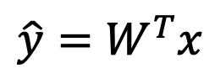
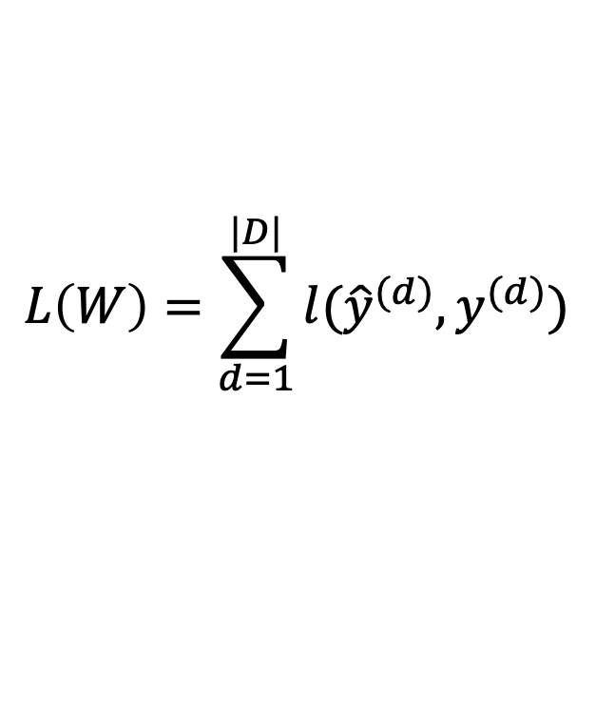


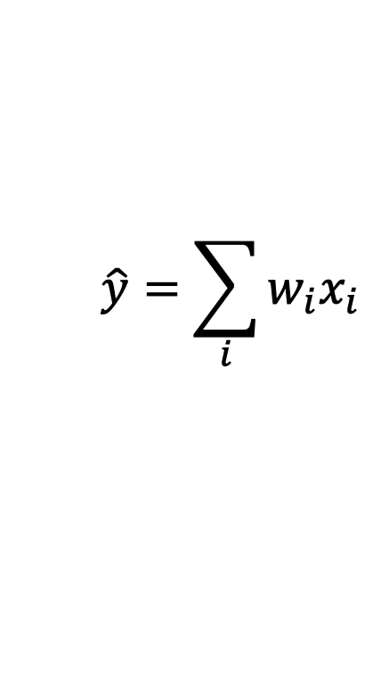
Linear Regression
$$\hat{y}=\sum_{i}{w_{i}x_{i}}$$
Prediction,
Inference,
Testing
$$\hat{y}=W^{T}x$$
$$L\left(W\right)=\sum_{d=1}^{|D|}{l({\hat{y}}^{(d)}, y^{(d)})}$$
Training,
Learning,
Parameter
estimation
Objective
minimization
$$D=\{(x^{\left(d\right)},y^{\left(d\right)})\}$$
$$W^{∗}=argmin L(W)$$

Slide 9
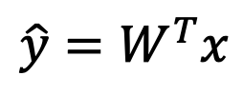
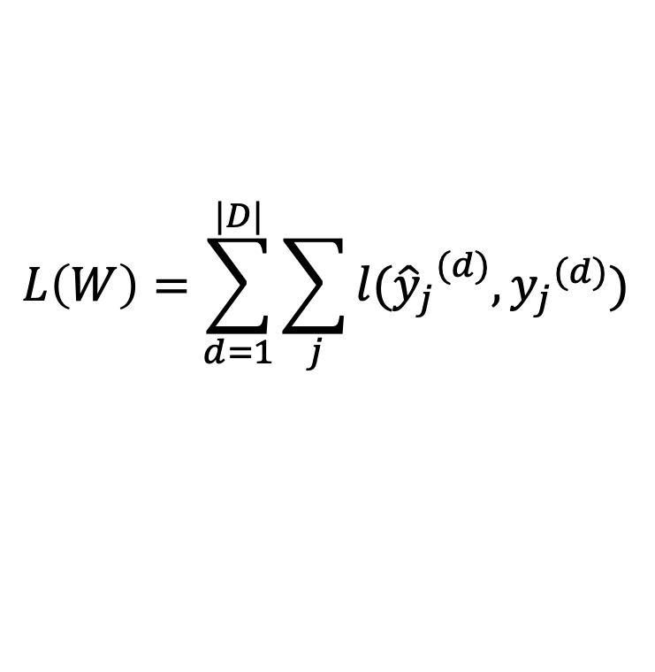
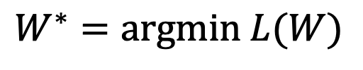

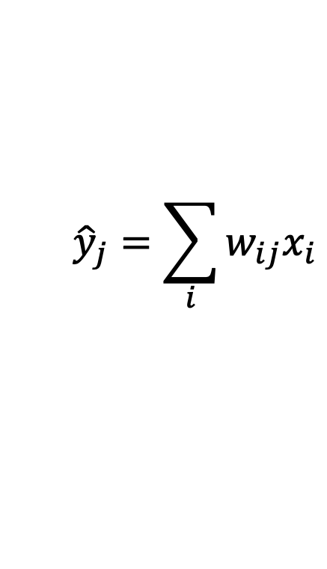
Linear Regression
$${\hat{y}}_{j}=\sum_{i}{w_{ij}x_{i}}$$
Prediction,
Inference,
Testing
$$\hat{y}=W^{T}x$$
$$L\left(W\right)=\sum_{d=1}^{|D|}{\sum_{j}{l({{\hat{y}}_{j}}^{(d)}, {y_{j}}^{(d)})}}$$
Training,
Learning,
Parameter
estimation
Objective
minimization
$$D=\{(x^{\left(d\right)},y^{\left(d\right)})\}$$
$$W^{∗}=argmin L(W)$$

Slide 10
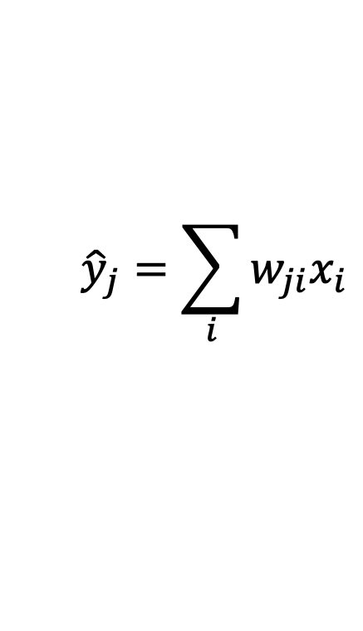
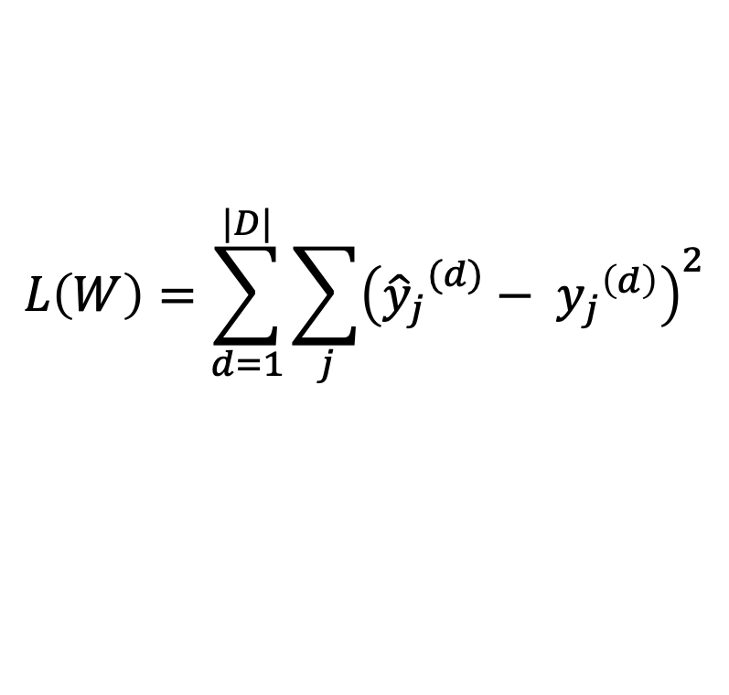
Linear Regression – Least Squares
$${\hat{y}}_{j}=\sum_{i}{w_{ji}x_{i}}$$
$$\hat{y}=W^{T}x$$
$$L\left(W\right)=\sum_{d=1}^{|D|}{\sum_{j}{{\left({{\hat{y}}_{j}}^{(d)}− {y_{j}}^{\left(d\right)}\right)}^{2}}}$$
Training,
Learning,
Parameter
estimation
Objective
minimization
$$D=\{(x^{\left(d\right)},y^{\left(d\right)})\}$$
$$W^{∗}=argmin L(W)$$

Slide 11
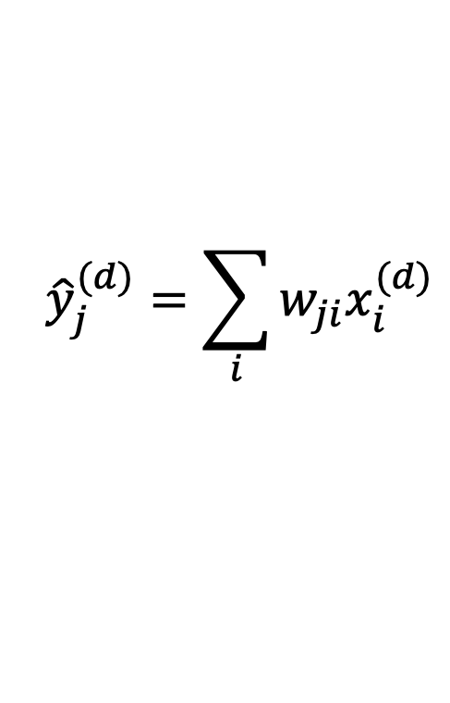
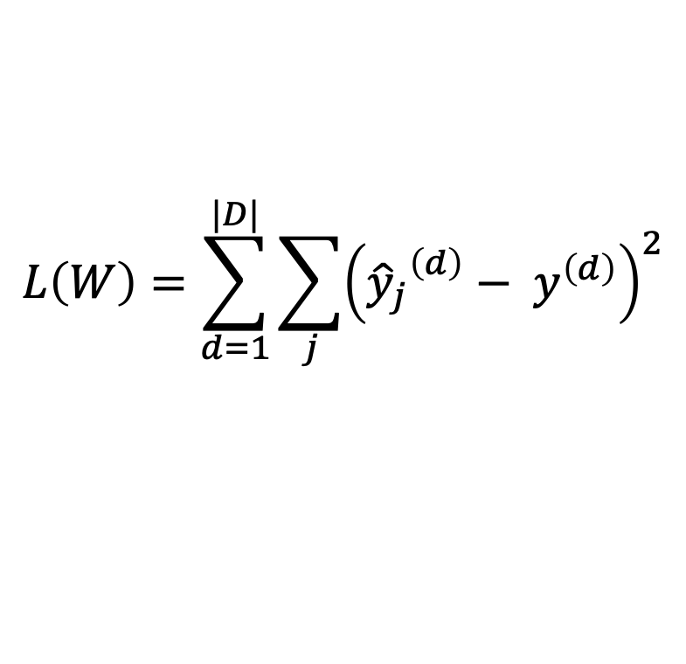
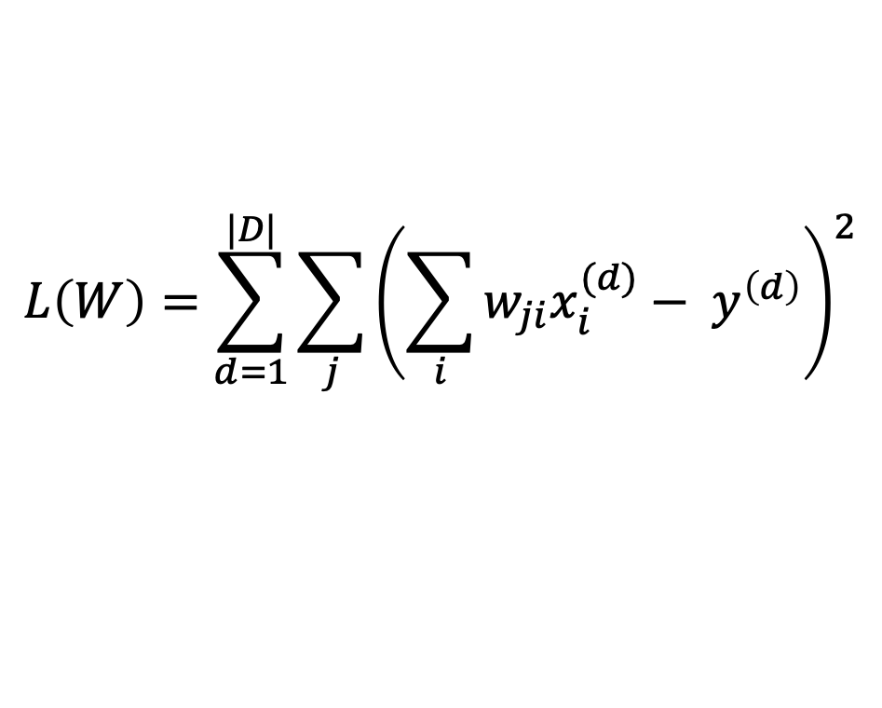
Linear Regression – Least Squares
$$L\left(W\right)=\sum_{d=1}^{|D|}{\sum_{j}{{\left({{\hat{y}}_{j}}^{\left(d\right)}− y^{\left(d\right)}\right)}^{2}}}$$
$${\hat{y}}_{j}^{(d)}=\sum_{i}{w_{ji}x_{i}^{(d)}}$$
$$L\left(W\right)=\sum_{d=1}^{|D|}{\sum_{j}{{\left(\sum_{i}{w_{ji}x_{i}^{(d)}}− y^{\left(d\right)}\right)}^{2}}}$$

Slide 12
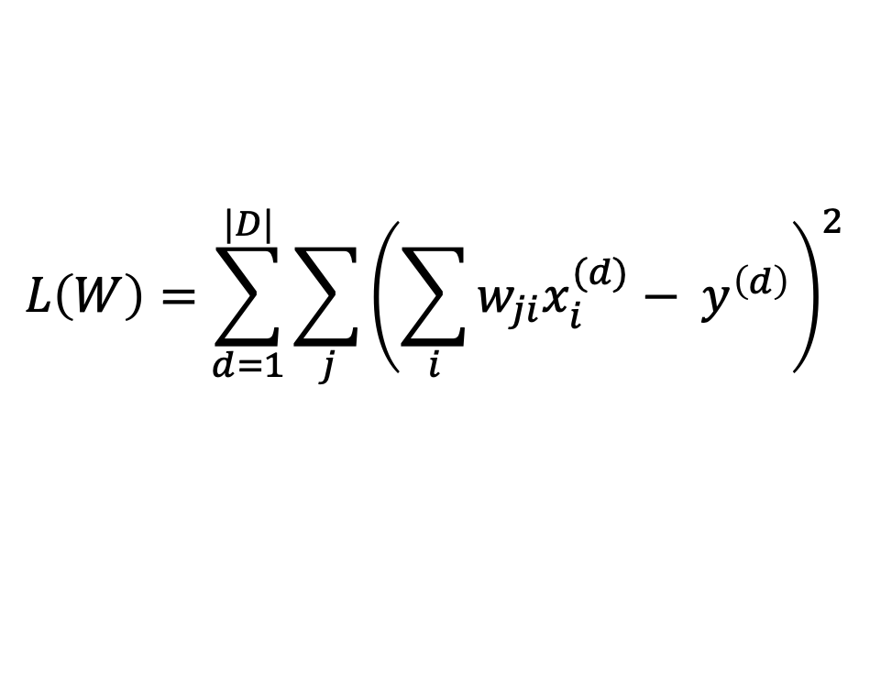
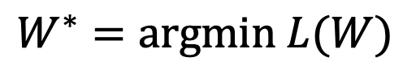
Linear Regression – Least Squares
$$L\left(W\right)=\sum_{d=1}^{|D|}{\sum_{j}{{\left(\sum_{i}{w_{ji}x_{i}^{(d)}}− y^{\left(d\right)}\right)}^{2}}}$$
$$W^{∗}=argmin L(W)$$

Slide 13


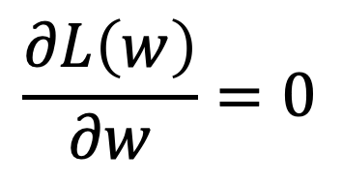
How to find the minimum of a function L(W)?
$$L\left(w\right)$$
$$\frac{∂L\left(w\right)}{∂w}=0$$
$$w$$

Slide 14
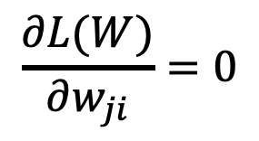
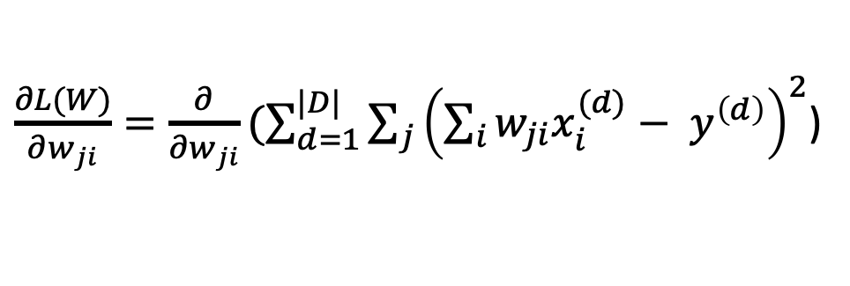

Linear Regression – Least Squares
$\frac{∂L(W)}{∂w_{ji}}=\frac{∂}{∂w_{ji}}(\sum_{d=1}^{|D|}{\sum_{j}{{\left(\sum_{i}{w_{ji}x_{i}^{(d)}}− y^{\left(d\right)}\right)}^{2}}}$)
$$\frac{∂L(W)}{∂w_{ji}}=0$$
…
$$W={(X}^{T}{X)}^{−1}X^{T}Y$$

Slide 15
ML Classifier / Regression models
K-nearest neighbors
Linear classifier / Linear regression
Naïve Bayes classifiers
Decision Trees
Random Forests
Boosted Decision Trees
Neural Networks

Slide 16
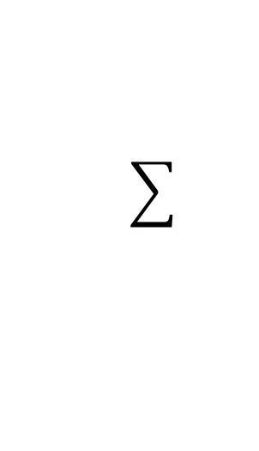
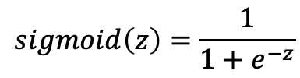





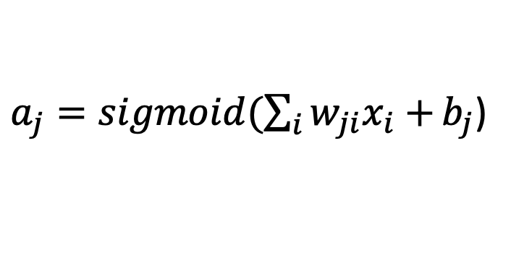



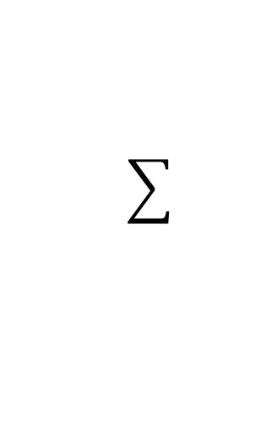
Neural Network with One Layer
$$sigmoid\left(z\right)=\frac{1}{1+e^{−z}}$$
$$x_{1}$$
$${W=[w}_{ji}]$$
$$a_{1}$$
$$x_{2}$$
$$x_{3}$$
$$a_{2}$$
$$x_{4}$$
$$x_{5}$$
$a_{j}=sigmoid(\sum_{i}{w_{ji}x_{i}+}b_{j}$)

Slide 17
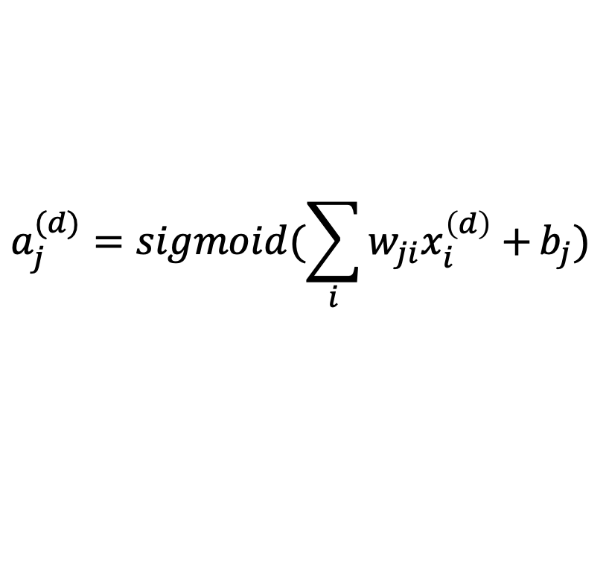
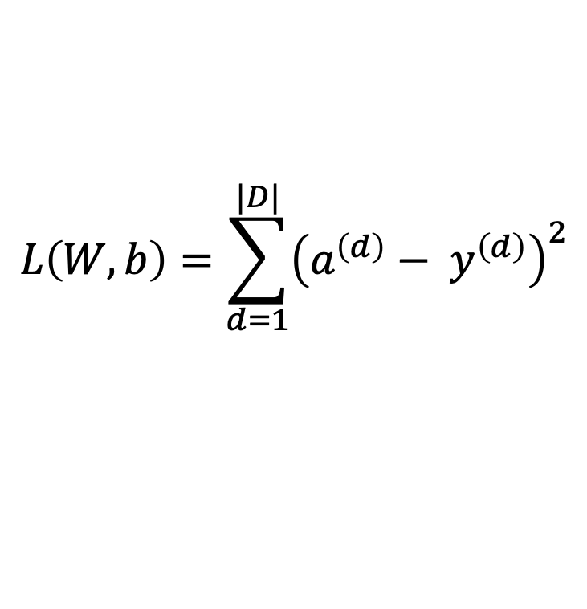
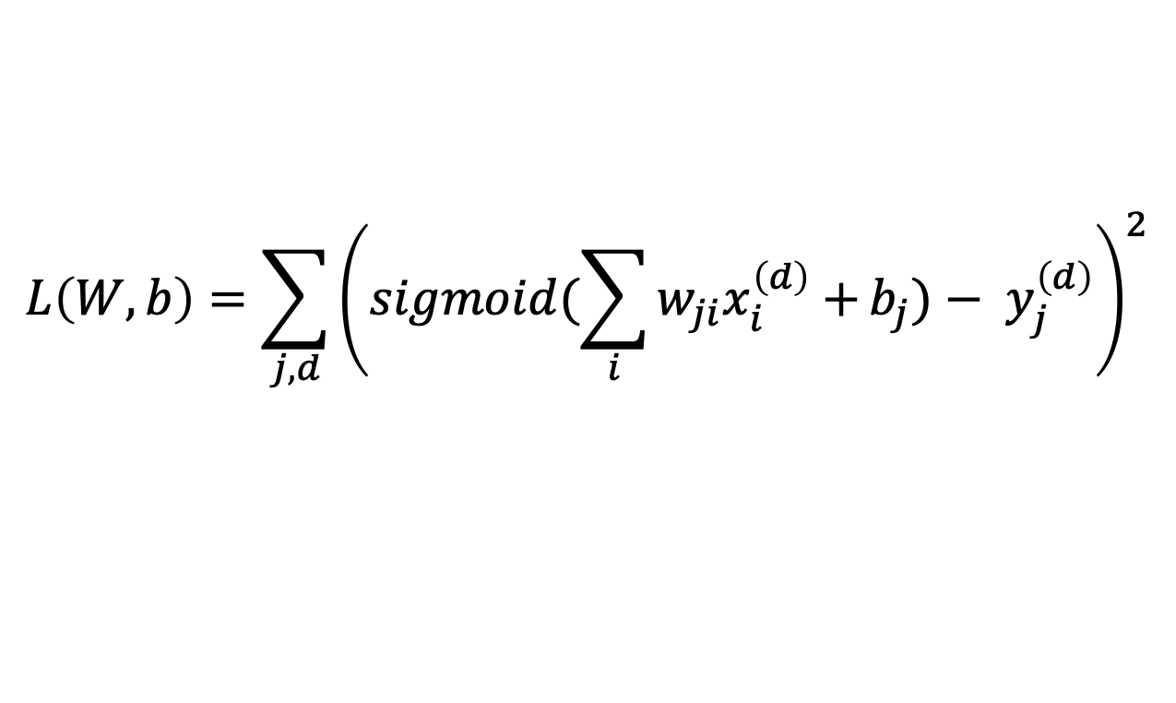
Neural Network with One Layer
$$L\left(W, b\right)=\sum_{d=1}^{|D|}{{\left(a^{\left(d\right)}− y^{\left(d\right)}\right)}^{2}}$$
$$a_{j}^{(d)}=sigmoid(\sum_{i}{w_{ji}x_{i}^{\left(d\right)}+}b_{j})$$
Bias parameters
$$L\left(W, b\right)=\sum_{j,d}{{\left(sigmoid(\sum_{i}{w_{ji}x_{i}^{\left(d\right)}+}b_{j})− y_{j}^{\left(d\right)}\right)}^{2}}$$

Slide 18
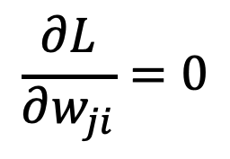
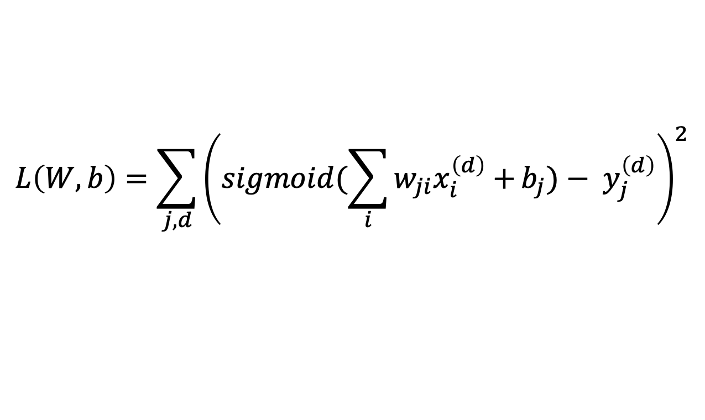
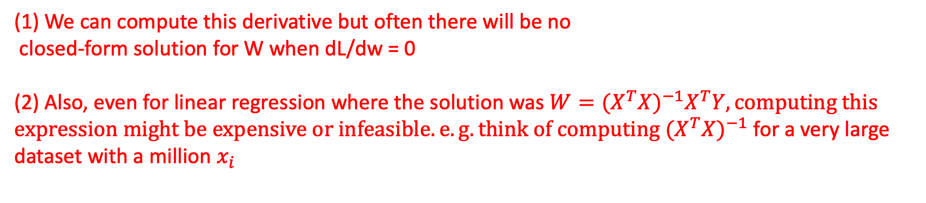
Neural Network with One Layer
$$L\left(W, b\right)=\sum_{j,d}{{\left(sigmoid(\sum_{i}{w_{ji}x_{i}^{\left(d\right)}+}b_{j})− y_{j}^{\left(d\right)}\right)}^{2}}$$
$$\frac{∂L}{∂w_{ji}}=0$$
(1) We can compute this derivative but often there will be no
closed-form solution for W when dL/dw = 0
(2) Also, even for linear regression where the solution was $W={(X}^{T}{X)}^{−1}X^{T}Y, computing this expression might be expensive or infeasible. e.g. think of computing {(X}^{T}{X)}^{−1}$ for a very large
dataset with a million $x_{i}$

Slide 19


Gradient Descent
1. Start with a random value
of w (e.g. w = 12)
$$L\left(w\right)$$
2. Compute the gradient
(derivative) of L(w) at point
w = 12. (e.g. dL/dw = 6)
3. Recompute w as:
w = w – lambda * (dL / dw)
w=12
$$w$$

Slide 20
Gradient Descent
$$L\left(w\right)$$
2. Compute the gradient
(derivative) of L(w) at point
w = 12. (e.g. dL/dw = 6)
3. Recompute w as:
w = w – lambda * (dL / dw)
w=10
$$w$$

Slide 21
Gradient Descent
$$L\left(w\right)$$
2. Compute the gradient
(derivative) of L(w) at point
w = 12. (e.g. dL/dw = 6)
3. Recompute w as:
w = w – lambda * (dL / dw)
w=8
$$w$$

Slide 22



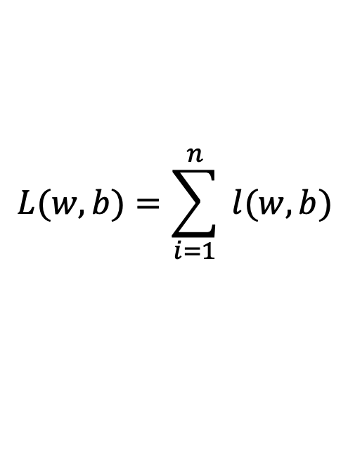



Gradient Descent
expensive
$$λ=0.01$$
$$L(w,b)=\sum_{i=1}^{n}{ l(w,b)}$$
Initialize w and b randomly
for e = 0, num_epochs do
Compute:
$$dL(w,b)/dw$$
and
$$dL(w,b)/db$$
Update w:
$$w=w −λ dL(w,b)/dw$$
Update b:
$$b=b −λ dL(w,b)/db$$
Print:
$$L(w,b)$$
// Useful to see if this is becoming smaller or not.
end

Slide 23
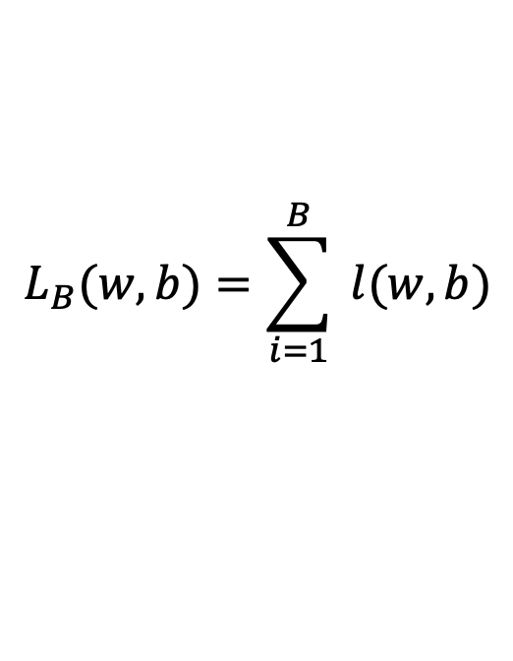





Stochastic Gradient Descent (mini-batch)
$$λ=0.01$$
$$L_{B}(w,b)=\sum_{i=1}^{B}{ l(w,b)}$$
Initialize w and b randomly
for e = 0, num_epochs do
for b = 0, num_batches do
Compute:
$$dL_{B}(w,b)/dw$$
and
$$dL_{B}(w,b)/db$$
Update w:
$$w=w −λ dl(w,b)/dw$$
Update b:
$$b=b −λ dl(w,b)/db$$
Print:
$$L_{B}(w,b)$$
// Useful to see if this is becoming smaller or not.
end
end

Slide 24
In this class we will mostly rely on…
K-nearest neighbors
Linear classifiers
Naïve Bayes classifiers
Decision Trees
Random Forests
Boosted Decision Trees
Neural Networks

Slide 25
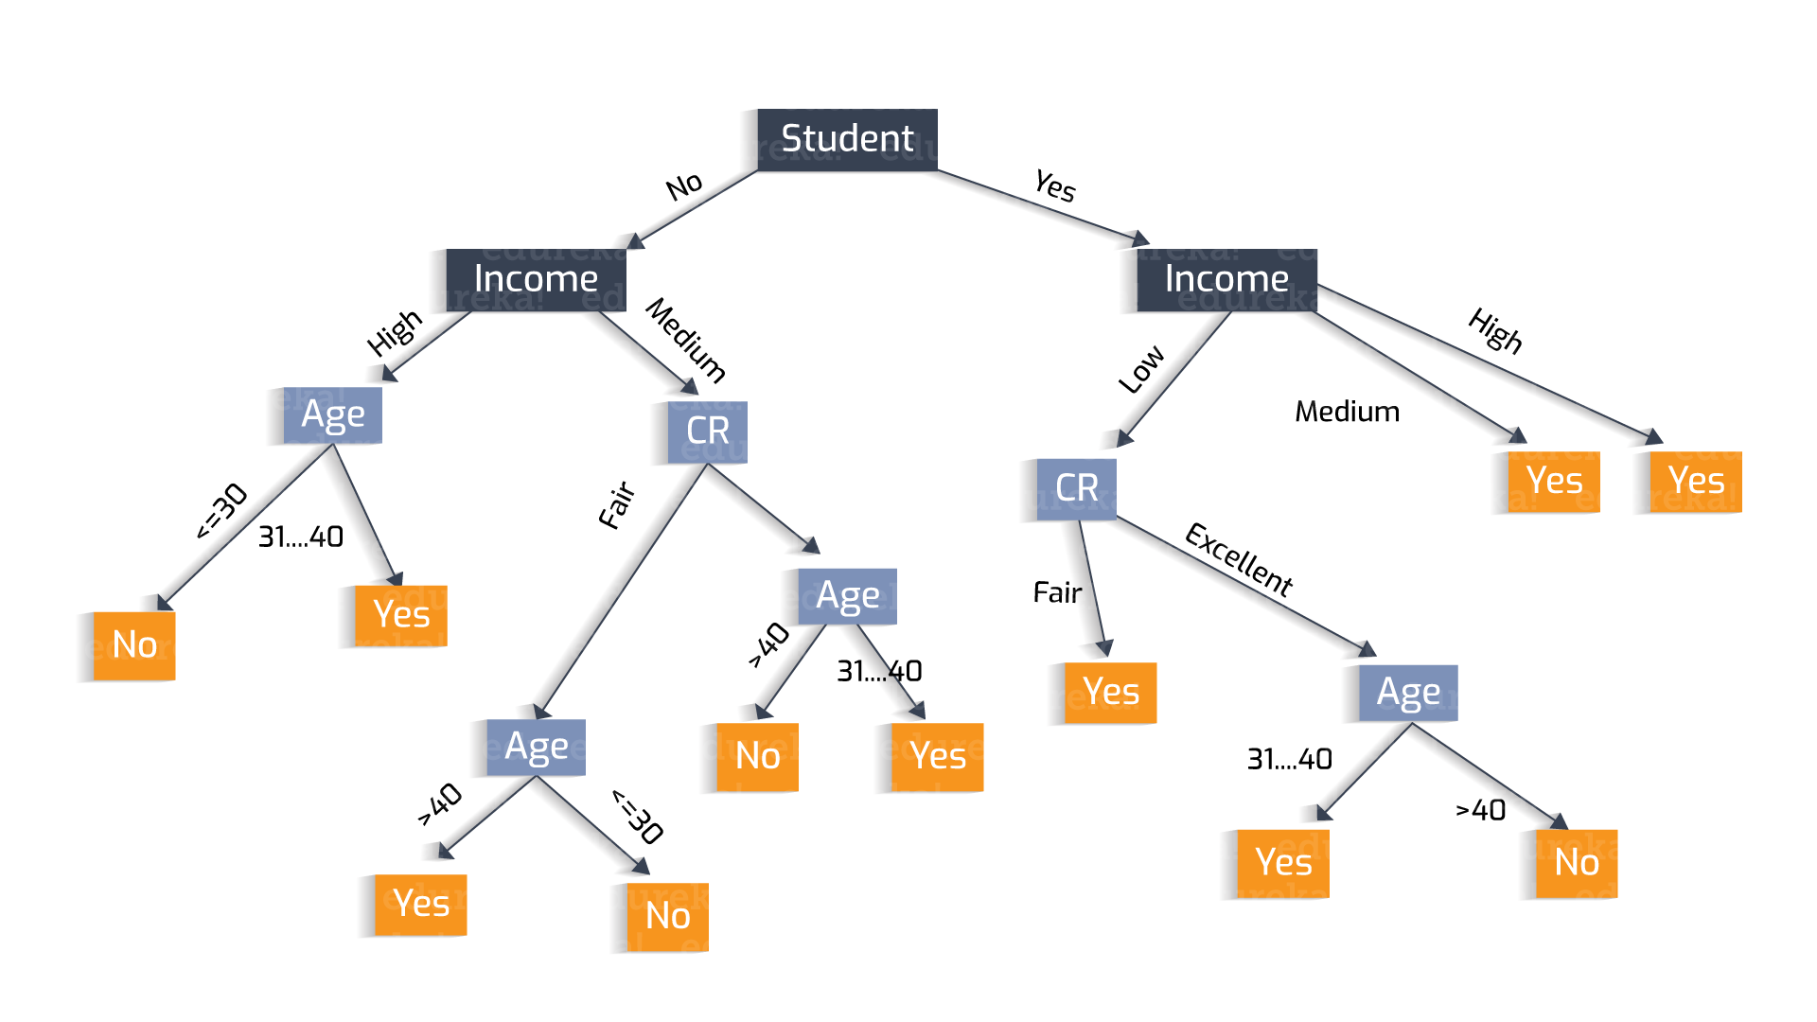
Why?
Decisions Trees
https://heartbeat.fritz.ai/understanding-the-mathematics-behind-decision-trees-22d86d55906 by Nikita Sharma

Slide 26
Why?
Decisions Trees are great because they are often interpretable.
However, they usually deal better with categorical data – not input pixel data.
https://heartbeat.fritz.ai/understanding-the-mathematics-behind-decision-trees-22d86d55906 by Nikita Sharma

Slide 27
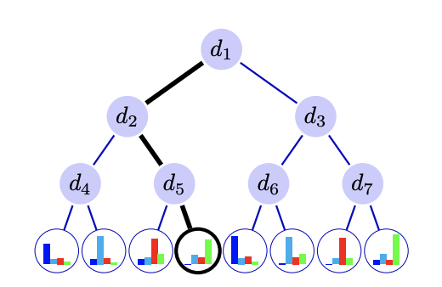

That said
There have been efforts to combine neural networks and decision trees, where pixels first go through a neural network and then a decision tree structure.

Slide 28
Review
Image Classification Assignment from the Deep Learning for Visual Recognition class
NOTE: This is not an assignment for this class. Do at your own pace, no need to hand out anything. You can always ask us questions about it during office hours.

Slide 29
Regression vs Classification
Regression
Labels are continuous variables – e.g. distance.
Losses: Distance-based losses, e.g. sum of distances to true values.
Evaluation: Mean distances, correlation coefficients, etc.
Classification
Labels are discrete variables (1 out of K categories)
Losses: Cross-entropy loss, margin losses, logistic regression (binary cross entropy)
Evaluation: Classification accuracy, etc.

Slide 30
Stochastic Gradient Descent
How to choose the right batch size B?
How to choose the right learning rate lambda?
How to choose the right loss function, e.g. is least squares good enough?
How to choose the right function/classifier, e.g. linear, quadratic, neural network with 1 layer, 2 layers, etc?

Slide 31
Linear Regression
Example: Hollywood movie data
input variables x
output variables y
production
costs
promotional
costs
genre of
the movie
box office
first week
total book
sales
total revenue
USA
total revenue
international
$$x_{1}^{(1)}$$
$$x_{2}^{(1)}$$
$$x_{3}^{(1)}$$
$$x_{4}^{(1)}$$
$$x_{5}^{(1)}$$
$$y_{1}^{(1)}$$
$$y_{2}^{(1)}$$
training
data
$$x_{1}^{(2)}$$
$$x_{2}^{(2)}$$
$$x_{3}^{(2)}$$
$$x_{4}^{(2)}$$
$$x_{5}^{(2)}$$
$$y_{1}^{(2)}$$
$$y_{2}^{(2)}$$
$$x_{1}^{(3)}$$
$$x_{2}^{(3)}$$
$$x_{3}^{(3)}$$
$$x_{4}^{(3)}$$
$$x_{5}^{(3)}$$
$$y_{1}^{(3)}$$
$$y_{2}^{(3)}$$
$$x_{1}^{(4)}$$
$$x_{2}^{(4)}$$
$$x_{3}^{(4)}$$
$$x_{4}^{(4)}$$
$$x_{5}^{(4)}$$
$$y_{1}^{(4)}$$
$$y_{2}^{(4)}$$
test
data
$$x_{1}^{(5)}$$
$$x_{2}^{(5)}$$
$$x_{3}^{(5)}$$
$$x_{4}^{(5)}$$
$$x_{5}^{(5)}$$
$$y_{1}^{(5)}$$
$$y_{2}^{(5)}$$

Slide 32
Training, Validation (Dev), Test Sets
Training Set
Validation Set
Testing Set

Slide 33
Training, Validation (Dev), Test Sets
Training Set
Validation Set
Testing Set
Used during development

Slide 34
Training, Validation (Dev), Test Sets
Training Set
Validation Set
Testing Set
Only to be used for evaluating the model at the very end of development and any changes to the model after running it on the test set, could be influenced by what you saw happened on the test set, which would invalidate any future evaluation.

Slide 35
How to pick the right model?

Slide 36










Linear Regression – 1 output, 1 input
$$y$$
$$(x_{8},y_{8})$$
$$(x_{6},y_{6})$$
$$(x_{7},y_{7})$$
$$(x_{4},y_{4})$$
$$(x_{5},y_{5})$$
$$(x_{2},y_{2})$$
$$(x_{3},y_{3})$$
$$(x_{1},y_{1})$$
$$x$$

Slide 37

Linear Regression – 1 output, 1 input
$$y$$
$$(x_{8},y_{8})$$
$$(x_{6},y_{6})$$
$$(x_{7},y_{7})$$
$$(x_{4},y_{4})$$
$$(x_{5},y_{5})$$
$$(x_{2},y_{2})$$
$$(x_{3},y_{3})$$
$$(x_{1},y_{1})$$
$$x$$
Model:
$$\hat{y}=wx+b$$

Slide 38
Linear Regression – 1 output, 1 input
$$y$$
$$(x_{8},y_{8})$$
$$(x_{6},y_{6})$$
$$(x_{7},y_{7})$$
$$(x_{4},y_{4})$$
$$(x_{5},y_{5})$$
$$(x_{2},y_{2})$$
$$(x_{3},y_{3})$$
$$(x_{1},y_{1})$$
$$x$$
Model:
$$\hat{y}=wx+b$$

Slide 39
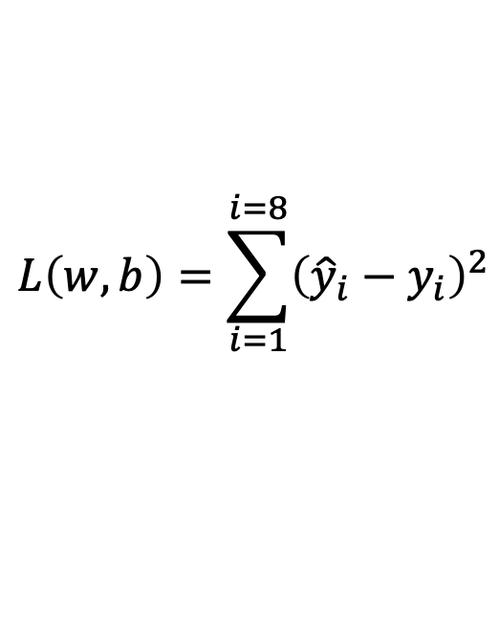
Linear Regression – 1 output, 1 input
$$y$$
$$(x_{8},y_{8})$$
$$(x_{6},y_{6})$$
$$(x_{7},y_{7})$$
$$(x_{4},y_{4})$$
$$(x_{5},y_{5})$$
$$(x_{2},y_{2})$$
$$(x_{3},y_{3})$$
$$(x_{1},y_{1})$$
$$x$$
$$L\left(w,b\right)=\sum_{i=1}^{i=8}{{\left({\hat{y}}_{i}−y_{i}\right)}^{2}}$$
Model:
$$\hat{y}=wx+b$$
Loss:

Slide 40

Quadratic Regression
$$y$$
$$(x_{8},y_{8})$$
$$(x_{6},y_{6})$$
$$(x_{7},y_{7})$$
$$(x_{4},y_{4})$$
$$(x_{5},y_{5})$$
$$(x_{2},y_{2})$$
$$(x_{3},y_{3})$$
$$(x_{1},y_{1})$$
$$x$$
$$L\left(w,b\right)=\sum_{i=1}^{i=8}{{\left({\hat{y}}_{i}−y_{i}\right)}^{2}}$$
Model:
$$\hat{y}=w_{1}x^{2}+w_{2}x+b$$
Loss:

Slide 41

n-polynomial Regression
$$y$$
$$(x_{8},y_{8})$$
$$(x_{6},y_{6})$$
$$(x_{7},y_{7})$$
$$(x_{4},y_{4})$$
$$(x_{5},y_{5})$$
$$(x_{2},y_{2})$$
$$(x_{3},y_{3})$$
$$(x_{1},y_{1})$$
$$x$$
$$L\left(w,b\right)=\sum_{i=1}^{i=8}{{\left({\hat{y}}_{i}−y_{i}\right)}^{2}}$$
Model:
$$\hat{y}=w_{n}x^{n}+…+w_{1}x+b$$
Loss:

Slide 42
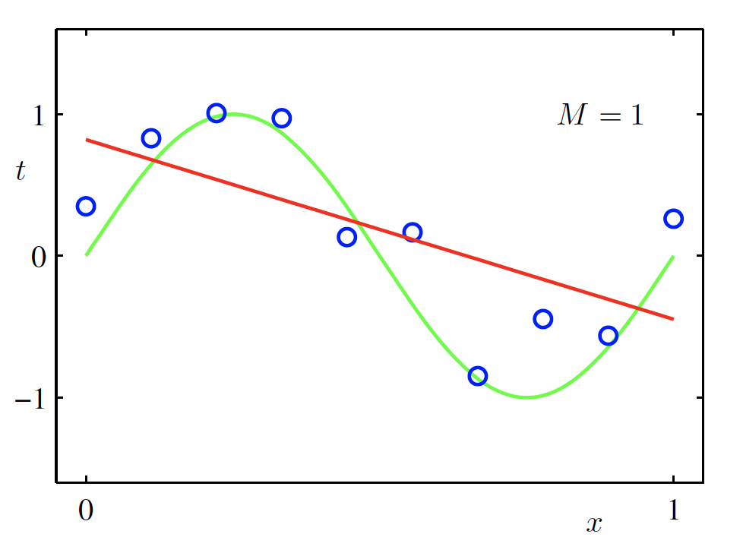
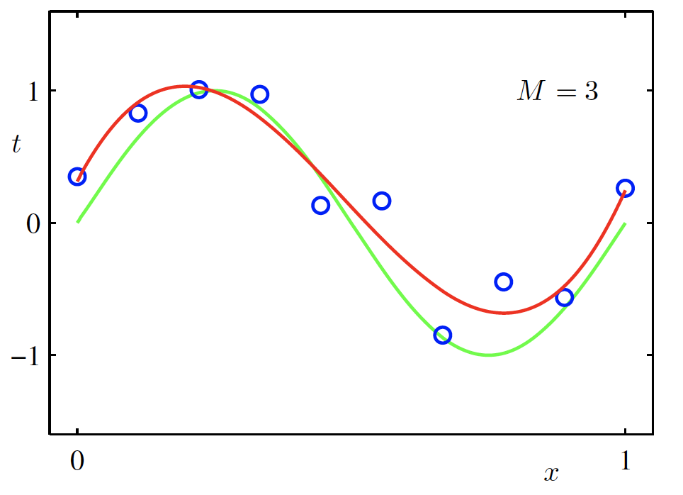
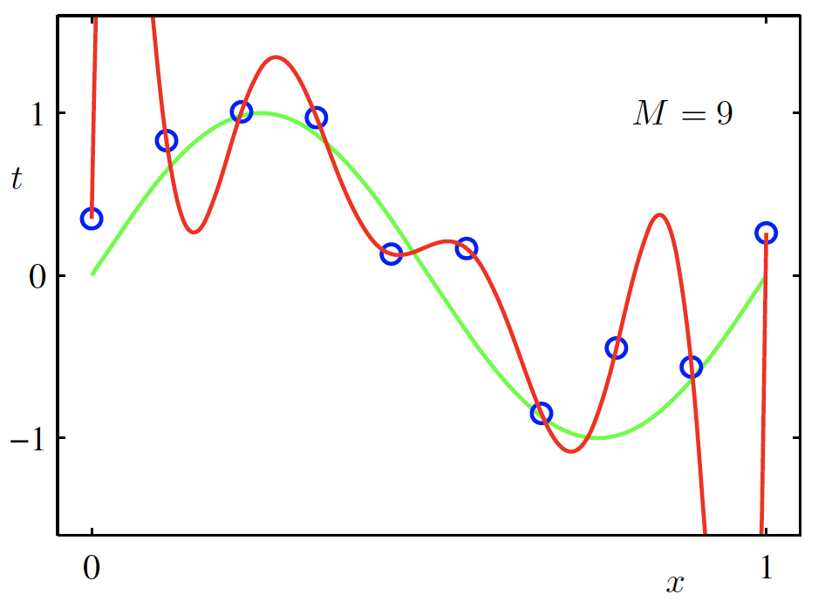

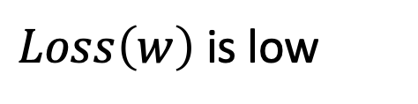
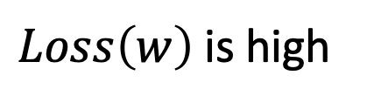
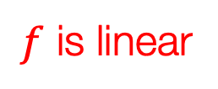
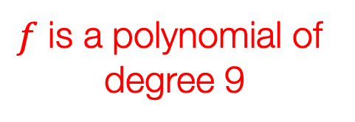
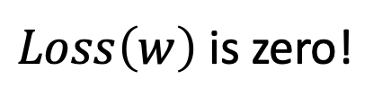
Overfitting
$f$ is a polynomial of
degree 9
$f$ is linear
$f$ is cubic
$Loss\left(w\right)$ is high
$Loss\left(w\right)$ is low
$Loss\left(w\right)$ is zero!
Underfitting
Overfitting
High Bias
High Variance
Christopher M. Bishop – Pattern Recognition and Machine Learning
Credit: C. Bishop. Pattern Recognition and Mach. Learning.

Slide 43
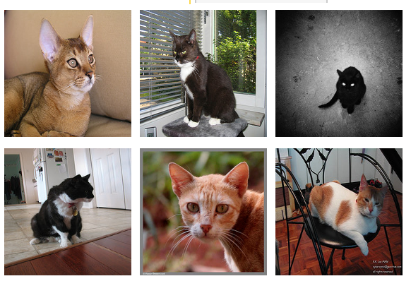
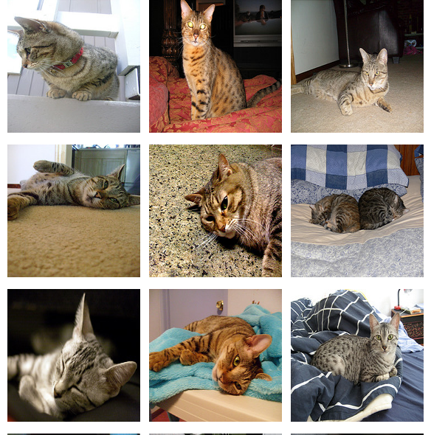
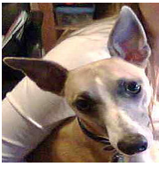
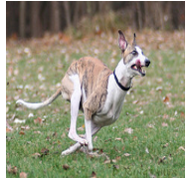
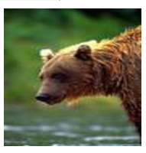
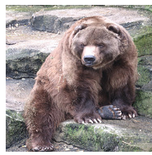
Supervised Learning - Classification
Training Data
Test Data
cat
dog
cat
.
.
.
.
.
.
bear

Slide 44








Supervised Learning - Classification
Training Data
cat
$$x_{1}=[ ]$$
$$y_{1}=[ ]$$
dog
$$x_{2}=[ ]$$
$$y_{2}=[ ]$$
cat
$$x_{3}=[ ]$$
$$y_{3}=[ ]$$
.
.
.
bear
$$x_{n}=[ ]$$
$$y_{n}=[ ]$$

Slide 45







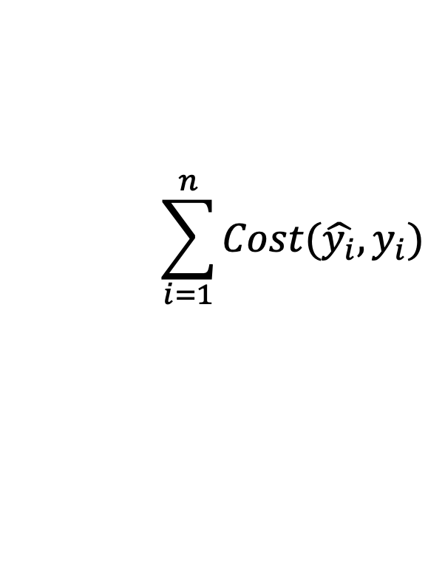


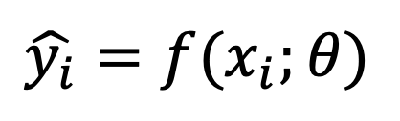



Supervised Learning - Classification
Training Data
targets /
labels /
ground truth
We need to find a function that
maps x and y for any of them.
inputs
predictions
$$x_{1}=[x_{11} { x}_{12} x_{13} { x}_{14}]$$
$$y_{1}=$$
1
$${\hat{y}}_{1}=$$
1
$$\hat{y_{i}}=f(x_{i};θ)$$
$$x_{2}=[x_{21} { x}_{22} x_{23} { x}_{24}]$$
$$y_{2}=$$
2
$${\hat{y}}_{2}=$$
2
$$x_{3}=[x_{31} { x}_{32} x_{33} { x}_{34}]$$
$$y_{3}=$$
1
$${\hat{y}}_{3}=$$
2
How do we ”learn” the parameters
of this function?
.
.
.
We choose ones that makes the
following quantity small:
$$\sum_{i=1}^{n}{Cost(\hat{y_{i}}, y_{i})}$$
$$x_{n}=[x_{n1} { x}_{n2} x_{n3} { x}_{n4}]$$
$$y_{n}=$$
3
$${\hat{y}}_{n}=$$
1

Slide 46
Supervised Learning – Linear Softmax
Training Data
targets /
labels /
ground truth
inputs
$$x_{1}=[x_{11} { x}_{12} x_{13} { x}_{14}]$$
$$y_{1}=$$
1
$$x_{2}=[x_{21} { x}_{22} x_{23} { x}_{24}]$$
$$y_{2}=$$
2
$$x_{3}=[x_{31} { x}_{32} x_{33} { x}_{34}]$$
$$y_{3}=$$
1
.
.
.
$$x_{n}=[x_{n1} { x}_{n2} x_{n3} { x}_{n4}]$$
$$y_{n}=$$
3

Slide 47




Supervised Learning – Linear Softmax
Training Data
targets /
labels /
ground truth
inputs
predictions
$$x_{1}=[x_{11} { x}_{12} x_{13} { x}_{14}]$$
$$y_{1}=$$
[1 0 0]
$${\hat{y}}_{1}=$$
[0.85 0.10 0.05]
$$x_{2}=[x_{21} { x}_{22} x_{23} { x}_{24}]$$
$$y_{2}=$$
[0 1 0]
$${\hat{y}}_{2}=$$
[0.20 0.70 0.10]
$$x_{3}=[x_{31} { x}_{32} x_{33} { x}_{34}]$$
$$y_{3}=$$
[1 0 0]
$${\hat{y}}_{3}=$$
[0.40 0.45 0.15]
.
.
.
$$x_{n}=[x_{n1} { x}_{n2} x_{n3} { x}_{n4}]$$
$$y_{n}=$$
[0 0 1]
$${\hat{y}}_{n}=$$
[0.40 0.25 0.35]

Slide 48






Supervised Learning – Linear Softmax
$$x_{i}=[x_{i1} { x}_{i2} x_{i3} { x}_{i4}]$$
$$y_{i}=$$
[1 0 0]
$${\hat{y}}_{i}= [f_{c} f_{d} f_{b}]$$
$$g_{c}=w_{c1}x_{i1}+w_{c2}x_{i2}+w_{c3}x_{i3}+w_{c4}x_{i4}+b_{c}$$
$$g_{d}=w_{d1}x_{i1}+w_{d2}x_{i2}+w_{d3}x_{i3}+w_{d4}x_{i4}+b_{d}$$
$$g_{b}=w_{b1}x_{i1}+w_{b2}x_{i2}+w_{b3}x_{i3}+w_{b4}x_{i4}+b_{b}$$
$$f_{c}=e^{g_{c}}/{(e}^{g_{c}}+e^{g_{d}}+e^{g_{b}})$$
$$f_{d}=e^{g_{d}}/{(e}^{g_{c}}+e^{g_{d}}+e^{g_{b}})$$
$$f_{b}=e^{g_{b}}/{(e}^{g_{c}}+e^{g_{d}}+e^{g_{b}})$$

Slide 49
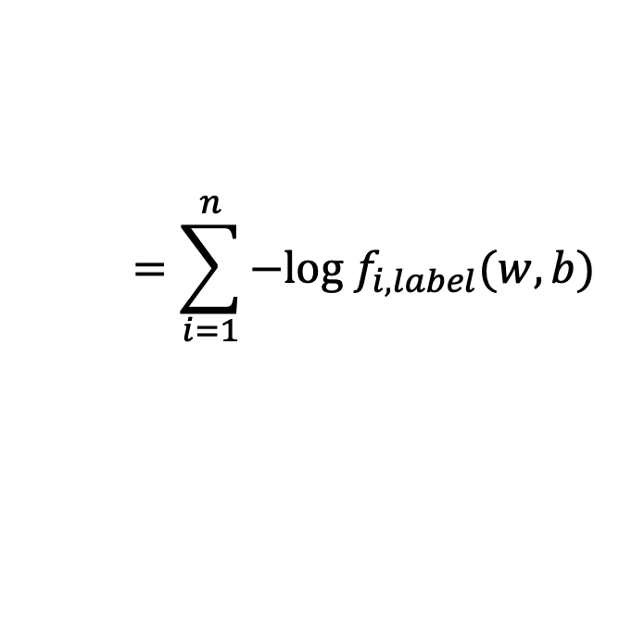
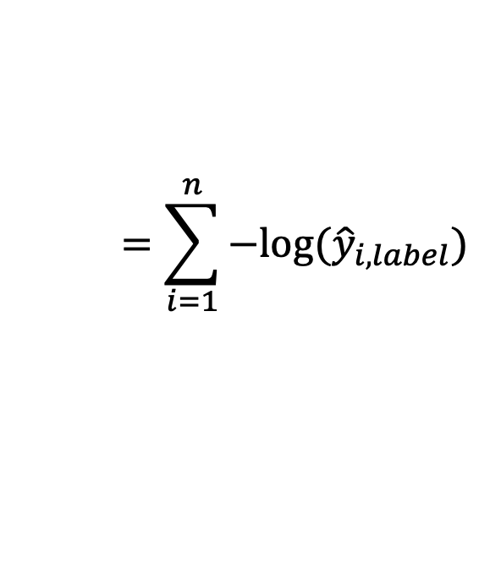


How do we find a good w and b?
$$x_{i}=[x_{i1} { x}_{i2} x_{i3} { x}_{i4}]$$
$$y_{i}=$$
[1 0 0]
$${\hat{y}}_{i}= [f_{c}(w,b) f_{d}(w,b) f_{b}(w,b)]$$
We need to find w, and b that minimize the following:
$$L\left(w,b\right)=\sum_{i=1}^{n}{\sum_{j=1}^{3}{−y_{i,j}log⁡({\hat{y}}_{i,j})}}$$
$$=\sum_{i=1}^{n}{−log⁡({\hat{y}}_{i,label})}$$
$$=\sum_{i=1}^{n}{−log f_{i,label}(w,b)}$$
Why?

Slide 50
Questions?

