Slide 1
Deep Learning for Vision & Language
Neural Networks I: Softmax + Multi-layer Perceptrons

Slide 2
About the class
COMP 646: Deep Learning for Vision and Language
Instructor: Vicente Ordóñez (Vicente Ordóñez Román)
Website: https://www.cs.rice.edu/~vo9/deep-vislang
Location: Zoom – Rice Canvas has the links OR Duncan Hall 1070
Times: Mondays, Wednesdays, and Fridays from 1pm to 1:50pm Central Time
Office Hours: TBD
Teaching Assistants: In the works!
Discussion Forum: Rice Canvas

Slide 3
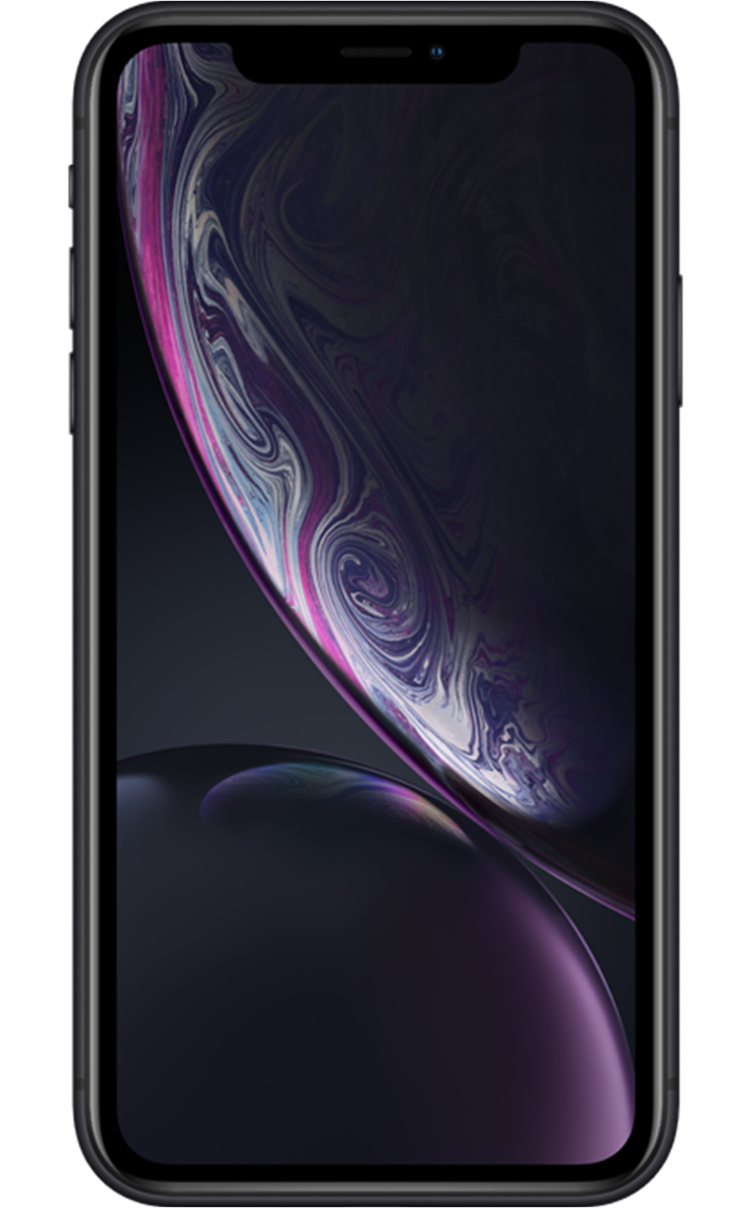
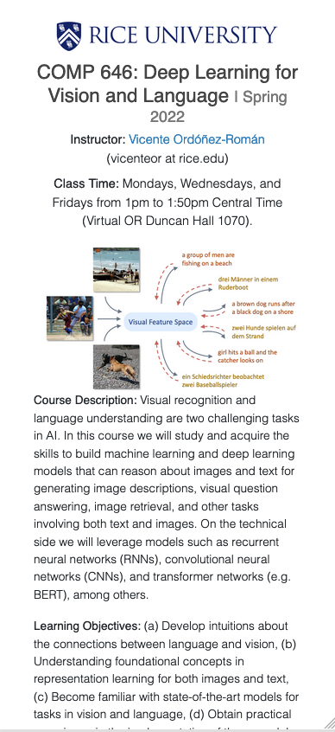
https://www.cs.rice.edu/~vo9/deep-vislang/

Slide 4
Regression vs Classification
Regression
Labels are continuous variables – e.g. distance.
Losses: Distance-based losses, e.g. sum of distances to true values.
Evaluation: Mean distances, correlation coefficients, etc.
Classification
Labels are discrete variables (1 out of K categories)
Losses: Cross-entropy loss, margin losses, logistic regression (binary cross entropy)
Evaluation: Classification accuracy, etc.

Slide 5
Stochastic Gradient Descent
How to choose the right batch size B?
How to choose the right learning rate lambda?
How to choose the right loss function, e.g. is least squares good enough?
How to choose the right function/classifier, e.g. linear, quadratic, neural network with 1 layer, 2 layers, etc?

Slide 6
Linear Regression
Example: Hollywood movie data
input variables x
output variables y
production
costs
promotional costs
genre of
the movie
box office first week
total book
sales
total revenue USA
total revenue international
$$x_{1}^{(1)}$$
$$x_{2}^{(1)}$$
$$x_{3}^{(1)}$$
$$x_{4}^{(1)}$$
$$x_{5}^{(1)}$$
$$y_{1}^{(1)}$$
$$y_{2}^{(1)}$$
training
data
$$x_{1}^{(2)}$$
$$x_{2}^{(2)}$$
$$x_{3}^{(2)}$$
$$x_{4}^{(2)}$$
$$x_{5}^{(2)}$$
$$y_{1}^{(2)}$$
$$y_{2}^{(2)}$$
$$x_{1}^{(3)}$$
$$x_{2}^{(3)}$$
$$x_{3}^{(3)}$$
$$x_{4}^{(3)}$$
$$x_{5}^{(3)}$$
$$y_{1}^{(3)}$$
$$y_{2}^{(3)}$$
$$x_{1}^{(4)}$$
$$x_{2}^{(4)}$$
$$x_{3}^{(4)}$$
$$x_{4}^{(4)}$$
$$x_{5}^{(4)}$$
$$y_{1}^{(4)}$$
$$y_{2}^{(4)}$$
test
data
$$x_{1}^{(5)}$$
$$x_{2}^{(5)}$$
$$x_{3}^{(5)}$$
$$x_{4}^{(5)}$$
$$x_{5}^{(5)}$$
$$y_{1}^{(5)}$$
$$y_{2}^{(5)}$$

Slide 7
Training, Validation (Dev), Test Sets
Training Set
Validation Set
Testing Set

Slide 8
Training, Validation (Dev), Test Sets
Training Set
Validation Set
Testing Set
Used during development

Slide 9
Training, Validation (Dev), Test Sets
Training Set
Validation Set
Testing Set
Only to be used for evaluating the model at the very end of development and any changes to the model after running it on the test set, could be influenced by what you saw happened on the test set, which would invalidate any future evaluation.

Slide 10
How to pick the right model?

Slide 11
Linear Regression – 1 output, 1 input
$$y$$
$$(x_{8},y_{8})$$
$$(x_{6},y_{6})$$
$$(x_{7},y_{7})$$
$$(x_{4},y_{4})$$
$$(x_{5},y_{5})$$
$$(x_{2},y_{2})$$
$$(x_{3},y_{3})$$
$$(x_{1},y_{1})$$
$$x$$

Slide 12
Linear Regression – 1 output, 1 input
$$y$$
$$(x_{8},y_{8})$$
$$(x_{6},y_{6})$$
$$(x_{7},y_{7})$$
$$(x_{4},y_{4})$$
$$(x_{5},y_{5})$$
$$(x_{2},y_{2})$$
$$(x_{3},y_{3})$$
$$(x_{1},y_{1})$$
$$x$$
Model:
$$\hat{y}=wx+b$$

Slide 13
Linear Regression – 1 output, 1 input
$$y$$
$$(x_{8},y_{8})$$
$$(x_{6},y_{6})$$
$$(x_{7},y_{7})$$
$$(x_{4},y_{4})$$
$$(x_{5},y_{5})$$
$$(x_{2},y_{2})$$
$$(x_{3},y_{3})$$
$$(x_{1},y_{1})$$
$$x$$
Model:
$$\hat{y}=wx+b$$

Slide 14
Linear Regression – 1 output, 1 input
$$y$$
$$(x_{8},y_{8})$$
$$(x_{6},y_{6})$$
$$(x_{7},y_{7})$$
$$(x_{4},y_{4})$$
$$(x_{5},y_{5})$$
$$(x_{2},y_{2})$$
$$(x_{3},y_{3})$$
$$(x_{1},y_{1})$$
$$x$$
$$L\left(w,b\right)=\sum_{i=1}^{i=8}{{\left({\hat{y}}_{i}−y_{i}\right)}^{2}}$$
Model:
$$\hat{y}=wx+b$$
Loss:

Slide 15
Quadratic Regression
$$y$$
$$(x_{8},y_{8})$$
$$(x_{6},y_{6})$$
$$(x_{7},y_{7})$$
$$(x_{4},y_{4})$$
$$(x_{5},y_{5})$$
$$(x_{2},y_{2})$$
$$(x_{3},y_{3})$$
$$(x_{1},y_{1})$$
$$x$$
$$L\left(w,b\right)=\sum_{i=1}^{i=8}{{\left({\hat{y}}_{i}−y_{i}\right)}^{2}}$$
Model:
$$\hat{y}=w_{1}x^{2}+w_{2}x+b$$
Loss:

Slide 16
n-polynomial Regression
$$y$$
$$(x_{8},y_{8})$$
$$(x_{6},y_{6})$$
$$(x_{7},y_{7})$$
$$(x_{4},y_{4})$$
$$(x_{5},y_{5})$$
$$(x_{2},y_{2})$$
$$(x_{3},y_{3})$$
$$(x_{1},y_{1})$$
$$x$$
$$L\left(w,b\right)=\sum_{i=1}^{i=8}{{\left({\hat{y}}_{i}−y_{i}\right)}^{2}}$$
Model:
$$\hat{y}=w_{n}x^{n}+…+w_{1}x+b$$
Loss:

Slide 17
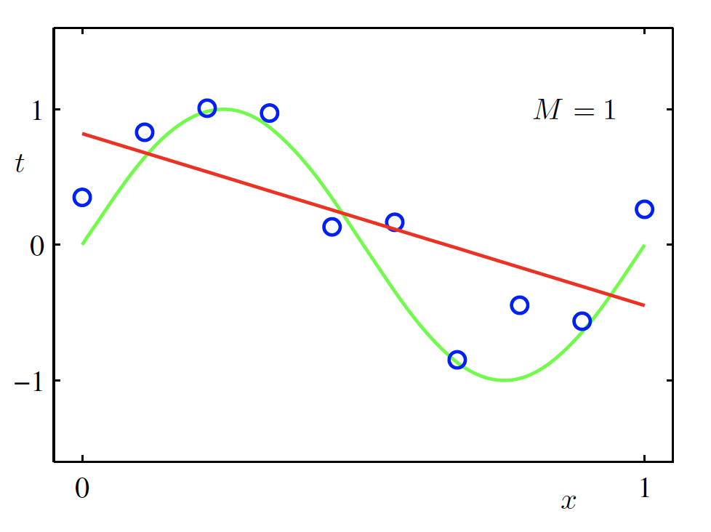
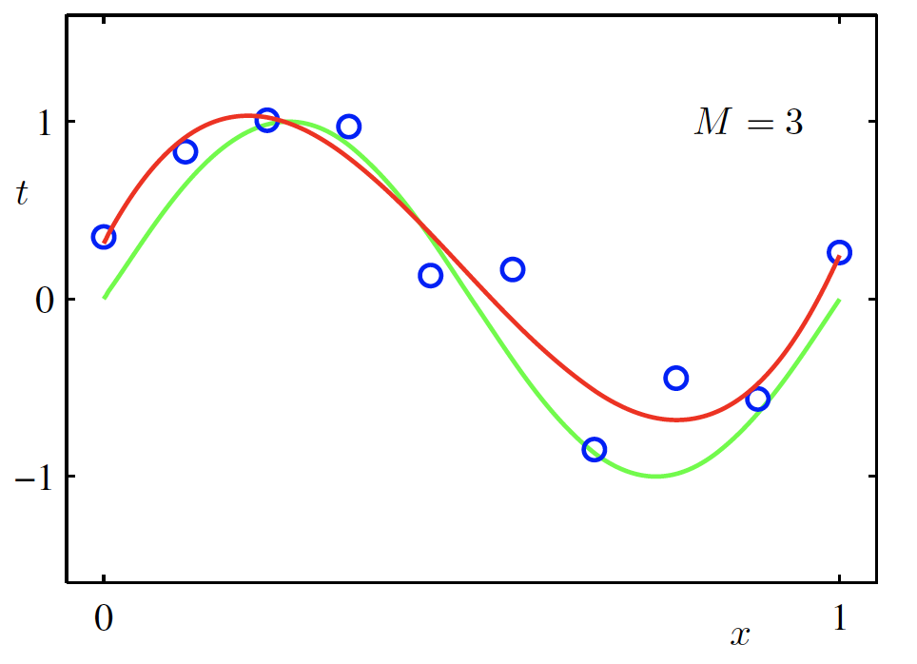
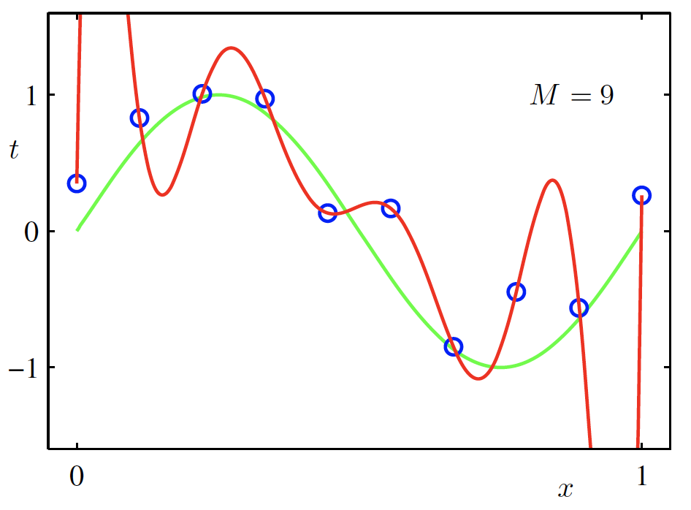
Overfitting
$f$ is a polynomial of degree 9
$f$ is linear
$f$ is cubic
$Loss\left(w\right)$ is high
$Loss\left(w\right)$ is low
$Loss\left(w\right)$ is zero!
Underfitting
Overfitting
High Bias
High Variance
Christopher M. Bishop – Pattern Recognition and Machine Learning
Credit: C. Bishop. Pattern Recognition and Mach. Learning.

Slide 18
Supervised Learning - Classification
Training Data
Test Data
cat
dog
cat
.
.
.
.
.
.
bear

Slide 19
Supervised Learning - Classification
Training Data
cat
$$x_{1}=[ ]$$
$$y_{1}=[ ]$$
dog
$$x_{2}=[ ]$$
$$y_{2}=[ ]$$
cat
$$x_{3}=[ ]$$
$$y_{3}=[ ]$$
.
.
.
bear
$$x_{n}=[ ]$$
$$y_{n}=[ ]$$

Slide 20
Supervised Learning - Classification
Training Data
targets /
labels /
ground truth
We need to find a function that
maps x and y for any of them.
inputs
predictions
$$x_{1}=[x_{11} { x}_{12} x_{13} { x}_{14}]$$
$$y_{1}=$$
1
$${\hat{y}}_{1}=$$
1
$$\hat{y_{i}}=f(x_{i};θ)$$
$$x_{2}=[x_{21} { x}_{22} x_{23} { x}_{24}]$$
$$y_{2}=$$
2
$${\hat{y}}_{2}=$$
2
$$x_{3}=[x_{31} { x}_{32} x_{33} { x}_{34}]$$
$$y_{3}=$$
1
$${\hat{y}}_{3}=$$
2
How do we ”learn” the parameters
of this function?
.
.
.
We choose ones that makes the
following quantity small:
$$\sum_{i=1}^{n}{Cost(\hat{y_{i}}, y_{i})}$$
$$x_{n}=[x_{n1} { x}_{n2} x_{n3} { x}_{n4}]$$
$$y_{n}=$$
3
$${\hat{y}}_{n}=$$
1

Slide 21
Supervised Learning – Linear Softmax
Training Data
targets /
labels /
ground truth
inputs
$$x_{1}=[x_{11} { x}_{12} x_{13} { x}_{14}]$$
$$y_{1}=$$
1
$$x_{2}=[x_{21} { x}_{22} x_{23} { x}_{24}]$$
$$y_{2}=$$
2
$$x_{3}=[x_{31} { x}_{32} x_{33} { x}_{34}]$$
$$y_{3}=$$
1
.
.
.
$$x_{n}=[x_{n1} { x}_{n2} x_{n3} { x}_{n4}]$$
$$y_{n}=$$
3

Slide 22
Supervised Learning – Linear Softmax
Training Data
targets /
labels /
ground truth
inputs
predictions
$$x_{1}=[x_{11} { x}_{12} x_{13} { x}_{14}]$$
$$y_{1}=$$
[1 0 0]
$${\hat{y}}_{1}=$$
[0.85 0.10 0.05]
$$x_{2}=[x_{21} { x}_{22} x_{23} { x}_{24}]$$
$$y_{2}=$$
[0 1 0]
$${\hat{y}}_{2}=$$
[0.20 0.70 0.10]
$$x_{3}=[x_{31} { x}_{32} x_{33} { x}_{34}]$$
$$y_{3}=$$
[1 0 0]
$${\hat{y}}_{3}=$$
[0.40 0.45 0.15]
.
.
.
$$x_{n}=[x_{n1} { x}_{n2} x_{n3} { x}_{n4}]$$
$$y_{n}=$$
[0 0 1]
$${\hat{y}}_{n}=$$
[0.40 0.25 0.35]

Slide 23
Supervised Learning – Linear Softmax
$$x_{i}=[x_{i1} { x}_{i2} x_{i3} { x}_{i4}]$$
$$y_{i}=$$
[1 0 0]
$${\hat{y}}_{i}= [f_{c} f_{d} f_{b}]$$
$$g_{c}=w_{c1}x_{i1}+w_{c2}x_{i2}+w_{c3}x_{i3}+w_{c4}x_{i4}+b_{c}$$
$$g_{d}=w_{d1}x_{i1}+w_{d2}x_{i2}+w_{d3}x_{i3}+w_{d4}x_{i4}+b_{d}$$
$$g_{b}=w_{b1}x_{i1}+w_{b2}x_{i2}+w_{b3}x_{i3}+w_{b4}x_{i4}+b_{b}$$
$$f_{c}=e^{g_{c}}/{(e}^{g_{c}}+e^{g_{d}}+e^{g_{b}})$$
$$f_{d}=e^{g_{d}}/{(e}^{g_{c}}+e^{g_{d}}+e^{g_{b}})$$
$$f_{b}=e^{g_{b}}/{(e}^{g_{c}}+e^{g_{d}}+e^{g_{b}})$$

Slide 24
How do we find a good w and b?
$$x_{i}=[x_{i1} { x}_{i2} x_{i3} { x}_{i4}]$$
$$y_{i}=$$
[1 0 0]
$${\hat{y}}_{i}= [f_{c}(w,b) f_{d}(w,b) f_{b}(w,b)]$$
We need to find w, and b that minimize the following:
$$L\left(w,b\right)=\sum_{i=1}^{n}{\sum_{j=1}^{3}{−y_{i,j}log⁡({\hat{y}}_{i,j})}}$$
$$=\sum_{i=1}^{n}{−log⁡({\hat{y}}_{i,label})}$$
$$=\sum_{i=1}^{n}{−log f_{i,label}(w,b)}$$
Why?

Slide 25
Today’s Class
Neural Networks
The Perceptron Model
The Multi-layer Perceptron (MLP)
Forward-pass in an MLP (Inference)
Backward-pass in an MLP (Backpropagation)

Slide 26
Perceptron Model
Frank Rosenblatt (1957) - Cornell University
Activation function
$$x_{1}$$
$$w_{1}$$
$$f\left(x\right)=\left\{\begin{aligned}1, if \sum_{i=0}^{n}{w_{i}x_{i}}+b>0 \\ &0, otherwise \end{aligned}\right.$$
$$x_{2}$$
$$w_{2}$$
$$w_{3}$$
$$x_{3}$$
$$w_{4}$$
$$x_{4}$$
More: https://en.wikipedia.org/wiki/Perceptron

Slide 27
Perceptron Model
Frank Rosenblatt (1957) - Cornell University
!?
$$x_{1}$$
$$w_{1}$$
$$f\left(x\right)=\left\{\begin{aligned}1, if \sum_{i=0}^{n}{w_{i}x_{i}}+b>0 \\ &0, otherwise \end{aligned}\right.$$
$$x_{2}$$
$$w_{2}$$
$$w_{3}$$
$$x_{3}$$
$$w_{4}$$
$$x_{4}$$
More: https://en.wikipedia.org/wiki/Perceptron

Slide 28
Perceptron Model
Frank Rosenblatt (1957) - Cornell University
Activation function
$$x_{1}$$
$$w_{1}$$
$$f\left(x\right)=\left\{\begin{aligned}1, if \sum_{i=0}^{n}{w_{i}x_{i}}+b>0 \\ &0, otherwise \end{aligned}\right.$$
$$x_{2}$$
$$w_{2}$$
$$w_{3}$$
$$x_{3}$$
$$w_{4}$$
$$x_{4}$$
More: https://en.wikipedia.org/wiki/Perceptron

Slide 29
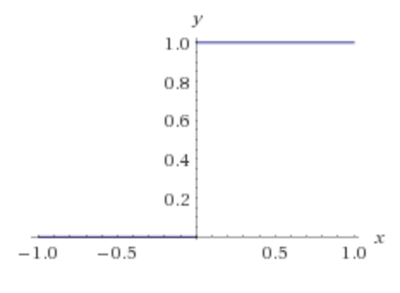
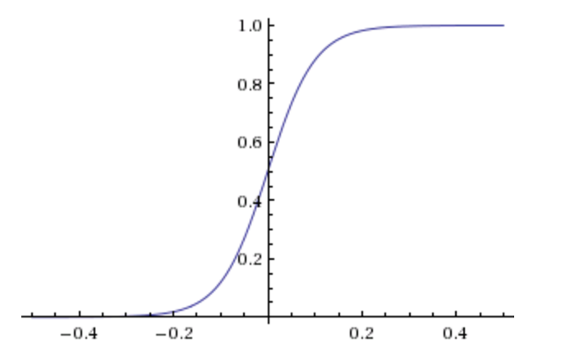
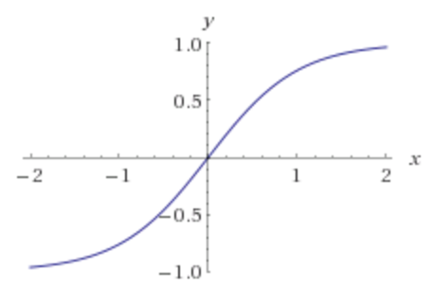
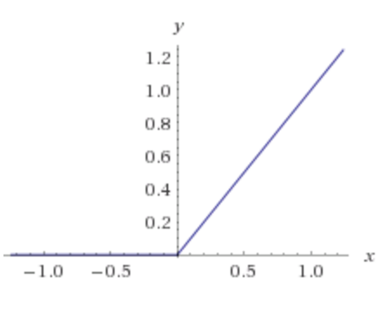
Activation Functions
Step(x)
Sigmoid(x)
Tanh(x)
ReLU(x) = max(0, x)

Slide 30
Two-layer Multi-layer Perceptron (MLP)
”hidden" layer
Loss / Criterion
$$x_{1}$$
$$a_{1}$$
$$x_{2}$$
$$a_{2}$$
$${\hat{y}}_{1}$$
$$y_{1}$$
$$x_{3}$$
$$a_{3}$$
$$x_{4}$$
$$a_{4}$$

Slide 31
Linear Softmax
$$x_{i}=[x_{i1} { x}_{i2} x_{i3} { x}_{i4}]$$
$$y_{i}=$$
[1 0 0]
$${\hat{y}}_{i}= [f_{c} f_{d} f_{b}]$$
$$g_{c}=w_{c1}x_{i1}+w_{c2}x_{i2}+w_{c3}x_{i3}+w_{c4}x_{i4}+b_{c}$$
$$g_{d}=w_{d1}x_{i1}+w_{d2}x_{i2}+w_{d3}x_{i3}+w_{d4}x_{i4}+b_{d}$$
$$g_{b}=w_{b1}x_{i1}+w_{b2}x_{i2}+w_{b3}x_{i3}+w_{b4}x_{i4}+b_{b}$$
$$f_{c}=e^{g_{c}}/{(e}^{g_{c}}+e^{g_{d}}+e^{g_{b}})$$
$$f_{d}=e^{g_{d}}/{(e}^{g_{c}}+e^{g_{d}}+e^{g_{b}})$$
$$f_{b}=e^{g_{b}}/{(e}^{g_{c}}+e^{g_{d}}+e^{g_{b}})$$

Slide 32
Linear Softmax
$$x_{i}=[x_{i1} { x}_{i2} x_{i3} { x}_{i4}]$$
$$y_{i}=$$
[1 0 0]
$${\hat{y}}_{i}= [f_{c} f_{d} f_{b}]$$
$$g_{c}=w_{c1}x_{i1}+w_{c2}x_{i2}+w_{c3}x_{i3}+w_{c4}x_{i4}+b_{c}$$
$$w=\left[\begin{matrix}w_{c1} & w_{c2} & w_{c3} & w_{c4} \\ w_{d1} & w_{d2} & w_{d3} & w_{d4} \\ w_{b1} & w_{b2} & w_{b3} & w_{b4}\end{matrix}\right]$$
$$g_{d}=w_{d1}x_{i1}+w_{d2}x_{i2}+w_{d3}x_{i3}+w_{d4}x_{i4}+b_{d}$$
$$g_{b}=w_{b1}x_{i1}+w_{b2}x_{i2}+w_{b3}x_{i3}+w_{b4}x_{i4}+b_{b}$$
$$b=\left[\begin{matrix}b_{c} & b_{d} & b_{b}\end{matrix}\right]$$
$$f_{c}=e^{g_{c}}/{(e}^{g_{c}}+e^{g_{d}}+e^{g_{b}})$$
$$f_{d}=e^{g_{d}}/{(e}^{g_{c}}+e^{g_{d}}+e^{g_{b}})$$
$$f_{b}=e^{g_{b}}/{(e}^{g_{c}}+e^{g_{d}}+e^{g_{b}})$$

Slide 33
Linear Softmax
$$x_{i}=[x_{i1} { x}_{i2} x_{i3} { x}_{i4}]$$
$$y_{i}=$$
[1 0 0]
$${\hat{y}}_{i}= [f_{c} f_{d} f_{b}]$$
$$w=\left[\begin{matrix}w_{c1} & w_{c2} & w_{c3} & w_{c4} \\ w_{d1} & w_{d2} & w_{d3} & w_{d4} \\ w_{b1} & w_{b2} & w_{b3} & w_{b4}\end{matrix}\right]$$
$$g=wx^{T}+b^{T}$$
$$b=\left[\begin{matrix}b_{c} & b_{d} & b_{b}\end{matrix}\right]$$
$$f_{c}=e^{g_{c}}/{(e}^{g_{c}}+e^{g_{d}}+e^{g_{b}})$$
$$f_{d}=e^{g_{d}}/{(e}^{g_{c}}+e^{g_{d}}+e^{g_{b}})$$
$$f_{b}=e^{g_{b}}/{(e}^{g_{c}}+e^{g_{d}}+e^{g_{b}})$$

Slide 34
Linear Softmax
$$x_{i}=[x_{i1} { x}_{i2} x_{i3} { x}_{i4}]$$
$$y_{i}=$$
[1 0 0]
$${\hat{y}}_{i}= [f_{c} f_{d} f_{b}]$$
$$w=\left[\begin{matrix}w_{c1} & w_{c2} & w_{c3} & w_{c4} \\ w_{d1} & w_{d2} & w_{d3} & w_{d4} \\ w_{b1} & w_{b2} & w_{b3} & w_{b4}\end{matrix}\right]$$
$$g=wx^{T}+b^{T}$$
$$b=\left[\begin{matrix}b_{c} & b_{d} & b_{b}\end{matrix}\right]$$
$$f=softmax(g)$$

Slide 35
Linear Softmax
$$x_{i}=[x_{i1} { x}_{i2} x_{i3} { x}_{i4}]$$
$$y_{i}=$$
[1 0 0]
$${\hat{y}}_{i}= [f_{c} f_{d} f_{b}]$$
$$f=softmax(wx^{T}+b^{T})$$

Slide 36
Two-layer MLP + Softmax
$$x_{i}=[x_{i1} { x}_{i2} x_{i3} { x}_{i4}]$$
$$y_{i}=$$
[1 0 0]
$${\hat{y}}_{i}= [f_{c} f_{d} f_{b}]$$
$$a_{1}=sigmoid(w_{[1]}x^{T}+b_{[1]}^{T})$$
$$f=softmax(w_{[2]}x^{T}+b_{[2]}^{T})$$

Slide 37
N-layer MLP + Softmax
$$x_{i}=[x_{i1} { x}_{i2} x_{i3} { x}_{i4}]$$
$$y_{i}=$$
[1 0 0]
$${\hat{y}}_{i}= [f_{c} f_{d} f_{b}]$$
$$a_{1}=sigmoid(w_{[1]}x^{T}+b_{[1]}^{T})$$
$$a_{2}=sigmoid(w_{[2]}a_{1}^{T}+b_{[2]}^{T})$$
$$…$$
$$a_{k}=sigmoid(w_{[k]}a_{k−1}^{T}+b_{[k]}^{T})$$
$$…$$
$$f=softmax(w_{[n]}a_{n−1}^{T}+b_{[n]}^{T})$$

Slide 38
How to train the parameters?
$$x_{i}=[x_{i1} { x}_{i2} x_{i3} { x}_{i4}]$$
$$y_{i}=$$
[1 0 0]
$${\hat{y}}_{i}= [f_{c} f_{d} f_{b}]$$
$$a_{1}=sigmoid(w_{[1]}x^{T}+b_{[1]}^{T})$$
$$a_{2}=sigmoid(w_{[2]}a_{1}^{T}+b_{[2]}^{T})$$
$$…$$
$$a_{k}=sigmoid(w_{[k]}a_{k−1}^{T}+b_{[k]}^{T})$$
$$…$$
$$f=softmax(w_{[n]}a_{n−1}^{T}+b_{[n]}^{T})$$

Slide 39
Forward pass (Forward-propagation)
$${\hat{y}}_{1}$$
$$x_{1}$$
$$a_{1}$$
$$x_{2}$$
$$a_{2}$$
$${\hat{y}}_{2}$$
$$y_{1}$$
$$x_{3}$$
$$a_{3}$$
$$x_{4}$$
$$a_{4}$$

Slide 40
Forward pass (Forward-propagation)
$$z_{i}=\sum_{i=0}^{n}{w_{1ij}x_{i}}+b_{1}$$
$$a_{i}= Sigmoid(z_{i})$$
$$p_{1}=\sum_{i=0}^{n}{w_{2i}a_{i}}+b_{2}$$
$$y_{1}= Sigmoid(p_{i})$$
$$x_{1}$$
$$a_{1}$$
$$x_{2}$$
$$a_{2}$$
$${\hat{y}}_{1}$$
$$y_{1}$$
$$x_{3}$$
$$a_{3}$$
$$x_{4}$$
$$a_{4}$$
$Loss=L(y_{1},$ ${\hat{y}}_{1})$

Slide 41
How to train the parameters?
$$x_{i}=[x_{i1} { x}_{i2} x_{i3} { x}_{i4}]$$
$$y_{i}=$$
[1 0 0]
$${\hat{y}}_{i}= [f_{c} f_{d} f_{b}]$$
$$a_{1}=sigmoid(w_{[1]}x^{T}+b_{[1]}^{T})$$
$$a_{2}=sigmoid(w_{[2]}a_{1}^{T}+b_{[2]}^{T})$$
$$…$$
We can still use SGD
$$a_{k}=sigmoid(w_{[k]}a_{k−1}^{T}+b_{[i]}^{T})$$
$$…$$
We need!
$$\frac{∂l}{∂w_{[k]ij}}$$
$$\frac{∂l}{∂b_{\left[k\right]i}}$$
$$f=softmax(w_{[n]}a_{n−1}^{T}+b_{[n]}^{T})$$

Slide 42
How to train the parameters?
$$x_{i}=[x_{i1} { x}_{i2} x_{i3} { x}_{i4}]$$
$$y_{i}=$$
[1 0 0]
$${\hat{y}}_{i}= [f_{c} f_{d} f_{b}]$$
$$a_{1}=sigmoid(w_{[1]}x^{T}+b_{[1]}^{T})$$
$$a_{2}=sigmoid(w_{[2]}a_{1}^{T}+b_{[2]}^{T})$$
$$…$$
We can still use SGD
$$a_{i}=sigmoid(w_{[k]}a_{k−1}^{T}+b_{[k]}^{T})$$
$$…$$
We need!
$$f=softmax(w_{[n]}a_{n−1}^{T}+b_{[n]}^{T})$$
$$\frac{∂l}{∂w_{[k]ij}}$$
$$\frac{∂l}{∂b_{\left[k\right]i}}$$
$$l=loss(f, y)$$

Slide 43
How to train the parameters?
$$x_{i}=[x_{i1} { x}_{i2} x_{i3} { x}_{i4}]$$
$$y_{i}=$$
[1 0 0]
$${\hat{y}}_{i}= [f_{c} f_{d} f_{b}]$$
$$a_{1}=sigmoid(w_{[1]}x^{T}+b_{[1]}^{T})$$
$$a_{2}=sigmoid(w_{[2]}a_{1}^{T}+b_{[2]}^{T})$$
$$…$$
We can still use SGD
$$a_{i}=sigmoid(w_{[k]}a_{k−1}^{T}+b_{[k]}^{T})$$
$$…$$
We need!
$$f=softmax(w_{[n]}a_{n−1}^{T}+b_{[n]}^{T})$$
$$\frac{∂l}{∂w_{[k]ij}}$$
$$\frac{∂l}{∂b_{\left[k\right]i}}$$
$$l=loss(f, y)$$

Slide 44
How to train the parameters?
$$x_{i}=[x_{i1} { x}_{i2} x_{i3} { x}_{i4}]$$
$$y_{i}=$$
[1 0 0]
$${\hat{y}}_{i}= [f_{c} f_{d} f_{b}]$$
$$a_{1}=sigmoid(w_{[1]}x^{T}+b_{[1]}^{T})$$
$$a_{2}=sigmoid(w_{[2]}a_{1}^{T}+b_{[2]}^{T})$$
$$…$$
$$\frac{∂l}{∂w_{[k]ij}}=\frac{∂l}{∂a_{n−1}} \frac{∂a_{n−1}}{∂a_{n−2}}…\frac{∂a_{k−2}}{∂a_{k−1}}\frac{∂a_{k−1}}{∂w_{\left[k\right]ij}}$$
$$a_{i}=sigmoid(w_{[k]}a_{k−1}^{T}+b_{[k]}^{T})$$
$$…$$
$$f=softmax(w_{[n]}a_{n−1}^{T}+b_{[n]}^{T})$$
$$l=loss(f, y)$$

Slide 45
Backward pass (Back-propagation)
$${\frac{∂L}{∂x_{k}}}_{}=(\frac{∂}{∂x_{k}}\sum_{i=0}^{n}{w_{1ij}x_{i}}+b_{1})\frac{∂L}{∂z_{i}}$$
$${\frac{∂L}{∂z_{i}}}_{}=\frac{∂}{∂z_{i}}Sigmoid(z_{i})\frac{∂L}{∂a_{k}}$$
$${\frac{∂L}{∂a_{k}}}_{}=(\frac{∂}{∂a_{k}}\sum_{i=0}^{n}{w_{2i}a_{i}}+b_{2})\frac{∂L}{∂p_{1}}$$
${\frac{∂L}{∂p_{1}}}_{}=\frac{∂}{∂p_{1}}Sigmoid(p_{i})$ $\frac{∂L}{∂{\hat{y}}_{1}}$
$$x_{1}$$
$$a_{1}$$
$$x_{2}$$
$$a_{2}$$
$${\hat{y}}_{1}$$
$$y_{1}$$
$$x_{3}$$
$$a_{3}$$
$$x_{4}$$
$$a_{4}$$
$${\frac{∂L}{∂w_{2i}}=\frac{∂p_{1}}{∂w_{2i}}\frac{∂L}{∂p}}_{1}$$
$\frac{∂L}{∂{\hat{y}}_{1}}=\frac{∂}{∂{\hat{y}}_{1}}L(y_{1},$ ${\hat{y}}_{1})$
$${\frac{∂L}{∂w_{1ij}}=\frac{∂z_{i}}{∂w_{1ij}}\frac{∂L}{∂z}}_{i}$$

Slide 46
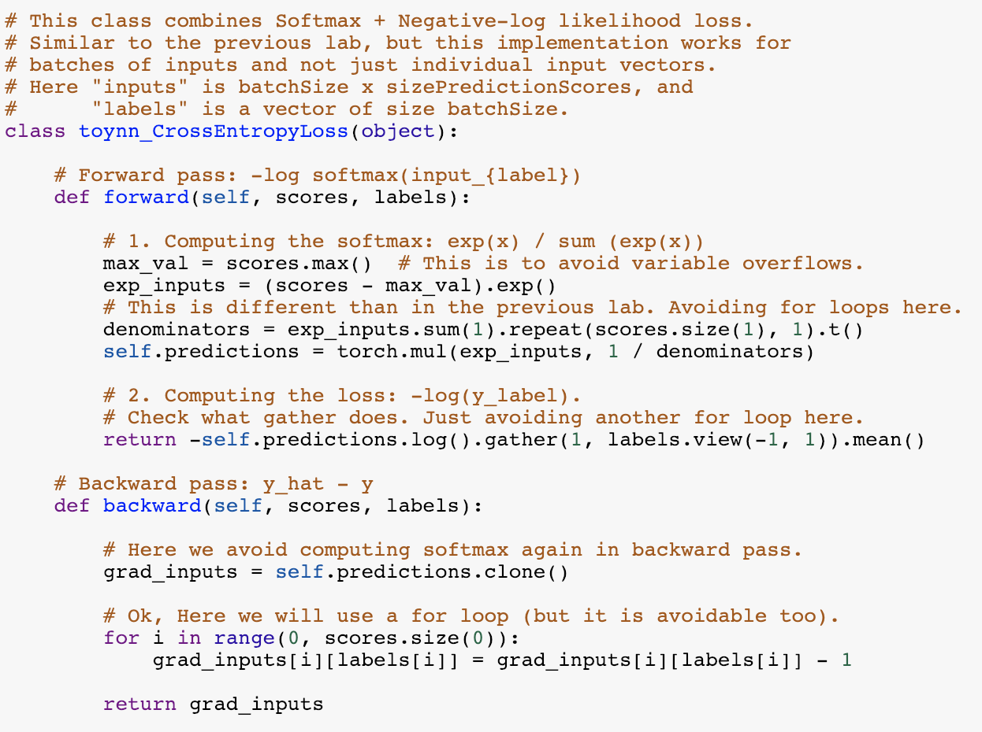
Softmax
+ Negative Log
Likelihood

Slide 47
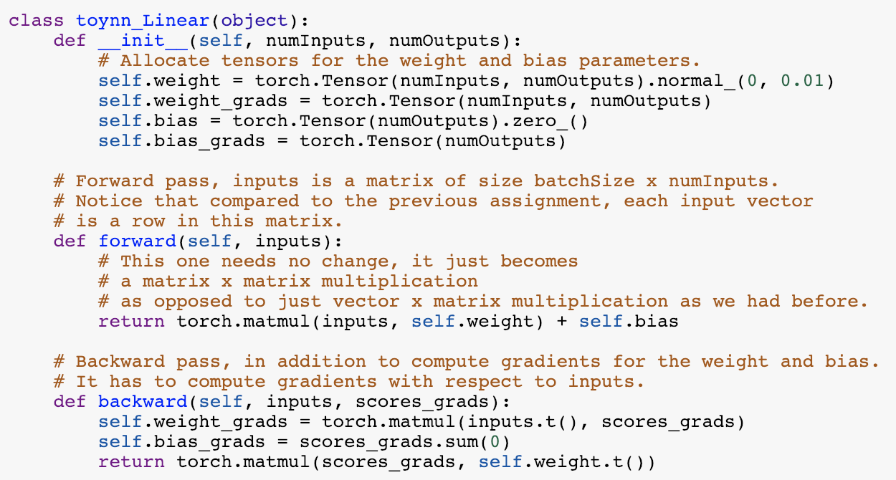
Linear
layer

Slide 48
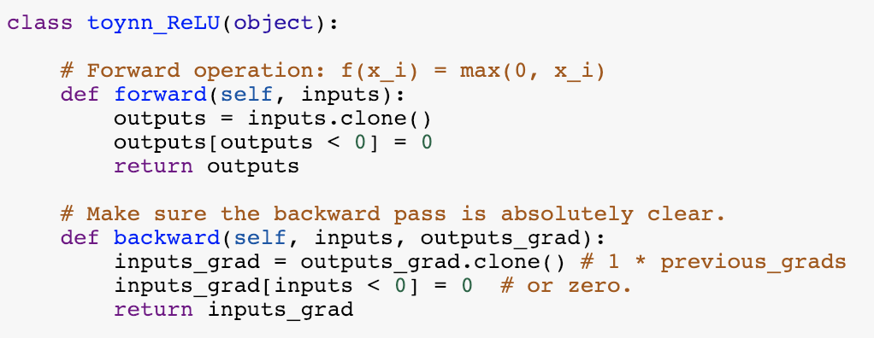
ReLU
layer

Slide 49
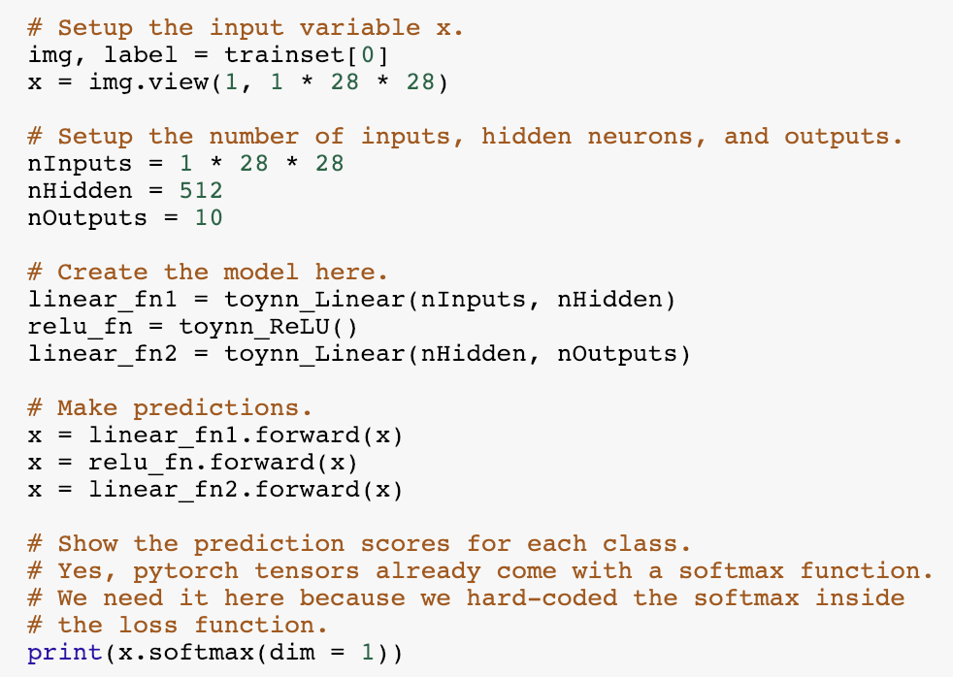
Two-layer Neural Network – Forward Pass

Slide 50
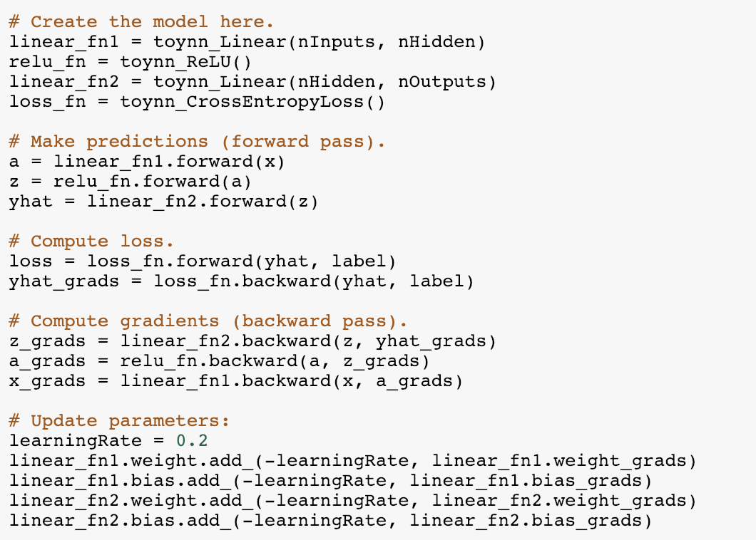
Two-layer Neural Network – Backward Pass

Slide 51
Automatic Differentiation
You only need to write code for the forward pass,
backward pass is computed automatically.
Pytorch (Facebook -- mostly):
Tensorflow (Google -- mostly):
MXNet (Amazon -- mostly):
https://pytorch.org/
https://www.tensorflow.org/
https://mxnet.apache.org/versions/1.9.0/

Slide 52
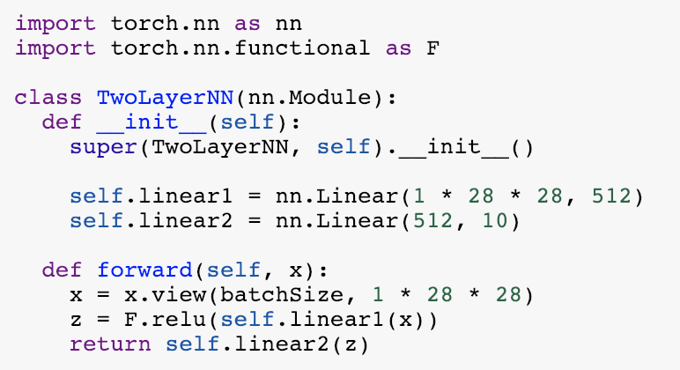
Defining a Model in Pytorch (Two Layer NN)

Slide 53
1. Creating Model, Loss, Optimizer

Slide 54
2. Running forward and backward on a batch
Compare this to what we had to do for toynn

Slide 55
Questions?

Slide 56
Computing Analytic Gradients
This is what we have:

Slide 57
Computing Analytic Gradients
This is what we have:
Reminder:
$$a_{i}=(w_{i,1}x_{1}+w_{i,2}+w_{i,3}+w_{i,4})+b_{i}$$

Slide 58
Computing Analytic Gradients
This is what we have:

Slide 59
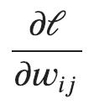
Computing Analytic Gradients
This is what we have:
This is what we need:
for each
for each

Slide 60
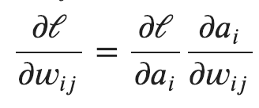
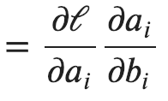
Computing Analytic Gradients
This is what we have:
Step 1: Chain Rule of Calculus

Slide 61
Computing Analytic Gradients
This is what we have:
Step 1: Chain Rule of Calculus
Let’s do these first

Slide 62
Computing Analytic Gradients
$$a_{i}=(w_{i,1}x_{1}+w_{i,2}x_{2}+w_{i,3}x_{3}+w_{i,4}x_{4})+b_{i}$$
$$\frac{∂a_{i}}{∂w_{i, 3}}=\frac{∂}{∂w_{i, 3}}(w_{i,1}x_{1}+w_{i,2}x_{2}+w_{i,3}x_{3}+w_{i,4}x_{4})+b_{i}$$
$$\frac{∂a_{i}}{∂w_{i, 3}}=x_{3}$$
$$\frac{∂a_{i}}{∂w_{i, j}}=x_{j}$$

Slide 63
Computing Analytic Gradients
$$\frac{∂a_{i}}{∂w_{i, j}}=x_{j}$$
$$a_{i}=(w_{i,1}x_{1}+w_{i,2}x_{2}+w_{i,3}x_{3}+w_{i,4}x_{4})+b_{i}$$
$$\frac{∂a_{i}}{∂b_{i}}=\frac{∂}{∂b_{i}}(w_{i,1}x_{1}+w_{i,2}x_{2}+w_{i,3}x_{3}+w_{i,4}x_{4})+b_{i}$$
$$\frac{∂a_{i}}{∂b_{i}}=1$$

Slide 64
Computing Analytic Gradients
$$\frac{∂a_{i}}{∂w_{i, j}}=x_{j}$$
$$\frac{∂a_{i}}{∂b_{i}}=1$$

Slide 65
Computing Analytic Gradients
This is what we have:
Step 1: Chain Rule of Calculus
Now let’s do this one (same for both!)

Slide 66
Computing Analytic Gradients
In our cat, dog, bear classification example: i = {0, 1, 2}

Slide 67
Computing Analytic Gradients
In our cat, dog, bear classification example: i = {0, 1, 2}
$$\frac{∂ℓ}{∂a_{0}}$$
$$\frac{∂ℓ}{∂a_{1}}$$
$$\frac{∂ℓ}{∂a_{2}}$$
Let’s say: label = 1
We need:

Slide 68
Computing Analytic Gradients
$$\frac{∂ℓ}{∂a_{0}}$$
$$\frac{∂ℓ}{∂a_{2}}$$
$$={\hat{y}}_{i}$$

Slide 69
Remember this slide?
$$x_{i}=[x_{i1} { x}_{i2} x_{i3} { x}_{i4}]$$
$$y_{i}=$$
[1 0 0]
$${\hat{y}}_{i}= [f_{c} f_{d} f_{b}]$$
$$g_{c}=w_{c1}x_{i1}+w_{c2}x_{i2}+w_{c3}x_{i3}+w_{c4}x_{i4}+b_{c}$$
$$g_{d}=w_{d1}x_{i1}+w_{d2}x_{i2}+w_{d3}x_{i3}+w_{d4}x_{i4}+b_{d}$$
$$g_{b}=w_{b1}x_{i1}+w_{b2}x_{i2}+w_{b3}x_{i3}+w_{b4}x_{i4}+b_{b}$$
$$f_{c}=e^{g_{c}}/{(e}^{g_{c}}+e^{g_{d}}+e^{g_{b}})$$
$$f_{d}=e^{g_{d}}/{(e}^{g_{c}}+e^{g_{d}}+e^{g_{b}})$$
$$f_{b}=e^{g_{b}}/{(e}^{g_{c}}+e^{g_{d}}+e^{g_{b}})$$

Slide 70
Computing Analytic Gradients
$$\frac{∂ℓ}{∂a_{0}}$$
$$\frac{∂ℓ}{∂a_{2}}$$
$$={\hat{y}}_{i}$$

Slide 71
Computing Analytic Gradients
$$\frac{∂ℓ}{∂a_{1}}$$
$$={\hat{y}}_{i}−1$$

Slide 72
Computing Analytic Gradients
label = 1
$$\frac{∂ℓ}{∂a_{0}}={\hat{y}}_{0}$$
$$\frac{∂ℓ}{∂a_{1}}={\hat{y}}_{1}−1$$
$$\frac{∂ℓ}{∂a_{1}}={\hat{y}}_{2}$$
$\frac{∂ℓ}{∂a}=\left[\begin{aligned}\frac{∂ℓ}{∂a_{0}} \\ \frac{∂ℓ}{∂a_{1}} \\ \frac{∂ℓ}{∂a_{2}}\end{aligned}\right]$= $\left[\begin{aligned}{\hat{y}}_{0} \\ {\hat{y}}_{1}−1 \\ {\hat{y}}_{2}\end{aligned}\right]=\left[\begin{aligned}{\hat{y}}_{0} \\ {\hat{y}}_{1} \\ {\hat{y}}_{2}\end{aligned}\right]−\left[\begin{aligned}0 \\ 1 \\ 0\end{aligned}\right]=\hat{y}−y$
$$\frac{∂ℓ}{∂a_{i}}={\hat{y}}_{i}−y_{i}$$

Slide 73
Computing Analytic Gradients
$$\frac{∂a_{i}}{∂w_{i, j}}=x_{j}$$
$$\frac{∂a_{i}}{∂b_{i}}=1$$
$$\frac{∂ℓ}{∂a_{i}}={\hat{y}}_{i}−y_{i}$$
$$\frac{∂ℓ}{∂w_{i, j}}=\left({\hat{y}}_{i}−y_{i}\right)x_{j}$$
$$\frac{∂ℓ}{∂b_{i}}=\left({\hat{y}}_{i}−y_{i}\right)$$

