Slide 1
Deep Learning for Vision & Language
Computer Vision II: Convolutional Neural Network Architectures

Slide 2
About the class
COMP 646: Deep Learning for Vision and Language
Instructor: Vicente Ordóñez (Vicente Ordóñez Román)
Website: https://www.cs.rice.edu/~vo9/deep-vislang
Location: Zoom – Rice Canvas has the links OR Duncan Hall 1070
Times: Mondays, Wednesdays, and Fridays from 1pm to 1:50pm Central Time
Office Hours: Fridays 2 to 3pm
Teaching Assistants: Brian Hoepfl, Liuba Orlov Savko
Discussion Forum: Rice Canvas

Slide 3
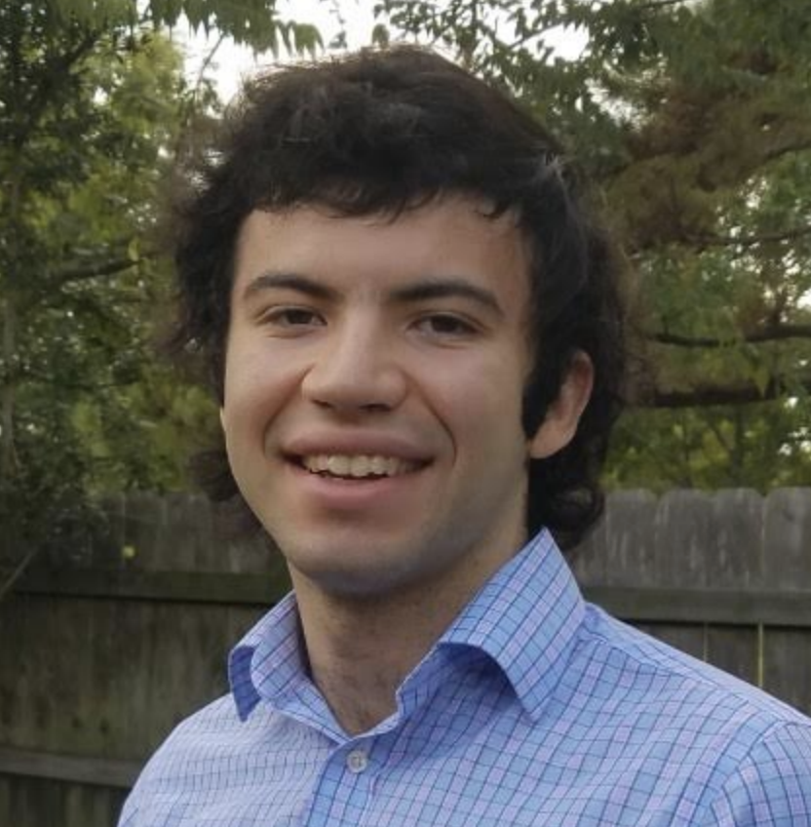
TAs and Office Hours
Brian Hopfl Wednesdays 2:30pm to 4:30pm (today) Next week Location: McMurtry commons Contact email: beh3@rice.edu
Liuba Orlov Savko Fridays 4pm to 5pm Location: Sid’s Place (2nd Floor Duncan near fridge)
Contact email: lo13@rice.edu

Slide 4
ILSVRC: Imagenet Large Scale Visual Recognition Challenge [Russakovsky et al 2014]

Slide 5
The Problem: Classification
Classify an image into 1000 possible classes: e.g. Abyssinian cat, Bulldog, French Terrier, Cormorant, Chickadee,
red fox, banjo, barbell, hourglass, knot, maze, viaduct, etc.
cat, tabby cat (0.71) Egyptian cat (0.22)
red fox (0.11)
…..

Slide 6
The Data: ILSVRC
Imagenet Large Scale Visual Recognition Challenge (ILSVRC): Annual Competition
1000 Categories
~1000 training images per Category
~1 million images in total for training
~50k images for validation
Only images released for the test set but no annotations, evaluation is performed centrally by the organizers (max 2 per week)

Slide 7
The Evaluation Metric: Top K-error
Top-1 error: 1.0
Top-1 accuracy: 0.0
Top-2 error: 1.0
Top-2 accuracy: 0.0
True label: Abyssinian cat
Top-3 error: 1.0
Top-3 accuracy: 0.0
Top-4 error: 0.0
Top-4 accuracy: 1.0
Top-5 error: 0.0
Top-5 accuracy: 1.0
cat, tabby cat (0.61) Egyptian cat (0.22)
red fox (0.11)
Abyssinian cat (0.10)
French terrier (0.03)
…..

Slide 8
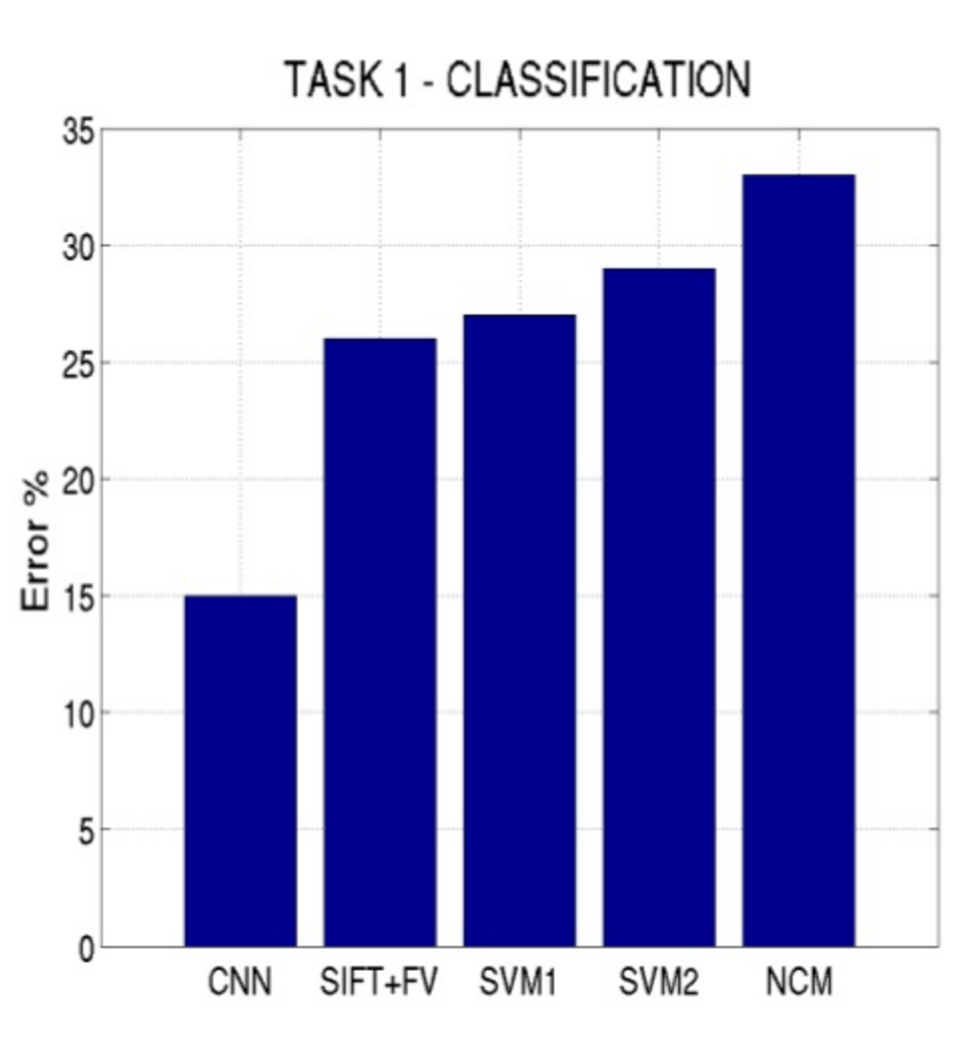
Top-5 error on this competition (2012)

Slide 9
Alexnet (Krizhevsky et al NIPS 2012)

Slide 10
Alexnet
https://www.saagie.com/fr/blog/object-detection-part1

Slide 11
Pytorch Code for Alexnet
In-class analysis https://github.com/pytorch/vision/blob/master/torchvision/models/alexnet.py

Slide 12
Dropout Layer
Happens for every batch for a different set of connections only during training
Important
model.train()
model.eval()
Srivastava et al 2014

Slide 13
Preprocessing and Data Augmentation

Slide 14
Preprocessing and Data Augmentation
256
256

Slide 15
Preprocessing and Data Augmentation
224x224

Slide 16
Preprocessing and Data Augmentation
224x224

Slide 17
True label: Abyssinian cat

Slide 18
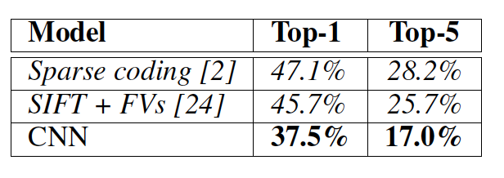
Some Important Aspects
Using ReLUs instead of Sigmoid or Tanh
Momentum + Weight Decay
Dropout (Randomly sets Unit outputs to zero during training)
GPU Computation!

Slide 19
What is happening?
https://www.saagie.com/fr/blog/object-detection-part1

Slide 20
SIFT + FV + SVM (or softmax)
Feature extraction (SIFT)
Feature encoding (Fisher vectors)
Classification (SVM or softmax)
Deep Learning
Convolutional Network
(includes both feature extraction and classifier)

Slide 21
VGG Network
Top-5:
https://github.com/pytorch/vision/blob/master/torchvision/models/vgg.py
Simonyan and Zisserman, 2014.
https://arxiv.org/pdf/1409.1556.pdf

Slide 22
GoogLeNet
https://github.com/kuangliu/pytorch-cifar/blob/master/models/googlenet.py
Szegedy et al. 2014
https://www.cs.unc.edu/~wliu/papers/GoogLeNet.pdf

Slide 23
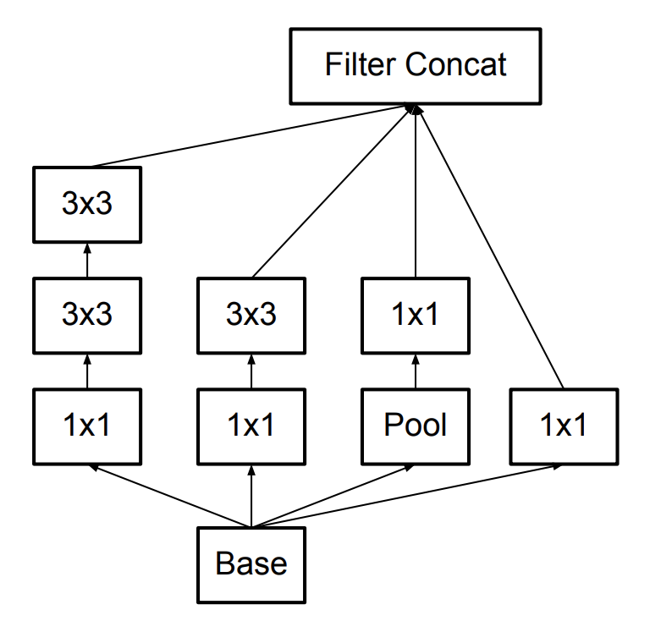
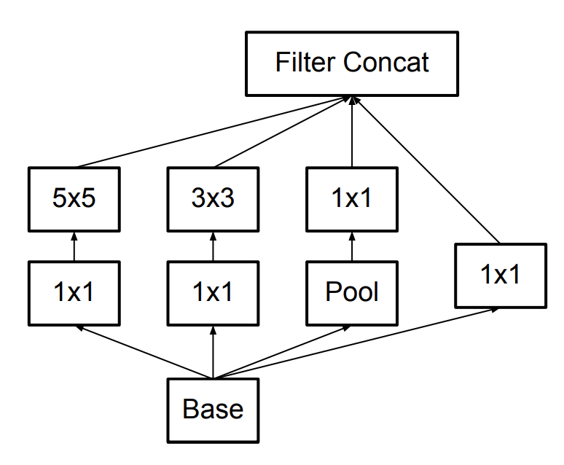
Further Refinements – Inception v3, e.g.
GoogLeNet (Inceptionv1)
Inception v3

Slide 24
BatchNormalization Layer
https://arxiv.org/abs/1502.03167

Slide 25
ResNet (He et al CVPR 2016)
Sorry, does not fit in slide.
http://felixlaumon.github.io/assets/kaggle-right-whale/resnet.png
https://github.com/pytorch/vision/blob/master/torchvision/models/resnet.py

Slide 26
Slide by Mohammad Rastegari

Slide 27
Densenet

Slide 28
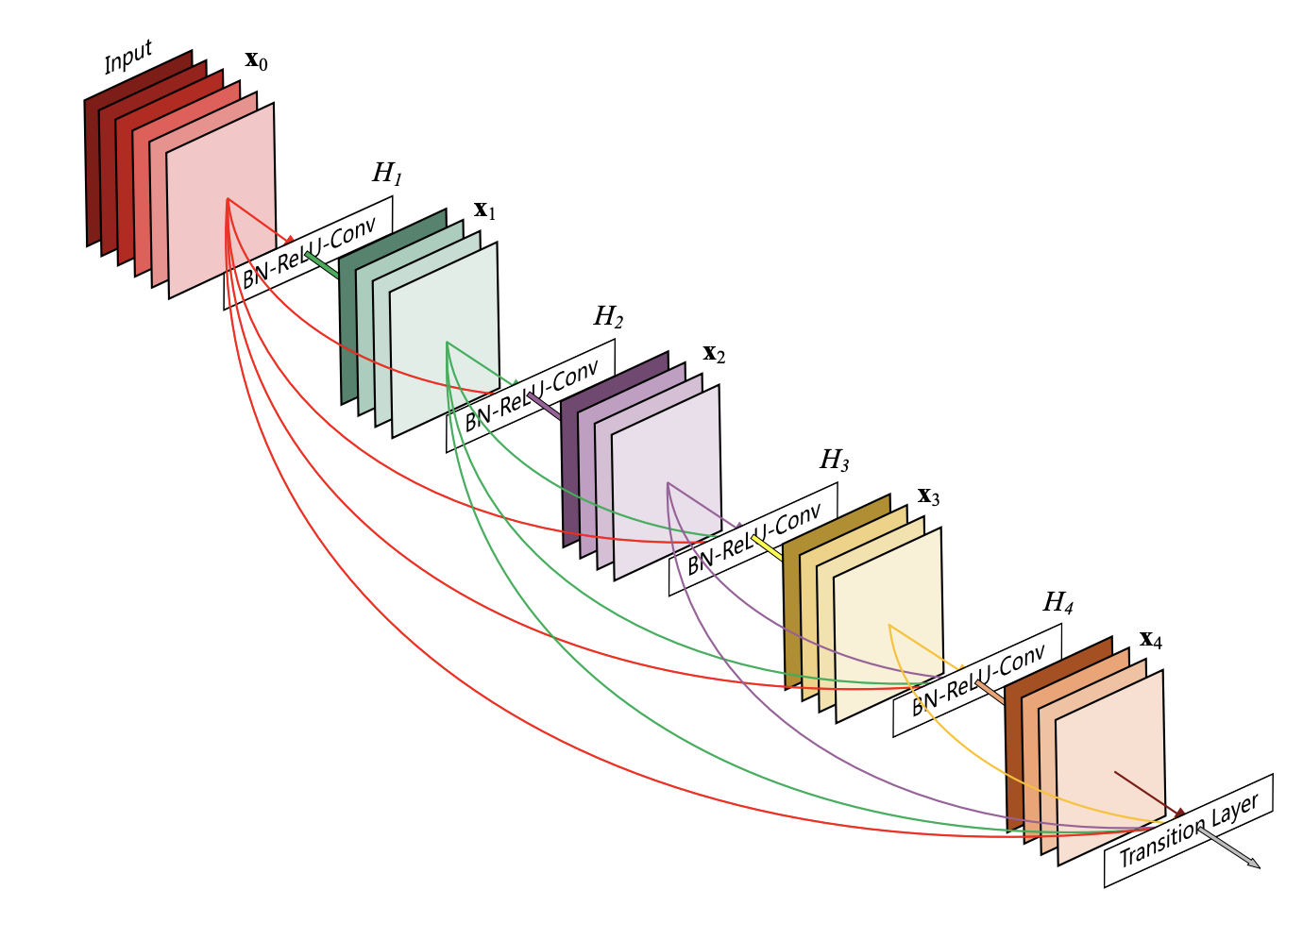
Densenet
https://arxiv.org/pdf/1608.06993.pdf

Slide 29
Densenet
https://arxiv.org/pdf/1608.06993.pdf

Slide 30
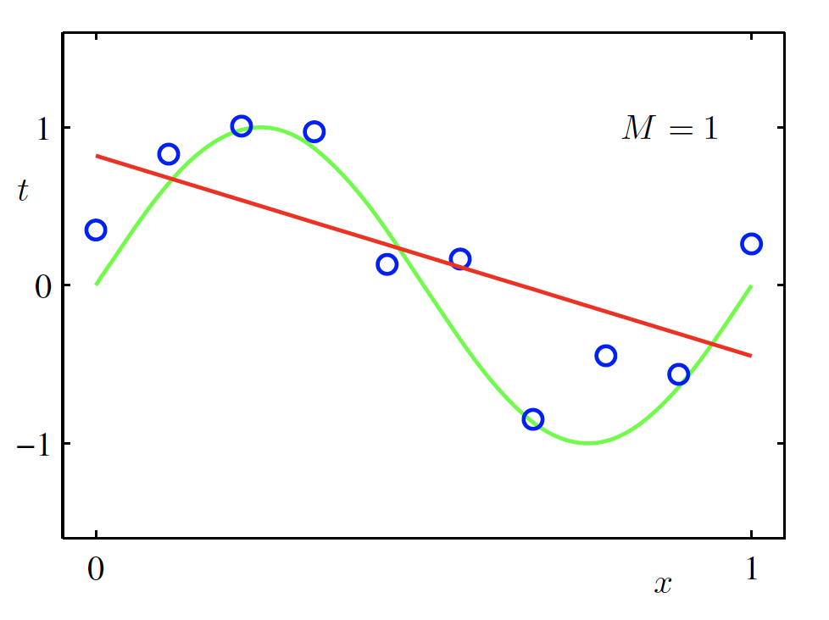
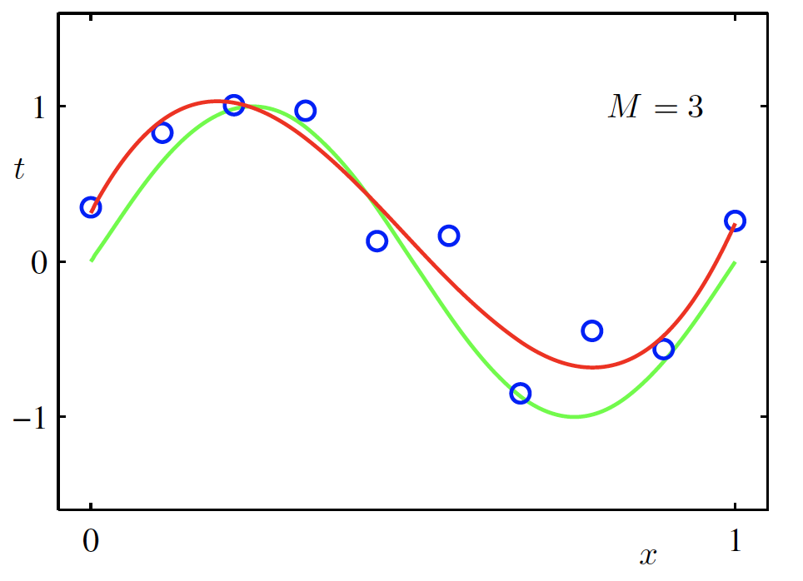
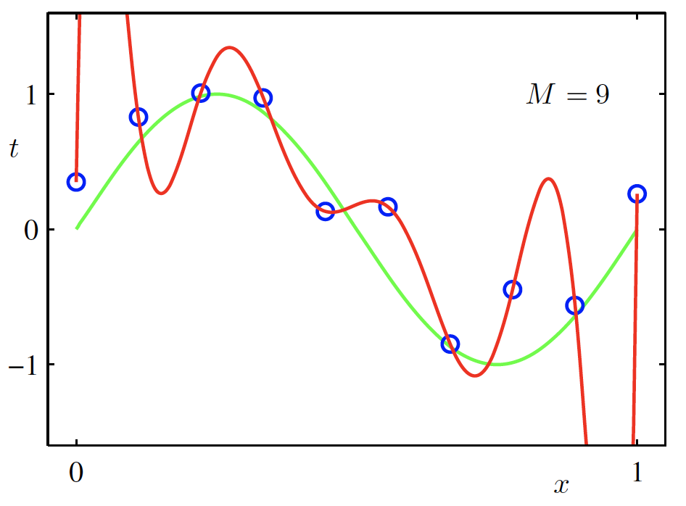
Pending Topic: Regularization
$f$ is a polynomial of degree 9
$f$ is linear
$f$ is cubic
$Loss\left(w\right)$ is high
$Loss\left(w\right)$ is low
$Loss\left(w\right)$ is zero!
Underfitting
Overfitting

Slide 31
(mini-batch) Stochastic Gradient Descent (SGD)
$$λ=0.01$$
$$l(w,b)=\sum_{i∈B}{Cost\left(w,b\right)}$$
Initialize w and b randomly
for e = 0, num_epochs do
for b = 0, num_batches do
Compute:
$$dl(w,b)/dw$$
and
$$dl(w,b)/db$$
Update w:
$$w=w −λ dl(w,b)/dw$$
Update b:
$$b=b −λ dl(w,b)/db$$
Print:
$$l(w,b)$$
// Useful to see if this is becoming smaller or not.
end
end

Slide 32
Regularization
Large weights lead to large variance. i.e. model fits to the training data too strongly.
Solution: Minimize the loss but also try to keep the weight values small by doing the following:
$$L\left(w,b\right)+α\sum_{i}{{|w_{i}|}^{2}}$$
minimize
Credit: C. Bishop. Pattern Recognition and Mach. Learning.

Slide 33
Regularization
Large weights lead to large variance. i.e. model fits to the training data too strongly.
Solution: Minimize the loss but also try to keep the weight values small by doing the following:
$$L\left(w,b\right)+α\sum_{i}{{|w_{i}|}^{2}}$$
minimize
Regularizer term
e.g. L2- regularizer
Credit: C. Bishop. Pattern Recognition and Mach. Learning.

Slide 34
SGD with Regularization (L-2)
$$λ=0.01$$
$l\left(w,b\right)=l\left(w,b\right)+α$ $\sum_{i}{{|w_{i}|}^{2}}$
Initialize w and b randomly
for e = 0, num_epochs do
for b = 0, num_batches do
Compute:
$$dl(w,b)/dw$$
and
$$dl(w,b)/db$$
Update w:
$$w=w −λ dl(w,b)/dw−λαw$$
Update b:
$$b=b −λ dl(w,b)/db−λαw$$
Print:
$$l(w,b)$$
// Useful to see if this is becoming smaller or not.
end
end

Slide 35
Revisiting Another Problem with SGD
$$λ=0.01$$
$l\left(w,b\right)=l\left(w,b\right)+α$ $\sum_{i}{{|w_{i}|}^{2}}$
Initialize w and b randomly
for e = 0, num_epochs do
These are only approximations to the true gradient with respect to $L(w,b)$
for b = 0, num_batches do
Compute:
$$dl(w,b)/dw$$
and
$$dl(w,b)/db$$
Update w:
$$w=w −λ dl(w,b)/dw−λαw$$
Update b:
$$b=b −λ dl(w,b)/db−λαw$$
Print:
$$l(w,b)$$
// Useful to see if this is becoming smaller or not.
end
end

Slide 36
Revisiting Another Problem with SGD
$$λ=0.01$$
$l\left(w,b\right)=l\left(w,b\right)+α$ $\sum_{i}{{|w_{i}|}^{2}}$
Initialize w and b randomly
for e = 0, num_epochs do
This could lead to “un-learning” what has been learned in some previous steps of training.
for b = 0, num_batches do
Compute:
$$dl(w,b)/dw$$
and
$$dl(w,b)/db$$
Update w:
$$w=w −λ dl(w,b)/dw−λαw$$
Update b:
$$b=b −λ dl(w,b)/db−λαw$$
Print:
$$l(w,b)$$
// Useful to see if this is becoming smaller or not.
end
end

Slide 37
Solution: Momentum Updates
$$λ=0.01$$
$l\left(w,b\right)=l\left(w,b\right)+α$ $\sum_{i}{{|w_{i}|}^{2}}$
Initialize w and b randomly
for e = 0, num_epochs do
Keep track of previous gradients in an accumulator variable! and use a weighted average with current gradient.
for b = 0, num_batches do
Compute:
$$dl(w,b)/dw$$
and
$$dl(w,b)/db$$
Update w:
$$w=w −λ dl(w,b)/dw−λαw$$
Update b:
$$b=b −λ dl(w,b)/db−λαw$$
Print:
$$l(w,b)$$
// Useful to see if this is becoming smaller or not.
end
end

Slide 38
Solution: Momentum Updates
$$λ=0.01$$
$$τ=0.9$$
Initialize w and b randomly
$l\left(w,b\right)=l\left(w,b\right)+α$ $\sum_{i}{{|w_{i}|}^{2}}$
global $v$
for e = 0, num_epochs do
for b = 0, num_batches do
Keep track of previous gradients in an accumulator variable! and use a weighted average with current gradient.
Compute:
$$dl(w,b)/dw$$
Compute:
$$v=τv+dl(w,b)/dw+αw$$
Update w:
$$w=w −λ v$$
Print:
$$l(w,b)$$
// Useful to see if this is becoming smaller or not.
end
end

Slide 39
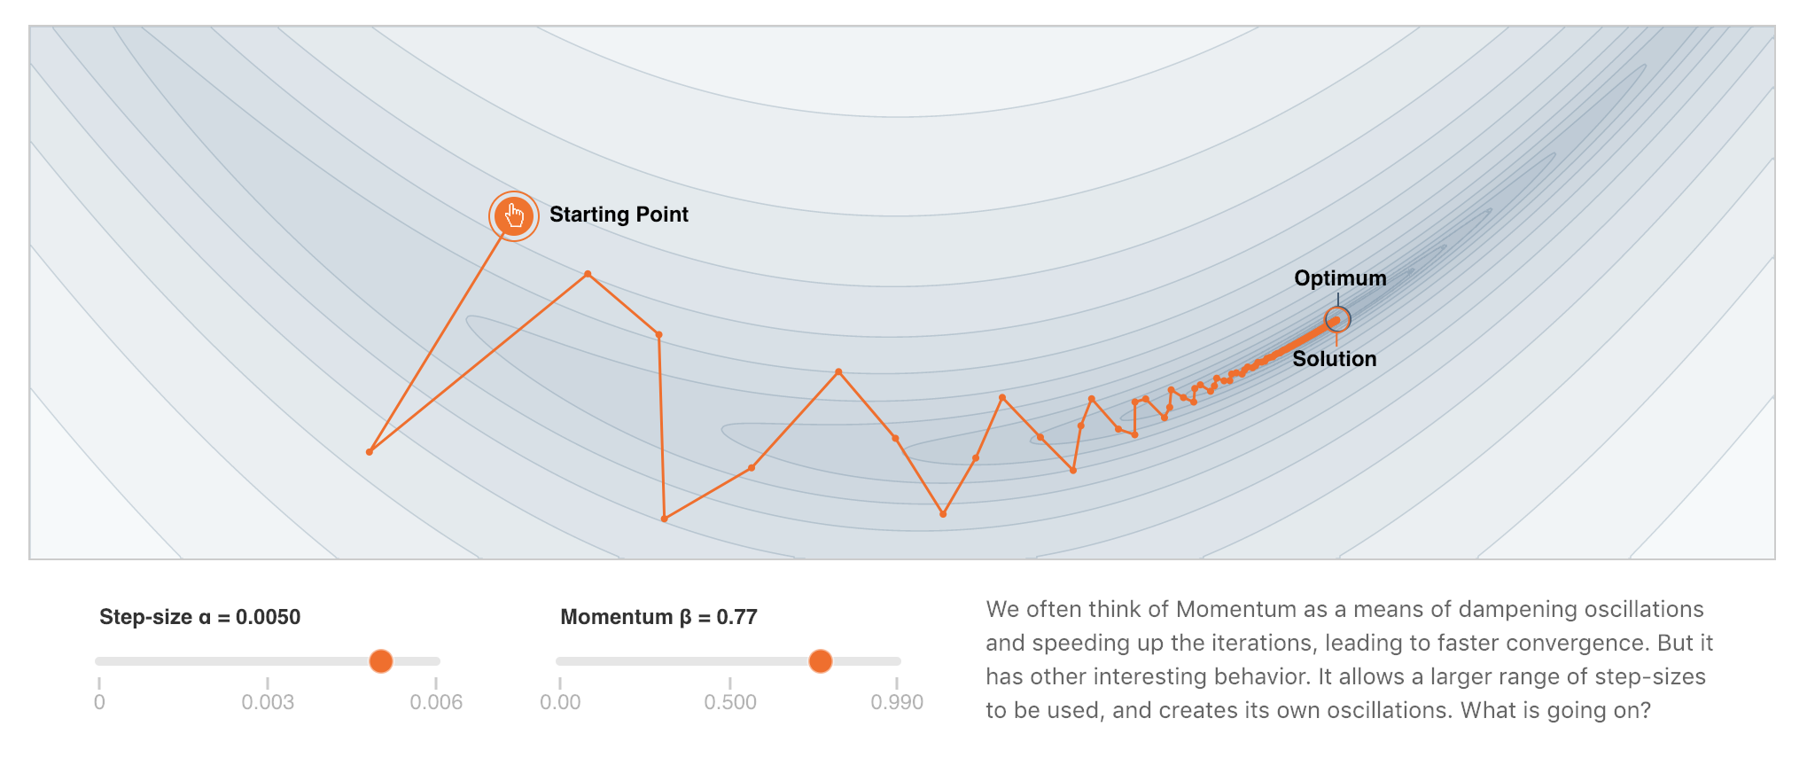
More on Momentum
https://distill.pub/2017/momentum/

Slide 40
Questions

