Slide 1
Deep Learning for Vision & Language
Natural Language Processing II: Embeddings / Representing Words and Sentences

Slide 2
Second Assignment
Released! Start working on it – due next week – start early.

Slide 3







How to represent a word?
one-hot encodings
dog
cat
person
holding
tree
computer
using
1
2
3
4
5
6
7
$$[1 0 0 0 0 0 0 0 0 0 ]$$
$$[0 1 0 0 0 0 0 0 0 0 ]$$
$$[0 0 1 0 0 0 0 0 0 0 ]$$
$$[0 0 0 1 0 0 0 0 0 0 ]$$
$$[0 0 0 0 1 0 0 0 0 0 ]$$
$$[0 0 0 0 0 1 0 0 0 0 ]$$
$$[0 0 0 0 0 0 1 0 0 0 ]$$
What we see

Slide 4




How to represent a phrase/sentence?
bag-of-words representation
person holding dog
{1, 3, 4}
$$[1 0 1 1 0 0 0 0 0 0 ]$$
person holding cat
{2, 3, 4}
dog
cat
person
holding
tree
computer
using
$$[0 1 1 1 0 0 0 0 0 0 ]$$
person using computer
{3, 7, 6}
$$[0 0 1 0 0 1 1 0 0 0 ]$$
person using computer person holding cat
{3, 3, 7, 6, 2}
$$[0 1 2 1 0 1 1 0 0 0 ]$$
What we see
What if vocabulary is very large?

Slide 5
Sparse Representation
bag-of-words representation
person holding dog
{1, 3, 4}
indices = [1, 3, 4] values = [1, 1, 1]
person holding cat
{2, 3, 4}
indices = [2, 3, 4] values = [1, 1, 1]
person using computer
{3, 7, 6}
indices = [3, 7, 6] values = [1, 1, 1]
person using computer person holding cat
{3, 3, 7, 6, 2}
indices = [3, 7, 6, 2] values = [2, 1, 1, 1]
What we see

Slide 6
Recap
Bag-of-words encodings for text (e.g. sentences, paragraphs, captions, etc)
You can take a set of sentences/documents and classify them, cluster them, or compute distances between them using this representation.

Slide 7
Problem with this bag-of-words representation
my friend makes a nice meal
These would be the same using bag-of-words
my nice friend makes a meal

Slide 8
Bag of Bi-grams
indices = [10132, 21342, 43233, 53123, 64233] values = [1, 1, 1, 1, 1]
my friend makes a nice meal
{my friend, friend makes, makes a, a nice, nice meal}
indices = [10232, 43133, 21342, 43233, 54233] values = [1, 1, 1, 1, 1]
my nice friend makes a meal
{my nice, nice friend, friend makes, makes a, a meal}
A dense vector-representation would be very inefficient
Think about tri-grams and n-grams
What we see

Slide 9
Recommended reading: n-gram language models
Kai-Wei’s course on Natural Language Processing
http://www.cs.virginia.edu/~kc2wc/teaching/NLP16/slides/02-ngram.pdf
http://www.cs.virginia.edu/~kc2wc/teaching/NLP16/slides/03-smooth.pdf
Yejin Choi’s course on Natural Language Processing
http://www3.cs.stonybrook.edu/~ychoi/cse628/lecture/02-ngram.pdf

Slide 10
Problem with this bag-of-words representation
my friend makes a nice meal
Alternatives:
Continuous Bag of Words (CBOW) – Word embeddings
Sequence-based representations (RNNs, LSTMs)
Transformer-based representations (e.g. BERT)
chicken makes a nice meal

Slide 11
Back to how to represent a word?
Problem: distance between words using one-hot encodings always the same
dog
cat
person
1
2
3
$$[1 0 0 0 0 0 0 0 0 0 ]$$
$$[0 1 0 0 0 0 0 0 0 0 ]$$
$$[0 0 1 0 0 0 0 0 0 0 ]$$
Idea: Instead of one-hot-encoding use a histogram of commonly co-occurring words.
What we see

Slide 12
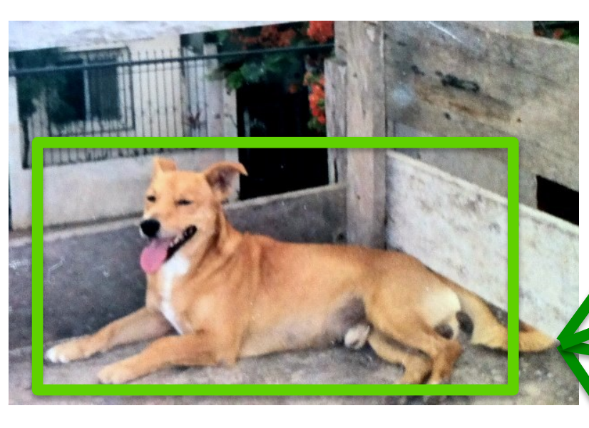
Distributional Semantics
Dogs are man’s best friend.
I saw a dog on a leash walking in the park.
friend
leash
park
walking
walks
food
legs
runs
sleeps
sits
…
His dog is his best companion.
He walks his dog in the late afternoon
…
dog
$$[3 2 3 4 2 4 3 5 6 7 …]$$
What we see

Slide 13
Distributional Semantics
food
walks
window
runs
mouse
invented
legs
sleeps
mirror
tail
…
dog
cat
person
$$[5 5 0 5 0 0 5 5 0 2 …]$$
$$[5 4 1 4 2 0 3 4 0 3 … ]$$
$$[5 5 1 5 0 2 5 5 0 0 …]$$
This vocabulary can be extremely large
What we see

Slide 14
Toward more Compact Representations
food
walks
window
runs
mouse
invented
legs
sleeps
mirror
tail
…
dog
cat
person
$$[5 5 0 5 0 0 5 5 0 2 …]$$
$$[5 4 1 4 2 0 3 4 0 3 … ]$$
$$[5 5 1 5 0 2 5 5 0 0 …]$$
This vocabulary can be extremely large
What we see

Slide 15
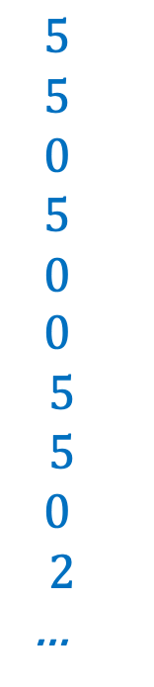
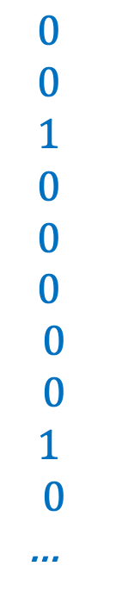
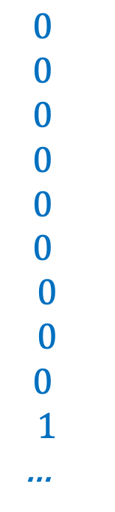
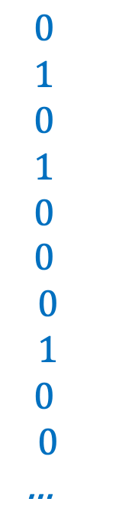
Toward more Compact Representations
$$5$$
$$5$$
$$0$$
$$5$$
$$0$$
$$0$$
$$5$$
$$5$$
$$0$$
$$2$$
…
$$0$$
$$1$$
$$0$$
$$1$$
$$0$$
$$0$$
$$0$$
$$1$$
$$0$$
$$0$$
…
$$0$$
$$0$$
$$0$$
$$0$$
$$0$$
$$0$$
$$0$$
$$0$$
$$0$$
$$1$$
…
$$0$$
$$0$$
$$1$$
$$0$$
$$0$$
$$0$$
$$0$$
$$0$$
$$1$$
$$0$$
…
dog =
=
w1
+ w2
+ w3
+ …
What we see
legs, running,
walking
tail, fur,
ears
mirror, window,
door

Slide 16
Toward more Compact Representations
dog =
w1
w2
w3
The basis vectors can be found using Principal Component Analysis (PCA)
This is known as Latent Semantic Analysis in NLP
What we see

Slide 17
Toward more Compact Representations:
Word Embeddings
dog =
w1
w2
w3
The weights w1, …, wn are found using a neural network
Word2Vec: https://arxiv.org/abs/1301.3781
What we see

Slide 18



Word2Vec – CBOW Version
First, create a huge matrix of word embeddings initialized with random values – where each row is a vector for a different word in the vocabulary.
d
$$w_{1}$$
$$w_{2}$$
n
…
$$w_{n}$$

Slide 19
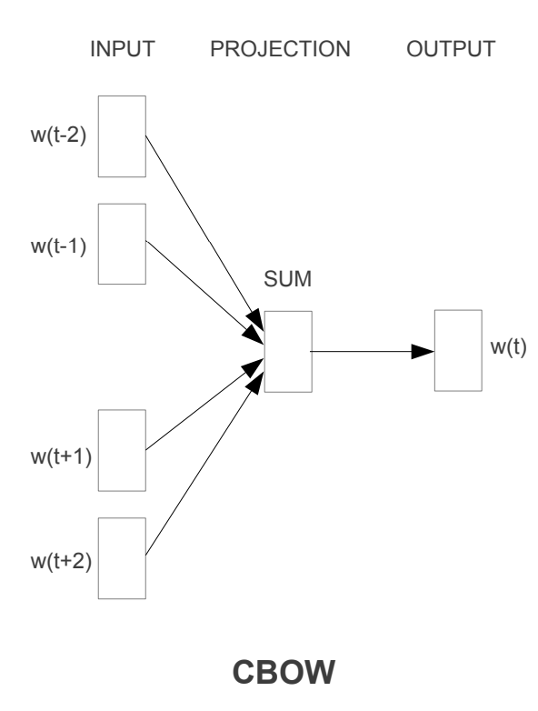



Word2Vec – CBOW Version
Then, collect a lot of text, and solve the following regression problem for a large corpus of text:
d
“the big dog plays ball”
$$w_{1}$$
the
$$w_{2}$$
big
n
…
dog
plays
ball
$$w_{n}$$

Slide 20
Practical Issues - Tokenization
For each text representation we usually need to separate a sentence into tokens – we have assumed words in this lecture (or pairs of words) – but tokens could also be characters and anything in-between.
Word segmentation can be used as tokenization.
  In the assignment I was lazy I just did “my sentence”.split(“ “) and called it a day.
  However, even English is more difficult than that because of punctuation, double spaces, quotes, etc. For English I would recommend you too look up the great word tokenization tools in libraries such as Python’s NLTK and Spacy before you try to come up with your own word tokenizer.

Slide 21
Issues with Word based Tokenization
We already mentioned that tokenization can be hard even when word-based for other languages that don’t use spaces in-between words.
Word tokenization can also be bad for languages where the words can be “glued” together like German or Turkish.
  Remember fünf­hundert­fünf­und­fünfzig? It wouldn’t be feasible to have a word embedding for every number in the German language.
It is problematic to handle words that are not in the vocabulary e.g. a common practice is to use a special <OOV> (out of vocabulary) token for those words that don’t show up in the vocabulary.

Slide 22
Tokenization can be complex
Think of Japanese
  Three vocabularies/sets of symbols:
  Katakana and Hiragana symbols represent syllables / sounds
  く= ku, ぎ = gi, ナ = na, ア= a
  Kanji represent ideas / words (Chinese characters).
    日 = day, sun, 大 = big, 凸= convex 凹 = concave
  They can be combined – e.g. tomorrow = 明日
  Each symbol also has some structure within the symbols. They are not independently created. e.g. bright= 明るい , rising sun = 旭
  And of course there are no spaces in between the characters.

Slide 23
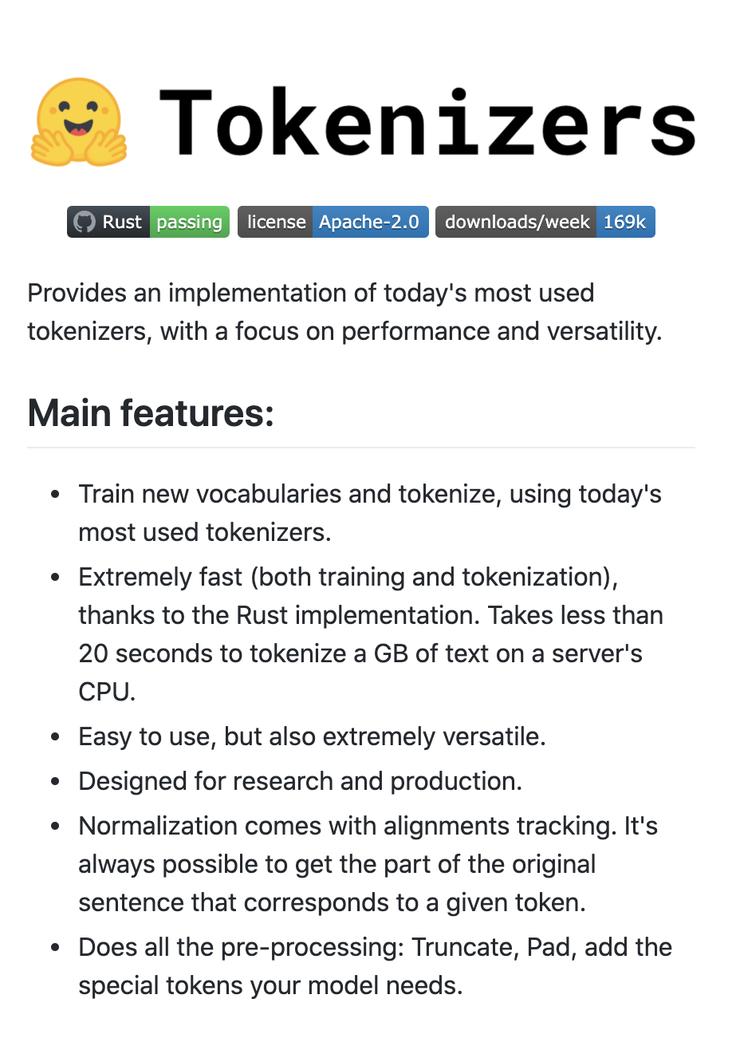
Solution: Sub-word Tokenization
Byte-pair Encoding Tokenization (BPE)
  Start from small strings and based on substring counts iteratively use larger sequences until you define a vocabulary that maximizes informative subtokens. That way most will correspond to words at the end.
Byte-level BPE Tokenizer
  Do the same but at the byte representation level not at the substring representation level.
We will discuss these more as we discuss Transformer Models
huggingface/tokenizers

Slide 24
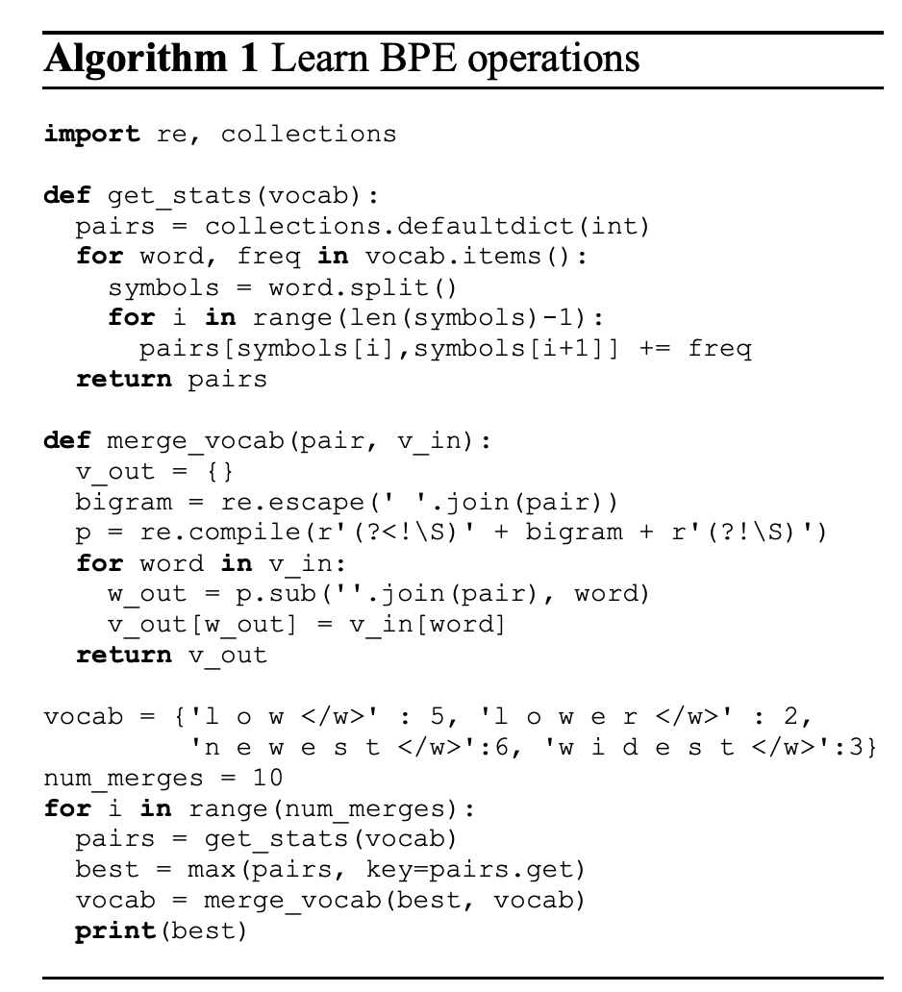
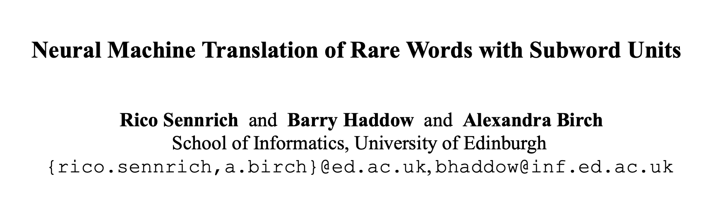
BPE Tokenization Overview
Learn BPE operations (python code on the right) – from the paper.
Use said operations to construct your sub-word vocabulary.
Treat each sub-word token as a “word” in any models we will discuss.
https://colab.research.google.com/drive/1gUjL_h2tXdTtPSfxbBP-6MkE_BMck6gm?usp=sharing

Slide 25
Questions?

