Slide 1
Deep Learning for Vision & Language
Natural Language Processing III: Recurrent Neural Networks

Slide 2
Second Assignment
Released! Start working on it – due next week – start early.
Don’t forget about your project proposal: Project should be like an Assignment #4 – but it is yours. I won’t push you to do anything but it should hopefully be relevant to the class topic – vision and language. e.g. not prediction of the weather using ML – or email spam classification.

Slide 3
Recurrent Neural Networks
These are models for handling sequences of things.
Each input is not a vector but a sequence of input vectors.
e.g. Each input can be a “word embedding” or any “word” representation – we will use in our first examples one-hot encoded tokens but in practice continuous dense word embeddings are used.

Slide 4
Recurrent Neural Network Cell
$$h_{0}$$
$$RNN$$
$$h_{1}$$
$$x_{1}$$

Slide 5
Recurrent Neural Network Cell
$$h_{1}=tanh⁡(W_{hh}h_{0}+W_{hx}x_{1})$$
$$h_{0}$$
$$RNN$$
$$h_{1}$$
$$x_{1}$$

Slide 6
Recurrent Neural Network Cell
$$y_{1}$$
$$h_{1}$$
$$h_{0}$$
$$RNN$$
$$h_{1}$$
$$h_{1}=tanh⁡(W_{hh}h_{0}+W_{hx}x_{1})$$
$$x_{1}$$
$$y_{1}=softmax⁡(W_{hy}h_{1})$$

Slide 7
Recurrent Neural Network Cell
$$y_{1}=[0.1, 0.05, 0.05, 0.1, 0.7]$$
$$h_{1}=[0.1 0.2 0 −0.3 −0.1 ]$$
$$h_{0}=[0 0 0 0 0 0 0 ]$$
$$RNN$$
$$h_{1}=[0.1 0.2 0 −0.3 −0.1 ]$$
$$h_{1}=tanh⁡(W_{hh}h_{0}+W_{hx}x_{1})$$
$$x_{1}= [0 0 1 0 0]$$
$$y_{1}=softmax⁡(W_{hy}h_{1})$$

Slide 8
Recurrent Neural Network Cell
$$y_{1}=[0.1, 0.05, 0.05, 0.1, 0.7]$$
e (0.7)
$$h_{1}=[0.1 0.2 0 −0.3 −0.1 ]$$
$$h_{0}=[0 0 0 0 0 0 0 ]$$
$$RNN$$
$$h_{1}=[0.1 0.2 0 −0.3 −0.1 ]$$
$$x_{1}= [0 0 1 0 0]$$
c
a b c d e

Slide 9
Recurrent Neural Network Cell
$$y_{1}$$
$$h_{1}$$
$$h_{0}$$
$$RNN$$
$$h_{1}$$
$$h_{1}=tanh⁡(W_{hh}h_{0}+W_{hx}x_{1})$$
$$x_{1}$$
$$y_{1}=softmax⁡(W_{hy}h_{1})$$

Slide 10
Recurrent Neural Network Cell
$$h_{1}$$
$$h_{0}$$
$$RNN$$
$$h_{1}$$
$$h_{1}=tanh⁡(W_{hh}h_{0}+W_{hx}x_{1})$$
$$x_{1}$$

Slide 11
Recurrent Neural Network Cell
$$h_{0}$$
$$RNN$$
$$h_{1}$$
$$h_{1}=tanh⁡(W_{hh}h_{0}+W_{hx}x_{1})$$
$$x_{1}$$

Slide 12
(Unrolled) Recurrent Neural Network
$$h_{0}$$
$$RNN$$
$$h_{1}$$
$$h_{2}$$
$$h_{3}$$
$$RNN$$
$$RNN$$
$$x_{1}$$
$$x_{2}$$
$$x_{3}$$

Slide 13
How can it be used? – e.g. Tagging a Text Sequence One-to-one Sequence Mapping Problems
<<possessive>>
<<noun>>
<<verb>>
$$y_{1}$$
$$y_{2}$$
$$y_{3}$$
$$h_{1}$$
$$h_{2}$$
$$h_{3}$$
$$h_{0}$$
$$RNN$$
$$h_{1}$$
$$h_{2}$$
$$h_{3}$$
$$RNN$$
$$RNN$$
$$x_{1}$$
$$x_{2}$$
$$x_{3}$$
my
car
works

Slide 14
How can it be used? – e.g. Tagging a Text Sequence One-to-one Sequence Mapping Problems
Training examples don’t need to be the same length!
input
output
my car works
<<possessive>> <<noun>> <<verb>>
my dog ate the assignment
<<possessive>> <<noun>> <<verb>> <<pronoun>> <<noun>>
my mother saved the day
<<possessive>> <<noun>> <<verb>> <<pronoun>> <<noun>>
the smart kid solved the problem
<<pronoun>> <<qualifier>> <<noun>> <<verb>> <<pronoun>> <<noun>>

Slide 15
How can it be used? – e.g. Tagging a Text Sequence One-to-one Sequence Mapping Problems
Training examples don’t need to be the same length!
input
output
L(my car works) = 3
L (<<possessive>> <<noun>> <<verb>>) = 3
L( my dog ate the assignment ) = 5
L (<<possessive>> <<noun>> <<verb>> <<pronoun>> <<noun>>) = 5
L( my mother saved the day ) = 5
L (<<possessive>> <<noun>> <<verb>> <<pronoun>> <<noun>>) = 5
L( the smart kid solved the problem ) = 6
L (<<pronoun>> <<qualifier>> <<noun>> <<verb>> <<pronoun>> <<noun>>) = 6

Slide 16
How can it be used? – e.g. Tagging a Text Sequence One-to-one Sequence Mapping Problems
Training examples don’t need to be the same length!
If we assume a vocabulary of a 1000 possible words and 20 possible output tags
input
output
T: 1000 x 3
T: 20 x 3
T: 1000 x 5
T: 20 x 5
T: 1000 x 5
T: 20 x 5
T: 1000 x 6
T: 20 x 6

Slide 17
How can it be used? – e.g. Tagging a Text Sequence One-to-one Sequence Mapping Problems
Training examples don’t need to be the same length!
If we assume a vocabulary of a 1000 possible words and 20 possible output tags
input
output
T: 1000 x 3
T: 20 x 3
T: 1000 x 5
T: 20 x 5
T: 1000 x 5
T: 20 x 5
T: 1000 x 6
T: 20 x 6
How do we create batches if inputs and outputs have different shapes?

Slide 18
How can it be used? – e.g. Tagging a Text Sequence One-to-one Sequence Mapping Problems
Training examples don’t need to be the same length!
If we assume a vocabulary of a 1000 possible words and 20 possible output tags
input
output
T: 1000 x 3
T: 20 x 3
T: 1000 x 5
T: 20 x 5
T: 1000 x 5
T: 20 x 5
T: 1000 x 6
T: 20 x 6
How do we create batches if inputs and outputs have different shapes?
Solution 1: Forget about batches, just process things one by one.

Slide 19
How can it be used? – e.g. Tagging a Text Sequence One-to-one Sequence Mapping Problems
Training examples don’t need to be the same length!
If we assume a vocabulary of a 1000 possible words and 20 possible output tags
input
output
T: 1000 x 3
T: 20 x 3
T: 1000 x 5
T: 20 x 5
T: 1000 x 5
T: 20 x 5
T: 1000 x 6
T: 20 x 6
How do we create batches if inputs and outputs have different shapes?
Solution 2: Zero padding.
We can put the above vectors in
T: 4 x 1000 x 6

Slide 20
How can it be used? – e.g. Tagging a Text Sequence One-to-one Sequence Mapping Problems
Training examples don’t need to be the same length!
If we assume a vocabulary of a 1000 possible words and 20 possible output tags
input
output
T: 1000 x 3
T: 20 x 3
T: 1000 x 5
T: 20 x 5
T: 1000 x 5
T: 20 x 5
T: 1000 x 6
T: 20 x 6
How do we create batches if inputs and outputs have different shapes?
Solution 3: Advanced. Dynamic Batching or Auto-batching
https://dynet.readthedocs.io/en/latest/tutorials_notebooks/Autobatching.html

Slide 21
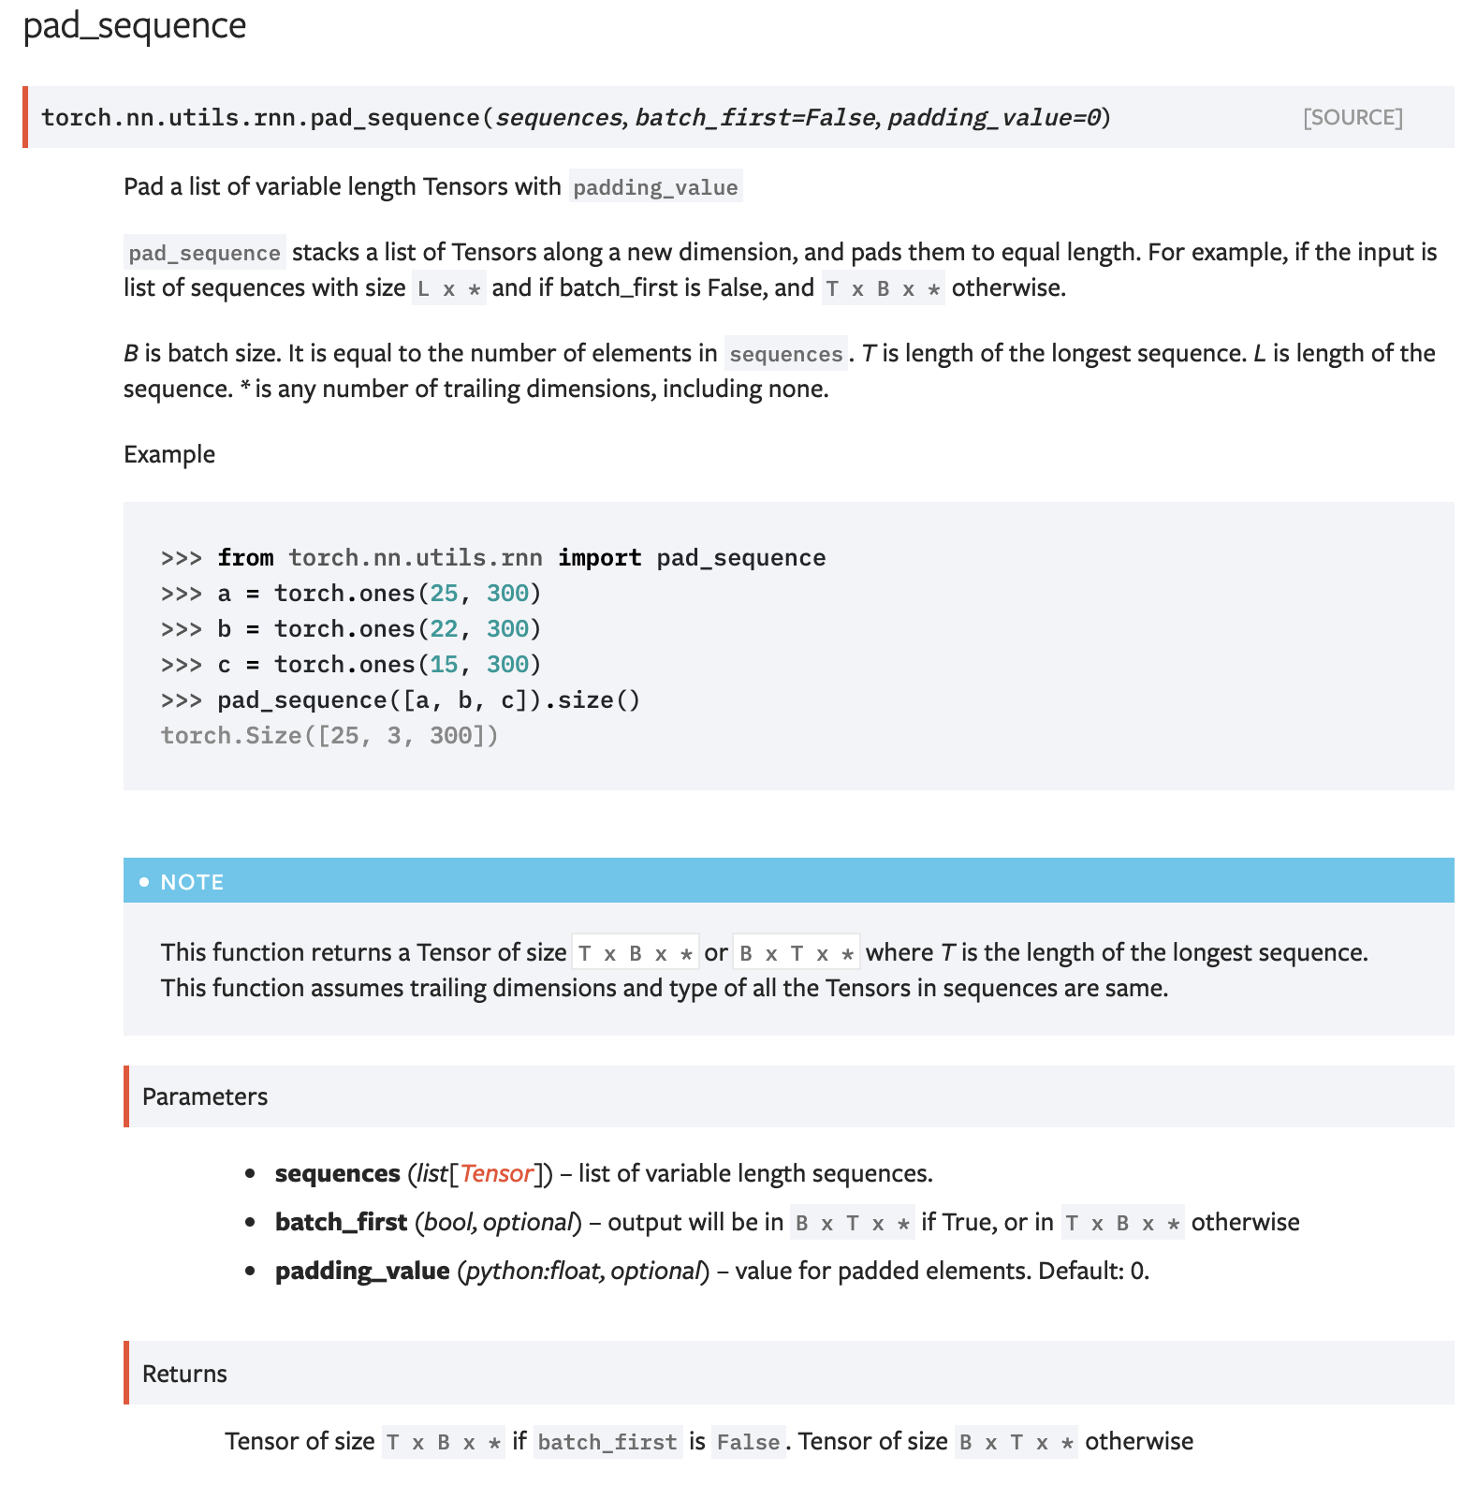
How can it be used? – e.g. Tagging a Text Sequence One-to-one Sequence Mapping Problems
Solution 4: Pytorch stacking, padding, and sorting combination

Slide 22
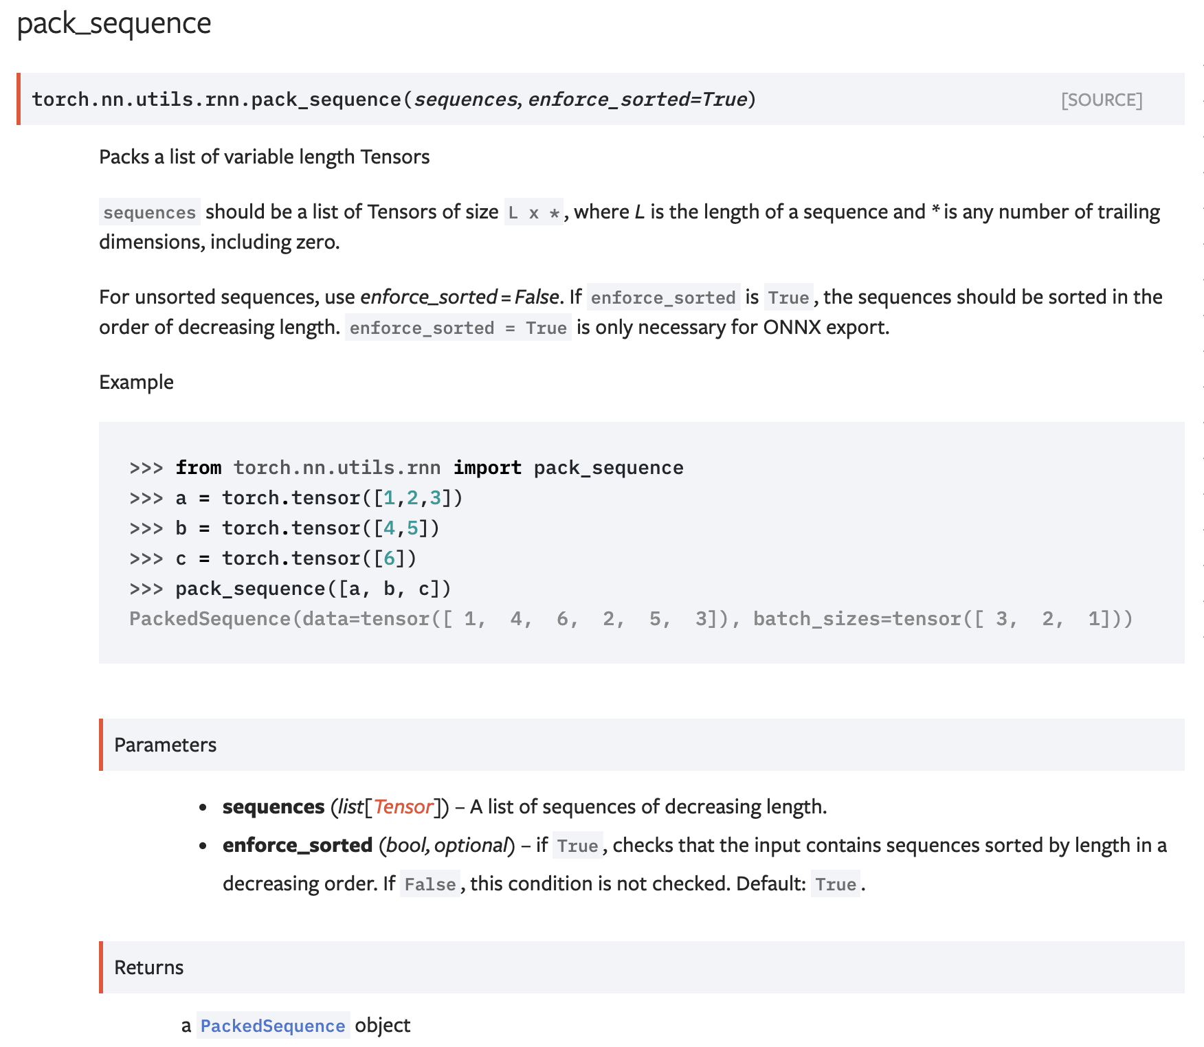
How can it be used? – e.g. Tagging a Text Sequence One-to-one Sequence Mapping Problems
Solution 4: Pytorch stacking, padding, and sorting combination

Slide 23
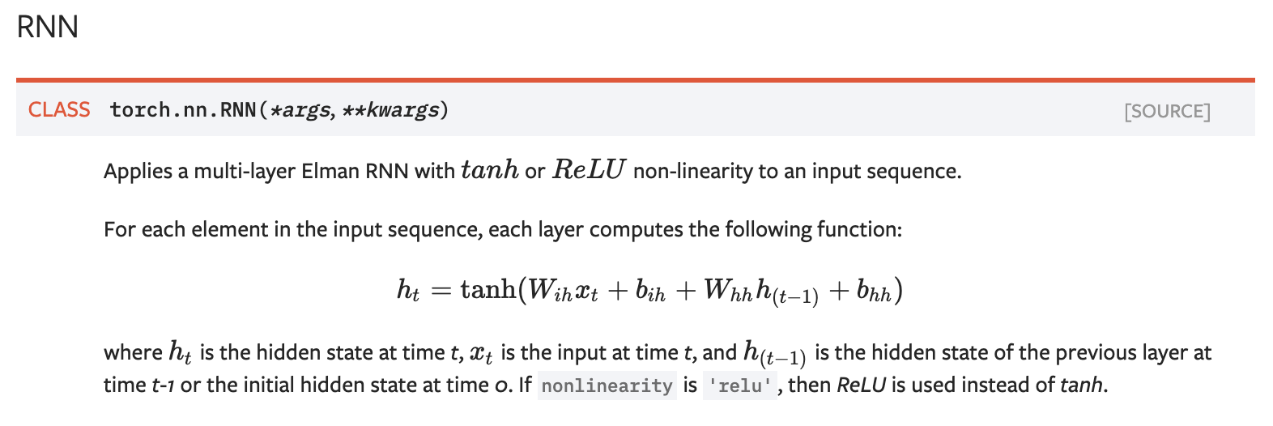
Pytorch RNN

Slide 24
How can it be used? – e.g. Scoring the Sentiment of a Text Sequence Many-to-one Sequence to score problems
positive / negative sentiment rating
$$y_{}$$
$$h_{n}$$
$$h_{0}$$
$$RNN$$
$$h_{1}$$
$$h_{2}$$
…
$$RNN$$
$$h_{n}$$
$$RNN$$
$$RNN$$
$$x_{1}$$
$$x_{2}$$
$$x_{3}$$
$$x_{n}$$
the
cat
likes
<<EOS>>

Slide 25
How can it be used? – e.g. Sentiment Scoring Many to one Mapping Problems
Input training examples don’t need to be the same length! In this case outputs can be.
input
output
this restaurant has good food
Positive
this restaurant is bad
Negative
this restaurant is the worst
Negative
this restaurant is well recommended
Positive

Slide 26
How can it be used? – e.g. Text Generation Auto-regressive model – Sequence to Sequence during Training, Auto-regressive during test
DURING TRAINING
The
world
is
not
enough
<END>
$$y_{1}$$
$$y_{2}$$
$$y_{3}$$
$$y_{4}$$
$$y_{5}$$
$$y_{6}$$
$$h_{1}$$
$$h_{2}$$
$$h_{3}$$
$$h_{4}$$
$$h_{5}$$
$$h_{6}$$
$$h_{0}$$
RNN
$$h_{1}$$
RNN
$$h_{2}$$
RNN
$$h_{3}$$
RNN
$$h_{4}$$
RNN
$$h_{5}$$
RNN
$$x_{1}$$
$$x_{2}$$
$$x_{3}$$
$$x_{4}$$
$$x_{5}$$
$$x_{6}$$
<START>
The
world
is
not
enough

Slide 27
How can it be used? – e.g. Text Generation Auto-regressive Models
Input training examples don’t need to be the same length! In this case outputs can be.
input
output
<START> this restaurant has good food
this restaurant has good food <END>
<START> this restaurant is bad
this restaurant is bad <END>
<START> this restaurant is the worst
this restaurant is the worst <END>
<START> this restaurant is well recommended
this restaurant is well recommended <END>

Slide 28
How can it be used? – e.g. Text Generation Auto-regressive model – Sequence to Sequence during Training, Auto-regressive during test
DURING TESTING
$$h_{0}$$
RNN
$$x_{1}$$
<START>

Slide 29
How can it be used? – e.g. Text Generation Auto-regressive model – Sequence to Sequence during Training, Auto-regressive during test
DURING TESTING
The
$$y_{1}$$
$$h_{1}$$
$$h_{0}$$
RNN
$$h_{1}$$
$$x_{1}$$
<START>

Slide 30
How can it be used? – e.g. Text Generation Auto-regressive model – Sequence to Sequence during Training, Auto-regressive during test
DURING TESTING
The
$$y_{1}$$
$$h_{1}$$
$$h_{0}$$
RNN
$$h_{1}$$
RNN
$$x_{1}$$
$$x_{2}$$
<START>

Slide 31
How can it be used? – e.g. Text Generation Auto-regressive model – Sequence to Sequence during Training, Auto-regressive during test
DURING TESTING
The
world
$$y_{1}$$
$$y_{2}$$
$$h_{1}$$
$$h_{2}$$
$$h_{0}$$
RNN
$$h_{1}$$
RNN
$$h_{2}$$
$$x_{1}$$
$$x_{2}$$
<START>

Slide 32
How can it be used? – e.g. Text Generation Auto-regressive model – Sequence to Sequence during Training, Auto-regressive during test
DURING TESTING
The
world
is
not
enough
<END>
$$y_{1}$$
$$y_{2}$$
$$y_{3}$$
$$y_{4}$$
$$y_{5}$$
$$y_{6}$$
$$h_{1}$$
$$h_{2}$$
$$h_{3}$$
$$h_{4}$$
$$h_{5}$$
$$h_{6}$$
$$h_{0}$$
RNN
$$h_{1}$$
RNN
$$h_{2}$$
RNN
$$h_{3}$$
RNN
$$h_{4}$$
RNN
$$h_{5}$$
RNN
$$x_{1}$$
$$x_{2}$$
$$x_{3}$$
$$x_{4}$$
$$x_{5}$$
$$x_{6}$$
<START>

Slide 33
Character-level Models
a
t
<<space>>
$$y_{1}$$
$$y_{2}$$
$$y_{3}$$
$$h_{1}$$
$$h_{2}$$
$$h_{3}$$
$$h_{0}$$
$$RNN$$
$$h_{1}$$
$$h_{2}$$
$$h_{3}$$
$$RNN$$
$$RNN$$
$$x_{1}$$
$$x_{2}$$
$$x_{3}$$
c
a
t

Slide 34
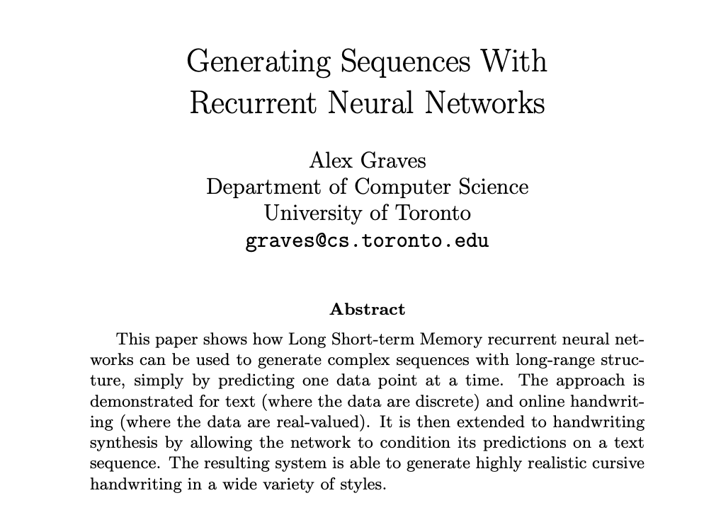

Slide 35
How can it be used? – e.g. Machine Translation Sequence to Sequence – Encoding – Decoding – Many to Many mapping
DURING TRAINING
The
world
is
not
enough
<END>
$$y_{1}$$
$$y_{2}$$
$$y_{3}$$
$$y_{4}$$
$$y_{5}$$
$$y_{6}$$
$$h_{1}$$
$$h_{2}$$
$$h_{3}$$
$$h_{4}$$
$$h_{5}$$
$$h_{6}$$
$$h_{0}$$
RNN
$$h_{1}$$
RNN
$$h_{2}$$
RNN
$$h_{3}$$
RNN
$$h_{4}$$
RNN
$$h_{5}$$
RNN
$$h_{0}$$
RNN
$$h_{1}$$
RNN
$$h_{2}$$
RNN
$$h_{3}$$
RNN
$$h_{4}$$
RNN
$$h_{5}$$
RNN
$$x_{1}$$
$$x_{2}$$
$$x_{3}$$
$$x_{4}$$
$$x_{5}$$
$$x_{6}$$
$$x_{1}$$
$$x_{2}$$
$$x_{3}$$
$$x_{4}$$
$$x_{5}$$
$$x_{6}$$
<START>
El
mundo
no
es
suficiente
<START>
The
world
is
not
enough

Slide 36
How can it be used? – e.g. Machine Translation
Sequence to Sequence Models
Input training examples don’t need to be the same length! In this case outputs can be.
input
output
<START> este restaurante tiene buena comida
this restaurant has good food <END>
<START> this restaurant has good food
<START> el mundo no es suficiente
the world is not enough <END>
<START> the world is not enough

Slide 37
How can it be used? – e.g. Machine Translation Sequence to Sequence – Encoding – Decoding – Many to Many mapping
DURING TRAINING – (Alternative)
The
world
is
not
enough
<END>
$$y_{1}$$
$$y_{2}$$
$$y_{3}$$
$$y_{4}$$
$$y_{5}$$
$$y_{6}$$
$$h_{1}$$
$$h_{2}$$
$$h_{3}$$
$$h_{4}$$
$$h_{5}$$
$$h_{6}$$
$$h_{0}$$
RNN
$$h_{1}$$
RNN
$$h_{2}$$
RNN
$$h_{3}$$
RNN
$$h_{4}$$
RNN
$$h_{5}$$
RNN
$$x_{1}$$
$$x_{2}$$
$$x_{3}$$
$$x_{4}$$
$$x_{5}$$
$$x_{6}$$
The
world
is
not
enough
$$h_{0}$$
RNN
$$h_{1}$$
RNN
$$h_{2}$$
RNN
$$h_{3}$$
RNN
$$h_{4}$$
RNN
$$h_{5}$$
RNN
$$x_{1}$$
$$x_{2}$$
$$x_{3}$$
$$x_{4}$$
$$x_{5}$$
$$x_{6}$$
<START>
El
mundo
no
es
suficiente

Slide 38
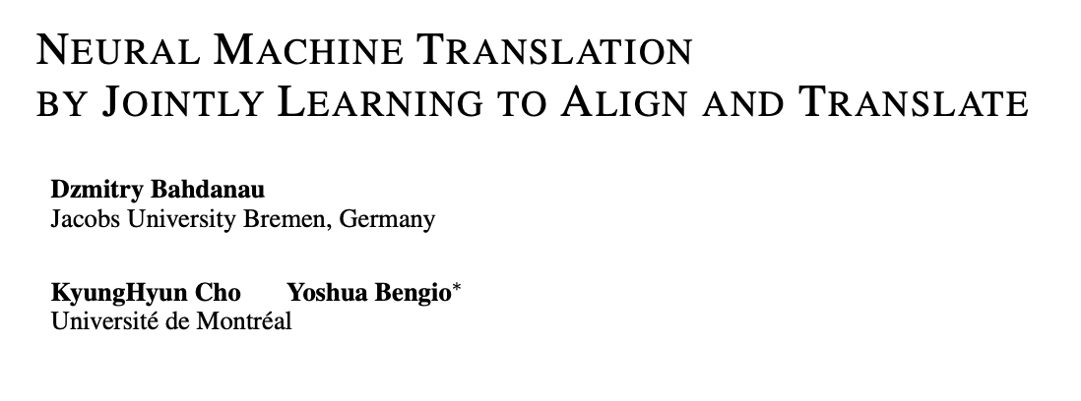

Slide 39
Bidirectional Recurrent Neural Network
<<pronoun>>
<<noun>>
<<verb>>
$$y_{1}$$
$$y_{2}$$
$$y_{3}$$
$$h_{1}$$
$$h_{2}$$
$$h_{3}$$
$$h_{0}$$
$$BRNN$$
$$h_{1}$$
$$BRNN$$
$$h_{2}$$
$$BRNN$$
$$h_{3}$$
$$x_{1}$$
$$x_{2}$$
$$x_{3}$$
the
cat
wants

Slide 40
Stacked Recurrent Neural Network
$$y_{1}$$
$$y_{2}$$
$$y_{3}$$
$$h_{1}$$
$$h_{2}$$
$$h_{3}$$
$$h_{0}$$
$$RNN$$
$$h_{1}$$
$$RNN$$
$$h_{2}$$
$$RNN$$
$$h_{3}$$
$${\check{h}}_{1}$$
$${\check{h}}_{2}$$
$${\check{h}}_{3}$$
$${\check{h}}_{0}$$
$$RNN$$
$${\check{h}}_{1}$$
$$RNN$$
$${\check{h}}_{2}$$
$$RNN$$
$${\check{h}}_{3}$$
$$x_{1}$$
$$x_{2}$$
$$x_{3}$$
c
a
t

Slide 41
Stacked Bidirectional Recurrent Neural Network
$$y_{1}$$
$$y_{2}$$
$$y_{3}$$
$$h_{1}$$
$$h_{2}$$
$$h_{3}$$
$$h_{0}$$
$$RNN$$
$$h_{1}$$
$$RNN$$
$$h_{2}$$
$$RNN$$
$$h_{3}$$
$${\check{h}}_{1}$$
$${\check{h}}_{2}$$
$${\check{h}}_{3}$$
$${\check{h}}_{0}$$
$$RNN$$
$${\check{h}}_{1}$$
$$RNN$$
$${\check{h}}_{2}$$
$$RNN$$
$${\check{h}}_{3}$$
$$x_{1}$$
$$x_{2}$$
$$x_{3}$$
c
a
t

Slide 42
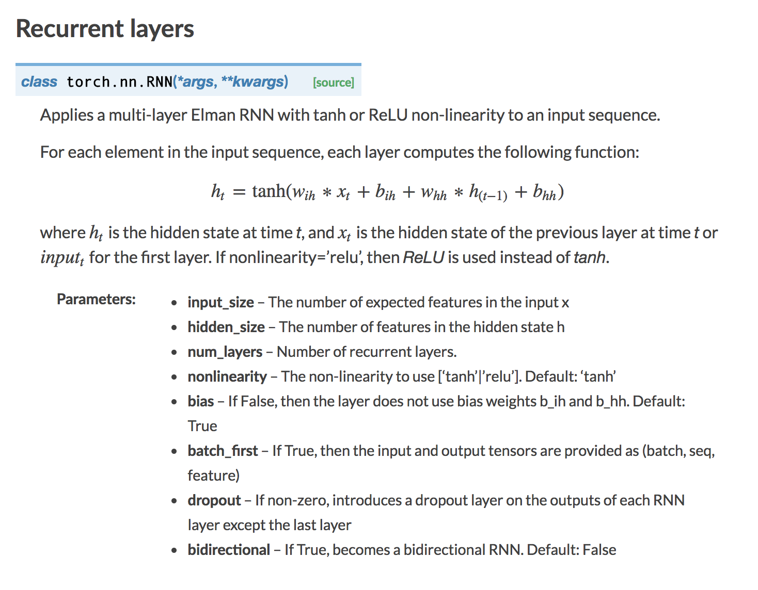
RNN in Pytorch

Slide 43
LSTM Cell (Long Short-Term Memory)
$$h_{0}$$
$$h_{1}$$
$$LSTM$$
$$c_{0}$$
$$c_{1}$$
$$x_{1}$$

Slide 44
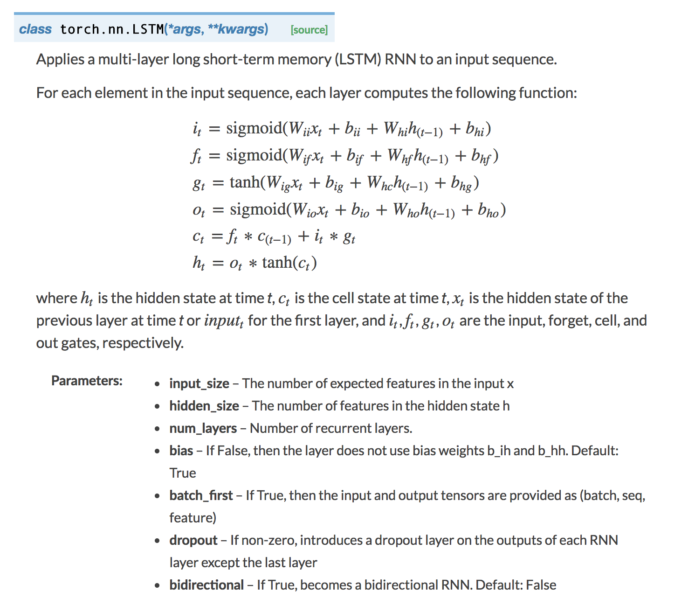
LSTM in Pytorch

Slide 45
GRU in Pytorch

Slide 46
RNNs for Image Caption Generation
The
world
is
not
enough
<END>
$$y_{1}$$
$$y_{2}$$
$$y_{3}$$
$$y_{4}$$
$$y_{5}$$
$$y_{6}$$
$$h_{1}$$
$$h_{2}$$
$$h_{3}$$
$$h_{4}$$
$$h_{5}$$
$$h_{6}$$
$$h_{0}$$
RNN
$$h_{1}$$
RNN
$$h_{2}$$
RNN
$$h_{3}$$
RNN
$$h_{4}$$
RNN
$$h_{5}$$
RNN
$$x_{1}$$
$$x_{2}$$
$$x_{3}$$
$$x_{4}$$
$$x_{5}$$
$$x_{6}$$
The
world
is
not
enough
$$h_{0}$$
RNN
$$h_{1}$$
RNN
$$h_{2}$$
RNN
$$h_{3}$$
RNN
$$h_{4}$$
RNN
$$h_{5}$$
RNN
$$x_{1}$$
$$x_{2}$$
$$x_{3}$$
$$x_{4}$$
$$x_{5}$$
$$x_{6}$$
<START>
El
mundo
no
es
suficiente

Slide 47
RNNs for Image Caption Generation
Nice
view
of
sunny
beach
<END>
$$y_{1}$$
$$y_{2}$$
$$y_{3}$$
$$y_{4}$$
$$y_{5}$$
$$y_{6}$$
$$h_{1}$$
$$h_{2}$$
$$h_{3}$$
$$h_{4}$$
$$h_{5}$$
$$h_{6}$$
$$h_{0}$$
RNN
$$h_{1}$$
RNN
$$h_{2}$$
RNN
$$h_{3}$$
RNN
$$h_{4}$$
RNN
$$h_{5}$$
RNN
$$x_{1}$$
$$x_{2}$$
$$x_{3}$$
$$x_{4}$$
$$x_{5}$$
$$x_{6}$$
The
world
is
not
enough
CNN

Slide 48
References (a lot of them)
Vinyals et al. Show and Tell: A Neural Image Caption Generator https://arxiv.org/abs/1411.4555
Mao et al. Deep Captioning with Multimodal Recurrent Neural Networks (m-RNN). https://arxiv.org/abs/1412.6632
Karpathy and Fei-Fei. Deep Visual-Semantic Alignments for Generating Image Descriptions. https://arxiv.org/abs/1412.2306
Fang et al. From Captions to Visual Concepts and Back. https://arxiv.org/abs/1411.4952
Yin and Ordonez. Obj2Text: Generating Visually Descriptive Language from Object Layouts. https://arxiv.org/abs/1707.07102 (not exactly targeting image captioning specifically but locally grown paper so let me self-promote)

Slide 49
Questions?

