Slide 1
Deep Learning for Vision & Language
Transformers I: Introduction

Slide 2
Today
Sequence-to-sequence (RNNs) for Machine Translation
Learning to Align and Translate with Soft Attention
Image Captioning (CNNs + RNNs): Show and Tell
Image Captioning (CNNs + RNNs + Attention): Show Attend and Tell
Attention is All you Need!
Encoder Transformers: BERT
Decoder Transformers: GPT-2 – maybe next class

Slide 3






















RNNs – One-to-one sequence prediction
DT
NN
RB
VB
JJ
$$y_{1}$$
$$y_{2}$$
$$y_{3}$$
$$y_{4}$$
$$y_{5}$$
$$y_{6}$$
$$h_{1}$$
$$h_{2}$$
$$h_{3}$$
$$h_{4}$$
$$h_{5}$$
$$h_{6}$$
$$h_{0}$$
RNN
$$h_{1}$$
RNN
$$h_{2}$$
RNN
$$h_{3}$$
RNN
$$h_{4}$$
RNN
$$h_{5}$$
RNN
$$x_{1}$$
$$x_{2}$$
$$x_{3}$$
$$x_{4}$$
$$x_{5}$$
$$x_{6}$$
<START>
El
mundo
no
es
suficiente

Slide 4
RNNs – Sequence to score prediction
Classify
[English, German, Swiss German, Gaelic, Dutch, Afrikaans, Luxembourgish, Limburgish, other]
$$y_{6}$$
$$h_{6}$$
$$h_{0}$$
RNN
$$h_{1}$$
RNN
$$h_{2}$$
RNN
$$h_{3}$$
RNN
$$h_{4}$$
RNN
$$h_{5}$$
RNN
$$x_{1}$$
$$x_{2}$$
$$x_{3}$$
$$x_{4}$$
$$x_{5}$$
$$x_{6}$$
<START>
El
mundo
no
es
suficiente

Slide 5
RNNs for Text Generation (Auto-regressive)
The
world
is
not
enough
<END>
$$y_{1}$$
$$y_{2}$$
$$y_{3}$$
$$y_{4}$$
$$y_{5}$$
$$y_{6}$$
$$h_{1}$$
$$h_{2}$$
$$h_{3}$$
$$h_{4}$$
$$h_{5}$$
$$h_{6}$$
$$h_{0}$$
RNN
$$h_{1}$$
RNN
$$h_{2}$$
RNN
$$h_{3}$$
RNN
$$h_{4}$$
RNN
$$h_{5}$$
RNN
$$x_{1}$$
$$x_{2}$$
$$x_{3}$$
$$x_{4}$$
$$x_{5}$$
$$x_{6}$$
<START>
The
world
is
not
enough
+ Noise vector

Slide 6

RNNs for Machine Translation Seq-to-Seq
The
world
is
not
enough
<END>
$$y_{1}$$
$$y_{2}$$
$$y_{3}$$
$$y_{4}$$
$$y_{5}$$
$$y_{6}$$
$$h_{1}$$
$$h_{2}$$
$$h_{3}$$
$$h_{4}$$
$$h_{5}$$
$$h_{6}$$
$$h_{0}$$
RNN
$$h_{1}$$
RNN
$$h_{2}$$
RNN
$$h_{3}$$
RNN
$$h_{4}$$
RNN
$$h_{5}$$
RNN
$$x_{1}$$
$$x_{2}$$
$$x_{3}$$
$$x_{4}$$
$$x_{5}$$
$$x_{6}$$
The
world
is
not
enough
$$h_{6}$$
$$h_{0}$$
RNN
$$h_{1}$$
RNN
$$h_{2}$$
RNN
$$h_{3}$$
RNN
$$h_{4}$$
RNN
$$h_{5}$$
RNN
$$x_{1}$$
$$x_{2}$$
$$x_{3}$$
$$x_{4}$$
$$x_{5}$$
$$x_{6}$$
<START>
El
mundo
no
es
suficiente

Slide 7



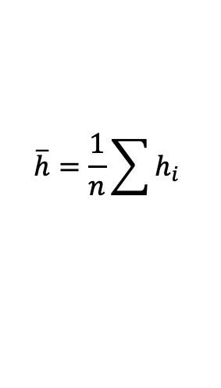




RNNs for Machine Translation Seq-to-Seq
The
world
is
not
enough
<END>
Perhaps a better idea is to
compute the average h vector across all steps
and pass this to the decoder
$$y_{1}$$
$$y_{2}$$
$$y_{3}$$
$$y_{4}$$
$$y_{5}$$
$$y_{6}$$
$$h_{1}$$
$$h_{2}$$
$$h_{3}$$
$$h_{4}$$
$$h_{5}$$
$$h_{6}$$
$$h_{0}$$
RNN
$$h_{1}$$
RNN
$$h_{2}$$
RNN
$$h_{3}$$
RNN
$$h_{4}$$
RNN
$$h_{5}$$
RNN
$$x_{1}$$
$$x_{2}$$
$$x_{3}$$
$$x_{4}$$
$$x_{5}$$
$$x_{6}$$
The
world
is
not
enough
$$\overline{h}$$
$$h_{1}$$
$$h_{2}$$
$$h_{3}$$
$$h_{4}$$
$$h_{5}$$
$$h_{6}$$
$$\overline{h}=\frac{1}{n}\sum{h_{i}}$$
$$h_{0}$$
RNN
$$h_{1}$$
RNN
$$h_{2}$$
RNN
$$h_{3}$$
RNN
$$h_{4}$$
RNN
$$h_{5}$$
RNN
$$x_{1}$$
$$x_{2}$$
$$x_{3}$$
$$x_{4}$$
$$x_{5}$$
$$x_{6}$$
<START>
El
mundo
no
es
suficiente

Slide 8
RNNs for Machine Translation Seq-to-Seq
The
world
is
not
enough
<END>
Perhaps an even better idea is to
compute the average h vector across all steps
and pass this to the decoder at each time
step in the decoder!
$$y_{1}$$
$$y_{2}$$
$$y_{3}$$
$$y_{4}$$
$$y_{5}$$
$$y_{6}$$
$$h_{1}$$
$$h_{2}$$
$$h_{3}$$
$$h_{4}$$
$$h_{5}$$
$$h_{6}$$
$$h_{0}$$
RNN
$$h_{1}$$
RNN
$$h_{2}$$
RNN
$$h_{3}$$
RNN
$$h_{4}$$
RNN
$$h_{5}$$
RNN
$$x_{1}$$
$$x_{2}$$
$$x_{3}$$
$$x_{4}$$
$$x_{5}$$
$$x_{6}$$
The
world
is
not
enough
$$\overline{h}$$
$$h_{1}$$
$$h_{2}$$
$$h_{3}$$
$$h_{4}$$
$$h_{5}$$
$$h_{6}$$
$$\overline{h}=\frac{1}{n}\sum{h_{i}}$$
$$h_{0}$$
RNN
$$h_{1}$$
RNN
$$h_{2}$$
RNN
$$h_{3}$$
RNN
$$h_{4}$$
RNN
$$h_{5}$$
RNN
$$x_{1}$$
$$x_{2}$$
$$x_{3}$$
$$x_{4}$$
$$x_{5}$$
$$x_{6}$$
<START>
El
mundo
no
es
suficiente

Slide 9
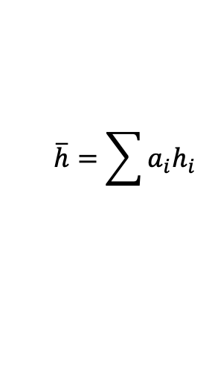
RNNs for Machine Translation Seq-to-Seq
The
world
is
not
enough
<END>
Perhaps an even better idea is to
compute the average h vector across all steps
and pass this to the decoder at each time
step in the decoder but using a weighted average
with learned weights!!
$$y_{1}$$
$$y_{2}$$
$$y_{3}$$
$$y_{4}$$
$$y_{5}$$
$$y_{6}$$
$$h_{1}$$
$$h_{2}$$
$$h_{3}$$
$$h_{4}$$
$$h_{5}$$
$$h_{6}$$
$$h_{0}$$
RNN
$$h_{1}$$
RNN
$$h_{2}$$
RNN
$$h_{3}$$
RNN
$$h_{4}$$
RNN
$$h_{5}$$
RNN
$$x_{1}$$
$$x_{2}$$
$$x_{3}$$
$$x_{4}$$
$$x_{5}$$
$$x_{6}$$
The
world
is
not
enough
$$\overline{h}$$
$$h_{1}$$
$$h_{2}$$
$$h_{3}$$
$$h_{4}$$
$$h_{5}$$
$$h_{6}$$
$$\overline{h}=\sum{a_{i}h_{i}}$$
$$h_{0}$$
RNN
$$h_{1}$$
RNN
$$h_{2}$$
RNN
$$h_{3}$$
RNN
$$h_{4}$$
RNN
$$h_{5}$$
RNN
$$x_{1}$$
$$x_{2}$$
$$x_{3}$$
$$x_{4}$$
$$x_{5}$$
$$x_{6}$$
<START>
El
mundo
no
es
suficiente

Slide 10




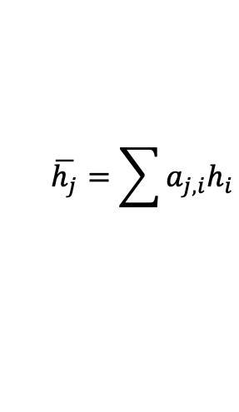






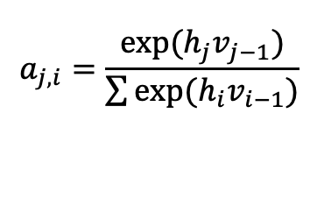
RNNs for Machine Translation Seq-to-Seq
Only showing the third time step encoder-decoder connection
The
world
is
not
enough
<END>
Perhaps an even better idea is to
compute the average h vector across all steps
and pass this to the decoder at each time
step in the decoder but using a weighted average
with learned weights, and the weights are specific
for each time step!!!
$$y_{1}$$
$$y_{2}$$
$$y_{3}$$
$$y_{4}$$
$$y_{5}$$
$$y_{6}$$
$$h_{1}$$
$$h_{2}$$
$$h_{3}$$
$$h_{4}$$
$$h_{5}$$
$$h_{6}$$
$$v_{0}$$
RNN
$$v_{1}$$
RNN
$$v_{2}$$
RNN
$$v_{3}$$
RNN
$$v_{4}$$
RNN
$$v_{5}$$
RNN
$$x_{1}$$
$$x_{2}$$
$$x_{3}$$
$$x_{4}$$
$$x_{5}$$
$$x_{6}$$
The
world
is
not
enough
$$\overline{h}$$
$$h_{1}$$
$$h_{2}$$
$$h_{3}$$
$$h_{4}$$
$$h_{5}$$
$$h_{6}$$
$$\overline{h_{j}}=\sum{a_{j,i}h_{i}}$$
RNN
RNN
RNN
RNN
RNN
RNN
such that:
$$h_{0}$$
$$h_{1}$$
$$h_{2}$$
$$h_{3}$$
$$h_{4}$$
$$h_{5}$$
$$a_{j,i}=\frac{exp⁡(h_{j}v_{j−1})}{\sum{exp⁡(h_{i}v_{i−1})}}$$
$$x_{1}$$
$$x_{2}$$
$$x_{3}$$
$$x_{4}$$
$$x_{5}$$
$$x_{6}$$
<START>
El
mundo
no
es
suficiente

Slide 11
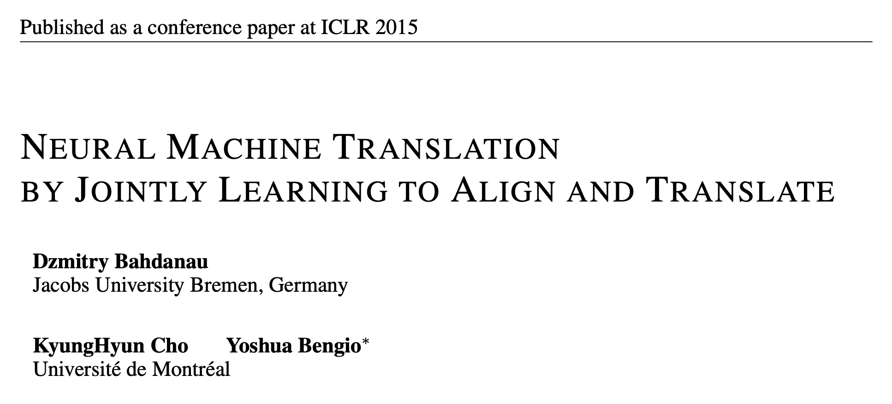
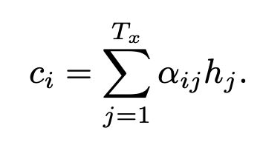
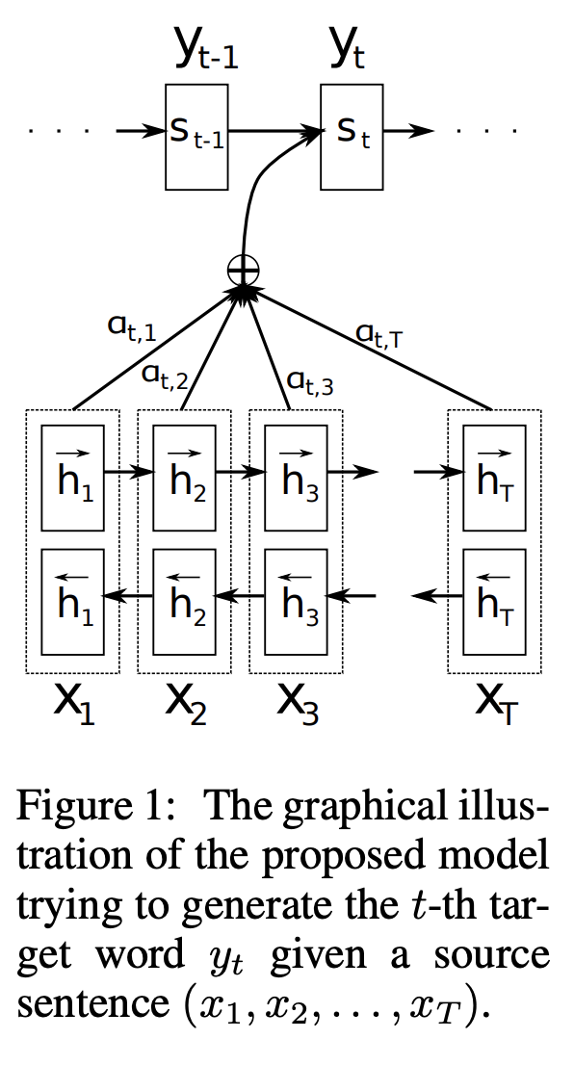
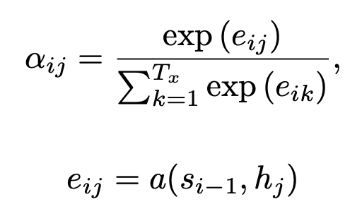
Let’s take a look at one of the first papers introducing this idea.

Slide 12
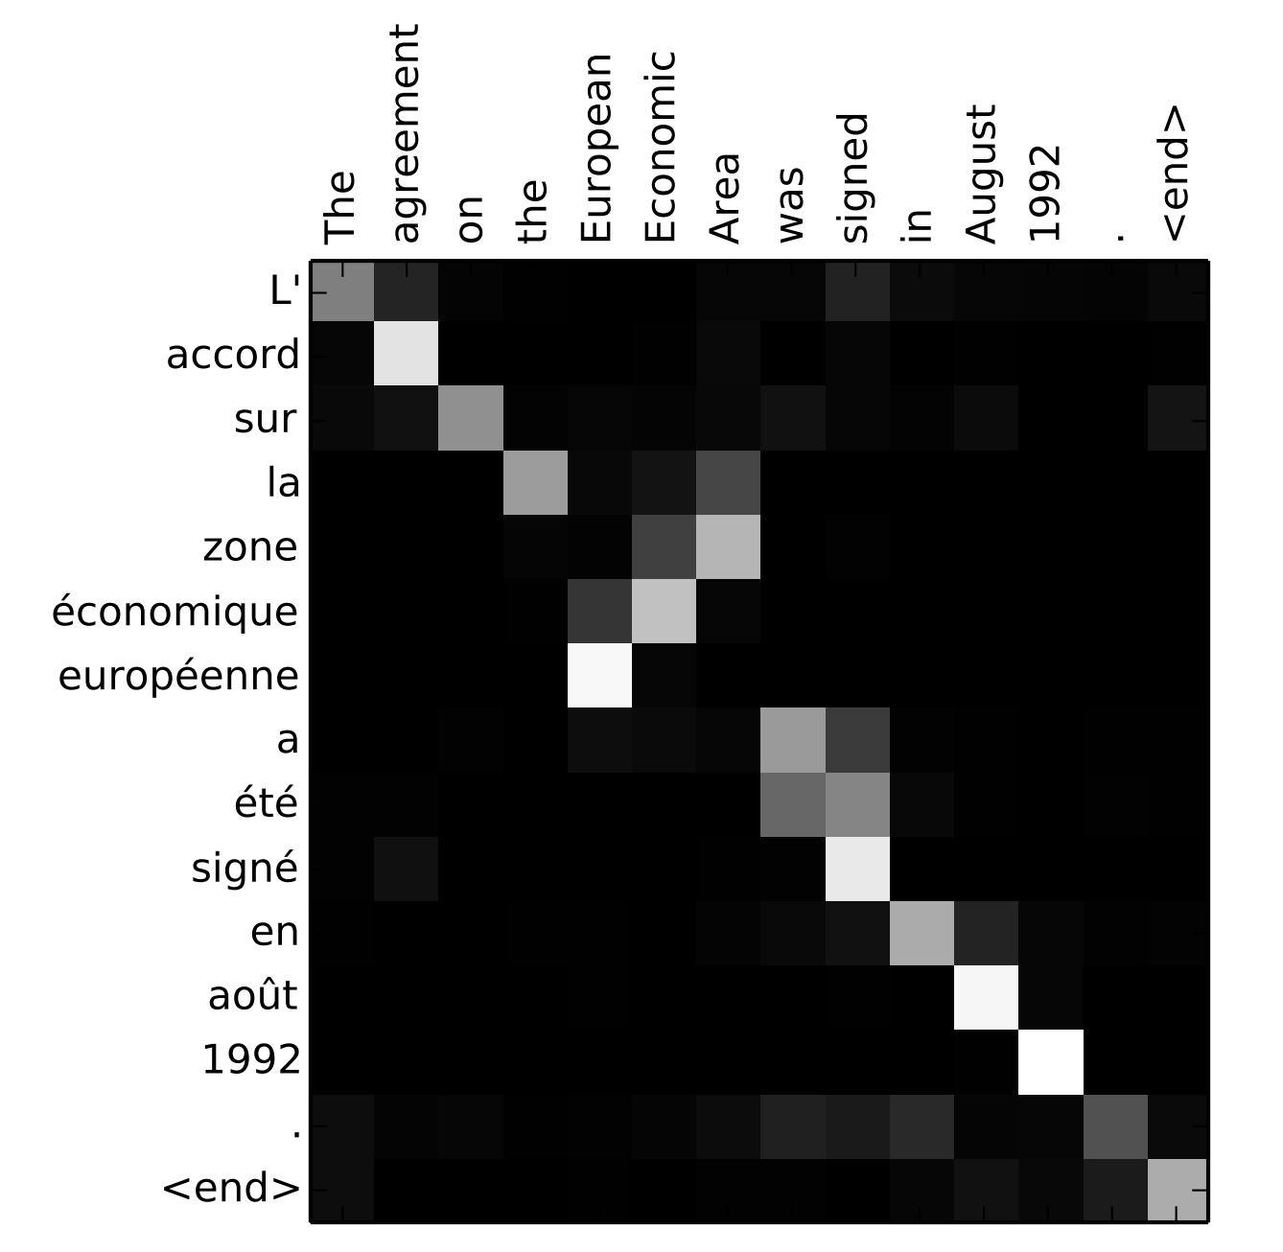
Let’s look at the Attention weights

Slide 13
CNNs + RNNs for Image Captioning
Vinyals et al. Show and Tell: A Neural Image Caption Generator https://arxiv.org/abs/1411.4555
Nice
view
of
sunny
beach
<END>
$$y_{1}$$
$$y_{2}$$
$$y_{3}$$
$$y_{4}$$
$$y_{5}$$
$$y_{6}$$
$$h_{1}$$
$$h_{2}$$
$$h_{3}$$
$$h_{4}$$
$$h_{5}$$
$$h_{6}$$
$$h_{0}$$
RNN
$$h_{1}$$
RNN
$$h_{2}$$
RNN
$$h_{3}$$
RNN
$$h_{4}$$
RNN
$$h_{5}$$
RNN
$$x_{1}$$
$$x_{2}$$
$$x_{3}$$
$$x_{4}$$
$$x_{5}$$
$$x_{6}$$
The
world
is
not
enough
CNN

Slide 14
References (a lot of them)
Vinyals et al. Show and Tell: A Neural Image Caption Generator https://arxiv.org/abs/1411.4555
Mao et al. Deep Captioning with Multimodal Recurrent Neural Networks (m-RNN). https://arxiv.org/abs/1412.6632
Karpathy and Fei-Fei. Deep Visual-Semantic Alignments for Generating Image Descriptions. https://arxiv.org/abs/1412.2306
Fang et al. From Captions to Visual Concepts and Back. https://arxiv.org/abs/1411.4952
Yin and Ordonez. OBJ2TEXT: Generating Visually Descriptive Language from Object Layouts. https://arxiv.org/abs/1707.07102 (not exactly targeting image captioning specifically but locally grown paper so let me self-promote)

Slide 15

CNNs + RNNs for Image Captioning w/ Attention
Only showing the third time step encoder-decoder connection
Xu et al. Show, Attend and Tell: Neural Image Caption Generation with Visual Attention
https://arxiv.org/abs/1502.03044
world
is
not
enough
<END>
The
$$y_{1}$$
$$y_{2}$$
$$y_{3}$$
$$y_{4}$$
$$y_{5}$$
$$y_{6}$$
$$h_{1}$$
$$h_{2}$$
$$h_{3}$$
$$h_{4}$$
$$h_{5}$$
$$h_{6}$$
$$v_{0}$$
RNN
$$v_{1}$$
RNN
$$v_{2}$$
RNN
$$v_{3}$$
RNN
$$v_{4}$$
RNN
$$v_{5}$$
RNN
$$x_{1}$$
$$x_{2}$$
$$x_{3}$$
$$x_{4}$$
$$x_{5}$$
$$x_{6}$$
The
world
is
not
enough
$$\overline{h}$$
$$h_{1}$$
$$h_{2}$$
$$h_{3}$$
$$h_{4}$$
$$h_{5}$$
$$h_{6}$$
convert to 49 vectors of size 512 and those become
$$h_{i}$$
CNN
output tensor of size CxHxW e.g. 512x7x7

Slide 16
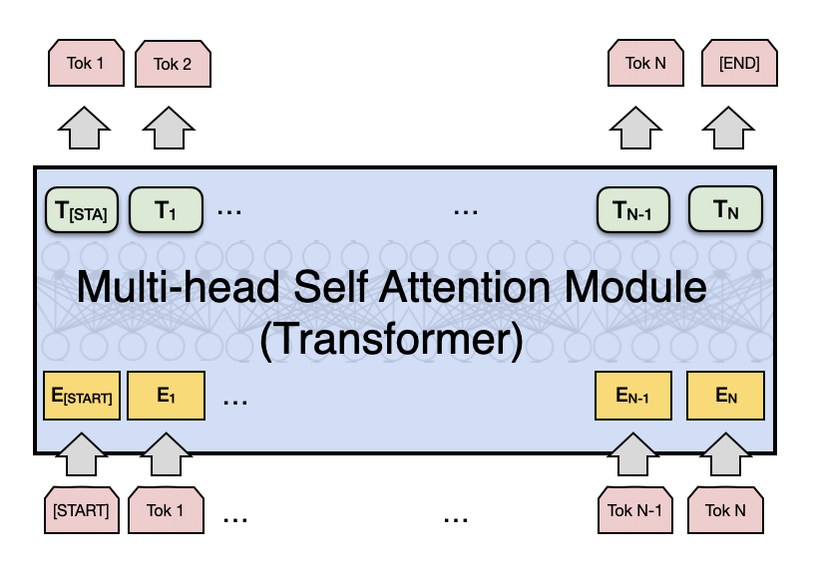
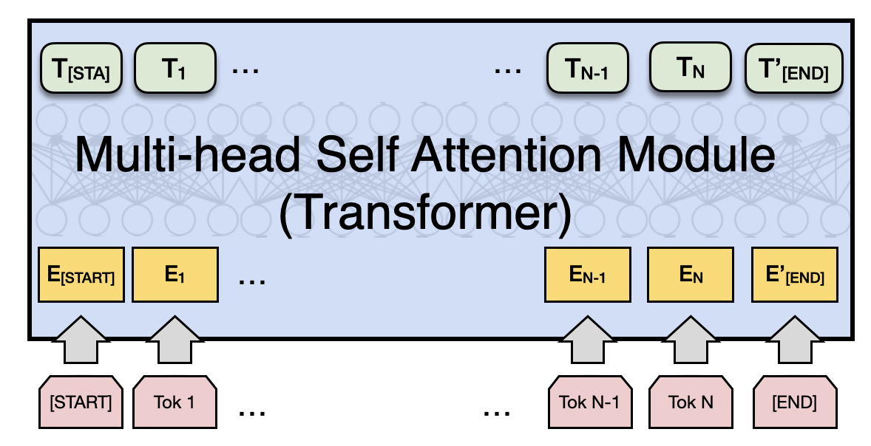
Attention is All you Need (no RNNs)
Vaswani et al. Attention is all you need
https://arxiv.org/abs/1706.03762
Decoder
Encoder
Fixed number of input tokens
[but hey! we can always define a large enough length and add mask tokens]

Slide 17
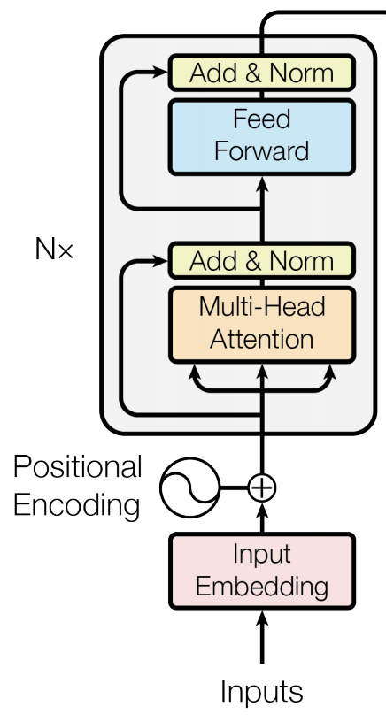
Attention is All you Need (no RNNs)
Vaswani et al. Attention is all you need
https://arxiv.org/abs/1706.03762
Decoder
Encoder
Fixed number of input tokens
[but hey! we can always define a large enough length and add mask tokens]

Slide 18
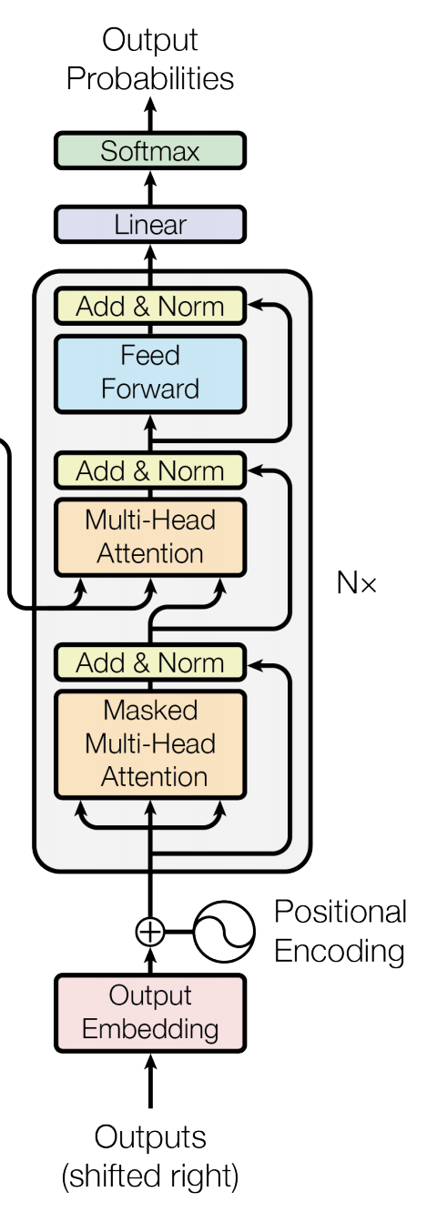
Attention is All you Need (no RNNs)
Vaswani et al. Attention is all you need
https://arxiv.org/abs/1706.03762
Decoder
Encoder
Fixed number of input tokens
[but hey! we can always define a large enough length and add mask tokens]

Slide 19
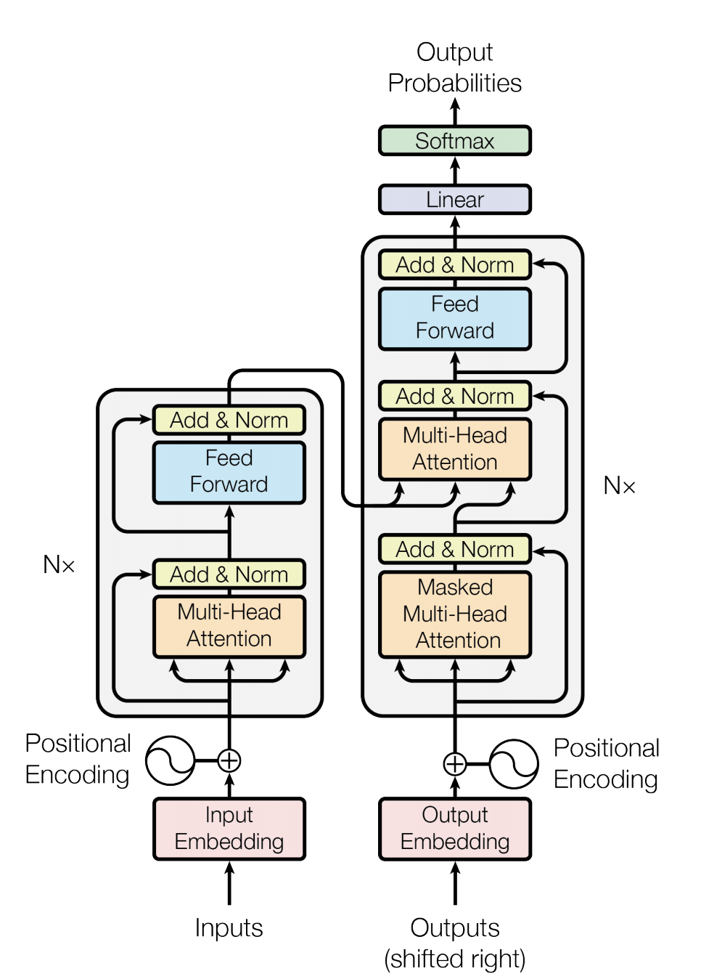
We can also draw this as in the paper:
Vaswani et al. Attention is all you need
https://arxiv.org/abs/1706.03762

Slide 20
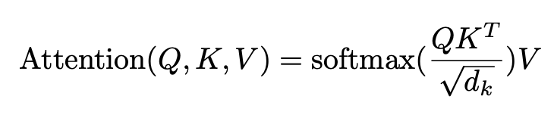
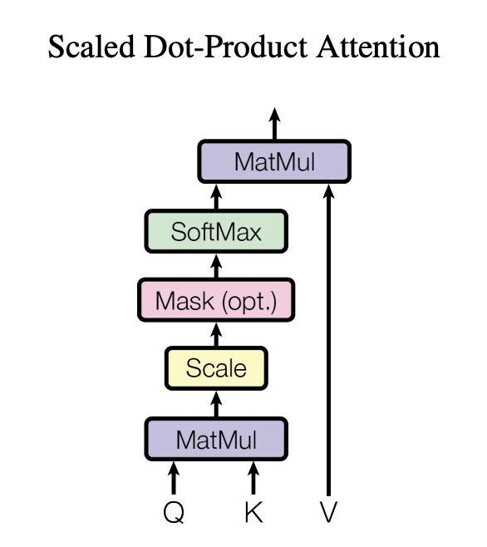
Regular Attention: + Scaling factor
Vaswani et al. Attention is all you need
https://arxiv.org/abs/1706.03762

Slide 21
This is not unlike what we already used before
Only showing the third time step encoder-decoder connection
The
world
is
not
enough
<END>
V: those are h’s here
Q: those are h’s here
K: those are v’s here
$$y_{1}$$
$$y_{2}$$
$$y_{3}$$
$$y_{4}$$
$$y_{5}$$
$$y_{6}$$
$$h_{1}$$
$$h_{2}$$
$$h_{3}$$
$$h_{4}$$
$$h_{5}$$
$$h_{6}$$
$$v_{0}$$
RNN
$$v_{1}$$
RNN
$$v_{2}$$
RNN
$$v_{3}$$
RNN
$$v_{4}$$
RNN
$$v_{5}$$
RNN
$$x_{1}$$
$$x_{2}$$
$$x_{3}$$
$$x_{4}$$
$$x_{5}$$
$$x_{6}$$
The
world
is
not
enough
$$\overline{h}$$
$$h_{1}$$
$$h_{2}$$
$$h_{3}$$
$$h_{4}$$
$$h_{5}$$
$$h_{6}$$
$$\overline{h_{j}}=\sum{a_{j,i}h_{i}}$$
RNN
RNN
RNN
RNN
RNN
RNN
such that:
$$h_{0}$$
$$h_{1}$$
$$h_{2}$$
$$h_{3}$$
$$h_{4}$$
$$h_{5}$$
$$a_{j,i}=\frac{exp⁡(h_{j}v_{j−1})}{\sum{exp⁡(h_{i}v_{i−1})}}$$
$$x_{1}$$
$$x_{2}$$
$$x_{3}$$
$$x_{4}$$
$$x_{5}$$
$$x_{6}$$
<START>
El
mundo
no
es
suficiente

Slide 22
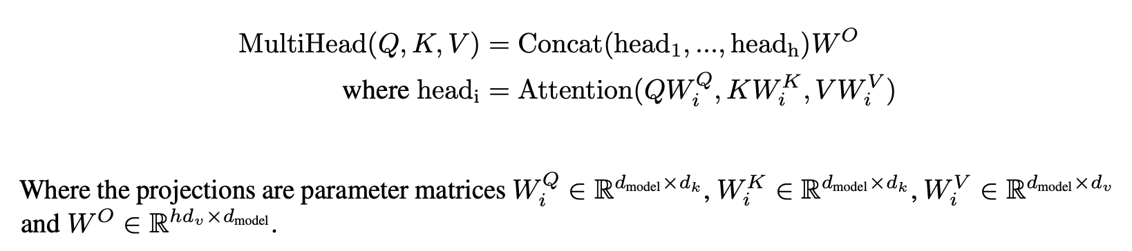
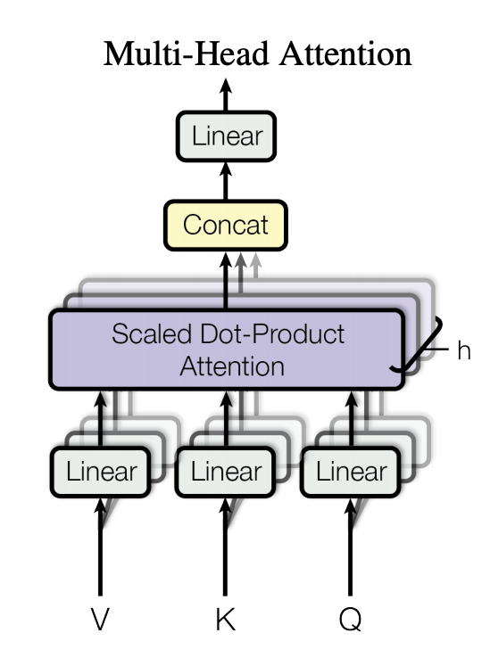
Multi-head Attention: Do not settle for just one set of attention weights.
Vaswani et al. Attention is all you need
https://arxiv.org/abs/1706.03762

Slide 23
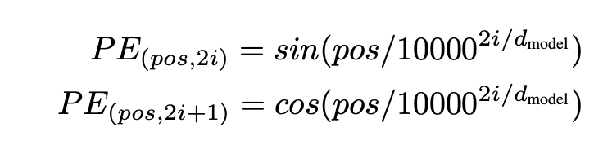
We can lose track of position since we are aggregating across all locations
Vaswani et al. Attention is all you need
https://arxiv.org/abs/1706.03762

Slide 24
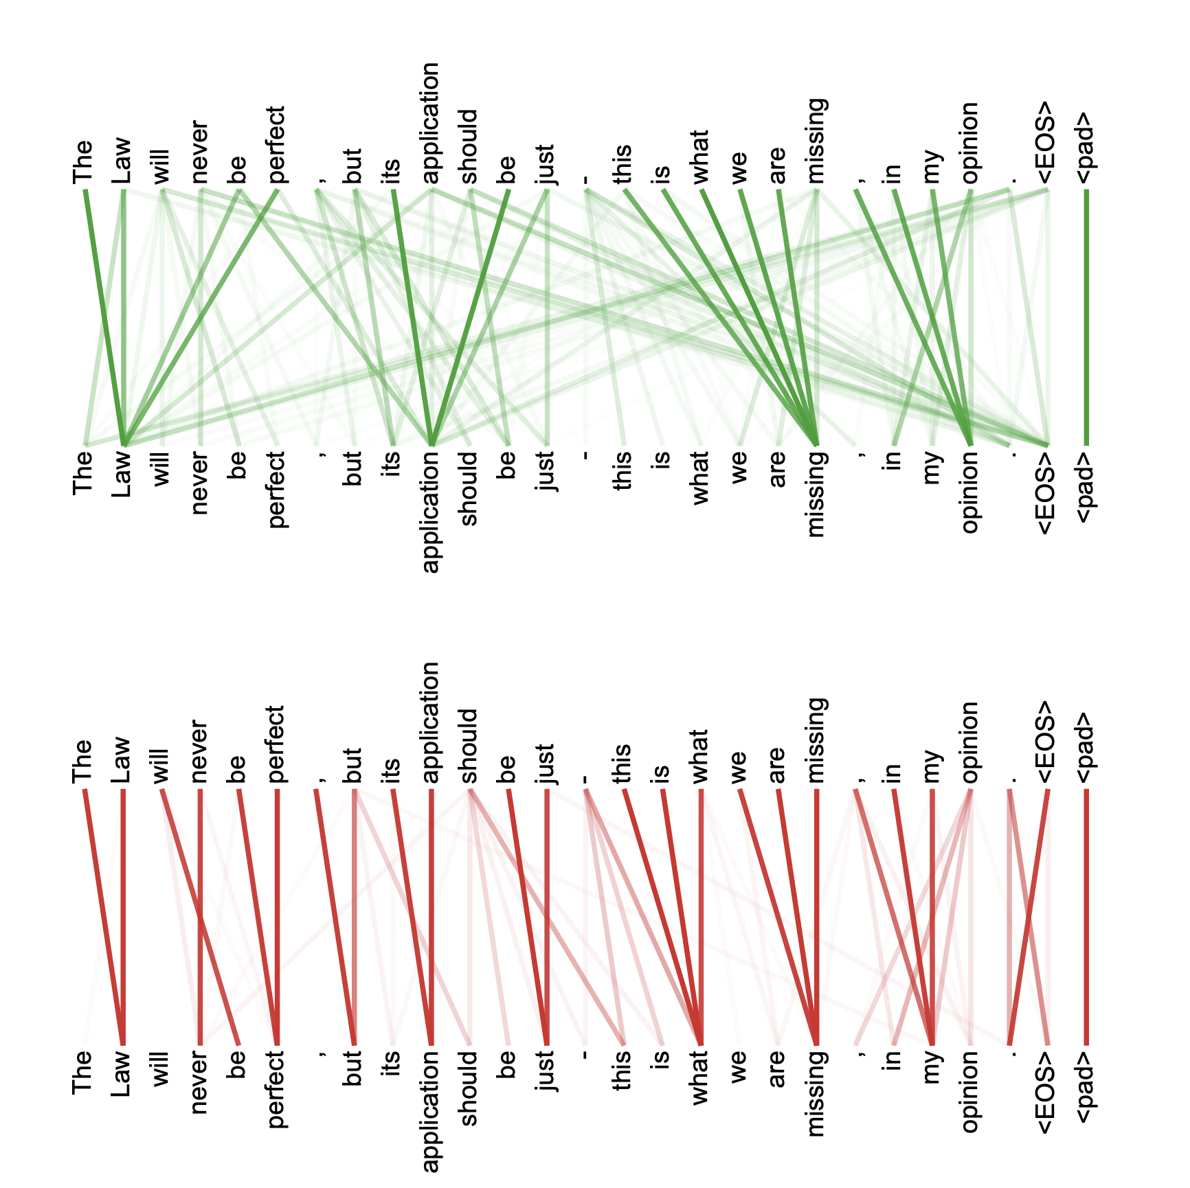
Multi-headed attention weights are harder to interpret obviously

Slide 25
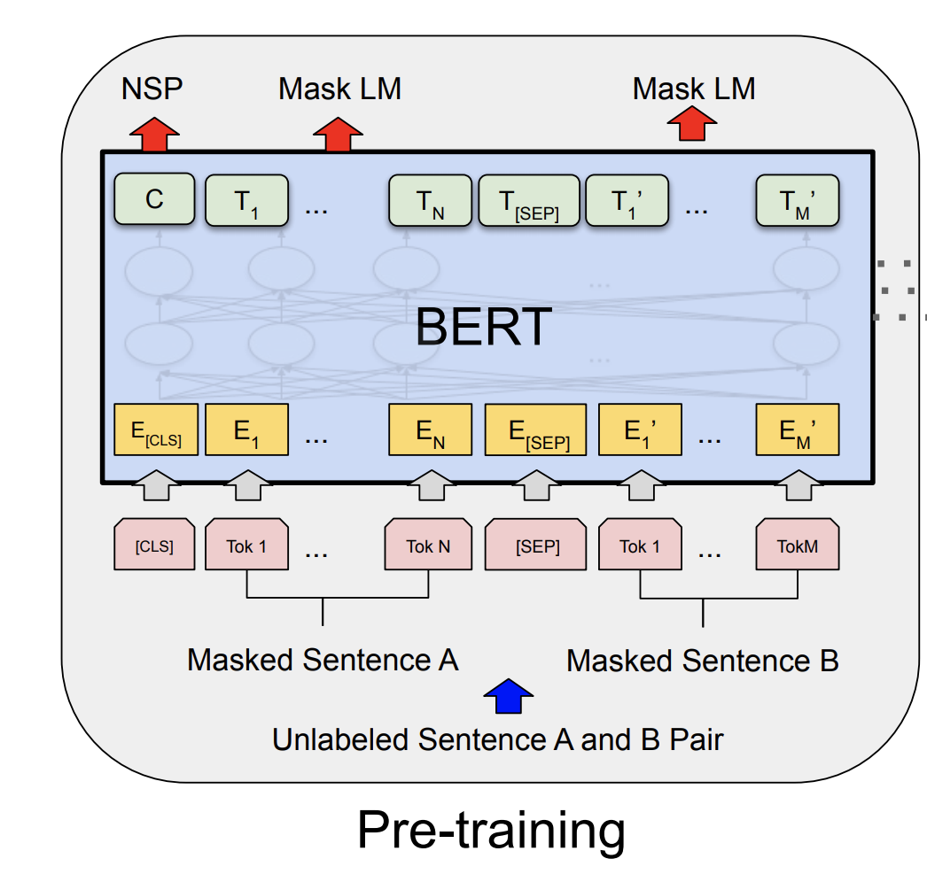
The BERT Encoder Model
Devlin et al. BERT: Pre-training of Deep Bidirectional Transformers for Language Understanding . https://arxiv.org/abs/1810.04805
Important things to know
No decoder
Train the model to fill-in-the-blank by masking some of the input tokens and trying to recover the full sentence.
The input is not one sentence but two sentences separated by a [SEP] token.
Also try to predict whether these two input sentences are consecutive or not.

Slide 26
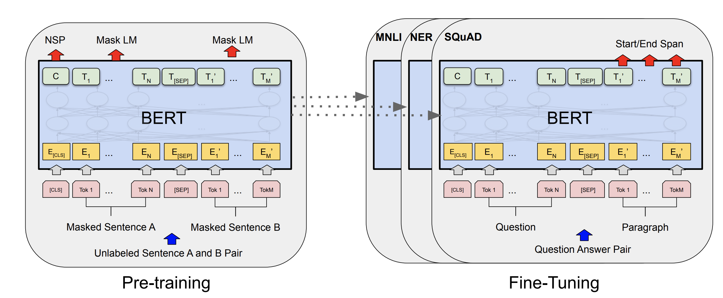
The BERT Encoder Model
Devlin et al. BERT: Pre-training of Deep Bidirectional Transformers for Language Understanding . https://arxiv.org/abs/1810.04805

Slide 27
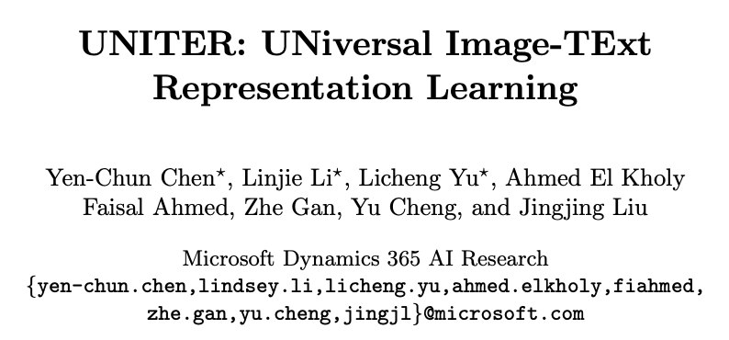
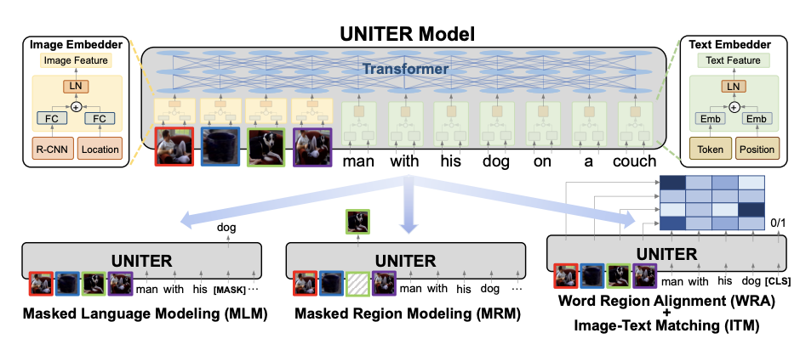

Reading for you (apart from mentioned papers)

Slide 28
Questions?

