Slide 1
Video and Language

Slide 2
Today’s Class
Video:
Optical flow
Two-Stream Networks
CNN + LSTM
CNN + Temporal Pooling
3D CNNs

Slide 3
From images to videos
A video is a sequence of frames captured over time
Now our image data is a function of space (x, y) and time (t)

Slide 4
Why is motion useful?

Slide 5
Why is motion useful?

Slide 6
Optical flow
Definition: optical flow is the apparent motion of brightness patterns in the image
Note: apparent motion can be caused by lighting changes without any actual motion
Think of a uniform rotating sphere under fixed lighting vs. a stationary sphere under moving illumination
GOAL: Recover image motion at each pixel from optical flow
Source: Silvio Savarese

Slide 7
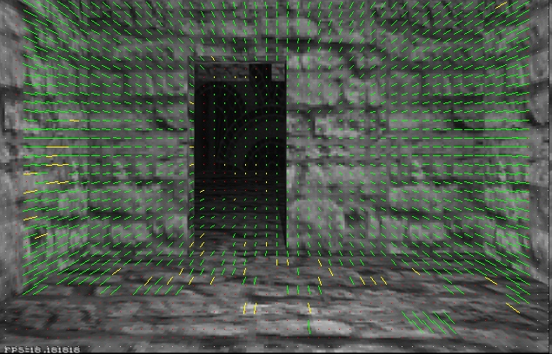
Optical flow
Vector field function of the spatio-temporal image brightness variations
Picture courtesy of Selim Temizer - Learning and Intelligent Systems (LIS) Group, MIT

Slide 8
Estimating optical flow
I(x,y,t–1)
I(x,y,t)
Given two subsequent frames, estimate the apparent motion field u(x,y), v(x,y) between them
Key assumptions
Brightness constancy: projection of the same point looks the same in every frame
Small motion: points do not move very far
Spatial coherence: points move like their neighbors
Source: Silvio Savarese

Slide 9
Key Assumptions: small motions

Slide 10
Key Assumptions: spatial coherence
* Slide from Michael Black, CS143 2003

Slide 11
Key Assumptions: brightness Constancy
* Slide from Michael Black, CS143 2003

Slide 12
The brightness constancy constraint
I(x,y,t–1)
I(x,y,t)
Brightness Constancy Equation:
Linearizing the right side using Taylor expansion:
Image derivative along x
Source: Silvio Savarese
Hence,

Slide 13
The brightness constancy constraint
B. Lucas and T. Kanade. An iterative image registration technique with an application to stereo vision. In Proceedings of the International Joint Conference on Artificial Intelligence, pp. 674–679, 1981.
I(x,y,t–1)
I(x,y,t)
Brightness Constancy Equation:
Linearizing the right side using Taylor expansion:
Image derivative along x
Source: Silvio Savarese
Hence,

Slide 14
Action Classification from Video
Recommended Paper to Read:

Slide 15
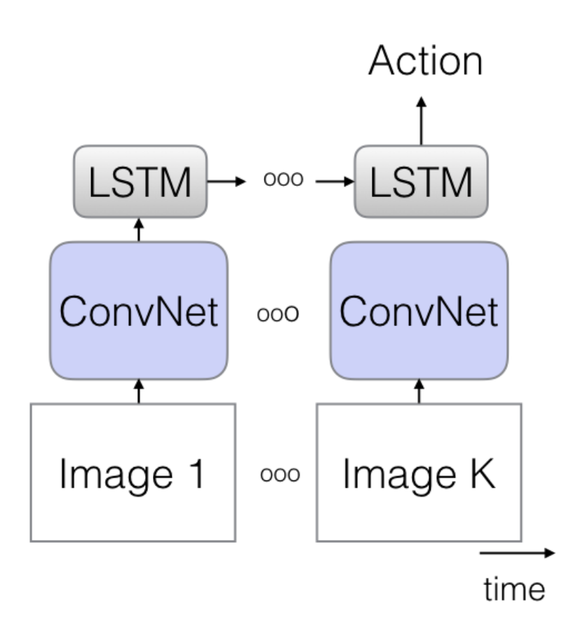
Action Classification from Video
CNN + LSTM over sequence of frames
Figure from Carreira & Zisserman, 2018

Slide 16
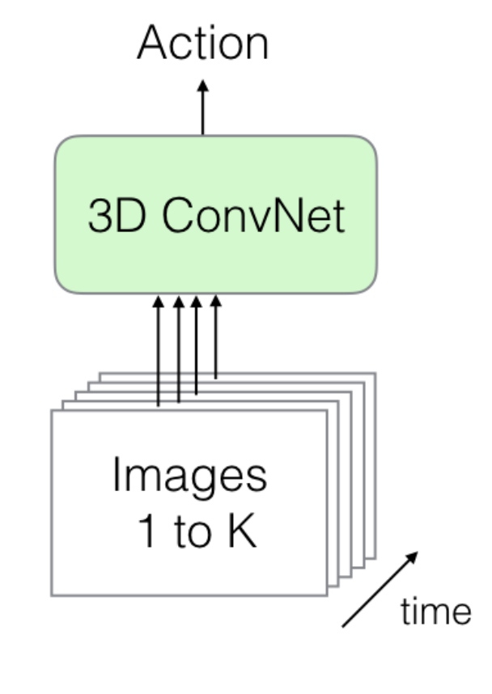
Action Classification from Video
3D CNN of consecutive frames across time
Figure from Carreira & Zisserman, 2018

Slide 17
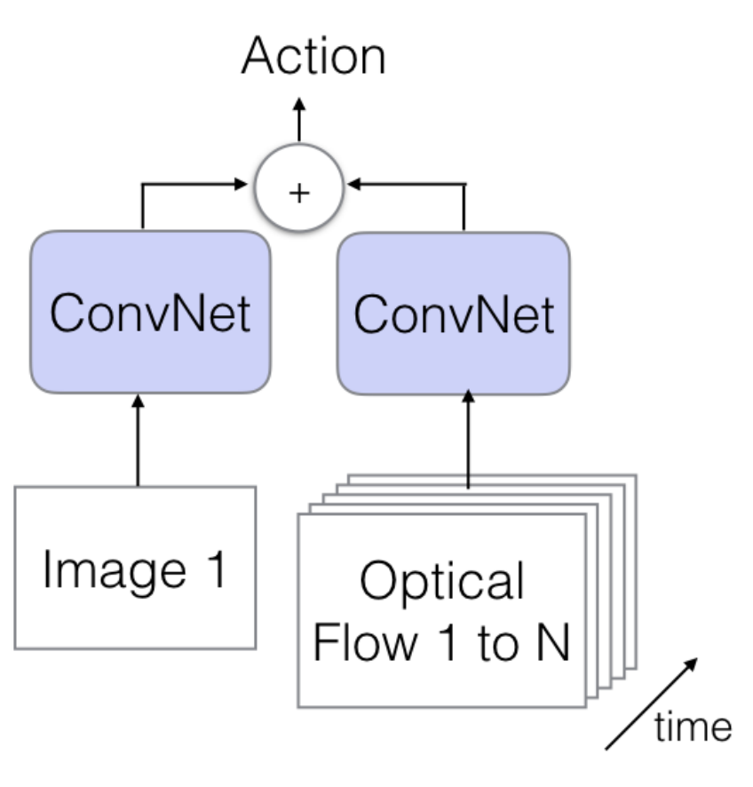
Action Classification from Video
Two Stream CNN: Images + Flow Map
Figure from Carreira & Zisserman, 2018

Slide 18
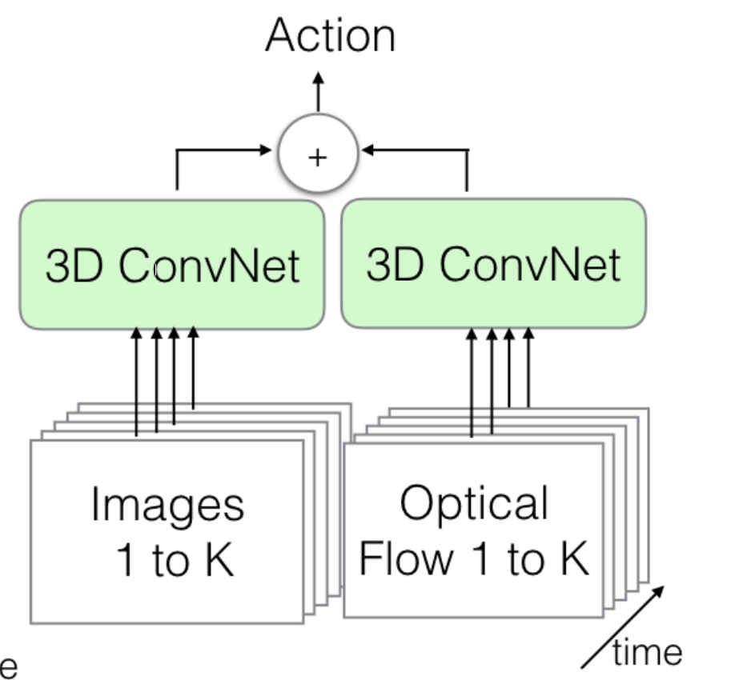
Action Classification from Video
Two Stream 3D CNN: Images + Flow Map
Figure from Carreira & Zisserman, 2018

Slide 19
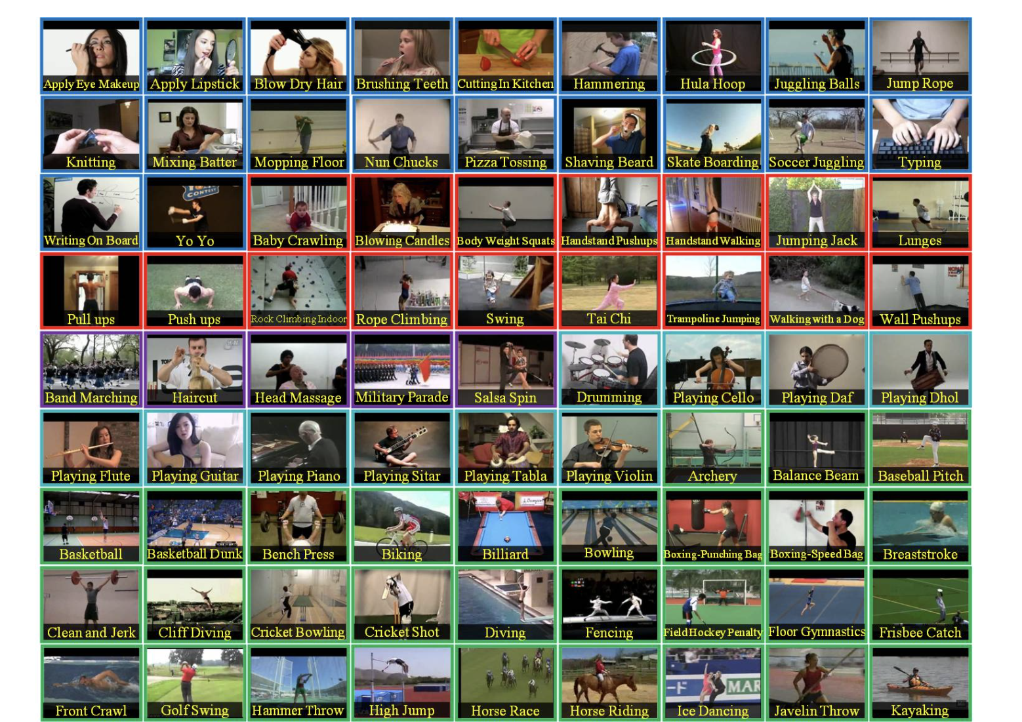
UCF-101 Action Dataset
https://www.crcv.ucf.edu/data/UCF101.php

Slide 20
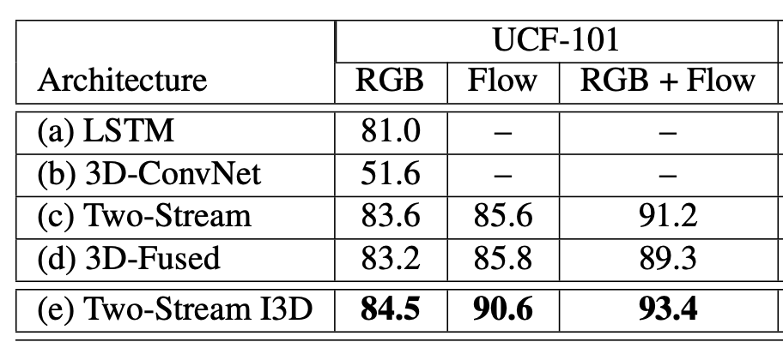
Action Classification from Video
Results on UCF101 actions
Figure from Carreira & Zisserman, 2018

Slide 21
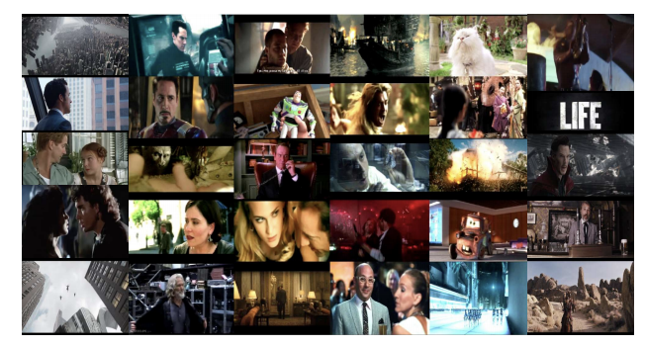
Movie Trailers
https://arxiv.org/abs/1908.03180

Slide 22
Movie Trailers
Movie Trailers
Movie Plots
Movie Posters
Movie Metadata
https://arxiv.org/abs/1908.03180

Slide 23
CNN + Temporal Pooling

Slide 24
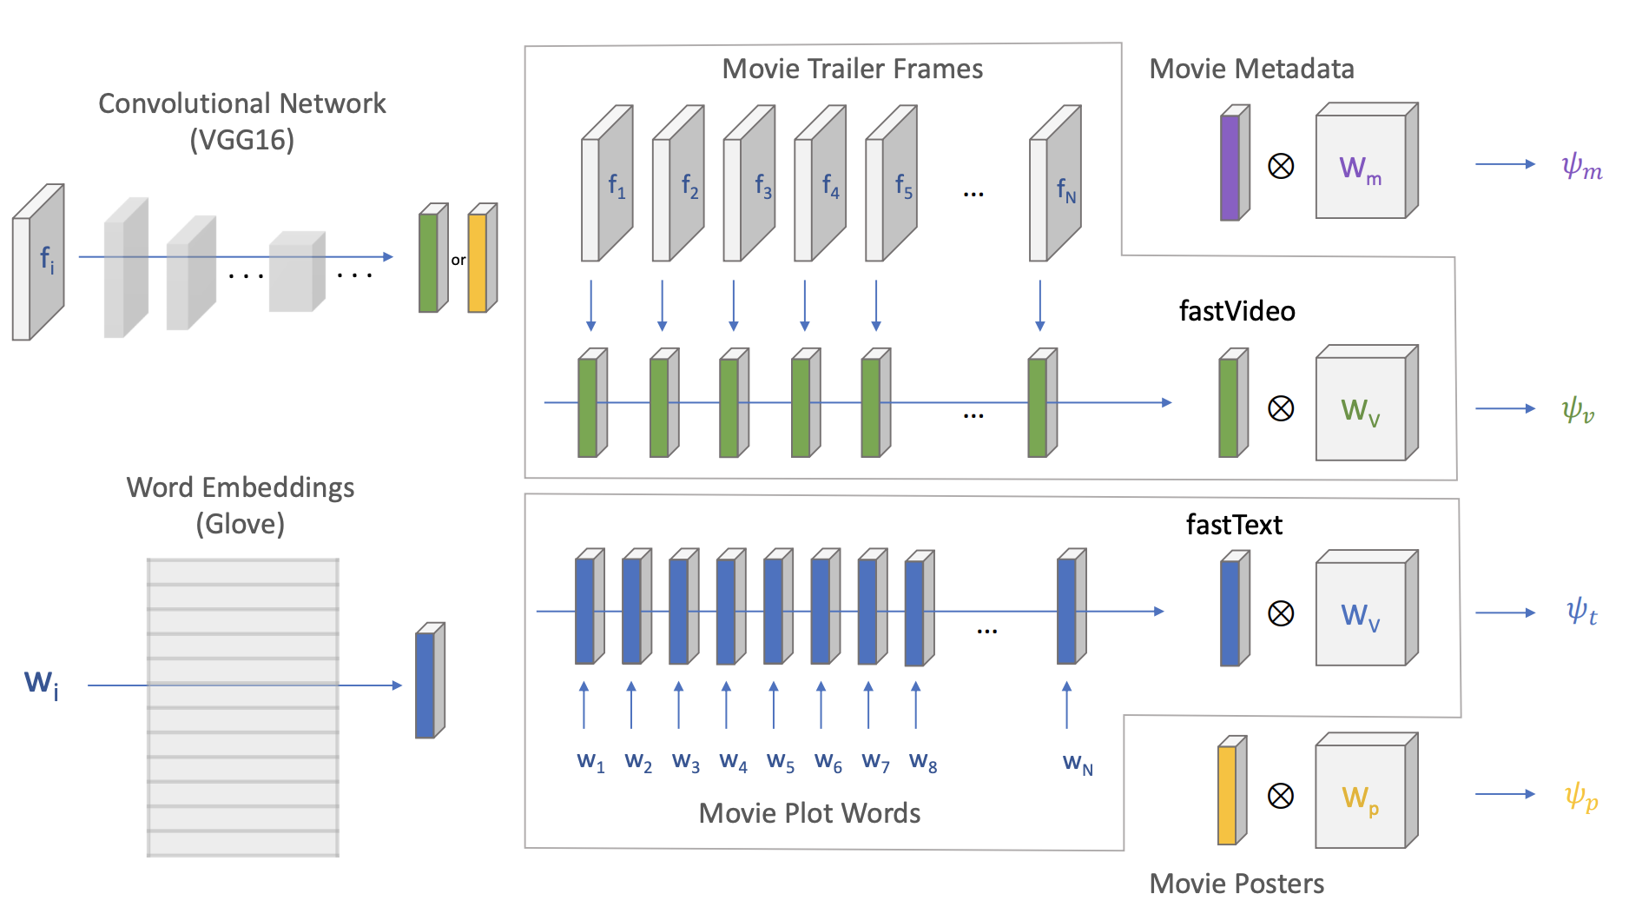
CNN + Temporal Pooling

Slide 25
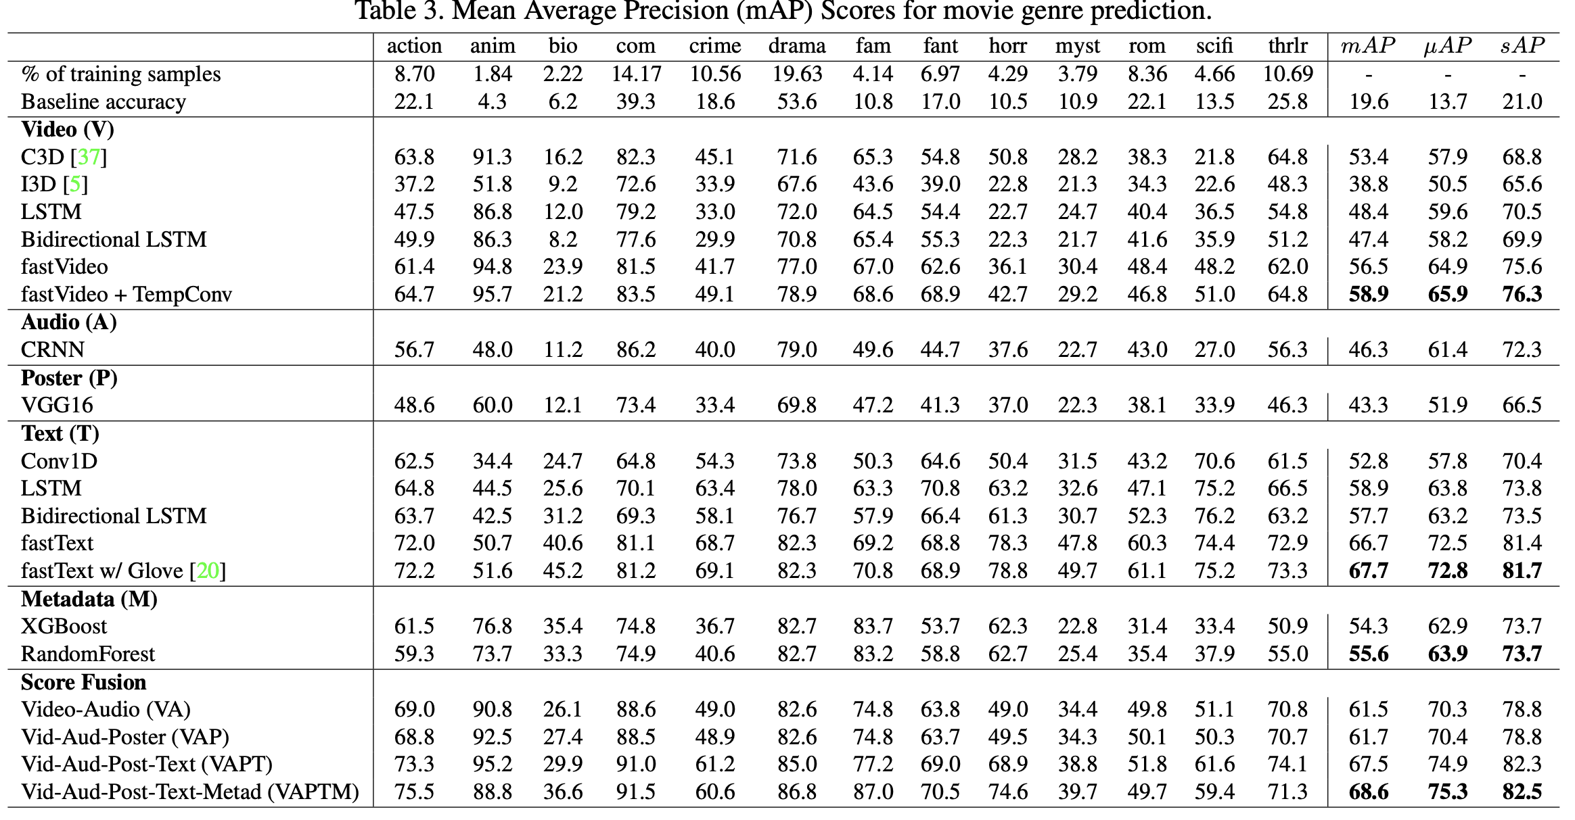
Results

Slide 26
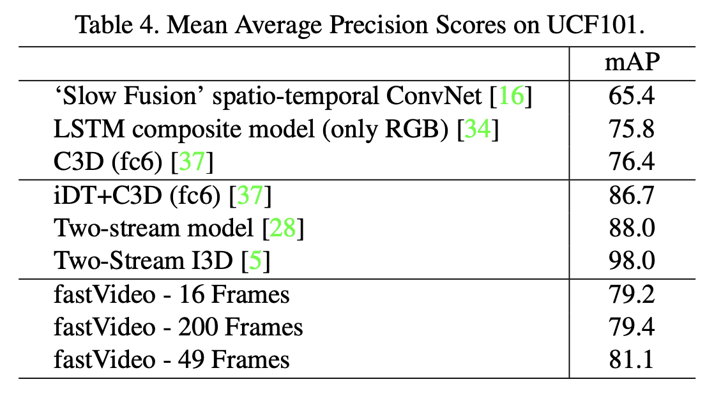
Results

Slide 27
Other Video and Language
Youtube videos with titles
http://aliensunmin.github.io/project/video-language/index.html#VTW
YouCook2 Dataset
http://youcook2.eecs.umich.edu/
MSRVTT: Microsoft Video and Text Dataset
https://www.microsoft.com/en-us/research/publication/msr-vtt-a-large-video-description-dataset-for-bridging-video-and-language/

Slide 28
Questions?

