Slide 1
Multimodal Machine Translation

Slide 2
Today’s Class
Brief overview on
  Multilingual Image Captioning
  Multimodal Machine Translation

Slide 3
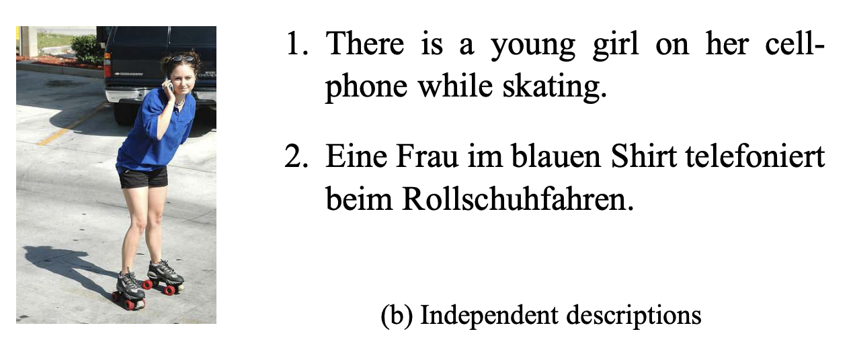
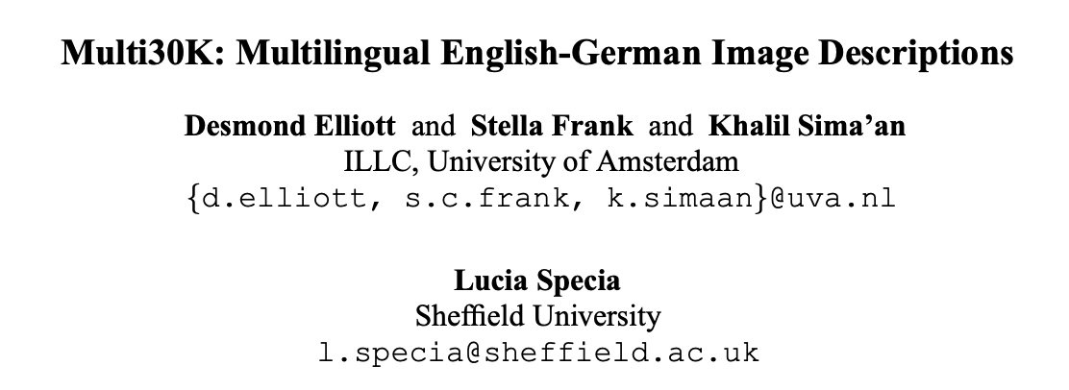
Multilingual Image Captioning
In the latest version
Captions in English and German
30,000 images
5 captions per image per language = 5 * 30,000 * 2
Images from the Flickr30k dataset
https://arxiv.org/abs/1605.00459

Slide 4
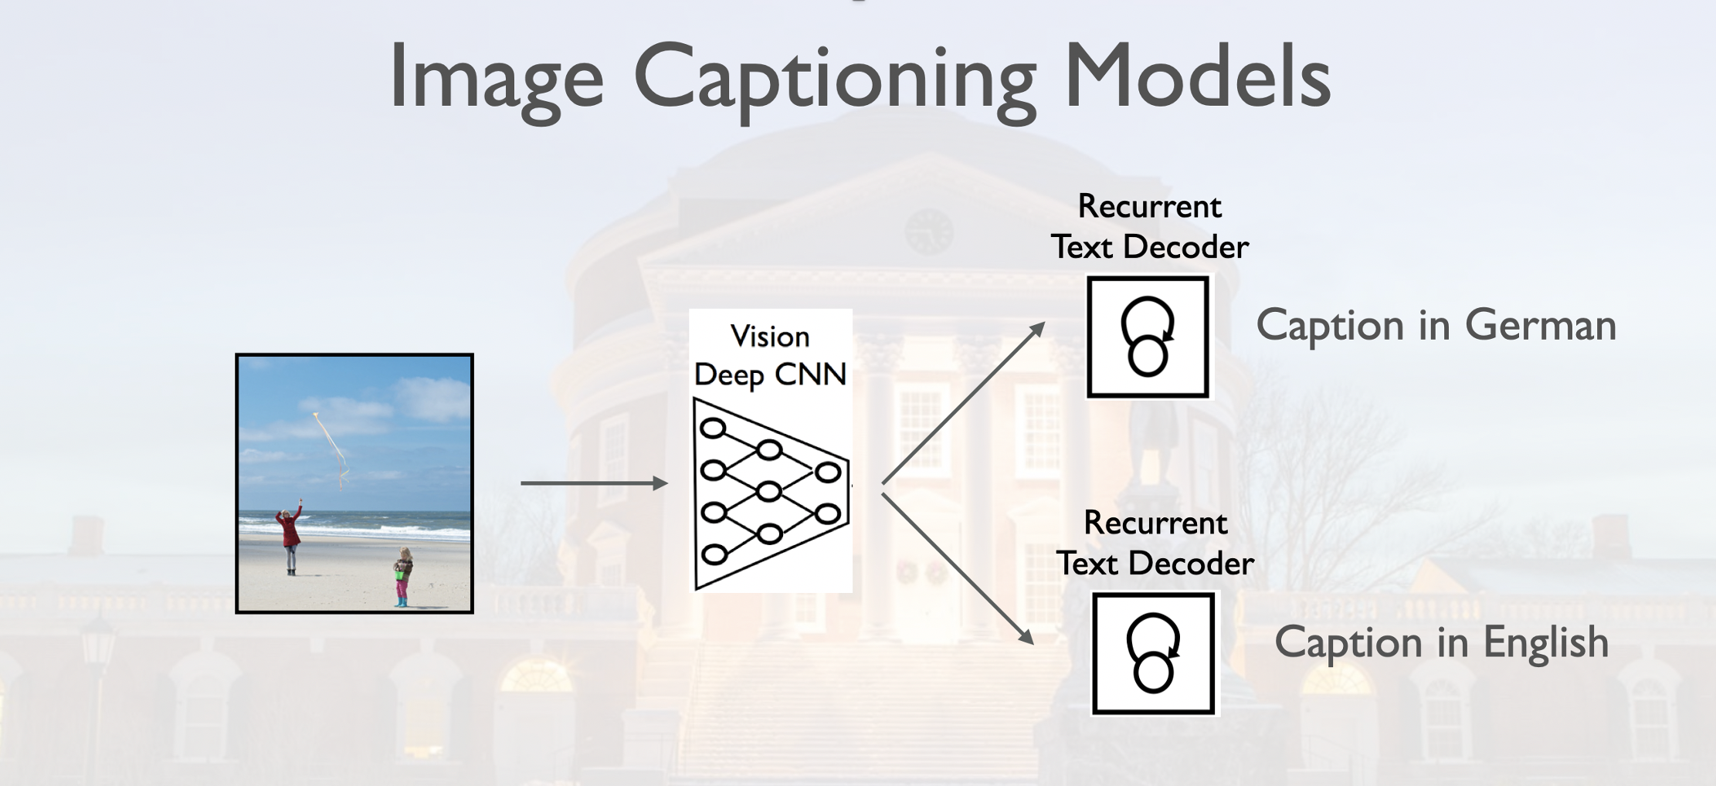

Slide 5
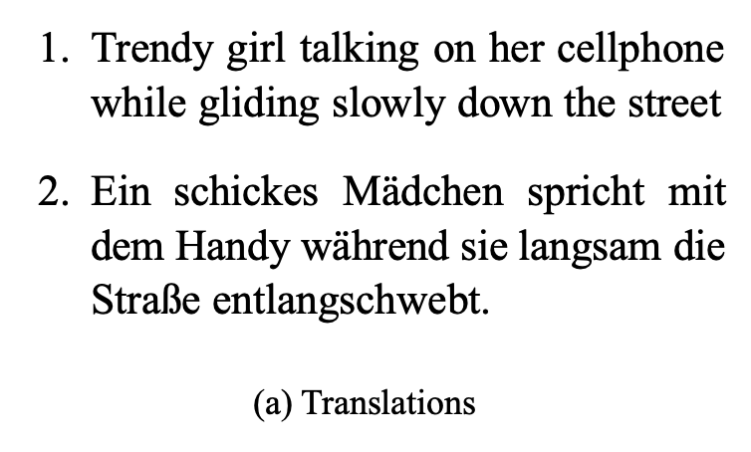
Multimodal Machine Translation
In the latest version
Captions in English, German, French and Czech
30,000 images
1 captions per image per language = 30,000 * 4
Images from the Flickr30k dataset
https://arxiv.org/abs/1605.00459

Slide 6
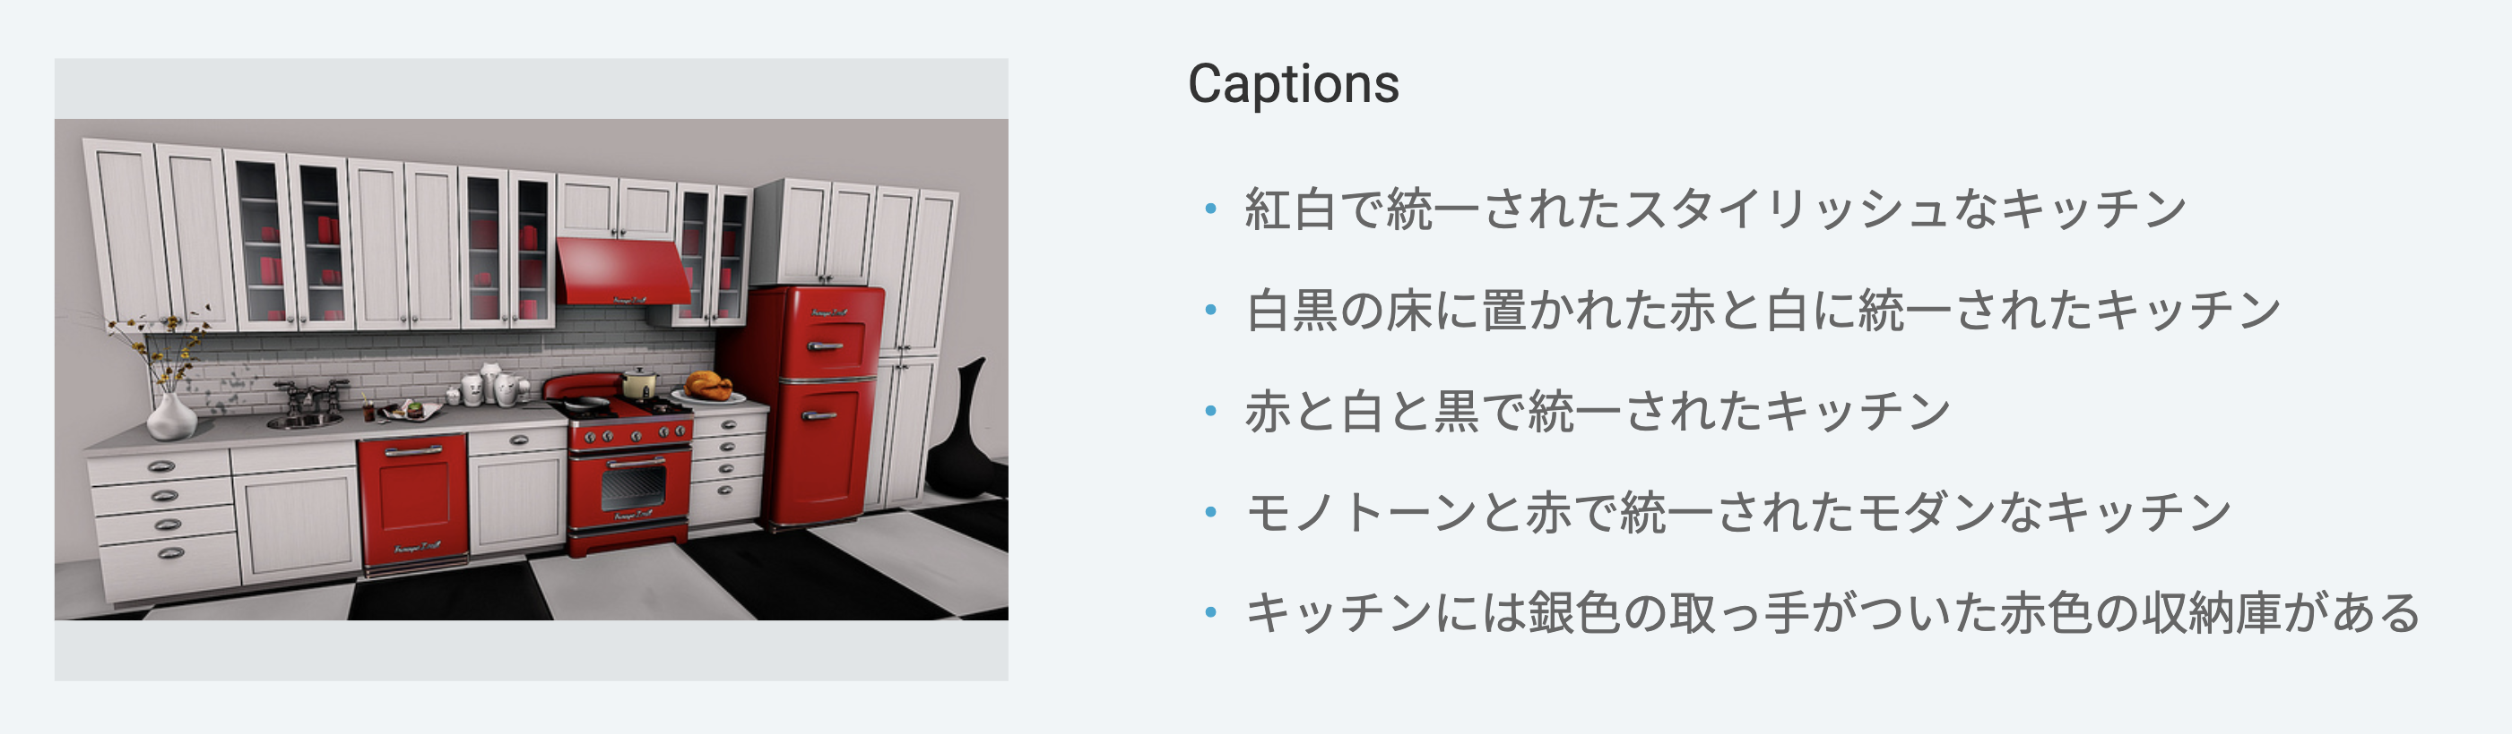
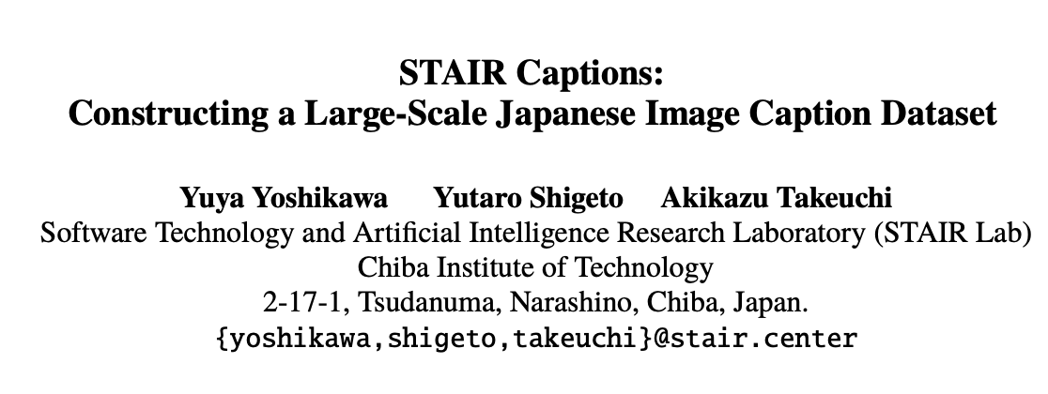
Multimodal Machine Translation
Based on the COCO Dataset but with Japanese – so combined with COCO it is 10 captions per image for > 100,000 images.
https://arxiv.org/abs/1705.00823

Slide 7
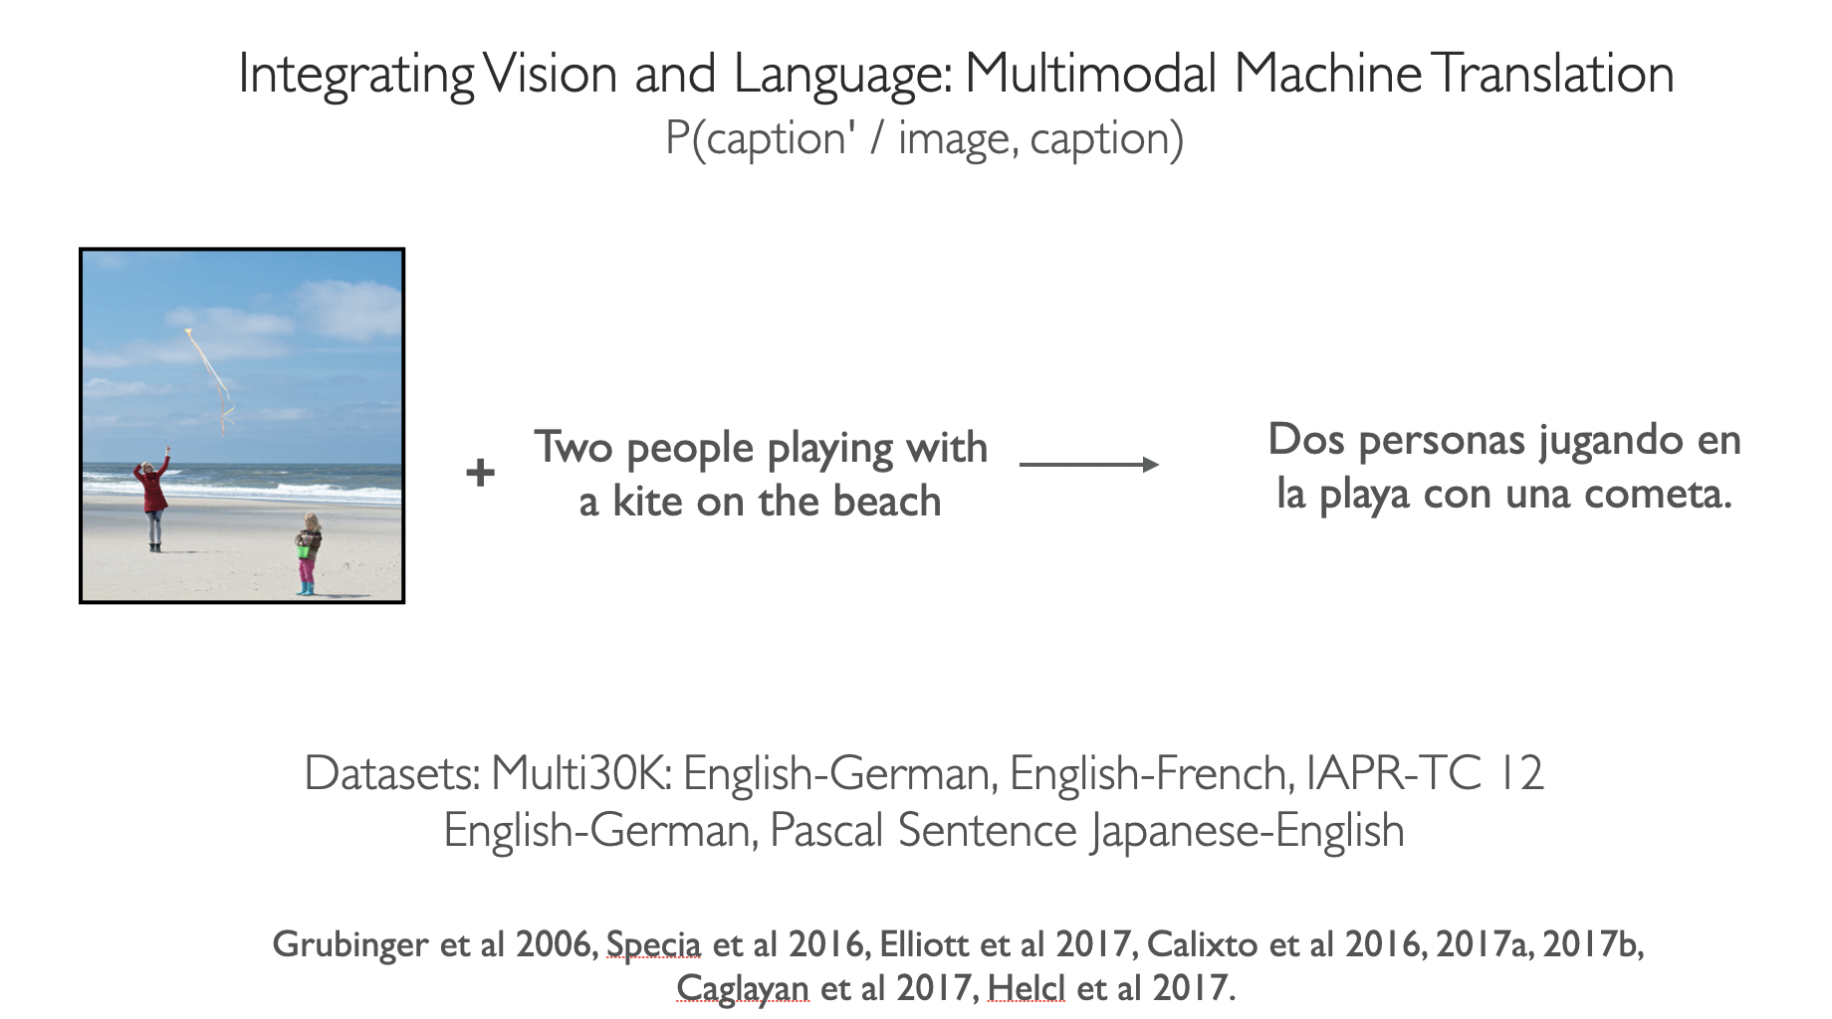

Slide 8
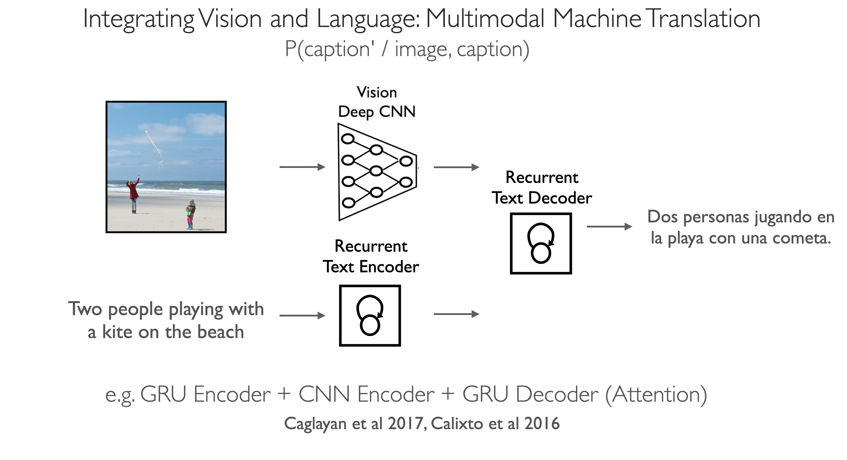

Slide 9
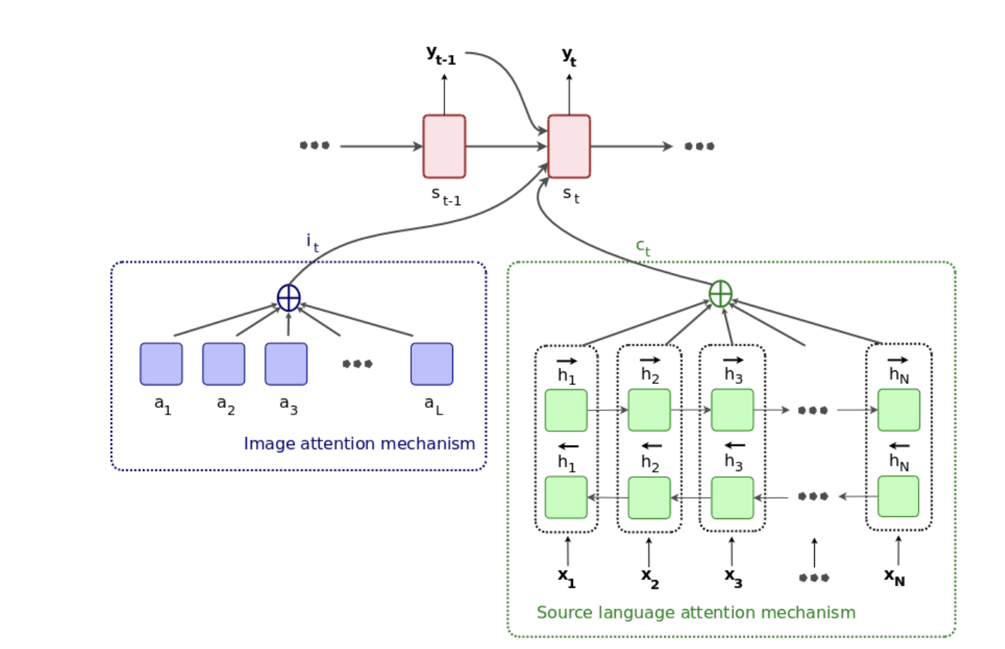
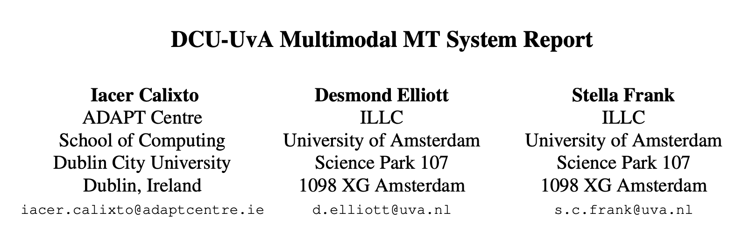
Sample Multimodal MT Model in more detail
https://www.aclweb.org/anthology/W16-2359.pdf

Slide 10
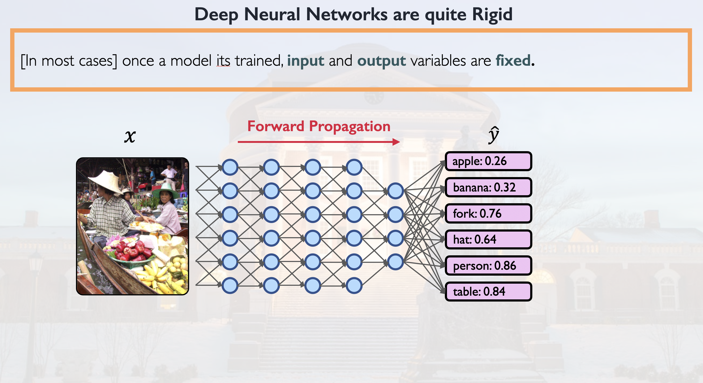

Slide 11
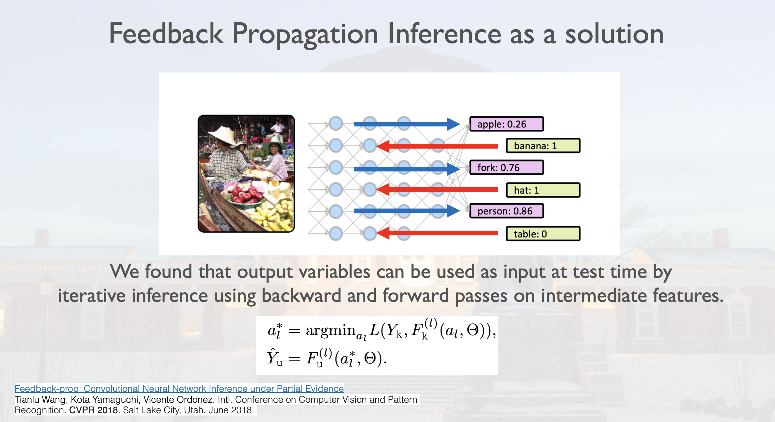

Slide 12
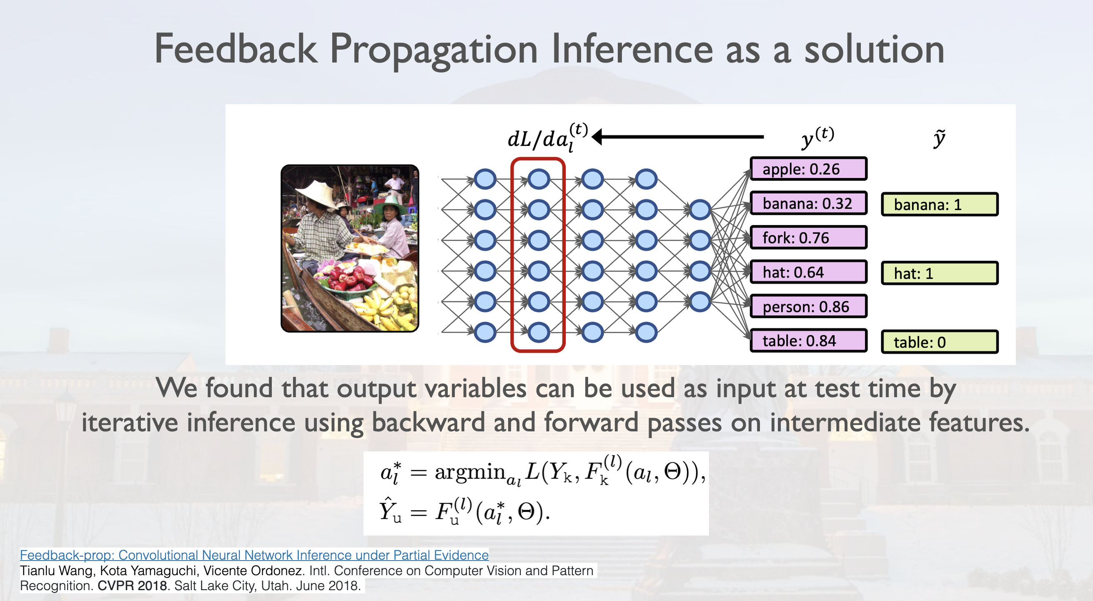

Slide 13
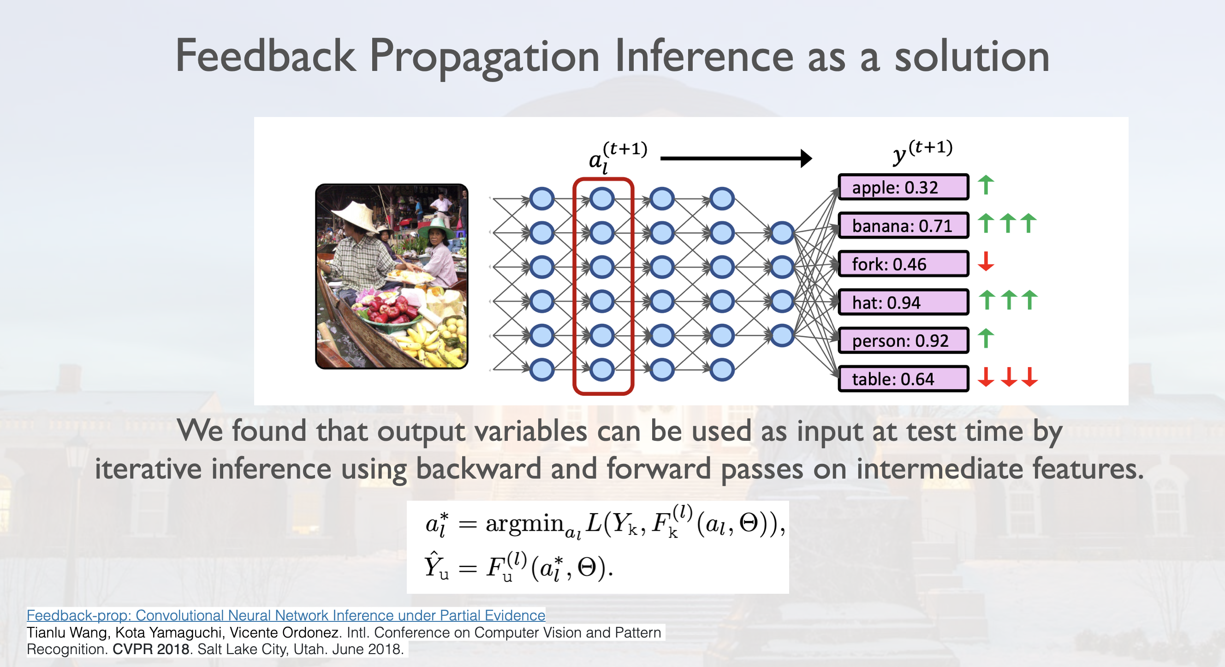

Slide 16
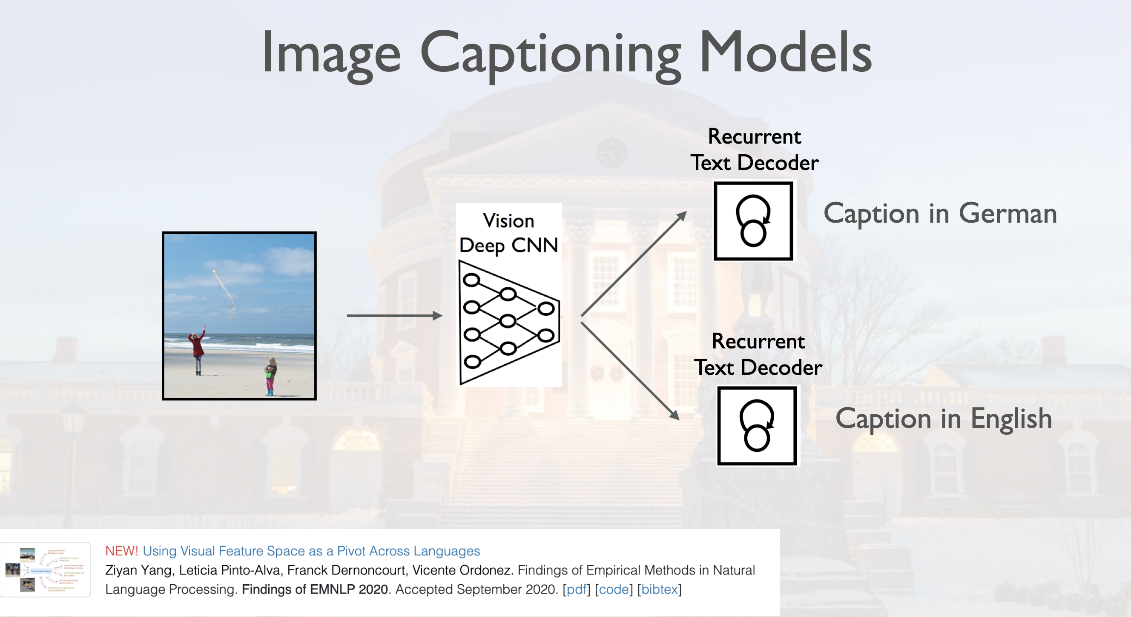

Slide 17
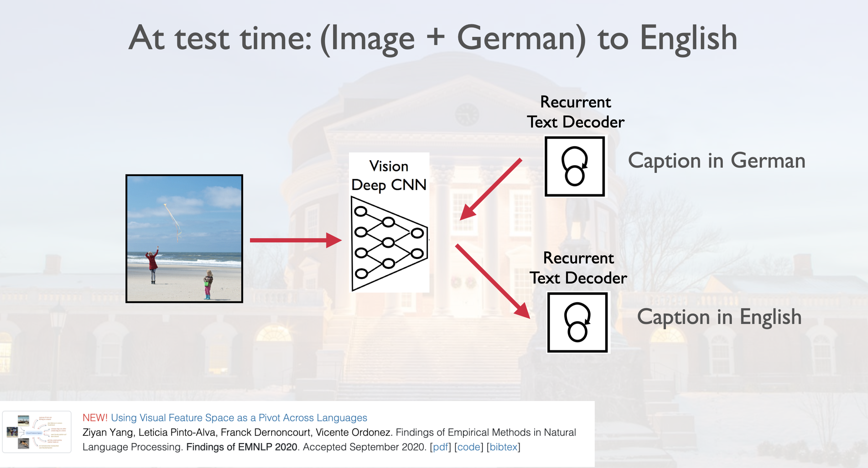

Slide 18
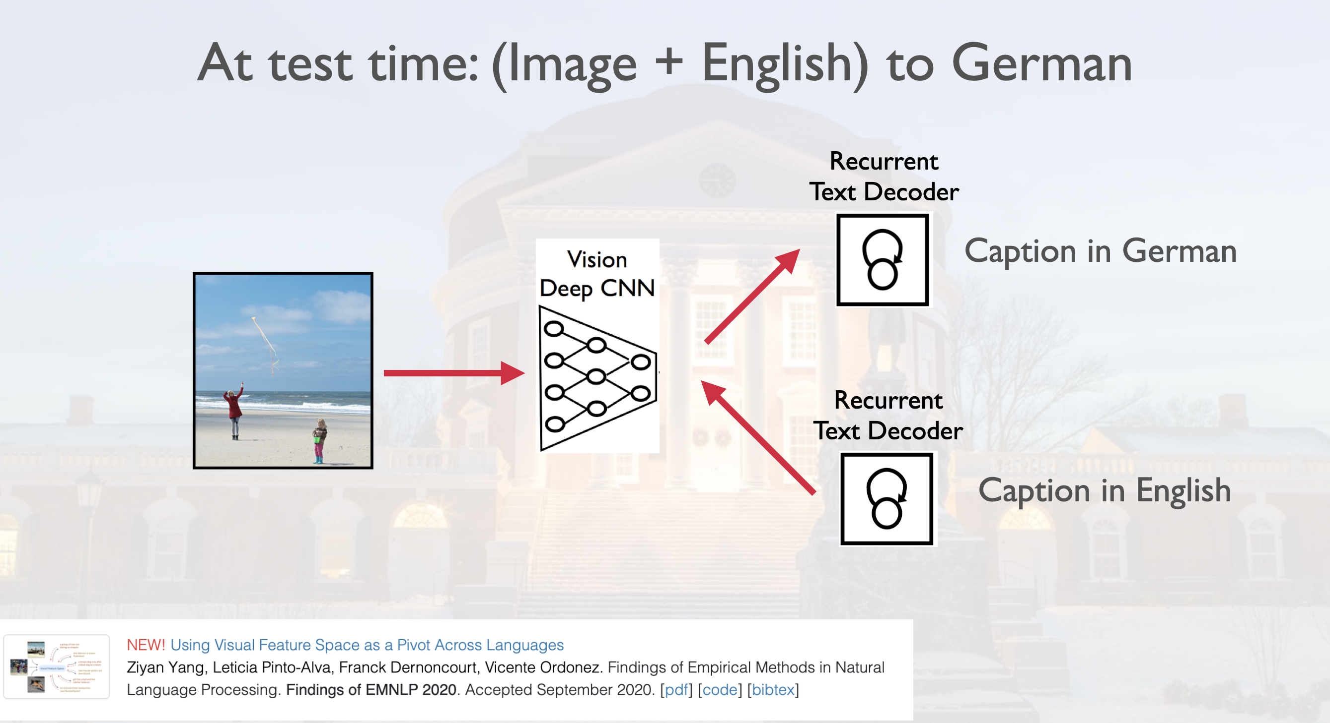

Slide 19
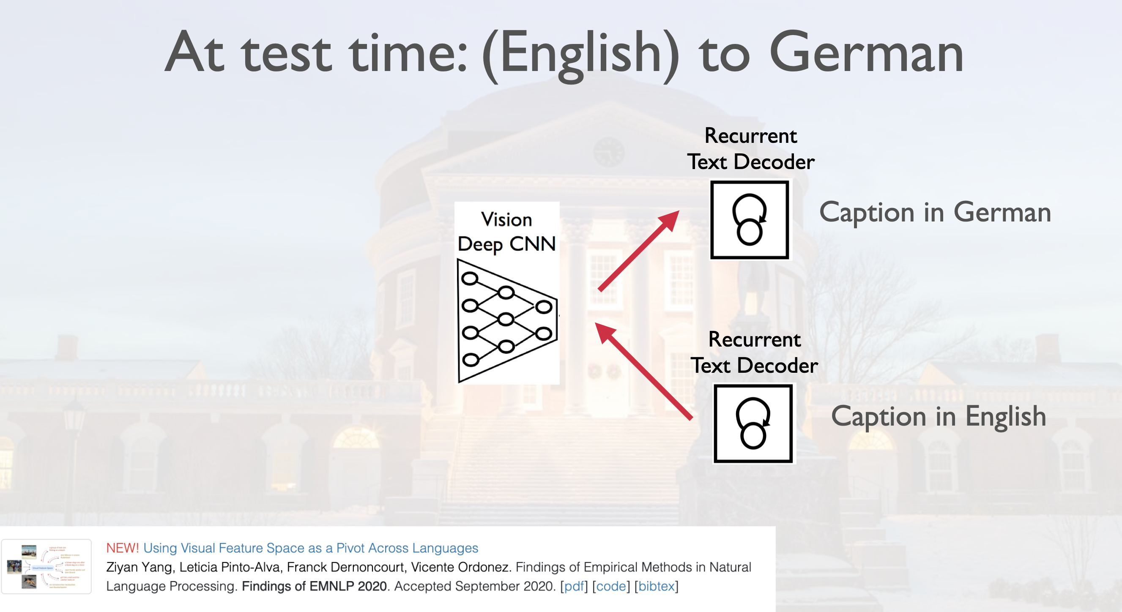

Slide 20
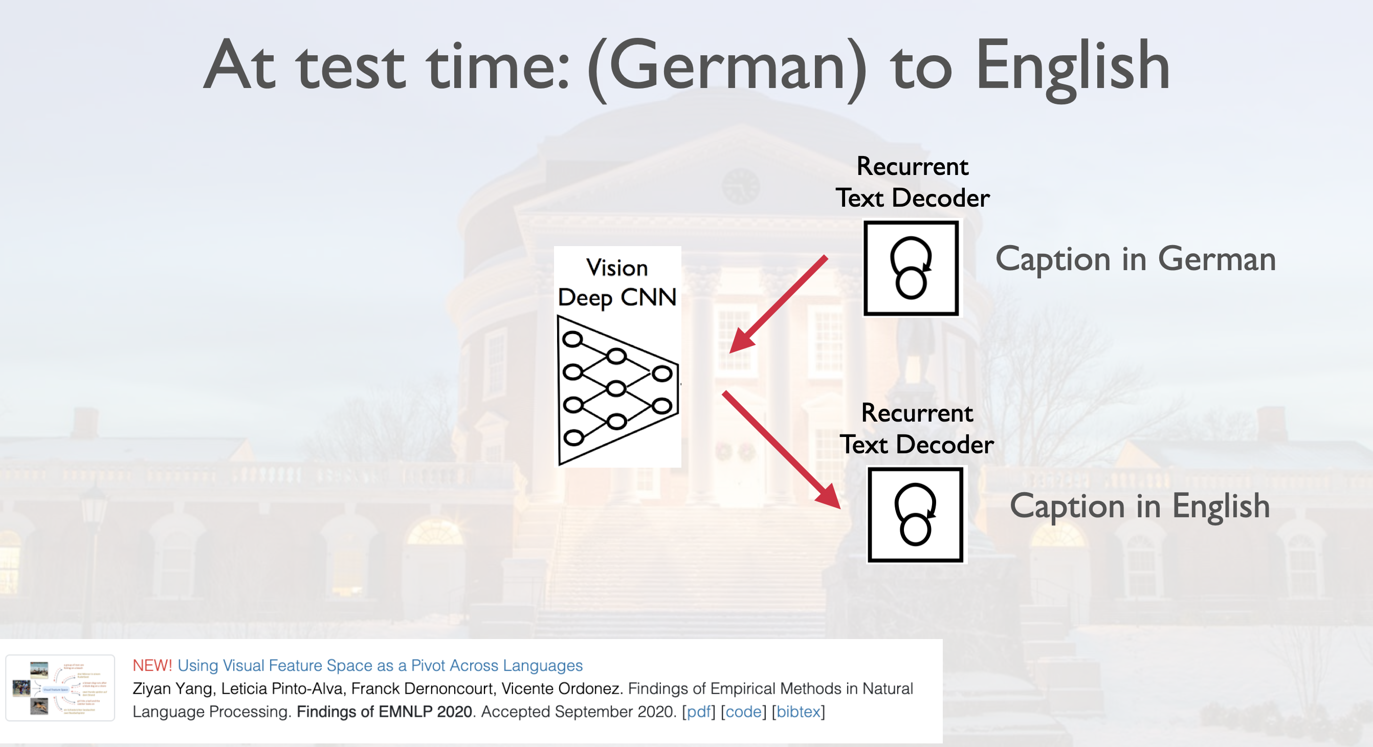

Slide 21
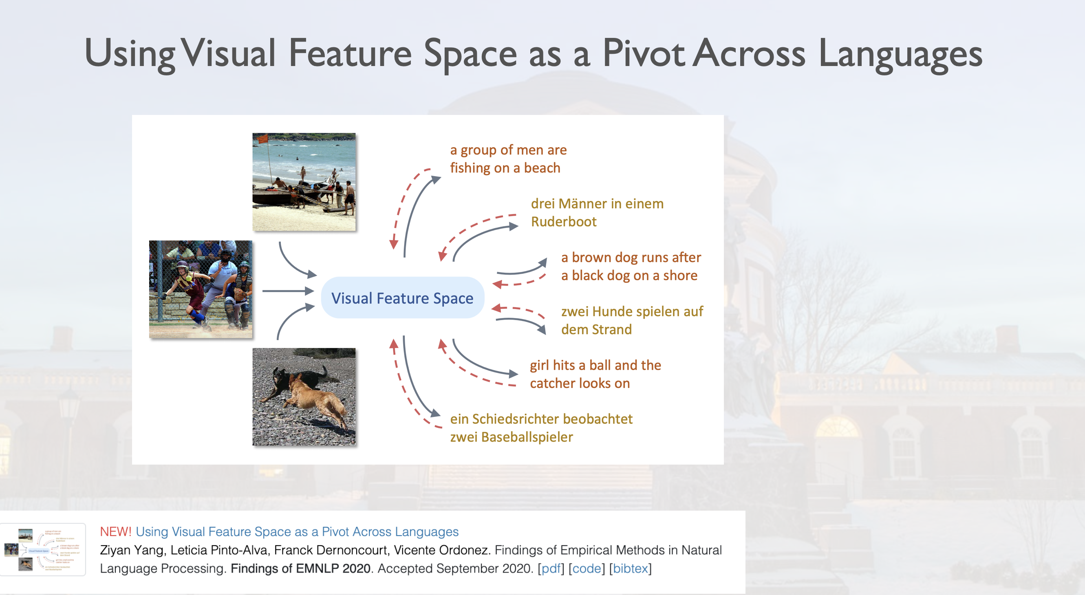

Slide 22
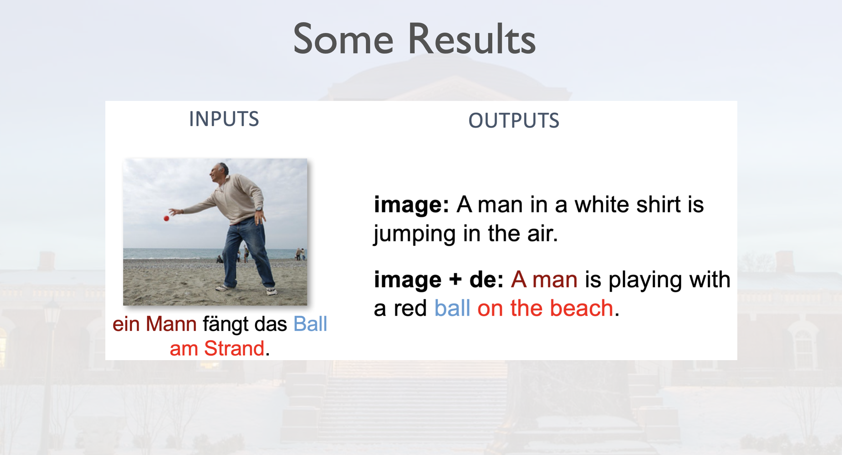

Slide 23
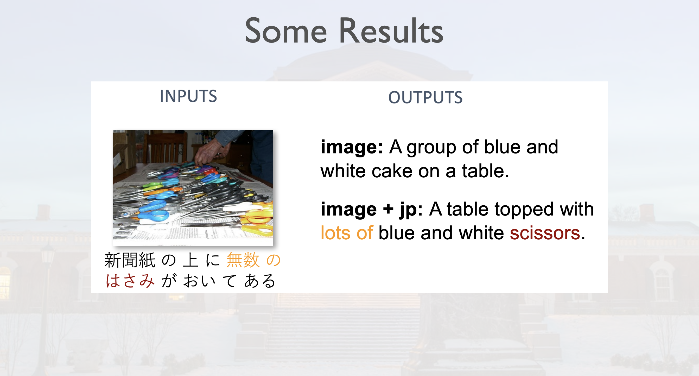

Slide 24
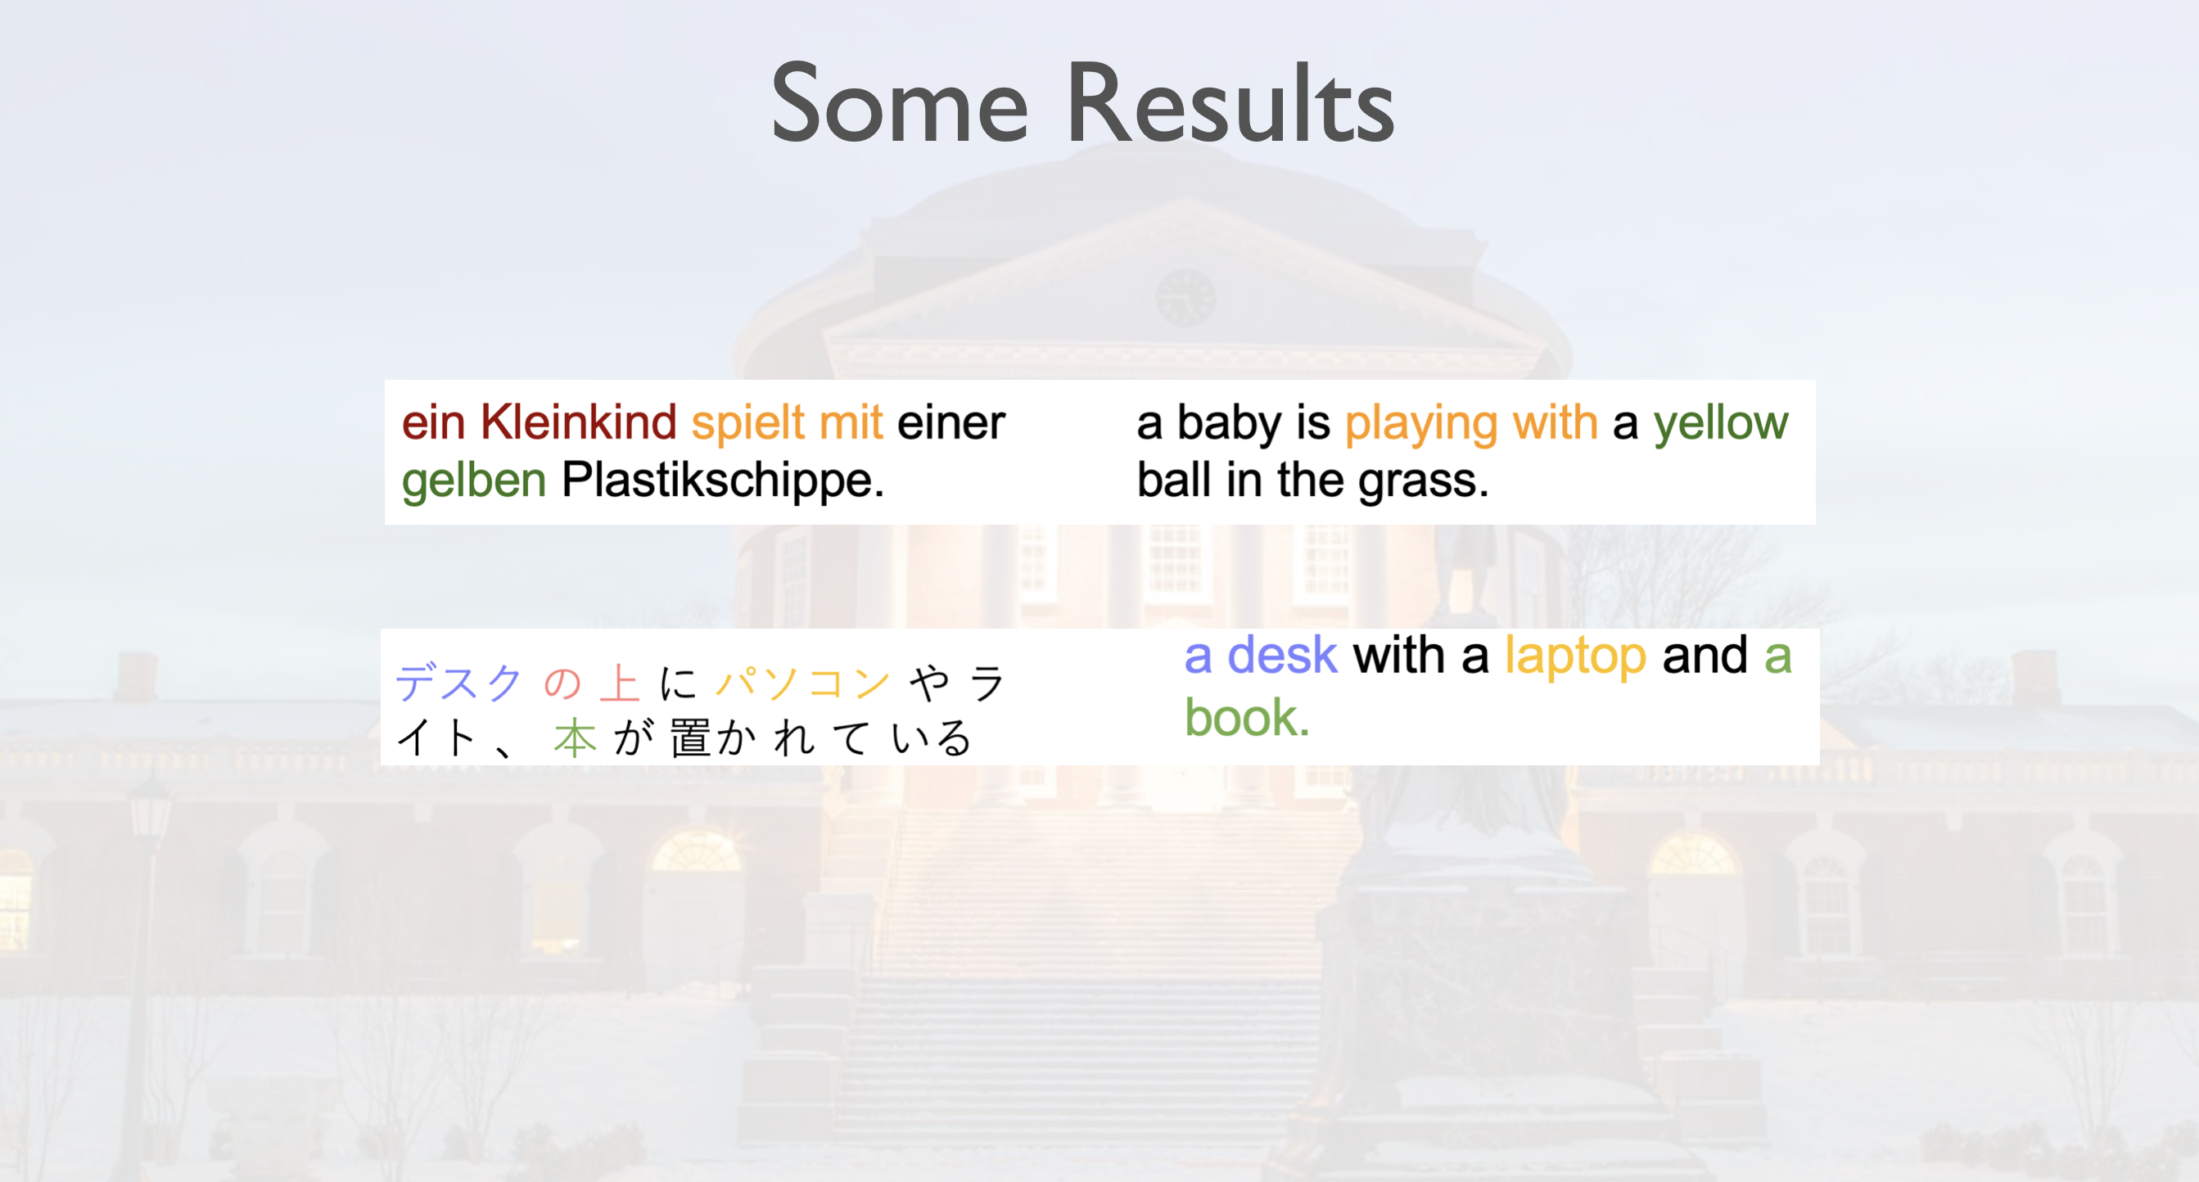

Slide 25
Questions?

