Slide 1
Describe and motivate your work
Scoring the Sentiment of Paper Reviews in Spanish with a Multilingual BERT Transformer
Vicente Ordonez, Ziyan Yang, Paola Cascante, Anshuman Suri Department of Computer Science University of Virginia
In this project we aim to examine the ability for text-based classification models to score paper reviews comments in Spanish for their general assessment of the paper. We will examine how modern text-based representations based on transformers such as BERT with strong sub-word tokenizers compare to previous representations based on bag-of-word representations with word-based tokenizers. Our results indicate that for small datasets, strong state-of-the-art models such as multilingual BERT don’t attain significant gains in the low data regime of the Spanish Paper Reviews Dataset of Keith et al, which was collected from reviews submitted to a scientific conference. We examine the difference across these models and present detailed experimental results.

Slide 2
Introduce your work – motivate and contextualize
Introduction
Automated peer-review analysis is an active area of research where the goal is to enhance and improve the process of scientific progress. Our work applies methods from automatic text analysis and natural language processing to the analysis of peer reviews for a scientific conference. Our work builds on the dataset by Keith et al. 2017 [1], which collected a dataset of 405 reviews corresponding to XX papers. These were collected between 20XX and 20XX for the conference XXXX. We additionally applied our method a second dataset consisting of….
Our work applies the transformer-based BERT (Devlin et al 2018 [2]) representation model trained on multi-lingual data which includes Spanish. We use the pretrained model and reference implementation from the huggingface transformers library and their associated subword tokenizers [3]. We additionally compare simpler models based on bag-of-words using word-based tokenizers and find that generally for this small scale problem we obtained no significant gains under a linear classifier.
We present detailed analysis of three models: (1) a text-based linear classifier using bag-of-words encoding and word-tokenization, (2) a text-based classifier using bag-of-words encoding and sub-word tokenization (BPE), and (3) a text-based linear classifier with a BERT pretrained encoding and sub-word tokenization (BPE) ….

Slide 3
Do a literature review even if small
Related Work
Text based classifiers: There is a lot of work in text based classifiers, traditionally people have used bag-of-words or bag-of-ngrams encoding [cite][cite], then people adopted continuous bag of words models with pretrained word embeddings [cite] [cite]. More recent work has adopted transformer-based features with robust tokenization tools in a number of applications [cite][cite][cite]. For example people have used to categorize movie reviews [cite][cite], to categorize legal documents [cite], or to score the sentiment of product reviews on e-commerce websites [cite][cite]. In our work we aim to classify scientific reviews using these methods.
Other works have attempted before us to perform scientific review categorization using text-based methods. For example the work of [cite] has explored this problem but they relied only on bag-of-word features while our work also considers the more recently proposed BERT encoding features. Other work on this general area include scoring the text of the paper itself to determine its quality [cite], in our work we instead judge a paper’s quality by using the review text provided by referees. The work of [cite] has also explored this problem but this work was limited to English while our work is focused on Spanish. The only other works we found in this area using Spanish are [cite][cite][cite], although [cite] did not use paper reviews but movie reviews.

Slide 4
Describe your methods
Methods
First we introduce the different tokenizers we use in this work, then encoders, then our classifier and loss function:
Tokenizers: We use two types of tokenizers, first a simple word tokenizers where we split the sentences into words using a spaces, which generally works well for Spanish which separates words with spaces. Then we also adopt a more general BPE tokenizers as included in the huggingface tokenizers library [cite].
Encodings: We use two different types of encoders, the bag of words encoder with single tokens and binary representation (no counts), and a BERT pretrained model as included in the huggingface transformers library [cite] which contains XXX parameters and was pretrained using a large multilingual dataset consisting of…
Classifier: We use a linear classifier with an input size matching the size of the corresponding encoding and an output sigmoid function which will be trained using a binary cross entropy loss function.
Our three possible models under evaluation are illustrated in Figure 01, where we show all the ways these components are combined to form three models (a), (b) and (c).

Slide 5
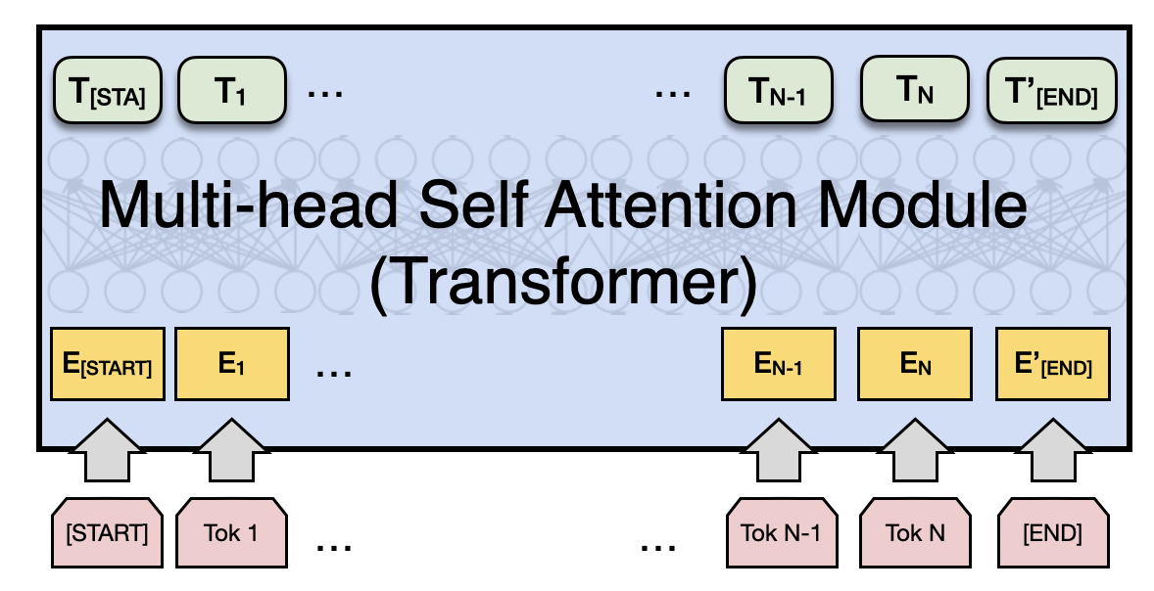
Use Figures and Diagrams to explain!
Linear Classifier
Bag-of-words-encoding
Word Tokenizer
Multilingual BPE Tokenizer
Text: - El artículo aborda un problema contingente y muy relevante, e incluye tanto un diagnóstico nacional de uso de buenas p...
(a) Word-tokenizer + BoW
(b) Subword-BPE tokenizer + BoW
(c) Subword-BPE tokenizer + BERT
Figure 1. Overview of our work, we use three types of classifier (a) word-tokenizer with bag-of-words encoding, and (b) subword BPE tokenizer with bag-of-tokens encoding, and (c) BERT encoding with sub-word BPE tokenizer.

Slide 6
Describe your experiments
Experiments
We trained our classifiers until convergence for a maximum of XXX epochs using a batch size of XXX and a learning rate of XXX. The dataset was split into a training, validation and test splits of sizes XXX, YYY, and ZZZ. We experimented with various batch sizes and learning rates while developing our model and chose the parameters that led to the best accuracy on our validation set. In all of our experiments we used a Google Colab instance with one GPU and the experiments for each of our models (a), (b) and (c) took XXX minutes, YYY minutes, and ZZZ minutes respectively. For the BERT encoding models we pre-computed the encodings for accelerated execution time. However, fully tuning the BERT model is something we did not perform but that might lead to improved results.
We also performed a second experiment on a larger dataset consisting of ….

Slide 7
Describe your Results
Results
We found that the classifier using word tokenizers and bag of words encoding performed the best despite its simplicity. We think this happens because the dataset is rather small and either larger or smaller models tend to overfit or underfit to the training data. However, more experiments are perhaps needed to verify this observation as well as experiments on larger datasets.
Figure 02 presents results for accuracy on our validation set while developing our model across many epochs of training. The first two models were trained for 150 epochs while the last model was trained for 300 epochs.
The dataset consists of 55% of examples in negative category and 45% of examples in the positive category so obtaining an accuracy bigger than 60% as is the case in all of our experiments is a positive result. Particularly our stronger classifier obtained an accuracy close to 70% in accuracy. We also analyzed the words that more frequently led to a positive categorization and we found words such as “bueno, bien” (good, well) correlated with positive examples, and negative words such as “no, ni”, (not, neither) as correlated with negative reviews. In addition to that we observed …

Slide 8
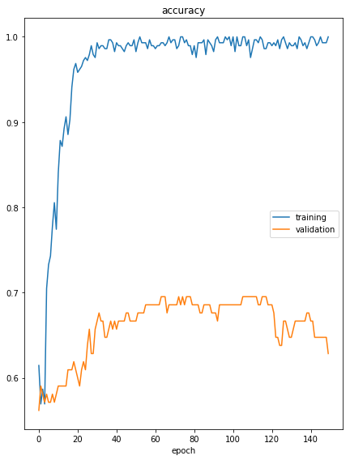
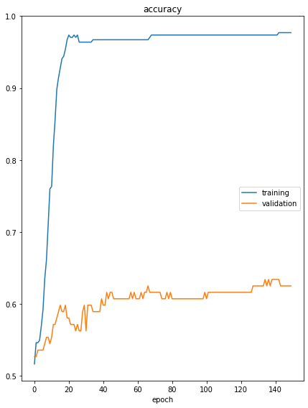
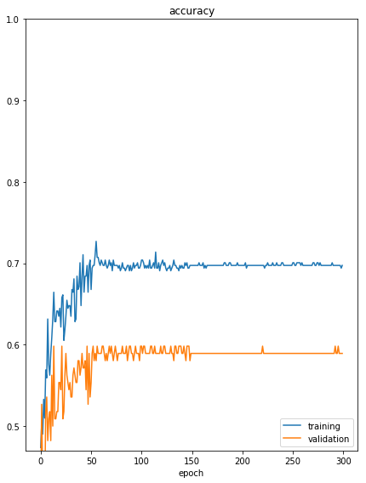
Present your results: Also, what not to do to present your results!
(a) Word-tokenizer + BoW
(b) Subword-BPE tokenizer + BoW
(c) Subword-BPE tokenizer + BERT
Figure 1. Results for our three classifiers (a) word-tokenizer with bag-of-words encoding, and (b) subword BPE tokenizer with bag-of-tokens encoding, and (c) BERT encoding with sub-word BPE tokenizer.

Slide 9
One thing is to plot things to get help for yourself and one for your project report: Learn to plot and export figures properly
(a) Word-tokenizer + BoW
(b) Subword-BPE tokenizer + BoW
(c) Subword-BPE tokenizer + BERT
Figure 1. Results for our three classifiers (a) word-tokenizer with bag-of-words encoding, and (b) subword BPE tokenizer with bag-of-tokens encoding, and (c) BERT encoding with sub-word BPE tokenizer.

Slide 10
Show Actual Results! Not just plots!
Examples of positive reviews scored by our model.
Examples of negative reviews scored by our model.
Examples of mistakes our model makes. Maybe discussion on why these mistakes happened?

Slide 11
Write a short conclusion and future work
Conclusion
Automatic analysis of paper reviews is a challenging problem especially when not a lot of data is available for training. Perhaps it is also challenging when a language-agnostic tool such as multilingual BERT is used, as it has been show that language-specific models tend to lead to better results in other tasks. These are possible avenues of further investigation and improvement. Our work intends to make a contribution in this general direction. …..

